Slide 1
VPP ELITE AND VPP EMERITUS OVERVIEW
WHAT YOU NEED TO KNOW
DIRECTORATE OF COOPERATE AND STATE PROGRAMS

Slide 2
VPP ELITE AND VPP EMERITUS ORIENTATION
WELCOME

Slide 3
VPP ELITE AND EMERITUS BACKGROUND
OSHA’s VPP modernization efforts
Changes over time
More recognition

Slide 4
WHAT ARE VPP ELITE AND VPP EMERITUS?
Voluntary levels of recognition of long-term achievement in VPP
Must meet inclusion criteria
VPP Elite: must maintain inclusion criteria
VPP Emeritus: one-time recognition of honor

Slide 5
VPP ELITE ELIGIBILITY
VPP star site-based for 15 or more years
Participated as an active star site for the previous five years, AND have not experienced:
  Injury and illness rates/RRP
  One-year conditional
  Fatality/catastrophe
  Failure to report
  Citations - serious, willful, failure to abate
  Whistleblower merit findings

Slide 6
VPP ELITE BENEFITS
Reapproval frequency every seven to eight years
Continuing your relationship with OSHA
Better use of resources

Slide 7

HOW WILL I KNOW IF I QUALIFY FOR VPP ELITE?
Invited by Regional VPP Manager
Accept or decline invitation within 30 days
Congratulatory letter from the Regional Administrator
Reapproval frequency will automatically reset
Maintain inclusion criteria

Slide 8
VPP ELITE - CRITERIA NOT MAINTAINED
If one or more of the inclusion criteria lapses your site will lose VPP Elite distinction
No longer able to display the VPP Elite Flag or Logo
Return to the three- to five-year reapproval frequency
Ability for re-invitation after five years

Slide 9
VPP EMERITUS ELIGIBILITY
VPP Star for 25 or more years
Participated as an active star site for the previous five years, AND have not experienced:
  Injury and illness rates/ rate reduction plan
  One-year conditional
  Fatality/catastrophe
  Failure to report
  Citations - serious, willful, or failure to abate
  Whistleblower merit findings

Slide 10
VPP EMERITUS BENEFITS
No reapprovals
Permanent honorary distinction
A steward for your industry for occupational safety and health

Slide 11
VPP EMERITUS: NEXT STEPS
You will continue to carry this status as long as you continue to meet the tenets of VPP.
Carry in your establishments, the desire to maintain a superior SHMS.
Act as mentors to other establishments by sharing your experience from your years in VPP and best practices you have learned along your journey.
No longer a VPP participant.
No longer subject to OSHA reapproval visits
Returned to OSHA’s programmed inspection lists

Slide 12

HOW WILL I KNOW IF I QUALIFY FOR VPP EMERITUS?
Invited by OSHA’s National Office
Accept or decline within 60 days
Congratulatory letter from OSHA’s Assistant Secretary
OSHA will send notifications about significant events or activities of interest (Safe & Sound Week and the Construction Round Table)

Slide 13
RETURNING TO VPP STAR
If you wish to return to VPP Star from VPP Emeritus, you can reapply.
VPP Emeritus distinction is removed once you become VPP Star.

Slide 14
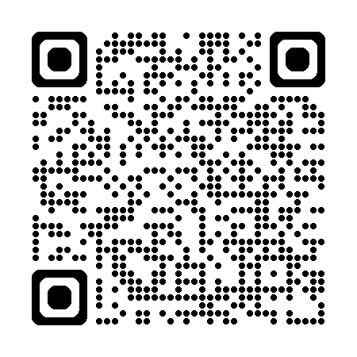
VPP POLICIES AND PROCEDURES MANUAL
Chapter 14 – VPP Elite
Chapter 15 – VPP Emeritus

Slide 15
QUESTIONS?

