Slide 1
OSHA Safety Champions Program Information Session
Directorate of Cooperative and State Programs

Slide 2
INFORMATION SESSION AGENDA
Overview of the Safety Champions Program
Role of the Safety Champions Coordinator
Role of Special Government Employees
How to Participate

Slide 3

Safety Champions Program (SCP)
Meeting businesses where they are to help strengthen safety culture and prevent workplace injuries, illnesses, and fatalities.

Slide 4

Safety Champions Program (CONT’D)
Resource aimed at improving safety and health nationwide.
SCP provides comprehensive framework of policies, guidance and requirements to assist employers enhancing their safety and health management system.
Utilize a Step Guide and Tracker to work through the Steps.

Slide 5

Guiding Principles
Continuous improvement
Compliance with the OSH Act
Address hazards
Worker and Employer rights
Cooperative relationship
Protecting Whistleblower rights

Slide 6

Goals for Safety Champions Program
Reduce
Reduce injuries, illnesses, and fatalities.
Reduce or eliminate
Reduce or eliminate worksite hazards.
Assist
Assist small and medium size worksites with safety and health program development, implementation and continuous improvement.
Improve
Improve safety culture and worker communication.

Slide 7

Eligibility and Requirements
Private or public sector employers under Federal OSHA jurisdiction.
Continued participation in SCP requires meaningful improvements to the SHP and active participation in the program.

Slide 8
THE SEVEN ELEMENTS OF THE RECOMMENDED PRACTICES
VPP
(4 Elements)
Safety Champions/VPP
(7 Elements)
Management Leadership
Management Leadership/ Employee Involvement
Worker Participation
Hazard Identification & Assessment
Worksite Analysis
Hazard Prevention & Control
Hazard Prevention & Control
Education & Training
Program Evaluation & Improvement
Safety & Health Training
Communication & Coordination for Host Employers, Contractors, and Staffing Agencies

Slide 9
THE SEVEN ELEMENTS OF THE RECOMMENDED PRACTICES (CONT’D)
MANAGEMENT LEADERSHIP
HAZARD IDENTIFICATION & ASSESSMENT
EDUCATION & TRAINING
WORKER PARTICIPATION
HAZARD PREVENTION & CONTROL
PROGRAM EVALUATION & IMPROVEMENT
COMMUNICATION AND COORDINATION FOR HOST EMPLOYERS, CONTRACTORS, AND STAFFING AGENCIES

Slide 10

Three Progressive Steps
Three progressive Steps: Introductory, Intermediate and Advanced.
Each Step breaks down core elements into manageable and comprehensive sections.
A recognition letter will be issued after each Step once all items have been completed and verified.

Slide 11

Participant Requirements
Participants take sole responsibility for developing, implementing, and improving their SHP.
OSHA and SGEs can assist and answer questions and help with progression through the program.
Assessment and documentation.
Maintain communication with OSHA.
Attend orientation training.

Slide 12
SCP – Where TO START
Sign up for Safety Champions Program
Receive confirmation email from DCSP
Attend SCP Orientation training

Slide 13
SCP TOOLS AND RESOURCES
Safety Champions Directive
Safety Champions Step Guide
Safety Champions One-Pager
OSHA Website

Slide 14
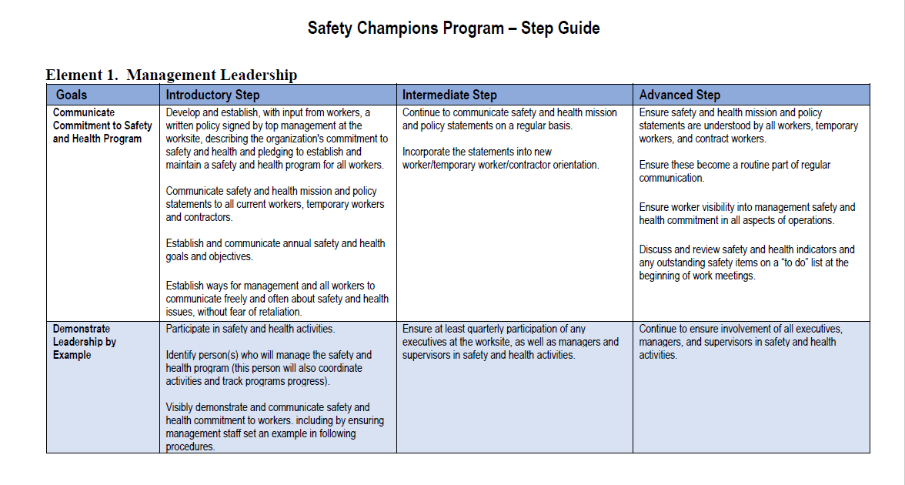
Safety Champions Program Step guide

Slide 15
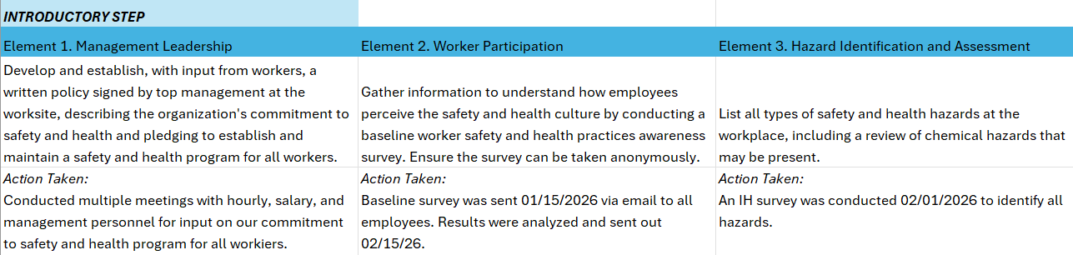
Safety Champions tracker (SCT)

Slide 16
Safety Champions tracker (SCT) (CONT’D)
Tracks progress toward the SHP goals
SGE signs off on each Step as verification of completion
SCP Coordinator will review and determine final completion
SGE and OSHA can assist with answering questions

Slide 17
Role of the SCP Coordinator
Will manage the Safety Champions Program (SCP)
Connect Participants with Special Government Employees (SGE)
Communicate with Participants
Recognize Step completion

Slide 18

SCP Coordinator CONTACT
SafetyChampions@dol.gov

Slide 19

SPECIAL GOVERNMENT EMPLOYEES (SGE)
What is an SGE?
Eligibility and Qualifications
Apply through our website - https://www.osha.gov/sge/
Attend SGE Training
Be sworn-in and begin assisting worksites across the country improve their safety and health!
SGECoordinator@dol.gov

Slide 20
ROLE OF THE SPECIAL GOVERNMENT EMPLOYEE
Collaborates with participants about progress and data needed for SCT
Answers questions from participants on specialty topics on an as-needed basis
Evaluates completion of each step
Determines participant is able to move to the next Step
Reviews the Safety Champions Tracker (SCT) and provides feedback.

Slide 21
MANAGEMENT LEADERSHIP
Communicate safety and health mission and policy statements to all current workers, temporary workers and contractors.
Examples:
Posting mission and policy statements around worksite.
Emailing current employees, temporary workers, and contractors the established statements.

Slide 22
WORKER PARTICIPATION
Incorporate the statements into new worker/temporary worker/contractor orientation.
Example:
Orientation training includes safety and health mission and policy statements

Slide 23
HAZARD IDENTIFICATION AND ASSESSMENT
Increase frequency to at least monthly, with the entire worksite covered at least quarterly.
Example:
Past inspections logs with corrective actions for identified hazards and date hazard was abated.

Slide 24
HAZARD PREVENTION AND CONTROL
Continue to proactively identify, prioritize, and implement controls for hazards identified through all means (hazard analysis, trend analysis, accident and near miss investigation, self-inspections, employee reports of hazards, pre-use analysis, etc.). Adjust controls as needed on an ongoing basis.
Example:
A worksite noticed that employees who shifted from day to night shift had a higher accident rate the first week of their new schedule. The worksite implemented a policy that for those individuals changing shifts, they could not stand watch their first week. This allowed time to adjust to their new schedule which reduced accident rates.

Slide 25
EDUCATION AND TRAINING
Train workers to recognize hazards they may encounter in their own jobs and to identify appropriate controls.
Examples:
Hazard identification training.
Employees feel empowered to call a safety timeout.

Slide 26
PROGRAM EVALUATION AND IMPROVEMENT
Verify core elements of the program have been fully implemented.
Examples:
Safety and health programs have been established and there are written programs available for review.
Written program matches what is being carried out.

Slide 27
COMMUNICATION AND COORDINATION FOR HOST EMPLOYERS, CONTRACTORS, AND STAFFING AGENCIES
Improve and continue to enforce policies for contractors and staffing agency employees to comply with contractor rules.
Contractor employees feel empowered to report a hazard or concern to their contracting agency and the worksite.
Establish a policy to review contractors’ safety and health programs prior to working with them

Slide 28

Safety Champions Program
www.osha.gov/safety-champions

Slide 29

QUESTIONS
Please email the SCP Coordinator at SafetyChampions@dol.gov.
Notes:
This Photo by Unknown Author is licensed under CC BY-NC

Slide 30

www.osha.gov
800-321-OSHA (6742)

