Slide 1

Use our frame to create a social media post of your team after they solved the mystery and completed the Hunt for Hazards:
Insert your picture
Right click and send the picture to the back
Size the picture and crop the picture to fit the frame
Save as a JPG or PNG file to use on social media

Slide 2
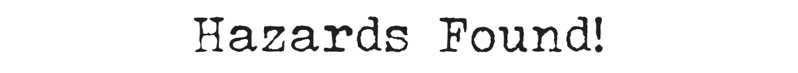
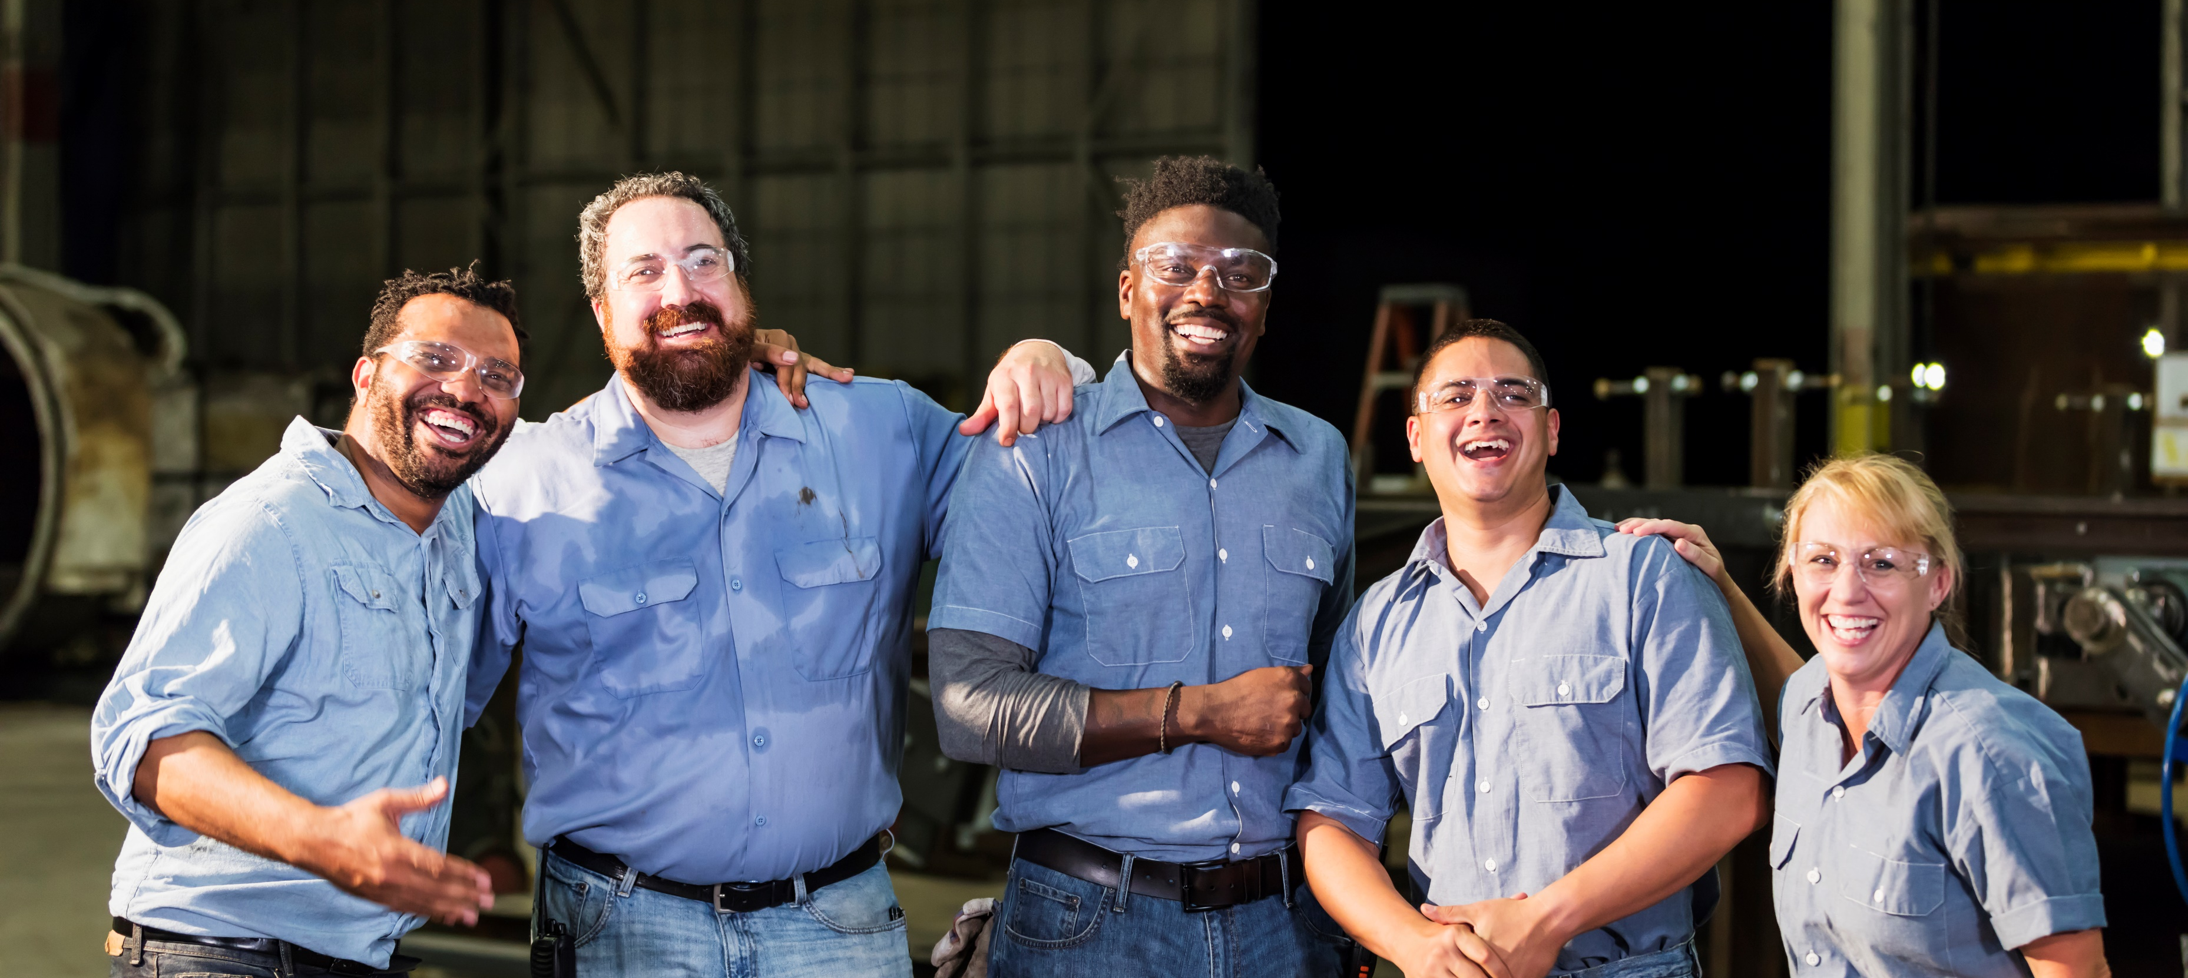
Example Post:

Slide 3
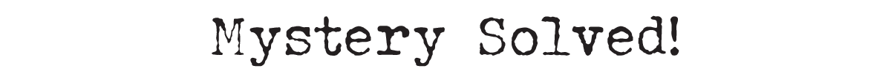
Example Post:

Slide 4
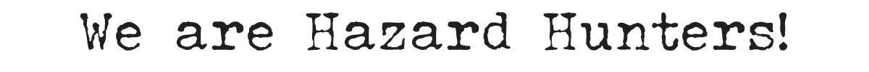
Example Post:

Slide 5
Sample Post Text
Use this text or write your own for your social media post:
🔍 We Solved the Mystery! 🔍
We're proud to announce we participated in Safe + Sound Week! Throughout the week, our team searched for and uncovered hazards at our workplace and implemented effective controls. [Include an example or share an activity you completed]
We're dedicated to continuously improving our safety and health programs throughout the year because workplace safety is a core value. #SafeAndSoundAtWork

