Slide 1
OSHA Special Government Employee (SGE) Training
United States Department of Labor
Occupational Safety and Health Administration

Slide 2
In this section we’ll discuss:
How to handle an unusual situation
Reporting Writing

Slide 3
Expecting the Unexpected
What do you do?
Unusual Situations:
Fatality, catastrophe, fire, severe injury, etc. occurs while the team is on-site
Complaint Inspection is initiated during the VPP evaluation
An employee of the site makes an inappropriate comment to you about you, or someone else on the team, or at the site

Slide 4
Expecting the Unexpected
What do you do?
Unusual Situations:
You or one of the other team members becomes ill during the on-site
You arrive at the site and realize you used to work with the safety rep, or plant manager
You arrive at the site and realize you used to work with the safety rep, or plant manager, and you REALLY don’t like him very much!
Avoid even the appearance of impropriety!!

Slide 5
Expecting the Unexpected
What do you do?
Unusual Situations:
During the evaluation you strongly disagree with one of the other team members or team leader
During the evaluation you get into a disagreement with one of the site representatives

Slide 6
Report Writing

Slide 7
Report Writing
Approval Reports
A report is developed following every Approval visit to provide the Assistant Secretary with the teams recommendation and verification of the site’s program which lead to the recommendation made by the team

Slide 8
Report Writing
Approval Reports: Each Approval report will include:
  VPP Site Report – designed to reflect the overall findings from the evaluation in a short and concise narrative format
  VPP Site Worksheet – designed to document findings and provides the technical basis and rationale that support the team’s findings and recommendation for participation

Slide 9
Report Writing
Report Preparation
The report is developed following the instructions provided in the VPP Policies and Procedures Manual
The Team Leader will assign sections of the report to each team member for completion

Slide 10
Report Writing
Report Preparation
SGE report writing assignments will generally be in worksite analysis, hazard prevention and control, and safety and health training (Sections II, III, and IV)
The Team Leader will combine all sections of the report and develop a final product

Slide 11
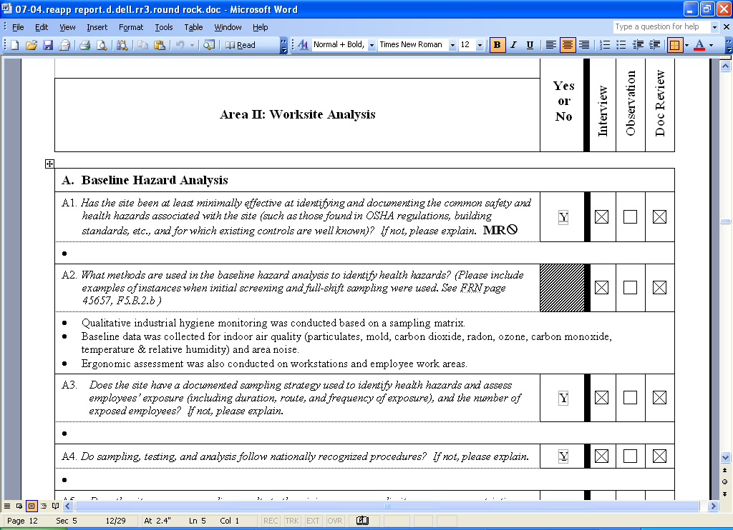
Report Writing
Report Writing

Slide 12
Report Writing Workshop
In your group:
Answer the following questions on the worksheet
  I Mgmt Commitment – C1-2; E1-11; F1-4
  II Worksite Analysis – A2; A4; C1-4; D7; E1; G4
  III Haz. Prev/Cont – A8-16; B1-3
  IV Training - All
Use Worksheet format & answer selected questions
Use case study notes
Support response with evidence (or lack of) and how assessed (Observations, Interviews, Walkthroughs)
Group report out!

Slide 13
Merit Goals/Recommendations
In this section, we’ll discuss:
  What are Merit Goals/Recommendations
  How to write Merit Goals/Recommendations

Slide 14
Merit Goals
If the team is going to recommend participation in the Merit Program, they must give the site a list of goals to complete to attain Star quality
Merit goals will usually be negotiated with management by the Team Leader with input from the team members
Merit goals must relate to deficiencies in Star Program requirements and necessary improvements in the site’s SHMS; NOT for specific OSHA violations

Slide 15
Writing a Merit Goal
A good Merit Goal tells the company:
  the specific deficiency in the SHMS
  what can be done to correct the deficiency
  how the deficiency should be addressed
Merit Goals

Slide 16
Examples of BAD Merit Goals
Get your injury rates to below the National Average
Document JHA’s
Increase employee involvement

Slide 17
Example of a Good Merit Goal
Routine inspections – Routine inspection reports did not indicate a responsible party for correction of hazards and the dates that hazards must be corrected. This resulted in several hazards not being corrected for a long period of time. -- (See Worksheet Section II, Question D.6.)
  Ensure that inspection reports assign a responsible party and a correction date for hazards

Slide 18
90-day items
To do
1.
2.
…...
90-day items are compliance related
issues that can be corrected within 90-days
  In construction, the correction is immediate or no longer than 30 days
A program recommendation may be deferred by the team leader until all 90-day items have been corrected
Failure to correct 90-day items may result in withdrawal from the VPP or termination

Slide 19
90-day items - Examples
Specific LOTO procedures need to be developed for two hydraulic presses in the maintenance shop
Point of operation guarding needs be provided for the riveting machine
Exit signage needs to be added in the laundry area hallway
A fall protection system needs to be implemented for maintenance personnel accessing the top of the corrugator

Slide 20
Recommendations
Recommendations are made to the site to help them further improve their SHMS
Recommendations are not specific VPP requirement or violation of an OSHA standard

Slide 21
Recommendations - Examples
Extend safety and health accountability beyond managers to include all employees
Site personnel should attend the Regional VPPPA Conference and participate in the Mentoring Program
Site S&H personnel should consider becoming SGEs

Slide 22
Best Practices
Contractors are included in all aspects of SHMS including leading teams of joint contractor/company employees participating in routine inspections of company areas and training of all employees at the site
In addition to annual evacuation drills, the site also conducts annual drills weather for weather emergencies, chemical leaks and bomb threats

Slide 23

Contact Information
www.osha.gov
800-321-OSHA (6742)

