Slide 1
TUTORIAL ON COMPLETING THE OSHA RECORDKEEPING FORMS
Notes:
Last update: 2026

Slide 2
Completing the OSHA Recordkeeping Forms
Overview of the recordkeeping requirements and forms:
Requirement to complete the forms and evaluate specific exceptions
The forms in OSHA’s recordkeeping package
Recordability criteria for injuries and illnesses
Recording injuries/illnesses on the forms
Notes:
This brief presentation reviews OSHA recordkeeping requirements at a high level, with an emphasis on how to fill out the forms provided in OSHA’s Recordkeeping Forms package. The tutorial covers what types of industries come under the recordkeeping rule and thus are required to complete the forms, what types of injury and illness incidents must be recorded, and what information is to be included on each of the three OSHA forms respectively.

Slide 3
Who has to complete the OSHA injury and illness forms?
Many, but not all, employers are required to keep injury and illness records.
Exceptions include:
Small employer exemption (1904.1) – 10 or fewer employees at all times during the year.
Low-hazard industry exemption (1904.2) – see list of Partially Exempt Industries.
1904.39: All employers are required to notify OSHA when an employee is killed on the job or suffers a work-related hospitalization, amputation, or loss of an eye. Fatalities must be reported within 8 hours; serious injuries must be reported within 24 hours.
Notes:
Many but not all employers must complete the OSHA injury and illness recordkeeping forms on an ongoing basis.
Employers with 10 or fewer employees throughout the previous calendar year do not need to complete these forms. Said another way, if there are more than 10 employees at any time during that calendar year, the employer may come under the requirement. When counting employees, you must include full-time, part-time, temporary, and seasonal workers. This exemption is based on the employment of the entire company rather than the establishment. For example, if a company has two establishments, one with 5 employees and one with 7 employees, the company must fill out the forms for each establishment because the company employment is greater than 10.
In addition to the small employer exemption, there is a partial exemption for establishments classified in certain industries. For example, the forms do not need to be completed for restaurants, banks, and medical offices. A complete list of exempt industries can be found on this slide by using the Partially Exempt Industries link.
Establishments normally exempt from keeping the OSHA forms must complete the forms if they are informed in writing to do so by the Bureau of Labor Statistics or OSHA. Also, all employers under OSHA jurisdiction, including these exempt establishments, must report to OSHA within 8 hours any work-related fatality. Work-related amputations, in-patient hospitalizations, and the loss of an eye must be reported to OSHA within 24 hours of learning of the incident. These events can be reported by phone to the local OSHA Area Office or by using the OSHA 800 number (1-800-321-6742) or by using the reporting application on OSHA’s public website.

Slide 4
What OSHA forms must be completed?
OSHA Form 300 – Log of Work-Related Injuries and Illnesses
OSHA Form 301 – Injury and Illness Incident Report
OSHA Form 300A – Summary of Work-Related Injuries and Illnesses
www.osha.gov/recordkeeping/forms
Notes:
There are three forms you--the employer--must complete. OSHA forms 300 and 301 are maintained on an ongoing basis. Recordable injuries and illnesses must be entered on these forms as they occur throughout the year. The OSHA Form 300A is completed after the end of the year, summarizing the number of recordable cases that occurred. Employers may use equivalent forms in place of these forms as long as the equivalent forms contain all of the same data elements and are as easy to read as the OSHA forms.

Slide 5
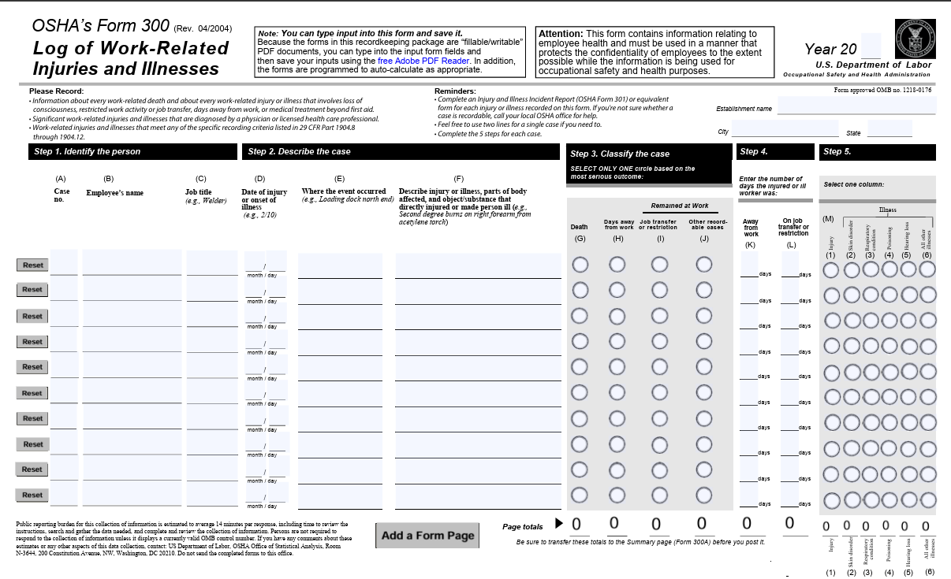
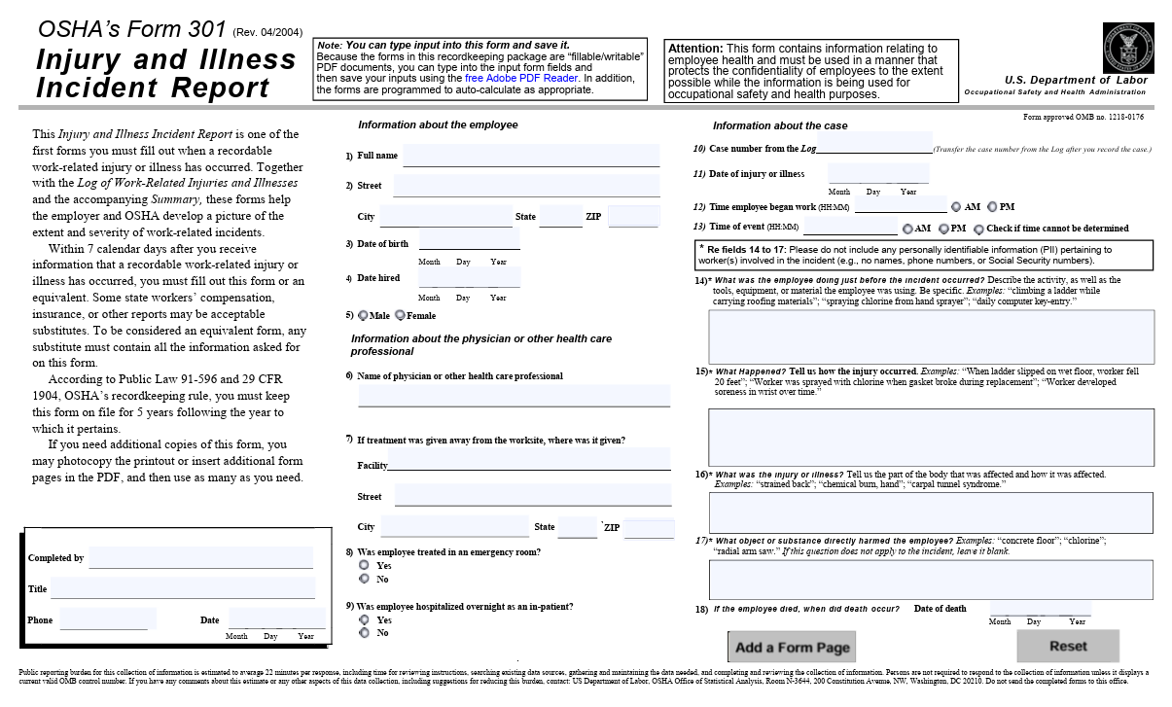
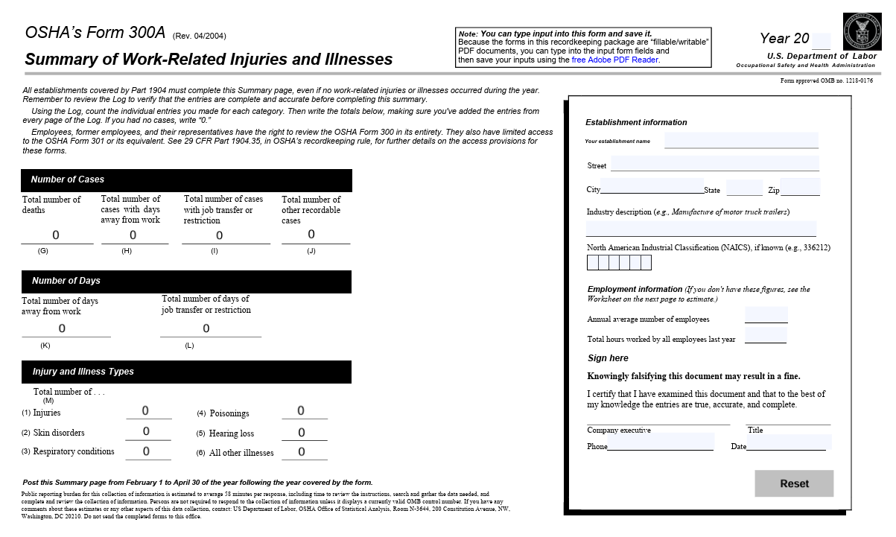
OSHA Recordkeeping Forms
www.osha.gov/recordkeeping/forms

Slide 6
What needs to be recorded on the forms?
Covered employers must record each fatality, injury, and illness that:
  Is work-related, and
  Is a new case, and
  Meets one or more of the criteria contained in sections 1904.7 through 1904.11.
Please note: Work-related injuries and illnesses that are recordable must be recorded within 7 calendar days of learning about the incident.
Notes:
Any work-related injury or illness that meets the recording criteria must be entered on the forms within 7 calendar days of learning about its occurrence.

Slide 7
What is considered an injury or illness?
An injury or illness is an abnormal condition or disorder.
  Injuries include cases such as, but not limited to, a cut, fracture, sprain, or amputation.
  Illnesses include both acute and chronic illnesses, such as, but not limited to, a skin disease, respiratory disorder, or poisoning.
Notes:
OSHA defines an injury or illness as an abnormal condition or disorder. Injuries and illnesses include cases such as cuts, fractures, sprains, skin diseases, or respiratory conditions. For OSHA recordkeeping purposes, an injury or illness can also consist of only subjective symptoms such as aches or pain.
Exposures that do not result in signs or symptoms are not considered injuries or illnesses and should therefore not be recorded on the OSHA forms. For example, if an employee is exposed to chlorine and does not exhibit any signs or symptoms due to the exposure, the case would not be recorded on the Log, even if it involved prophylactic—that is, preventative--medical treatment.

Slide 8
What is considered work-related?
Cases caused by events or exposures in the work environment.
Cases contributed to by events or exposures in the work environment.
Cases significantly aggravated by events or exposures in the work environment.
(For a list of activities that are not considered work-related, see section 1904.5(b)(2))
Notes:
Cases that are caused, contributed to, or significantly aggravated by events or exposures in the work environment are considered work related for OSHA recordkeeping purposes. Work-relatedness is presumed for injuries and illnesses occurring in the workplace or in locations where the employee is located as a condition of employment. It’s important to remember that if any exposure or event in the work environment makes any contribution to the injury or illness, it is considered work-related for OSHA recordkeeping purposes.
There are certain activities that may occur in the work environment that OSHA does not consider work related. For example, injuries resulting directly from eating, drinking, or preparing one’s own food at the workplace are not considered work related. For a complete list of these activities, refer to section 1904.5(b)(2) using the link found on this slide.

Slide 9
1904.7 - General recording criteria for recording work-related injuries and illnesses in the workplace
Death
Days away from work
Restricted work or job transfer
Medical treatment beyond first aid
Loss of consciousness
A significant injury or illness diagnosed by a physician or other licensed health care professional (PLHCP)
Notes:
Work-related injuries and illnesses that result in death, days away from work, restricted work activity or transfer to another job, medical treatment beyond first aid, loss of consciousness, or a significant injury or illness diagnosed by a PLHCP must be recorded on the OSHA forms. We’ll talk about these criteria on the next few slides.
Work-related cases of cancer, chronic irreversible disease, fractured or cracked bones or teeth, or a punctured ear drum must also be entered on the OSHA forms. These are considered significant injuries and illnesses.

Slide 10
OSHA Form 300: Recording a Fatality
www.osha.gov/recordkeeping/forms
Notes:
For cases involving a fatality, enter a checkmark in column G on the OSHA Form 300. Note in column M whether the case involved an injury or an illness.
Also remember that you must report the fatality to OSHA within 8 hours of learning of its occurrence. The event can be reported by phone to the local OSHA Area Office or by using the OSHA 800 number (1-800-321-6742) or by using the reporting application on OSHA’s public website.

Slide 11
OSHA Form 300: Recording a Case with Days Away from Work
www.osha.gov/recordkeeping/forms
Notes:
For cases that involve one or more days away from work, you must place a checkmark in column H on the OSHA Form 300 and enter the number of calendar days the employee was away from work in column K. Then note in column M whether the case involves an injury or an illness.
When counting days, be sure to count the days the employee would not have been able to work regardless of whether he or she was scheduled to work. This would include weekends and holidays. Do not count the day of the injury. If the day count reaches 180 calendar days, you may stop counting subsequent days and enter 180 in column K.

Slide 12
OSHA Form 300: Recording a Case with Restricted Work Activity or Job Transfer
www.osha.gov/recordkeeping/forms
Notes:
For cases that involve restricted work activity or job transfer, you must place a checkmark in column I on the OSHA Form 300 and enter the number of calendar days the employee was restricted in column L. You count the days in the same manner as counting days away from work. Then note in column M whether the case involves an injury or an illness.
An employee is considered restricted if he or she is unable to work a full shift or is unable to perform all of the work activities he or she would be expected to do at least once during a week.
Some cases may involve more than one outcome. Only one classification category should be selected under Step 3. Classify the case by recording the most serious outcome of the case, with column G (Death) being the most serious and column J (Other recordable cases) being the least serious.
For example, if a case involves both days away from work AND days of restricted work activity, place a checkmark in column H, leave column I blank, and enter the correct day counts in both columns K and L. (For example, if an employee had 3 days away from work and 2 of restricted work activity, place a checkmark in column H and enter a 3 in column K and a 2 in column L.) Again, note in column M whether the case involves an injury or an illness.

Slide 13
Other Recording Criteria
  1904.8: Needlestick and sharps injuries
  1904.9: Medical removal
  1904.10: Occupational hearing loss
  1904.11: Tuberculosis
https://www.osha.gov/laws-regs/regulations/standardnumber/1904
Notes:
The recordkeeping rule also contains special criteria for recording occupational hearing loss, tuberculosis, injuries from needlesticks and sharps potentially contaminated with bloodborne pathogens, and cases involving medical removal required by other OSHA standards. For the specific requirements, refer to sections 1904.8 through 1904.11 by looking in the Overview section of the Recordkeeping Forms package.

Slide 14
OSHA Form 300: Recording a Case with Medical Treatment Beyond First Aid
www.osha.gov/recordkeeping/forms
Notes:
For cases that involve medical treatment beyond first aid or loss of consciousness, you must place a checkmark on the OSHA Form 300 in column J, which is for “other recordable cases.” Then note in column M whether the case involves an injury or an illness.
For OSHA recordkeeping purposes, medical treatment is any treatment for an injury or illness except diagnostic procedures, observation and counseling, and first aid. First aid consists of 14 specific treatments listed in section 1904.7(b)(5) of the regulatory text. It includes items such as non-prescription medication, wound coverings, and hot and cold treatment. You can access the complete list using the Regulatory Text link on this web page or by looking in the Overview section of the Recordkeeping Forms package.

Slide 15
OSHA Form 301: Injury and Illness Incident Report
www.osha.gov/recordkeeping/forms
Notes:
You must fill out an Injury and Illness Incident Report for every recordable work-related injury or illness. Together with the Log of Work-Related Injuries and Illnesses and the accompanying Summary, these forms help the employer and OSHA develop a picture of the extent and severity of work-related incidents.
Within 7 calendar days after you receive information that a recordable work-related injury or illness has occurred, you must fill out this form or an equivalent. Some state workers' compensation, insurance, or other reports may be acceptable substitutes. To be considered an equivalent form, any substitute must contain all the information asked for on this form.

Slide 16
OSHA Form 300A: Summary of Work-Related Injuries and Illnesses
www.osha.gov/recordkeeping/forms
Notes:
All establishments covered by Part 1904 must complete the Summary of Work-Related Injuries and Illnesses, even if no injuries or illnesses occurred during the year. Remember to review the Log to verify that the entries are complete and accurate before completing this summary. Using the Form 300, count the individual entries you made for each category. Then, write the totals on the left side of the Form 300A, making sure you've added the entries from every page of the Log. If you had no cases, write in a zero.

Slide 17
OSHA Form 300A: Summary of Work-Related Injuries and Illnesses (continued)
www.osha.gov/recordkeeping/forms
Notes:
On the right side of the Form 300A, fill in the establishment information.
Also in this section of the form, a company official must certify that the entries on the summary are true, accurate, and complete. The certifying official must be the owner of the company, an officer of the corporation, the highest ranking company official at the establishment, or that person’s supervisor.
You must post a copy of the annual summary in each establishment in a conspicuous place or places where notices to employees are customarily posted. You must post it no later than February 1 of the year following the year covered by the records and keep the posting in place for three months until April 30.

Slide 18
OSHA Forms Requirements
1904.32: Each year, fill out the the OSHA 300A Summary and then post it Feb 1 – Apr 30.
1904.33: Keep the forms for 5 years.
1904.35: Allow access to the records to employees and their representatives.
1904.41: Electronic submission of injury and illness records from OSHA Forms 300A, 300, and 301 (if required).
  See ITA Coverage Application at www.osha.gov/itareportapp for help to determine what data, if any, your establishment is required to submit.
Notes:
You must keep these forms on file for 5 years following the year to which they pertain. You must also update the Form 300 with any changes that may occur to the recorded cases during that period. Do not send completed copies of the forms to OSHA. You must make the forms available to employees, former employees, their representatives, and to OSHA officials upon request. (Note, however, that both the Log 300 and Form 301 incident reports may include information relating to employee health. Certain types of cases must be marked as “privacy concern cases” on the OSHA Form 300. Also, an employee or former employee, or their authorized representative, can only obtain a copy of the OSHA Form 301 if it describes an injury or illness to that employee, and all information except the “Tell Us About the Case” section must be removed before providing the form to an authorized representative.

Slide 19
Resources
Recordkeeping web page: www.osha.gov/recordkeeping
Injury Tracking Application (ITA): www.osha.gov/injuryreporting
Local OSHA Offices: https://www.osha.gov/contactus/bystate
Contact us: https://www.osha.gov/contactus
E-correspondence (Ask a Workplace Safety and Health Question): https://www.osha.gov/form/ecorrespondence
Notes:
In conclusion, this presentation reviewed OSHA’s injury and illness recordkeeping requirements at a very high level. The Recordkeeping page, however, includes links to reference documents that address the specific requirements of the recordkeeping rule and answer many reoccurring questions, as well as a link to the recordkeeping forms package itself. To learn the details of what you need to do to be in compliance with the recordkeeping rule, you may want to take some time to familiarize yourself with the Regulatory Text and FAQs posted here. The Letters of Interpretation are also useful reference documents linked from the Recordkeeping page.
If you have specific questions that you cannot find direct guidance for in these documents, you may want to try the Recordkeeping Q&A Search application. Also, feel free to call your local OSHA office or submit your question using OSHA’s e-correspondence web page. You can get a list of OSHA offices and can access OSHA’s Electronic Mail Form using the Contact Us link at the bottom of the Recordkeeping page.
Thanks for helping to make the nation’s workplaces safer.

