Slide 1
29 CFR Part 1904
Recording and Reporting Occupational Injuries and Illnesses
Notes:
FULL DISCLAIMER
This information has been developed by OSHA and is intended to assist employers, workers, and others improve workplace health and safety. While we attempt to thoroughly address specific topics], it is not possible to include discussion of everything necessary to ensure a healthy and safe working environment in this presentation. This is not an exhaustive statement of an employer’s legal obligations, which are defined by statute, regulations, and standards. This document does not have the force and effect of law and is not meant to bind the public in any way. This document is intended only to provide information to the public regarding existing requirements under the law or agency policies. It does not create (or diminish) legal obligations under the Occupational Safety and Health Act. Finally, OSHA may modify rules and related interpretations in light of new technology, information, or circumstances; to keep apprised of such developments, or to review information on a wide range of occupational safety and health topics, you can visit OSHA’s website at www.osha.gov.

Slide 2
Organization of the Rule
Subpart A – Purpose
Subpart B – Scope
Subpart C – Forms and recording criteria
Subpart D – Other requirements
Subpart E – Reporting to the government
Subpart F – Transition
Subpart G - Definitions
Notes:
The rule is organized into seven sections, or subparts. The regulation is written in a question and answer format to make it easy for people to understand and follow. The “definitions” section does not include all terms used in the regulation because many of those definitions are included in the Subpart where the terms are used. Three key terms: establishment, injury or illness, and physician or other licensed health care professional (referred to as a PLHCP) are defined in Subpart G.

Slide 3
Purpose of the Rule
To require employers to record and report work-related fatalities, injuries, and illnesses.
  Note: Recording or reporting a work-related injury, illness, or fatality does not mean the employer or employee was at fault, an OSHA rule has been violated, or that the employee is eligible for workers’ compensation or other benefits.
OSHA injury and illness recordkeeping and Workers’ Compensation are independent of each other.
Notes:
The “purpose” section states the basic purpose of the rule: to require employers to collect injury and illness data and report it to the government, but it doesn’t tell how the data are used or why they are important. The records provide the base data for the BLS survey of occupational injuries and illnesses, the Nation’s primary source of occupational injury and illness statistics.
The records are also used by employers and employees to manage safety and health programs at individual workplaces. Analysis of the data is a widely recognized method for discovering workplace safety and health problems, and for tracking progress in solving those problems.
Finally, the data are used by OSHA. We collect the data to help us direct our programs and measure our own performance, and our inspectors use the data during inspections to help direct their efforts to the hazards that are hurting workers.
The purpose section also includes a note to make it clear that recording an injury or illness does not have any effect on workers’ compensation nor prove violation of an OSHA rule. Hopefully, this will reduce the stigma some employers feel accompanies the recording of a work-related injury or illness.

Slide 4
Subpart B - Scope
1904.1 – Small employer partial exemptions.
1904.2 – Industry partial exemptions (see Appendix A to Subpart B for complete list).
1904.3 – Keeping records for other federal agencies.
Notes:
The “scope” section includes an exemption from recording requirements for smaller employers and for establishments in certain industrial classifications. The scope section also deals with injury and illness recordkeeping requirements from multiple government agencies.

Slide 5
Partial Exemption
Employers that are partially exempt from the recording requirements because of their size or industry must continue to comply with:
  1904.39 – Reporting fatalities, amputations, the loss of an eye, or the in-patient hospitalization of one or more employees
  1904.42 – Bureau of Labor Statistics (BLS) Annual Survey of Injuries and Illnesses (if specifically requested to do so by BLS)
Notes:
While the Part 1904 regulation exempts many employers from keeping records at all times, these employers are not exempted from all of the 1904 requirements.
All employers are required to report work-related fatalities to OSHA within 8 hours of learning of the incident. Work-related amputations, loss of an eye , or the in-patient hospitalization of one or more employees must be reported to OSHA within 24 hours of learning of the incident. Partially exempt employers may need to keep injury and illness records when the government asks them to do so.
Employers exempt from recording are also exempt from electronic reporting requirements. The scope of employers required to submit data electronically through the ITA is addressed later in this presentation.

Slide 6
1904.1 – Size Exemption
If your company had 10 or fewer employees at all times during the last calendar year, you do not need to keep the injury and illness records unless surveyed by BLS or requested to do so in writing by OSHA.
The size exemption is based on the number of employees in the entire company.
Include temporary employees who you supervised on a day-to-day basis in the total employee count.
Notes:
The size exemption is based on the company’s peak employment during the last calendar year. If, at any time last year, the company reached 11 or more workers, the company is not size exempt. However, the company, or some of its individual establishments, may still be exempt because of industry classification.

Slide 7
1904.2 – Industry Exemption
Partially Exempt Industries
Section 1904.2 provides that employers with establishments classified in certain low-hazard industries are not required to routinely keep injury and illness records – Non-Mandatory Appendix A to Subpart B.
The partial exemption is based on the NAICS code of the individual establishment rather than the entire company, and the employer should rely on the establishment’s primary NAICS (See 1904.2(b)(2)(i)).
All employers, including those partially exempted by reason of company size or industry classification, must report to OSHA any workplace incident that results in a fatality, in-patient hospitalization, amputation, or loss of an eye (see § 1904.39).
Notes:
Appendix A to Subpart B lists the partially exempt service and retail industries. Establishments in these industries are exempt even if they are very large. For example, a very large chain of shoe stores or a very large bank is exempt. Some of the State Plan States have different industry exemptions.
The industry exemption applies to individual establishments, so a company that is engaged in several lines of business could have some establishments that keep records, and others that do not.
Employers are not required to keep OSHA injury and illness records for any establishment classified in the following North American Industry Classification System (NAICS), unless they are asked in writing to do so by OSHA, the Bureau of Labor Statistics (BLS), or a state agency operating under the authority of OSHA or the BLS. All employers, including those partially exempted by reason of company size or industry classification, must report to OSHA any workplace incident that results in a fatality, in-patient hospitalization, amputation, or loss of an eye (see § 1904.39). The list of partially exempt industries is based on the 2007 NAICS codes. If an industry listed on the “Non-Mandatory Appendix A to Sub part B – Partially Exempt Industries” no longer exists in the 2017 and 2022 NAICS coding system, this would not change your partially exempt status. {See FAQ 2-3 and 2-4}. For a list of industries that are covered by this recordkeeping rule, click here.

Slide 8
Recording Criteria
Subpart C – Recordkeeping Forms and Recording Criteria
  1904.4 – Recording criteria
  1904.5 – Work-relatedness
  1904.6 – New case
  1904.7 – General recording criteria
  1904.8 – Needlesticks and sharps
  1904.9 – Medical Removal
  1904.10 – Hearing Loss
  1904.11 – Tuberculosis
  1904.29 - Forms
Notes:
Subpart C defines which cases should be recorded on the OSHA 300 Log and which should not be recorded.
The sections of the rule follow the process for deciding if a case is recordable: determining work-relatedness, if it is a new case, if it meets the general recording criteria, and whether it has special criteria for a specific injury/illness type.

Slide 9
1904.4 – Recording Criteria
Covered employers must record each fatality, injury, or illness that:
  Is work-related, and
  Is a new case, and
  Meets one or more of the criteria contained in sections 1904.7 through 1904.11.
Notes:
Paragraph 1904.4 explains the overall process for deciding whether or not to record a case. All cases (both injury and illness cases) are analyzed using the same criteria. Illness cases are only recorded if they meet the same criteria as injury cases.
1904.4 also includes a flowchart that provides a visual representation of the overall process for deciding whether or not to record an injury or illness.

Slide 10
OSHA Injury and Illness Recordkeeping
5 Step process
Notes:
There is a five-step process of determining whether an injury or illness is work-related and recordable. If you answer yes to the first four questions, then step 5 is record the case.
Did the employee experience an injury or illness?
Is the injury or illness work-related?
Is the injury or illness a new case?
Does the injury or illness meet the general criteria or the application to specific cases?
RECORD the injury or illness.

Slide 11
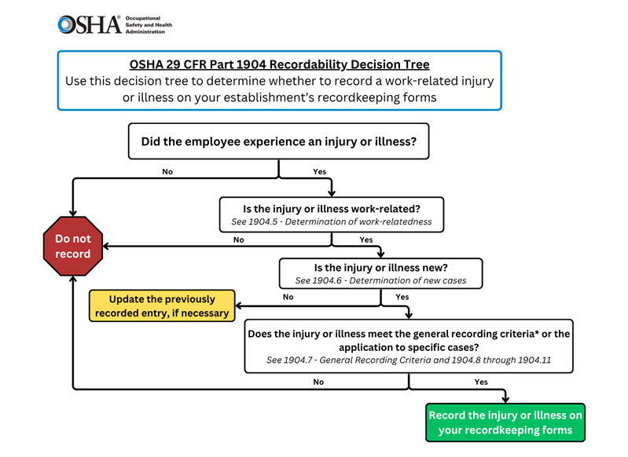
OSHA 29 CFR Part 1904 Recordability Decision Tree
Step 1
Notes:
Did the employee experience an injury or illness?
Section 1904.46 - Injury or illness. An injury or illness is an abnormal condition or disorder. Injuries include cases such as, but not limited to, a cut, fracture, sprain, or amputation. Illnesses include both acute and chronic illnesses, such as, but not limited to, a skin disease, respiratory disorder, or poisoning. (Note: Injuries and illnesses are recordable only if they are new, work-related cases that meet one or more of the part 1904 recording criteria.)

Slide 12
Step 1: Did the employee experience an injury or illness?
Definition 1904.46 - Injury or illness.
An injury or illness is an abnormal condition or disorder. Injuries include cases such as, but not limited to, a cut, fracture, sprain, or amputation. Illnesses include both acute and chronic illnesses, such as, but not limited to, a skin disease, respiratory disorder, or poisoning.
Notes:
Note: Injuries and illnesses are recordable only if they are new, work-related cases that meet one or more of the part 1904 recording criteria.

Slide 13
Step 1: Did the employee experience an injury or illness?
Scenario A:
A worker reports to nurses’ station with complaint of painful wrists. Employee is given two ibuprofen and returned to job.
Did the employee experience an injury or illness? Yes or No
YES, go to Step 2: Is the injury or illness work-related?
Notes:
Answer: Yes
Why: Painful wrists was the abnormal condition (injury) experienced.

Slide 14
Step 1: Did the employee experience an injury or illness?
Scenario B:
There is a chlorine gas leak at XYZ establishment and the two employees in the area are rushed to the hospital. They are told to stay home the next day as a precautionary measure.
Did the employee experience an injury or illness? Yes or No
It depends! We need to know if either employee exhibited signs or symptoms of a work-related injury or illness. If yes, then go to Step 2. If no, STOP
Notes:
An exposure does not mean the case is recordable. If the employee does NOT exhibit ANY signs or symptoms and given prophylactic treatment (medical treatment), the case is not recordable. If the employee shows signs or symptoms of a work-related injury and is given medical treatment, restricted work / job transfer, or days away from work, the case is recordable.

Slide 15

OSHA 29 CFR Part 1904 Recordability Decision Tree
Step 2
Notes:
Is the injury or illness work-related?
Section 1904.5 - Determination of work-relatedness
You must consider an injury or illness to be work-related if an event or exposure in the work environment either caused or contributed to the resulting condition or significantly aggravated a pre-existing injury or illness. Work-relatedness is presumed for injuries and illnesses resulting from events or exposures in the work environment unless an exception specifically applies.
It’s important to remember that if any exposure or event in the work environment makes any contribution to the injury or illness, it is considered work-related for OSHA recordkeeping purposes. There are certain activities that may occur in the work environment that OSHA does not consider work related, and these are discussed later in this presentation.

Slide 16
Step 2: Is the injury or illness work-related?
Determination of work-relatedness (1904.5)
Work-relatedness is presumed for injuries and illnesses resulting from events or exposures occurring in the work environment unless an exception specifically applies.
A case is presumed work-related if, and only if, an event or exposure in the work environment is a discernible cause of the injury or illness or of a significant aggravation to a pre-existing condition.
Notes:
OSHA's approach to work-relationship reflects two important principles. The first is that work need only be a causal factor for an injury or illness to be work-related. The rule requires neither precise quantification of the occupational cause, nor an assessment of the relative weight of occupational and non-occupational causal factors. If work is a tangible, discernible causal factor, the injury or illness is work-related. The second principle is that a "geographic presumption" applies for injuries and illnesses caused by events or exposures that occur in the work environment. These injuries and illnesses must be considered work-related unless an exception to the presumption specifically applies.

Slide 17
1904.5 – Work Environment
The work environment is defined as the establishment and other locations where one or more employees are working or present as a condition of employment.
The work environment includes not only physical locations, but also the equipment or materials used by employees during the course of their work.
Notes:
When employees are at the establishment, they are in the work environment. When employees are working away from the establishment, then any location where the employee is working as a condition of employment is the work environment.

Slide 18
1904.5 – Significant Aggravation
A pre-existing injury or illness is significantly aggravated when an event or exposure in the work environment results in any of the following (which otherwise would not have occurred)
  Death
  Loss of consciousness
  Days away, days restricted, or days on job transfer
  Medical treatment
Notes:
There must be significant aggravation of a pre-existing injury or illness to establish work-relatedness with regard to that injury or illness. The workplace event or exposure must aggravate a pre-existing injury or illness enough that it results in greater consequences than what would have occurred but for that event or exposure. This means that the pre-existing condition requires more medical treatment than otherwise needed; more restrictions, more days away, etc.

Slide 19
1904.5 - Exceptions
1904.5(b)(2) | You are not required to record injuries and illnesses if…
(i) | At the time of injury or illness, the employee was present in the work environment as a member of the general public rather than as an employee.
(ii) | The injury or illness involves signs or symptoms that surface at work but result solely from a non-work-related event or exposure that occurs outside the work environment.
(iii) | The injury or illness results solely from voluntary participation in a wellness program or in a medical, fitness, or recreational activity such as blood donation, physical examination, flu shot, exercise class, racquetball, or baseball.
(iv) | The injury or illness is solely the result of an employee eating, drinking, or preparing food or drink for personal consumption (whether bought on the employer’s premises or brought in). For example, if the employee is injured by choking on a sandwich while in the employer’s establishment, the case would not be considered work-related. Note: if the employee is made ill by ingesting food contaminated by workplace contaminants (such as lead) or gets food poisoning from food supplied by the employer, the case would be considered work-related.
(v) | The injury or illness is solely the result of an employee doing personal tasks (unrelated to their employment) at the establishment outside of the employee’s assigned work hours.
Exceptions continue in next slide
Notes:
Cases meeting the conditions of the listed exceptions to work relationship in the rule are not considered work-related and are, therefore, not recordable.
(i) For example, the employee is a member of the general public, where they work at a department store, but they are shopping at the store on their day off.
(ii) Regardless of where signs or symptoms surface, a case is work-related only if a work event or exposure is a discernable cause of the injury or illness or of a significant aggravation to a pre-existing condition.
(iii) If an employee passes out giving blood or is injured playing basketball – the case is due to voluntary participation in a wellness or fitness program and is not work-related.
(iv) When an employee brings in their own food and get food poisoning, then this is not work-related. Only if food is supplied by the employer the case would be work-related.
(v) If an employee uses the employer’s sewing machine to make tents for a youth scouting troop after the shift has ended, this is a personal task outside of assigned working hours and any injury that would occur during that task is not work-related.

Slide 20
1904.5 – Exceptions (continued)
1904.5(b)(2) (continued) | You are not required to record injuries and illnesses if…
(vi) | The injury or illness is solely the result of personal grooming, self medication for a non-work-related condition, or is intentionally self-inflicted.
(vii) | The injury or illness is caused by a motor vehicle accident and occurs on a company parking lot or company access road while the employee is commuting to or from work.
(viii) | The illness is the common cold or flu (note: contagious diseases such as tuberculosis, brucellosis, hepatitis A, or plague are considered work-related if the employee is infected at work).
(ix) | The illness is a mental illness. Mental illness will not be considered work-related unless the employee voluntarily provides the employer with an opinion from a physician or other licensed health care professional with appropriate training and experience (psychiatrist, psychologist, psychiatric nurse practitioner, etc.) stating that the employee has a mental illness that is work-related.
Notes:
(vi) If an employee has a negative reaction to asthma medication for personal allergies, gets mascara in the eye, or commits suicide – the cases are from self medication for a non-work-related condition, personal grooming, or intentionally self-inflicted and are not work-related.
(vii) If an employee is injured in a motor vehicle accident going to or leaving work at the beginning or end of the shift, or for a personal errand – the case is not work-related. However, if the employee slips on the ice in the parking lot or is in a car wreck doing business - the case is work-related.
(viii) If an employee catches a cold or the flu, the case is not work-related.
(ix) Mental illness is work-related only if the employee voluntarily provides the employer with a written opinion from a PLHCP with appropriate qualifications and experience that affirms a work-related mental illness. The employer is under no responsibility to seek out mental illnesses. In addition, the employer may also get a second opinion from another PLHCP and accept the opinion of the most qualified PLHCP.

Slide 21
1904.5 – Travel Status
An injury or illness that occurs while an employee is on travel status is work-related if it occurred while the employee was engaged in work activities in the interest of the employer.
Home away from home.
Detour for personal reasons is not work-related.
Notes:
When employees are traveling, an injury or illness that occurs while the employee is engaged in work activities for the employer is considered work-related.
Travel to and from customer contacts and entertaining or being entertained at the direction of the employer are work-related. For example, if an employee falls in the airport while on a business trip, the case is work-related.
When an employee checks into a hotel or motel, he/she establishes a “home away from home” as long as the employee is not required to stay there as a condition of employment. While they’re in that “home away from home” status, cases that occur are not work-related. For example, if an employee slips in the hotel shower and is injured, the case is not work-related.
For example: For purposes of Part 1904 recordkeeping, all injuries and illnesses occurring at housing sites owned, managed, or controlled by employers and furnished to employees as a condition of employment are considered work-related, and such injuries and illnesses must be recorded if they meet the recording criteria in Part 1904. OSHA considers the furnishing of housing accommodations by employers to employees to be a "condition of their employment" when (1) employees are required by the employer to use them or (2) are compelled by the practical realities of the employment situation to use them. This means that employer-provided living accommodations are considered a condition of employment when there is an employer policy or contractual agreement that the employee reside at the employer-furnished housing, or a practical, economical, geographical, or physical necessity leading to the same result. However, if housing made available by the employer is accepted by the employee voluntarily, for example, on a normal landlord-tenant base, and in preference to other reasonably-available facilities, such housing would not constitute a condition of employment.
Likewise, if the employee takes a side trip while in transit for a vacation, to go sightseeing or shopping, etc., and is injured, the case is not work-related.

Slide 22
1904.5 – Work at Home
Injuries and illnesses that occur while an employee is working at home are work-related if they:
  Occur while the employee is performing work for pay or compensation in the home, and
  Are directly related to the performance of work rather than the general home environment.
Notes:
When employees are working at home, a case is work-related when an employee is injured or becomes ill while working for pay or compensation. Cases are not work-related if they are related to the general home environment.
For example, if an employee drops a box of work documents and injures her foot, the case would be considered work-related. If an employee's fingernail was punctured and became infected by a needle from a sewing machine used to perform garment work at home, the injury would be considered work-related.
If an employee was injured because he tripped on the family dog while rushing to answer a work phone call, the case would not be considered work-related. If an employee working at home is electrocuted because of faulty home wiring, the injury would not be considered work-related.

Slide 23
Step 2: Is the injury or illness work-related?
Scenario A:
Employee gives blood at voluntary employer-sponsored blood drive and passes out (loss of consciousness).
Is this work-related?
NO. Exception 1904.5(b)(2)(iii):
The injury or illness results solely from voluntary participation in a wellness program or in a medical, fitness, or recreational activity such as blood donation, physical examination, flu shot, exercise class, racquetball, or baseball.

Slide 24
Step 2: Is the injury or illness work-related?
Scenario B:
Employee sprains ankle in company parking lot on his way to work.
Is this work-related?
Maybe, go to step 3. There is no exception that applies in this scenario. Parking lot exception applies only to motor vehicle accidents during commute.

Slide 25
Step 2: Is the injury or illness work-related?
Scenario C:
Employee slips and falls in hallway at work, breaking their arm while working on daughter’s science project on Saturday, the employee’s day off.
Is this work-related?
NO. Exception 1904.5(b)(2)(v):
The injury or illness is solely the result of an employee doing personal tasks (unrelated to their employment) at the establishment outside of the employee’s assigned working hours.

Slide 26
OSHA 29 CFR Part 1904 Recordability Decision Tree step 3
Step 3
Notes:
Is the injury or illness a new case?
Section 1904.46 - The employee has not previously experienced a recorded injury or illness of the same type that affects the same part of the body, or the employee previously experienced a recorded injury or illness of the same type that affected the same part of the body but had recovered completely (all signs and symptoms had disappeared) from the previous injury or illness and an event or exposure in the work environment caused the signs or symptoms to reappear.

Slide 27
Step 3: Is the injury or illness a new case?
Determination of a new case:
Consider an injury or illness a “new case” if the employee has not previously experienced a recorded injury or illness of the same type that affects the same part of the body.
OR
The employee previously experienced a recorded injury or illness of the same type that affected the same part of the body but had recovered completely (all signs and symptoms had disappeared) from the previous injury or illness and an event or exposure in the work environment caused the signs or symptoms to reappear.

Slide 28
1904.6 – New Case
If there is a medical opinion regarding resolution of a case, the employer must follow that opinion.
If an exposure triggers the recurrence, it is a new case (e.g., asthma, rashes).
If signs and symptoms recur even in the absence of exposure, it is not a new case (e.g., silicosis, tuberculosis, asbestosis).
Notes:
If there is a medical opinion regarding resolution of a case, the employer must follow that opinion.
If two or more PLHCPs make conflicting recommendations, the employer is required to base the decision on the best documented and most well reasoned evidence.
Generally, if an exposure triggers the recurrence, it is a new case. This is generally the case in asthma or occupational dermatitis cases.
If signs and symptoms recur even in the absence of exposure, it is not a new case. This is commonly the case for silicosis or tuberculosis.

Slide 29
Step 3: Is the injury or illness a new case?
Scenario A:
Five weeks ago, an employee sprained their wrist at work and received support, prescription medication, and was assigned “light duty”. Two weeks ago, the employee was back on their normal job duties and completely recovered. Today, five weeks after the initial injury, the employee complains of pain in the same wrist as before after moving boxes.
Is this considered a new case?
Yes. The employee completely recovered from the previous injury and a new event or exposure occurred in the work environment. This meets this requirement, so go on to the next step to determine recordability.

Slide 30
Step 3: Is the injury or illness a new case?
Scenario B:
Five weeks ago, an employee sprained their wrist at work and received support, prescription medication, and was assigned “light duty”. Two weeks ago, the employee was back on their normal job duties but continued to take their prescription medication. Today, five weeks after the initial injury, the employee complains of pain in the same wrist after moving some boxes.
Is this considered a new case?
No. The employee had not completely recovered from the previous injury. Update the previously recorded entry, if necessary.

Slide 31
Step 3: Is the injury or illness a new case?
Scenario C:
An employee fractures their foot at work. Every six months or so it bothers her and she is placed on light duty for a day or two.
Is this considered a new case?
It depends. We need more information. Was the employee completely recovered? If no, stop. If yes, was there a new event or exposure in the work environment?

Slide 32
OSHA 29 CFR Part 1904 Recordability Decision Tree step 4
Step 4
Notes:
Does the injury or illness meet the general criteria or the application to specific cases?
Section 1904.7 - General Recording Criteria
You must consider an injury or illness to meet the general recording criteria, and therefore to be recordable, if it results in any of the following:
Death
days away from work
restricted work or transfer to another job
medical treatment beyond first aid
loss of consciousness.
You must also consider a case to meet the general recording criteria if it involves a significant injury or illness diagnosed by a physician or other licensed health care professional, even if it does not result in death, days away from work, restricted work or job transfer, medical treatment beyond first aid, or loss of consciousness. This is specifically defined by OSHA and discussed later in this presentation.
Application to specific cases
Section 1904.8 - Recording criteria for needlestick and sharps injuries.
Section 1904.9 - Recording criteria for cases involving medical removal under OSHA standards.
Section 1904.10 - Recording criteria for cases involving occupational hearing loss.
Section 1904.11 - Recording criteria for work-related tuberculosis cases.

Slide 33
Step 4: Does the injury or illness meet the general criteria or the application to specific cases?
General Recording Criteria 1904.7
An injury or illness is recordable if it results in one or more of the following:
Death
Days away from work
Restricted work activity
Transfer to another job
Medical treatment beyond first aid
Loss of consciousness
Significant injury or illness diagnosed by a physician or other licensed health care professional (PLHCP)

Slide 34
1904.7(b)(3) – Days Away Cases
Record if the case involves one or more days away from work.
Check the box on the OSHA Form 300 for days away cases and count the number of days.
Do not include the day of the injury/illness in counting days away.
Notes:
Cases that result in days away from work are recordable. The employer is to check the box for days away cases and count the number of days away. The day of the injury or illness is not counted as a day away.

Slide 35
1904.7(b)(3) – Days Away Cases
Day counts (days away from work or days on job transfer or restriction)
  Count the number of calendar days the employee was unable to work (include weekend days, holidays, vacation days, etc.).
  Cap day count at 180 days away and/or days restricted.
  You may stop the day count if the employee leaves company for a reason unrelated to the injury or illness.
  If a medical opinion exists, employer must follow that opinion.
Notes:
For days away or days restricted, count calendar days.
When an employee is injured on a Friday or right before a vacation and returns on the next scheduled day, if a PLHCP gives information that the employee should not have worked during those days off, then those days should still be counted as days away.
The employer may stop counting days when they reach 180 days away from work or days of restricted work or both. We then know that this was a serious case. The employer may also stop counting days if the employee leaves the company for some reason not related to the injury or illness – for example, a plant shutdown.
If the employee is away from work for an extended time, the employer must first record the case within 7 days with an estimate of the days away and then must update the day count when the actual number of days away or restricted becomes known.

Slide 36
1904.7(b)(4) – Restricted Work Cases
Record if the case involves one or more days of restricted work or job transfer.
Check the box on the OSHA 300 Form for restricted/transfer cases and count the number of days.
Do not include the day of the injury/illness in counting days of restricted work or job transfer.
Restricted work activity exists if the employee is:
  Unable to work the full workday they would otherwise have been scheduled to work; or
  Unable to perform one or more routine job functions.
An employee’s routine job functions are those activities the employee regularly performs at least once per week.
Notes:
Cases that result in days of restricted work or job transfer are recordable. The employer is to check the box for restricted work cases and count the number of days restricted or transferred. The day of injury/illness is not counted as a day of restriction. A restriction that is limited only to the day of injury or illness does not make a case recordable.
Restricted work activity is evaluated by looking at two components: time and job functions. If, because of a work-related injury or illness, an employee is unable to work the full shift he or she was scheduled to work, then that worker is considered to be on restricted work activity. For example, if the employee was scheduled to work an 8-hour day, but is only able to work 4 hours, then his work activity is restricted.
If an employee is able to work a full shift, but is unable to perform all of his or her routine job functions, then the worker is also considered to be on restricted work activity.
OSHA has defined routine job functions as work that an employee would regularly have performed at least once per week, because OSHA believes that the range of activities captured by this interval of time will generally reflect the range of an employee’s usual work activities. Activities performed less frequently than once per week reflect more uncommon work activities that are not considered routine duties for the purposes of this rule.

Slide 37
1904.7(b)(4) – Restricted Work Cases
A case is not recordable under 1904.7(b)(4) as a restricted work case if:
The employee experiences minor musculoskeletal discomfort;
A health care professional determines that the employee is fully able to perform all of their routine job functions; and
The employer assigns a work restriction to that employee for the purpose of preventing a more serious condition from developing.
Notes:
OSHA’s policy regarding preventive transfers is explained in the Recordkeeping Policies and Procedures Directive (CPL 02-00-172) and Frequently Asked Question (FAQ ) 7-19 the Part 1904 recordkeeping requirements. Under that policy, a case is not recordable under section 1904.7(b)(4) as a restricted work case if three conditions are met:
the employee experiences minor musculoskeletal discomfort,
a health care professional determines that the employee is fully able to perform all or his or her routine job functions, and
the employer assigns a work restriction to that employee for the purpose of preventing a more serious condition from developing.

Slide 38
1904.7(b)(4) – Job Transfer
Job transfer:
  An injured or ill employee is assigned to a job other than his or her regular job for part of the day.
  A case is recordable if the injured or ill employee performs their routine job duties for part of a day and is assigned to another job for the rest of the day.
Notes:
Most job transfers involve some type of restriction. Even if they don’t, job transfers due to an injury or illness are recordable events. If an injured or ill employee is transferred to another job for half days, this is also a job transfer.
As described in the Recordkeeping Policies and Procedures Directive (CPL 02-00-172) and FAQ 7-12 for recordkeeping, the employer may stop counting days of restricted work or transfer to another job if the restriction or transfer is made permanent. A permanent restriction or transfer is one that is expected to last for the remainder of the employee's career. If a permanent job transfer is made immediately, that is, on the day of injury or illness, at least one day of restricted work activity must be recorded.

Slide 39
1904.7(b)(5) – Medical Treatment
Medical treatment is the management and care of a patient to combat disease or disorder.
Medical treatment does not include:
  Visits to a physician or other licensed healthcare provider solely for observation or counseling.
  Diagnostic procedures.
  First aid.
Notes:
Medical treatment is the management and care of a patient to combat disease or disorder. Medical treatment does not include visits to a PLHCP solely for observation or counseling, including follow-up visits.
Medical treatment also does not include diagnostic procedures, such as x-rays, blood tests, or MRIs. Use of prescription medications for diagnostic purposes is also not considered medical treatment; for example, prescription eye drops used to dilate the pupils, is not considered medical treatment.
Finally, medical treatment does not include first aid procedures.

Slide 40
1904.7(b)(5) – First Aid
What does OSHA consider “first aid”?
Using non-prescription medication at non-prescription strength
Tetanus immunizations
Cleaning, flushing, or soaking surface wounds
Wound coverings, butterfly bandages, Steri-Strips
Hot or cold therapy
Non-rigid means of support
Temporary immobilization device used to transport accident victims
Drilling of fingernail or toenail, draining fluid from blister
Eye patches
Removing foreign bodies from eye using irrigation or cotton swab
Removing splinters or other foreign material from areas other than the eye by irrigation, tweezers, cotton swabs, or other simple means
Finger guards
Massages
Drinking fluids for relief of heat stress

Slide 41
1904.7(b)(6) – Loss of Consciousness
All work-related cases involving loss of consciousness must be recorded.
Notes:
You must record a work-related injury or illness if the worker becomes unconscious, regardless of the length of time the employee remains unconscious.
A preexisting injury or illness will be considered to have been significantly aggravated, for the purposes of OSHA injury and illness recordkeeping, when an event or exposure in the work environment results in loss of consciousness, providing that the preexisting injury or illness would likely not have resulted in loss of consciousness but for the occupational event or exposure.

Slide 42
1904.7(b)(7) – Significant Diagnosed Injury or Illness
The following work-related conditions must always be recorded at the time of diagnosis by a physician or other licensed health care professional:
  Cancer
  Chronic irreversible disease
  Punctured eardrum
  Fractured or cracked bone or tooth
Notes:
“Note to § 1904.7: OSHA believes that most significant injuries and illnesses will result in one of the criteria listed in § 1904.7(a): death, days away from work, restricted work or job transfer, medical treatment beyond first aid, or loss of consciousness. However, there are some significant injuries, such as a punctured eardrum or a fractured toe or rib, for which neither medical treatment nor work restrictions may be recommended. In addition, there are some significant progressive diseases, such as byssinosis, silicosis, and some types of cancer, for which medical treatment or work restrictions may not be recommended at the time of diagnosis but are likely to be recommended as the disease progresses. OSHA believes that cancer, chronic irreversible diseases, fractured or cracked bones, and punctured eardrums are generally considered significant injuries and illnesses, and must be recorded at the initial diagnosis even if medical treatment or work restrictions are not recommended, or are postponed, in a particular case.” 29 CFR 1904.7.

Slide 43
1904.8 – Bloodborne Pathogens
Record all work-related needlesticks and cuts from sharp objects that are contaminated with another person’s blood or other potentially infectious material (includes human bodily fluids, tissues and organs; other materials infected with HIV or HBV such as laboratory cultures).
Record splashes or other exposures to blood or other potentially infectious material if it results in diagnosis of a bloodborne disease or meets the general recording criteria.
Notes:
The rule requires the recording of all work-related needlesticks and cuts from contaminated sharp objects.
The requirements of the bloodborne pathogen standard for sharps injury logs are linked to the recordkeeping rule. If the establishment is exempted from the Part 1904 requirements, it is also exempted from the sharps injury log requirements of section 1910.1030.
As described in Frequently Asked Question (FAQ ) 8-2 for recordkeeping, an employer can use the 300 Log to meet the requirements for a sharps log in section 1910.1030. To do so, the employer must be able to segregate the sharps injury data and must include information on the type and brand of device that caused the injury.

Slide 44
1904.9 – Medical Removal
If an employee is medically removed under the medical surveillance requirements of an OSHA standard, you must record the case.
The case is recorded as either one involving days away from work or days of restricted work activity.
If the case involves voluntary removal below the removal levels required by the standard, the case need not be recorded.
Notes:
Section 1904.9 requires the employer to record cases where an employee is medically removed under an OSHA standard. Several OSHA standards have medical removal criteria, including the lead, cadmium, and benzene standards.
The case is recorded as a days away or restricted work case depending on how the employer deals with the removal.
If employers voluntarily remove employees below the thresholds in the standards, the case does not need to be recorded under this paragraph.

Slide 45
1904.10 – Hearing Loss
Must record all work-related hearing loss cases where:
  Employee has experienced a Standard Threshold Shift (STS)* and
  Employee’s hearing level is 25 decibels (dB) or more above audiometric zero (averaged at 2000, 3000, and 4000 hertz [Hz]) in the same ear(s) as the STS.
*An STS is defined in OSHA’s Noise Standard at 29 CFR 1910.95(g)(10)(i) as a change in hearing threshold, relative to the baseline audiogram, of an average of 10 dB or more at 2000, 3000, and 4000 Hz in one or both ears.
Notes:
Employers must record work-related hearing loss cases when an employee’s hearing test shows a marked decrease in overall hearing.
If an event or exposure in the work environment caused or contributed to the hearing loss, or significantly aggravated a pre-existing hearing loss, the case is work related. If a physician or other licensed health care professional determines that the hearing loss is not work related or has not been significantly aggravated by occupational noise exposure, employers are not required to record the case.
If an employee’s hearing test (audiogram) reveals that the employee has experienced a work related Standard Threshold Shift (STS) in hearing in one or both ears, and the employee’s hearing level is 25 decibels (dB) or more above audiometric zero [averaged at 2000, 3000, and 4000 Hertz (Hz)] in the same ear(s) as the STS, you must record the case on the OSHA 300 Log.
A Standard Threshold Shift, or STS, is defined in OSHA’s general industry noise standard at 29 CFR 1910.95(g)(10)(i) as a change in hearing threshold, relative to the baseline audiogram for that employee, of an average of 10 dB or more at 2000, 3000, and 4000 Hz in one or both ears.

Slide 46
1904.10 – Hearing Loss (continued)
Must compute the STS in accordance with OSHA’s Noise Standard 1910.95.
Compare the employee’s current audiogram to the original baseline audiogram or the revised baseline audiogram allowed by 1910.95(g)(9).
May adjust for aging to determine whether an STS has occurred using tables in Appendix F of 1910.95.
May not adjust for aging to determine whether or not hearing level is 25 dB or more above audiometric zero.
Notes:
Paragraph 1910.95(g)(9) of OSHA’s noise standard states:
Revised baseline. An annual audiogram may be substituted for the baseline audiogram when, in the judgment of the audiologist, otolaryngologist, or physician who is evaluating the audiogram:
The standard threshold shift revealed by the audiogram is persistent, or
The hearing threshold shown in the annual audiogram indicates significant improvement over the baseline audiogram.
When you are determining whether an STS has occurred, you may age adjust the employee’s current audiogram results by using Tables F-1 or F-2, as appropriate, in Appendix F of 29 CFR 1910.95. You may not use an age adjustment when determining whether the employee’s hearing level is 25 dB or more above audiometric zero.
In short, a recordable hearing loss case occurs when an employee experiences an STS (as defined in 1910.95), the STS is work-related, and the employee’s aggregate hearing loss exceeds 25 dB from audiometric zero.

Slide 47
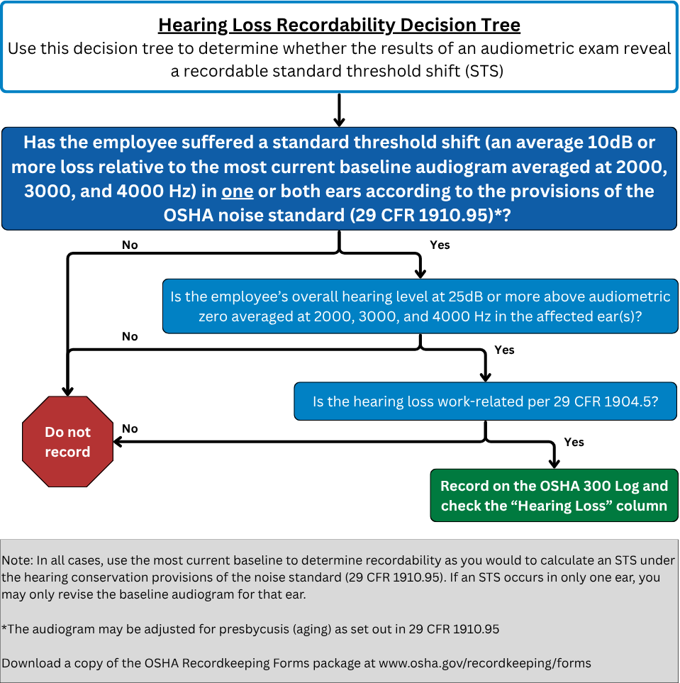
1904.10 – Hearing Loss Decision Tree

Slide 48
1904.11 - Tuberculosis
Record a case where an employee is exposed at work to someone with a known case of active tuberculosis and subsequently develops a TB infection.
A case is not recordable when:
  The worker is living in a household with a person who is diagnosed with active TB.
  The Public Health Department has identified the worker as a contact of an individual with active TB.
  A medical investigation shows the employee’s infection was caused by exposure away from work.
Notes:
If an employee is exposed to an active case of tuberculosis at work, and then has a positive TB skin test or becomes an active case, then it must be recorded.
The case does not have to be recorded if there is evidence that the case did not arise from a workplace exposure.

Slide 49
1904.29 – Recordkeeping Forms
OSHA requires employers to use three forms to track occupational injuries and illnesses: the OSHA 300, 300A, and 301 forms:
  OSHA Form 300, Log of Work-Related Injuries and Illnesses
  OSHA Form 300A, Summary of Work-Related Injuries and Illnesses
  OSHA Form 301, Injury and Illness Incident Report
www.osha.gov/recordkeeping/forms
Notes:
OSHA’s Recordkeeping rule requires employers to keep 3 forms: a 300 Log, a 300A Summary form, and a 301 Incident Report. (Revised April 2004)
The forms are included in a forms package (Recordkeeping - Recordkeeping Forms | Occupational Safety and Health Administration) which contains:
- enough 300 and 300A forms for the average employer to keep records for 3 years
- instructions and examples
- a worksheet for calculating injury and illness rates, and
- a worksheet to help employers fill out the summary.
The package also includes references to tell employers where they can get more help.

Slide 50
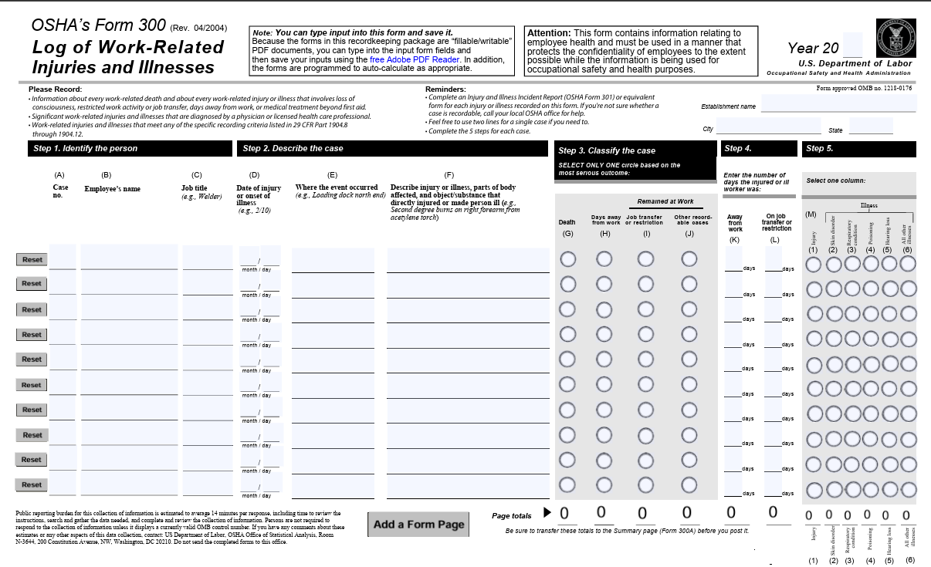
OSHA Form 300, Log of Work-Related Injuries and Illnesses
www.osha.gov/recordkeeping/forms
Notes:
Also available in Spanish!

Slide 51
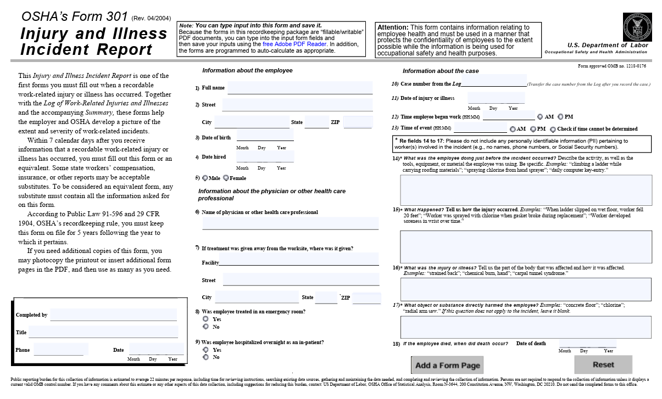
OSHA Form 301, Injury and Illness Incident Report
www.osha.gov/recordkeeping/forms
Notes:
Also available in Spanish!

Slide 52
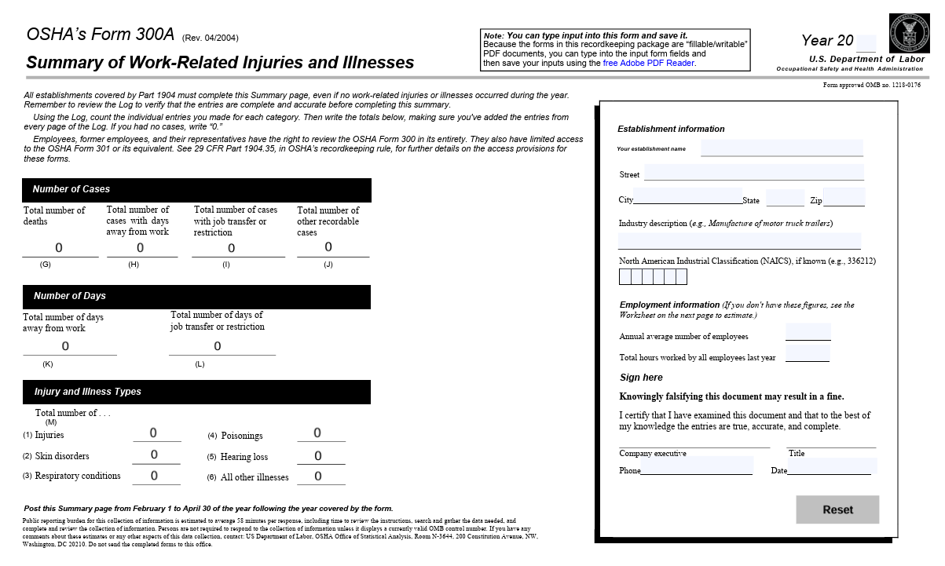
OSHA Form 300A, Summary of Work-Related Injuries and Illnesses
www.osha.gov/recordkeeping/forms
Notes:
Also available in Spanish!

Slide 53
1904.29 – Recordkeeping Forms Requirements
Employers must enter each recordable injury or illness on the OSHA 300 Log and 301 Incident Report within seven (7) calendar days of receiving information that a recordable injury or illness has occurred.
Employers may use an equivalent form if it has the same information, is as readable and understandable, and is completed using the same instructions as the OSHA form it replaces.
Equivalent forms can be kept on the computer as described under 1904.35 and 1904.40.
If an employer has a "privacy concern case," you may not enter the employee's name on the OSHA 300 Log. Instead, enter "privacy case" in the space normally used for the employee's name.

Slide 54
1904.29 – Privacy Protection
For certain privacy concern cases, do not enter the name of an employee on the OSHA Form 300.
Enter “privacy case” in the name column.
Keep a separate confidential list of the case numbers and employee names.
Notes:
For certain “privacy concern cases,” employers must not enter the employee’s name on the 300 form. Instead, they are to enter “privacy case.”
A separate, confidential list of the employee’s names and case numbers must be kept by the employer and provided to an OSHA inspector upon request.

Slide 55
1904.29 – Privacy Protection (continued)
Privacy concern cases are defined specifically in 1904.29 and include:
  An injury or illness to an intimate body part or reproductive system
  An injury or illness resulting from sexual assault
  Mental illness
  HIV infection, hepatitis, tuberculosis
  Needlestick and sharps injuries that are contaminated with another person’s blood or other potentially infectious material
  Employee voluntarily requests to keep name off for other illness cases
Notes:
Privacy concern cases are defined very specifically in the rule. Privacy concern cases are:
- an injury or illness to an intimate body part or the reproductive system,
- an injury or illness resulting from sexual assault,
- mental illness,
- HIV infection, hepatitis or tuberculosis,
- needlestick and sharps injuries that are contaminated with another person’s blood or other potentially infectious material, or
- illness cases where employees independently and voluntarily request that their names not be entered on the log.

Slide 56
1904.29 – Privacy Protection (continued)
Employers may use discretion in describing the case if the employee can be identified.
If you give the forms to people not authorized by the rule, you must remove the names first.
  Exceptions for:
    Auditor/consultant
    Workers’ compensation or other insurance
    Public health authority or law enforcement agency
Notes:
For a privacy concern case, if the employee’s identity can still be implied, the employer may use some discretion in describing the case. The rule requires that enough information be entered to identify the cause and general severity of the incident. For example, a sexual assault can be entered as “assault” or an injury to a reproductive organ can be entered as a “lower abdominal injury.” The employer is not required to go into graphic detail in these types of cases.
If the employer gives out the forms to the public, the names must be removed first. There are exceptions for employee access, OSHA access, auditors, insurance, or law enforcement personnel.

Slide 57
Subpart D – Other Requirements
Subpart D includes other requirements such as telling the employer how to handle multiple business establishments and temporary employees, how to summarize and store the data, what to do if the business is sold, employee involvement, state plans and variances.
  1904.30 – Multiple business establishments
  1904.31 – Covered employees
  1904.32 – Annual Summary
  1904.33 – Retention and updating
  1904.34 – Change of ownership
  1904.35 – Employee Involvement
  1904.36 – Discrimination
  1904.37 – State Plans
  1904.38 - Variances
Notes:
Subpart D includes other requirements, telling the employer how to handle multiple business establishments and temporary employees, how to summarize and store the data, what to do if the business is sold, employee involvement, state plans and variances.

Slide 58
1904.30 – Multiple Business Establishments
Keep a separate OSHA Form 300 for each establishment that is expected to be in operation for more than a year.
May keep one OSHA Form 300 for all short-term establishments.
Each employee must be linked with one establishment.
Notes:
When the employer has more than one establishment, a separate log must be kept for each establishment expected to be in operation for more than a year.
For the short-term establishments (those expected to be in operation for less than a year), the employer may keep one log that includes all of the injuries and illnesses at the short-term establishments or keep logs by state or district.
An employer with multiple lines of business may have some exempt and some covered establishments, and each employee must be linked to an establishment for recordkeeping purposes.

Slide 59
1904.31 – Covered Employees
Employees on payroll.
Employees not on payroll who are supervised on a day-to-day basis.
Exclude self-employed and partners.
Temporary help agencies should not record the cases experienced by temp workers who are supervised by the using firm.
Notes:
Employees on the payroll must be included in the employer’s records, unless the company is acting as a temporary help service.
Employees not covered in the OSH Act are also not included in the OSHA records. These include unpaid volunteers, sole proprietors, family members on family farms, domestic workers in residential settings.
Temporary workers will be the employees of the party exercising day-to-day control over them, and the supervising party will record their injuries and illnesses.
The employer and the temporary help service can discuss each case to see who is recording it. We do not want a case to be recorded twice if it can be avoided.

Slide 60
1904.32 – Annual Summary
Review OSHA Form 300 for completeness and accuracy and correct any deficiencies
Complete OSHA Form 300A
  Certify summary, and
  Post summary.
Notes:
The annual summary requirements lay out a process for completing the end-of-year processing.
The employer must first review the records and correct them if necessary, then complete the form, certify the form, and post it for 3 months.
The form includes data on average employment and hours worked to make it easier to calculate incidence rates. The employer may estimate these figures using the optional worksheet provided in the forms package.

Slide 61
1904.32 – Annual Summary (continued)
A company executive must certify the summary, which may include:
  An owner of the company
  An officer of the corporation
  The highest-ranking company official working at the establishment, or
  The immediate supervisor of the highest-ranking company official working at the establishment.
Must post for 3-month period from February 1 – April 30 of the year following the year covered by the summary.
Notes:
The rule requires certification by a company executive to help improve management involvement in the records.
A company executive is narrowly defined as:
- an owner of the company,
- an officer of the corporation
- the highest ranking person at the establishment, or
- their immediate supervisor
The records must be posted for 3 months from February 1st through April 30th.

Slide 62
1904.33 – Retention and Updating
Retain the forms for 5 years following the year that they cover.
Update the OSHA Form 300 during that period.
  Need not update the OSHA Form 300A or OSHA Form 301.
Notes:
The records must be retained for five years.
During the retention period, the employer must update the 300 form to include any cases that are newly discovered or whose status has changed but does not have to change the summary or the 301 form.
The employer is required to update the entries on the OSHA 300 Log to include newly discovered cases and show changes that have occurred to previously recorded cases. The provisions in section 1904.33 state that the employer is not required to update the 300A Annual Summary or the 301 Incident Reports, although the employer is permitted to update these forms if he or she wishes to do so.

Slide 63
1904.35 – Employee Involvement
You must inform each employee about how to report an injury or illness.
  Establish a way for employees to report work-related injuries and illnesses promptly; and
  Notify each employee how to report work-related injuries and illnesses to you.
Notes:
The rule requires each employer to set up a way for employees to report injuries and illnesses. Employers also must tell each employee how to report. This is a very basic step to make sure employees report cases so they can be recorded.

Slide 64
1904.35 – Employee Involvement (continued)
Must provide limited access to injury and illness records to employees, former employees and their personal and authorized representatives.
  Provide copy of OSHA Form 300 by the end of the next business day.
  Provide copy of OSHA Form 301 to employee, former employee, or personal representative by end of next business day.
  Provide copies of OSHA Form 301 to authorized representative within 7 calendar days. Provide only “Information about the case” section of form.
Notes:
Employers are also required to provide the records to employees. The 300 Log is available to employees, former employees, or employee representatives by the end of the next business day.
An employee, former employee or personal representative is allowed to receive a copy of his or her own 301 form.
An authorized representative can get 301 information for all the injuries and illnesses at the establishment, but only the information about the injury or illness. That information is provided on the right side of the 301 form.

Slide 65
1904.36 – Prohibition Against Discrimination
Section 11(c) of the Act prohibits you from discriminating against an employee for reporting a work-related fatality, injury, or illness
Section 11(c) also protects the employee who files a safety and health complaint, asks for access to the Part 1904 records, or otherwise exercises any rights afforded by the OSH Act.
Notes:
Section 1904.35 includes a provision that employers are prohibited from discharging or discriminating against employees for reporting work-related injuries or illnesses. In addition, section 1904.36 reminds employers about the anti-discrimination provisions of the OSH Act. Employers may not discriminate against an employee for reporting a work-related injury or illness case.

Slide 66
1904.37 – State Plans
State Plan states must have the same requirements as Federal OSHA for determining which injuries and illnesses are recordable and how they are recorded.
For other Part 1904 requirements, State Plan requirements may be more stringent.
Check your OSHA-Approved State Plan website to see if any additional requirements apply: https://www.osha.gov/stateplans
Notes:
The State Plan States must collect the same information as federal OSHA.
However, the States may have more stringent or supplemental requirements on other matters, such as industry and size exemptions, the reporting of fatalities and catastrophes, and the access provisions.
The State Plan States must cover public sector employees, so in these states records are kept by state and local government agencies.

Slide 67
Subpart E – Reporting Information to the Government
1904.39 – Fatality and catastrophe reporting
1904.40 – Access for Government representatives
1904.41 – Electronic submission of injury and illness data to OSHA
1904.42 – BLS Survey
Notes:
Subpart E includes the requirements for providing information to the government.

Slide 68
1904.39 – Fatality/Catastrophe Reporting
Required to report:
  Any work-related fatality within 8 hours.
  Any work-related amputation, loss of an eye, or inpatient hospitalization of one or more employees within 24 hours.
NOT required to report:
  Highway or public street motor vehicle accidents (outside a construction work zone).
  Commercial airplane, train, subway, or bus accidents.
Notes:
All employers are required to report work-related fatalities to OSHA within 8 hours. Work-related amputations, loss of an eye , or the in-patient hospitalization of one or more employees must be reported to OSHA within 24 hours of learning of the incident.
The case can be called in to the local area office or phoned in to 1-800-321-OSHA. The case can also be reported to OSHA using the web application available from OSHA’s public website.
Cases may be recordable but not reportable, for example, a fatality due to a motor vehicle accident on a public highway does not have to be reported within 8 hours, but it is a recordable fatality on the 300 Log.

Slide 69
1904.40 – Providing Records to Government Representatives
Must provide copies of records within 4 business hours.
Use the business hours of the establishment where the records are located.
Notes:
Employers must provide the records within 4 business hours of a request by an OSHA, NIOSH, or State Plan official. If an inspection is in Texas and the records are in New York, use the business hours of New York.

Slide 70
1904.41 – Electronically Submit Injury and Illness Data
YOU MUST electronically submit your establishment’s 300A data to the Injury Tracking Application if your establishment meets one of the following criteria:
  250 or more employees and is not in an industry listed in the Exempt Industries list in Appendix A to Subpart B of OSHA’s recordkeeping regulation of 29 CFR Part 1904 or
  20-249 employees and is in an industry listed in Appendix A to Subpart E of 29 CFR Part 1904.
YOU MUST also submit 300/301 data if your establishment(s) has 100 or more employees and is in an industry listed in Appendix B to Subpart E of 29 CFR Part 1904.
Notes:
Certain employers are also required to electronically submit certain injury and illness data from their OSHA Forms to OSHA through the Injury Tracking Application (ITA). More information about these requirements is available on OSHA’s ITA website: https://www.osha.gov/injuryreporting/

Slide 71
For more help
OSHA’s Recordkeeping Page:
  www.osha.gov/recordkeeping
OSHA Recordkeeping Forms Package (in English and Spanish)
  www.osha.gov/recordkeeping/forms
OSHA’s Injury Tracking Application (ITA) Page:
  www.osha.gov/injuryreporting
ITA Coverage Application determines if your establishment is required to electronically submit
  https://www.osha.gov/itareportapp
OSHA’s Severe Injury Report page
  www.osha.gov/severeinjury
Report a fatality, catastrophe, or severe injury
  www.osha.gov/report

