Slide 1
29 CFR Part 1904
Recording and Reporting Occupational Injuries and Illnesses
Revised 7/2014
Notes:
FULL DISCLAIMER
These materials were developed by OSHA’s Office of Training and Education and are intended to assist employers, workers, and others as they strive to improve workplace health and safety. While we attempt to thoroughly address specific topics, it is not possible to include discussion of everything necessary to ensure a healthy and safe working environment in a presentation of this nature. Thus, this information must be understood as a tool for addressing workplace hazards, rather than an exhaustive statement of an employer’s legal obligations, which are defined by statute, regulations, and standards. Likewise, to the extent that this information references practices or procedures that may enhance health or safety, but which are not required by a statute, regulation, or standard, it cannot, and does not, create additional legal obligations. Finally, over time, OSHA may modify rules and interpretations in light of new technology, information, or circumstances; to keep apprised of such developments, or to review information on a wide range of occupational safety and health topics, you can visit OSHA’s website at www.osha.gov.

Slide 2
Organization of the Rule
Subpart A - Purpose
Subpart B - Scope
Subpart C - Forms and recording criteria
Subpart D - Other requirements
Subpart E - Reporting to the government
Subpart F - Transition
Subpart G - Definitions
Notes:
The rule is organized into seven sections, or subparts.
The regulation is written in a question and answer format to make it easy for people to understand and follow. The “definitions” section contains only a few terms because most definitions are included where the terms are used. However, three important terms: establishment, injury or illness, and physician or other licensed health care professional (referred to as a PLHCP) are included in Subpart G.

Slide 3
Purpose (of the Rule)
To require employers to record and report work-related fatalities, injuries and illnesses
  Note: Recording or reporting a work-related injury, illness, or fatality does not mean the the employer or employee was at fault, an OSHA rule has been violated, or that the employee is eligible for workers’ compensation or other benefits.
OSHA injury and illness recordkeeping and Workers’ Compensation are independent of each other
Notes:
The “purpose” section states the basic purpose of the rule: to require employers to collect injury and illness data and report it to the government, but it doesn’t tell how the data are used or why they are important. The records provide the base data for the BLS survey of occupational injuries and illnesses, the Nation’s primary source of occupational injury and illness statistics.
The records are also used by employers and employees to manage safety and health programs at individual workplaces. Analysis of the data is a widely recognized method for discovering workplace safety and health problems, and for tracking progress in solving those problems.
Finally, the data are used by OSHA. We collect the data to help us direct our programs and measure our own performance, and our inspectors use the data during inspections to help direct their efforts to the hazards that are hurting workers.
The purpose section also includes a note to make it clear that recording an injury or illness does not have any effect on workers’ compensation nor prove violation of an OSHA rule. Hopefully, this will reduce the stigma some employers feel accompanies the recording of a work-related injury or illness.

Slide 4
Subpart B - Scope
1904.1 – Small employer partial exemptions
1904.2 – Industry partial exemptions (see Appendix A to Subpart B for complete list)
1904.3 – Keeping records for other Federal agencies
Notes:
The “scope” section includes an exemption for smaller employers and for establishments in certain industrial classifications. The scope section also deals with injury and illness recordkeeping requirements from multiple government agencies.
Out of 7.5 million U.S. establishments, about 1.5 million are required to keep records. This means that about 20% of American workplaces must keep OSHA records, and about 80% are partially exempt.

Slide 5
Partial Exemption
Employers that are partially exempt from the recordkeeping requirements because of their size or industry must continue to comply with:
  1904.39, Reporting fatalities, amputations, the loss of an eye, or the in-patient hospitalization of one or more employees
  1904.41, Annual OSHA injury and illness survey (if specifically requested to do so by OSHA)
  1904.42, BLS Annual Survey (if specifically requested to do so by BLS)
Notes:
While the 1904 regulation exempts many employers from keeping records at all times, these employers are not exempted from all of the 1904 requirements.
All employers are required to report work-related fatalities to OSHA within 8 hours of learning of the incident. Work-related amputations, loss of an eye , or the in-patient hospitalization of one or more employees must be reported to OSHA within 24 hours of learning of the incident. Partially exempt employers may need to keep injury and illness records when the government asks them to do so.

Slide 6
1904.1 – Size Exemption
If your company had 10 or fewer employees at all times during the last calendar year, you do not need to keep the injury and illness records unless surveyed by OSHA or BLS
The size exemption is based on the number of employees in the entire company
Include temporary employees who you supervised on a day to day basis in the count
Notes:
The size exemption is based on the company’s peak employment during the last calendar year. If, at any time last year, the company reached 11 or more workers, the company is not size exempt. However, the company, or some of its individual establishments, may still be exempt because of industry classification.

Slide 7
1904.2 - Industry Exemption
All industries in agriculture, construction, manufacturing, utilities and wholesale trade sectors are covered
In the transportation, retail and service sectors, some industries are partially exempt
Appendix A to Subpart B lists partially exempt industries
Notes:
Appendix A to Subpart B lists the partially exempt service and retail industries. Establishments in these industries are exempt even if they are very large. For example, a very large chain of shoe stores or a very large bank is exempt. Some of the State Plan States have different industry exemptions.
The exempt transportation, retail and service industries were chosen by comparing the Days Away, Restricted Work Activity and Job Transfer (DART) injury and illness experience of the industry with the national average. If the industry’s DART rate for the last 3 years was below 75% of the national average, the industry was exempted. As an example, sectors such as doctors’ and dentists’ offices are exempted.
The industry exemption applies to individual establishments, so a company that is engaged in several lines of business could have some establishments that keep records, and others that do not.

Slide 8
Recording Criteria
Subpart C - Recordkeeping Forms and Recording Criteria
  1904.4 Recording criteria
  1904.5 Work-relatedness
  1904.6 New case
  1904.7 General recording criteria
  1904.8 Needlesticks and sharps
  1904.9 Medical removal
  1904.10 Hearing loss
  1904.11 Tuberculosis
  1904.29 Forms
Notes:
For the injury and illness statistics, Subpart C is the most important section of the rule, because it defines which cases should be recorded on the OSHA 300 Log and which should not be recorded.
The sections of the rule follow the process for deciding if a case is recordable: determining work-relatedness, if it is a new case, if it meets the general recording criteria, and whether it has special criteria for a specific injury/illness type.

Slide 9
1904.4 – Recording Criteria
Covered employers must record each fatality, injury or illness that:
  is work-related, and
  is a new case, and
  meets one or more of the criteria contained in sections 1904.7 through 1904.11.
Notes:
Paragraph 1904.4 explains the overall process for deciding whether or not to record a case. All cases (both injury and illness cases) are analyzed using the same criteria. Illness cases are only recorded if they meet the same criteria as injury cases.
1904.4 also includes a flowchart that provides a visual representation of the overall process for deciding whether or not to record an injury or illness.

Slide 10
OSHA Injury and Illness Recordkeeping
OSHA INJURY AND
ILLNESS RECORDKEEPING
5 STEP PROCESS

Slide 11
Injury and Illness Recordkeeping flowchart
Did the employee experience an injury or illness?
YES
Is the injury or illness work-related?
YES
Is the injury or illness a new case?
YES
Does the injury or illness meet the general criteria
or the application to specific cases?
YES
RECORD THE INJURY OR ILLNESS

Slide 12
Definition of an injury or illness
STEP 1:
Did the employee experience an injury or illness?
Definition [1904.46]
An injury or illness is an abnormal condition or disorder. Injuries include cases such as, but not limited to, a cut, fracture, sprain, or amputation. Illnesses include both acute and chronic illnesses, such as, but not limited to, a skin disease, respiratory disorder, or poisoning.

Slide 13
Did the employee experience an injury or illness? Scenario A
STEP 1:
Did the employee experience an injury or illness?
Scenario A:
A worker reports to nurses’ station with complaint of painful wrists. Employee given 2 Advil™ and returned to job.
Stop Here
OR
Go On To The Next Step?
Answer: Go on to the next step.
Why: Painful wrists was the injury experienced.

Slide 14
Did the employee experience an injury or illness? Scenario B
STEP 1:
Did the employee experience an injury or illness?
Scenario B:
There is a chlorine gas leak at XYZ establishment and the two employees in the area are rushed to the hospital. They are told to stay home the next day as a precautionary measure.
Stop Here
OR
Go On To The Next Step?
Answer: It depends ! ! We need more information.
Why: We need to know if either employee exhibited signs or symptoms of an injury/illness. If yes, then go to the next step. If no, STOP. We have an event or exposure only.

Slide 15
Is the injury or illness work-related? Step 1
Did the employee experience an injury or illness?
YES
Is the injury or illness work-related?

Slide 16
Is the injury or illness work-related? Step 2
STEP 2:
Is the injury or illness work-related?
Determination of Work-Relatedness [1904.5]
Work-relatedness is presumed for injuries and illnesses resulting
from events or exposures occurring in the work environment
unless an exception specifically applies.
A case is presumed work-related if, and only if, an event or exposure
in the work environment is a discernable cause of the injury or illness
or of a significant aggravation to a pre-existing condition.

Slide 17
1904.5 – Work Environment
The work environment is defined as the establishment and other locations where one or more employees are working or present as a condition of employment
The work environment includes not only physical locations, but also the equipment or materials used by employees during the course of their work
Notes:
When employees are at the establishment, they are in the work environment. When employees are working away from the establishment, they carry a “bubble” of work environment wherever they go.

Slide 18
1904.5 – Significant Aggravation
A pre-existing injury or illness is significantly aggravated when an event or exposure in the work environment results in any of the following (which otherwise would not have occurred):
  Death
  Loss of consciousness
  Days away, days restricted or job transfer
  Medical treatment
Notes:
There must be significant aggravation of a pre-existing injury or illness to establish work-relatedness. The workplace event or exposure must aggravate a pre-existing injury or illness enough that it results in greater consequences than what would have occurred but for that event or exposure. This means that the pre-existing condition requires more medical treatment than otherwise needed; more restrictions, more days away, etc.

Slide 19
1904.5 – Exceptions
Present as a member of the general public
Symptoms arising in work environment that are solely due to non-work-related event or exposure (Regardless of where signs or symptoms surface, a case is work-related only if a work event or exposure is a discernable cause of the injury or illness or of a significant aggravation to a pre-existing condition.)
Voluntary participation in wellness program, medical, fitness or recreational activity
Eating, drinking or preparing food or drink for personal consumption
Notes:
Cases meeting the conditions of the listed exceptions to work relationship in the rule are not considered work-related and are, therefore, not recordable.
For example, if a grocery store employee is shopping in the store after work, falls and is injured, the employee is present as a member of the general public and the case is not work-related.
Likewise, if an employee has a diabetic episode and must be given prescription medications, the diabetes is solely due to a non-work-related event or exposure, and is not work-related.
Regardless of where signs or symptoms surface, a case is work-related only if a work event or exposure is a discernable cause of the injury or illness or of a significant aggravation to a pre-existing condition.
If an employee passes out giving blood or is injured playing basketball – the case is due to voluntary participation in a wellness or fitness program and is not work-related.
If an employee burns his lip on a cup of coffee or chokes on a sandwich – the case is due to eating food or drink for personal consumption, and is not work-related.

Slide 20

1904.5 – Exceptions contd.
1904.5 – Exceptions
Personal tasks outside assigned working hours
Personal grooming, self medication for non-work-related condition, or intentionally self-inflicted
Motor vehicle accident in parking lot/access road during commute
Common cold or flu
Mental illness, unless employee voluntarily provides a medical opinion from a physician or licensed health care professional (PLHCP) having appropriate qualifications and experience that affirms work-relatedness
Notes:
If an employee uses the employer’s sewing machine to make tents for the Girl Scouts after the shift has ended, this is a personal task outside of assigned working hours and any injury that would occur during that task is not work-related.
If an employee has a negative reaction to asthma medication for personal allergies, gets mascara in the eye, or commits suicide – the cases are from self medication for a non-work-related condition, personal grooming, or intentionally self-inflicted and are not work-related.
If an employee is injured in a motor vehicle accident going to or leaving work at the beginning or end of the shift, or for a personal errand – the case is not work-related. However, if the employee slips on the ice in the parking lot, or is in a car wreck doing business - the case is work-related.
If an employee catches a cold or the flu, the case is not work-related.
Mental illness is work-related only if the employee voluntarily provides the employer with a written opinion from a PLHCP with appropriate qualifications and experience that affirms a work-related mental illness. The employer is under no responsibility to seek out mental illnesses. In addition, the employer may also get a second opinion from another PLHCP and accept the opinion of the most qualified PLHCP.

Slide 21
1904.5 – Travel Status
An injury or illness that occurs while an employee is on travel status is work-related if it occurred while the employee was engaged in work activities in the interest of the employer
Home away from home
Detour for personal reasons is not work-related
Notes:
When employees are traveling, an injury or illness that occurs while the employee is engaged in work activities for the employer is considered work-related.
Travel to and from customer contacts and entertaining or being entertained at the direction of the employer are work-related. For example, if an employee falls in the airport while on a business trip, the case is work-related.
When an employee checks into a hotel or motel, he/she establishes a “home away from home.” While they’re in that “home away from home” status, cases that occur are not work-related. For example, if an employee slips in the hotel shower and is injured, the case is not work-related.
Likewise, if the employee takes a side trip while in transit for a vacation, to go sightseeing or shopping, etc., and is injured, the case is not work-related.

Slide 22
1904.5 – Work at Home
Injuries and illnesses that occur while an employee is working at home are work-related if they:
  occur while the employee is performing work for pay or compensation in the home, and
  are directly related to the performance of work rather than the general home environment
Notes:
When employees are working at home, a case is work-related when an employee is injured or becomes ill while working for pay or compensation. Cases are not work-related if they are related to the general home environment.
For example, if an employee drops a box of work documents and injures her foot, the case would be considered work-related. If an employee's fingernail was punctured and became infected by a needle from a sewing machine used to perform garment work at home, the injury would be considered work-related.
If an employee was injured because he tripped on the family dog while rushing to answer a work phone call, the case would not be considered work-related. If an employee working at home is electrocuted because of faulty home wiring, the injury would not be considered work-related.
OSHA Directive CPL 2-0.125 gives guidance on OSHA’s policy for employees who are working at home and explains that OSHA will not conduct inspections at home offices.

Slide 23
Is the injury or illness work-related? Scenario A Step 2
STEP 2:
Is the injury or illness work-related?
Scenario A:
Employee gives blood at voluntary employer-sponsored blood drive and passes out (loss of consciousness).
Stop Here
OR
Go On To The Next Step?
Answer: Stop Here
Why?: Exception - The injury or illness results solely from voluntary participation in a wellness program or in a medical, fitness, or recreational activity such as blood donation, physical examination, flu shot, exercise class, racquetball, or baseball.

Slide 24
Is the injury or illness work-related? Scenario B Step 2
STEP 2:
Is the injury or illness work-related?
Scenario B:
Employee sprains ankle in company parking lot on his way in to work.
Stop Here
OR
Go On To The Next Step?
Answer: Go on
Why?: There is no exception that applies. Parking lot exception applies only to motor vehicle accidents during commute.

Slide 25
Is the injury or illness work-related? Scenario C Step 2
STEP 2:
Is the injury or illness work-related?
Scenario C:
Employee slips and falls in hallway, breaking arm while working on daughter’s science project on Saturday, employee’s day off.
Stop Here
OR
Go On To The Next Step?
Answer: Stop
Why?: Exception - The injury or illness is solely the result of an employee doing personal tasks (unrelated to their employment) at the establishment outside of the employee’s assigned working hours.

Slide 26
Did the employee experience and injury or illness flowchart
Did the employee experience an injury or illness?
YES
Is the injury or illness work-related?
YES
Is the injury or illness a new case?

Slide 27
Step 3 Is the injury or illness a new case?
STEP 3:
Is the injury or illness a new case?
Determination of a new case
Consider an injury or illness a “new case” if the employee
has not previously experienced a recorded injury or illness
of the same type that affects the same part of the body,
OR
the employee previously experienced a recorded injury or illness
of the same type that affected the same part of body but had
recovered completely (all signs and symptoms had disappeared)
from the previous injury or illness and an event or exposure in
the work environment caused the signs or symptoms to reappear.

Slide 28
1904.6 – New Case
If there is a medical opinion regarding resolution of a case, the employer must follow that opinion
If an exposure triggers the recurrence, it is a new case (e.g., asthma, rashes)
If signs and symptoms recur even in the absence of exposure, it is not a new case (e.g., silicosis, tuberculosis, asbestosis)
Notes:
If there is a medical opinion regarding resolution of a case, the employer must follow that opinion.
If two or more PLHCPs make conflicting recommendations, the employer is required to base the decision on the best documented and most well reasoned evidence.
Generally, if an exposure triggers the recurrence, it is a new case. This is generally the case in asthma or occupational dermatitis cases.
If signs and symptoms recur even in the absence of exposure, it is not a new case. This is commonly the case for silicosis or tuberculosis.

Slide 29
Is the injury or illness a new case? Scenario A Step 3
STEP 3:
Is the injury or illness a new case?
Scenario A: Five weeks ago, employee sprained wrist at work and received support, prescription medication, and “light duty.” Two weeks ago employee was back on normal job and completely recovered. Today (5 weeks after the injury) employee complains of pain in same wrist after moving boxes.
Stop Here
OR
Go On to the Next Step?
Answer: Go on
Why?: Employee had completely recovered from the previous injury and a new event or exposure occurred in the work environment.

Slide 30
Is the injury or illness a new case? Scenario B Step 3
STEP 3:
Is the injury or illness a new case?
Scenario B: Five weeks ago, employee sprained wrist at work and received support, prescription medication, and “light duty.” Two weeks ago, employee was back on normal job, but continued to take prescription medication. Today (5 weeks after the injury) employee complains of pain in same wrist after moving boxes.
Stop Here
OR
Go On to the Next Step?
Answer: Stop
Why?: Employee had not completely recovered from the previous injury or illness. Update the previously recorded entry, if necessary.

Slide 31
Is the injury or illness a new case? Scenario C Step 3
STEP 3:
Is the injury or illness a new case?
Scenario C: Employee fractures foot at work. Every six months or so it bothers him and he is placed on light duty for a day or two.
Stop Here
OR
Go On to the Next Step?
Answer: It depends. We need more information
Why?: Was the employee completely recovered? If no, stop. If yes, was there a new event or exposure in the work environment?

Slide 32
Is the injury or illness a new case flowchart
Did the employee experience an injury or illness?
YES
Is the injury or illness work-related?
YES
Is the injury or illness a new case?
YES
Does the injury or illness meet the general criteria
or the application to specific cases?

Slide 33
Step 4 Does the injury or illness meet the general criteria?
Step 4:
Does the injury or illness meet the general criteria
or the application to specific cases?
General Recording Criteria 1904.7
An injury or illness is recordable if it results in one or more
of the following:
  Death
  Days away from work
  Restricted work activity
  Transfer to another job
  Medical treatment beyond first aid
  Loss of consciousness
  Significant injury or illness diagnosed by a PLHCP

Slide 34
1904.7(b)(3) - Days Away Cases
Record if the case involves one or more days away from work
Check the box for days away cases and count the number of days
Do not include the day of injury/illness
Notes:
Cases that result in days away from work are recordable. The employer is to check the box for days away cases and count the number of days away. The day of the injury or illness is not counted as a day away.

Slide 35
1904.7(b)(3) – Days Away Cases
Day counts (days away or days restricted)
  Count the number of calendar days the employee was unable to work (include weekend days, holidays, vacation days, etc.)
  Cap day count at 180 days away and/or days restricted
  May stop day count if employee leaves company for a reason unrelated to the injury or illness
  If a medical opinion exists, employer must follow that opinion
Notes:
For days away or days restricted, count calendar days.
Under this system, a special case arises when an employee is injured on a Friday or right before a vacation, and returns on the next scheduled day. If a PLHCP gives information that the employee should not have worked during those days off, then the days should be counted.
The employer may stop counting days when they reach 180 days away from work or days of restricted work or both. We then know that this was a serious case. The employer may also stop counting days if the employee leaves the company for some reason not related to the injury or illness – for example, a plant shutdown.
If the employee is away from work for an extended time, the employer must record the case within 7 days with an estimate of the days away and then must update the day count when the actual number of days away or restricted becomes known.

Slide 36
1904.7(b)(4) – Restricted work cases (1)
1904.7(b)(4) - Restricted Work Cases
Record if the case involves one or more days of restricted work or job transfer
Check the box for restricted/transfer cases and count the number of days
Do not include the day of injury/illness
Notes:
Cases that result in days of restricted work or job transfer are recordable. The employer is to check the box for restricted work cases and count the number of days restricted or transferred. The day of injury/illness is not counted as a day of restriction. A restriction that is limited only to the day of injury or illness does not make a case recordable.

Slide 37
1904.7(b)(4) - Restricted Work Cases (2)
Restricted work activity exists if the employee is:
  Unable to work the full workday he or she would otherwise have been scheduled to work; or
  Unable to perform one or more routine job functions
An employee’s routine job functions are those activities the employee regularly performs at least once per week
Notes:
Restricted work activity is evaluated by looking at two components: time and job functions. If, because of a work-related injury or illness, an employee is unable to work the full shift he or she was scheduled to work, then that worker is considered to be on restricted work activity. For example, if the employee was scheduled to work an 8-hour day, but is only able to work 4 hours, then his work activity is restricted.
If an employee is able to work a full shift, but is unable to perform all of his or her routine job functions, then the worker is also considered to be on restricted work activity.
OSHA has defined routine job functions as work that an employee would regularly have performed at least once per week, because OSHA believes that the range of activities captured by this interval of time will generally reflect the range of an employee’s usual work activities. Activities performed less frequently than once per week reflect more uncommon work activities that are not considered routine duties for the purposes of this rule.

Slide 38
1904.7(b)(4) – Restricted Work
A case is not recordable under 1904.7(b)(4) as a restricted work case if:
the employee experiences minor musculoskeletal discomfort,
a health care professional determines that the employee is fully able to perform all of his or her routine job functions, and
the employer assigns a work restriction to that employee for the purpose of preventing a more serious condition from developing.
Notes:
OSHA’s policy regarding preventive transfers is explained in the recordkeeping compliance directive (CPL 2-0.131). Under that policy, a case is not recordable under 1904.7(b)(4) as a restricted work case if three conditions are met:
the employee experiences minor musculoskeletal discomfort,
a health care professional determines that the employee is fully able to perform all or his or her routine job functions, and
the employer assigns a work restriction to that employee for the purpose of preventing a more serious condition from developing.

Slide 39
1904.7(b)(4) – Job Transfer
Job transfer
  An injured or ill employee is assigned to a job other than his or her regular job for part of the day
  A case is recordable if the injured or ill employee performs his or her routine job duties for part of a day and is assigned to another job for the rest of the day
Notes:
Most job transfers involve some type of restriction. Even if they don’t, job transfers due to an injury or illness are recordable events. If an injured or ill employee is transferred to another job for half days, this is also a job transfer.
If a permanent job transfer is made immediately, that is, on the day of injury or illness, at least one day of restricted work activity must be recorded.

Slide 40
1904.7(b)(5) – Medical Treatment
Medical treatment is the management and care of a patient to combat disease or disorder.
It does not include:
  Visits to a PLHCP solely for observation or counseling
  Diagnostic procedures
  First aid
Notes:
Medical treatment is the management and care of a patient to combat disease or disorder. Medical treatment does not include visits to a PLHCP solely for observation and counseling, including follow-up visits.
Medical treatment also does not include diagnostic procedures, such as x-rays, blood tests, or MRIs. Use of prescription medications for diagnostic purposes is also not considered medical treatment; for example, prescription eye drops used to dilate the pupils.
Finally, medical treatment does not include first aid procedures.

Slide 41

1904.7(b)(5) – First Aid
Using nonprescription medication at nonprescription strength
Tetanus immunizations
Cleaning, flushing, or soaking surface wounds
Wound coverings, butterfly bandages, Steri-Strips
Hot or cold therapy
Non-rigid means of support
Temporary immobilization device used to transport accident victims
Notes:
First Aid is defined using a list of procedures that are all-inclusive. If a procedure is not on the list, it is not considered first aid for record keeping purposes.
The first item in the list is using nonprescription medication at nonprescription strength. This means that if an employee is provided prescription medications or non-prescription medications at prescription strength, it is considered medical treatment.
The rule also makes it clear that wound coverings, butterfly bandages, and Steri-Strips are first aid. Use of wound closure methods such as sutures, medical glues or staples is considered medical treatment.
The rule also makes it clear that hot or cold therapy is first aid regardless of how many times it is used.

Slide 42
1904.7(b)(5) – First Aid, cont’d.
Drilling of fingernail or toenail, draining fluid from blister
Eye patches
Removing foreign bodies from eye using irrigation or cotton swab
Removing splinters or foreign material from areas other than the eye by irrigation, tweezers, cotton swabs or other simple means
Finger guards
Massages
Drinking fluids for relief of heat stress
Notes:
Removing foreign bodies from the eye using irrigation or a cotton swab is first aid. Using other methods to remove materials from the eye is medical treatment.
Massage therapy is first aid. Physical therapy or chiropractic treatment is considered medical treatment.
Drinking fluids for relief of heat stress is first aid, but administering fluids through an IV is medical treatment.

Slide 43
1904.7(b)(6) –
Loss of Consciousness
All work-related cases involving loss of consciousness must be recorded
Notes:
All work-related cases involving loss of consciousness must be recorded.
The length of time the person is unconscious is irrelevant.

Slide 44
1904.7(b)(7) – Significant Diagnosed Injury or Illness
The following work-related conditions must always be recorded at the time of diagnosis by a PLHCP:
  Cancer
  Chronic irreversible disease
  Punctured eardrum
  Fractured or cracked bone or tooth
Notes:
OSHA believes that most significant injuries and illnesses will result in one of the criteria listed in § 1904.7(a): death, days away from work, restricted work or job transfer, medical treatment beyond first aid, or loss of consciousness.
However, there are some significant injuries, such as a punctured eardrum or a fractured toe or rib, for which neither medical treatment nor work restrictions may be recommended. In addition, there are some significant progressive diseases, such as byssinosis, silicosis, and some types of cancer, for which medical treatment or work restrictions may not be recommended at the time of diagnosis but are likely to be recommended as the disease progresses. OSHA believes that cancer, chronic irreversible diseases, fractured or cracked bones, and punctured eardrums are generally considered significant injuries and illnesses, and must be recorded at the initial diagnosis even if medical treatment or work restrictions are not recommended, or are postponed, in a particular case.

Slide 45

1904.8 – Bloodborne Pathogens
Record all work-related needlesticks and cuts from sharp objects that are contaminated with another person’s blood or other potentially infectious material (includes human bodily fluids, tissues and organs; other materials infected with HIV or HBV such as laboratory cultures)
Record splashes or other exposures to blood or other potentially infectious material if it results in diagnosis of a bloodborne disease or meets the general recording criteria
Notes:
The rule requires the recording of all work-related needlesticks and cuts from contaminated sharp objects. This provision has the greatest effect on the health care sector, especially hospitals and nursing homes.
The requirements of the bloodborne pathogen standard for sharps injury logs are linked to the recordkeeping rule. If the establishment is exempted from the 1904 requirements, it is also exempted from the sharps injury log requirements of 1910.1030.
An employer can use the 300 Log to meet the requirements for a sharps log. To do so, the employer must be able to segregate the sharps injury data and must include information on the type and brand of device that caused the injury.

Slide 46
1904.9 – Medical Removal
If an employee is medically removed under the medical surveillance requirements of an OSHA standard, you must record the case
The case is recorded as either one involving days away from work or days of restricted work activity
If the case involves voluntary removal below the removal levels required by the standard, the case need not be recorded
Notes:
1904.9 requires the employer to record cases where an employee is medically removed under an OSHA standard. Several OSHA standards have medical removal criteria, including the lead, cadmium, and benzene standards.
The case is recorded as a days away or restricted work case depending on how the employer deals with the removal.
If employers voluntarily remove employees below the thresholds in the standards, the case does not need to be recorded under this paragraph.

Slide 47
1904.10 – Hearing Loss
Must record all work-related hearing loss cases where:
  Employee has experienced a Standard Threshold Shift (STS)¹, and
  Employee’s hearing level is 25 decibels (dB) or more above audiometric zero [averaged at 2000, 3000, and 4000 hertz (Hz)] in the same ears as the STS
¹ An STS is defined in OSHA’s noise standard at 29 CFR 1910.95(g)(10)(i) as a change in hearing threshold, relative to the baseline audiogram, of an average of 10 dB or more at 2000, 3000, and 4000 Hz in one or both ears.
Notes:
Employers must record work-related hearing loss cases when an employee’s hearing test shows a marked decrease in overall hearing.
If an event or exposure in the work environment caused or contributed to the hearing loss, or significantly aggravated a pre-existing hearing loss, the case is work related. If a physician or other licensed health care professional determines that the hearing loss is not work related or has not been significantly aggravated by occupational noise exposure, employers are not required to record the case.
If an employee’s hearing test (audiogram) reveals that the employee has experienced a work related Standard Threshold Shift (STS) in hearing in one or both ears, and the employee’s hearing level is 25 decibels (dB) or more above audiometric zero [averaged at 2000, 3000, and 4000 Hertz (Hz)] in the same ear(s) as the STS, you must record the case on the OSHA 300 Log.
A Standard Threshold Shift, or STS, is defined in OSHA’s general industry noise standard at 29 CFR 1910.95(g)(10)(i) as a change in hearing threshold, relative to the baseline audiogram for that employee, of an average of 10 dB or more at 2000, 3000, and 4000 Hz in one or both ears.

Slide 48
1904.10 – Hearing Loss (cont’d)
Must compute the STS in accordance with OSHA’s noise standard, 1910.95
Compare employee’s current audiogram to the original baseline audiogram or the revised baseline audiogram allowed by 1910.95(g)(9)
May adjust for aging to determine whether an STS has occurred using tables in Appendix F of 1910.95
May not adjust for aging to determine whether or not hearing level is 25 dB or more above audiometric zero
Notes:
Paragraph 1910.95(g)(9) of OSHA’s noise standard states:
(9) Revised baseline. An annual audiogram may be substituted for the baseline audiogram when, in the judgment of the audiologist, otolaryngologist, or physician who is evaluating the audiogram:
The standard threshold shift revealed by the audiogram is persistent, or
The hearing threshold shown in the annual audiogram indicates significant improvement over the baseline audiogram.
When you are determining whether an STS has occurred, you may age adjust the employee’s current audiogram results by using Tables F-1 or F-2, as appropriate, in Appendix F of 29 CFR 1910.95. You may not use an age adjustment when determining whether the employee’s hearing level is 25 dB or more above audiometric zero.
In short, a recordable hearing loss case occurs when an employee experiences an STS (as defined in 1910.95), the STS is work-related, and the employee’s aggregate hearing loss exceeds 25 dB from audiometric zero.

Slide 49
1904.11 - Tuberculosis
Record a case where an employee is exposed at work to someone with a known case of active tuberculosis, and subsequently develops a TB infection
A case is not recordable when:
  The worker is living in a household with a person who is diagnosed with active TB
  The Public Health Department has identified the worker as a contact of an individual with active TB
  A medical investigation shows the employee’s infection was caused by exposure away from work
Notes:
If an employee is exposed to an active case of tuberculosis at work, and then has a positive TB skin test or becomes an active case, then it must be recorded.
The case does not have to be recorded if there is evidence that the case did not arise from a workplace exposure.

Slide 50
1904.29 – Forms (1)
OSHA Form 300, Log of Work-Related Injuries and Illnesses
OSHA Form 300A, Summary of Work-Related Injuries and Illnesses
OSHA Form 301, Injury and Illness Incident Report
Notes:
The rule requires employers to keep 3 forms: a 300 Log, a 300A Summary form, and a 301 Incident Report.
The forms are included in a forms package which contains:
- enough 300 and 300A forms for the average employer to keep records for 3 years
- instructions and examples
- a worksheet for calculating injury and illness rates, and
- a worksheet to help employers fill out the summary.
The package also includes references to tell employers where they can get more help.
The 300 Log and 300A Summary were revised January 1, 2004.

Slide 51
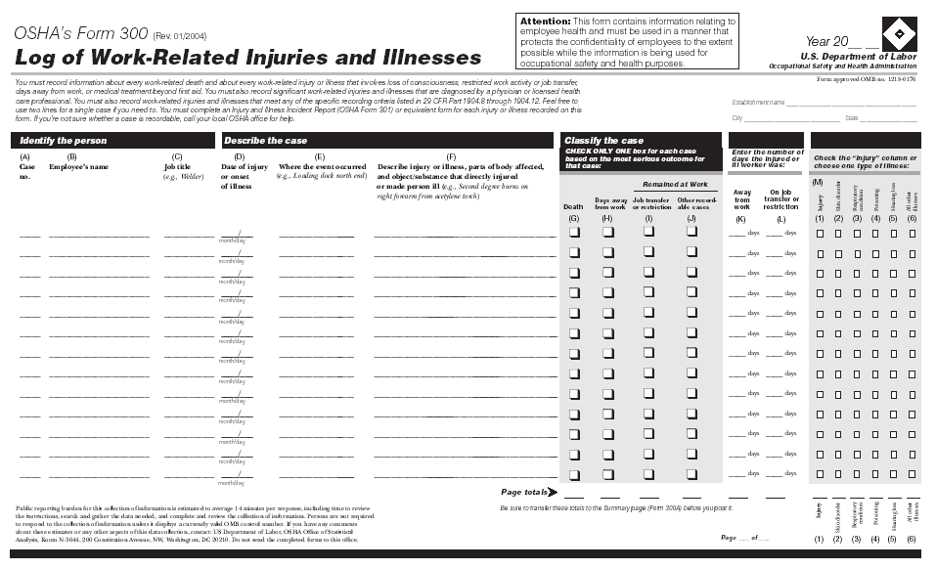
OSHA Form 300
Notes:
On the 300 Log, the employer checks one and only one of the outcome columns for each case, the one representing the most serious outcome of the case. If the status of the case changes, then the entry must be changed. For example, if the injured employee is experiencing days away from work, then dies, the employer must remove (or line out) the days away entry and the day count and check the box for a fatality.

Slide 52
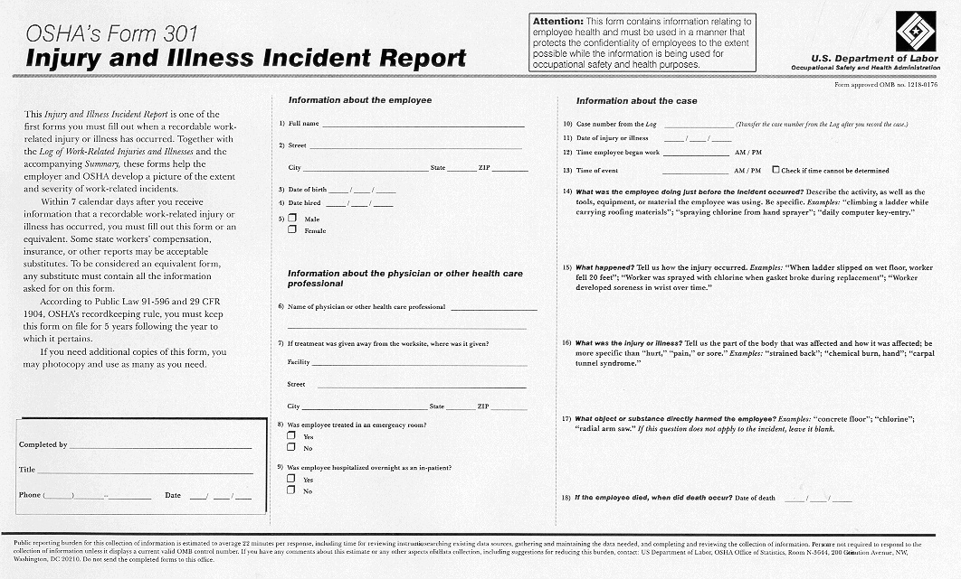
OSHA Form 301
Notes:
The 301 form captures data on each injury and illness (the length of service, what time the injury occurred, what time the employee started work, etc.).
The questions about how the person was injured or became ill are identical to the BLS survey questions, which makes it easier for employers to complete the survey forms when they receive them.
Many employers use a Worker’s Compensation Report, a First Report of Injury or a Company Accident Report as an equivalent form, and they can continue to do this. They just need to make sure that their form includes all of the same data that is found on the 301 form or can be supplemented so that that data is attached to it.

Slide 53
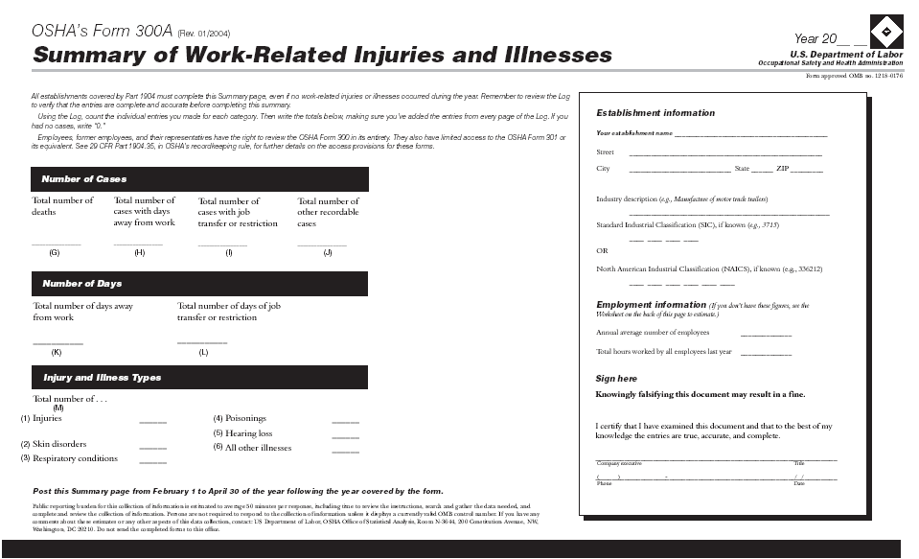
OSHA Form 300A
Notes:
There is a separate form for the summary, the 300A. This makes it easier to protect the privacy of injured or ill workers.
The form asks for additional data on the average number of employees and hours worked to make it easier to calculate rates.
Incidence rates are the best way to compare an establishment or an individual company’s data to the national statistics and to their prior performance.

Slide 54
1904.29 – Forms (2)
Employers must enter each recordable case on the forms within 7 calendar days of receiving information that a recordable case occurred
Notes:
The employer is required to record a case within 7 calendar days.

Slide 55
1904.29 – Forms (3)
An equivalent form has the same information, is as readable and understandable, and uses the same instructions as the OSHA form it replaces
Forms can be kept on a computer as long as they can be produced when they are needed (i.e., meet the access provisions of 1904.35 and 1904.40)
Notes:
Employers can keep their records on equivalent forms, on a computer, or at a central location provided that they can get information into the system within 7 calendar days after an injury or illness occurs, and they can produce the data at the establishment when required.

Slide 56
1904.29 – Privacy Protection (1)
Do not enter the name of an employee on the OSHA Form 300 for “privacy concern cases”
Enter “privacy case” in the name column
Keep a separate confidential list of the case numbers and employee names
Notes:
For certain “privacy concern cases,” employers must not enter the employee’s name on the 300 form. Instead, they are to enter “privacy case.”
A separate, confidential list of the employee’s names and case numbers must be kept by the employer and provided to an OSHA inspector upon request.

Slide 57
1904.29 – Privacy Protection (2)
Privacy concern cases are:
  An injury or illness to an intimate body part or reproductive system
  An injury or illness resulting from sexual assault
  Mental illness
  HIV infection, hepatitis, tuberculosis
  Needlestick and sharps injuries that are contaminated with another person’s blood or other potentially infectious material
  Employee voluntarily requests to keep name off for other illness cases
Notes:
Privacy concern cases are defined very specifically in the rule. Privacy concern cases are:
- an injury or illness to an intimate body part or the reproductive system,
- an injury or illness resulting from sexual assault,
- mental illness,
- HIV infection, hepatitis or tuberculosis,
- needlestick and sharps injuries that are contaminated with another person’s blood or other potentially infectious material, or
- illness cases where employees independently and voluntarily request that their names not be entered on the log.

Slide 58
1904.29 – Privacy Protection (3)
Employer may use discretion in describing the case if employee can be identified
If you give the forms to people not authorized by the rule, you must remove the names first
  Exceptions for:
    Auditor/consultant,
    Workers’ compensation or other insurance
    Public health authority or law enforcement agency
Notes:
For a privacy concern case, if the employee’s identity can still be implied, the employer may use some discretion in describing the case.
The rule requires that enough information be entered to identify the cause and general severity of the incident. For example, a sexual assault can be entered as “assault” or an injury to a reproductive organ can be entered as a “lower abdominal injury.” The employer is not required to go into graphic detail in these types of cases.
If the employer gives out the forms to the public, the names must be removed first. There are exceptions for employee access, OSHA access, auditors, insurance, or law enforcement personnel.

Slide 59
Subpart D - Other Requirements
1904.30 Multiple business establishments
1904.31 Covered employees
1904.32 Annual summary
1904.33 Retention and updating
1904.34 Change of ownership
1904.35 Employee involvement
1904.36 Discrimination
1904.37 State plans
1904.38 Variances
Notes:
Subpart D includes other requirements, telling the employer how to handle multiple business establishments and temporary employees, how to summarize and store the data, what to do if the business is sold, employee involvement, state plans and variances.

Slide 60
1904.30 – Multiple
Business Establishments
Keep a separate OSHA Form 300 for each establishment that is expected to be in operation for more than a year
May keep one OSHA Form 300 for all short-term establishments
Each employee must be linked with one establishment
Notes:
When the employer has more than one establishment, a separate log must be kept for each establishment expected to be in operation for more than a year.
For the short term establishments (those expected to be in operation for less than a year), the employer may keep one log that includes all of the injuries and illnesses at the short term establishments, or keep logs by state or district.
An employer with multiple lines of business may have some exempt and some covered establishments, and each employee must be linked to an establishment for recordkeeping purposes.

Slide 61
1904.31 – Covered Employees
Employees on payroll
Employees not on payroll who are supervised on a day-to-day basis
Exclude self-employed and partners
Temporary help agencies should not record the cases experienced by temp workers who are supervised by the using firm
Notes:
Employees on the payroll must be included in the employer’s records, unless the company is acting as a temporary help service.
Employees not covered in the OSH Act are also not included in the OSHA records. These include unpaid volunteers, sole proprietors, family members on family farms, domestic workers in residential settings.
Temporary workers will be the employees of the party exercising day-to-day control over them, and the supervising party will record their injuries and illnesses.
The employer and the temporary help service can discuss each case to see who is recording it. We do not want a case to be recorded twice if it can be avoided.

Slide 62
1904.32 – Annual Summary
Review OSHA Form 300 for completeness and accuracy, correct deficiencies
Complete OSHA Form 300A
Certify summary
Post summary
Notes:
The annual summary requirements lay out a process for completing the end-of-year processing.
The employer must first review the records and correct them if necessary, then complete the form, certify the form, and post it for 3 months.
The form includes data on average employment and hours worked to make it easier to calculate incidence rates. The employer may estimate these figures using the optional worksheet provided in the forms package.

Slide 63

1904.32 – Annual Summary, cont’d.
A company executive must certify the summary:
  An owner of the company
  An officer of the corporation
  The highest ranking company official working at the establishment, or
  His or her supervisor
Must post for 3-month period from February 1 to April 30 of the year following the year covered by the summary
Notes:
The rule requires certification by a company executive to help improve management involvement in the records.
A company executive is narrowly defined as:
- an owner of the company,
- an officer of the corporation
- the highest ranking person at the establishment, or
- his or her boss.
The records must be posted for 3 months.

Slide 64
1904.33 – Retention and Updating
Retain forms for 5 years following the year that they cover
Update the OSHA Form 300 during that period
Need not update the OSHA Form 300A or OSHA Form 301
Notes:
The records must be retained for five years.
During the retention period, the employer must update the 300 form to include any cases that are newly discovered or whose status has changed, but does not have to change the summary or the 301 form.

Slide 65
1904.35 – Employee Involvement
You must inform each employee of how to report an injury or illness
  Must set up a way for employees to report work-related injuries and illnesses promptly; and
  Must tell each employee how to report work-related injuries and illnesses to you
Notes:
The rule requires each employer to set up a way for employees to report injuries and illnesses. Employers also must tell each employee how to report. This is a very basic step to make sure employees report cases so they can get into the records.

Slide 66
1904.35 – Employee Involvement, cont’d.
Must provide limited access to injury and illness records to employees, former employees and their personal and authorized representatives
  Provide copy of OSHA Form 300 by end of next business day
  Provide copy of OSHA Form 301 to employee, former employee or personal representative by end of next business day
  Provide copies of OSHA Form 301 to authorized representative within 7 calendar days. Provide only “Information about the case” section of form
Notes:
Employers are also required to provide the records to employees. The 300 Log is available to employees, former employees, or employee representatives by the end of the next business day.
An employee, former employee or personal representative is allowed to receive a copy of his or her own 301 form.
An authorized representative can get 301 information for all the injuries and illnesses at the establishment, but only the information about the injury or illness. That information is provided on the right side of the 301 form.

Slide 67
1904.36 – Prohibition
Against Discrimination
Section 11(c) of the Act prohibits you from discriminating against an employee for reporting a work-related fatality, injury or illness
Section 11(c) also protects the employee who files a safety and health complaint, asks for access to the Part 1904 records, or otherwise exercises any rights afforded by the OSH Act
Notes:
The rule reminds employers about the anti-discrimination provisions of the OSH Act. Employers may not discriminate against an employee for reporting a work-related injury or illness case.

Slide 68
1904.37 – State Plans
State Plan States must have the same requirements as Federal OSHA for determining which injuries and illnesses are recordable and how they are recorded
For other Part 1904 requirements, State Plan requirements may be more stringent
1952.4 has been modified to reflect these concepts
Notes:
The State Plan States must collect the same information as federal OSHA.
However, the States may have more stringent or supplemental requirements on other matters, such as industry and size exemptions, the reporting of fatalities and catastrophes, and the access provisions.
The State Plan States must cover public sector employees, so in these states records are kept by state and local government agencies.

Slide 69
Subpart E - Reporting Information to the Government
1904.39 Fatality and catastrophe reporting
1904.40 Access for Government representatives
1904.41 OSHA Survey
1904.42 BLS Survey
Notes:
Subpart E includes the requirements for providing information to the government.
The federal government conducts two surveys of 1904 information – one by OSHA and one by the Bureau of Labor Statistics. If employers receive a form for either survey in the mail, they must complete and return the form using the instructions on the form.

Slide 70
1904.39 – Fatality/Catastrophe Reporting
Report within 8 hours any work-related fatality
Report within 24 hours any work-related amputation, loss of an eye, or in-patient hospitalization of one or more employees
Do not need to report highway or public street motor vehicle accidents (outside of a construction work zone)
Do not need to report commercial airplane, train, subway or bus accidents
Notes:
All employers are required to report work-related fatalities to OSHA within 8 hours. Work-related amputations, loss of an eye , or the in-patient hospitalization of one or more employees must be reported to OSHA within 24 hours of learning of the incident.
The case can be called in to the local area office or phoned in to 1-800-321-OSHA. The case can also be reported to OSHA using the web application available from OSHA’s public website.
Cases may be recordable but not reportable, for example, a fatality due to a motor vehicle accident on a public highway does not have to be reported within 8 hours, but it is a recordable fatality on the 300 Log.

Slide 71
1904.40 – Providing Records to Government Representatives
Must provide copies of the records within 4 business hours
Use the business hours of the establishment where the records are located
Notes:
Employers must provide the records within 4 business hours of a request by an OSHA or NIOSH official. If an inspection is in Texas and the records are in New York, use the business hours of New York.

Slide 72
Electronically Report Form 300A Data to OSHA
Many, but not all, establishments must electronically report their Form 300A data to OSHA on an annual basis.
  Establishments with 20-249 employees that are classified in certain industries.
  Establishments with 250 or more employees that are currently required to keep OSHA injury and illness records
Covered establishments must submit information from their completed Form 300A by March 2 of each year.
OSHA provides a secure website where employers create an account, enter, and submit their data. Information about and access to the Injury Tracking Application (ITA) is available at https://www.osha.gov/injuryreporting/index.html
Notes:
https://www.osha.gov/recordkeeping/NAICScodesforelectronicsubmission.html (removed link from presentation)

Slide 73
For More Help
OSHA’s Recordkeeping Page
OSHA Regional Recordkeeping Coordinators
State Plan States
OSHA Training Institute Education Centers
Notes:
The best source of current information on OSHA recordkeeping requirements is OSHA’s Recordkeeping page. Here you will find regulatory and compliance information, frequently asked questions, forms, contact information and training materials.
You may also contact your OSHA Regional Office or Area Office. Those of you in State Plan States can contact your State Plan Office. There are also State Consultation Programs that can provide recordkeeping information and assistance.
Finally, there are OSHA Training Institute Education Centers located throughout the country (see OSHA’s web page). These centers provide training on safety and health topics, including recordkeeping, to employers and employees.

