Slide 1
ELECTRICAL ROLL UP INITIATIVE

Slide 2

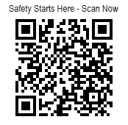
#ELECTRICALROLLUP INITIATIVE
Main goal
Raise awareness of electrical hazards when using extension cords, ground fault circuit interrupters (GFCI), and power tools.

Slide 3
ELECTRICAL TRAINING/INSPECTION
Electrical equipment, cords and power tools are used in all industry settings
Improper use can result in serious injuries or fatalities
In most cases:
GFCIs were not used
Ungrounded extension cords were used
Improperly repaired or modified extension cords used
Estimated 4,000 injuries annually associated with extension cords (CPSC.gov)

Slide 4
HOW TO USE EXTENSION CORDS SAFELY
Inspect
Check cords for fraying, cracking, or other damage.
Inspect the plug ends for bent prongs or other deformities
Ensure that the cord is free from water or other contaminants
Apply
Use flexible cords for intended applications as specified by the manufacturer
Avoid using flexible cords as a substitute for fixed wiring
Install
Securely connect flexible cords to equipment and outlets to prevent accidental disconnection
Avoid running flexible cords through walls, ceilings, floors, or doors unless specifically rated for such use

Slide 5
HOW TO USE EXTENSION CORDS SAFELY
Environment
Ensure that cords are used in appropriate environments (check for exposure to moisture, chemicals, or heat)
Keep cords away from vehicles or areas with potential for physical damage
Route/Placement
Do not run cords across walkways or high-traffic areas unless necessary, and use protective methods if so
Avoid placing cords in pinch points, such as under materials or heavy equipment
Load
Ensure the flexible cord is rated for the load it will carry
Do not overload circuits by plugging too many devices into a single cord

Slide 6
USE THE CORRECT WIRE
Wire used depends on operation, building materials, electrical load, and environmental factors
Use the correct extension cord
Hard/Extra-hard use will have (S, SO, ST, SEO, or 600V) stamped on the jacket (NEC Table 400.4) Voltage rating is a key indicator: 600V cords (S-Series) are extra-hard usage 300V cords (SJ-Series) are hard usage
Notes:
1926.405(a)(2)(ii)(J)
The OSHA standard requires flexible cords to be rated for hard or extra-hard usage. These ratings are to be indelibly marked approximately every foot of the cord. Since deterioration occurs more rapidly in cords which are not rugged enough for construction conditions, the National Electric Code and OSHA have specified the types of cords to use in a construction environment. This rule designates the types of cords that must be used for various applications including portable tools, appliances, temporary and portable lights. The cords are designated HARD and EXTRA HARD SERVICE.
Examples of HARD SERVICE designation types include S, ST, SO, STO, SJ, SJO, SJT, & SJTO. Extension cords must be durably marked as per 1926.405(g)(2)(ii) with one of the HARD or EXTRA HARD SERVICE designation letters, size and number of conductors.

Slide 7
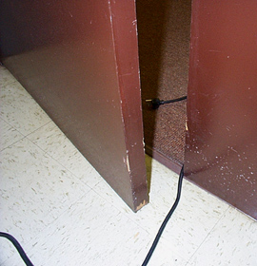
DAMAGED EXTENSION CORDS
Extension cords can be damaged by:
Aging, strain, improper storage
Door or window edges
Staples or fastenings
Abrasion from adjacent materials
Activity in the area (vehicles, equipment)
Damaged extension cords can cause shocks, burns, or fire
Notes:
Reference 1926.405(a)(2)(ii)(I)
The normal wear and tear on extension and flexible cords at your site can loosen or expose wires, creating hazardous conditions. Cords that are not 3-wire type, not designed for hard-usage, or that have been modified, increase your risk of contacting electrical current.

Slide 8
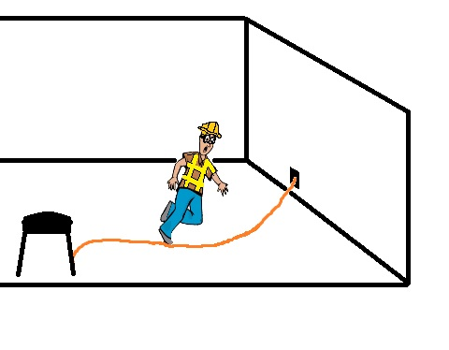
DAMAGED EXTENSION CORDS
Protect extension cords from foot traffic by using protective covers or overhead pendants to prevent tripping hazards and damage to the extension cords. The insulation in extension cords and electrical tools can become damaged.
Damaged insulation can expose live wires, leading to the risk of electric shock, burns, and possibly even fires. If a live wire touches exposed metal parts inside a tool, the tool can become energized and shock the user.

Slide 9
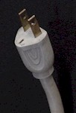

IMPROPER GROUNDING
Tools plugged into improperly grounded circuits may become energized
Broken wire or plug on extension cord
Frequently cited by OSHA due to common violations like improper use, overloading, or using damaged or frayed extension cords
Notes:
The most frequently violated OSHA electrical regulation is improper grounding of equipment and circuitry. The metal parts of an electrical wiring system that we touch (switch plates, ceiling light fixtures, conduit, etc.) should be grounded and at 0 volts. If the system is not grounded properly, these parts may become energized. Metal parts of motors, appliances, or electronics that are plugged into improperly grounded circuits may be energized. When a circuit is not grounded properly, a hazard exists because unwanted voltage cannot be safely eliminated. If there is no safe path to ground for fault currents, exposed metal parts in damaged appliances can become energized.
Extension cords may not provide a continuous path to ground because of a broken ground wire or plug.
Electrical systems are often grounded to metal water pipes that serve as a continuous path to ground. If plumbing is used as a path to ground for fault current, all pipes must be made of conductive material (a type of metal). Many electrocutions and fires occur because (during renovation or repair) parts of metal plumbing are replaced with plastic pipe, which does not conduct electricity.

Slide 10
ENVIRONMENTAL DETERIORATION OF EQUIPMENT
Unless listed or identified for use, no conductors or equipment should be in:
Damp or wet locations
Harmful chemicals, fumes or vapors
Excessive temperatures

Slide 11
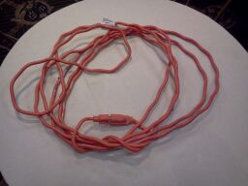

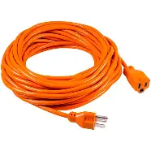

EXTENSION CORDS CAN BE ABUSED
Damage to insulation and conductors can occur if the cord is improperly wound and/or stored.

Slide 12

GROUND FAULT CIRCUIT INTERRUPTERS (GFCIS)
A GFCI is a safety device that shuts off electricity if the amount going out doesn’t match the amount coming back. This means some electricity is flowing somewhere unsafe (like through a person or water), so the GFCI cuts the power right away to help prevent shock.
A GFCI is not an overcurrent device like a fuse or circuit breaker.
GFCIs are designed to sense an imbalance in current flow over the normal path.

Slide 13
FUNCTION OF GFCIS
GFCI devices compare the amount of current going to and returning from equipment
If the current flow differs by more than 5 mA, the GFCI reacts quickly to trip or shut off the circuit

Slide 14
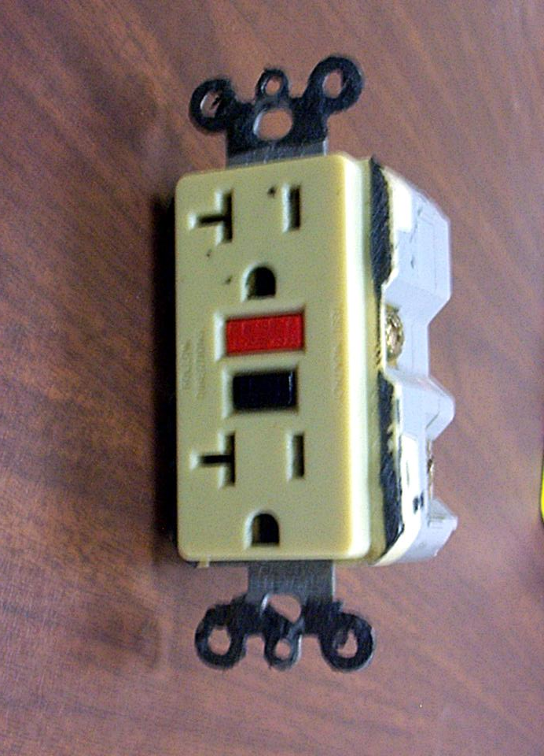
TYPES OF GFCIS
Receptacle type:
Incorporates within one device one or more receptacle outlets, protected by the GFCI
Popular and inexpensive
Most are of duplex type
Can protect additional non-GFCI type receptacles connected “downstream”

Slide 15
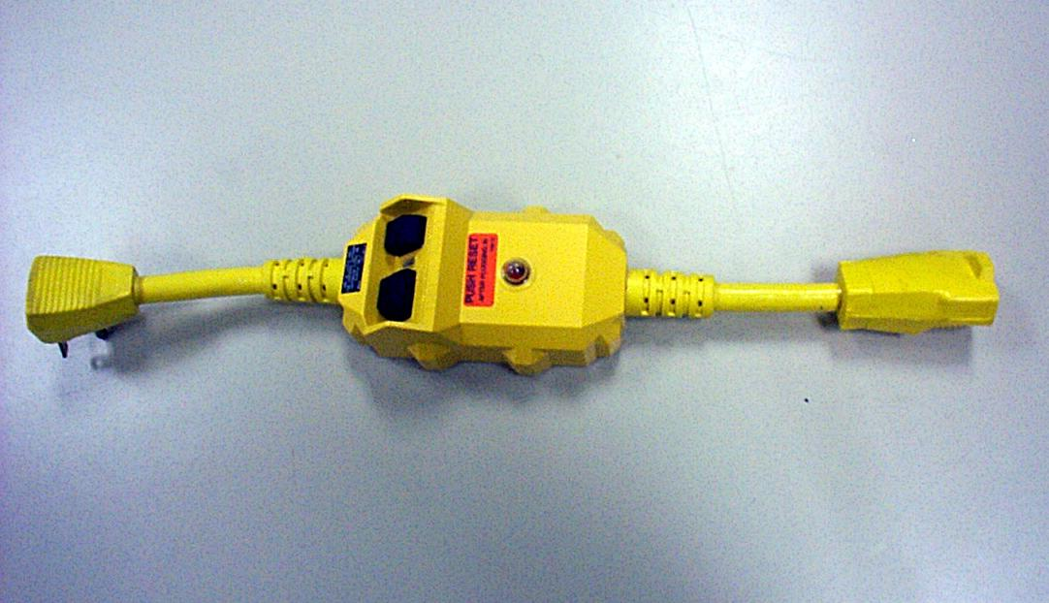
TYPES OF GFCIS
Cord Connected (Portable) type:
Attachment plug incorporates the GFCI module.
Protects the cord, and any equipment attached to the cord.
Attachment has non-standard appearance
Equipped with test and reset buttons
No-voltage release feature

Slide 16
TESTING GFCIS
GFCIs are complex mechanisms, they must be tested on a regular basis
GFCIs often have manual test buttons (TEST/RESET), although many new GFCIs will auto or self-test
For permanently mounted types, monthly testing is recommended
Portable GFCIs should be tested before each use
GFCIs have a test-circuit which imposes an artificial ground fault when the test button is pushed

Slide 17
POWER TOOLS - PRECAUTIONS
Disconnect tools when not in use, before servicing and cleaning, and when changing accessories
Wear appropriate PPE, such as safety glasses and gloves
Keep unauthorized or untrained workers away from power tools that they have not bee adequately trained to use
Secure work with clamps or a vise, freeing both hands to operate the tool
Don’t engage power switch while carrying a plugged-in tool
Remove damaged electric tools & tag them: “Do Not Use”

Slide 18
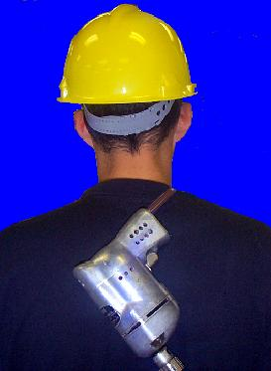
POWER TOOLS – PRECAUTIONS
Don’t carry portable tools by the cord
Don’t use electric cords to hoist or lower tools
Don’t yank cord or hose to disconnect it
Keep cords and hoses away from heat, oil, and sharp edges
Inspect tools for damage
Use GFCIs
Notes:
1926.302(a)(2)

Slide 19
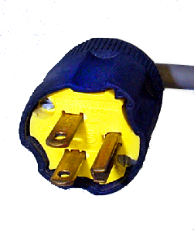
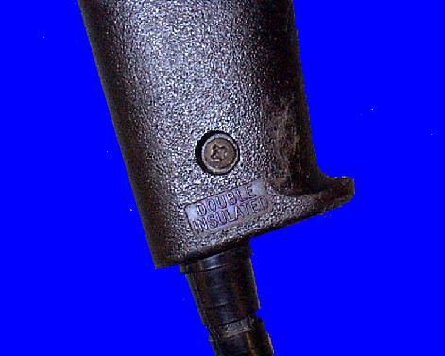
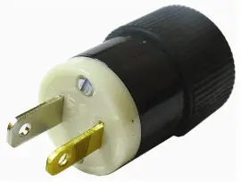
ELECTRIC POWER TOOLS
To protect a worker from shock, these tools must:
have cord plugged into a grounded receptacle and be double insulated, or
be powered by a low-voltage isolation transformer
Double insulated markings
Polarized 2-prong Plug
Plug with a grounding pin
Notes:
1926.302 (a)(1)
Three-wire cords contain two current-carrying conductors and a grounding conductor. Any time an adapter is used to accommodate a two-hole receptacle, the adapter wire must be attached to a known ground. The third prong must never be removed from the plug.
Double-insulated tools are available that provide protection against electrical shock without third-wire grounding. On double-insulated tools, an internal layer of protective insulation completely isolates the external housing of the tool.

Slide 20
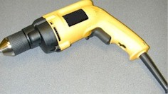
GROUND TOOLS & EQUIPMENT
Ensure power supply systems, electrical circuits, and electrical equipment are grounded
Frequently inspect electrical systems to ensure path to ground is continuous
Inspect electrical equipment before use
Don’t remove ground prongs from tools or extension cords
Ground exposed metal parts of equipment
Notes:
A typical extension cord grounding system has four components:
a third wire in the cord, called a ground wire;
a three-prong plug with a grounding prong on one end of the cord;
a three-wire, grounding-type receptacle at the other end of the cord; and
a properly grounded outlet.
Two kinds of grounds are required by the standard:
1. Service or system ground. In this instance, one wire, called the neutral conductor or grounded conductor, is grounded. In an ordinary low-voltage circuit, the white (or gray) wire is grounded at the generator or transformer and again at the service entrance of the building. This type of ground is primarily designed to protect machines, tools, and insulation against damage.
2. For enhanced worker protection, an additional ground, called the equipment ground, must be furnished by providing another path from the tool or machine through which the current can flow to the ground. This additional ground safeguards the electric equipment operator if a malfunction causes the metal frame of the tool to become energized.

Slide 21


OSHA
OSHA CARES
We want every worker to go home safe
osha.gov
800-321-OSHA (6742)
Notes:
If you want to stay up to date on new resources for your workplace, subscribe to our QuickTakes newsletter and Spanish-language newsletter Información Rápida. Also, you can follow us on X formerly known as Twitter and LinkedIn.

