Slide 1
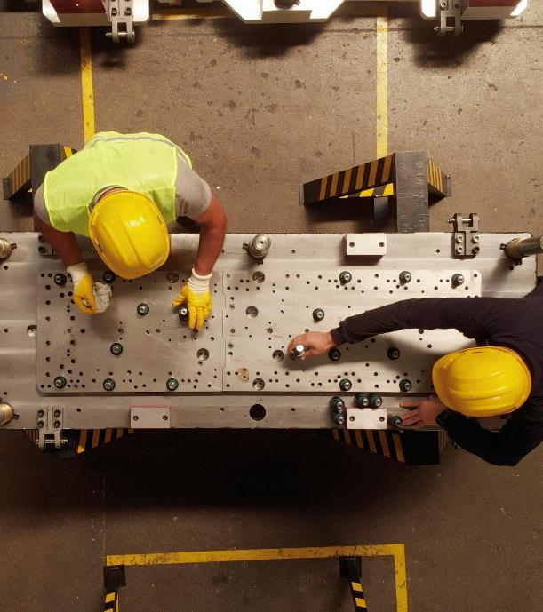
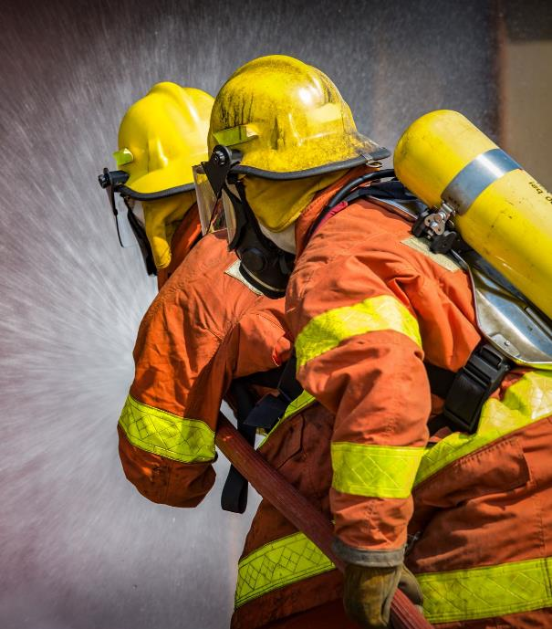
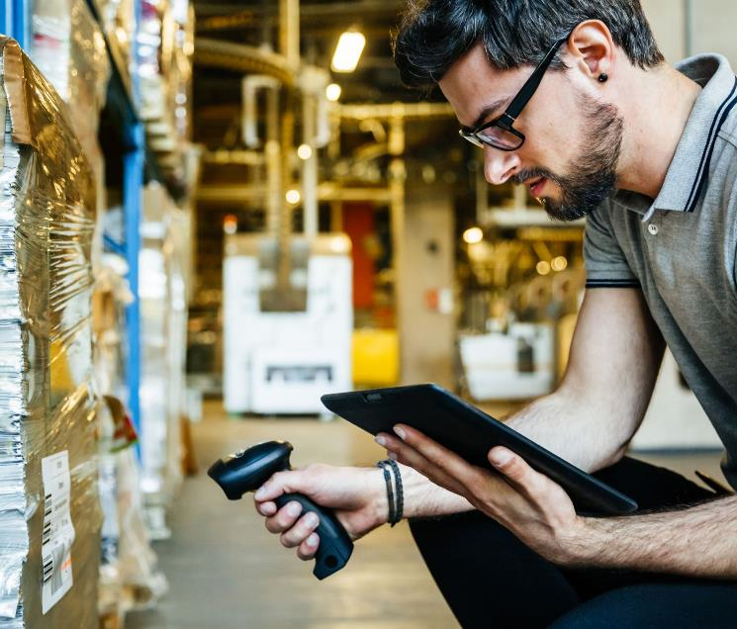
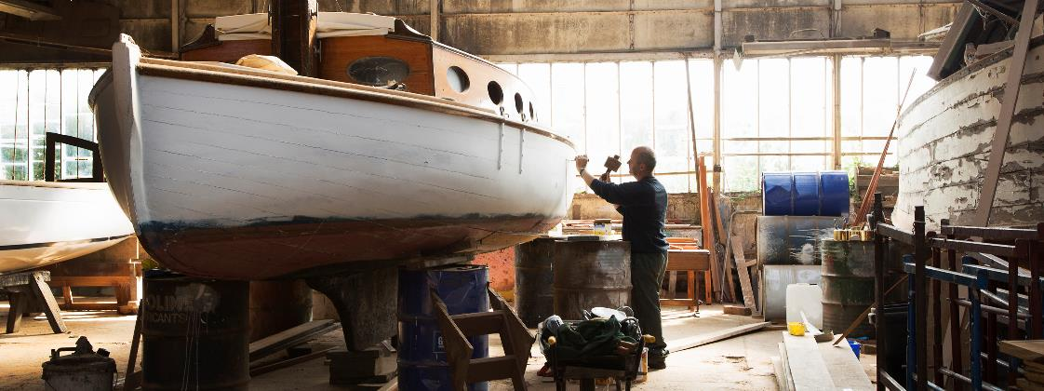
Can You Take the Heat?
An interactive and educational tool for employers and employees designed to prevent work-related heat illness.

Slide 2
Instructions for Host
The gameboards are interactive and should be viewed in slide show mode. There are three rounds to this game: Heatwave, the Second Heatwave, and Final Heatwave. The categories precede each gameboard and are listed at the top of each board. For best use, play the boards in order.
Pick a category and a dollar value.
Click on the chosen box for the question.
Players must give the answer in the form of a question.
To see if the player is correct, click again for the answer.
Click the “Home” button on the slide to return to the main board.
Once a question has been used, the number on the gameboard is greyed out.
Continue until all questions have been answered.
Consider hosting a “lunch and learn” with a group, offering the training individually, or make it a competition amongst employees in a department to see who wins with the highest score.
The Final Heatwave includes music so make sure the sound is turned on.

Slide 3
Heatwave Categories
Raytheon Technologies - Unrestricted Content

Slide 4
Did You Know?
Raytheon Technologies - Unrestricted Content

Slide 5
An Ounce of Prevention
Raytheon Technologies - Unrestricted Content

Slide 6
Is Worth a
Pound of Cure
(First Aid)
Raytheon Technologies - Unrestricted Content

Slide 7
America the Beautiful
Raytheon Technologies - Unrestricted Content

Slide 8
Indoor
True or False
Raytheon Technologies - Unrestricted Content

Slide 9
Heat-related Illnesses
Raytheon Technologies - Unrestricted Content

Slide 10
Heatwave
Did You Know? | An Ounce of Prevention | Is Worth a Pound of Cure (First Aid) | America the Beautiful | Indoor True or False | Heat-related Illnesses
$100 | $100 | $100 | $100 | $100 | $100
$200 | $200 | $200 | $200 | $200 | $200
$300 | $300 | $300 | $300 | $300 | $300
$400 | $400 | $400 | $400 | $400 | $400
$500 | $500 | $500 | $500 | $500 | $500
Skip to the Second Heatwave

Slide 11
Workers above this age are more at risk for heat-related illnesses.
Raytheon Technologies - Unrestricted Content

Slide 12
What is over 65 years old?
Raytheon Technologies - Unrestricted Content

Slide 13
Produce such as watermelon, cucumbers, cantaloupe, and strawberries contain high amounts of this hydrating compound.
Raytheon Technologies - Unrestricted Content

Slide 14
What is water?
Raytheon Technologies - Unrestricted Content

Slide 15
Blood pressure pills or antihistamines can increase a construction worker's risk of this.
Raytheon Technologies - Unrestricted Content

Slide 16
What is heat-related illness?
Raytheon Technologies - Unrestricted Content

Slide 17
The two heat sources that contribute to heat-related illnesses are metabolic (body) heat and this.
Raytheon Technologies - Unrestricted Content

Slide 18
What is environmental heat?
Raytheon Technologies - Unrestricted Content

Slide 19
Workers need training on how to prevent, recognize, and do this regarding heat-related illness.
Raytheon Technologies - Unrestricted Content

Slide 20
What is treat?
Raytheon Technologies - Unrestricted Content

Slide 21
Special cooling devices like neck wraps and cooling vests can be categorized as this type of equipment.
Raytheon Technologies - Unrestricted Content

Slide 22
What is personal protective equipment?
Raytheon Technologies - Unrestricted Content

Slide 23
In situations where a heat illness could occur, workers should not perform job duties unsupervised. Instead, this type of system should be instituted to help spot signs of heat illness.
Raytheon Technologies - Unrestricted Content

Slide 24
What is the buddy system?
Raytheon Technologies - Unrestricted Content

Slide 25
When heat-related illnesses and disorders occur mainly during heat waves in the summer, this type of program should be established for preventive purposes.
Raytheon Technologies - Unrestricted Content

Slide 26
What is a Heat Alert Program (HAP)?
Raytheon Technologies - Unrestricted Content

Slide 27
Reducing steam leaks, using cooling fans, and insulating hot surfaces are all considered this type of control. It is also the most effective type of control.
Raytheon Technologies - Unrestricted Content

Slide 28
What is engineering controls?
Raytheon Technologies - Unrestricted Content

Slide 29
Acclimatization periods and adjusting work schedules to limit the time exposed to heat stress conditions are examples of this type of control.
Raytheon Technologies - Unrestricted Content

Slide 30
What is administrative controls?
Raytheon Technologies - Unrestricted Content

Slide 31
A coworker has heat cramps. After moving her to a shaded area, loosening clothing, and providing an electrolyte-replacing beverage, you notice the cramps are not going away. This should be your next step.
Raytheon Technologies - Unrestricted Content

Slide 32
What is seek medical care?
Raytheon Technologies - Unrestricted Content

Slide 33
Working outside with your buddy in the summer heat, you notice he has become confused, has slurred speech, and is sweating through his clothes. Concerned about heat stroke, this is your first action.
Raytheon Technologies - Unrestricted Content

Slide 34
What is call 911?
Raytheon Technologies - Unrestricted Content

Slide 35
Your coworker complains of dizziness, headache, and nausea while in the sun. Suspecting heat exhaustion you do this before removing unnecessary clothing and giving him liquids to drink.
Raytheon Technologies - Unrestricted Content

Slide 36
What is move him to a cooler location?
Raytheon Technologies - Unrestricted Content

Slide 37
Your friend is new on the job and notices small blisters on his chest. Suspecting heat rash, you tell him to avoid putting this on the area because he should keep it dry.
Raytheon Technologies - Unrestricted Content

Slide 38
What are ointments or creams?
Raytheon Technologies - Unrestricted Content

Slide 39
Reapplying sunblock at this time interval protects from ultraviolet ray damage.
Raytheon Technologies - Unrestricted Content

Slide 40
What is every 2 hours?
Raytheon Technologies - Unrestricted Content

Slide 41
Located primarily in southeastern California and southern Nevada, this is the hottest desert in North America.
Raytheon Technologies - Unrestricted Content

Slide 42
What is the Mojave Desert?
Raytheon Technologies - Unrestricted Content

Slide 43
Home to majestic cacti, this national park is divided into two districts: the Tucson Mountain District and the Rincon Mountain District.
Raytheon Technologies - Unrestricted Content

Slide 44
What is Saguaro National Park?
Raytheon Technologies - Unrestricted Content

Slide 45
Also called nopal, this species of cactus is known to bear a brightly colored edible fruit.
Raytheon Technologies - Unrestricted Content

Slide 46
What is the prickly pear cactus?
Raytheon Technologies - Unrestricted Content

Slide 47
This state has the widest observed temperature range of any state, with a record high of 117 °F and a record low of -70 °F.
Raytheon Technologies - Unrestricted Content

Slide 48
What is Montana?
Raytheon Technologies - Unrestricted Content

Slide 49
Home to a national park, this place holds the world record for highest air temperature of 134 °F (56.7 °C) recorded in 1913.
Raytheon Technologies - Unrestricted Content

Slide 50
What is Death Valley, California?
Raytheon Technologies - Unrestricted Content

Slide 51
Fans are not useful in maintaining constant airflow in an indoor environment.
Raytheon Technologies - Unrestricted Content

Slide 52
What is false?
Raytheon Technologies - Unrestricted Content

Slide 53
Warehouse workers, bakers, and those working in laundromats are at equal risk of heat related illness compared to construction workers, landscapers, and firefighters.
Raytheon Technologies - Unrestricted Content

Slide 54
What is true?
Raytheon Technologies - Unrestricted Content

Slide 55
Exhaust hoods can aid in reducing a worker's exposure to heat.
Raytheon Technologies - Unrestricted Content

Slide 56
What is true?
Raytheon Technologies - Unrestricted Content

Slide 57
Cooled seats or benches in the break room are not useful as an engineering control in preventing heat-related illness.
Raytheon Technologies - Unrestricted Content

Slide 58
What is false?
Raytheon Technologies - Unrestricted Content

Slide 59
OSHA recommends that employers set thermostats between 68 °F and 78 °F in an office environment.
Raytheon Technologies - Unrestricted Content

Slide 60
What is true?
Raytheon Technologies - Unrestricted Content

Slide 61
When working in the heat, abdominal muscle spasms and soreness are likely signs of this.
Raytheon Technologies - Unrestricted Content

Slide 62
What are heat cramps?
Raytheon Technologies - Unrestricted Content

Slide 63
This is the most serious heat-related illness that should be treated as a medical emergency.
Raytheon Technologies - Unrestricted Content

Slide 64
What is heat stroke?
Raytheon Technologies - Unrestricted Content

Slide 65
This heat-related illness sits between heat cramps and heat stroke and occurs when your body overheats.
Raytheon Technologies - Unrestricted Content

Slide 66
What is heat exhaustion?
Raytheon Technologies - Unrestricted Content

Slide 67
A skin irritation caused by excessive sweating.
Raytheon Technologies - Unrestricted Content

Slide 68
What is heat rash?
Raytheon Technologies - Unrestricted Content

Slide 69
Dark urine, muscle pain, and weakness is a sign your body is experiencing this serious medical condition.
Raytheon Technologies - Unrestricted Content

Slide 70
What is rhabdomyolysis?
Raytheon Technologies - Unrestricted Content

Slide 71
The Second Heatwave
Categories
Raytheon Technologies - Unrestricted Content

Slide 72
Is It Getting
Hot in Here?
Raytheon Technologies - Unrestricted Content

Slide 73
I’m Thirsty
Raytheon Technologies - Unrestricted Content

Slide 74
This or That
Raytheon Technologies - Unrestricted Content

Slide 75
OSHA Says
Raytheon Technologies - Unrestricted Content

Slide 76
Outdoor
True or False
Raytheon Technologies - Unrestricted Content

Slide 77
Heebee-Jeebies
Raytheon Technologies - Unrestricted Content

Slide 78
The Second Heatwave
Is It Getting Hot in Here? | I’m Thirsty | This or That | OSHA Says | Outdoor True or False | Heebee-Jeebies
$200 | $200 | $200 | $200 | $200 | $200
$400 | $400 | $400 | $400 | $400 | $400
$600 | $600 | $600 | $600 | $600 | $600
$800 | $800 | $800 | $800 | $800 | $800
$1000 | $1000 | $1000 | $1000 | $1000 | $1000
Skip to the Final Heatwave

Slide 79
These rays are the most intense between the hours of 10 a.m. to 4 p.m.
Raytheon Technologies - Unrestricted Content

Slide 80
What are UV (ultraviolet) rays?
Raytheon Technologies - Unrestricted Content

Slide 81
Sun exposure without protection can lead to cataracts and this type of cancer.
Raytheon Technologies - Unrestricted Content

Slide 82
What is skin cancer?
Raytheon Technologies - Unrestricted Content

Slide 83
This is your body's natural way of cooling itself.
Raytheon Technologies - Unrestricted Content

Slide 84
What is sweating?
Raytheon Technologies - Unrestricted Content

Slide 85
For unacclimatized workers, according to OSHA, a worker carrying a heavy workload is at high risk for heat-related illness if working above this temperature.
Raytheon Technologies - Unrestricted Content

Slide 86
What is 77 °F or 37.8 °C?
Raytheon Technologies - Unrestricted Content

Slide 87
The 10 warmest years on record have all occurred since this year.
Raytheon Technologies - Unrestricted Content

Slide 88
What is 2010?
Raytheon Technologies - Unrestricted Content

Slide 89
This electrolyte abnormality is caused by drinking large amounts of water and losing sodium by excessive sweating.
Raytheon Technologies - Unrestricted Content

Slide 90
What is hyponatremia?
Raytheon Technologies - Unrestricted Content

Slide 91
A construction worker has a choice between consuming a cold beer, an iced coffee, or cold water at the end of the day after working in a high heat area. This is the best choice.
Raytheon Technologies - Unrestricted Content

Slide 92
What is cold water?
Raytheon Technologies - Unrestricted Content

Slide 93
Drinking more than this amount of water over the course of 24 hours in the workplace can be harmful.
Raytheon Technologies - Unrestricted Content

Slide 94
What is 12 quarts or 48 cups?
Raytheon Technologies - Unrestricted Content

Slide 95
Dehydration can be influenced by how much of this you get. Doctors recommend at least 8 hours.
Raytheon Technologies - Unrestricted Content

Slide 96
What is sleep?
Raytheon Technologies - Unrestricted Content

Slide 97
A good way to tell if you’re drinking enough fluid is to check the color of this. If it’s pale in color and clear, you are likely well-hydrated.
Raytheon Technologies - Unrestricted Content

Slide 98
What is urine?
Raytheon Technologies - Unrestricted Content

Slide 99
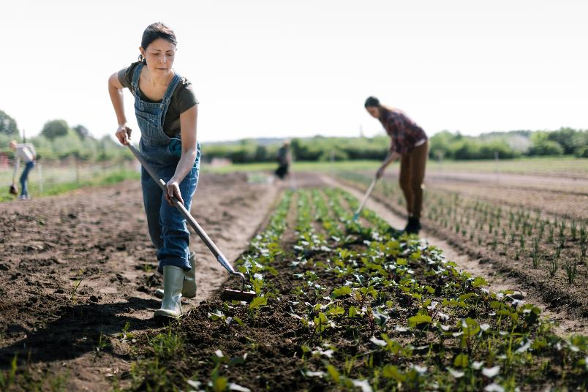
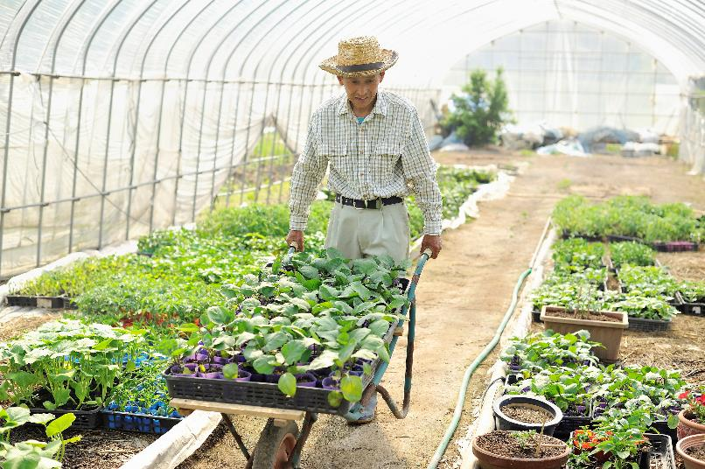
The better choice
A
B
Raytheon Technologies - Unrestricted Content

Slide 100
What is B?
Raytheon Technologies - Unrestricted Content

Slide 101
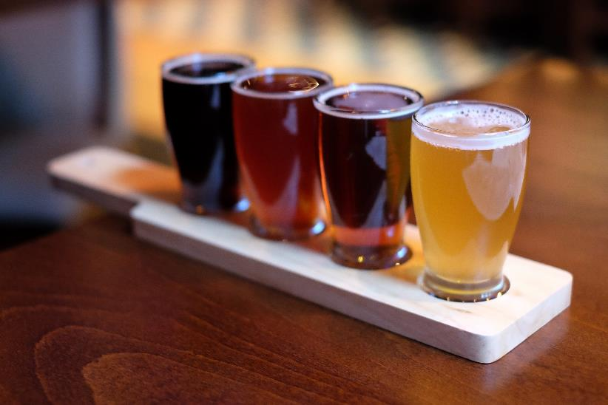
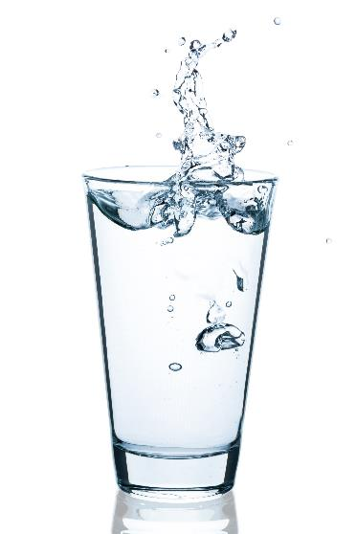
The better choice
A
B
Raytheon Technologies - Unrestricted Content

Slide 102
What is B?
Raytheon Technologies - Unrestricted Content

Slide 103
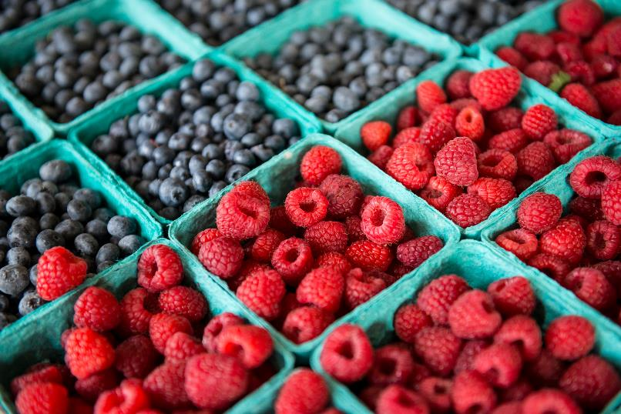
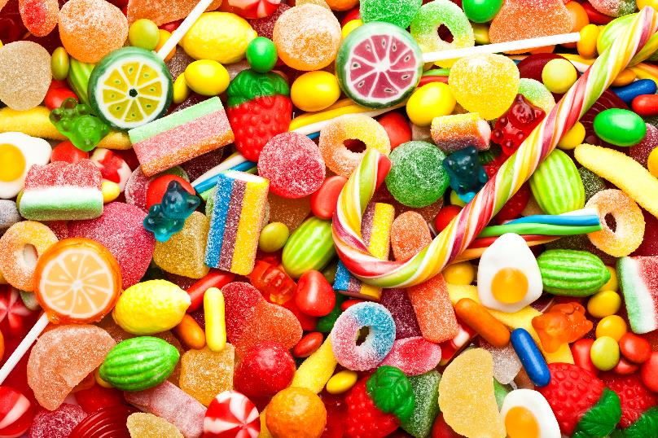
The better choice
A
B
Raytheon Technologies - Unrestricted Content

Slide 104
What is A?
Raytheon Technologies - Unrestricted Content

Slide 105
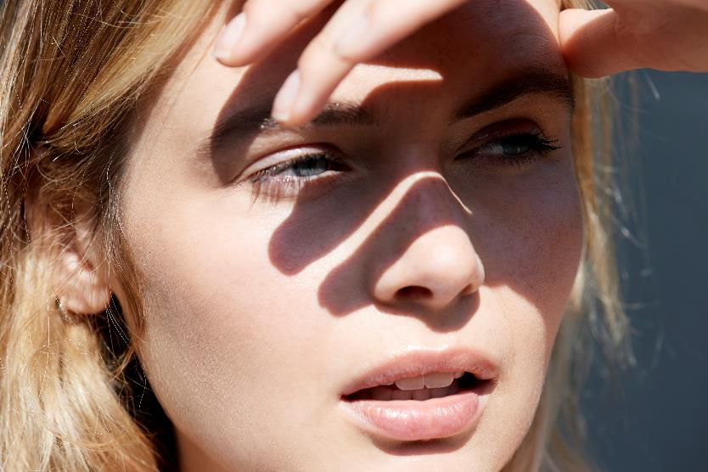
The Better Choice
A
B
Raytheon Technologies - Unrestricted Content

Slide 106
What is B?
Raytheon Technologies - Unrestricted Content

Slide 107
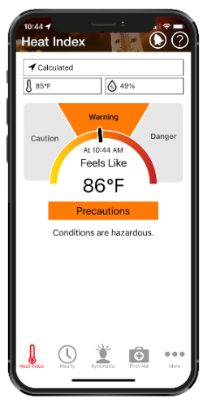
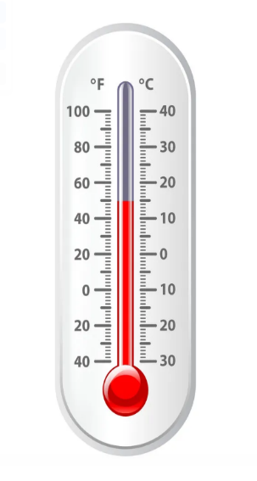
Choose the better tool to measure worksite temperature
A
B
Raytheon Technologies - Unrestricted Content

Slide 108
What is A?
Raytheon Technologies - Unrestricted Content

Slide 109
In addition to Minnesota and Washington, this state has its own OSHA-approved state plan for heat exposure.
Raytheon Technologies - Unrestricted Content

Slide 110
What is California?
Raytheon Technologies - Unrestricted Content

Slide 111
The risk for heat-related illnesses is not limited to outdoor workers. It can occur here as well.
Raytheon Technologies - Unrestricted Content

Slide 112
What is indoors?
Raytheon Technologies - Unrestricted Content

Slide 113
OSHA says when working in the heat, this amount of water should be consumed every 15-20 minutes.
Raytheon Technologies - Unrestricted Content

Slide 114
What is 1 cup of water?
Raytheon Technologies - Unrestricted Content

Slide 115
OSHA recommends employers establish this process in which the body builds a tolerance to heat gradually over time.
Raytheon Technologies - Unrestricted Content

Slide 116
What is heat acclimatization?
Raytheon Technologies - Unrestricted Content

Slide 117
In order to prevent heat-related illness, OSHA recommends employers offer this in addition to water and shade.
Raytheon Technologies - Unrestricted Content

Slide 118
What is rest?
Raytheon Technologies - Unrestricted Content

Slide 119
Heat-related illnesses only occur in outdoor work environments.
Raytheon Technologies - Unrestricted Content

Slide 120
What is false?
Raytheon Technologies - Unrestricted Content

Slide 121
Wearing a wide-brimmed hat will not help prevent heat-related illnesses.
Raytheon Technologies - Unrestricted Content

Slide 122
What is false?
Raytheon Technologies - Unrestricted Content

Slide 123
Heat-related illness is only a concern if the temperature reaches 100 °F (37.8 °C).
Raytheon Technologies - Unrestricted Content

Slide 124
What is false?
Raytheon Technologies - Unrestricted Content

Slide 125
A day with over 100 °F (37.8 °C) is associated with an up to 15% increase in traumatic workplace injuries.
Raytheon Technologies - Unrestricted Content

Slide 126
What is true?
Raytheon Technologies - Unrestricted Content

Slide 127
The Heat Index is a better indicator than the wet bulb globe temperature (WBGT) to measure worksite heat.
Raytheon Technologies - Unrestricted Content

Slide 128
What is false?
Raytheon Technologies - Unrestricted Content

Slide 129
This predator has a heat sensing pit located behind each nostril that can detect differences in temperature that are only a fraction of a degree apart. Step away when you hear it rattle!
Raytheon Technologies - Unrestricted Content

Slide 130
What is the western diamondback rattlesnake?
Raytheon Technologies - Unrestricted Content

Slide 131
These nocturnal hunters have no teeth and give many the heebie-jeebies due to their large hairy bodies and multiple legs.
Raytheon Technologies - Unrestricted Content

Slide 132
What is the tarantula?
Raytheon Technologies - Unrestricted Content

Slide 133
Enjoying desert shrub environments and known for its huge ears, this animal can run as fast as 40mph in short bursts.
Raytheon Technologies - Unrestricted Content

Slide 134
What is the jack rabbit?
Raytheon Technologies - Unrestricted Content

Slide 135
Only one of two venomous lizards in the world, a component of this creature's venom has FDA-approval for use in a drug to treat type-2 diabetes.
Raytheon Technologies - Unrestricted Content

Slide 136
What is the gila monster?
Raytheon Technologies - Unrestricted Content

Slide 137
Known as "ships of the desert," these animals can survive temperatures as high as 120 °F (49 °C) and go a week or more without consuming water.
Raytheon Technologies - Unrestricted Content

Slide 138
What are camels?
Raytheon Technologies - Unrestricted Content

Slide 139
The Final Heatwave

Slide 140
Category:
Measuring Devices
Raytheon Technologies - Unrestricted Content

Slide 141
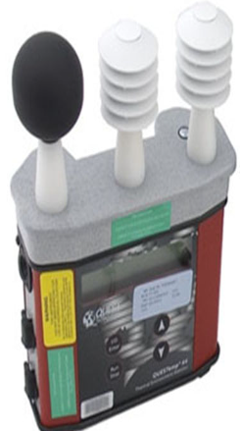
OSHA recommends the use of this type of monitor to measure workplace environmental heat.
Click to start –
30 seconds
Raytheon Technologies - Unrestricted Content
Notes:
Click to Start Timer

Slide 142
What is a wet bulb globe temperature (WBGT) monitor?
Raytheon Technologies - Unrestricted Content

Slide 143
Thanks for participating and increasing your awareness on heat-related illness in the workplace. You did great!
Raytheon Technologies - Unrestricted Content

