Slide 1
Lock Out Tag Out
Hazardous Energy Control

Slide 2
Sponsorship - Disclaimer
Department of Labor
Occupational Health and Safety Administration (OSHA)
Susan Harwood Training Grant
This material was produced by the SPI-OSHA Alliance, and distributed by the Occupational Safety and Health Administration, U.S. Department of Labor. The contents in this presentation do not necessarily reflect the views or policies of the U.S. Department of Labor, nor does the mention of trade names, commercial products, or organizations imply endorsement by the U.S. Government.
Revisions were made to this material under grant number SH-05059-SH8 from the Occupational Safety and Health Administration, U.S. Department of Labor.
Notes:
Introduce the class with brief overview:
This project will deliver occupational health and safety training to new and established small businesses with less than 250 employees; included in this targeted population are limited English proficiency workers, non-literate/low literacy workers, young workers, temporary workers, minority and other hard-to-reach- workers, and workers in high-hazard industries.

Slide 3
Learning Objectives
Understand the purpose of the energy control program
Recognition of hazardous energy sources, and the methods necessary for energy control
Discuss the primary causes of injury from hazardous energy
Understand the steps necessary to properly control hazardous energy when servicing equipment
Know the responsibilities of Authorized and Affected employee in terms of logout / tagout
Notes:
The key purpose of this standard is to prevent an injury from unexpected startup or release of stored energy. The standard doesn’t apply unless the worker is performing service or maintenance in an area of a machine where he/she could be injured from unexpected startup or release of stored energy. For example, if a worker is making adjustments or cleaning parts of a machine away from pinch points, dangerous areas, hot surfaces, etc., Lockout would not apply.

Slide 4
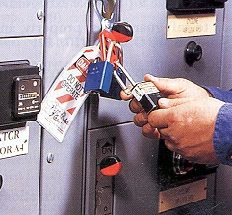
Preventing Unexpected Startup or Release of Energy
Energy isolation:
Minimize potential for inadvertent activation and/or release of stored energy
Ensure power to the machine is isolated and locked at control points
Use a method that cannot readily be removed, bypassed, overridden or otherwise defeated
Notes:
The entire lockout/tagout standard is based on the practices and procedures that are necessary to disable and isolate machines or equipment from the unexpected release hazardous energy. The employer’s primary tool for providing protection under the standard is the isolating device, which is the physical device that prevents the transmission or release of energy.

Slide 5



Types of Hazardous Energy
Mechanical – the potential energy and kinetic energy present in the components of a mechanical system
  Kinetic – energy possessed by virtue of its motion
  Potential – energy stored by the mechanical system
Electrical – energy as a result of a generated electrical power source or a static source
Thermal – energy as a result of mechanical work, radiation, chemical reaction or electrical resistance

Slide 6



Types of Hazardous Energy, continued
Chemical – energy released as a result of chemical reactions
Hydraulic – energy released as a result liquids under pressure
Pneumatic – energy released as a result of compressed gasses under pressure

Slide 7
Definitions
Servicing and/or maintenance where employees may be exposed to unexpected start-up or release of hazardous energy
  Construction
  Installing and setting up
  Adjusting, inspecting, modifying
  Lubricating, cleaning or unjamming
  Tool changes
Notes:
As you can tell, this standard covers a lot of activities that may be performed by employees other than maintenance people. Regardless of employee’s job title, the Lockout standard applies when any of these functions are being performed and when there is potential for injury. In addition, employees performing these tasks must be authorized employees under the Lockout standard.

Slide 8
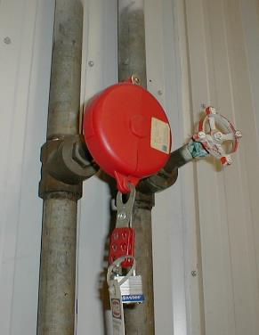
Definitions (continued)
Set-up - Work to prepare a machine to perform its normal production operation
Lockout – Placement of lockout device on an energy isolating device
Lockout device – Device that uses a physical means to prevent operation of a machine or equipment

Slide 9
Definitions (cont’d)
Energized - Connected to an energy source, or containing residual or stored energy
Energy isolating device - A mechanical device that physically prevents the transmission or release of energy
Energy source - Any source of electrical, mechanical, hydraulic, pneumatic, chemical, thermal, or other energy
Notes:
Push buttons, selector switches and other control circuit devices are not energy isolating devices.
Control circuit devices only interrupt the control circuit. They do not isolate the energy sources. Motors, pumps and other equipment can restart from electrical shorts in the system.
Switches can fail and go unnoticed, or employees may start up machines without knowing that other employees are in a dangerous area.

Slide 10
LOTO applies when:
Employees are performing servicing or maintenance and there is a potential for injury from unexpected start-up or release of stored energy
Service and maintenance that takes place during normal production if the employee:
  Must remove or bypass a guard or safety device
  Must place any part of their body into the danger zone
Notes:
Normal production operations are covered by the OSHA machine guarding standard and are not part of Service and Maintenance.
The danger zone includes the point of operation or an associated danger zone exists during a machine operating cycle.
1910.147(a)(2)(ii)(B)

Slide 11
Exception to LOTO
Minor servicing activities that takes place during normal production when alternative effective protection is used
Notes:
The first thing to consider is that the activities must be minor and have to take place during normal production. By definition, set-up work (except minor tools changes and adjustments) is not production.
Some lubricating, cleaning and un-jamming activities may not meet these criteria.
Example of tasks that might meet the exemption for minor servicing activity: While operating an injection molding machine, the employee needs to reach into the mold area to pull off parts by hand that stick about 10 times an hour. This work may be considered minor, routine, repetitive and part of the production process.
The employee is protected by interlocked gates and guards around the mold area. The standard allows this activity because the employee is provided with alternative effective protection, such as a properly operating interlocked operator gate.
By contrast, consider the service and maintenance that takes place while the operator is making parts, such as, a major jam, where the mold opened up too soon and the part is melted around the ejector pins, and inside the mold cavity. Assume this is going to require scraping of the mold and adjustments to the ejector pins, etc. The employee will probably not have to remove or bypass a guard, but will probably have to place their hands/ arms into the mold area or the ejector area. Although this takes place during production, this type of un-sticking would in most cases not be considered routine and repetitive, and the lockout standard would apply. However, if this same employee could use special tools to remove this part, which would keep his body out of the mold area, lockout would not apply.
1910.147 (a)(2)(ii)(B) Note: Exception

Slide 12
Minor Servicing during Normal Production Operations
Routine
Repetitive
Integral to the use of the equipment for production
Notes:
Requires that the work is performed using alternative measures which provide effective protection.
For further information, see OSHA's Subpart O - Machinery and Machine Guarding Standard.

Slide 13
Alternative effective protection such as:
Remote lubricators or other remote devices
Interlocked gates and barriers
Other effective guarding devices as described in OSHA’s Subpart O and the most current ANSI B 151.1 standard

Slide 14
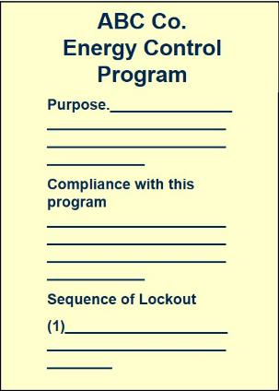
Core Components of an Energy Control Program
Energy control procedures for each type of machine
Training and retraining to ensure employees understand the program
Periodic inspection to ensure procedures are being followed
Notes:
These are the 3 core components of the Energy Control Program. We will be getting into each one of these components.

Slide 15
Energy Control Procedures
Must be specific to each type of machine and equipment you are working on
Must include
  Statement of intended use of the procedure
  Steps for shutting down and securing machines and equipment
  Steps for placing, removing, and transferring of lockout devices
  Requirements for testing and verifying effectiveness of lockout devices
Notes:
Energy control procedures provide authorized employees with written instructions specifying how to safely control hazardous energy while performing servicing and maintenance on specific machines.
The procedure must identify the type and magnitude of the hazardous energy they expect to encounter and the approved methods to control it.
If the control procedures are the same for various pieces of equipment, then a single energy control procedure may be sufficient.

Slide 16

Required Training
Authorized employees
  Recognition of hazardous energy sources
  Type and magnitude of energy in the workplace
  Methods for energy isolation / control
Affected employees
  Purpose and use of energy control procedures
Other employees in work area
  Procedures related to restarting machines
Notes:
Training in lockout must be provided to all employees who may be in an area where energy control procedures are used.
This training must ensure that the purpose and function of the energy control program is understood and that employees gain the needed knowledge and skills to safely apply, use, and remove energy controls.

Slide 17
Retraining Requirements
Retraining is required if:
Change in job assignments
Change in machines
Change in energy control procedures
Equipment or processes present new hazards
Inspections reveal deficiencies in employee's knowledge of energy control procedures
Retraining must reestablish employee proficiency
Notes:
Retraining must be provided for all authorized and affected employees whenever there is a change in their job assignments, a change in machines, equipment or processes that present a new hazard, or when there is a change in the energy control procedures. 1910.147 (c)(7)(iii)
Additional retraining must also be conducted whenever a periodic inspection under paragraph (c)(6) of this section reveals or whenever the employer has reason to believe that there are deviations from or inadequacies in the employee's knowledge or use of the energy control procedures.

Slide 18
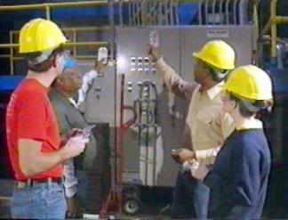
Periodic Inspections
Performed at least annually
Conducted by authorized employees
Intended to correct inadequacies identified in the program
Certified
Notes:
Employer is responsible for conducting inspections to ensure that the procedures and the lockout standard are being followed.
Inspections are conducted by authorized employees other than the one(s) utilizing the energy control procedure being inspected. 1910.147(c)(6)(i)(A)
An authorized employee is a person who locks out the equipment or machine in order to perform service and maintenance on it.

Slide 19
Certification Requirements
Identification of equipment or machinery
Date of inspection
Names of employees involved in the inspection
Name of person(s) performing inspection

Slide 20
Steps of Lockout Procedure
Prepare for shutdown
Shut down equipment
Isolate all energy sources
Apply locks & tags
Release stored energy
Verify equipment isolation
Perform the task
Release from Lockout

Slide 21
Step 1: Prepare for Shutdown
Understand equipment hazards
Notify other workers of shutdown
Notes:
Machinery and equipment should be shut down in an orderly manner using normal shutdown procedures.

Slide 22
Step 2: Shut down equipment
Use the normal shutdown procedures
Turn all switches to Off or Neutral

Slide 23
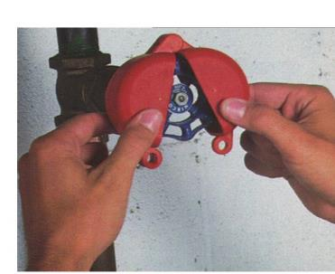
Step 3: Isolate all Energy Sources
Use energy isolation devices in accordance with established procedures to prevent transmission or release of energy
Valve lockout device
Notes:
Open breakers and disconnects
Shut off or close all control valves
Relieve, block or otherwise control stored or residual energy
Disable all sources of energy

Slide 24

Step 4: Apply Locks & Tags
Apply locks and tags to:
Valves
Breakers/electrical disconnects
Mechanical blocks
Notes:
Before applying and after removing lockout/tagout devices, the authorized employee must notify all affected employees.
Blank and tag flanges

Slide 25
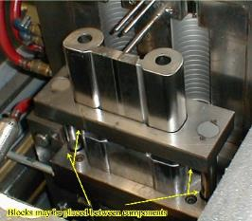
Step 5: Release or Block all Stored Energy
Discharge capacitors
Block/disconnect lines
Block or release springs
Block elevated parts
Relieve system pressure
Drain fluids
Vent gases
Allow system to cool (or use PPE)
Apply any additional locks and tags needed

Slide 26
Step 6: Verify Equipment Isolation
Check that other workers are clear of potential hazards
Check that locking devices are secure
Attempt normal startup
Return control to Off or Neutral

Slide 27
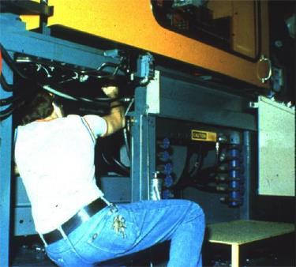
Step 7: Perform the Task
Perform maintenance or service

Slide 28
Step 8: Release from Lockout
Ensure machinery is properly assembled and all tools removed
Ensure that employees are outside of danger zones and are notified that devices are being removed
Remove LOTO devices
  Must be removed by authorized employee who applied it
Notes:
The authorized employee should follow these procedures prior to removing LOTO devices and restoring energy.
Exception:
When authorized employee is not at the facility and all reasonable efforts have been taken to inform him/her that the LOTO device has been removed written procedures must be in place to remove LOTO devices.

Slide 29
Summary
Lockout-Tagout prevents energy from accidentally being released while a machine or equipment is being serviced
There are 6 types of hazardous energy common to most work environments – Mechanical, Electrical, Thermal, Chemical, Hydraulic and Pneumatic
Most injuries and fatalities are a result of improper hazardous energy control procedures
If an energy-isolating device is capable of being locked out, a lock out system MUST be used
General energy control procedures follow an 8-step process
Only the authorized employee may attach and remove the logout / tagout device
Affected employees or any other employees should NEVER remove or tamper with a logout / tagout device

Slide 30
Questions?

