Slide 1


Respirable Crystalline Silica in Construction Workplaces
Sample Employee Training Presentation
Developed by OSHA, 2018
Notes:
Notes to employers and other trainers:
This is a sample presentation developed by OSHA to help employers or other instructors train employees covered under the OSHA respirable crystalline silica standard for construction (29 CFR 1926.1153).
Employers and other instructors can customize this PowerPoint to meet their training needs. Examples of ways to customize this PowerPoint:
Employers can add the specific tasks and controls used in their workplace.
If an employer uses only controls on Table 1 and strictly follows the specified exposure control methods, the employer can skip the more detailed slides describing the alternative exposure control methods.
If required respirator use for a workplace does not trigger medical surveillance of any employees, extensive details about medical surveillance do not need to be discussed.
This presentation can either be projected or printed as handouts.
**Employees should be given a chance to ask questions about the material presented.**

Slide 2
Respirable Crystalline Silica in Construction Workplaces (cont.)
• This presentation contains copyrighted content. You may use, copy, distribute, and display the presentation as a whole. However, any copying, distribution, display, or modification of an individual copyrighted image or photo separate and apart from the presentation is not permitted without prior permission of the copyright holder, except as authorized by federal copyright law.
• The appearance of particular vendors or their equipment and/or services in this document does not constitute an endorsement by OSHA or the U.S. Department of Labor.
Photo on the title slide is courtesy of DeWALT Industrial Tool Co.

Slide 3
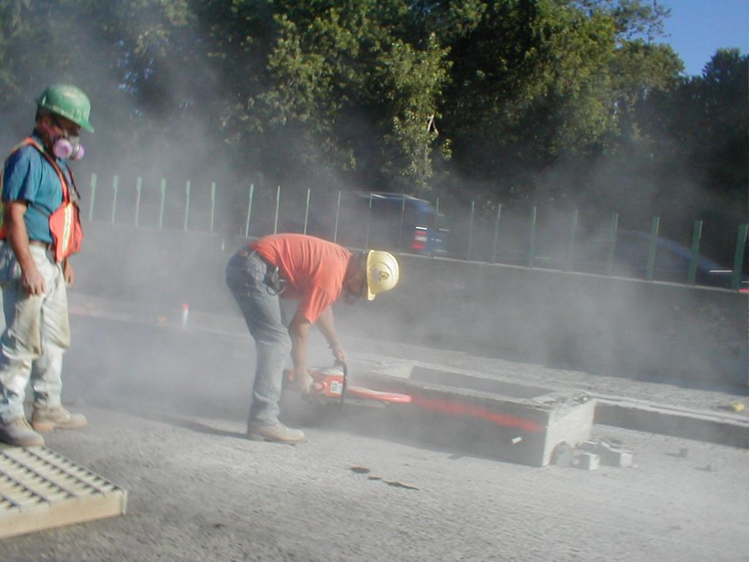
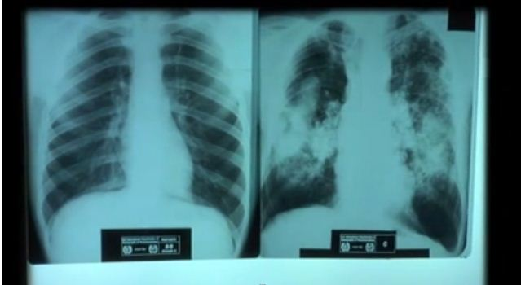
What You Will Learn
What respirable crystalline silica is
How employees are exposed
Health effects from breathing respirable crystalline silica
Mount Sinai/CHEP/elcosh.org
Notes:
You are receiving this training because you may be exposed to respirable crystalline silica in your workplace.
This training will teach you:
What respirable crystalline silica is;
The tasks done in your workplace that can expose you to respirable crystalline silica; and
How breathing in respirable crystalline silica could affect your health.

Slide 4


What You Will Learn (Standard)
              Silica standard
Photo courtesy of DeWALT Industrial Tool Co.
              Workplace protections
Notes:
This training will also teach you:
What employers must do to protect you, such as provide you with equipment that keeps dust out of the air. Such equipment could include the vacuum shown in the slide.
You will also learn about the major requirements that your employer must follow under the silica standard. “The silica standard” means the silica regulation for construction.

Slide 5


What You Will Learn (Minimize Hazards)
Medical surveillance
Neil Lippy/Hoar Construction/elcosh.org
Competent person
Amanda Mills/CDC
Notes:
The training will help you identify the competent person for silica. The competent person is someone your employer designates to help minimize silica hazards in the workplace.
You will also learn the purpose of medical surveillance and what makes up the medical surveillance program. The medical surveillance requirements provide at-risk employees access to medical evaluations to help with early detection of health effects related to silica exposure.

Slide 6
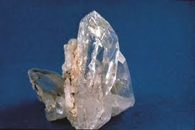
Crystalline Silica
NIOSH
Notes:
We will start off by describing crystalline silica and how employees can be exposed.
Crystalline silica is a mineral. The most common form is quartz.

Slide 7
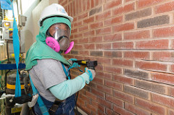
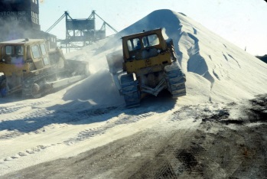
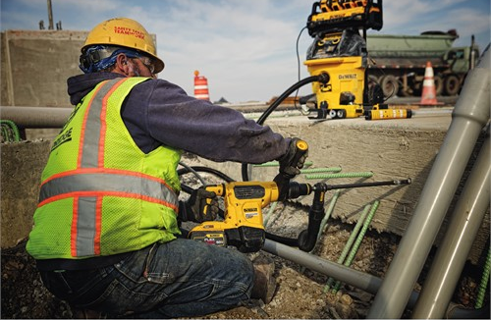
Crystalline Silica Is Found In Many Construction Materials
Department of Labor/Shawn T Moore
John F. Rekus, PE, MS, CIH, FAIHA/elcosh.org
Photo courtesy of DeWALT Industrial Tool Co.
Notes:
Crystalline silica is found in many materials used in construction.
This includes natural materials such as sand, rock, and stone.
It also includes man-made materials such as concrete, brick, block, mortar, tile, and artificial stone.

Slide 8
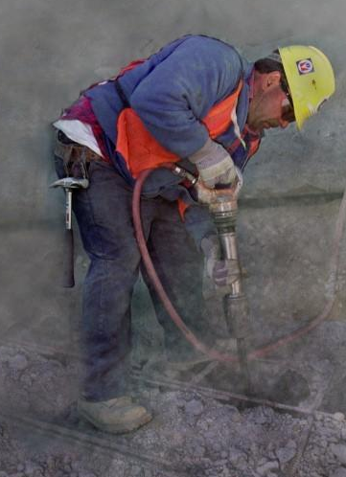

Respirable Crystalline Silica
NIOSH
Used with permission (©) www.earldotter.com
Notes:
Dust containing crystalline silica is generated when, for example, power tools are used to chip, cut, saw, drill, grind, sand, or crush crystalline silica-containing materials; it is also produced when sand is used in abrasive blasting.
This dust contains respirable particles of crystalline silica. These respirable particles are very small -- about 100 times smaller than a grain of sand found on the beach. In the picture on the right, the pen is pointing to grains of sand that are similar in size to sand found on the beach. To the right of that sand is dust made up mostly of respirable crystalline silica. The picture shows how much finer respirable crystalline silica is than beach sand.
When these very fine respirable silica particles are breathed in, they can travel deep into the lungs, where they can become trapped and cause disease.
(For the remainder of this training, we will simply refer to “silica”, when we talk about respirable crystalline silica.)

Slide 9
Workplace Tasks with Exposure
Employers must train employees on tasks in their workplace that can expose them to respirable crystalline silica
Notes:
Note to employers: Employers must train employees on the specific tasks that could expose employees to silica in their workplace (for example, cutting bricks with a handheld power saw, cutting concrete blocks with a stationary masonry saw, grinding mortar). This slide can be modified to include those tasks.

Slide 10
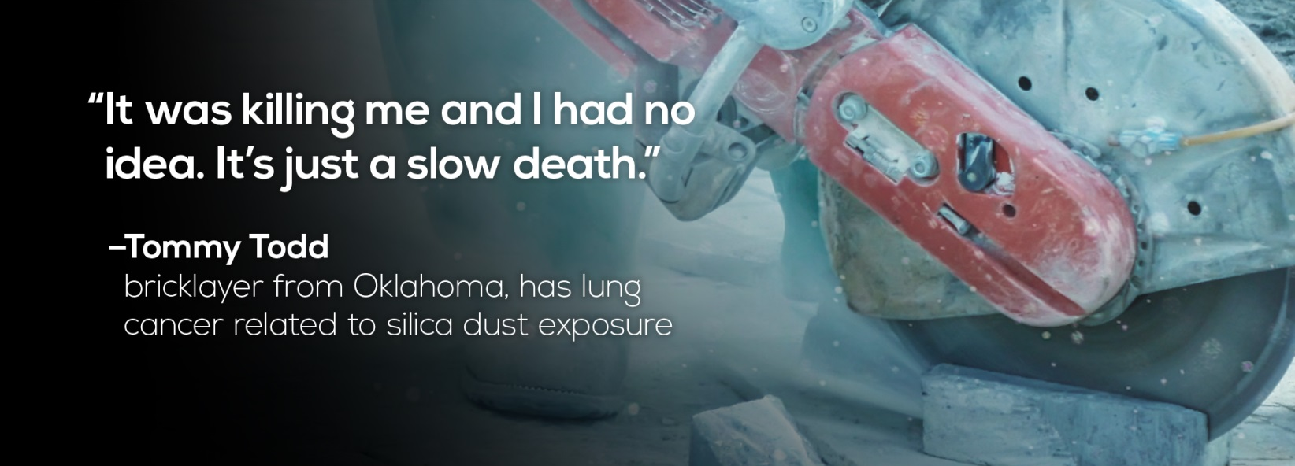
Health Hazards of Silica
Silicosis
Lung cancer
Chronic obstructive pulmonary disease (COPD)
Kidney diseases
Autoimmune diseases
Notes:
Breathing in silica can increase employees’ chances of developing lung diseases, including silicosis, lung cancer, and chronic obstructive pulmonary disease (COPD). It also increases their chances of developing kidney and autoimmune diseases.
The higher the levels of silica employees are exposed to and the longer they are exposed to it, the greater the chances of developing these diseases.
Silicosis and COPD are lung diseases that are permanent and not curable, and can become deadly or disabling.
Less than 16 percent of people diagnosed with lung cancer live longer than five years.
Kidney diseases can cause problems like high blood pressure or even end stage renal disease, which often requires dialysis or a kidney transplant.
Autoimmune diseases occur when antibodies that protect the body from diseases attack the body itself.
Rheumatoid arthritis is an example of an autoimmune disease.

Slide 11
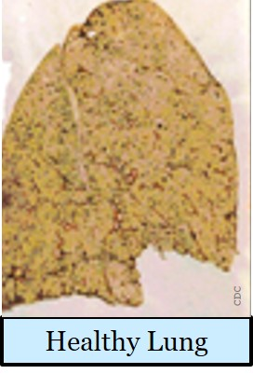
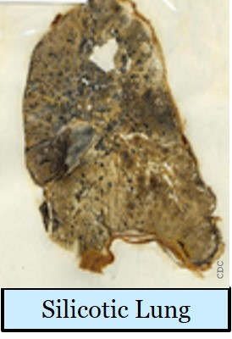
Health Hazards - Silicosis
Three types:
  Chronic
  Accelerated
  Acute
Permanent
Can be debilitating or deadly
CDC
CDC
Notes:
Employees exposed to silica could develop silicosis.
There are three forms of silicosis that can develop, based on how much silica employees are exposed to and for how long.
Most employees who develop silicosis develop chronic silicosis. It typically develops after repeated exposures over 10 or more years.
Accelerated silicosis typically develops after 5-10 years of exposure to higher levels.
Acute silicosis typically develops after exposures to extremely high levels, such as could occur with abrasive blasting with sand. It usually occurs within a few months to less than two years of exposure. It is the rarest form of silicosis.
All forms of silicosis are permanent and irreversible. This means that once you have silicosis, it does not go away or get better and there is no way to cure it. Silicosis can get worse over time and can lead to disability or death.
The top picture shows a healthy lung and the bottom picture shows a lung from a silicosis victim.

Slide 12

Symptoms of Lung Diseases
Sometimes, no symptoms in early stage of disease
Coughing and shortness of breath
Fever, weight loss, exhaustion, and coughing up blood
Notes:
Employees might not have symptoms in the early stages of silica-related diseases, but symptoms can develop as the diseases get worse over time.
Symptoms of lung diseases associated with silica exposure include shortness of breath and coughing. In some employees, these symptoms can get so severe that they cannot work or do common, everyday activities. For example, someone with silicosis might have trouble walking at a normal speed or going up stairs.
Fever, weight loss, exhaustion, and coughing up blood can occur with severe lung disease, lung cancer, and lung infections.
People who have lung diseases, such as silicosis, have a greater chance of developing lung infections such as the flu and pneumonia.

Slide 13
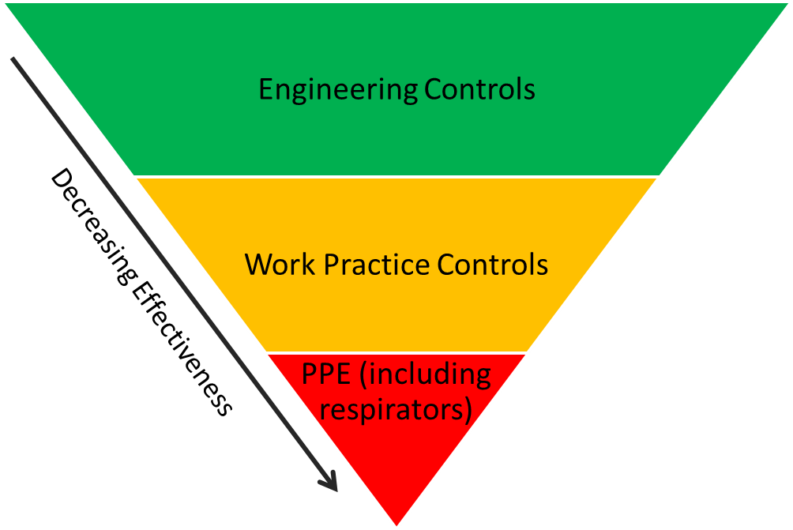
Protecting Employees
Hierarchy of Controls
Notes:
Your employer must protect you from being exposed to silica dust above certain levels. This decreases the chances that you will develop silica-related diseases.
This pyramid shows OSHA’s hierarchy of controls, which lists the types of controls in order of their effectiveness.
It shows the most effective form of protection – engineering controls – at the top of the pyramid. Engineering controls remove or isolate silica dust at the point where it is made.
The second most effective type of protection is work practice controls. Work practice controls involve doing tasks in ways that reduce dust exposure.
The least effective type of protection is personal protective equipment, such as respirators. This is shown at the bottom of the pyramid.
The silica standard requires employers to use engineering controls and work practice controls first to reduce exposures. They can have employees use respirators only if engineering and work practice controls aren’t sufficient to reduce exposures.

Slide 14
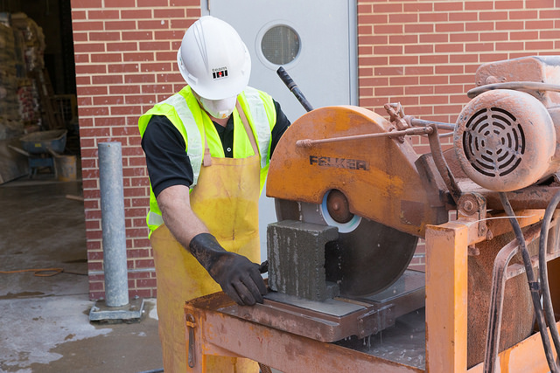
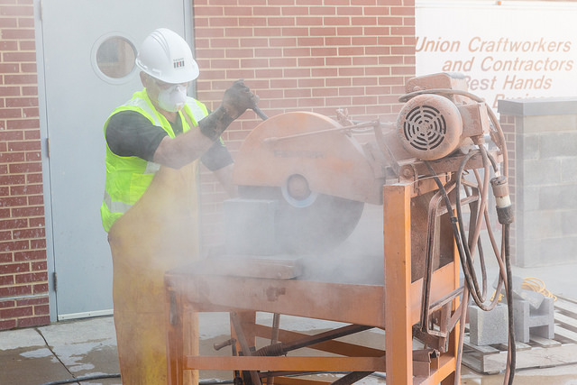
Engineering Controls
Cutting block
without engineering controls
Department of Labor/Shawn T Moore
Cutting block using water to control the dust
Department of Labor/Shawn T Moore
Notes:
The three major types of engineering controls for silica dust are wet methods, vacuum dust collection systems, and isolation.
Wet methods involve using water or a foam to keep dust down and out of the air.
These pictures show an employee cutting concrete block, with and without the use of water.
The picture shows how water greatly reduces the dust released into the air.

Slide 15
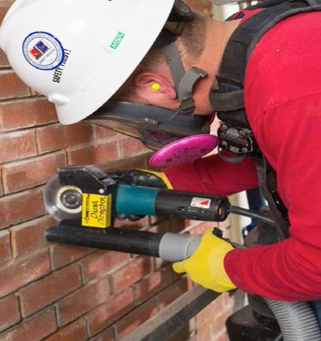
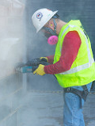
Engineering Controls
Grinding mortar without engineering controls
Department of Labor/Shawn T Moore
Department of Labor/Shawn T Moore
Grinding mortar using a vacuum dust collector
Notes:
Another type of engineering control for silica dust is a vacuum dust collection system.
Vacuum dust collection systems remove dust at the point where it is made.
These pictures show employees grinding mortar, with and without a dust collection system.
The pictures show how capturing the dust at the point where it is made greatly reduces the amount of dust in the air.

Slide 16
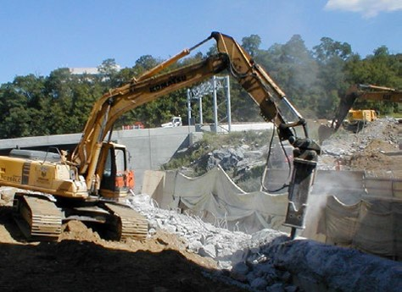
Engineering Controls (cont)
Employee protected inside the cab of heavy equipment used for demolition
Mount Sinai/CHEP/elcosh.org
Notes:
The third type of engineering control used for silica dust is isolation.
Isolation separates the employee from silica dust.
This picture shows how the cab on this heavy equipment protects the operator from the dust being generated.
This type of control is effective for operators in the cab, but does not protect employees working outside the cab.

Slide 17
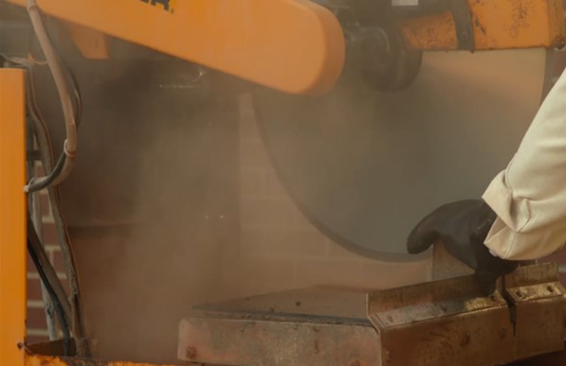
Work Practice Controls
Example: Fixing controls that are not working properly
Department of Labor/Shawn T Moore
Notes:
Training you how to use effective work practices is another way employers can protect you.
Work practice controls involve doing tasks in ways that decrease exposures.
One type of a work practice control is making sure that engineering controls are working properly. An example is checking that nozzles on a tool with wet controls are not clogged and are pointed in the direction where dust is produced.
Immediately addressing an engineering control that is not working properly is another example of a work practice control. If you can see dust levels starting to increase, as is shown in this picture, this is a sign of a problem with engineering controls.
Another example of a work practice control is using cleaning methods, such as wet sweeping, to decrease the amount of dust that gets into the air.
Your employer might also schedule dusty tasks when other employees will not be around.

Slide 18
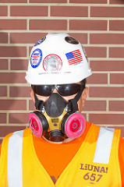

Respirators
Department of Labor/Shawn T Moore
Notes:
Personal protective equipment, such as respirators, is at the bottom of the hierarchy of controls.
Your employer must give you a respirator if engineering controls and work practices are not enough to control exposures down to the exposure limit.
Even when respirators must be used, your employer must still use engineering and work practice controls to lower exposures as much as possible.
One of the major reasons why engineering and work practice controls must always be used before respirators is because they decrease dust at the point where it is made. As a result, they protect everyone in the area.
Respirators are effective if they are properly selected, fitted, maintained, and worn. However, they protect only the people wearing them.

Slide 19
Specific Protections in This Workplace
Employers must train employees on workplace-specific:
Engineering controls
Work practice controls
Respiratory protection
Notes:
Note 1 to employers: Employers must inform employees of the specific engineering controls, work practice controls, and respiratory protection used in their workplace. If exposures are controlled by substituting a different material for a silica-containing material, employees must be trained on that as well. The controls used in the workplace can be included as part of this slide if it is convenient for employers.
Note 2 to employers: Employees must be trained on the proper work practices associated with the tasks they perform. For example, an employee who operates a hand-held saw must know how to fully and properly implement the dust controls on the saw.
Note to trainers other than employers: The slide can be modified to let employees know that their employers must train them about the specific engineering controls, work practices, and respiratory protection used in their workplace. They should also know that the employer should show them how to fully and properly implement controls for any tools they operate.

Slide 20
Respirable Crystalline Silica Standard for Construction
Other Requirements:
All employers
2. Alternative Exposure Controls
1. Specified Exposure Controls
Two Choices
For Employers:
Notes:
We will now talk about the major requirements of the silica standard.
The silica standard gives employers in construction two options for protecting employees.
The first option is called specified exposure control methods. It involves following the requirements for engineering and work practice controls and, in some cases, respiratory protection, that are listed in Table 1 of the standard.
The second option is called alternative exposure control methods. This option allows employers to choose their own effective controls. Employers using this option must also follow certain other requirements, such as determining how much silica employees are exposed to.
All construction employers must follow other requirements such as training employees and offering medical exams to some employees. (We will talk more about those requirements later.)

Slide 21
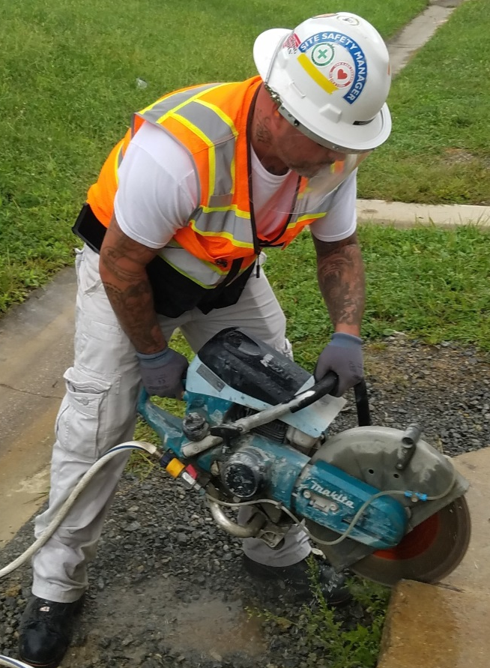
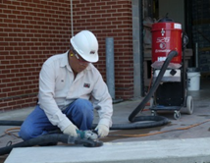
Specified Exposure Control Methods: Table 1
Table 1:
Handheld power saw
Table 1:
Handheld grinder for uses other than mortar removal
Department of Labor/Shawn T Moore
Notes:
As we discussed earlier, employers must limit silica exposures using engineering and work practice controls, and have employees use respiratory protection if those controls are not enough to limit exposures.
Employers can meet these obligations by following Table 1. Table 1 lists effective engineering and work practice controls, sometimes supplemented with respiratory protection, for 18 common construction tasks. Some Table 1 tasks require tools to be used with water, such as handheld power saws (shown on the left). Other Table 1 tasks require tools to be used with vacuum dust collection systems, such as grinders (shown on the right).
If an employer fully and properly implements the protections in Table 1, the employer does not need to determine employees’ exposures. OSHA reviewed the control measures specified on Table 1 and found that they are effective at limiting employee exposures to acceptable limits most of the time. For the few tasks where existing control measures cannot limit employee exposures to acceptable limits most of the time, Table 1 requires respirator use.
Note to employers: If you have not done so already in this training, you must train employees on the full and proper implementation of controls for Table 1 tasks they are doing

Slide 22
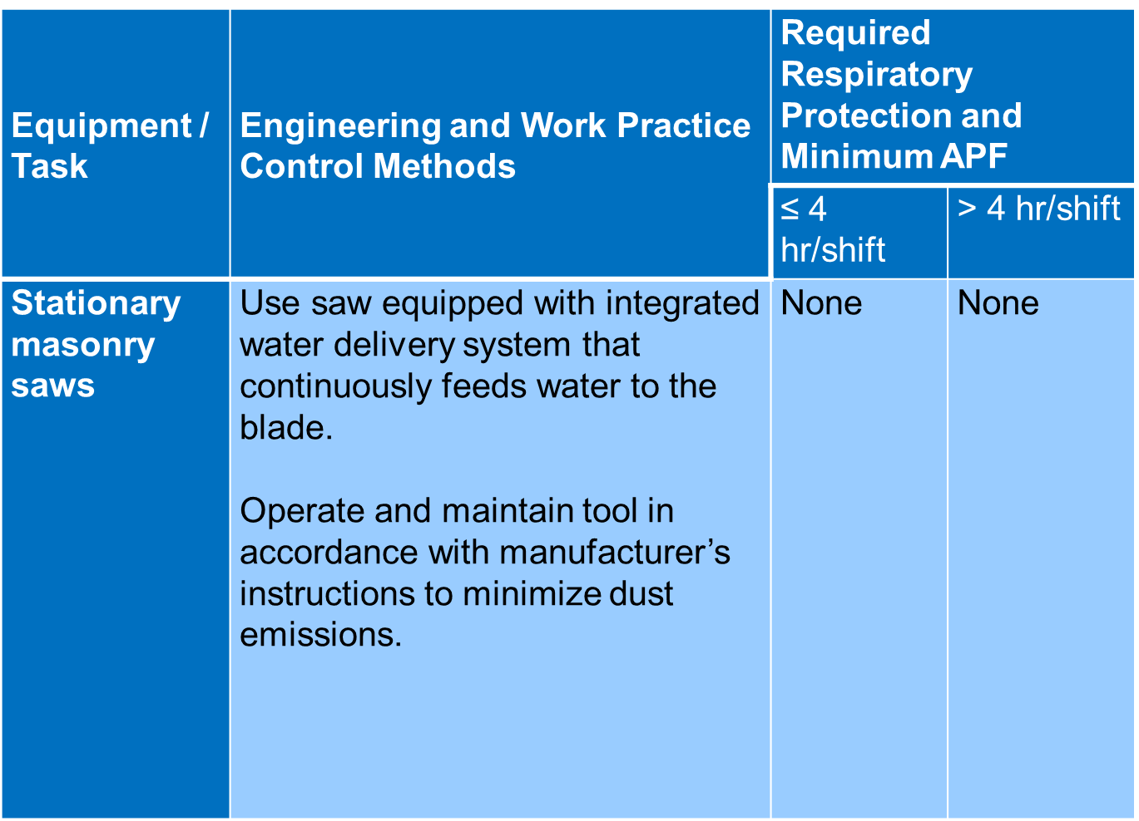
Example of a Table 1 Entry
Notes:
This is what the Table 1 entry looks like for stationary masonry saws.
An employer following Table 1 for stationary masonry saws must make sure that the saw is equipped with an integrated water delivery system. Integrated means that the system must be built into the tool. A water hose taped to the saw is not considered to be “integrated”.
The system must also continuously feed water to the blade. Occasional application of water is not sufficient.
The employer must follow the manufacturer’s instructions for minimizing dust release. Such instructions might include water flow rate and how often water should be changed. Manufacturers’ instructions that are not related to controlling dust, such as the type of engine oil to use for a tool, do not have to be followed under the silica standard.
The employer does not have to provide respiratory protection when the controls for the saw are fully and properly implemented.

Slide 23
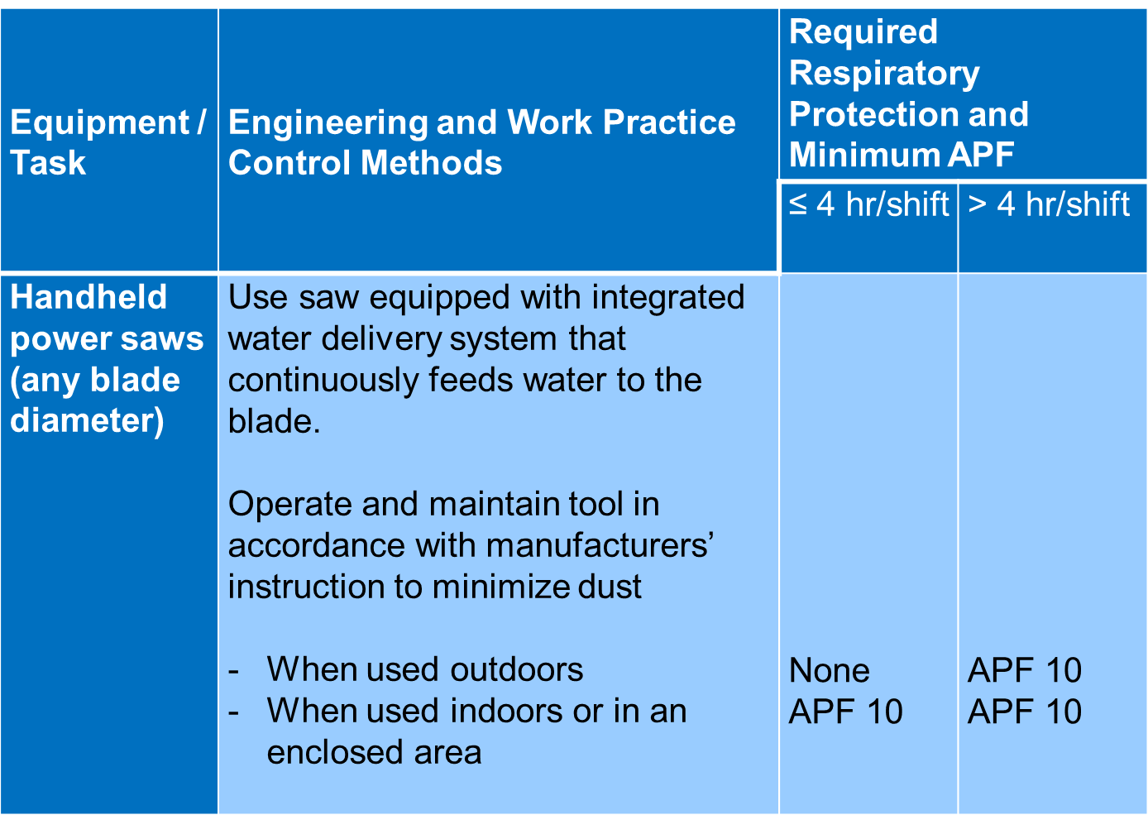
Example of a Table 1 Entry (cont)
Notes:
This is another example that shows the Table 1 entry for handheld power saws. In this case, when the saw is used outdoors for more than 4 hours or indoors or in an enclosed area for any amount of time, employers must provide respirators to employees engaged in the task. These are the employees who are doing the task or helping out with the task, or responsible for getting the task done.
Table 1 has some other requirements that your employer must follow.
The first requirement involves working indoors or in enclosed spaces; this can include areas such as a garage or a trench. When working in such areas, visible dust can sometimes build up, even if you are using Table 1 controls correctly. If this occurs, your employer must provide you with a way to safely disperse the dust, such as using a fan.
When using tools with water controls, your employer must make sure the water flow rate is enough to minimize release of visible dust.
If enclosed cabs or booths are used, your employer must follow a number of requirements to make sure the cab or booth protects you.

Slide 24
List of Table 1 Entries
Stationary masonry saws
Handheld power saws
Handheld power saws for fiber cement board
Walk-behind saws
Drivable saws
Rig-mounted core saws or drills
Handheld and stand-mounted drills
Dowel drilling rigs for concrete
Vehicle-mounted drilling rigs for rock and concrete
Jackhammers and handheld powered chipping tools
Handheld grinders for mortar removal (tuckpointing)
Handheld grinders for other than mortar removal
Walk-behind milling machines and floor grinders
Small drivable milling machines
Large drivable milling machines
Crushing machines
Heavy equipment and utility vehicles to abrade or fracture silica materials
Heavy equipment and utility vehicles for grading and excavating
Notes:
These are all the entries on Table 1.

Slide 25
Alternative Exposure Control Methods – Permissible Exposure Limit (PEL)
50 Micrograms per Cubic Meter of Air (µg/m³)
Averaged over an 8-hour work day
Notes:
In some cases, employers may have you perform tasks that are not on Table 1, or they may choose to use other types of engineering and work practice controls for tasks that are listed on Table 1.
In those cases employers must follow the alternative exposure control methods option.
Construction employers who follow the alternative exposure control methods option must determine how much silica you are exposed to and whether your exposure is at or below the permissible exposure limit (PEL). The PEL is 50 micrograms of respirable crystalline silica per cubic meter of air averaged over an 8-hour work day (µg/m³).
The units of µg/m³ represent the weight of respirable crystalline silica suspended in a specific amount of air.

Slide 26



Perspective on PEL
1,000 µg in the air of this room = 50 µg/m³
20 cubic meters of air
1,000 µg of silica
2.4 meters
3.1 meters
2.7 meters
Notes:
The photo on the left shows 1,000 micrograms of respirable crystalline silica next to a dime.
The photo on the right shows a room that contains approximately 20 cubic meters of air.
1,000 micrograms of respirable crystalline silica suspended in 20 cubic meters of air is an average concentration of 50 micrograms per cubic meter, which is equal to the PEL.
A person who worked in this room for no more than 8 hours would not be exposed to silica above the PEL.
You might not notice 1,000 micrograms of pure respirable crystalline silica dust when it’s airborne in a room of this size. But, because silica is typically a small part of total dust, the air would likely be noticeably dusty.
Your exposures to silica may increase and decrease throughout the shift.
For example, you may be exposed while performing a silica-generating task and then not receive additional exposures when performing a task that doesn’t generate silica dust.
Although exposures are increasing and decreasing throughout the shift, your average exposure must remain at or below 50 µg/m³ for each 8-hour work shift.

Slide 27
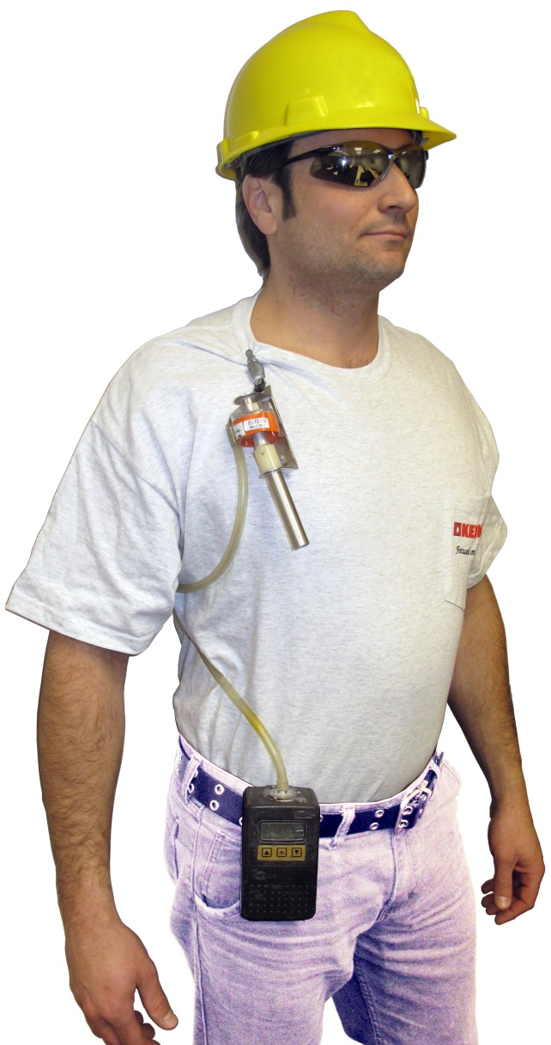
Alternative Exposure Control Methods – Exposure Assessment
Employers must:
Determine exposures
Give employees results
Let representatives observe
Construction Safety Council
Notes:
If your employer is following the alternative exposure control methods option, your employer must determine how much respirable crystalline silica you are exposed to.
Employers can determine exposure to silica in different ways.
They might measure exposures by attaching a pump to you that collects silica dust. This picture shows the pump attached to an employee’s belt. The pump draws in air through the cyclone, which is the device attached near the employee’s collar. The cyclone contains a filter that is sent to the lab to determine the employee’s exposure level.
Employers might also determine exposures using other methods. For example, some meters directly measure the concentration of total respirable dust. The amount of silica can then be determined based on the fraction of silica in the material being worked on, such as concrete, brick, block, mortar, tile, or stone.
(Note: Under the hazard communication standard, employers must train employees on how silica is detected in the workplace.)
Employers must notify you about your exposure levels within 5 days of getting the results. They can notify you personally or by posting the results in a convenient location (employers should let employees know how they will be notified).
Employers must also notify you about corrective actions they will be taking if exposures exceed the PEL. Corrective actions might include use of engineering controls and/or respirators.
Employers must also let you or your representative observe exposure measurements they take in the workplace.

Slide 28
Alternative Exposure Control Methods – Methods of Compliance
Employers must select:
Engineering controls
Work practice controls
Respirators, if needed
Hierarchy of Controls
Notes:
If your employer is following the alternative exposure control methods option, your employer must follow OSHA’s hierarchy of controls to determine effective engineering and work practice controls and must only require the use of respirators when those controls are not enough to decrease exposures to the PEL or below.
Even if employers cannot reduce exposures to the PEL with engineering and work practice controls, they must reduce exposures as much as possible using those controls.

Slide 29
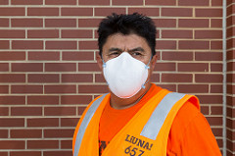
Respiratory Protection
Employers must:
Provide respirators if needed
Follow the respiratory protection standard
Department of Labor/Shawn T Moore
Notes:
As mentioned earlier in the presentation, in some cases employers must provide you with respirators to protect you from breathing in silica dust.
If respirators are used in the workplace, employers must follow all requirements of the respiratory protection standard, including training about respirators, testing to make sure respirators fit properly, and providing medical evaluations.

Slide 30
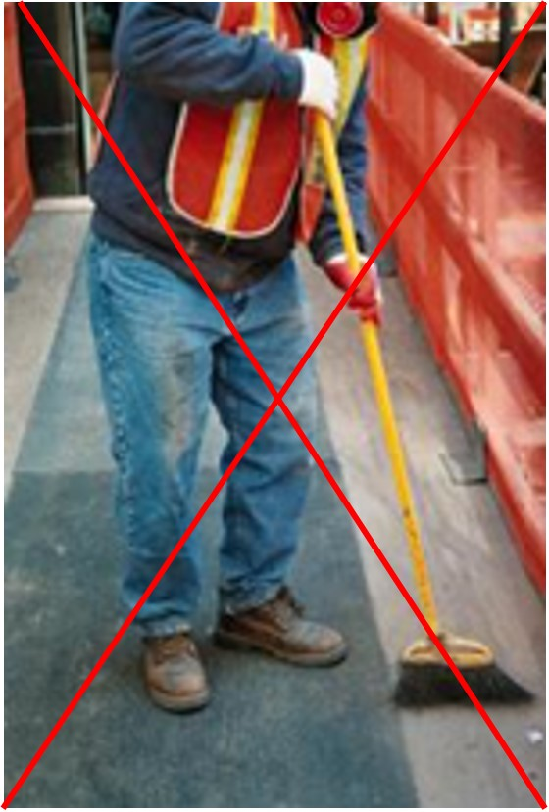
Housekeeping
When cleaning silica dust, avoid:
Dry sweeping/brushing
Compressed air without a ventilation system to capture the dust
Mount Sinai/CHEP/elcosh.org
Notes:
The rest of this training focuses on requirements for all employers covered by the silica standard, regardless of whether they are following Table 1 or the alternative exposure control methods. The first of these requirements is housekeeping.
Certain cleaning methods can increase employee exposures to silica by releasing dust into the air.
Therefore, the silica standard requires employers to avoid cleaning methods that release dust into the air and use cleaning methods that reduce the likelihood of exposures.
Dry sweeping and dry brushing should not be used if they can contribute to silica exposures.
Compressed air should not be used to clean clothing or surface, unless the compressed air is used with a ventilation system that captures and gets rid of the dust in a way that prevents workers from being exposed.
Less dusty cleaning methods, such as HEPA-filtered vacuuming, wet sweeping, or the use of oil- or wax-based sweeping compounds, should be used instead.
Employers can, however, use dry sweeping, dry brushing, or compressed air when the less dusty cleaning methods would cause damage, create a hazard in the workplace, or be ineffective. An example of a housekeeping method that would create a hazard is wet sweeping near electrical equipment.
Note: A HEPA-filtered vacuum is a type of vacuum that effectively captures respirable dust.
Note: The housekeeping prohibitions in the standard do not apply when cleaning up materials that can’t release respirable crystalline silica, such as ordinary dirt, beach sand, large debris, or saw dust.

Slide 31
Housekeeping (cont.)
Employers must let employees know which housekeeping methods:
  Must be used in the workplace
  Must not be used in the workplace
Notes:
Note to employers: Because proper housekeeping is a work practice that controls exposures, employers must train employees on the specific housekeeping methods used in their workplace. Employers can update this slide to address the cleaning practices that should be used and practices that must not be used in their workplace.

Slide 32

Written Exposure Control Plan
Employers must:
Prepare and implement plan addressing:
  Exposure sources
  Controls
  Housekeeping
  Restricting access
Review plan yearly
Make it available
Notes:
Employers must prepare and implement a written exposure control plan that describes tasks involving exposure to silica. The plan must also address engineering controls, work practices, and respiratory protection for each task. Housekeeping measures must also be addressed in the plan.
The plan must also describe procedures for restricting access, when necessary to limit exposures. When employees are engaged in tasks that require respirator use under the silica standard, access to those higher-exposure areas must be restricted for employees who are not involved with the task. This means that employees who are not involved in those tasks should not be in the area.
Your employer must review the plan at least once a year and make any updates if needed.
Your employer must let you and your representative look at or copy the written exposure control plan if requested.
(Employers should let employees know where they can view or request a copy of the written exposure control plan).

Slide 33
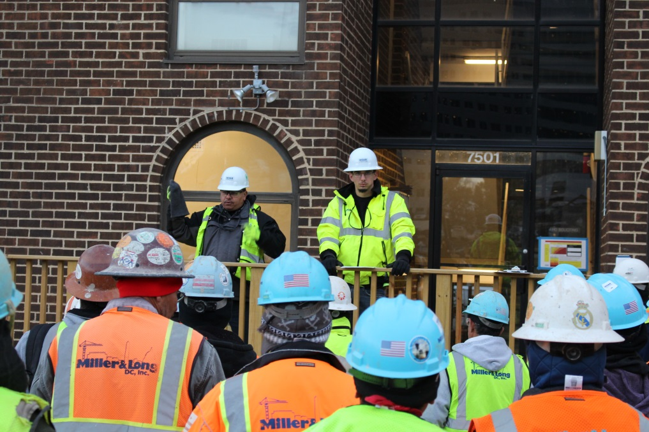
Competent Person
Identifies and minimizes silica hazards
Employees must know the competent person
Morgan Zavertnik/Hoar Construction/elcosh.org
Notes:
Your employer must designate a competent person to frequently inspect the job site, materials, and equipment to implement the written exposure control plan.
The competent person must be able to identify silica hazards and must be authorized to quickly eliminate or minimize those hazards.
Employers must let you know who the competent person is. This could be as simple as making an announcement at the start of the work shift.
Note to employers: Let employees know who the competent person is or how they will find out (for example, announcing at the start of each work shift). You should also let them know how they can contact the competent person if he or she is not always on site. This slide can be updated to include that information.

Slide 34

Medical Surveillance
For employees who must wear a respirator under the silica standard for 30 or more days/year
Offered:
  Within 30 days of assignment
  Every three years
Amanda Mills/CDC
Notes:
Employers must offer you a medical exam if you will be required by the silica standard to wear a respirator for 30 or more days a year.
The employer must offer you an initial medical exam within 30 days of assigning you to a job that will require respirator use under the silica standard, unless you have had a medical exam for silica within the last three years.
The employer must continue to offer periodic medical exams at least every three years if you will perform tasks that require you to wear a respirator under the silica standard for 30 or more days a year.
Note that the medical exam for silica is different than the medical evaluation required by the respiratory protection standard. If you will be required to wear a respirator, you must undergo the medical evaluation for respiratory protection before you are fit tested for the respirator or wear the respirator in the workplace.

Slide 35
Medical Exams
Medical and work history
Physical exam
X-rays
Notes:
If you have a medical exam, it will include:
A medical and work history. This will include questions about your health, past jobs you have done, and the exposures in those jobs;
A physical exam, including listening to your heart and lungs with a stethoscope, and measuring blood pressure; and
A chest X-ray to help evaluate the health of your lungs.

Slide 36
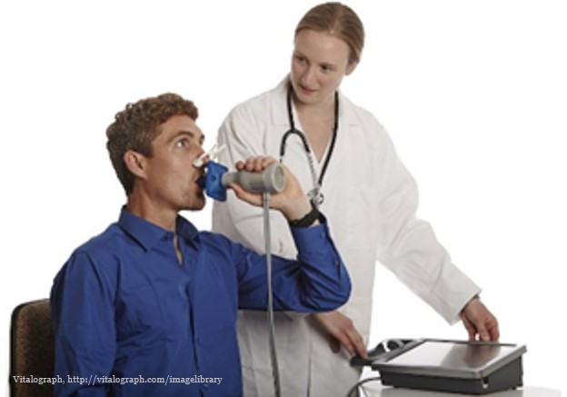
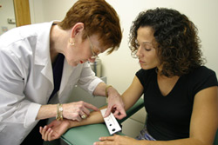
Medical Exams (cont)
Tuberculosis (TB test)
Lung function test
CDC
Notes:
The medical exam also includes:
A lung function test. This involves using an instrument called a spirometer to measure how much air you can blow out and how fast you can blow it out after taking a deep breath, as shown in this picture.
A tuberculosis (TB) test. A TB test is done only for the initial exam, which is the first exam that you receive under the silica standard.
The purpose of the test is to determine if you have a latent TB infection. Latent TB is a stage of TB infection in which a person does not have signs or symptoms of TB and cannot spread the disease to others. Latent TB cannot be detected with a chest X-ray, so a skin test is needed.
Testing for TB is done because exposure to silica can increase the chances that someone with a latent TB infection can develop active TB disease. A person with active TB disease has symptoms and can spread the disease to others.
If you were born or grew up in a country other than the U.S., you should let the health care professional know. Many countries outside the U.S. vaccinate children to prevent TB-related diseases. Persons who have received the vaccine and are given the skin test for TB may have a false positive finding. This means that they appear to have a latent TB infection, when they are not actually infected. If you grew up in a country that vaccinates children for TB diseases, the health care professional might consider a blood test instead of a skin test for TB. This would decrease the chances of a false positive finding.

Slide 37
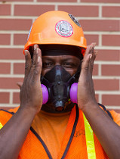
Why Medical Exams are Important
Determine fitness to use respirator
Find disease or increased sensitivity to silica exposure
Department of Labor/Shawn T Moore
Notes:
Getting the exam is important for the following reasons:
First, an exam can determine whether you have a disease related to silica exposure. This will allow you to take actions to protect your health, including: quitting smoking; getting jobs with lower exposures to silica; or getting flu shots.
The exam will also determine whether you might have any condition, such as a lung disease, that is not caused by silica exposure but that might make you more sensitive to silica exposure.
In addition, the exam will let you know whether you have a health condition that does not allow you to wear certain kinds of respirators. This could prevent you from endangering your health or life by wearing the wrong kind of respirator.

Slide 38

Medical Report for the Employee
Medical conditions
Recommended limitations on respirator use and exposure to silica
Recommendation for specialist exam
Only goes to the employee
Notes:
If you have had a medical exam, your employer must make sure that the healthcare professional explains the results of the medical exam to you and gives you a written medical report within 30 days of the exam.
The report must include the following information:
If you have a medical condition related to silica exposure or one that might make you more sensitive to silica exposure;
If the healthcare professional recommends limiting exposure to silica;
If the health care professional recommends that you be examined by a specialist.
The healthcare professional does not give a copy of the report to your employer; it belongs to you alone.

Slide 39

Medical Opinion for the Employer
Only medical info included:
  Recommended respirator limitations
Additional information requiring employee consent:
  Recommended exposure limitations
  Recommendation for specialist exam
Notes:
The employer will get a written medical opinion from the healthcare professional.
The opinion that your employer gets is different than the report you get.
The written opinion to your employer will include the exam date, a statement that the exam met the requirements of the silica standard, and any recommended limitations on respirator use.
Only if you give written permission to the healthcare provider will the medical opinion for your employer include more information. This could include recommended limitations on silica exposure, or a recommendation for a specialist exam. You can authorize either one or both recommendations to be included in the opinion to the employer.
Your employer does not receive information about your health because employees might fear retaliation or discrimination based on this information.
Under the Occupational Safety and Health Act, employers must not discriminate or retaliate against employees for participating in medical surveillance or based on the results of their medical exam.

Slide 40
Employee’s Copy of the Employer’s
Written Medical Opinion
Written
Medical
Opinion
Employees also get a copy
Proof of exam for future employers
Notes:
You must receive a copy of the written medical opinion that went to your employer within 30 days of the exam.
You should hold onto that opinion because you can use it as proof of a current medical exam for future employers.
This will prevent you from getting medical tests more often than required.

Slide 41

Exams at No Cost to Employees
Employer covers costs of:
Exams
Tests
Time spent traveling and getting exam
Notes:
Employers must offer exams at a reasonable time and place and cover all costs of medical exams. This includes:
Cost of the exam;
Costs of tests – including additional tests that are related to silica exposure; and
Costs of specialist exams.
If you get a medical exam, your employer must also cover the costs of travel and pay you for the time spent getting the exam and the time spent traveling to and from the exam.
Your employer must pay for an additional medical exam by a specialist, but only if you authorize your employer to receive the recommendation for the specialist exam.
The healthcare professional might let you know about other health conditions that are not related to silica exposures. Employers are not responsible for costs of additional exams or tests for conditions that are not related to silica. You will need to see your personal health care provider about those conditions.

Slide 42
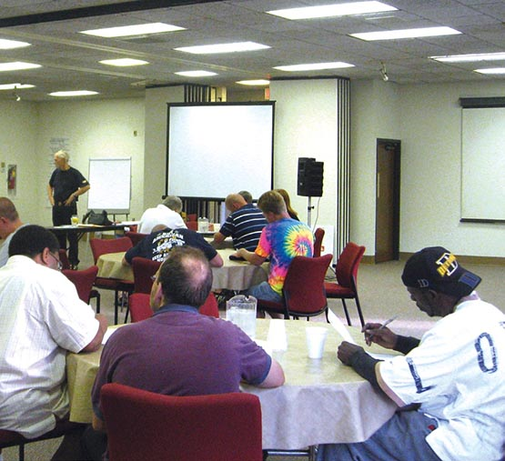
Other Training
Hazard communication program
Respiratory protection program
United Steelworkers – Tony Mazzocchi Center
Notes:
Employees exposed to silica in their workplace must also receive training under other OSHA standards.
The hazard communication standard requires that you be trained on the written hazard communication program in your workplace and where to find information about those hazards. The hazard communication standard also requires that employees be trained on how substances such as silica are detected in the workplace.
If respirators are used in your workplace, you must also receive the training required under the respiratory protection standard.

Slide 43
Copy of the Standard
Employers must:
Make a copy of the standard available
At no charge
Notes:
Employers must make a copy of the standard available to you and let you know how you can view it, free of charge.
Employers can update this slide to include this information.
Note to employers: This slide can be updated to include information on how employees can get access to a copy of the standard.

Slide 44

Recordkeeping
Employers must:
Keep medical and exposure records
Make them available
Notes:
Employers must keep exposure and medical records.
If you or your representative requests these records, employers must make them available.

Slide 45

More Information
www.osha.gov/silica/

