Slide 1
Respiratory Protection
Trainer’s Guide for the Instructor

Slide 2
Limitation of Liability
This training material and the training guide for the instructor was prepared with the federal sponsorship of Susan Harwood Grants, with number SH-05034-SH8 of the Occupational Health and Safety Administration of the United States Department of Labor. The contents of this presentation does not necessarily reflect the point of view or policies of the United States Department of Labor, nor does the mention of trademarks, products or commercial organizations imply endorsement by the Government of the United States of America
Trainer’s Guide for the Instructor
Notes:
The source of funds for the training is identified

Slide 3
DUTIES AND RESPONIBILITIES
eMPLOYER
EMPLOYEE
Obey the Health and Safety regulations imposed by the employer and use all the equipment provided while working.
Observing your employer's workplace safety practices.
Report any hazardous conditions to a supervisor.
Report any dangerous conditions to OSHA, if employers do not rectify it.
The Occupational Health and Safety Act requires employers to provide a safe and healthy workplace, free of recognized hazards, and to respect the standards set by OSHA. This includes offering training and medical examinations to their employees, and not retaliating when the employee makes use of the protections of the law
Trainer Guide for Instructor
Notes:
A brief summary of the responsibilities of employers and employees under OSHA Act

Slide 4

Occupational Safety and Health Law
Trainer’s Guide for the Instructor
Notes:
Posters supporting discussion of previous transparency

Slide 5
OBJECTIVES
  Know the minimum requirements for establishing a Respiratory Protection Program based on the 1910.134 standard.
  Discuss the mandatory sections of Appendix C (medical questionnaire)
  Discussing the difference between a qualitative fit test versus a quantitative fit test
  Discuss the different Assigned Protection Factors (AFPs) according to the corresponding respirator
  Perform respirator selection exercise according to the contaminant presented
Trainer’s Guide for the Instructor

Slide 6
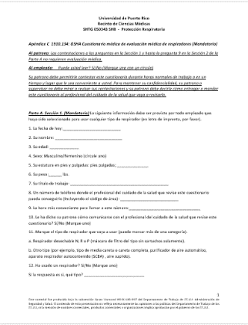
Medical Questionnaire - Appendix C
A medical evaluation is performed to determine the worker's ability to use a respirator.
The medical questionnaire may be replaced as long as you obtain the same information as provided in Part A in sections 1 and 2.
Affirmation of any of the questions provided in Section 2 of Part A may involve follow-up of the medical evaluation, including additional medical evidence.
Refer to the document contained in the folder.
Trainer’s Guide for the Instructor
Notes:
This slide shows participants Appendix C of OSHA standard 29CFR 1910.134.
A description of the purpose of the medical questions in each section is explained to participants so they can understand which information is important to the doctor performing the evaluation.
This discussion can take about 10 minutes.

Slide 7
Quantitative Fit Test and
Qualitative Fit Test
Trainer’s Guide for the Instructor
Notes:
The video associated with the quantitative fit test requirements is to be displayed.
This video lasts about 11 minutes and shows in detail the equipment and procedure for performing the test.
Also included are captions summarizing the audio from the video.

Slide 8
Show fit testing video

Slide 9
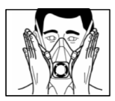
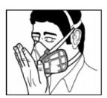
User Seal Check Procedures
Negative Pressure Check
POSItive Pressure Check
Photo credit by: hermandadebomberos.ning.com
Trainer’s Guide for the Instructor
Notes:
At this point the instructors demonstrate several important aspects namely;
How to properly position the respirator, whether particulate, half-face or full face
How to perform the fit check test in the negative pressure and positive pressure mode
How to properly remove the respirator

Slide 10
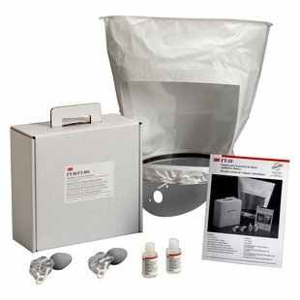
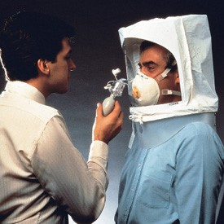
Demonstration of Qualitative Fit Test
Photo credit by: solutions.3m.com
Photo credit by: www.seton.ca
Trainer’s Guide for the Instructor
Notes:
The equipment used in the qualitative fit test is presented emphasizing that it depends entirely on the user's olfactory ability to detect the test (smell or taste) the test substance.
If there is time, a demonstration is performed between the instructors using the nebulizer and the hood.

Slide 11
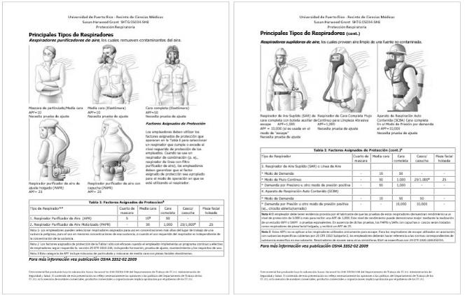
Assigned Protection Factor (APF)
Refer to the document contained in the folder.
Trainer’s Guide for the Instructor
Notes:
Using this reference sheet the instructor explains the protection factors assigned for each type of respirator and the differences between them.
It is important to emphasize that the type of fit test performed determines the maximum protection factor of the respirator, especially with the purifying respirators.
Supplied air respirators always require quantitative fit testing.

Slide 12
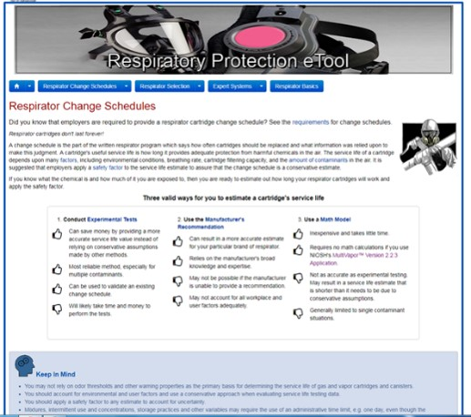
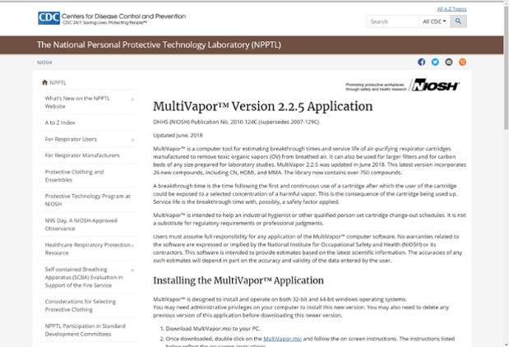
Estimated a Cartridge’s Service Life
Trainer’s Guide for the Instructor
Reference webpage: www.osha.gov/STLC/etools/respiratory
Notes:
The concept of cartridge life is discussed and how it is affected by factors such as:
Humidity
Temperature
Time of use
Type of work (light or heavy)
Working environment quality, among others

Slide 13
Demonstration of the cleaning process and respirator maintenance
Trainer’s Guide for the Instructor
Notes:
Here the instructors disarm at least two respirators, whether it is different brands of the same type; or two different types of respirators; for participants to see how the equipment is inspected and cleaned.
Emphasis is placed on the following:
Proper cleaning of the equipment avoiding solvents or strong detergents.
It establishes the importance of not exchanging parts between equipment unless authorized by the manufacturer
The correct assembly of parts to ensure proper sealing at the time of use
The identification of possible damage to the equipment parts, which will require a immediate replacement.
Proper storage inside clean plastic bags avoiding moisture and excessive heat
Indication of storing filters or cartridges separated from respirators.

Slide 14
Summary -Respiratory Protection Program Requirements
Select and provide a appropriate respirator for exposed respiratory hazards
Evaluación medica (Apéndice C)
Fit Test (Qualitative or Quantitative)
User seal check procedures
Cleaning and Maintenance
Storage
Training
Program Evaluation
Trainer’s Guide for the Instructor
Notes:
Using the points outlined in transparency, the most important elements of the Respiratory Protection program are summarized.

Slide 15
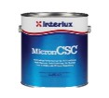
Exercise: Respirator selection
Situation #1
The work area is an outdoor space used to repair boats. The task consists of painting the hull of the boat using a paint sprayer gun driven by compressed air. Two men are working on this task. One is applying the paint on the boat surface, while the other is walking around the boat and under the paint mist while arranging hoses and other tools.
The paint used was Micron CSC, which has a reduced solvent base. The Safety Data Sheet (SDS) indicates that the material is considered an irritating and flammable material, which can be toxic to aquatic life.
Trainer’s Guide for the Instructor
Notes:
A situation is presented where there is paint application on a boat, and participants are asked to suggest which equipment should be used. Important SDS data from the used paint is provided.

Slide 16


Exercise: Respirator selection cont.
Situation #2
While cleaning an office space, a janitor discovered a stain on the sides of some boxes and on the adjacent wall. After thorough inspection, the concierge suspects that the stain may be mold. He decided to use a respirator to avoid inhaling mold while cleaning the area. What kind of respirator should be used?
Photo credit by: https://chicago.suntimes.com/working/mold-toxicity-goes-undiagnosed-for-millions/
Photo credit by:
http://www.healthvermont.gov/health-environment/healthy-homes/mold
Trainer’s Guide for the Instructor
Notes:
The exercise shows how a worker finds a situation in which, on his own he decides to use a respirator.
The discussion emphasizes what the correct procedure of selection of equipment should be and which equipment should be used.

Slide 17
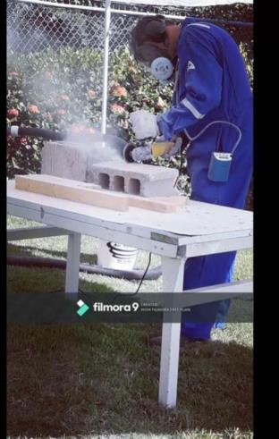
Exercise 3: Respirator selection
Situation #3
A construction worker is assigned to cut a portion of a cement block. Among the personal protective equipment provided by the employer, the worker wears a full-face respirator with particulate air filter. He used a cement cutter without guards to perform the task. Will the full-face respirator provide the proper protection required for this task?
Photo credit by: S Caporali, University of Puerto Rico, Medical Sciences Campus
Trainer’s Guide for the Instructor
Notes:
Situation oriented towards the construction industry
It raises the situation of the selection of equipment based on custom (for a lot of dust-use a full face).
In this case the task involves silica exposure, so they must refer to the silica regulations 29CFR1926.1153 in order to make the appropriate selection using Table I as a reference.

Slide 18
Instructor:
Date:
Location:
Time:
Trainer’s Guide for the Instructor
Notes:
To make it easier to fill out the Evaluation Sheet, the header information is projected onto the board. Here's an example.

