Slide 1
BPSOS Employer training Program:
Nail salon Health & Safety of Vietnamese Workers and Employers
This material was produced under grant number SH-05066-SH8 from the Occupational Safety and Health Administration, US Department of Labor. It does not necessarily reflect the views or policies of the US Department of Labor, nor does mention of trade names, commercial products, or organizations imply endorsement by the US Government.
Welcome!
Notes:
Say: Welcome everyone to the BPSOS-OSHA Trainer Program for Nail Salon Safety Training.
We are here today to talk about improving the healthy & safety of Vietnamese nail salon workers and employers. Let’s start off by going over the agenda for these next 2 days.

Slide 2

Activity: what do we have in common?
Introductions
Everyone stand in a circle.
Listen to the instructions read by the trainer.
Based on the instructions, find one or more people that share the common quality with you and introduce yourself:
        Your name
        Your hometown
        What organization are you working for?
        Get to know each other until the next instruction is called out
Notes:
Process: Change slide to “Icebreaker Introductions.” Introduce the “Find In Common” icebreaker. Have everyone move and stand in a space where groups can gather. Allow 3 minutes after each direction is called out.
Say: We will start by introducing ourselves in a quick icebreaker. Please stand up and form a circle in the space outside of our conference room. I will call out directions like “Find someone who is the same Chinese zodiac as you,” and you will have to gather in a team of one or more who have that thing in common with you. Then, introduce yourself, share where you’re from and what organization you’re in. Let’s start. Find someone who is the same Chinese zodiac as you. *Wait 3 minutes* Find someone who was born in the same month as you. *Wait* Find someone who grew up in a city close to where you grew up. *Wait*
Transition: Okay, now that we’ve all met each other, let’s head back into the room and start our training by going over the agenda for these next 2 days.
Come up and draw on the map (of Vietnam) where you are from...
What was your favorite food to eat growing up?
How did you come to the US? How did you feel getting used to living in the US?
What was difficult? What did you enjoy? What experiences do you have with nail salon workers/employees?

Slide 3
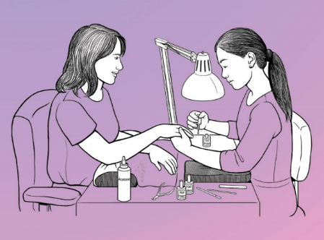
Agenda Day 1
Introduction/Icebreaker
Objectives
Pre-Test Survey
I: Why are we doing this training?
Lunch
II: What are the hazards in nail salons?
III: What can you do to prevent hazards from affecting you?
Notes:
Say: On your agenda, you will see our schedule for the program. For Day 1, our agenda includes reviewing objectives, doing a pre-test survey, and the first 3 components of safety training: 1. Why are we doing this training? 2. What are the hazards in nail salons? 3. What can you do to prevent hazards from affecting you?

Slide 4
Agenda Day 2
O ccupational
S afety and
H ealth
A dministration
IV: How can OSHA help you?
V: How will we support employees?
Lunch
VI: Review & Practice
Post-Test Survey
Conclusion
Notes:
Say: For Day 2, our agenda includes the other 3 components: 1. How can OSHA help you? 2. How will we do outreach? 3. Review & Practice. Then we will finish with a post-test survey, and a conclusion. Lunch will be provided at 12 pm- 1 pm on both days. Bathrooms are across from the elevators and please make sure that your phones are on vibrate. Other than that, we’re ready to start our training.
Thank: Thank you all for coming. I understand that this training is a bit long and most of you have never had a reason to study nail salon safety before. But we really appreciate all of you for taking the time. Maybe some of us have family or friends who do nails, which work long hours around all kinds of hazards. All of you showing up today means that we all care and we want to make sure that the nail salon workers in our community are healthy and safe every day. We’re really excited to help you learn some techniques that will make you feel confident in reaching out to the community.
Transition: Now let’s go over objectives.

Slide 5

Objectives
By the end of this course, you should be able to understand:
The hazards in nail salons
What workers can do to protect themselves
How OSHA can help workers and employers
How to support workers
Notes:
Say: This training will be very hands on. Every topic we learn about, we will have practiced ourselves and be familiar with before going out to the community. By the end of this course, you should be able to understand:
What the hazards in nail salons are
What you can do to prevent them from affecting you
How you can use OSHA to help you
How to do outreach
Transition: Onto the pre-test survey.

Slide 6
Pre-Test Survey
Notes:
Process: Click to “Pre-test” slide. Pass out and explain pre-test surveys. Collect when they are done.
Say: We will now take a pre-test survey to see what you know, how you feel, and what you can do about nail safety . It is multiple-choice and should take 10 minutes. If you don’t know the answer, just fill out what you think the answer might be.
Transition: Thanks, everyone. Let’s move on to the next topic: why are we doing this training?
make sure survey has questions on knowledge, attitude, and perceived skills

Slide 7
1. Why are we doing this training?
    71,746 nail salon workers are first-generation Vietnamese Americans
    69% of Californian nail salon workers
    Better education and practical use of safe practices in the Vietnamese community are needed
Notes:
Say: There are more than 375,000 nail technicians working in the United States who are exposed to health hazards every day, like:
Exposure to chemicals. These can be found in glues, polishes, removers, and other products.
Ergonomic strains, which affect the muscle, joints, etc... Many nail techs slouch over the client’s hand or feet to see better or they do repetitive motions like filing nails.
Risk of infection. Many nail techs touch their clients without gloves, masks, or other protective gear. If there is blood or body fluid, that is a hazard.
Transition: Before we cover each of these hazards, we need to talk about the organizations we will be representing

Slide 8
I. Why are we doing this training?
OSHA (Occupational Safety and Health Administration)
Federal department
Ensures worker safety & health
BPSOS-CCA
Since 1980
Serves Orange County
ESL/Citizenship/Children with disabilities/Workplace safety
Notes:
Process: change slide to “1. Why are we doing this training?”
Say: To respond to the problem of worker safety, BPSOS is working with OSHA to talk about how we can improve the health of our community’s nail workers. To introduce OSHA, OSHA stands for:
-Occupational
-Safety and
-Health
-Administration
Say: It is a federal department whose job is to make sure that workers are safe and healthy in their workplace. They have been trying to reach Vietnamese people in the nail industry but because of barriers like language and culture, they have been funding us through the Harwood Grant Program to reach them. The Susan Harwood Training Grants target groups who are under-served, have low-English literacy, and work in high-hazard industries.
Say: To introduce ourselves, BPSOS is a nonprofit organization that serves the needs of the community in Orange County. We work with mostly Vietnamese Americans and have been since 1980. We provide services like:
-ESL and Citizenship classes
-Support for Children with Disabilities
-and now Nail Salon safety training
Say: We also have many students and staff who are either working or who are connected to nail workers.

Slide 9
2: What are the hazards in nail salons?
Notes:
Transition: Now that we’ve covered who is funding and organizing the program, let’s start with the actual training material: the 3 kinds of hazards that can be found in a nail salon.

Slide 10
2A. Chemical Hazards
Nail polish, nail polish remover, acrylic nail liquid, nail glue remover:
Irritate mouth/throat/lungs
Irritate skin/eyes
Cause asthma/fainting/nausea
Kidney/liver damage or pregnancy complications
Notes:
Say: The first type of hazard is chemical:
Nail polish, nail polish remover, acrylic nail liquid, nail glue remover all can:
Irritate mouth, throat, and lungs if they accidentally touch food or cigarettes or if they are inhaled
Irritate skin or eyes
Or cause asthma, fainting, or nausea
Some people may say that they’re used to the smell or they can’t smell anything from the chemicals they use. This does not mean that they are harmless. You still need to protect yourself. These products can also cause long-term problems like:
damage to your liver/kidney or pregnancy complications.

Slide 11
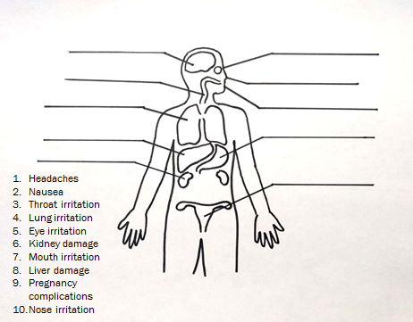
2B: Match the Symptom to the Body Part Activity
Notes:
Do activity sheet: Match the health symptom to the body part
Say: The correct answers going from the head-down are:
Brain: Headaches
Eye: Eye irritation
Nose: Nose irritation
Mouth: Mouth irritation
Throat: Throat irritation
Lung: Lung irritation
Liver: Liver damage
Stomach: Nausea
Kidney: Kidney damage
Uterus: Pregnancy complications

Slide 12

2C: Chemicals to avoid
The “Toxic Trio”
    Dibutyl Phthalate (nail polish): liver/kidney damage, pregnancy complications
    Formaldehyde (nail polish): cancer
    Toluene (nail polish, nail glue): liver/kidney damage, pregnancy complications
Notes:
Say: There are three chemicals in particular that are called “The Toxic Trio”. These are:
-Dibutyl Phthalate (polish): liver/kidney damage, pregnancy complications
-Formaldehyde (Nail polish): cancer
-Toluene (polish, nail glue): liver/kidney damage, pregnancy complications
Say: Avoid products that have any of these chemicals. They will be labelled as “three-free”. However, research on “three-free” chemicals found that chemicals used to replace the toxic trio might still be hazardous. We are still waiting on more research on these other chemicals. But for now, we know for sure that dibutyl phthalate, formaldehyde, and toluene are dangerous.

Slide 13
2C: Chemicals to avoid
  The Other Toxic Four:
    Ethyl methacrylate *EMA* (acrylic nail liquid): pregnancy complications
    Formalin:(nail hardener): breathing problems, cancer
    Methyl methacrylate *MMA* (nail primer): breathing problems
    Titanium dioxide (nail polish, artificial nail powder): lung fibrosis, cancer
Notes:
Process: Review “Chemical cheat sheet” business card
Say: We will be handing out these business cards to nail workers so that they can keep it in their wallet anytime they go shopping for nail products. It will be a reminder of what chemicals to avoid.
-Toxic trio (dibutyl phthalates, toluene and formaldehyde)
-Ethyl methacrylate (EMA) (acrylic nail liquid) pregnancy complication
-Formalin: (nail hardener) breathing problems, cancer
-Methyl methacrylate (MMA) (nail primer) breathing problems
-Titanium dioxide: (nail polish, artificial nail powder) lung fibrosis, cancer

Slide 14
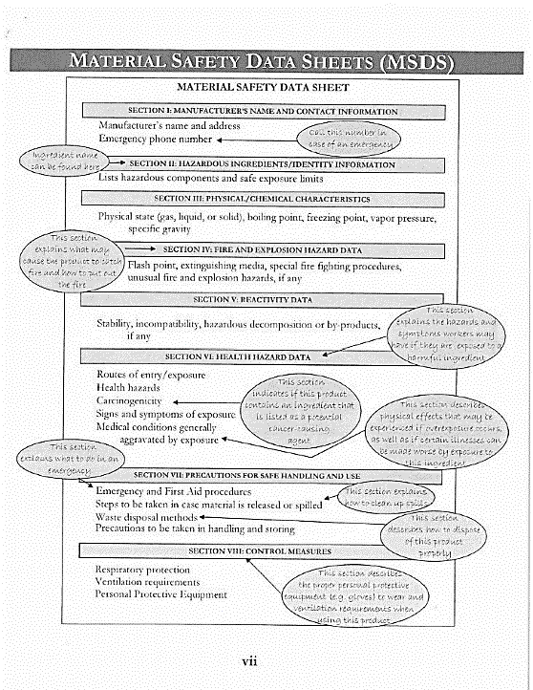
SDS Example
Notes:
Process: Review a sample Safety Data Sheet (SDS)
Say: Every salon is required to have a folder or binder of Safety Data Sheets for each chemical product in the salon. They are meant to tell the nail workers:
-What the product is called
-How to properly store the chemical
-How to use the product
-How to clean it up if it spills accidentally
-What equipment you should use in handling it
-How you should dispose it
-What hazards it has that might affect you
-What you should if you are exposed to the chemical

Slide 15
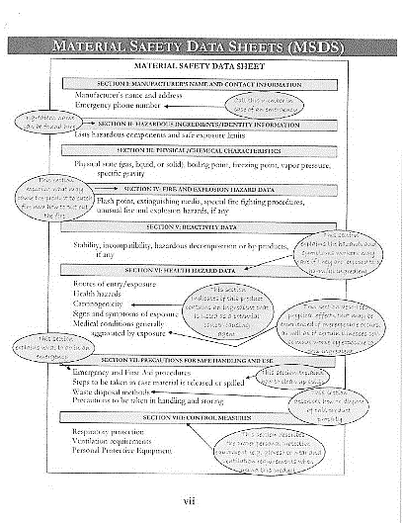
2D: Safety Data Sheets (SDS)
    Most important:
    How to clean it up if it spills accidentally
    What equipment you should use in handling it
    What you should if you are exposed to the chemical
Notes:
Say: But not many nail techs have the time to read all these details.
Usually, they learn the information on how to handle chemicals from their time in beauty school or from people they work with.
How we can make SDSs easy to understand is to encourage workers to read 3 main points:
How to clean it up if it spills accidentally
What equipment you should use in handling it
What you should if you are exposed to the chemical
Transition: Now that we have covered the chemical hazards, we will talk about what you can do to prevent them from affecting you.

Slide 16

2E: “Safe Nail Salons”
Protecting skin, preventing chemical ingestion, and proper storage
Ventilation and Protective Masks
  Play “Mỹ Viện Làm Móng An Toàn (Safe Nail Salons Pt. 1)”
  video 4:50-7:27 (2 mins, 37 secs)
https://www.youtube.com/watch?v=PksAPhmm15M&t=368s
  Play “Mỹ Viện Làm Móng An Toàn (Safe Nail Salons Pt. 1)”
  video 0:27-2:10 (1 min, 47 secs)
  https://www.youtube.com/watch?v=XBLbKfbLQ2w
Notes:
Process:
play “Mỹ Viện Làm Móng An Toàn (Safe Nail Salons Pt. 1)” video 4:50-7:27 (2 mins, 37 secs)
https://www.youtube.com/watch?v=PksAPhmm15M&t=368s
play “Mỹ Viện Làm Móng An Toàn (Safe Nail Salons Pt. 1)” video 0:27-2:10 (1 min, 47 secs)
https://www.youtube.com/watch?v=XBLbKfbLQ2w
Say: Now we are going to watch 2 videos about 1) Ventilation and Protective Masks and 2) Protecting skin, preventing chemical ingestion, and proper storage.
Transition: The video didn’t mention this but glasses can protect your eyes from chemicals and nail clippings. Now that we’ve seen an introduction of ways to protect yourself, let’s go more in detail.

Slide 17
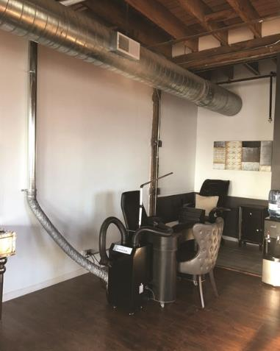
2E: Ventilation
    Equipment
    Use ventilated tables and ventilation machines
    Keep exhaust fans on
    Keep the HVAC (Heating, Ventilation, Air Conditioning) system on
Notes:
Process: Change slide to “Ventilation”:
Say: Who here works ten hours a week? Twenty? Thirty? Forty? More than forty? That’s a lot of time to spend in a salon working with chemicals all day. There are 2 ways to protect yourself from breathing in chemical vapors and dust. The first is to increase ventilation:
1) Ventilation
-Process: change slide to “Ventilation”
-Say: Ventilation is the best way to remove chemicals from the air. There are two ways you can do this. One way is more expensive. For example:
-If the salon has ventilated tables, make sure they are turned on or consider using portable ventilation machines.
-Always keep the nail salon's exhaust system on.
If your salon does not have an exhaust system, always keep the heating, ventilation, and air conditioning (or HVAC) system on during work hours.

Slide 18

2E: Ventilation
Practices
Tightly close chemical and nail polish bottles
Open doors and windows
Place fans on one end of the salon to push air to the other side
Take a break outside
Notes:
Say: There’s also the more affordable way.
-Tightly close nail polish/chemical bottles
-Open doors and windows.
-If the weather is too cold to leave both front and rear doors open, you should use the HVAC system.
-Place fans near open doors or windows. Fans should pull air in one end of the salon and push it out of the other end.
-You can also take breaks outside whenever you have the chance.

Slide 19
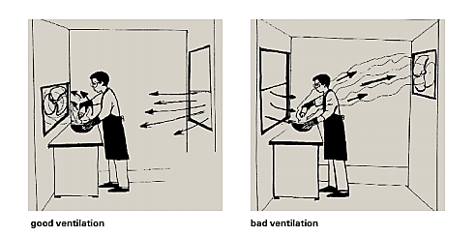
2E: How to control exposure to chemicals
Notes:
Process: Ask for a volunteer.
Say:
Can someone point out the difference between the ventilation between these two images? Take a look at where the worker, fan, and window is.
Correct Answer: In the bad ventilation example, the wind from the window is blowing the chemical vapor into the worker’s face. In the good ventilation example, the wind is blowing the vapors away from the worker. If you are refilling chemicals, make sure that the air flow/wind is blowing the chemical away from you, not towards your face.

Slide 20
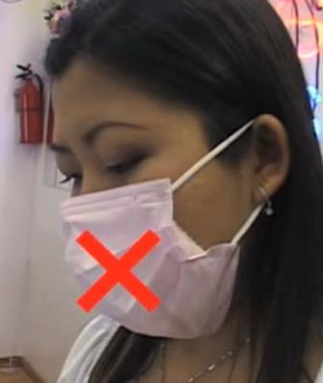
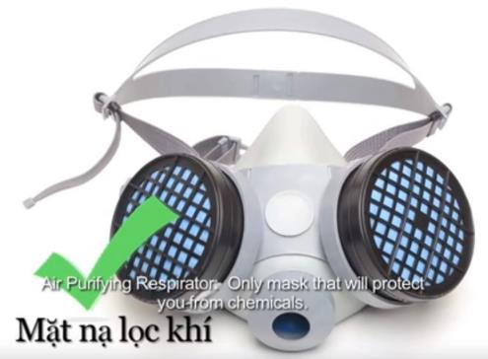
2F: which Mask to wear?
Notes:
Process: Bring 1 paper mask, 1 folded paper towel, and N-95 masks to show as examples
Say: By a show of hands, please raise your hands if you have used some the masks I’m about to show you. Who has used a paper mask? Who has used a paper mask with a piece of tissue inside? What about an N-95 mask? And what about a half-face respirator?
The most affordable and common mask that nail technicians wear is the paper mask. Some nail techs may put a tissue or paper towel in a paper mask. However, dust and chemicals are very small and can sneak in the little gaps in the mask.
On the other hand, the only mask that can protect from both dust and chemicals is a half-face respirator. These masks can be a bit expensive so this is what we think is the best option.

Slide 21
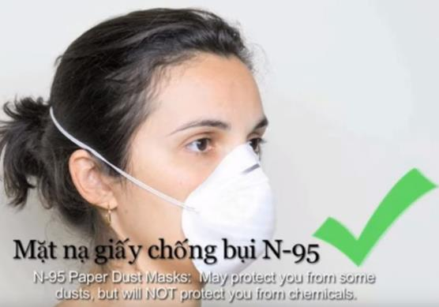
2F: which Mask to wear? Cont.
Great for:
Filing nails
Shaping artificial nails
Reusable
N95 + Good Ventilation = Prevents Chemical Inhalation
Notes:
Wear a N-95 mask when filing and shaping nails (when dust is coming up). To deal with chemicals, ventilate the salon while wearing a N-95 mask. You can reuse them until they’re dirty or if you have trouble breathing.
Your employer should provide you with N-95 masks. But if you are an independent nail worker, you may have to buy them for yourself.

Slide 22
2F: How to wear a N-95 Mask
Show Video
https://www.youtube.com/watch?v=bo-PEzHE7iw
Notes:
https://www.youtube.com/watch?v=bo-PEzHE7iw
Process: show video on how to wear an N-95 mask. Pass out N-95 masks. Have each participant try on a mask.

Slide 23
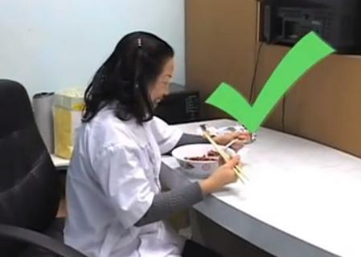
2G: Ingestion
    Chemicals can contaminate food, drinks, and loose cigarettes.
    Avoid leaving food, drinks, and cigarettes near the chemicals/ working space
      Ex. Eating lunch next to a working coworker
    Instead… kitchen & outside area
Notes:
-Chemicals can contaminate food and loose cigarettes. Eating food or smoking cigarettes that are contaminated will cause chemicals to enter your body through ingestion.
-Avoid having food or cigarettes be near the chemicals/ working space
-Even eating lunch next to a coworker while they are working can expose your food to chemicals and dust.
-Instead… eat in the kitchen area or outside

Slide 24
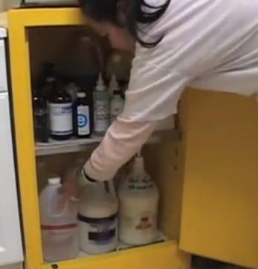
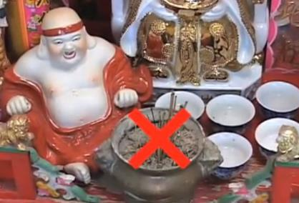
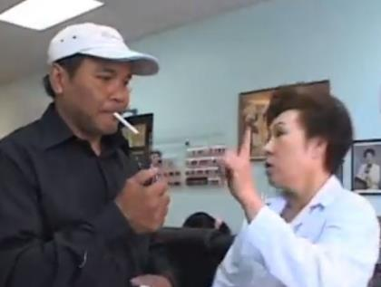

2F: Fire Safety
Notes:
Say: Fire safety is another important way that chemicals can affect you, your clientele, and the salon building itself. A salon with bad ventilation combined with chemical vapors in the air can lead to a serious risk for fire. A minor source of fire, like a stick of incense or a lit cigarette can lead to fire in your workplace.
This is why we need to store chemicals in a secure place that has signs telling people that the storage area is flammable. Do not allow smoking or lighting incense in the salon. It could spark a fire that could burn yourself, clients, workers, and the salon building.
If you must have an incense stick for good luck, *transition to next slide*

Slide 25
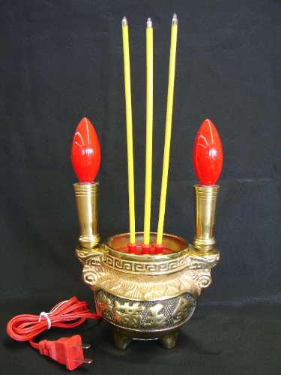

2F: Fire Safety
Notes:
If you have to have an incense stick for good luck, *transition to next slide*
You can buy these off of Amazon or Ebay on the internet.

Slide 26


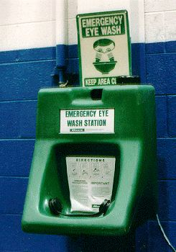
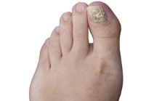
2G: Direct Contact to Eyes
Situations
      Accidentally rubbing eyes with contaminated gloves
      Chemical splashing from bottle or brush
      Nail clippings
Equipment:
      Eye wash stations
      Protective glasses
    Practices
      Wash hands before touching face
Notes:
-There are ways that chemicals can make contact with your eyes. You could accidentally rub your eyes, a brush or bottle might splash chemicals, a nail clipping can fly towards your eye.
-So to avoid this from happening, there are 3 ways to protect your eyes. One is a bit more expensive, the other is less expensive. One has no cost at all.
-The first is to have an eye wash station installed in the salon. What it does is that it sprays water into your eyes to get rid of the chemicals that is irritating your eyes.
-The other cheaper option is wearing protective goggles will protect your eyes from chemicals splashing or nail clippings from flinging into your eyes. Your employer should provide these to you, unless you are an independent contractor. Goggles are the more affordable option that can guarantee your eye safety.
-You can also make it a habit to wash your hands before touching your eyes.

Slide 27
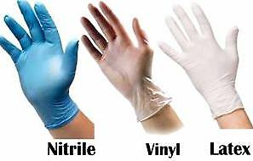
Direct Contact to Skin
    Situations
      Vapor evaporation on face
      Touching chemicals with hands/arms
  Solutions:
      Long sleeve shirts/ pants that cover lap
      Gloves
Notes:
-Something you might see in a salon is a nail tech leaning over a client’s hand or foot, polishing very carefully. However, there are vapors that will evaporate on the skin of your face. One way to protect your skin is to sit straight up away from the chemicals while you’re working with a client. Adjust lighting to see better.
-Your arms and thighs can also be places where chemicals might make contact with skin. Wearing long-sleeve shirts and pants that cover up to the knees will also protect you from chemicals spilling on your arms and lap.
-Another scenario is someone refilling bottles of chemicals while standing over the two bottles. They should actually stand away from the bottles, wear a N-95 mask, and wear the right type of gloves.
-When it comes to gloves, let’s take a quick vote.
-Gloves:
-Process: Bring a pair of latex, vinyl, and nitrile gloves.
-Say: Can somebody choose the correct material gloves?
-Latex: The problem with latex is that clients can have be allergic to latex. and they won’t protect you from chemicals
-Vinyl: also won’t protect you from chemicals, and may actually absorb chemicals that are in disinfectants.
Nitrile: are the best for using on clients and filling up chemicals because they don’t cause allergic reactions and will protect your skin.

Slide 28
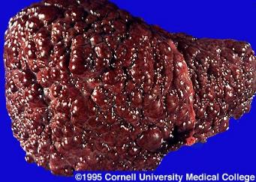
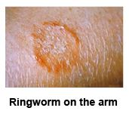
Infection Hazards
Situations
      Client’s blood/body fluid contacts open cut
      Client’s skin makes contact to your skin
      Nail tools and supplies are used on Client A with infection and reused for Client B
Viral (blood/body fluid) & fungal (skin) infections
      Can be transmitted to spouses, other clients, & children at birth
Notes:
-Say: The second kind of hazard happens through viruses and fungal infections that can transfer through blood or skin contact. Some situations that might spread infections include:
A client’s blood/body fluid making contact with your open cut
A client’s skin makes contact with your skin
Nail tools and supplies are used on Client A with infection and reused for Client B
-Viral infections are spread through blood or body fluids, meaning they can be spread through sex with a partner or from mother to child in birth and breastfeeding.
-Fungal infections like ringworm, which is also called “athlete’s foot”, can be spread through skin contact when massaging a client’s foot, legs, or arms. Also, it is contagious to others you touch like other clients, your family, and friends.

Slide 29
Infection Hazards
Viral | Fungal
Hepatitis B (liver scarring/cancer) | Ringworm / “athlete’s foot”
Hepatitis C (liver scarring/cancer)
HIV -> AIDS (weakened immune system)
Notes:
-Say: Bloodborne diseases include hepatitis B, hepatitis C, and HIV. These can start with contact with blood/body fluid at work and can be contagious through sex with a partner or birth/breastfeeding from mother to child:
-A hepatitis B infection can cause serious damage to your liver, such as scarring and cancer.
-A hepatitis C infection can cause similar damage to your liver and there is no vaccine that can protect you from Hep C.
-HIV is another disease you could contract that attacks your immune system and leads to AIDS.
-Most nail technicians think that these infections might never happen to them but it only needs a moment (a client’s blood/body fluid gets into your open cut or you’re massaging their skin without gloves) to transfer these diseases.

Slide 30
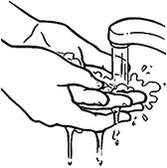
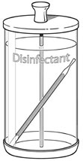
Avoid being exposed to infection
Get vaccinated for Hep B
Wash hands, bandage, and wear gloves before and after every client
Check for visible wounds
      If visible, ask client to return after healing
No sharp tools for calluses / non-cuticle skin
Do not touch blood/body fluid/skin without gloves
      Provide cotton ball/bandages and ask client to handle their wound and trash
Disinfect tools and supplies after every client
Notes:
-To avoid being exposed to viruses that can transferred through blood/body fluid and fungal infections spread through skin contact:
-There is a vaccine for Hepatitis B, so immunize yourself
-Wash hands with soap and hot water before and after every client
-Bandage any of your own open cuts and wear gloves
-Check the client’s nails and skin do not have any visible infections. If you can see an infection, ask them to come back when their wound has healed. If not visible, here are some things you can do to protect yourself from infection
-Do not use sharp tools to remove calluses or remove skin (besides cuticles)
-Do not touch blood or body fluid. Ask the client to use a cotton ball or tissue to stop the bleeding/fluid and to throw their trash into the trash can
-Clean and disinfect used tools, foot basins, and spas after every client

Slide 31
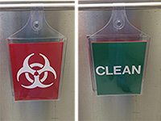
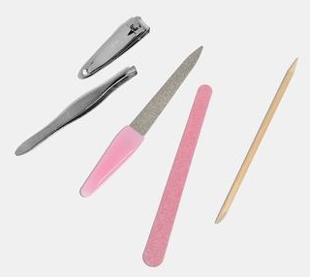
Disinfecting Tools
  Put a plastic bag in the foot basin before filling with water and soap
    Easy disposal
  After using tools, place them into a container labelled “Dirty” or “Contaminated”
  Scrub tools with soap and hot water.
  Immerse them in disinfectant for 10-30 minutes.
  After cleaning, place tools into a container labelled “Clean” or “Disinfected”
    Frequently disinfect your “Clean” container
  Change into a new pair of gloves
    Consider getting a second set of tools
Notes:
Say: Everyone has different ways of cleaning their tools and equipment. However this is the safest way to do so:
-Store all soiled non-electrical items (example: combs, brushes, nail clippers, buffers, nail files, drill pieces) in a container that which is labeled "Dirty", "Soiled", OR "Contaminated".
-Scrub tools with soap and hot water. Then immerse them in a disinfectant for 10-30 minutes.
-Always keep disinfectant solution covered and change disinfectant when it is cloudy or contains debris.
-Once clean, store all disinfected non-electrical items in a clean covered container which is labeled "Clean" or "Disinfected".
-Frequently disinfect your “Clean/Disinfected” container.
-Change into a new pair of gloves for your next client.
-If you have back-to-back clients, consider getting a second set of tools to use while the other set is being disinfected.

Slide 32
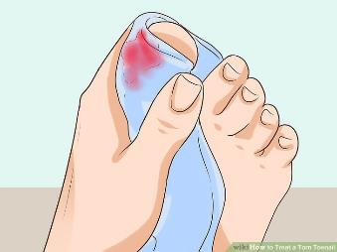
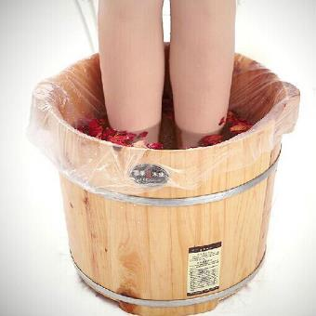
Role Play
  You are cutting a client’s toe cuticles and you accidentally make them bleed. While you are getting a band-aid, you notice that they put their foot back in the foot basin. You have another client waiting after.
  What should you do?
Notes:
You are cutting a client’s toe cuticles and you make a mistake. You accidentally make them bleed. While you are getting a band-aid, you notice that they put their foot back in the foot basin. You have another client waiting after. What do you do?
Ask for volunteers to say the different steps. Write them on a whiteboard/poster board.

Slide 33
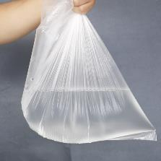
Role Play
  What should you do?
  Give them a cotton ball/tissue to stop the bleeding
  Let them throw the trash into trash can
  Give them a band-aid
  Scrub your tools with soap and hot water and soak in disinfectant for 10 minutes
  To keep your polish clean, skip the band-aided toe
  Dispose of the foot basin plastic bag
  Wash your hands and change into a new pair of nitrile gloves
Notes:
Give them a cotton ball/tissue to stop the bleeding
Let them throw the trash into trash can
Give them a band-aid
Scrub your tools with soap and hot water and soak in disinfectant for 10 minutes so that you can use your tools for the next client.
In the meantime, continue the pedicure.
To keep your polish clean, skip the band-aided toe
Dispose of the foot basin plastic bag
Wash your hands and change into a new pair of nitrile gloves
Now that we have discussed safe practices for infection hazards, let’s move onto ergonomic hazards.

Slide 34
Ergonomic Hazards
  Nail techs can develop injury to muscles, bones, joints, nerves, etc. by:
    Leaning over a table for a long time
    Doing repetitive movements like filing nails
    Resting their arms on the hard edge of a table
Notes:
Process: Change slide to “Ergonomic hazards”
Say: A very common health hazard is ergonomic, meaning pain to your muscles, bones, joints, ligaments, tendons, and nerves. This happens when you:
-Lean over a work table for a long time
-Do repetitive movements like filing and buffing nails
-Rest your hands, wrists, and forearms and/or elbows against hard surfaces or sharp edges of work tables.
Say: These aches and pains can be a part of your everyday life if you don’t do exercises to help reduce that pain.
Activity: Quick raise of hands to show what pain you feel
-Back pain
-Neck pain
-Pain in the hands and wrists
-Pain in forearm and elbows
-Muscle/ joint pain

Slide 35
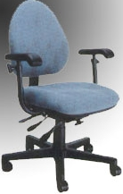
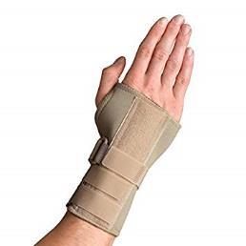
Reducing Ergonomic pain
Back pain: adjustable chair
Neck pain: Adjust the lighting and client
Wrist pain: wrist support
Forearms/elbows: Use a towel as cushion on the table
Muscle/joint pain: stretching, taking breaks
Notes:
To reduce stress in your body:
-Back pain: Use an adjustable chair that supports your back & stretching
-Neck pain: Use a bright light and bring the client’s hand or foot closer to see better
-Hand & wrist pain: stretch hand/wrists & wrist support
-Pain in forearms and elbows: Put a soft cushion like a towel between your arms and the table
-Muscle/joint pain: Take breaks between clients to stretch, pace the work, take frequent breaks, or do a different task.

Slide 36





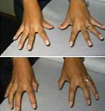
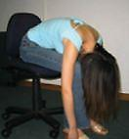
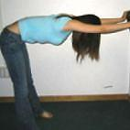
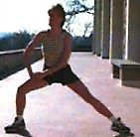
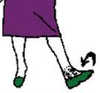
Activity
Notes:
Activity: Let’s practice some of these exercises.
Do: Neck, Shoulder, Upper back, *extend and bend* Elbow, *roll* Wrist, Hand, Lower back and Hip, Back of Legs, Inner thighs, Ankle exercises

Slide 37
Review of Hazards: Chemical, Infection, Ergonomic
Notes:
Transition:
I understand that a lot of the time at work, we believe that these serious work injuries won’t happen to us or maybe we just want to save time, which is precious in the nail industry.
Time is money.
However, if you develop a chronic illness, infection, or pain, that will be the biggest barrier to doing your work. All of these hazards happen over a long period of time, meaning you want to prevent something from growing rather than treating an illness for the rest of your life.
Some of these hazards are especially important to protect yourself because they may affect your other clients, spouse, or children if the hazard is infectious. But ultimately, your health and safety are #1 priority.

Slide 38
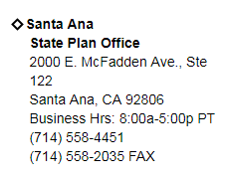
Help from OSHA
Contact local OSHA offices for information, training, and help
Workers: you may file a complaint for an OSHA inspections if you think your employer is not following OSHA standards or if your workplace has hazards
Owners: contact private OSHA’s Consultation Program for free to find out if your salon has hazards. You will not be cited or penalized.
Notes:
-Contact local OSHA offices for information, training, and help
Address: 2000 E. McFadden Ave, Suite 122, Santa Ana, CA 92806.
Business Hours: 8 AM – 5 PM
Phone: (714) 558-4451
Fax: (714) 558-2035
-Workers: you may file a complaint for an OSHA inspections if you think your employer is not following OSHA standards or if your workplace has hazards
-Owners: contact private OSHA’s Consultation Program for free to find out if your salon has hazards. You will not be cited or penalized.

Slide 39
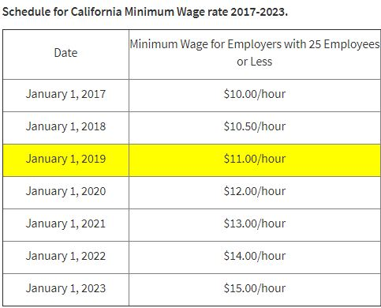
Employees vs. Independent Contractors
Employees:
Employer sets work schedule/appointments
Employer sets pay rate for services
Employer provides supplies & equipment
Employer has to protect workers from workplace hazards
Entitled to minimum wage and workers’ compensation (injury insurance)
No rent for work station
W-2 Form
Notes:
Employee:
-Your work schedule is set by the owner
-Paid by the hour
-Owner/receptionist makes your appointments
-You don’t pay rent for the space
-The owner sets the pay rate for your services
-The owner provides your tools and equipment
-You have a minimum wage and workers’ compensation (injury insurance)
-The owner has to protect you from workplace hazards

Slide 40

Employees vs. Independent Contractors cont.
Independent Contractors:
  Have your own business license
  Rent their station
  Buy their own supplies and tools
  Have your own customers
  Set your own schedule & appointments
  Set your own pay rate
  Receive clients’ payments directly
  IRS Form 1099
  IRS Form 1044 C/ 1044 C-EZ
Notes:
-Independent Contractors:
-Rent their station
-Buy their own supplies and tools
-Have your own customers
-Set your own schedule & appointments
-Set your own pay rate
-Receive clients’ payments directly
-Have your own business license

Slide 41

Employees vs. Independent Contractors
  If your employee is a payrolled employee, what should you provide for them?
    What is their responsibility?
  If your employee is an independent contractor, what should you provide for them?
    What is their responsibility?
Notes:
Be wary of being misclassified:
-If your employer gives you IRS Form 1099, instead of a W-2, does that mean you are an independent contractor?
-No.
-If your employer tells you that you are an independent contractor, does that mean you are an independent contractor?
-No.
Use the checklist attached to your binder to see which kind of worker you are.

Slide 42
Employees vs. Independent Contractors - continued
  If your employer gives you IRS Form 1099, instead of a W-2, does that mean you are an independent contractor?
  If your employer tells you that you are an independent contractor, does that mean you are an independent contractor?
Notes:
Be wary of being misclassified:
-If your employer gives you IRS Form 1099, instead of a W-2, does that mean you are an independent contractor?
-No.
-If your employer tells you that you are an independent contractor, does that mean you are an independent contractor?
-No.
Use the checklist attached to your binder to see which kind of worker you are.

Slide 43
Role Play cont.
Group 1:
  Dung just finished beauty school. She was hired in a nail salon and her employer charges her $80 per week for the table. Her employer tells her to buy her tools and start inviting new clients in. Her employer does not mention any safety training or provide safety equipment.
  Is Dung an employee or independent contractor?
Group 2:
  You are an employee in a salon. You and your coworkers are frequently getting headaches from the chemical fumes. Your daughter, who has asthma, often needs to use her inhaler while she waits for you to finish work. There are no fans in the salon and the HVAC system is broken.
  Do you have the right to ask your employer to bring fans into the salon?
    Group 3:
  You are the employer of a salon. Business is slow because customers have complained about the unsafe conditions of the salon. However you are unsure of what workplace hazards are.
  What can you do?
Notes:
Process: Break the group into 3 groups. Place the groups in three parts of the room.
Say: Now we are going to break into 3 groups. We are going to count ourselves off from 1 through 3. 1’s meet in the front, 2’s meet in the middle, 3’s meet in the back.

Slide 44
Role Play (cont)
Group 1:
  Dung just finished beauty school. She was hired in a nail salon and her employer charges her $80 per week for the table. Her employer tells her to buy her tools and start inviting new clients in. Her employer does not mention any safety training or provide safety equipment.
  Is Dung an employee or independent contractor?
  Independent contractor
Group 2:
  You are an employee in a salon. You and your coworkers are frequently getting headaches from the chemical fumes. Your daughter, who has asthma, often needs to use her inhaler while she waits for you to finish work. There are no fans in the salon and the HVAC system is broken.
  Do you have the right to ask your employer to bring fans into the salon?
  Yes. Employers are required to protect their employees from workplace hazards, such as poor ventilation.

Slide 45
Role Play *Bonus Question*
Group 2:
  Do you have the right to ask your employer to bring fans into the salon?
  Yes. Employers are required to protect their employees from workplace hazards, such as poor ventilation.
  Your employer ignores your request and suggests you bring a small personal fan.
  What can you do?
    You can inform them that a larger fan is needed to blow one side of the salon to the other to improve ventilation.
    Since your employer is not following OSHA standards, you can also file a complaint for an OSHA inspection.

Slide 46
Role Play group 3
    Group 3:
  You are the employer of a salon. Business is slow because customers have complained about the unsafe conditions of the salon. However you are unsure of what workplace hazards are.
  What can you do?
  You can call the local Santa Ana OSHA office for a free and private consultation. You will not be cited or penalized.

Slide 47

Review of Osha help for workers and employers
Notes:
Say:
There is a local OSHA office in Santa Ana on McFadden between Grand Ave & the Southbound 55 freeway.
You now know the difference between independent contractors and employees.
You also know how OSHA can serve you, as a worker and an employer.

Slide 48

Community Outreach and Relationship-Building
  Start every encounter with a friendly face
  Be willing to help
  Be well-versed in your training
  Ask the team if you are stuck
Notes:
This section is about reaching out to the community. Some people we meet will be familiar faces and others, we will be meeting for the first time.
To begin building these relationships, there are 4 base things to cover:
-Start every encounter with a friendly face
-Be willing to help
-Know your training well
-Ask the team if you are stuck
This section is very important so you will be receiving feedback on the activities we do together.
There are certain methods and techniques you will need to teach adults. First we need to understand how adult learners are thinking.

Slide 49

Adult Learning Principles
1. Mature self-concept
      Understanding of self
      Treat them as an equal
      Step into their world
  2. Experience-oriented
      Relevant to their needs
      Ask about their experience
  3. Goal-oriented
      Clearly state goals
  4. Problem-centered
      How can we solve their problems?
      Give useful tips
  5.Self-directed
      Engage them in conversation
      Allow them to choose what they want to learn
Notes:
Mature self-concept: Having a mature self-concept means that adult students have a solid understanding of who they are, much more than a student in high school for example. Treat the participant as an equal you are collaborating with, rather than a student who is learning from you. Especially since we are working with Vietnamese culture, where people really consider age groups, it is important to understand that these workers are in their 40s to 60s. We are stepping into their world, they are not stepping into ours. We could prepare a really good, long one-sided lecture, but this method will not contribute to their learning experience. Work with them and build off of who they are.
Experience-oriented: make the training relevant to their needs. Our needs assessment tells us that there were very different answers in terms of what equipment people use on a daily basis and how safe they feel at their workplaces. This means that we need to clarify exactly what equipment and practices should be used on a daily basis so that they can feel confident about protecting their health. How we can assess their needs is to ask them frequently about their experiences. Shape the training based on their experience level to keep the training relevant.
Goal-Oriented: Adult learners are focused on goals. Make sure to outline what the point is. Explicitly saying goals and learning objectives will keep the trainees focused on the goal.
Problem-Centered: Adult students are dealing with problems they don’t know how to solve. This is where our training comes in. Focus on how you can provide solutions to their problems. This focus will keep their attention and be directly useful after they leave the interaction with you.
Self-directed: Adults want to direct themselves in what they are learning. Give the trainees a role in their own training. One way you can do this is having small group or one-on-one discussions to allow them to choose what they would like to learn more about.
In conclusion, here are a few ways you can engage adult learners:
-Treat the participant as an equal you are working with, rather than a student who is learning from you.
-Ask them frequently about their experiences and shape the training based on their experience level.
-Explicitly state and remind them of the goals and learning objectives.
-Focus on how you can provide solutions to their problems.
-Having a small group or one-on-one discussion to allow them to choose what they would like to learn more about

Slide 50
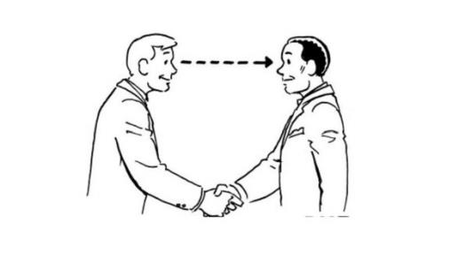

Body Language
Eye contact
Stand with confidence
Use the space
      *With permission*
Be calm, confident, and positive

Slide 51
Structuring the Conversation
Introduction
    Name & Organization
    Hook
Goals/Objectives
  Nail salon safety training
  Become a better decision-maker in your workplace
Benefits of training
  Have more control over health & safety
  Help others in our community
Risks of not learning
  Personal health & safety
  Health & safety of others
What is their experience?
  Ask them if they have any particular concerns in their workplace
What they can learn
How they will learn
  Facebook
  Viet-translated Materials
  BPSOS network & services
Review information & materials
Conclusion
  Questions?
  Thanks and contact information
Notes:
1. Introduction
-Name & Organization
-Hook
-Why should they trust us? Are we salespeople? No. We are a community organization that has been working with Vietnamese people in Orange County since 1980. We are also funded by OSHA, the federal government’s department for worker health & safety.
2. Goals/Objectives
-Nail salon safety training
-Become a better decision-maker in your workplace
3. Benefits of training
-Have more control over health & safety
-Help others in our community
4. Risks of not learning
-Personal health & safety
-Health & safety of others
5. What is their experience?
6. What they can still learn
7. How they will learn
-Facebook
-VN-translated Materials
-BPSOS network & services
8. Review information & materials
9. Conclusion
-Questions?
-Thanks and contact information

Slide 52
4 Barriers that you will face
Who will you be speaking with?
    Beauty school students?
    Nail salon owners?
      Will need more convincing
Time
    Work with their schedule
    Be concise
Legitimacy
    Vietnamese organization in Orange County since 1980
    Association with OSHA
Relevance
    Make it about community
    And their own personal health & safety!
    Other BPSOS services (ESL, Citizenship, etc.)
Notes:
Say:
There are 4 barriers you will have to overcome in doing outreach. The first is about who you are addressing. We will be going into both beauty schools and nail salons. Beauty school students will be relatively simple to address because they are in a learning environment. The difference between the two that we predict is that nail salon owners will need more convincing to engage in a conversation. Their focus is business and time, which is the next barrier.
Whether we go to a beauty school or salon, we must be considerate of the trainees’ time. Work with their schedule. Find out which day and time are they available. Secondly, be concise. You can do this by highlighting the important points that are relevant to them.
The third barrier is legitimacy. Why should they trust us? Are we salespeople? No. We are a community organization that has been working with Vietnamese people in Orange County since 1980. We are also affiliated with OSHA, the federal government’s department for worker health & safety.
The final barrier is relevance. The best way to keep their interest is to focus it on 3 things. Our training is about helping the community of nail workers and their families. We want to improve the lives of every individual nail worker that we can, meaning we care about them specifically! Also, we have other services like English Language classes, Citizenship classes, and in general are willing to help with anything else the community needs.
That is how you can overcome these barriers in doing outreach.

Slide 53
Activity: Structuring the Conversation
Introduction
    Name & Organization
    Hook
Goals/Objectives
  Nail salon safety training
  Become a better decision-maker in your workplace
Benefits of training
  Have more control over health & safety
  Help others in our community
Risks of not learning
  Personal health & safety
  Health & safety of others
What is their experience?
  Ask them if they have any particular concerns in their workplace
What they can learn
How they will learn
  Facebook
  Viet-translated Materials
  BPSOS network & services
Review information & materials
Conclusion
  Questions?
  Thanks and contact information
Notes:
Process: Ask trainers to partner with someone new.
Say: Now we are going to practice what we will say and do in our outreach. Take a few minutes to fill out your activity sheet. You will use your activity sheet to speak with the clients. Then you will partner with someone new to role play being the client and the trainer. After 10 minutes, we will switch roles.
After 10 minutes: now switch!

Slide 54
Share with a Partner & Hear their feedback
Greatest strengths?
What did you do very well?
Greatest weaknesses?
What did you struggle with?
How should you prepare to your needs for next time?
Notes:
Exercise: Self-Assessment
Say: For this portion, we want you to assess what you think are your greatest strengths and greatest weaknesses. Then ask your partner for what they noticed about your performance.
-What are your greatest strengths?
-What did you do very well? Write it down.
-Greatest weaknesses?
-What did you struggle with? Write it down.
-How should you prepare specific to your needs?

Slide 55
Review of Adult Learning
Treat the learner as an equal
Ask them about their experience
Clearly state learning goals
Focus on how you can solve their problems
Allow them to choose what they learn
  Structure your conversation to be concise
  Consider the 4 Barriers
  Prepare according to your needs
Notes:
In conclusion, here are a few ways you can engage adult learners:
-Treat the participant as an equal you are working with, rather than a student who is learning from you.
-Ask them frequently about their experiences and shape the training based on their experience level.
-Explicitly state and remind them of the goals and learning objectives.
-Focus on how you can provide solutions to their problems.
-Having a small group or one-on-one discussion to allow them to choose what they would like to learn more about

Slide 56
Review…
BINGO!
Notes:
Say: We are now going to play a Nail Salon Safety Bingo. Please turn to the next page where you will see a Bingo card. We will be playing 2 sessions of Bingo. You can win by getting a vertical, horizontal, or diagonal line.
Dibutyl Phthalates, Toluene and Formaldehyde are called the Toxic Trio.
One kind of fungal infections is called ringworm, which is also called “athlete’s foot.”
The federal department that ensures worker safety & health is called OSHA.
The document that has information about chemicals and should be available in every salon is called a SDS.
N-95: This type of mask protects from dust and should be used while filing and shaping nails.
Nitrile: This type of glove protects skin from chemicals.
Independent contractors should use Form 1099 for their taxes.
Every salon should have a first-aid kit in case of bodily injuries.
Adult learners are focused on goals.
Nail salon employees in Orange County are entitled to a minimum wage of $11/hr
BPSOS-CCA has been serving the Vietnamese community in Orange County since 1980.
Do not allow smoking or lighting incense in any salon.
Nail salon tools must be disinfected for at least 10+ minutes.
The local OSHA office is located in Santa Ana.
Wearing long-sleeve shirts help protect arms from chemical exposure.
The hazard about pain in the muscle, joints, and tendons are called ergonomic hazards.
Chemicals must have a specific place of storage labeled “flammable” to ensure fire safety.
Employers can contact OSHA for a free and private consultation to check for salon hazards.
To avoid contaminating food with chemicals, workers should store and eat food in the eating area.
Viral. This type of infection is spread through blood and body fluid.
Protective glasses. This type of equipment can protect eyes from chemicals and nail clippings.
An affordable way to improve ventilation is to open doors and windows on both sides of a salon.
Children of nail workers can be affected by viral infections through childbirth and breastfeeding.
Viral infections can spread to a nail worker’s spouse through sexual intercourse.

Slide 57
Evaluation
  Why do we evaluate?
  What worked?
  What needs improvement?
  More funding!
When do we evaluate?
Beginning: Pre-Test
Throughout: Notes
End: Post-Test
What do we evaluate?
Perceived knowledge
Attitudes
Actual knowledge

Slide 58
Review Materials
  Knowledge about:
    Chemical, Infection, Ergonomic Hazards
    How to protect ourselves
  List of Safe Work Practices with Images
  Business card of dangerous chemicals
  Vietnamese translated Hazard Communication documents
  BPSOS & OSHA contact information
  POST-TEST!
Notes:
Transition:
Now for the final part of our training… the post-test. Let’s see what we learned. Please also leave any feedback on how we can improve the training.

Slide 59
COnCLUSION
THANK YOU FOR JOININIG US!
Notes:
That is the end of our training. Thank you everyone for joining us. Now we will start the next journey of doing the outreach. We went into this training with the 4 goals of learning:
-What the hazards in nail salons are
-What you can do to prevent them from affecting you
-How you can use OSHA to help you
-How to do outreach
I hope this helped and please remember you can lean on us for more help as we continue with community outreach.

