Slide 1
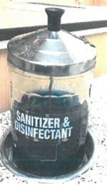
soak
Completely soak the tools in disinfectant for at least 10 minutes.

Slide 2
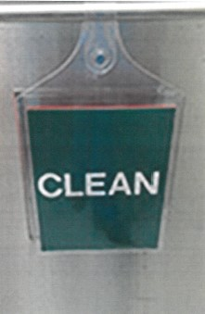
clean
Store all dirty non-electrical tools in a container that is labelled as “CLEAN.”

Slide 3
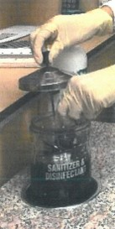
gloves
Wear nitrile gloves or use tongs to remove the tools from the disinfectant.

Slide 4

dirty
Store all dirty non-electrical tools in a container that is labelled as “DIRTY” or “SOILED.”

Slide 5
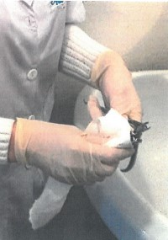
Dry tools
Use a clean paper towel to completely dry the tools.

Slide 6
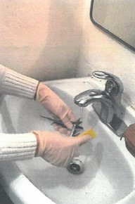
water
Clean tools using soap and hot water.

Slide 7
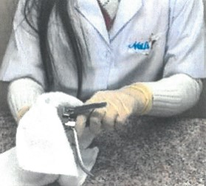
debris
Remove all visible debris (i.e. pieces of skin or nail.)

