Slide 1
Soiled
1. Store all dirty non-electrical tools in a container that is labelled as “DIRTY” or “SOILED.”

Slide 2
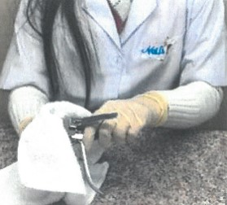
Clean
2. Remove all visible debris (i.e. pieces of skin or nail.)

Slide 3
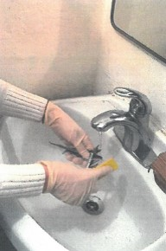
tools
3. Clean tools using soap and hot water.

Slide 4
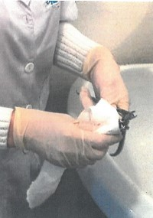
Dry
4. Use a clean paper towel to completely dry the tools.

Slide 5
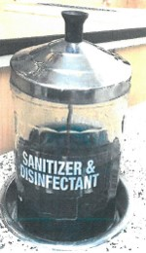
Soak
5. Completely soak the tools in disinfectant for at least 10 minutes.

Slide 6
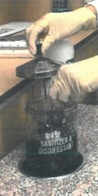
Remove tools
6. Wear nitrile gloves or use tongs to remove the tools from the disinfectant.

Slide 7
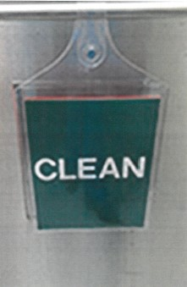
Cle an
7. Store all dirty non-electrical tools in a container that is labelled as “CLEAN.”

