Slide 1
BPSOS CHƯƠNG TRÌNH HUẤN LUYỆN:
Sức khỏe & An toàn của nhân viên và chủ tiệm nail
This material was produced under grant number SH-05066-SH8 from the Occupational Safety and Health Administration, US Department of Labor. It does not necessarily reflect the views or policies of the US Department of Labor, nor does mention of trade names, commercial products, or organizations imply endorsement by the US Government.
Welcome!
Notes:
Process: Make sure all recipients sign-in and give each recipient an agenda. Start powerpoint. Click to “Agenda” slide.
Say: Welcome everyone to the BPSOS-OSHA Trainer Program for Nail Salon Safety Training. We are here today to talk about improving the healthy & safety of Vietnamese nail salon workers and employers.
Transition: Let’s get to know each other better with an Icebreaker.
Chuong trinh dao tao: training program
huan luyen vien: trainers
Suc khoe: health
An toan safety

Slide 2
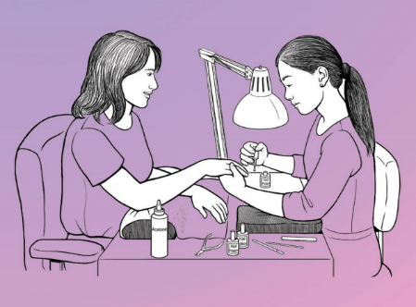
lịch trình
Hoạt động giới thiệu
Những mục đích
Khảo sát
I: Tại sao chúng ta thực hiện đào tạo này?
II: Các mối nguy hiểm trong tiệm nail là gì?
Notes:
Say: On your agenda, you will see our schedule for the program. For Day 1, our agenda includes reviewing objectives, doing a pre-test survey, and the first 3 components of safety training: 1. Why are we doing this training? 2. What are the hazards in nail salons? 3. What can you do to prevent hazards from affecting you?

Slide 3
Day 2 Agenda
O ccupational
S afety and
H ealth
A dministration
III: Bạn có thể làm gì để ngăn chặn các mối nguy hiểm ảnh hưởng đến bạn?
IV: OSHA có thể giúp bạn như thế nào?
V: Làm thế nào chúng ta sẽ tiếp cận cộng đồng?
VI: Ôn tập & thực hành
Khảo sát
Phần kết luận
Notes:
Say: For Day 2, our agenda includes the other 3 components: 1. How can OSHA help you? 2. How will we do outreach? 3. Review & Practice. Then we will finish with a post-test survey, and a conclusion. Lunch will be provided at 12 pm- 1 pm on both days. Bathrooms are across from the elevators and please make sure that your phones are on vibrate. Other than that, we’re ready to start our training.
Thank: Thank you all for coming. I understand that this training is a bit long and most of you have never had a reason to study nail salon safety before. But we really appreciate all of you for taking the time. Maybe some of us have family or friends who do nails, which work long hours around all kinds of hazards. All of you showing up today means that we all care and we want to make sure that the nail salon workers in our community are healthy and safe every day. We’re really excited to help you learn some techniques that will make you feel confident in reaching out to the community.
Transition: Now let’s go over objectives.

Slide 4

Những mục đích
Đến cuối khóa học, bạn sẽ có thể hiểu:
Những mối nguy hiểm trong tiệm nail
Nhân viên tiệm nail có thể làm gì để tự bảo vệ mình?
Làm thế nào OSHA có thể giúp nhân viên và chủ tiệm nail
Notes:
Say: This training will be very hands on. Every topic we learn about, we will have practiced ourselves and be familiar with before going out to the community. By the end of this course, you should be able to understand:
What the hazards in nail salons are
What you can do to prevent them from affecting you
How you can use OSHA to help you
How to do outreach
Transition: Onto the pre-test survey.

Slide 5
KIỂM TRA TRẮC NGHIỆM
Notes:
Process: Click to “Pre-test” slide. Pass out and explain pre-test surveys. Collect when they are done.
Say: We will now take a pre-test survey to see what you know, how you feel, and what you can do about nail safety . It is multiple-choice and should take 10 minutes. If you don’t know the answer, just fill out what you think the answer might be.
Transition: Thanks, everyone. Let’s move on to the next topic: why are we doing this training?
make sure survey has questions on knowledge, attitude, and perceived skills
https://vimeo.com/133309802
2:45 to 5:20

Slide 6
1. Tại sao chúng ta thực hiện đào tạo này?
  71,476 nhân viên tiệm nail người Mỹ gốc Việt thế hệ đầu tiên
  69% của tất cả các nhân viên tiệm nail ở California
  Cần giáo dục tốt hơn và sử dụng thực tế các hoạt động an toàn trong cộng đồng người Việt
Notes:
Say: There are over 71,476 first generation Vietnamese American nail salon workers. 69 percent of nail salon workers are living in California. These nail workers are exposed to health hazards every day, like:
Exposure to chemicals. These can be found in glues, polishes, removers, and other products.
Ergonomic strains, which affect the muscle, joints, etc... Many nail techs slouch over the client’s hand or feet to see better or they do repetitive motions like filing nails.
Risk of infection. Many nail techs touch their clients without gloves, masks, or other protective gear. If there is blood or body fluid, that is a hazard.
The reason why we started this program is because we saw a need for better education and practical use of safe work practices. Today we are doing this training to pass on the education to the Vietnamese community and their families.
Transition: Before we cover each of these hazards, we need to talk about the organizations we will be representing.

Slide 7

I. Why are we doing this training?
OSHA (Occupational Safety and Health Administration, Quản Lý An Toàn và Sức Khỏe Nghề Nghiệp)
Bộ liên bang
Bảo dảm an toàn & sức khỏe người lao động
BPSOS-CCA
Từ năm 1980
Phục vụ cư dân sống ở Orange County
ESL / Công dân / Trẻ em khuyết tật / Huấn luyện an toàn tại nơi làm việc
Notes:
Process: change slide to “1. Why are we doing this training?”
Say: To respond to the problem of worker safety, BPSOS is working with OSHA to talk about how we can improve the health of our community’s nail workers. To introduce OSHA, OSHA stands for:
-Occupational
-Safety and
-Health
-Administration
Say: It is a federal department whose job is to make sure that workers are safe and healthy in their workplace. They have been trying to reach Vietnamese people in the nail industry but because of barriers like language and culture, they have been funding us through the Harwood Grant Program to reach them. The Susan Harwood Training Grants target groups who are under-served, have low-English literacy, and work in high-hazard industries.
Say: To introduce ourselves, BPSOS is a nonprofit organization that serves the needs of the community in Orange County. We work with mostly Vietnamese Americans and have been since 1980. We provide services like:
-ESL and Citizenship classes
-Support for Children with Disabilities
-and now Nail Salon safety training
Say: We also have many students and staff who are either working or who are connected to nail workers.
Transition: Now that we’ve covered who is funding and organizing the program, let’s start with the actual training material: the 3 kinds of hazards that can be found in a nail salon and what you can do to protect yourself

Slide 8
2: Các mối nguy hiểm TIỀM TÀNG trong tiệm nail là gì?

Slide 9
HÓA CHẤT
Nước sơn móng tay, tẩy sơn móng tay, sơn móng tay acrylic, tẩy keo móng tay:
Dị ứng miệng / họng / phổi
Dị ứng da / mắt
Gây hen suyễn / ngất xỉu / buồn nôn
Tổn thương thận / gan hoặc biến chứng thai kỳ
Notes:
Say: The first type of hazard is chemical:
Nail polish, nail polish remover, acrylic nail liquid, nail glue remover all can:
Irritate mouth, throat, and lungs if they accidentally touch food or cigarettes or if they are inhaled
Irritate skin or eyes
Or cause asthma, fainting, or nausea
Some people may say that they’re used to the smell or they can’t smell anything from the chemicals they use. This does not mean that they are harmless. You still need to protect yourself. These products can also cause long-term problems like:
damage to your liver/kidney or pregnancy complications.

Slide 10
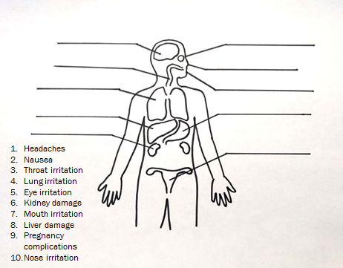
hoạt động: khớp các triệu chứng với bộ phận cơ thể
Notes:
Do activity sheet: Match the health symptom to the body part
Say: The correct answers going from the head-down are:
Brain: Headaches
Eye: Eye irritation
Nose: Nose irritation
Mouth: Mouth irritation
Throat: Throat irritation
Lung: Lung irritation
Liver: Liver damage
Stomach: Nausea
Kidney: Kidney damage
Uterus: Pregnancy complications

Slide 11

Hóa chất cần tránh
Các bộ ba độc hại:
  Dibutyl Phthalate (sơn móng tay): tổn thương gan / thận, biến chứng thai kỳ
  Formaldehyde (sơn móng tay): ung thư
  Toluene (sơn móng tay, keo dán móng): tổn thương gan / thận, biến chứng thai kỳ
Notes:
Say: There are three chemicals in particular that are called “The Toxic Trio”. These are:
-Dibutyl Phthalate (polish): liver/kidney damage, pregnancy complications
-Formaldehyde (Nail polish): cancer
-Toluene (polish, nail glue): liver/kidney damage, pregnancy complications
Say: Avoid products that have any of these chemicals. They will be labelled as “three-free”. However, research on “three-free” chemicals found that chemicals used to replace the toxic trio might still be hazardous. We are still waiting on more research on these other chemicals. But for now, we know for sure that dibutyl phthalate, formaldehyde, and toluene are dangerous.
Transition: One of the materials we will be giving out talks about this in a simpler way.

Slide 12
Hóa chất cần tránh
Bốn chất độc khác:
  Ethyl methacrylate *EMA* (chất lỏng móng tay acrylic): biến chứng thai kỳ
  Formalin (làm cứng móng): khó thở, ung thư
  Methyl methacrylate *MMA* (sơn lót móng tay): vấn đề hô hấp
  Titanium dioxide (sơn móng tay, bột móng tay nhân tạo): xơ phổi, ung thư
Notes:
Process: Review “Chemical cheat sheet” business card
Say: We will be handing out these business cards to nail workers so that they can keep it in their wallet anytime they go shopping for nail products. It will be a reminder of what chemicals to avoid.
-Toxic trio (dibutyl phthalates, toluene and formaldehyde)
-Ethyl methacrylate (EMA) (acrylic nail liquid) pregnancy complication
-Formalin: (nail hardener) breathing problems, cancer
-Methyl methacrylate (MMA) (nail primer) breathing problems
-Titanium dioxide: (nail polish, artificial nail powder) lung fibrosis, cancer
Transition: Next we will look at a Safety Data Sheet, a nail technician’s best friend.

Slide 13
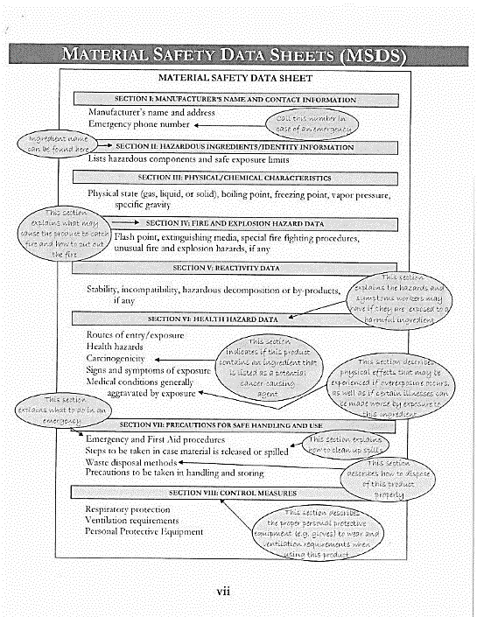
S afety
D ata
S heets
Notes:
Process: Review a sample Safety Data Sheet (SDS)
Say: Every salon is required to have a folder or binder of Safety Data Sheets for each chemical product in the salon. They are meant to tell the nail workers:
-What the product is called
-How to properly store the chemical
-How to use the product
-How to clean it up if it spills accidentally
-What equipment you should use in handling it
-How you should dispose it
-What hazards it has that might affect you
-What you should if you are exposed to the chemical
Transition: *information continues on next slide*

Slide 14
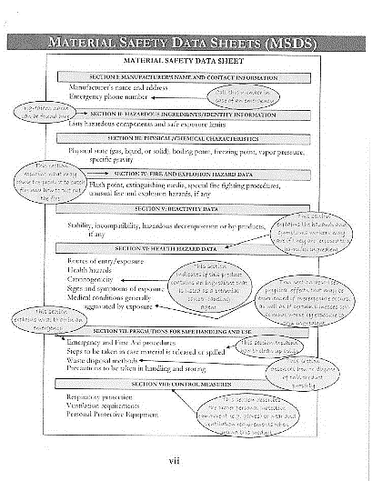
Tài liệu an toàn
(SDS, Safety Data Sheets)
    Quan trọng nhất:
    Làm thế nào để làm sạch nó nếu nó vô tình làm đổ
    Bạn nên sử dụng thiết bị gì để xử lý nó
    Bạn nên làm gì nếu tiếp xúc với hóa chất
Notes:
Say: But not many nail techs have the time to read all these details.
Usually, they learn the information on how to handle chemicals from their time in beauty school or from people they work with.
How we can make SDSs easy to understand is to encourage workers to read 3 main points:
How to clean it up if it spills accidentally
What equipment you should use in handling it
What you should if you are exposed to the chemical
Transition: Now that we have covered the chemical hazards, we will talk about what you can do to prevent them from affecting you.

Slide 15

“Tiệm nail an toàn”
Thông gió và mặt nạ bảo vệ
Bảo vệ da, ngăn ngừa ăn hóa chất và bảo quản đúng cách
play “Mỹ Viện Làm Móng An Toàn (Safe Nail Salons Pt. 1)” video 4:50-7:27 (2 mins, 37 secs)
https://www.youtube.com/watch?v=PksAPhmm15M&t=368s
play “Mỹ Viện Làm Móng An Toàn (Safe Nail Salons Pt. 1)” video 0:27-2:10 (1 min, 47 secs)
https://www.youtube.com/watch?v=XBLbKfbLQ2w
Notes:
Process:
play “Mỹ Viện Làm Móng An Toàn (Safe Nail Salons Pt. 1)” video 4:50-7:27 (2 mins, 37 secs)
https://www.youtube.com/watch?v=PksAPhmm15M&t=368s
play “Mỹ Viện Làm Móng An Toàn (Safe Nail Salons Pt. 1)” video 0:27-2:10 (1 min, 47 secs)
https://www.youtube.com/watch?v=XBLbKfbLQ2w
Say: Now we are going to watch 2 videos about 1) Ventilation and Protective Masks and 2) Protecting skin, preventing chemical ingestion, and proper storage.
Transition: The video didn’t mention this but glasses can protect your eyes from chemicals and nail clippings. Now that we’ve seen an introduction of ways to protect yourself, let’s go more in detail.

Slide 16
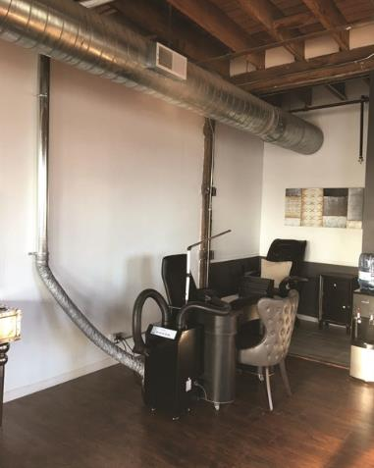
Thông gió
    Trang thiết bị
    Sử dụng bàn thông gió và máy thông gió
    Bật quạt hút
    Bật hệ thống HVAC (lò sưởi (Heating), thông gió (Ventilation), AC)
Notes:
Process: Change slide to “Ventilation”:
Say: Who here works ten hours a week? Twenty? Thirty? Forty? More than forty? That’s a lot of time to spend in a salon working with chemicals all day. There are 2 ways to protect yourself from breathing in chemical vapors and dust. The first is to increase ventilation:
1) Ventilation
-Process: change slide to “Ventilation”
-Say: Ventilation is the best way to remove chemicals from the air. There are two ways you can do this. One way is more expensive. For example:
-If the salon has ventilated tables, make sure they are turned on or consider using portable ventilation machines.
-Always keep the nail salon's exhaust system on.
If your salon does not have an exhaust system, always keep the heating, ventilation, and air conditioning (or HVAC) system on during work hours.
*continue to next slide*

Slide 17

Thông gió
Thực tiễn
Đóng chặt chai hóa chất và sơn móng tay
Mở cửa ra vào và cửa sổ
Đặt quạt ở một đầu của tiệm để đẩy không khí sang phía bên kia
Nghỉ ngơi bên ngoài
Notes:
Say: There’s also the more affordable way.
-Tightly close nail polish/chemical bottles
-Open doors and windows.
-If the weather is too cold to leave both front and rear doors open, you should use the HVAC system.
-Place fans near open doors or windows. Fans should pull air in one end of the salon and push it out of the other end.
-You can also take breaks outside whenever you have the chance.

Slide 18
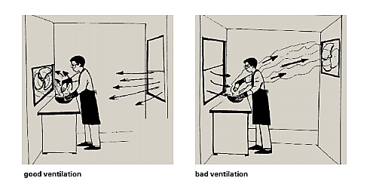
Cách kiểm soát tiếp xúc với hóa chất
Notes:
Process: Ask for a volunteer.
Say:
Can someone point out the difference between the ventilation between these two images? Take a look at where the worker, fan, and window is.
Correct Answer: In the bad ventilation example, the wind from the window is blowing the chemical vapor into the worker’s face. In the good ventilation example, the wind is blowing the vapors away from the worker. If you are refilling chemicals, make sure that the air flow/wind is blowing the chemical away from you, not towards your face.

Slide 19
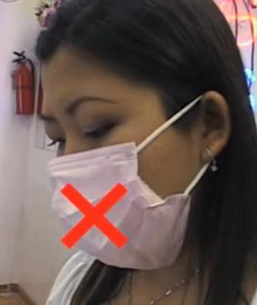
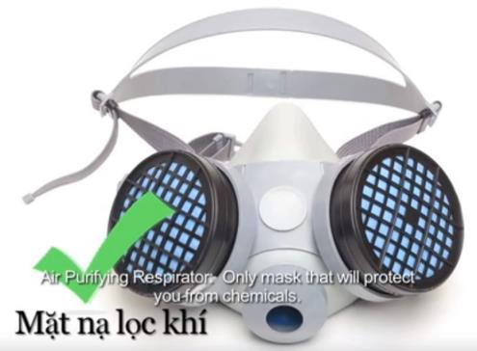
Nên đeo mặt nạ nào?
Notes:
Process: Bring 1 paper mask, 1 folded tissue, and N-95 masks to show as examples
Say: By a show of hands, please raise your hands if you have used some the masks I’m about to show you. Who has used a paper mask? Who has used a paper mask with a piece of tissue inside? What about an N-95 mask? And what about a half-face respirator?
The most affordable and common mask that nail technicians wear is the paper mask. Some nail techs may put a tissue or paper towel in a paper mask. However, dust and chemicals are very small and can sneak in the little gaps in the mask.
On the other hand, the only mask that can protect from both dust and chemicals is a half-face respirator. These masks can be a bit expensive so this is what we think is the best option.

Slide 20
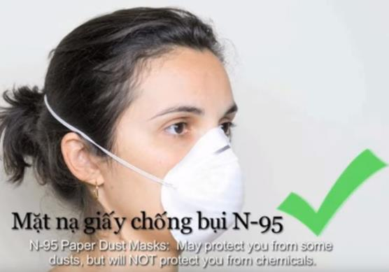
Nên đeo mặt nạ nào?
Tốt cho:
File móng tay
File bmóng tay acrylic
Tái sử dụng
N95 + Thông gió tốt = Ngăn ngừa Hít hóa chất
Notes:
Wear a N-95 mask when filing and shaping nails (when dust is coming up). To deal with chemicals, ventilate the salon while wearing a N-95 mask. You can reuse them until they’re dirty or if you have trouble breathing.
Your employer should provide you with N-95 masks. But if you are an independent nail worker, you may have to buy them for yourself.
Transition: We’re now going to practice wearing an N-95 mask ourselves.

Slide 21
Cách đeo mặt nạ N-95
https://www.youtube.com/watch?v=bo-PEzHE7iw
Notes:
https://www.youtube.com/watch?v=bo-PEzHE7iw
Process: show video on how to wear an N-95 mask. Pass out N-95 masks. Have each participant try on a mask.
Transition: Now, let’s talk about ingesting chemicals.

Slide 22
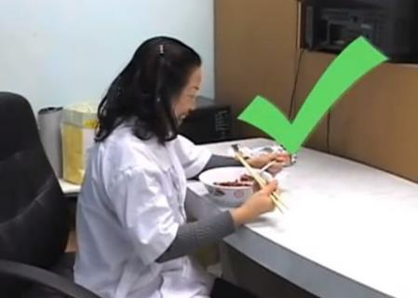
ăn vào Hóa chất
    Hóa chất có thể làm ô nhiễm thực phẩm, đồ uống và thuốc lá.
    Tránh để thức ăn, đồ uống và thuốc lá gần trạm hóa chất / trạm làm việc
      i.e. Ăn trưa bên cạnh một đồng nghiệp đang làm việc
    Thay vào đó bếp & khu vực bên ngoài
Notes:
Say: Chemicals can contaminate food and loose cigarettes. Eating food or smoking cigarettes that are contaminated will cause chemicals to enter your body through ingestion. Avoid having food or cigarettes be near the chemicals/ working space. Even eating lunch next to a coworker while they are working can expose your food to chemicals and dust. Instead… eat in the kitchen area or outside.
Transition: The next topic is fire safety in the salon.

Slide 23
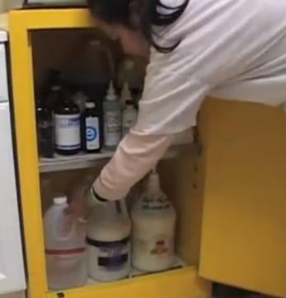
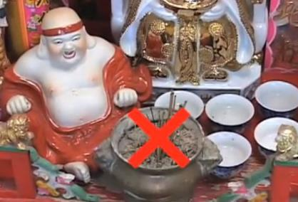
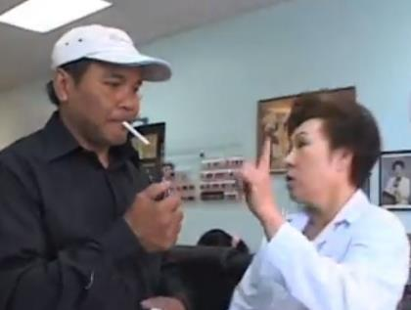

An toàn cháy nổ
Notes:
Say: Fire safety is another important way that chemicals can affect you, your clientele, and the salon building itself. A salon with bad ventilation combined with chemical vapors in the air can lead to a serious risk for fire. A minor source of fire, like a stick of incense or a lit cigarette can lead to fire in your workplace.
This is why we need to store chemicals in a secure place that has signs telling people that the storage area is flammable. Do not allow smoking or lighting incense in the salon. It could spark a fire that could burn yourself, clients, workers, and the salon building.
*continue to next slide*

Slide 24
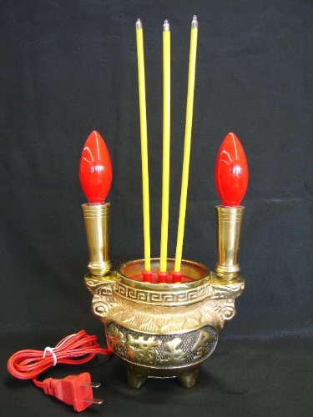

An toàn cháy nổ
Notes:
Say: You can buy these off of Amazon or Ebay on the internet.
Transition: Another safety method is about direct contact with chemicals.

Slide 25
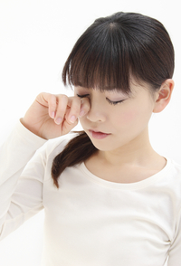

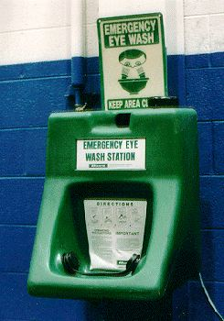
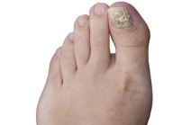
hóa chất chạm vào mắt
Tình huống
      Vô tình dụi mắt với găng tay bị nhiễm bẩn
      Tách hóa chất từ chai hoặc bàn chải
      Cắt móng tay
    Trang thiết bị:
      Bồn rửa mắt
      Kính bảo vệ
    Thực tiễn
      Rửa tay trước khi chạm vào mặt
Notes:
-There are ways that chemicals can make contact with your eyes. You could accidentally rub your eyes, a brush or bottle might splash chemicals, a nail clipping can fly towards your eye.
-So to avoid this from happening, there are 3 ways to protect your eyes. One is a bit more expensive, the other is less expensive. One has no cost at all.
-The first is to have an eye wash station installed in the salon. What it does is that it sprays water into your eyes to get rid of the chemicals that is irritating your eyes.
-The other cheaper option is wearing protective goggles will protect your eyes from chemicals splashing or nail clippings from flinging into your eyes. Your employer should provide these to you, unless you are an independent contractor. Goggles are the more affordable option that can guarantee your eye safety.
-You can also make it a habit to wash your hands before touching your eyes.
Transition: Now for skin protection.

Slide 26
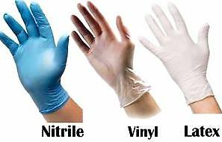
hóa chất chạm vào Da
    Tình hình
      Bốc hơi trên mặt
      Chạm hóa chất bằng tay / cánh tay
  Các giải pháp :
      Áo dài tay và quần dài
      Găng tay
Notes:
-Something you might see in a salon is a nail tech leaning over a client’s hand or foot, polishing very carefully. However, there are vapors that will evaporate on the skin of your face. One way to protect your skin is to sit straight up away from the chemicals while you’re working with a client. Adjust lighting to see better.
-Your arms and thighs can also be places where chemicals might make contact with skin. Wearing long-sleeve shirts and pants that cover up to the knees will also protect you from chemicals spilling on your arms and lap.
-Another scenario is someone refilling bottles of chemicals while standing over the two bottles. They should actually stand away from the bottles, wear a N-95 mask, and wear the right type of gloves.
-When it comes to gloves, let’s take a quick vote.
-Gloves:
-Process: Bring a pair of latex, vinyl, and nitrile gloves.
-Say: Can somebody choose the correct material gloves?
-Latex: The problem with latex is that clients can have be allergic to latex. and they won’t protect you from chemicals
-Vinyl: also won’t protect you from chemicals, and may actually absorb chemicals that are in disinfectants.
Nitrile: are the best for using on clients and filling up chemicals because they don’t cause allergic reactions and will protect your skin.
Transition: When it comes to gloves, let’s take a quick vote.

Slide 27
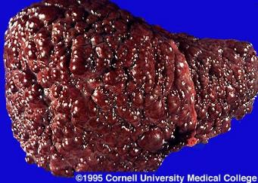
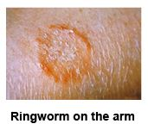
Nguy cơ nhiễm trùng
Tình hình
      Client’s blood/body fluid contacts open cut
      Da khách hàng tiếp xúc với da của bạn
      Sử dụng nguồn cung cấp móng tay cho khách A bị nhiễm trùng rồi lại sử dụng cho khách B
Vi rút (máu và dịch cơ thể) & nấm (da) sự truyền nhiểm
      Có thể truyền cho vợ / chồng, gia đình, khách hàng và trẻ em
Notes:
-Say: The second kind of hazard happens through viruses and fungal infections that can transfer through blood or skin contact. Some situations that might spread infections include:
A client’s blood/body fluid making contact with your open cut
A client’s skin makes contact with your skin
Nail tools and supplies are used on Client A with infection and reused for Client B
-Viral infections are spread through blood or body fluids, meaning they can be spread through sex with a partner or from mother to child in birth and breastfeeding.
-Fungal infections like ringworm, which is also called “athlete’s foot”, can be spread through skin contact when massaging a client’s foot, legs, or arms. Also, it is contagious to others you touch like other clients, your family, and friends.

Slide 28
Nguy cơ nhiễm trùng
Vi-rút | Fungal
Viêm gan B (sẹo gan / ung thư) | Ringworm
Viêm gan C (sẹo gan / ung thư)
HIV -> AIDS (hệ thống miễn dịch suy yếu)
Notes:
-Say: Bloodborne diseases include hepatitis B, hepatitis C, and HIV. These can start with contact with blood/body fluid at work and can be contagious through sex with a partner or birth/breastfeeding from mother to child:
-A hepatitis B infection can cause serious damage to your liver, such as scarring and cancer.
-A hepatitis C infection can cause similar damage to your liver and there is no vaccine that can protect you from Hep C.
-HIV is another disease you could contract that attacks your immune system and leads to AIDS.
-Most nail technicians think that these infections might never happen to them but it only needs a moment (a client’s blood/body fluid gets into your open cut or you’re massaging their skin without gloves) to transfer these diseases.
Transition: Here are some ways you can avoid infection.

Slide 29
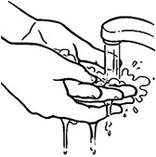
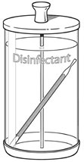
Tránh tiếp xúc với nhiễm trùng
Tiêm/nhận vắc-xin cho Viêm gan B
Rửa tay, băng bó và đeo găng tay trước và sau mỗi khách hàng
Kiểm tra các vết thương có thể nhìn thấy
      Nếu có vết thương thì kêu khách hàng quay lại sao khi vết thương đã lành
Không sử dụng các công cụ sắc bén cho vết chai
Không chạm vào máu / dịch cơ thể / da mà không có găng tay
      Cung cấp bông / băng và yêu cầu khách hàng xử lý vết thương và bỏ nó vào thùng rác
Khử trùng dụng cụ và vật tư sau mỗi khách hàng
Notes:
-To avoid being exposed to viruses that can transferred through blood/body fluid and fungal infections spread through skin contact:
-There is a vaccine for Hepatitis B, so immunize yourself
-Wash hands with soap and hot water before and after every client
-Bandage any of your own open cuts and wear gloves
-Check the client’s nails and skin do not have any visible infections. If you can see an infection, ask them to come back when their wound has healed. If not visible, here are some things you can do to protect yourself from infection
-Do not use sharp tools to remove calluses or remove skin (besides cuticles)
-Do not touch blood or body fluid. Ask the client to use a cotton ball or tissue to stop the bleeding/fluid and to throw their trash into the trash can
-Clean and disinfect used tools, foot basins, and spas after every client
Transition: let’s discuss how to properly clean tools.

Slide 30
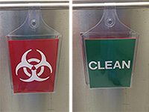
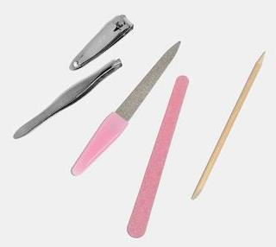
Dụng cụ khử trùng
  Đặt một túi nhựa vào bồn rửa chân trước khi đổ đầy nước và xà bông
    Xử lý dễ dàng
  Sau khi sử dụng các công cụ, hãy đặt chúng vào một thùng
  Dụng cụ chà bằng xà phòng và nước nóng
  Ngâm chúng trong chất khử trùng cho 10-30 phút
  Sau khi làm sạch, đặt các dụng cụ vào một thùng dán nhãn la sạch
    Thường xuyên khử trùng thùng dán nhãn la sạch
  Thường xuyên thay đổi thành một đôi găng tay mới
    Xem xét nhận một bộ công cụ thứ hai
Notes:
Say: Everyone has different ways of cleaning their tools and equipment. However this is the safest way to do so:
-Store all soiled non-electrical items (example: combs, brushes, nail clippers, buffers, nail files, drill pieces) in a container that which is labeled "Dirty", "Soiled", OR "Contaminated".
-Scrub tools with soap and hot water. Then immerse them in a disinfectant for 10-30 minutes.
-Always keep disinfectant solution covered and change disinfectant when it is cloudy or contains debris.
-Once clean, store all disinfected non-electrical items in a clean covered container which is labeled "Clean" or "Disinfected".
-Frequently disinfect your “Clean/Disinfected” container.
-Change into a new pair of gloves for your next client.
-If you have back-to-back clients, consider getting a second set of tools to use while the other set is being disinfected.
Transition: Let’s review these steps one more time with images.

Slide 31
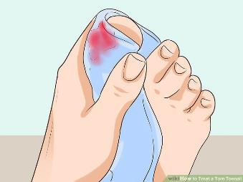
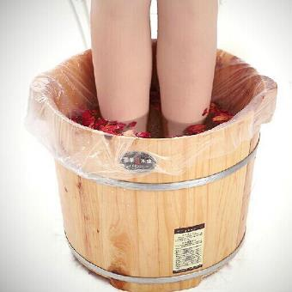
Hoạt động
  Quý vị đang cắt một lớp biểu bì ngón chân của khách hàng và quý vị vô tình làm chúng chảy máu. Trong khi quý vị đang đi lấy băng bó, quý vị nhận thấy rằng họ đặt chân trở lại trong bồn rửa chân. Quý vị có một khách hàng khác đang chờ sau đó.
  Quý vị sử lý như thế nào?
Notes:
Process: Give the participants a scenario. Ask for volunteers to write the different steps on the poster board. Write them on a whiteboard/poster board.
You are cutting a client’s toe cuticles and you make a mistake. You accidentally make them bleed. While you are getting a band-aid, you notice that they put their foot back in the foot basin. You have another client waiting after. What do you do? Can anyone write on the poster what the first step would be? Second step? Etc…
Transition: Now let’s review the correct answers.

Slide 32
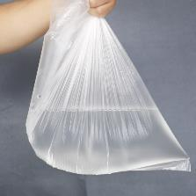
Hoạt động
  Quý vị nên làm gì?
  Cung cấp cho họ một quả bóng bông / khăn giấy để cầm máu
  Hãy để họ vứt rác vào thùng rác
  Cung cấp cho họ một hỗ trợ băng nhạc
  Chà dụng cụ của quý vị bằng xà phòng và nước nóng và ngâm trong chất khử trùng trong 10 phút
  Để giữ cho nước sơn của quý vị sạch sẽ, hãy bỏ qua ngón chân hỗ trợ
  Vứt bỏ túi nhựa chân chậu
  Rửa tay và thay một đôi găng tay nitrile mới
Notes:
CORRECT ANSWERS
Give them a cotton ball/tissue to stop the bleeding
Let them throw the trash into trash can
Give them a band-aid
Scrub your tools with soap and hot water and soak in disinfectant for 10 minutes so that you can use your tools for the next client.
In the meantime, continue the pedicure.
To keep your polish clean, skip the band-aided toe
Dispose of the foot basin plastic bag
Wash your hands and change into a new pair of nitrile gloves
Transition: Now that we have discussed safe practices for infection hazards, let’s move onto ergonomic hazards. Here’s how you can reduce it.

Slide 33
TƯ THẾ LÀM VIỆC
  Nhân viên làm móng có thể bị chấn thương cơ, xương, khớp, dây thần kinh bởi vì:
    Nghiêng người trên bàn trong một thời gian dài
    Thực hiện các động tác lặp đi lặp lại như giũa móng tay
    Đặt tay lên mép bàn cứng
Notes:
Say: A very common health hazard is ergonomic, meaning pain to your muscles, bones, joints, ligaments, tendons, and nerves. This happens when you:
-Lean over a work table for a long time
-Do repetitive movements like filing and buffing nails
-Rest your hands, wrists, and forearms and/or elbows against hard surfaces or sharp edges of work tables.
Say: These aches and pains can be a part of your everyday life if you don’t do exercises to help reduce that pain.
Activity: Quick raise of hands to show what pain you feel
-Back pain
-Neck pain
-Pain in the hands and wrists
-Pain in forearm and elbows
-Muscle/ joint pain
Transition: Now that we have discussed safe practices for infection hazards, let’s move onto ergonomic hazards. Here’s how you can reduce it.

Slide 34
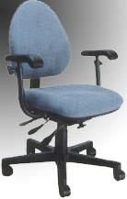
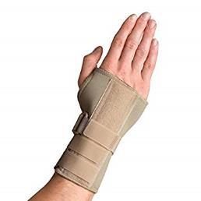
Giảm đau
Đau lưng: ghế có thể điều chỉnh
Đau cổ: Điều chỉnh ánh sáng và khách hàng
Đau cổ tay: hỗ trợ cổ tay
Cẳng tay / khuỷu tay: Sử dụng khăn làm đệm trên bàn
Đau cơ / khớp: stretching, nghỉ
Notes:
To reduce stress in your body:
-Back pain: Use an adjustable chair that supports your back & stretching
-Neck pain: Use a bright light and bring the client’s hand or foot closer to see better
-Hand & wrist pain: stretch hand/wrists & wrist support
-Pain in forearms and elbows: Put a soft cushion like a towel between your arms and the table
-Muscle/joint pain: Take breaks between clients to stretch, pace the work, take frequent breaks, or do a different task.
Transition: Let’s practice some of these exercises.

Slide 35





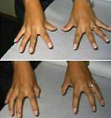
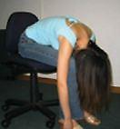
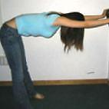
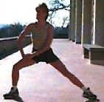
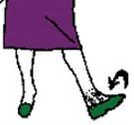
Hoạt động
Notes:
Process: Invite everyone to stand.
Say: Will everyone please stand or stay in their seat? Whatever is comfortable for you. Please follow me in doing these exercises.
Do: Neck, Shoulder, Upper back, *extend and bend* Elbow, *roll* Wrist, Hand, Lower back and Hip, Back of Legs, Inner thighs, Ankle exercises
Transition: have the participants take a seat and settle.

Slide 36
Đánh giá các mối nguy: Hóa chất, Nhiễm trùng, TƯ THẾ LÀM VIỆC
Notes:
I understand that a lot of the time at work, we believe that these serious work injuries won’t happen to us or maybe we just want to save time, which is precious in the nail industry.
Time is money.
However, if you develop a chronic illness, infection, or pain, that will be the biggest barrier to doing your work. All of these hazards happen over a long period of time, meaning you want to prevent something from growing rather than treating an illness for the rest of your life.
Some of these hazards are especially important to protect yourself because they may affect your other clients, spouse, or children if the hazard is infectious. But ultimately, your health and safety are #1 priority.
Transition: Now that you know how to protect yourself day-to-day, we want to share how OSHA can further help you.

Slide 37
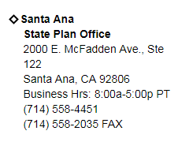
Trợ giúp từ OSHA
Liên lạc với các văn phòng OSHA địa phương để biết thông tin và trợ giúp
Nhân viên : quý vị có thể nộp đơn khiếu nại cho việc kiểm tra OSHA nếu bạn nghĩ rằng chủ nhân của quý vị không tuân theo các tiêu chuẩn OSHA hoặc nếu nơi làm việc của quý vị có mối nguy hiểm
Chủ cơ sở : liên hệ miễn phí Chương trình tư vấn OSHA riêng để tìm hiểu xem tiệm của bạn có nguy hiểm không. quý vị sẽ không được trích dẫn hoặc bị phạt.
Notes:
-Contact local OSHA offices for information, training, and help. The information for our local office is listed here:
Address: 2000 E. McFadden Ave, Suite 122, Santa Ana, CA 92806.
Business Hours: 8 AM – 5 PM
Phone: (714) 558-4451
Fax: (714) 558-2035
-Workers: you may file a complaint for an OSHA inspections if you think your employer is not following OSHA standards or if your workplace has hazards
-Owners: contact private OSHA’s Consultation Program for free to find out if your salon has hazards. You will not be cited or penalized.
Transition: Let’s review a bit about the rights that you have as a worker.

Slide 38
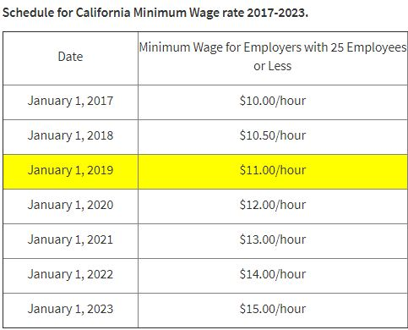
Nhân viên Biên Chế so với NHÂN VIÊN ĐỘC LẬP
Nhân viên biên chế :
Chủ tiệm lịch làm việc / các cuộc hẹn
Chủ tiệm dụng thiết lập mức lương cho các dịch vụ
Chủ tiệm dụng cung cấp vật tư & thiết bị
Chủ tiệm lao động phải bảo vệ nhân viên khỏi các mối nguy hiểm tại nơi làm việc
Được hưởng mức lương tối thiểu và người lao động Bồi thường (bảo hiểm chấn thương)
Không có tiền thuê trạm làm việc
Mẫu W-2
Notes:
Say: There are differences between being an employee of a salon and being an independent contractor. These are the differences.
Employee:
-Your work schedule is set by the owner
-Paid by the hour
-Owner/receptionist makes your appointments
-You don’t pay rent for the space
-The owner sets the pay rate for your services
-The owner provides your tools and equipment
-You have a minimum wage and workers’ compensation (injury insurance)
-The owner has to protect you from workplace hazards
*continue to independent contractor*

Slide 39

Nhân viên BIÊN CHẾ so với nhân viên hợp đồng
Nhân viên hợp đồng :
  Có giấy phép kinh doanh riêng của họ
  Thuê trạm của họ
  Mua vật tư và công cụ riêng của họ
  Có khách hàng riêng của họ
  Đặt lịch trình & cuộc hẹn riêng của họ
  Đặt mức thanh toán riêng của họ
  Nhận khách hàng thanh toán trực tiếp
  Mẫu IRS 1099 và
    mẫu IRS 1044 C/1044 C-EZ
Notes:
-Independent Contractors:
-Rent their station
-Buy their own supplies and tools
-Have your own customers
-Set your own schedule & appointments
-Set your own pay rate
-Receive clients’ payments directly
-Have your own business license
*continue*

Slide 40
HAY BỊ NHẦM LẪN?
  Nếu chủ tiệm nail của quý vị đưa cho quý vị Mẫu IRS 1099, thay vì W-2, điều đó có nghĩa là quý vị là nhân viên hợp đồng không?
    Không.
  Nếu chủ tiệm nail của quý vị nói với quý vị rằng quý vị là nhân viên hợp đồng , điều đó có nghĩa là quý vị là một nhà thầu độc lập không?
    Không.
  Quý vị là loại nhân viên nào?
Notes:
Be wary of being misclassified:
-If your employer gives you IRS Form 1099, instead of a W-2, does that mean you are an independent contractor?
-No.
-If your employer tells you that you are an independent contractor, does that mean you are an independent contractor?
-No.
Transition: now let’s try a group activity to review this information.
Responsibilities of Independent Contractor:
Calculate net loss/net profit: business income – business expense = net profit/loss
If net profit = $400+, must file taxes
If expenses $5000 or less, file form 1040 Schedule C-EZ form… if above 5000, form 1040 schedule C.
Also need to file form 1099 information return.
For employees,
File W-2 and W-3

Slide 41
Xem lại CÁC TÀI LIỆU HAZARD COMMUNICATION

Slide 42
Hoạt động
Nhóm số 1:
  Cô Dung vừa học xong lớp học làm nail. Cô đã được thuê trong một tiệm nail và chủ nhân của cô tính phí $80 mỗi tuần cho cô. Chủ nhân của cô bảo cô mua công cụ của mình và bắt đầu mời khách hàng mới. Chủ nhân của cô không đề cập đến bất kỳ khóa huấn luyện an toàn nào hoặc cung cấp thiết bị an toàn.
  Dung là nhân viên hay nhà thầu độc lập?
Nhóm số 2:
  Đại là một nhân viên trong một Tiệm nail. Cô và đồng nghiệp thường xuyên bị đau đầu vì khói hóa chất. Con gái cô, con cháu bị hen suyễn, thường cần sử dụng ống hít trong khi chờ Dai hoàn thành công việc. Tiệm này không có quạt trong tiệm và hệ thống HVAC.
  Đại có quyền yêu cầu chủ nhân của cô đưa quạt vào tiệm không?
Nhóm số 3:
  Hương là chủ của một tiệm nail. Kinh doanh chậm vì khách hàng đã phàn nàn về các điều kiện không an toàn của tiệm. Tuy nhiên, cô không chắc chắn về mối nguy hiểm nơi làm việc.
  Cô ấy có thể làm gì?
Notes:
Process: Break the group into 3 groups. Place the groups in three parts of the room.
Say: Now we are going to break into 3 groups. We are going to count ourselves off from 1 through 3. 1’s meet in the front, 2’s meet in the middle, 3’s meet in the back.
*Give 10-15 minutes for group to review*

Slide 43
* CÂU HỎI BONUS*
Nhóm số 2:
  Đại có quyền yêu cầu chủ nhân của cô đưa quạt vào tiệm không?
  Vâng. Chủ tiệm được yêu cầu bảo vệ nhân viên của họ khỏi các mối nguy hiểm tại nơi
  làm việc, chẳng hạn như thông gió kém.
  Chủ nhân bỏ qua yêu cầu của cô và đề nghị cô mang theo một cái quạt nhỏ.
  Cô ấy có thể làm gì?
  Cô ấy có thể thông báo cho chủ nhân rằng cái tiệm cần một chiếc quạt lớn hơn để thổi một bên của tiệm sang bên kia để cải thiện sự thông thoáng.
  Vì chủ nhân của cô ấy không tuân theo các tiêu chuẩn OSHA, cô ấy cũng có thể nộp đơn khiếu nại để kiểm tra OSHA.
Notes:
Say: This is a bonus question. *may offer a small prize to whoever gets the right answer*
Your employer ignores your request and suggests you bring a small personal fan. What can you do?
-You can tell them that a large fan is needed to blow one side of the salon to the other to improve ventilation.
-You can also file a complaint for an OSHA inspection since your employer is not following OSHA standards.

Slide 44
HOẠT ĐỘNG
Nhóm số 3:
  Hương là chủ của một tiệm nail. Kinh doanh chậm vì khách hàng đã phàn nàn về các điều kiện không an toàn của tiệm. Tuy nhiên, cô không chắc chắn về mối nguy hiểm nơi làm việc.
  Cô ấy có thể làm gì?
  Cô có thể gọi cho văn phòng Santa Ana OSHA tại địa phương để được tư vấn miễn phí và riêng tư. Cô sẽ không được trích dẫn hoặc bị phạt.

Slide 45
ĐÁNH GIÁ CỦA OSHA GIÚP CHO CÔNG NHÂN VÀ CHỦ TIỆM NAIL
Notes:
Say:
There is a local OSHA office in Santa Ana on McFadden between Grand Ave & the Southbound 55 freeway.
You now know the difference between independent contractors and employees.
You also know how OSHA can serve you, as a worker and an employer.
Transition: That concludes our training about the hazards. The next part is on how we will do outreach.

Slide 46
xem lại tài LIỆU
  Điều tôi biết:
      Hóa chất, nhiễm trùng, tư thế làm việc
      Làm thế nào để bảo vệ chính mình
      Danh thiếp hóa chất nguy hiểm
      SDS
      Tham khảo tài liệu việt Hazard Communication
      Thông tin liên lạc của BPSOS & OSHA
      BÀI KIỂM TRA!
Notes:
Process: Bring out materials and present to the participants.
Say: We will be providing beauty school students with:
List of Safe Work Practices with Images
Business card of dangerous chemicals
SDS
Vietnamese translated Hazard Communication documents
BPSOS & OSHA contact information
Transition:
Now for the final part of our training… the post-test. Let’s see what we learned. Please also leave any feedback on how we can improve the training.

Slide 47
KIỂM TRA TRẮC NGHIỆM
Notes:
Process: pass out and collect post-test and feedback forms.
Say: Here is our post-test and feedback form. Please take 15 minutes to complete it and we will collect it on your way out.
*continue*

Slide 48
PHẦN kết
CẢM ƠN QUÝ VỊ ĐÃ THAM GIA CHƯƠNG TRÌNH CÙNG CHÚNG TÔI!
Notes:
That is the end of our training. Thank you everyone for joining us. Now we will start the next journey of doing the outreach. We went into this training with the 4 goals of learning:
-What the hazards in nail salons are
-What you can do to prevent them from affecting you
-How you can use OSHA to help you
-How to do outreach
I hope this helped and please remember you can lean on us for more help as we continue with community outreach. Thank you all again for participating. We have completed our 2-day training. Does anyone have any questions or comments? Also please feel free to come up and ask questions if you have any.

