Slide 1
Heat-Illness Prevention
This material was produced under grant number SH-05032-SH8 from the Occupational Safety and Health Administration, U.S. Department of Labor. It does not necessarily reflect the views or policies of the U.S. Department of Labor, nor does mention of trade names, commercial products, or organizations imply endorsement by the U.S. Government.
Notes:
Introduce yourself
Ask about the type work they do and what projects they are working on.
Tell a joke.

Slide 2
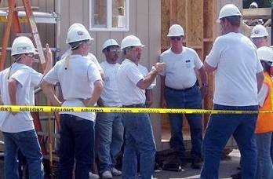
Photo Sources
  Bureau of Labor Statistics (BLS)
  California Occupational Safety and Health Administration (Cal OSHA)
  Centers for Disease Control and Prevention (CDC)
  Department of Defense (DOD)
  National Institute for Occupational Safety and Health (NIOSH)
  Occupational Safety and Health Administration (OSHA)
  Public Health Information Library (PHIL)
Source: Cal OSHA
Notes:
Skip…

Slide 3
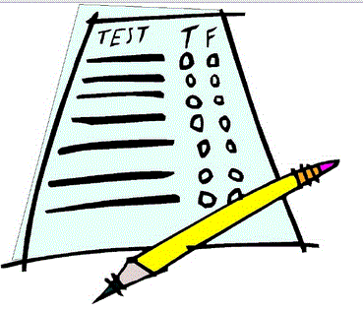
Take Pre-Test
The pre-test is compared to a post-test (at the end of the training) and helps us determine if we did a good job or need to make improvements.
It will also help you know what we will be covering in the training
Test (Clipart)
Notes:
Have them put name on test.
Read the questions and answer choices out loud.

Slide 4
Learning Objectives
  Discuss why heat-illness prevention is important
  Know cause, prevention and first aid for heat illnesses
  Understand the approach for heat-illness prevention
    Train workers and supervisors on prevention strategies and to recognize signs and symptoms of heat-related illnesses
    Monitor weather and workplace conditions
    Assess heat-related hazards
    Implement appropriate prevention strategies and controls
    Plan for heat-related medical emergencies
  Understand how physiological monitoring can be used to help prevent heat-related illnesses
Notes:
Key points:
1.

Slide 5
Section 1:
Why is heat-illness prevention important?

Slide 6

Class Discussion: Why is heat-illness prevention important?
________________________________________________________________________________________________________________________________________________________________________________________________________________________________________________________________________________________________________
Notes:
Go around room and ask for reasons.

Slide 7
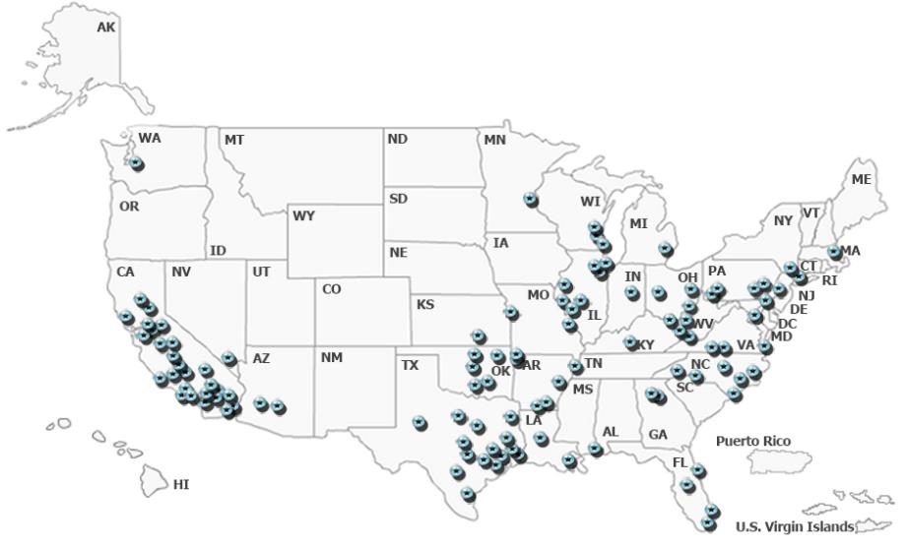
Heat-Illness Statistics
OSHA reported heat-related fatalities among outdoor workers (not all workers) 2008 to 2014
Source: OSHA

Slide 8
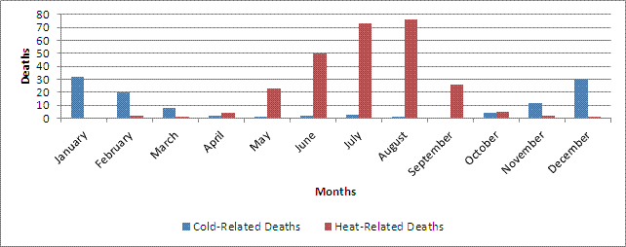
Statistics for Texas
Temperature-Related Deaths Texas, 2003-2008
Temperature-related Deaths
439 heat-related deaths reported among Texas residents
  Harris County 41
  Fort Bend 3
  Liberty 3
  Montgomery 3
  Brazoria 2
  Galveston 2
Source: Texas Health and Human Services (Temperature-related Deaths)

Slide 9
Houston Area Statistics
Houston Heat related data, 2013- 2016
Houston Epidemiology Report
Source: Houston Health Department

Slide 10

#1: The number one reason why we all need to look after each other on the job
We all deserve to go home safe to our family and friends

Slide 11
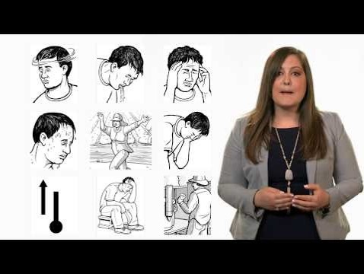
OSHA Video on Heat Stress
OSHA Heat Illness Prevention Campaign
OSHA Video on Heat Stress

Slide 12
Section 2:
Heat-Illness Prevention Plan

Slide 13

Elements Heat-Illness Prevention Plan
Training
Monitoring weather
Assess Heat-related hazards
Heat-Illness Prevention Strategies
Emergency Preparedness
Plan (Clipart)

Slide 14
Purpose and Scope
Purpose
This heat-illness prevention plan was developed to provide supervisors and workers with the training and tools to help protect them from heat-related exposures and illnesses.
Scope
Each work site and job task can be unique and contain a number of heat stress hazards that must be addressed prior to the beginning work and during work activities. Supervisors and workers are responsible for assessing these hazards and taking necessary corrective actions to reduce heat-related illnesses.

Slide 15
Employee Training and Responsibilities
Each employee trained on procedures and will strictly adhere to them except when doing so would expose them to a greater hazard
Employees are to notify their supervisor of a concern and have the concern addressed before proceeding

Slide 16
Section 3:
Training on Heat-Illness Prevention

Slide 17
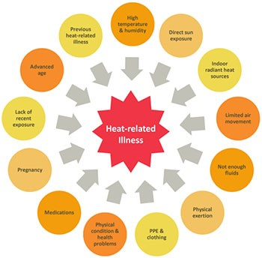
Risk Factors for Heat Stress
Environmental risk factors
Temperature
Humidity
Air movement
Radiant heat (e.g., sun exposure)
Risk Factors (Source: NIOSH)

Slide 18
Risk Factors for Heat Stress
Work-related risk factors
Age
Physical fitness
Acclimatization
Medical conditions
Medications
Alcohol and/or drug use
Caffeine
Risk Factors (Source: NIOSH)

Slide 19
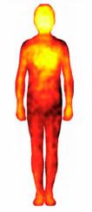
How the Body Handles Heat
Increased heart rate
Increased blood circulation to skin
Evaporative cooling from sweating
Thermogram (Stock Photo)

Slide 20
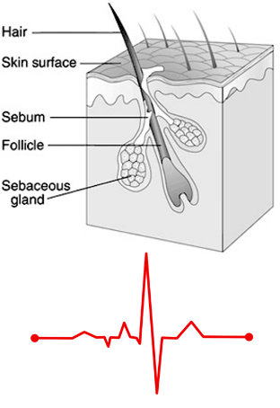
The importance of acclimatization
Reduces risks of dehydration and salt loss
  Sweating and evaporative cooling becomes more efficient
  Salt loss becomes more efficient (less loss)
Core body temperature maintained more efficiently
Reduces strain on heart
  Blood circulation to skin becomes more efficient
Recovery heart rate improves
More efficient sweating, blood flow to skin and heart rate recovery (CDC & Stock Photo)

Slide 21
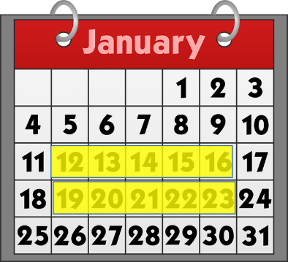
Human body needs to acclimate to hot environments, typically 10-14 days
Gradually increase exposure to hot environment over 7-14 days
Avoid prolonged exertion during hottest times of day
Schedule heavy exertion for cooler parts of day
Calendar (Clipart)

Slide 22
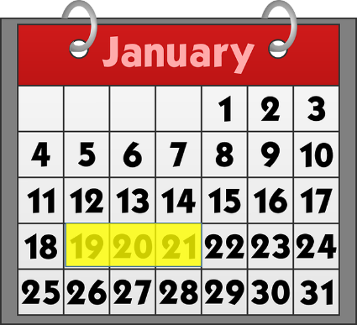
When acclimated workers take an extended break they need to re-acclimate
Acclimatized workers will need 2-3 days of re-acclimatization if they stop working under heat stress conditions more than a week
Calendar 2 to 3 days (Clipart)

Slide 23
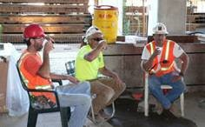
The importance of consuming water throughout the work shift
One cup (8 oz.) of cool water or an electrolyte replacement fluid every 15-20 minutes; four cups of water every hour.
Increased water intake may be needed to account for increased physical exertion and/or sweating.
Source: Cal OSHA

Slide 24
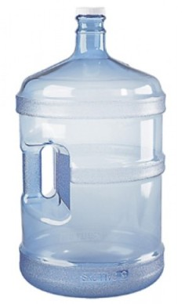
Too much water intake can be dangerous
Too much water intake can lead to headache, nausea, vomiting and/or mental confusion
Water bottle (Stock Photo)

Slide 25
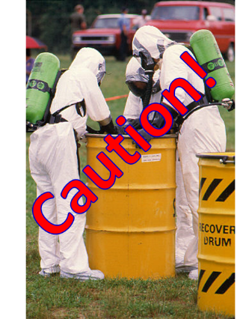
Physiological monitoring for dehydration may be necessary under extreme conditions
If sweat is not trapped within clothing, then we can monitor body weight, which should not drop below 1.5% of starting body weight.
Urine color is another indicator of potential dehydration. Normal urine should be a pale yellow.
Sweat trapped by encapsulating suit (Source: PHIL)

Slide 26
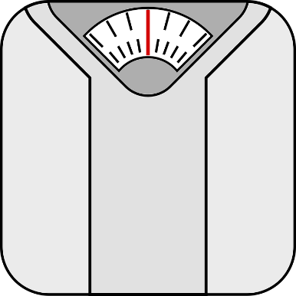
Monitoring Body Weight
Body Scale (Clipart)
Use a scale capable of accurately reading within ± 0.25 lbs.
Measure your weight at breaks, at least every hour if you are sweating a lot
Your body weight should not drop by more than 1.5%
  If 150 lbs., then not more than 2 lbs.
  If 200 lbs., then not more than 3 lbs.

Slide 27
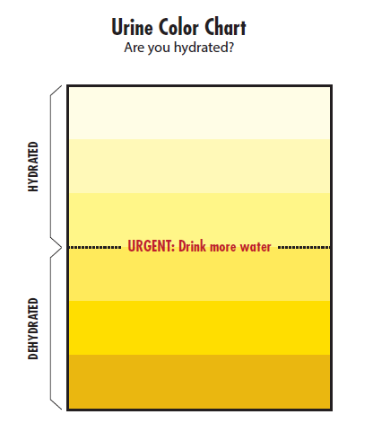
Monitoring Urine Color
Urine Color Chart
Normal urine should be pale yellow
Darker urine can indicate dehydration
Some diets, medications and illnesses may affect results
Source: NIOSH

Slide 28
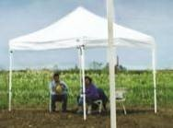
Importance of frequent rest breaks and shade
Prolonged physical exertion and muscle activity increases the body’s core temperature and reduces the body’s ability to cool itself.
Breaks allow blood to flow to the skin to be cooled.
Rest breaks slow down the buildup of heat in the body from prolonged muscle activity.
Rest breaks are important for the heart and allow your heart rate to recover from sustained heat stress and physical exertion.
Rest breaks in the shade help will cooling, especially if there is air movement with cool air.
Shade (Source Cal OSHA)

Slide 29
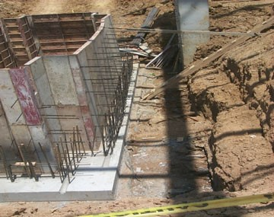
NIOSH Investigation: Construction Laborer
KY FACE #03KY053
What factors contributed to his heat stress?
41-year-old male sawing boards to make concrete forms
Clothing
  Heavy blue jeans
  Long-sleeved heavy shirt
Outside in sun during summer
  Temperature 90 °F
  Humidity 69%
Concrete pad (Source: NIOSH)

Slide 30
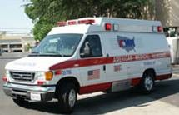
He suffered from heat stroke
He collapsed towards the end of the day
A co-worker found him at 5 PM
Emergency services removed clothing, provided first aid and water
After being transported to the hospital, his body temperature was 108 °F
He died of heat stroke
Ambulance (Source: Cal OSHA)

Slide 31
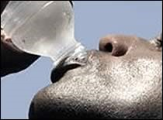
NIOSH Recommendations
Supervisors and their employees should be trained to understand heat exhaustion/stroke symptoms when there is high heat and humidity.
Breaks should be provided frequently to reduce dehydration and heat stroke/ exhaustion.
Adjust amount of hours working outside for high humidity and heat conditions
Drink water (Source: CDC

Slide 32
Heat-Related Illnesses
Major Heat-Related Illnesses
What You Need to Know
Heat Rash
Heat Cramps
Heat Syncope
Heat Exhaustion
Heat Stroke
Rhabdomyolysis
Cause
Preventative measures
Signs & symptoms
First aid treatment
When to report

Slide 33
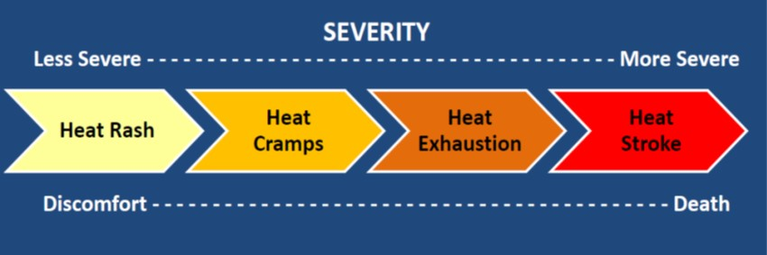
Progression of Heat-Related Illnesses (Source: NIOSH)
Less Severe More Severe
Heat Rash Heat Cramps Heat Exhaustion Heat Stroke
Heat Syncope Rhabdomyolysis

Slide 34
Heat Rash: Cause and Prevention
Cause
Preventative Measures
Irritation of skin due to excessive sweating
Wear loose fitting clothing that allows sweat to dissipate
Wear freshly laundered clothing each day
Avoid working in sweat soaked clothing for prolonged periods (e.g., change at breaks as needed)
Wash sweat-soaked areas with mild soap and water and dry thoroughly at breaks and after your shift ends

Slide 35
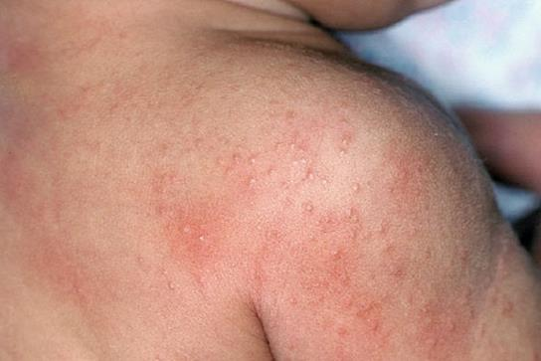
Heat Rash: Signs & Symptoms
Itchy and painful clusters of red blisters
Common to the neck, chest, groin, armpits and creases of the elbows and knees
Heat rash (Source DOD)

Slide 36
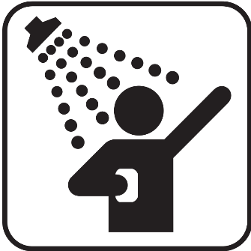
Heat Rash: First Aid Treatment
Move person to a cool location
Have person take a cool shower
Thoroughly dry the skin following shower
Continue to ensure skin is cleaned and dried frequently, especially before and after shifts
Seek medical treatment if rash persists for more than two days or if rash become infected
Shower (Clipart)

Slide 37
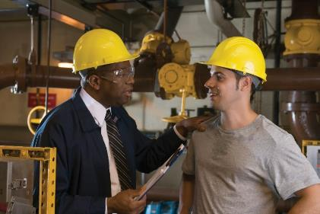
Heat Rash: Reporting
Report to supervisor or safety manager
Seek medical treatment if rash persists for more than two days or if rash becomes infected
Report to Supervisor (Stock Photo)

Slide 38
Heat Cramps: Cause and Prevention
Cause
Preventative Measures
Depletion of salt and water in body due to excessive sweating.
This is a precursor to more serious heat exhaustion and/or heat stroke.
Acclimatization to heat helps reduce salt and water loss
Drink adequate amounts of water throughout the day
Salt your foods to taste

Slide 39
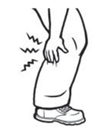
Heat Cramps: Signs & Symptoms
Muscle cramps, spasms and/or pain
Common to major muscles used for work
  Arm muscles
  Leg muscles
  Abdominal muscles
  Back muscles
Heat cramps (Source OSHA)

Slide 40
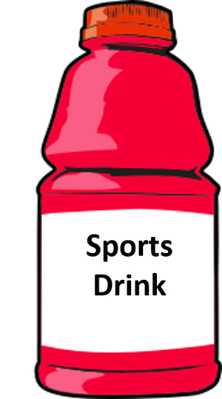
Heat Cramps: First Aid Treatment
Move person to a cool location
Provide person with an electrolyte replacement fluid to replace lost salt and water
Seek medical treatment if cramps persist or other heat-illness symptoms develop
Sports Drink (Stock Photo)

Slide 41
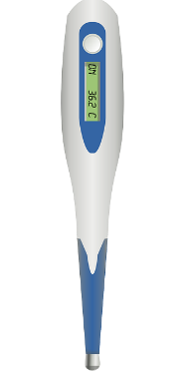
Heat Cramps: Reporting
Report to supervisor or safety manager
Seek medical treatment if cramps persist or other heat-illness symptoms develop
  Elevated body temperature
  Elevated heart rate
  Headache
  Dizziness, etc.
Check Temperature and heart rate (Stock Photo)

Slide 42
Heat Syncope: Cause and Prevention
Cause
Preventative Measures
Prolonged standing or sudden rising from a sitting or resting (supine) position
Dehydration can be a contributing factor
Acclimatization to heat helps reduce dehydration
Drink adequate amounts of water throughout the day
Break up long periods of standing with small rest breaks
Rise slowly from sitting or resting positions

Slide 43
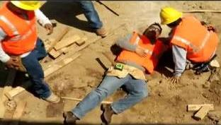
Heat Syncope: Signs & Symptoms
Light-headedness or dizziness
Fainting
Worker fainted on job (Source: Cal OSHA)

Slide 44
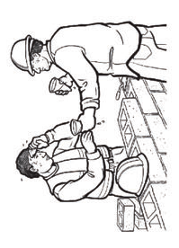
Heat Syncope: First Aid Treatment
If person fainted, then secure the area, elevate their feet above heart level and request immediate first aid and/or medical attention; do not allow them to get up quickly or walk
If person is only slightly dizzy and able to move
  Have two people assist and carefully move to a cool location and have them lay down on back with feet elevated above heart level
  Provide small amounts of water
  If the dizziness persists, request immediate first aid and/or medical attention
Provide water and rest (Source: OSHA)

Slide 45
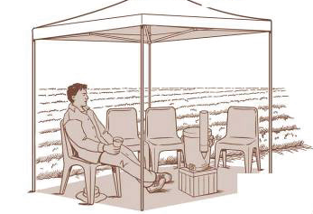
Heat Syncope: Reporting
Report to supervisor or safety manager
If they fainted or dizziness persists, request immediate first aid and/or medical attention
Provide water, rest and monitor (Source: OSHA)

Slide 46
Heat Exhaustion: Cause and Prevention
Cause
Preventative Measures
Inability of body to cool itself, often due to a combination of several factors (e.g., high temperatures, humidity, physical exertion, dehydration, clothing that blocks sweat evaporation or alcohol use).
  This is a serious condition that can lead to a life-threatening heat stroke.
Acclimatization to heat helps reduce dehydration
Drink adequate amounts of water throughout the day
Take small rest breaks in shade to allow body to recover from heavy physical exertion and heat exposure
Protect skin against sunburn, which reduces body’s ability to cool itself
If possible, perform heavier physical labor towards cooler part of the day (e.g., early morning or evening)

Slide 47
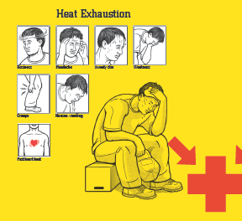
Heat Exhaustion: Signs & Symptoms
Elevated core body temperature of 100.4 to 102.2 °F; oral temperature 99.6 to 101.4 °F
Weak, but rapid pulse (elevated heart rate)
Cool, moist skin
May appear pale with clammy skin
Excessive sweating
Headache and possible irritability
Fatigue or weakness
Dizziness and/or feeling faint
Nausea and/or vomiting
Decreased urine output
Heat exhaustion (Source Cal OSHA)

Slide 48
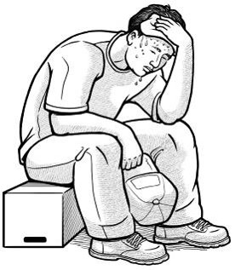
Heat Exhaustion: First Aid Treatment
Seek immediate medical care
Immediately help the person cool off
  Move to a cool location
  Remove or loosen unnecessary clothing
  Have them drink small amounts of cool water
  Spray skin with cool water and fan rapidly to increase evaporation and cooling
  Monitor body temperature and continue cooling efforts until body temperature returns to a normal temperature below 99 °F (37 °C).
  Implement additional heat stroke treatments if body temperature does not decrease below 100 °F (37.8 °C) after 30 minutes or increases above 102 °F (38.9 °C).
Heat exhaustion (Source: OSHA)

Slide 49
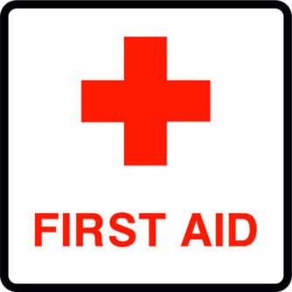
Heat Exhaustion: Reporting
Seek immediate medical care, especially if worker does not recover in first hour
Report to supervisor or safety manager
First aid (Clipart)

Slide 50
Heat Stroke: Cause and Prevention
Cause
Preventative Measures
Body is unable to cool itself and regulate core body temperature.
  This is a serious and life-threatening condition that requires immediate medical attention
  (call 911).
Same as for Heat Exhaustion
  Acclimatization
  Drink adequate amounts of water throughout the day
  Take small rest breaks in shade
  Protect skin against sunburn
  If possible, perform heavier physical labor towards cooler part of the day

Slide 51
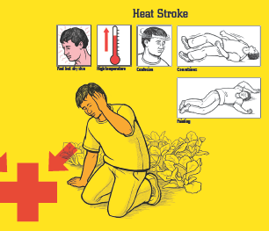
Heat Stroke: Signs & Symptoms
Elevated core body temperature above 104 °F
Oral temperature above 103.2 °F
Hot, dry skin or heavy sweating
Fainting or a loss of consciousness
Seizures or convulsions
Mental confusion, agitation
Irrational behavior
Clumsiness
Slurred speech
Heat stroke (Source Cal OSHA)

Slide 52
Heat Stroke: First Aid Treatment
Seek immediate medical care (call 911)
Provide immediate and aggressive cooling to their body
  Elevate feet above heart level
  Remove or loosen unnecessary clothing
  Pack ice in groin and armpit areas
  Soak skin with cool water and fan vigorously to increase cooling of skin
  As an alternative, immerse them in a tub of cool water or spray body with large amounts of cool water
  Do not give person fluids to drink if unconscious or vomiting
  Monitor body temperature and continue cooling efforts until body temperature returns to a normal temperature below 99 °F (37 °C).
  Administer CPR as needed, if blood circulation or breathing stops, until emergency medical services arrive
Call 911 (OSHA)

Slide 53
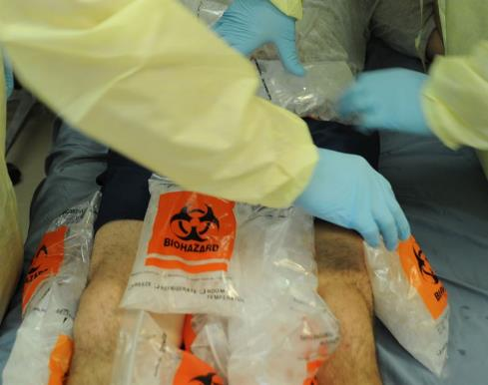
First Aid Treatment for Heat Stroke
Pack Ice along arm pit and groin areas (Source: DOD)
Remove clothing, spray skin with water and fan vigorously (Source: CDC)

Slide 54

Heat Stroke: Reporting
Seek immediate medical care (call 911)
Report to supervisor or safety manager
Hospital (Clipart)

Slide 55
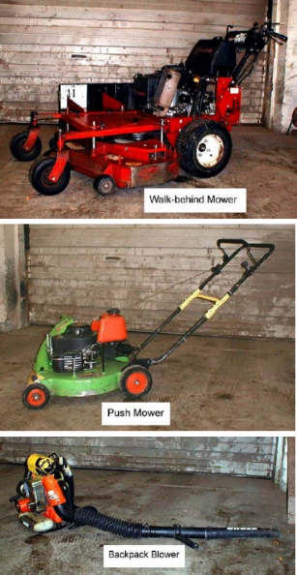
NIOSH Investigation: Landscaping
FACE #02-MI-75-01
What factors contributed to his heat stress?
30-year-old male performing lawn work
Two layers of clothing
Outside in sun during summer
  Temperature 81 °F
  Humidity likely > 60% (not reported)
Taking an antidepressant and antipsychotic
  Antipsychotic had warning on heat exposures and heavy physical exertion
Landscaping (Source: NIOSH)

Slide 56
He suffered and died from heat stroke due to a multiple drug intoxication
He complained of being light headed and short of breath at 3 PM
Co-worker brought him water and offered to get him help, but he refused help
Worked 30 more minutes at another location and then collapsed
After being transported to the hospital, his body temperature was 107.6 °F
Ambulance (Source: Cal OSHA)

Slide 57
NIOSH Investigation Recommendations
When hot outside, supervisors should consistently check on their employees for heat stress.
Have medical staff help workers who take medications understand what may happen to them when outside in high heat conditions.
Train staff on heat related illnesses before summer starts.
Train staff on heat-related illness signs and symptoms.
Give reminders throughout the day on drinking fluids.

Slide 58
Rhabdomyolysis: Cause and Prevention
Cause
Preventative Measures
Sometimes caused by a combination of heat stress and prolonged physical exertion
Muscle starts to break down and die, releasing proteins and electrolytes into the bloodstream.
  This is a potentially life-threatening condition affecting the kidneys that requires immediate medical attention.
Same as for heat exhaustion and heat stroke
Avoid overexertion, such as lifting objects heavier than you can comfortably lift or straining muscles to a point where they can no longer function properly.
Those with diabetes, thyroid conditions or muscular dystrophy are at greater risk.
Those with a viral infection, such as flu, HIV or herpes, are at greater risk.
Use of alcohol & illegal drugs, such as heroin, cocaine & amphetamines can increase the risk.
Some medications, such as such as antipsychotics or statins, can increase the risk.

Slide 59
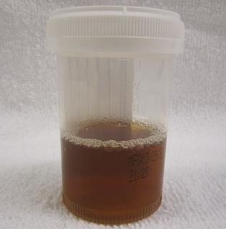
Rhabdomyolysis: Signs & Symptoms
Muscle cramps, pain and/or loss of range
Joint pain and/or stiffness
Swelling of muscles
Weakness and a decreased ability to perform physical exertion for even a small amount of time
Dark urine (similar to tea or cola in color)
If kidney damage and/or failure occurs the following life-threatening indicators may be observed:
  Shortness of breath
  Irregular heart beat
  Swelling in the legs and feet
  Seizures
  Coma
Rhabdomyolysis urine (Creative Commons: James Heilman, MD)

Slide 60
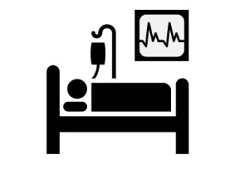
Rhabdomyolysis : First Aid Treatment
Seek immediate medical care (call 911)
IV fluids and treatments to combat toxic proteins in blood are needed to prevent kidney failure
Hospital (Clipart)

Slide 61

Rhabdomyolysis: Reporting
Seek immediate medical care (call 911)
Report to supervisor or safety manager
Hospital (Clipart)

Slide 62
Section 4:
Heat-illness prevention strategies

Slide 63
Heat-illness prevention strategies
When Risk Level is High Incorporate Physiological Monitoring
Hierarchy of controls
Engineering controls
Administrative controls
Protective clothing & equipment

Slide 64
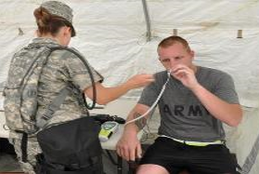
When Risk Level is High Incorporate Physiological Monitoring
Oral temperature
Heart rate recovery
Additional measures to help reduce dehydration
  Body weight
  Urine color
Oral temperature monitoring (US ARMY DOD)

Slide 65
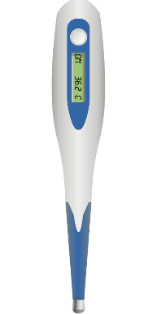
Oral temperature
It is important to make sure the thermometer is stored in a cool environment and not exposure to temperatures above 95 °F.
Readings should not be taken be taken within 15-minutes of consuming hot or cool liquids and foods or if breathing heavy (mouth breathing).
Oral temperatures should not exceed 99.5 °F.
As a precautionary measure, when the oral temperature is elevated above 99.1 °F, adjust the work-rest schedule to increase the frequency and duration of rest breaks or take other preventative measures.
Oral thermometer (Stock Photo)

Slide 66
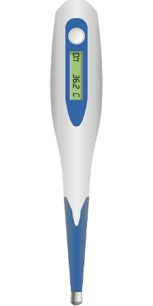
Oral Body Temperature
Guidelines
Oral temperature should not exceed 99.5 °F
When the oral temperature is elevated above 99.1 °F:
  Adjust the work-rest schedule to increase the frequency and duration of rest breaks or take other preventative measures
Oral thermometer (Stock Photo)

Slide 67

Oral Body Temperature Measurement
Use a reliable and accurate clinical thermometer according to the manufacturer’s instructions.
  Disposable oral thermometers; readings will take longer (e.g., 3-4 min).
  Digital oral thermometers can deliver an accurate reading in as little as 30 seconds.
Make sure the thermometer is stored in a cool environment below 95 °F.
Do not take readings within 15-minutes of consuming hot or cool liquids and foods or if the worker is breathing heavy by mouth.
Oral Thermometer
(Source: PHIL)

Slide 68
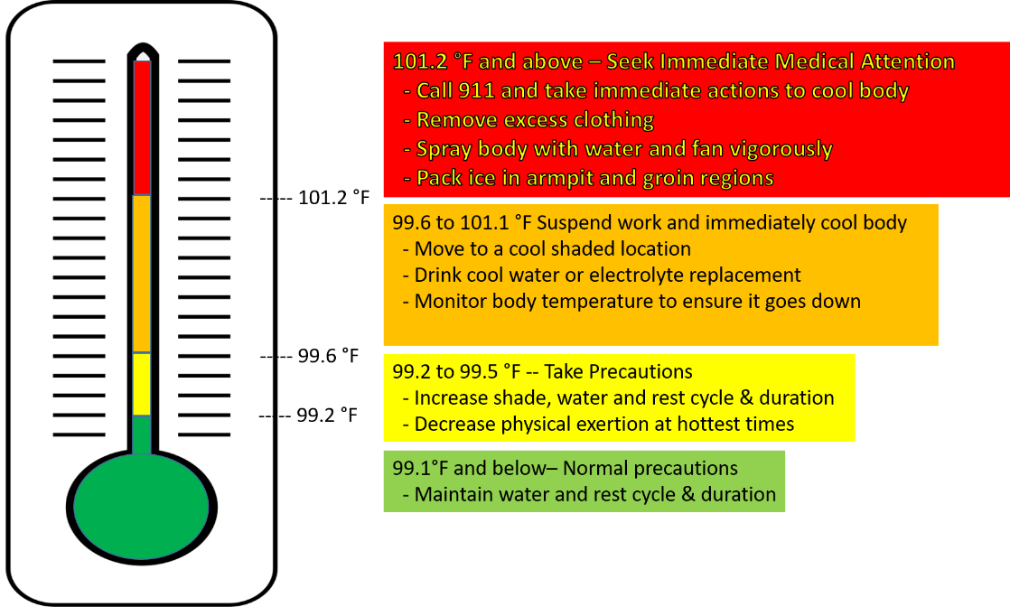
Oral Temperature Warning Levels

Slide 69
Table 13. Collection and Interpretation of Oral Temperatures
STEP | Instructions
Schedule times for collection | During the hottest times of the workday, collect oral temperatures at least every hour. Under severe conditions, the cycle should be at least every 30 minutes.
Collect oral temperature | If worker is not breathing heavily by mouth, then collect oral temperature at a scheduled rest breaks, before consumption of fluids. If worker is breathing heavily, then first drink fluids and collect temperature at end of rest break, 15-minutes after drinking fluids.
Reading less than 99.1 °F | If thermometer reading is less than 99.1 °F, then resume normal work activities and work-rest schedule.
Reading 99.2 to 99.5 °F | If thermometer reading is 99.2 to 99.5 °F, then take precautionary measures to reduce heat stress (e.g., adjust work-rest schedule or implement additional controls)
Reading above 99.5 °F | If thermometer reading is above 99.5 °F, then suspend work and physical exertion within the hot environment and take immediate actions to cool body temperature (e.g., relocate to a cool environment with air movement and provide cool fluids). Monitor body temperature and continue cooling efforts until body temperature returns to a normal temperature below 99 °F. Seek medical attention if worker exhibits additional signs of heat exhaustion or temperature does not drop or continues to elevate at rest.
Reading above 101.2 °F | If thermometer reading is above 101.2 °F, then seek immediate medical attention and take immediate actions to cool his/her body temperature assuming potential heat stroke conditions (e.g., relocate to a cool location with air movement, remove excess clothing, spray body with cool water and fan vigorously, and pack ice in armpits and groin area).

Slide 70
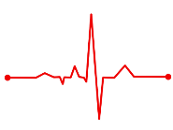
Methods for Collecting Pulse Rate
Heart rate pulse (Clipart)
The pulse rate can be collected manually
A reliable and accurate clinical pulse rate device for the finger, wrist or chest is recommended.
  Use the guidelines provided by the device manufacture when collecting pulse rates.
Collect pulse rate at start of rest break
As the pulse rate will change with time, it is important to collect the pulse rate within a consistent and short interval (e.g., 5 to 10 seconds).

Slide 71
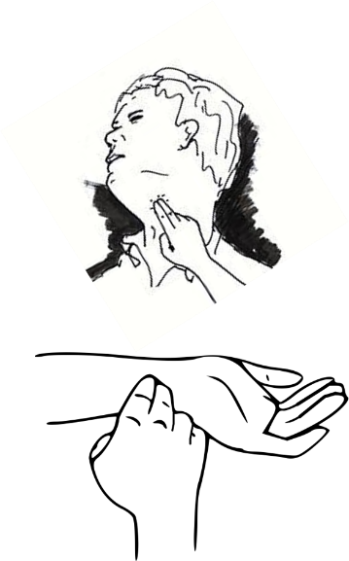
Manually Counting Pulse Rate
Count the pulses at the inner wrist just below the palm on the thumb or neck to the side of the windpipe over a 30 second timed interval (e.g., using a stopwatch).
Use the index and middle fingers to detect a pulse and do not start counting until a reliable pulse can be detected. A slight amount of pressure may be necessary.
The number of pulses is then multiplied by 2 to give the pulse rate in bpm.
Check pulse (Clipart)

Slide 72
Heart Rate Recovery
Take pulse rate readings at the beginning of a scheduled rest break.
With the worker sitting and resting, collect an initial pulse rate reading (P1) and if it is above 110 bpm, then take readings at a two-minute (P2) and four-minute (P3) interval.
If pulse rate does not drop to below 110 bpm, then this indicates heat stress conditions are above an acceptable level. The resting heart rate is too high, which indicates the work rate is too high for the individual.
With P1 above 110 bpm, if the difference between two-minute intervals is less than 10 bpm, then this also indicates heat stress conditions are above an acceptable level. The heart rate is not effectively recovering at rest, which also indicates the work rate is too high for the individual. It could also indicate dehydration.

Slide 73
General Guidelines for Heart Rate Recovery
Within the first few minutes of rest
Your heart rate should drop to below 110 bpm
If it does not, then measure again at 2-minute intervals
Your heart rate should drop by more than 10 bpm every 2-minutes

Slide 74
Table 14. Collection and Interpretation of Pulse Rates
STEP | Instructions
Schedule times for collection | During the hottest times of the workday, collect pulse rates at least every hour. Under severe conditions, the cycle should be at least every 30 minutes. Collect at the start of the rest break, within the first few minutes.
Collect initial pulse rate (P1) | Have the work sit on a stool or chair and rest. Collect the initial pulse rate within a few minutes after the worker has stopped working, at the start of the rest break.
If P1 is below 110 bpm | If the pulse rate is below 110 bpm, then resume normal work activities and work-rest schedule.
If P1 is above 110 bpm | If the pulse rate is above 110 bpm, then evaluate heart rate recovery by collecting two additional pulse rate measurements at two-minute intervals.
If differences between 2-minute intervals is greater than 10 bpm and the pulse rate drops below 110 bpm | If differences between 2-minute intervals is greater than 10 bpm and the pulse rate drops below 110 bpm, then resume normal work activities and work-rest schedule.
If differences between 2-minute intervals is less than 10 bpm | If differences between 2-minute intervals is less than 10 bpm, then suspend work and physical exertion within the hot environment and take immediate actions to cool his/her body temperature (e.g., move to a cool location with air movement and provide cool fluids). Monitor pulse rate and/or body temperature and continue cooling efforts until pulse rate drops below 90 bpm or body temperature returns to normal below 99 °F. Seek medical attention if worker exhibits additional signs of heat exhaustion or pulse rate and/or temperature do not drop or continue to elevate at rest.

Slide 75
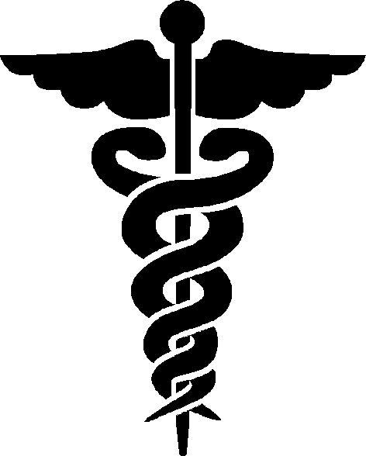
Caution: Heart Rate Recovery
There can be variation among individuals and some may exhibit much lower or higher resting pulse rates. A qualified medical provider should examine individuals with pre-work pulse rates above 100 bpm when at normal rest. High resting pulse rates could be indicative of an underlying medical condition.
Medical symbol (Clipart)

Slide 76
Class Exercise #1
Body Temperature and Heart Rate Recovery
Worker #1
Worker #2
Oral temperature 98.9 °F
Heart rate
  P1: 140 bpm
  P2: 115 bpm
  P3: 95 bpm
Oral temperature 99.4 °F
Heart rate
  P1: 125 bpm
  P2: 120 bpm
  P3: 118 bpm

Slide 77
Class Exercise #1
What is your assessment for each worker?
Can they return to normal duties?
Worker #1
Worker #2
___________________________________________________________________________________________________________________________________________________
__________________________________________________________________________________________________________________________________________________________

Slide 78
Hierarchy of Controls – a combination of several is always recommended
Engineering
Use tools & equipment to reduce physical exertion
Administrative
Acclimate workers
Training
Clothing & Equipment
Adjust clothing layers
Cooling vests and clothing
Reduce heat stress factors
Reduce WBGT
Adjust work schedule
Rest, water & shade
Light colored or reflective clothing

Slide 79
Engineering Controls
Reduce physical exertion and physical demands of work through use of powered tools and equipment, especially for tasks involving heavy lifting.
Reduce radiant heat loading from the sun or other sources of radiant heat (e.g., furnaces, combustion engines and compressors, hot surfaces, heated transfer lines, windows receiving intense sun, etc.). Place line-of-sight, reflective barriers between the heat source and workers. Insulate hot surfaces, such as furnaces.
If air temperatures are below 95 °F, then increase air speed across skin using fans or air movers, to increase evaporative cooling from skin.
If air temperatures are above 95 °F, then reduce air speed across skin, to reduce convective heat transfer from air to skin.
If humidity is below 50%, then evaporative coolers and portable fans with water mist systems can be used to effectively cool the air by about 10 to 20 °F.
Decrease humidity to below 50% to increase evaporative cooling from sweating.

Slide 80
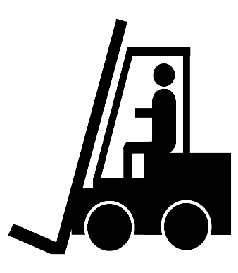
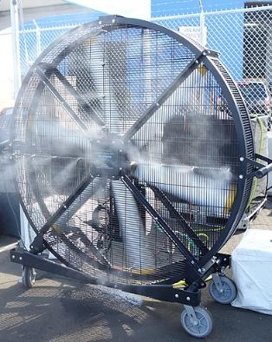
Examples of Engineering Controls
Forklift (Clipart)
Misting fan (Wikimedia Creative Commons by Tdorante10)

Slide 81
Administrative Controls 1 - 5
Adjust work schedule to acclimate workers to heat.
Schedule work or work requiring heavy physical exertion during the coolest parts of the day.
Modify the work-rest schedule to shorten heat exposure periods by including frequent rest breaks. Shorter, more frequent breaks are more effective than longer, less frequent rest breaks.
Encourage adequate water intake at frequent intervals to prevent dehydration (e.g., one 8-ounce cup of cool water or an electrolyte replacement fluid every 15-20 minutes).
Use a shaded and cool space nearby for rest and water breaks.

Slide 82
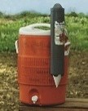
Water for Remote Job Sites
Water quantities need to be sufficient and at least 1 quart per worker per hour for the entire shift
Locate water containers as close as possible
Frequently drink water and not wait until thirsty – at least 1 cup every 15-20 minutes
Water cooler (Source: Cal OSHA)

Slide 83
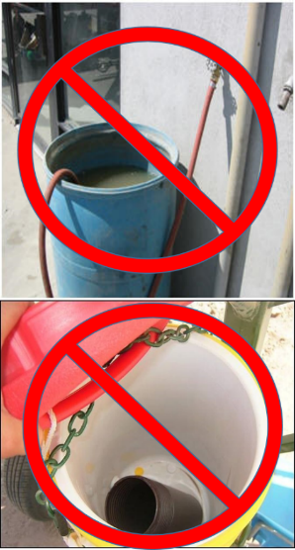
Review: Water for Remote Job Sites
Sanitation
  Ensure water containers are clean and sanitary
  Ensure water containers are filled at a sanitary location
  Use disposable cups
  Do not share cups and dispose properly
  Do not open the cooler top to fill cups - Instead use the provided spigot
Use only pure and cool potable water
  Do not use water from irrigation, sprinklers or fire systems
  Do not use water from a garden hose (may contain contaminants and/or microbes)
Unacceptable water (Source: Cal OSHA)

Slide 84
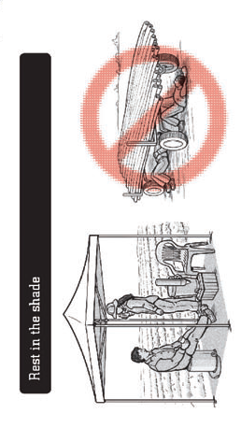

Examples of Administrative Controls
Adjust work schedule to have heavy physical exertion at cooler times of day (Clipart)
Rest in shade (OSHA)

Slide 85
Administrative Controls 6 - 11
Give training on the recognition of the signs and symptoms of heat-induced illness and on heat-illness prevention strategies.
Provide alerts for extreme heat events or heat stress conditions and review of the heat-illness prevention strategies for the day.
Work in pairs (buddy system) and monitor each other for signs and symptoms of heat stress or illness.
Avoid caffeine and alcohol before and during work in heat.
Report illnesses or medical conditions that may put you at risk of heat stress (e.g., diarrhea, fever, infection, etc.)
Get medically screened for work in hot environments.

Slide 86
Protective Clothing and Equipment Controls
Wear clothing designed to keep the body cool, such as air, cooled fluid or ice-cooled conditioned clothing.
Wear reflective clothing to reduce radiant heat loading from the sun or hot surfaces radiating heat.
If air temperatures are below 95 °F and you are protected from radiant heat, then decrease clothing coverage or layers (when feasible) to increase evaporative cooling from skin.
    Caution: Do not remove clothing designed to protect you from chemical, mechanical or other hazards without a proper evaluation to address those hazards.
If air temperatures are above 95 °F, then increase clothing coverage to reduce air speed across skin, which can help reduce convective heat transfer from air to skin.

Slide 87
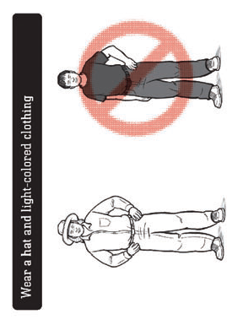

Examples of Protective Clothing Controls
Ice vest (DOD)
Light colored clothing (OSHA)

Slide 88

CalOSHA Video on Heat Stress
CalOSHA Video on Heat Stress
Water. Rest. Shade.

Slide 89
Section 5:
Preparing for medical emergencies

Slide 90
Preparing for Medical Emergencies
When workers are exposed to heat stress conditions, it is critical to ensure adequate supervision, first aid and medical services are readily available in the event a worker suffers from a heat illness.
This includes ensuring adequate first aid supplies are available and supervisors and workers are trained on what to do if a co-worker suffers from a heat-related illness.
Preparation
Supervision
Training
First aid supplies
First aid providers
Nearby medical services

Slide 91

First Aid Supplies: Have On Hand
Reliable oral thermometer for checking body temperature.
Reliable instrument or timer for checking heart rate.
Cool water or electrolyte replacement fluids.
Cold packs or ice packs for treatment of heat stroke.
Spray bottles with water or an available water source for treating heat stroke.
First aid (Clipart)

Slide 92

First Aid Providers
Each work site should have at least one person trained to administer first aid, with two or more preferred.
The location, physical address and phone number of the nearest hospital or emergency medical services must be obtained prior to the beginning of work activities under hot conditions.
First aid (Clipart)

Slide 93

Emergency Response Information
The following emergency response information must be obtained prior to the beginning of work activities.
Names, locations and phone numbers of all first aid trained supervisors or key personnel on site.
Phone numbers for on-site or local medical emergency services.
Address, phone number and directions from site to closest emergency medical services (e.g., hospital).
Physical address and detailed directions for emergency medical services. If the site is a remote location, then check with emergency medical services to ensure they can find the location. Some providers may require GPS coordinates.
Map (Source Cal OSHA)

Slide 94

Near the end… Anything to add?
________________________________________________________________________________________________________________________________________________________________________________________________________________________________________________________________________________________________________

Slide 95
Review of Learning Objectives
  Discuss why heat-illness prevention is important
  Know cause, prevention and first aid for heat illnesses
  Understand the approach for heat-illness prevention
    Train workers and supervisors on prevention strategies and to recognize signs and symptoms of heat-related illnesses
    Monitor weather and workplace conditions
    Assess heat-related hazards
    Implement appropriate prevention strategies and controls
    Plan for heat-related medical emergencies
  Understand how physiological monitoring can be used to help prevent heat-related illnesses

Slide 96
Take Post-Test and Complete Survey
The post-test and survey helps us determine if we did a good job or need to make improvements in certain areas.
THANK YOU!
BE SAFE!
Test (Clipart)

