Slide 1
Heat-Related Illnesses: Recognition
A Risk Easy to Battle

Slide 2
Instructor’s Notes: Heat-related Illnesses
Heat-related illnesses are caused by environmental exposure to heat.
Heat-related illnesses can occur indoors as well as outdoors.
Includes minor conditions such as heat cramps, heat rash and heat syncope (fainting), the serious condition of heat exhaustion, and the severe condition of heat stroke, which can be fatal.
Hyponatremia when caused by exercise, such as working outdoors, is considered a heat-related illnesses.
Heat rash – sweat produced by skin cannot evaporate – red bumps, tiny blisters, itching.

Slide 3
Heat-Related Illnesses
Caused by environmental exposure to heat
Can occur indoors as well as outdoors
Heat rash
Heat syncope
Heat cramps
Heat exhaustion
Hyponatremia
Heat stroke

Slide 4
Instructor’s Notes: Risk Factors
Lack of acclimatization. Workers should gradually increase their heat exposure over 7-14 days.
Environment: High temperatures, high humidity. direct sun exposure, lack of air movement. High humidity inhibits the evaporation of sweat, the bodies natural cooling mechanism.
Indoor radiant heat sources such as furnaces and ovens.
Clothing: multiple layers, dark colors, tight-fitting or restricts air movement. Personal protective equipment that is air and vapor impermeable increases the risk of heat-related illnesses.
Not drinking enough fluids may lead to dehydration.

Slide 5
Risk Factors
Workers who are not acclimatized to heat
Environmental: High temperatures, high humidity, direct sun exposure and lack of air movement
Indoor radiant heat sources
Clothing: multiple layers, dark colors, tight-fitting or restricts air movement
Not drinking enough fluids

Slide 6
Instructor’s Notes: Risk Factors Continued
Some medications affect heat tolerance. Workers should talk with their health care provider.
Alcohol use prior to or during work in a hot environment is known to increase the risk of heat-related illnesses.
Caffeine is a mild diuretic, is a hot beverage and should not be given to workers to replace fluids from sweating.
Age - Older workers are more susceptible to heat-related illnesses.
Obesity and lack of physical fitness.
Pregnant workers – as pregnancy progresses heat tolerance is reduced.
Workers in poor health
Previous heat-related illness.

Slide 7
Risk Factors Continued
Some medications
Alcohol and caffeine
Age
Obesity and lack of physical fitness
Pregnant workers
Workers in poor health
Previous heat-related illness

Slide 8
Instructor’s Notes: Dehydration
Your body doesn't have enough water and other fluids to carry out its normal functions.
Often caused by heavy sweating in high temperatures.
If dehydration exceeds 1.5% to 2% of body weight, then tolerance to heat stress begins to deteriorate, heart rate and body temperature increase, and work capacity decreases.

Slide 9
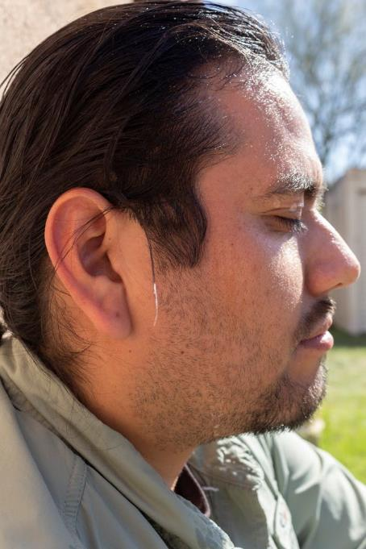
Dehydration
When you use or lose more fluid than you take in

Slide 10
Instructor’s Notes: Heat Cramps
Muscle cramps, pain or spasms that can be caused by the loss of electrolytes from heavy sweating.
Often in the abdomen, legs or arms.
Can also be caused by drinking large quantities of water and diluting the electrolytes.
Can be a sign and symptom of heat exhaustion.

Slide 11
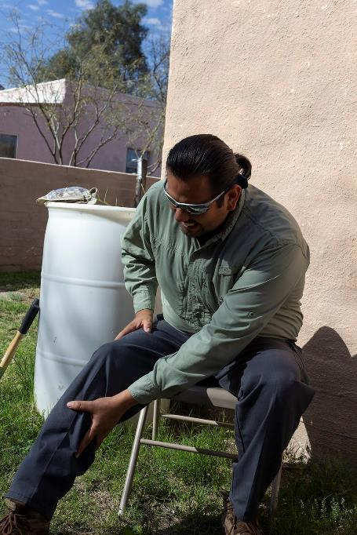
Heat Cramps
Muscle cramps or spasms caused by the loss of electrolytes from heavy sweating.

Slide 12
Instructor’s Notes: Heat Exhaustion
Heat exhaustion is a condition that is a result of your body overheating
Signs and symptoms of heat exhaustion include: headache, nausea, dizziness, heavy sweating, irritability, thirst, and an elevated body temperature.
Usually there is a decrease in urine output.
Heat cramps can also be a sign and symptom.
Skin is usually pale, cool and clammy.
Heat exhaustion can lead to heat stroke if not treated.

Slide 13
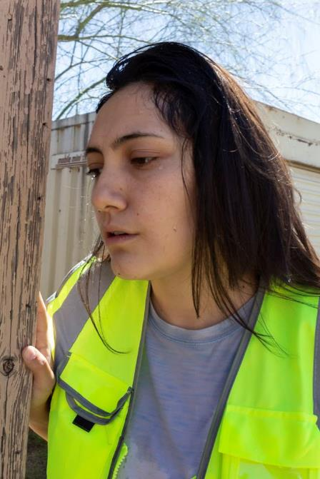
Heat Exhaustion
Your body is overheating
Headache, nausea, dizziness
Heavy sweating
Irritability
Thirst
Elevated body temperature

Slide 14
Instructor’s Notes: Heat Stroke
The most serious heat-related illnesses.
Heat stroke is a true medical emergency.
Signs and symptoms include confusion; loss of consciousness; hot, dry, and red skin; seizures and a very high body temperature.
We used to think that as long as someone was sweating they were not in heat stroke. This is wrong. Victims can be sweating.
Untreated heat stroke can quickly damage your brain, heart, kidneys and muscles.
Heat stroke can be FATAL if not quickly treated.

Slide 15
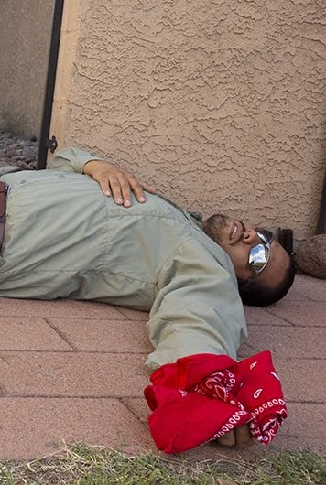
Heat Stroke
Your body can no longer regulate its core temperature
A true medical emergency.
Confusion
Loss of consciousness
Hot, dry, red skin
Seizures
Very high body temperature

Slide 16
Instructor’s Notes: Hyponatremia
Low plasma sodium.
Can occur in people working for long periods of time in hot environments, usually great than 4 hours.
Caused by drinking large quantities of water without replacing the sodium lost from sweating.
Signs and symptoms: nausea, vomiting, headache, confusion, loss of energy, fatigue, drowsiness, irritability, muscle weakness or cramps, seizures, coma. Can be fatal.
Frequent urination. Clear or very pale yellow urine.
Can be confused with heat exhaustion.

Slide 17
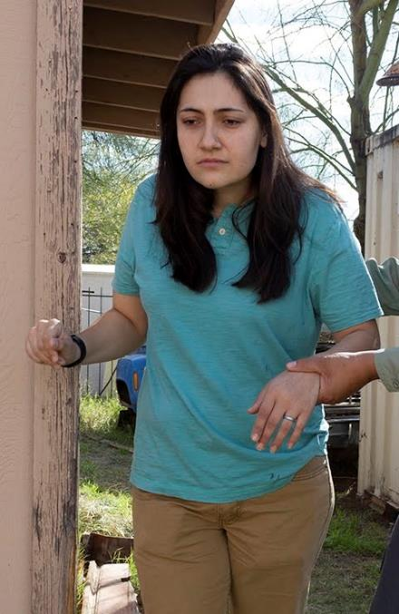
Hyponatremia
Low level of sodium in the blood
Nausea, vomiting
Headache, irritability, confusion
Loss of energy, fatigue and drowsiness
Muscle weakness or cramps
Frequent urination
Seizures, coma

Slide 18
Instructor’s Notes: Prevention:
We’ve talked about how to recognize and treat heat-related illnesses.
Now we are going to talk about ways workers can help prevent these illness while working in hot environments.

Slide 19
Heat-Related Illnesses: Prevention
A Risk Easy to Battle

Slide 20
Instructor’s Notes: Employer Responsibility
Every year, dozens of workers die and thousands more become ill while working in extreme heat or humid conditions.
OSHA does not have a specific standard that covers working in hot environments. Nonetheless, under the OSH Act, employers have a duty to protect workers from recognized serious hazards in the workplace, including heat-related hazards.
OSH Act – Occupational Safety and Health Act of 1970

Slide 21
Employer Responsibility
Under OSHA law:
Employers have a duty to protect workers from recognized serious hazards including heat-related illnesses.
Workers have a right to a safe workplace.

Slide 22
Instructor’s Notes: Prevention
  A heat-related illness prevention program includes training, acclimatizing, resting in shade, drinking fluids and monitoring. We’ll be discussing each of these in more detail.

Slide 23
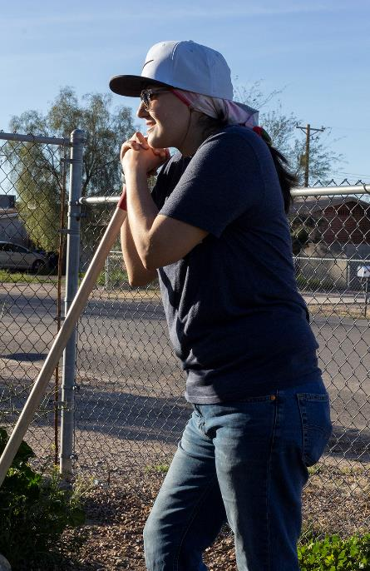
Prevention
Heat-related illnesses can be prevented
Key factors include:
  Training
  Acclimatizing
  Resting in shade
  Drinking fluids
  Monitoring

Slide 24
Instructor’s Notes: Acclimatize
Heat acclimatization means becoming more heat tolerant over time.
Gradually increase the time workers work in hot conditions over a period of 7 to 14 days.
Workers can regain acclimatization after a week-long vacation in a cooler climate in 2 to 3 days upon returning to a hot job.
Heat acclimati­zation increases sweating and therefore workers will have an increased need for fluids.

Slide 25
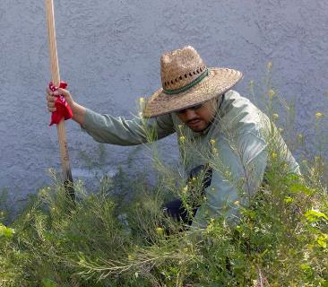
Acclimatize
Acclimatize – increasing your heat tolerance over time
Gradually increase work time in hot conditions over 10 – 14 days
After a vacation heat tolerance can be regained in 2 – 3 days.

Slide 26
Instructor’s Notes: Adjust Schedule
Try to work during the cooler part of the day if possible.
New workers who are not acclimatize to the heat should not work the same outdoor schedule for the first few days as acclimatized workers. Adjust their schedule until they are acclimatized.

Slide 27
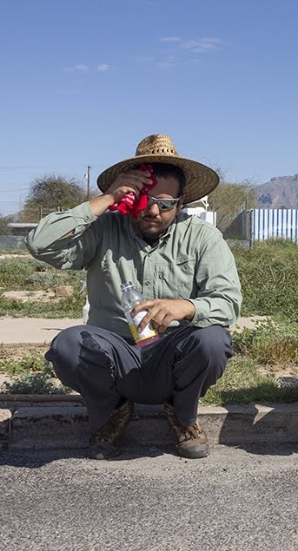
Adjust Schedule
Try to work during the cooler part of day
New workers may not be acclimatized – adjust schedule to allow time for acclimatization

Slide 28
Instructor’s Notes: Frequent Breaks
Take frequent breaks.
Get out of the direct sun.
Rest in a cool location
  Indoors in air conditioning
  Shady location
  No shade – provide a portable shade structure or industrial umbrella. These can be used while working as well to get workers out of the direct sun.
Use a fan to circulate air.

Slide 29
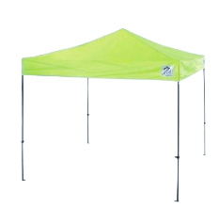
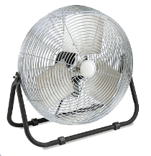
Take Frequent Breaks
Out of direct sun
Cool, shady location
Provide a shade structure if no shade available
Fan to circulate air

Slide 30
Instructor’s Notes: Fluids
Workers should drink a cup of cool water every 15 to 20 minutes when working in a hot environment.
Cool water is potable water less than 59 °F provided in individual not communal drinking cups.
During prolonged sweating lasting several hours workers should drink a drink that contains electrolytes such as a sports drink.

Slide 31
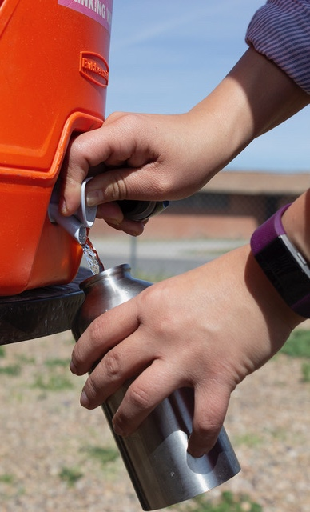
Drink Plenty of Fluids
A cup of cool water every 15 to 20 minutes
Water less than 59 °F
Individual drinking cups
During prolonged sweating - drinks such as sports drink to replace electrolytes

Slide 32
Instructor’s Notes: Salty Snacks
Workers working in hot environments should eat salty snacks to replace electrolytes.
Sports drinks alone do not replace electrolytes when workers are working in hot environments and sweating for prolonged periods of time.
Provide salty snacks and cool drinks during rest breaks.

Slide 33
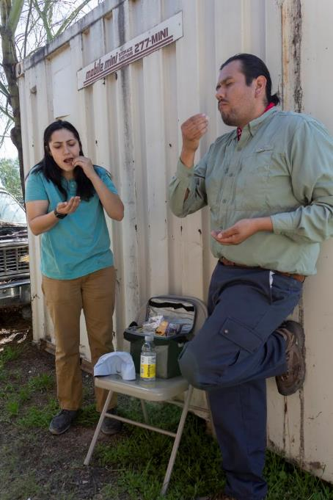
Eat Salty Snacks
Eat salty snacks in addition to drinking sports drinks
Replaces salt lost through sweating

Slide 34
Instructor’s Notes: Clothing
The clothing workers wear can help keep them cooler.
Workers should wear a hat with a wide brim. These are preferred over ball caps that only shade the face.
Light-colored, loose-fitting clothing is best.
Workers should wear sun glasses to protect their eyes.
Workers should use sunscreen to protect their skin.
Cooling garments can be worn to help keep workers cool.

Slide 35
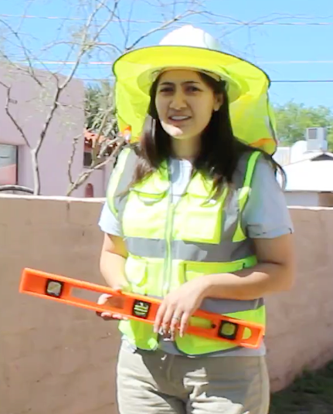
Wear Appropriate Clothing
Hat with a wide brim
Light-colored, loose-fitting clothing
Sun glasses
Sunscreen

Slide 36
Instructor’s Notes: Cooling Garments
Cooling garments can be worn to help keep workers cool.
Cooling bands that are wetted and worn around the neck. The water evaporates and cools the worker.
Cooling shirts that wick sweat away from the skin and help with evaporation and cooling
Special cooling personal protective equipment.

Slide 37
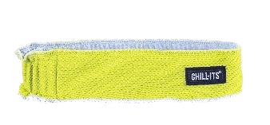
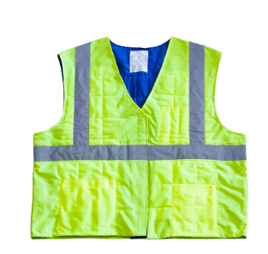
Wear Cooling Garments
Cooling bands - water evaporates and cool
Cooling shirts - wick sweat and cool
Special cooling personal protective equipment

Slide 38
Instructor’s Notes: Monitor
A buddy system can help prevent heat-related illnesses.
Workers should not working alone in hot environments.
Workers should be trained in recognizing, preventing and treating heat-related illnesses.
Workers should monitor each other for early signs and symptoms of heat-related illnesses.

Slide 39
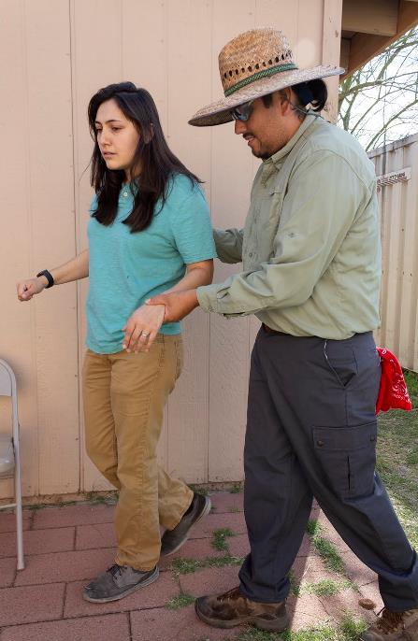
Monitor
Use a buddy system
Don’t work alone
Monitor each other for signs and symptoms of heat-related illnesses

Slide 40
Instructor’s Notes: Treatment
Now we are going to talk about treatment. Let’s review the heat-related illnesses first.
  Dehydration - when you use or lose more fluid than you take in
  Heat rash – sweat produced by skin cannot evaporate – red bumps, tiny blisters, itching.
  Heat syncope - fainting
  Heat cramps - muscle cramps or spasms caused by the loss of electrolytes from heavy sweating.
  Heat exhaustion – your body is overheating
  Heat stroke – your body can no longer regulate its core temperature

Slide 41
Heat-Related Illnesses: Treatment
A Risk Easy to Battle

Slide 42
Instructor’s Notes: Heat Stroke: Call
The first step is to recognize the emergency.
Heat stroke is a medical emergency and can be fatal. CALL 911.
Someone should stay with the worker until help arrives.
While waiting for help, there are additional first aid steps that you can take.

Slide 43
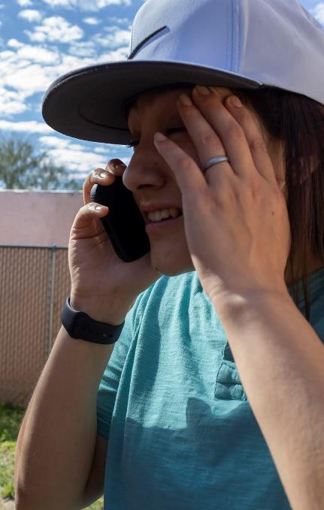
Heat Stroke: Call
CALL 911 - Heat stroke is a medical emergency

Slide 44
Instructor’s Notes: Heat Stroke: Cool
Move the worker to a shady cool area or air conditioned building.
Remove outer clothing.
Cool the worker any way you can.
  Cold compresses especially on head, neck, groin, and armpits
  Cold water or ice bath
  Spray with cold water
  Fan the worker
  Soak clothing with cold water
  Sponge with cold water

Slide 45
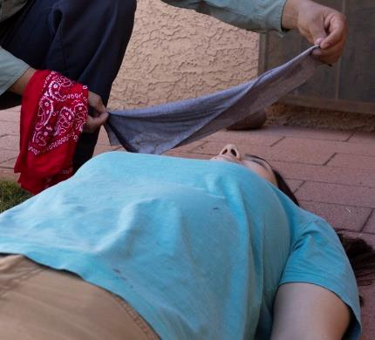
Heat Stroke: Cool
Move to shady cool area
Cool the worker any way you can

Slide 46
Instructor’s Notes: Heat Stroke: Drink
If the worker is responsive, give cool water to drink.
Do not give coffee, tea or other caffeinated beverages.
Do not give alcohol or sugary beverages.
Do not give very cold drinks as they may cause stomach cramps.
Be prepared to give CPR if worker stops breathing and is unresponsive.

Slide 47
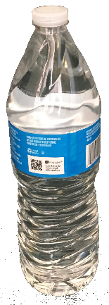
Heat Stroke: Drink
If the worker is responsive, give cool water to drink

Slide 48
Instructor’s Notes: Heat Exhaustion: Call
Call 911 if medical assistance is not available on site.
Move the worker to a shady cool area or air conditioned building.
Stay with the worker until help arrives.
While waiting for help, there are additional first aid steps that you can take.

Slide 49
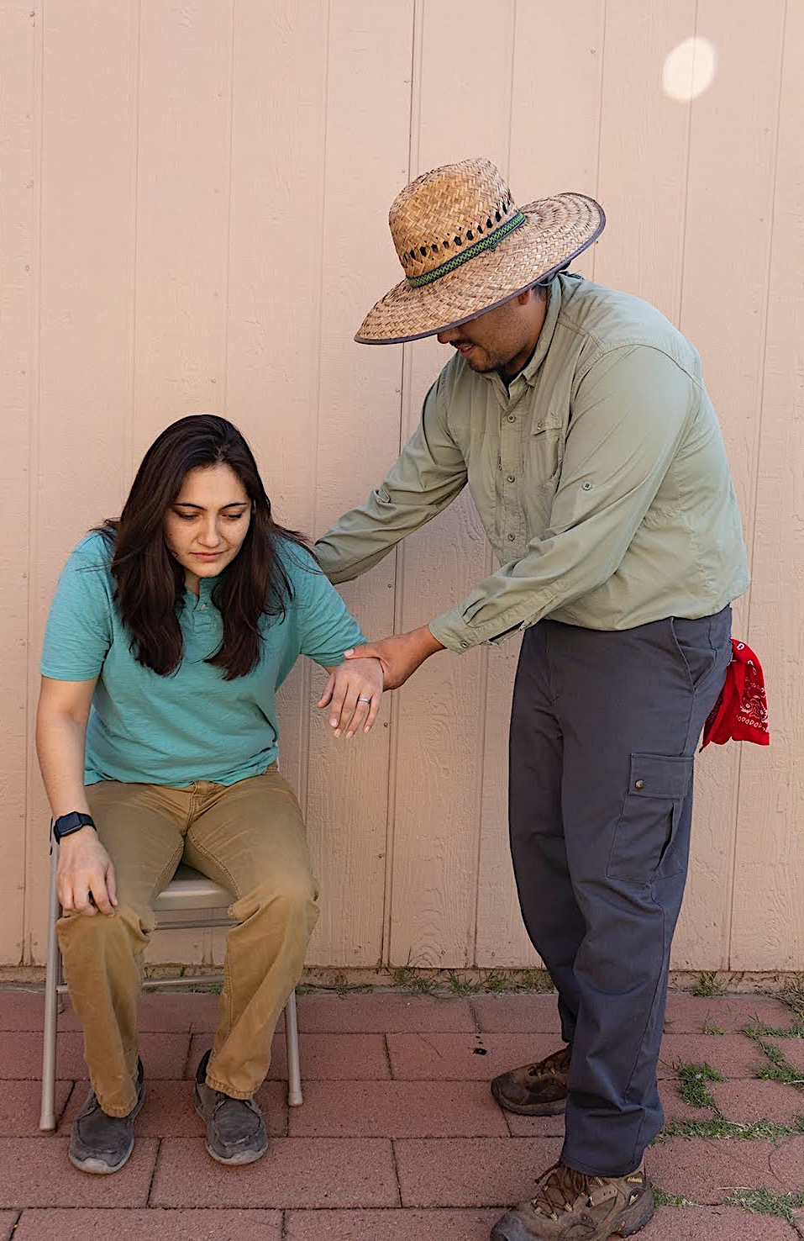
Heat Exhaustion: Call
Call 911 if no medical assistance on site
Move worker to a cool shady area

Slide 50
Instructor’s Notes: Heat Exhaustion: Cool
Loosen tight clothing and remove unnecessary layers.
Cool the worker.
  Cold compresses especially on head, neck, groin, and armpits
  Spray with cold water
  Fan the worker
  Soak clothing with cold water
  Sponge with cold water
  Have them rest.

Slide 51
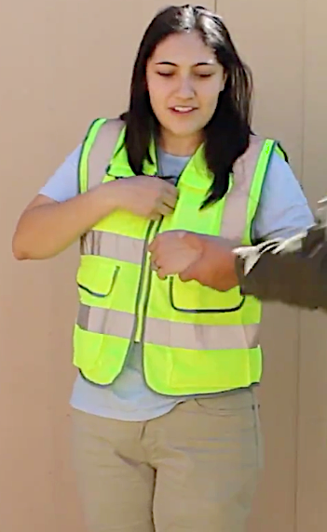
Heat Exhaustion: Cool
Loosen tight clothing and remove extra layers
Cool the worker

Slide 52
Instructor’s Notes: Heat Exhaustion: Drink
Give cool water or sports drinks to drink.
Encourage frequent small sips.
Do not give coffee, tea or other caffeinated beverages.
Do not give alcohol or sugary beverages.
Do not give very cold drinks as they may cause stomach cramps.
Monitor the person.

Slide 53
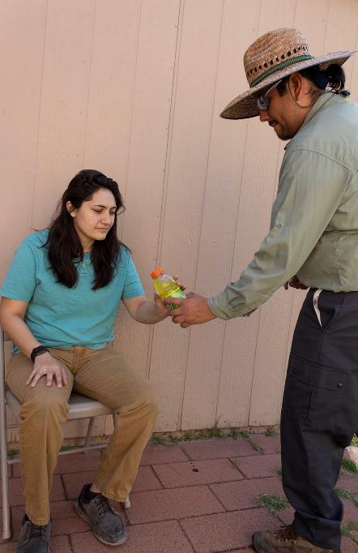
Heat Exhaustion: Drink
Give cool drinks
Water or sports drinks
No coffee or alcohol

Slide 54
Instructor’s Notes: Hyponatremia: Eat
Move the worker to a cool, shady area.
Have the worker rest.
Have the worker eat salty snacks.
Avoid salt tablets.

Slide 55
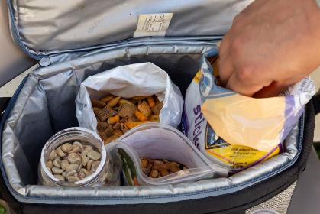
Hyponatremia: Eat
Move the worker to a cool, shady area
If the worker is responsive have them eat salty snacks
No salt tablets

Slide 56
Instructor’s Notes: Hyponatremia: Call
For hyponatremia, get medical help if the worker:
  Has a heart condition or on a low sodium diet,
  Is confused, disoriented or unresponsive, or
  Is not improving within an hour.

Slide 57
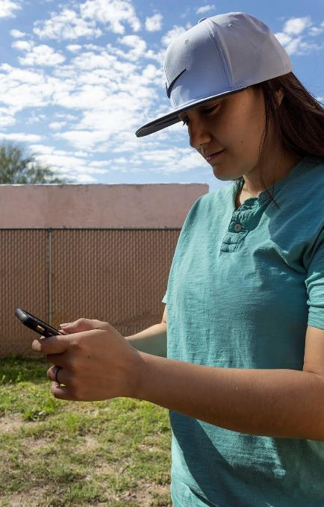
Hyponatremia: Call
If the worker is
  Confused, disoriented or unresponsive,
  Has a heart condition, or
  Not improving within an hour.

Slide 58
Instructor’s Notes: Heat Cramps: Treatment
Move the worker to a cool, shady location.
Have the worker rest.
Have the worker eat salty snacks.
Have the worker drink electrolyte replacement drinks (sports drinks).
Avoid salt tablets.
Call for medical assistance if worker does not improve within an hour.

Slide 59
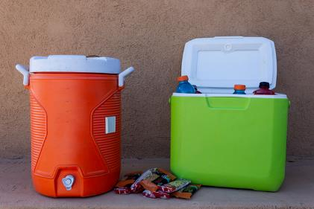
Heat Cramps: Treatment
Move the worker to a cool, shady area to rest
Have worker eat salty snacks and drink sports drinks
Call for medical assistance if not improving within an hour

Slide 60
Instructor’s Notes: Case Study
You can find more case studies. In the Case Study Worksheet or the Case Study PowerPoint Presentation.
Discussion:
  Your coworker is showing signs and symptoms of heat exhaustion.
  It’s the first hot day, so he may not be acclimatized to the heat yet, and you’ve been working outside for several hours.
  If medical care isn’t available at your work site, call 911.
  Remove your coworker from the hot area by going into the shade or indoors to a cool environment.
  Remove any unnecessary clothing including shoes and socks. Place cold compresses on his head, face and neck. Have him sip cool water or a cool sports drink. Stay with him until medical care arrives.

Slide 61
Case Study
You and your coworker have been working outside on a construction site for several hours. It’s one of the first really hot days of the year. You notice that your coworker is really sweating a lot and looks a little pale. When you ask him how he is feeling, he tells you that he feels a little dizzy and nauseous

