Slide 1
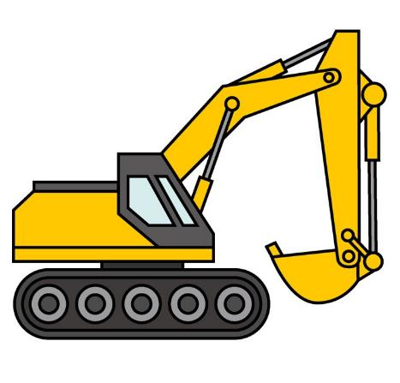
EXCAVATION AND TRENCHING
OSHA - Susan Harwood Training Grant

Slide 2
Welcome
Please sign the attendance sheet
Take one handout
Answer the pre-test

Slide 3
location
Emergency Exits
Emergency Stairs
Location of restrooms
Location of water fountains

Slide 4
Disclaimer
This material was produced under grant number SH-16582-SH7 (2007) from the Occupational Safety and Health Administration, U.S. Department of Labor. It does not necessarily reflect the views or policies of the U. S. Department of Labor, nor does mention of trade names, commercial products, or organizations imply endorsement by the U. S. Government.
Revisions were made to this material under grant number SH-05120-SH9 from the Occupational Safety and Health Administration, U.S. Department of Labor.

Slide 5
Agenda
Welcome
Introduction to OSHA
Worker’s rights
Introduction to Trenching and Excavation Hazards
  What is trenching?
  Preventing excavation hazard
Common Trenching and Excavation Hazards
Soil Classifications
Exercises
Certificates

Slide 6
Introduction to osha
Overview of anti-retaliation provisions, employee rights, employer responsibilities, whistleblower laws, and OSHA’s complaint investigation procedures

Slide 7
Why is OSHA Important to You?
OSHA began because, until 1970, there were no national laws for safety and health hazards.
On average, 14 workers die every day from job injuries
Worker deaths in America are down–on average, from about 38 worker deaths a day in 1970 to 14 a day in 2017
WORKER FATALITIES
5,147 workers died at the job in 2017, 971(20.7%) worked in construction
Excavation — an average of 19 death per year, from a low of 10 death in 2014 to a high of 33 death in 2016
(Source: BLS 2018)

Slide 8
Discussion Questions
When, during your work experience, did you first hear about OSHA?
What did you think about OSHA then?
What do you think OSHA’s job is?

Slide 9

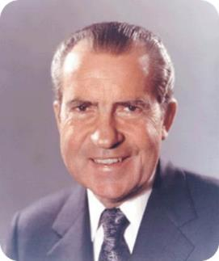
History of OSHA
OSHA stands for the Occupational Safety and Health Administration, an agency of the U.S. Department of Labor
OSHA’s responsibility is worker safety and health protection
On December 29, 1970, President Nixon signed the OSH Act
This Act created OSHA, the agency, which formally came into being on April 28, 1971

Slide 10

OSHA’s Mission
To save lives
To prevent injuries
To protect America’s workers

Slide 11
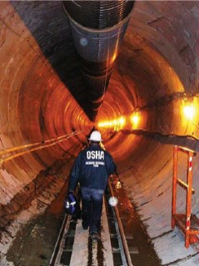
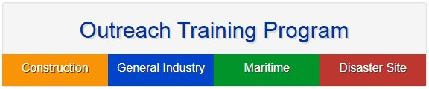

Strategies to Reduce Injuries and Deaths
Strong, fair, and effective enforcement.
Outreach, education, and compliance assistance.
Partnerships and other cooperative programs.

Slide 12
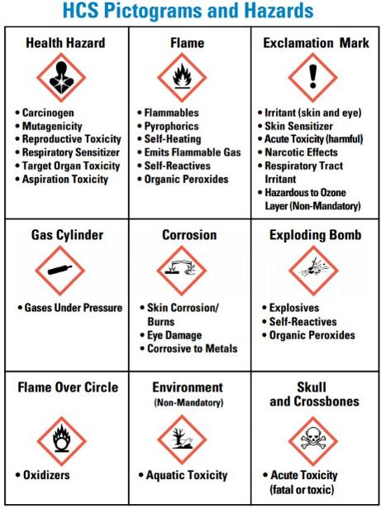
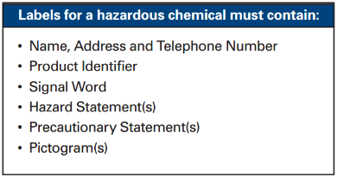
HCS PICTOGRAMS AND HAZARDS
Labels for hazardous substances in your workplace

Slide 13
OSHA Inspections
The OSH Act authorizes OSHA compliance safety and health officers (CSHOs) to conduct workplace inspections at reasonable times.
OSHA conducts inspections without advance notice, except in rare circumstances (e.g. Imminent Danger)
In fact, anyone who tells an employer about an OSHA inspection in advance can receive fines and a jail term.

Slide 14
Inspections Process
A typical OSHA on-site inspection includes four stages:
Presentation of inspector credentials.
An opening conference.
An inspection walk-around.
A closing conference.

Slide 15
OSHA’s Inspection Priorities
Priority | Category of Inspection
1st | Imminent Danger: Reasonable certainty an immediate danger exists
2nd | Fatality/Catastrophe: Reported to OSHA; inspected ASAP
3rd | Complaints/Referrals: Worker or worker representative can file a complaint about a safety or health hazard
4th | Programmed Inspections: Cover industries and employers with high injury and illness rates, specific hazards, or other exposures.

Slide 16
OSHA’s Complaint Investigations
OSHA evaluates each complaint to determine how it can be handled best--an off-site investigation or an on-site inspection
Before beginning an inspection, OSHA staff must be able to determine from the complaint that there are reasonable grounds to believe that a violation of an OSHA standard or a safety or health hazard exists.
If OSHA has information indicating the employer is aware of the hazard and is correcting it, the agency may not conduct an inspection after obtaining the necessary documentation from the employer.

Slide 17
CONT.
Employee may file a complain with OSHA under Section 11(c) if your employer retaliates against you by taking unfavorable personnel action because you engaged in protected activity relating to workplace safety and health.
OSHA requires that complaints must be filed within 30 days after the alleged retaliation.

Slide 18
Rights as a Whistleblower
Your employer may be found to have retaliated against you if your protected activity was a contributing or motivating factor in its decision to take unfavorable personnel action against you. Such actions may include:
  Firing or laying off
  Blacklisting
  Denying overtime or promotion
  Disciplining
  Denying benefits
  Failing to hire or rehire
  Intimidation
  Reassignment affecting promotion prospects
  Reducing pay or hour

Slide 19
Questions about OSHA?

Slide 20
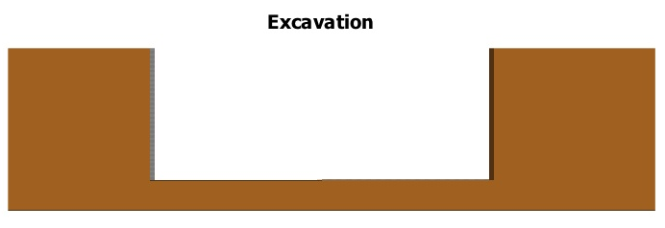
DEFINITIONS
Excavation
Any man-made cavity or depression in the earth’s surface (including its walls, floor and lip) formed by earth removal. For rescue purposes an excavation is wider than it is deep.

Slide 21
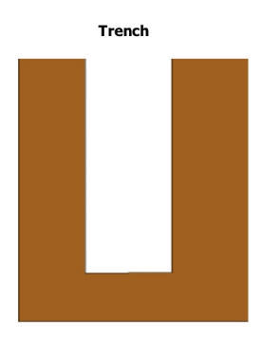
definitions
Trench
A narrow excavation which is deeper than it is wide, with a maximum width of fifteen (15) feet measured at the floor (bottom).

Slide 22
Excavations
Overview / Main Points
Excavation laws, regulations, standards
Soil classification
Soil testing
Competent person responsibilities
Hazards associated with trenches
Protective systems

Slide 23
Tragic Facts
Excavating is recognized as one of the most hazardous construction operations
  97 Workers were killed on Excavation/Trenching jobs from 2013-2017.
  From a low of 10 deaths in 2014 to a high of 33 in 2016.
  Cave-ins are more likely than other excavation related accidents to result in worker fatalities.
(Source: BLS 2018, www.osha.gov)

Slide 24
Tragic Facts
60% of related deaths are rescuers
  Civilians
  Fire dept personnel
  Co-workers
Cave-ins can happen without warning
All of the fatalities and injuries could have been prevented

Slide 25
Collapse Forces
24 inches of soil on a person’s chest weighs 750-1000 lb.
18 inches of soil covering a body weighs 1800-3000 lb.
Notes:
HOW MUCH CAN YOU LIFT, how well can you breathe
HOW MANY BREATHS CAN YOU TAKE
LOCK OUT/ TAG OUT
8” WATER MAIN CAN FLOW 19,000 GPM AT 100 PSI
CAN FILL A TRENCH 4X12X25 IN 24 SECONDS

Slide 26
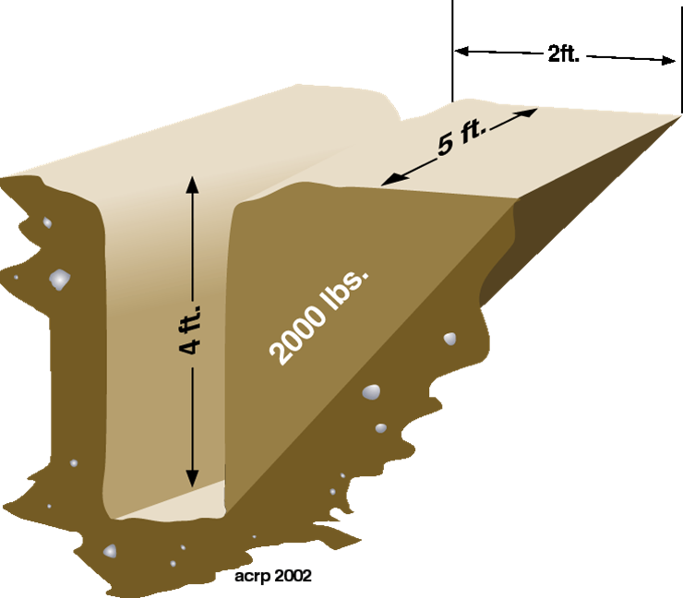
Soil Weight Example
20 cubic feet = 2,000 lbs.
How tall are you? This example is 4ft deep
Do you think you can get out?
© ACR Publications Used By Permission

Slide 27
Collapse Force
Shear wall collapse speed is 45 mph
1 cubic foot of soil can weigh from 100 to 125 lb.
Notes:
THINK YOU CAN OUT RUN IT
VW HITTING YOU AT 45MPH
PAST PRACTICES
JUMP INTO TRENCH
F/F ARE ACTION ORIENTED
COMPASSION KILLS
INADEQUATE SHORING
CHEAPER TO PAY DEATH BENEFITS

Slide 28

Speed of Collapsing Dirt
Imagine this coming down on top of you….
Weight of a Volkswagen
Weight of one cubic yard of soil
2,785 Pounds
2,700 Pounds

Slide 29
Effects On The Body
Respiratory distress
Crush syndrome
Total body impact
Notes:
How many breaths can you take with this much weight on your body, explain crush syndrome

Slide 30
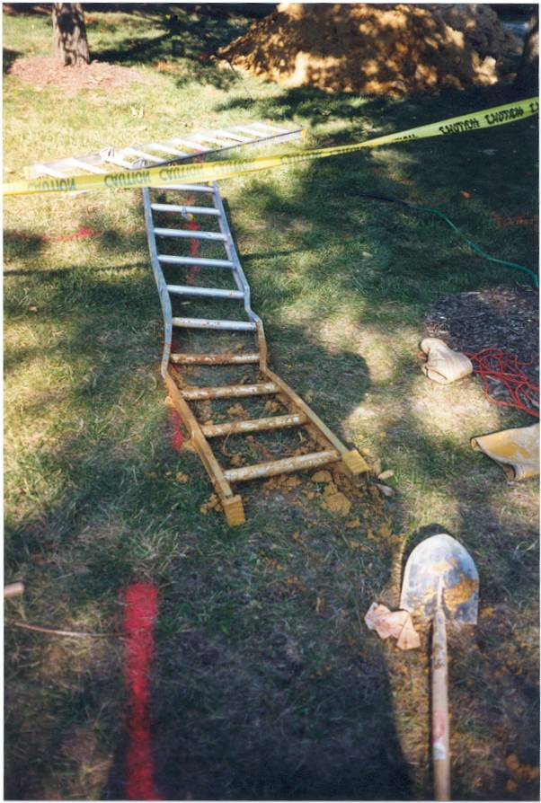
Trench collapse
Notes:
If dirt can do this to a ladder?

Slide 31
The Seven Trenching Hazards
Cave–ins
Electric Line Contact
  Overhead
  Buried
Falls into Excavations
Equipment Falling into Excavations
Explosion / Fire / Electrocution
Hazardous Atmosphere
Drowning

Slide 32

UNSAFE ATTITUDES
“I Know what I’m doing.”
“It can’t happen to me.”
“I’ve been doing it that way for years.”
“I’d sleep in that hole!”
“Don’t worry, we’ll watch the walls and tell you if you need to get out.”

Slide 33
Most Common Causes of Cave-ins:
Poor Planning
Misjudgment of soil type.
Inadequate, or incorrect installation of protective devices.
Defective protective devices.
Failure to adjust for changing conditions

Slide 34
Legal Aspects
OSHA [29 CFR 1926.650 - 652]
  Excavation standard applies to all open excavations made in the earth’s surfaces including trenches, all surface encumbrances that would create a hazard, and protective systems

Slide 35
What’s In the Standard?
Scope, application and definitions
Job Site Hazard Listing
Requirements for Protective Systems
Appendixes that detail:
  Soil Classification
  Sloping and Benching
  Timber and Aluminum Hydraulic Shoring
  Protective System Selection Decision Tree

Slide 36
General Requirements
1926.651
(a) Surface encumbrances
(b) Underground installations
(c) Access & egress
(d) Exposure to vehicle traffic
(e) Exposure to falling loads
(f) Warning systems for mobile equipment

Slide 37
General Requirements (CONT.)
1926.651
(g) Hazardous atmospheres
(h) Protection from hazards associated with water accumulation
(i) Stability of adjacent structures
(j) Protection from loose rock or soil
(k) Inspections
(l) Fall protection

Slide 38
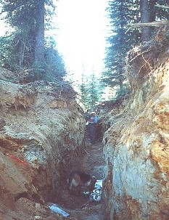
Surface Encumbrances
All surfaces encumbrances that are located so as to create a hazard to employees shall be removed or supported as necessary to safeguard employees

Slide 39
Underground Installations
Utility companies shall be contacted with in established local response times
  Advised of proposed work
  Asked to establish location of utility
  When request cannot be met, employer may proceed with caution with detection equipment of an acceptable means to locate utility
Notes:
Call before you dig: In Maryland and Delaware Dial 811

Slide 40
Underground Installations (CONT.)
While the excavation is open, underground installations shall be protected, supported or removed as necessary to safeguard employees

Slide 41
Access & Egress
Structural ramps
  Used by employees shall be designed by a competent person
  When used for equipment shall be designed competent person qualified in structural design
  Stairway, ladder, ramp or other safe means of egress require no more than 25 ft of lateral travel for employees in excavations that are 4 feet or more in depth
  Ladders must be secured and extend a minimum of 36 inches above the landing

Slide 42
Exposure to vehicle traffic
Employees exposed to public vehicle traffic shall be provided with and wear warning vests or other suitable garments
  Marked or made with reflectorized or highly visible material
  Requiring a designated, trained flag person along with signs, signals, and barricades when necessary

Slide 43
Exposure to falling loads
  No employee shall be permitted underneath loads handled by digging or lifting equipment
  Stand away from vehicle being loaded or unloaded to avoid being struck
  Operators may remain in cabs when vehicles are equipped in accordance with 1926.601

Slide 44
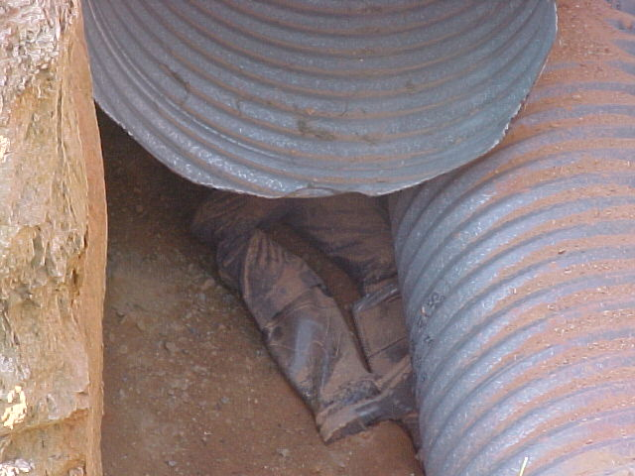
stuck-in
Notes:
Victim was working underneath load being moved

Slide 45
Warning systems for mobile equipment
When operator does not have clear view of edge of excavation
Warning system shall be utilized
  Barricades
  Hand or mechanical signals
  Stop logs

Slide 46
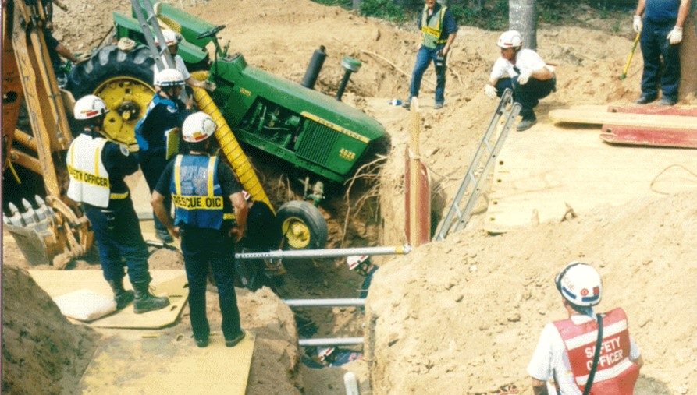
excavation without proper barricade
Notes:
Victim was ejected from tractor into the trench (lower center )

Slide 47
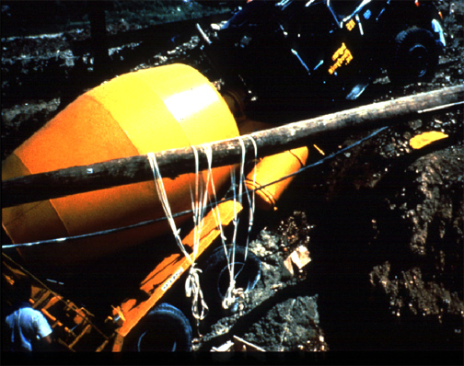
Vehicle falling in excavation
Notes:
How much vibration does a concrete truck put on the side of a trench when mixing his load. Enough to cause collapse?

Slide 48
Hazardous Atmospheres
Testing and controls
  To prevent harmful levels of atmospheric contaminants
  Less than 19.5% or more than 23.5% oxygen
  Atmosphere tested before entry
  Adequate precautions shall be taken
    Ventilation
    Proper respiratory protection
    Testing done often as necessary
Notes:
TEST IN MULTIPLE LEVELS – TOP/MIDDLE/BOTTOM ( SAME AS CONFINED SPACE)

Slide 49
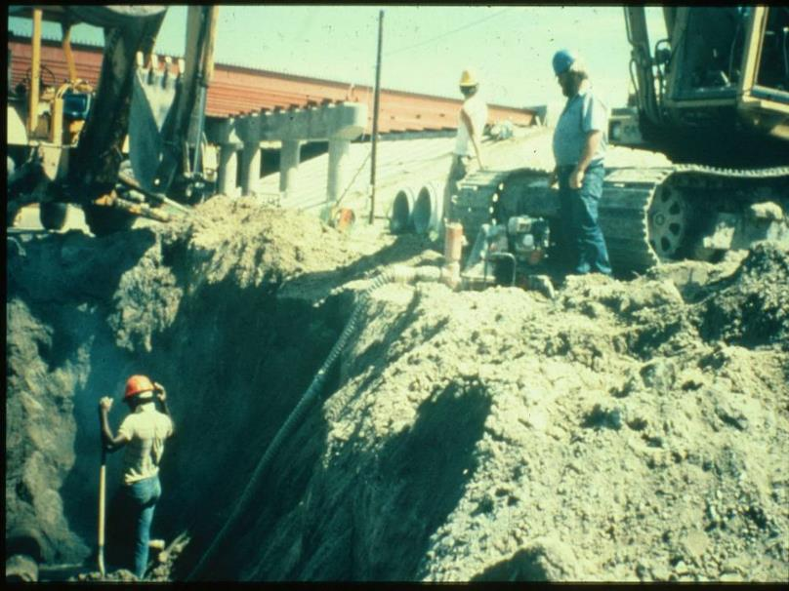
exposed to hazardous atmosphere
Notes:
Unshored trench with backhoe and track hoe on lip with trash pump for water removal

Slide 50
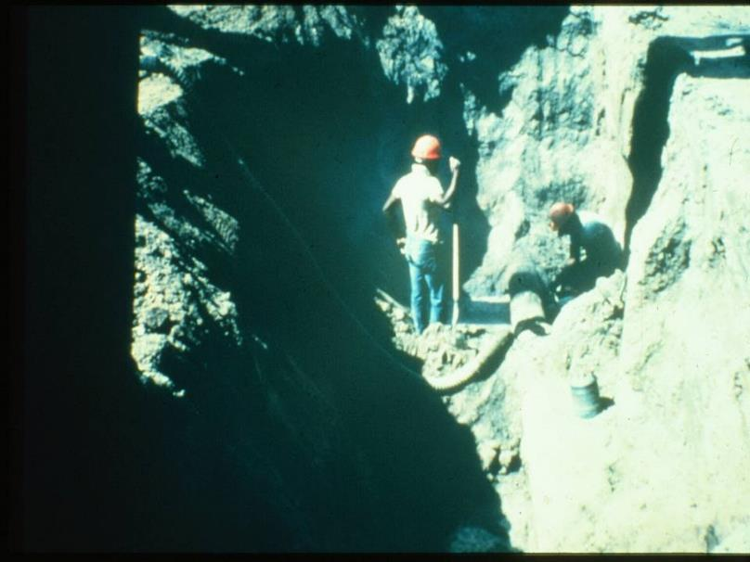
Employees exposed to hazardous atmosphere
Notes:
Worker using a cut-off saw, gas can also in excavation

Slide 51
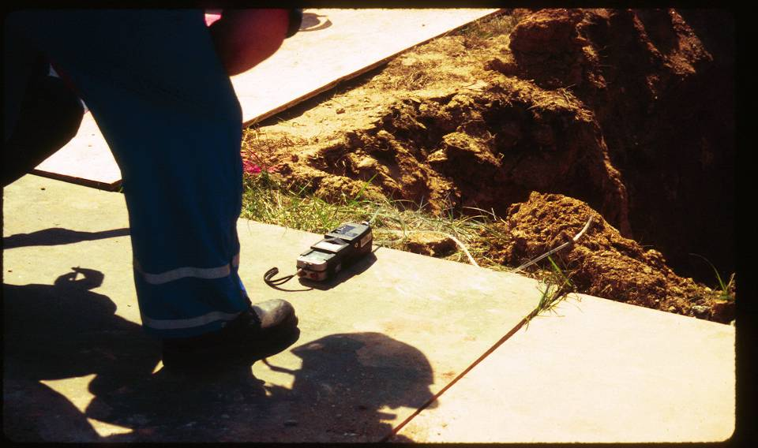
Monitoring
Notes:
Monitoring for hazardous atmospheres

Slide 52
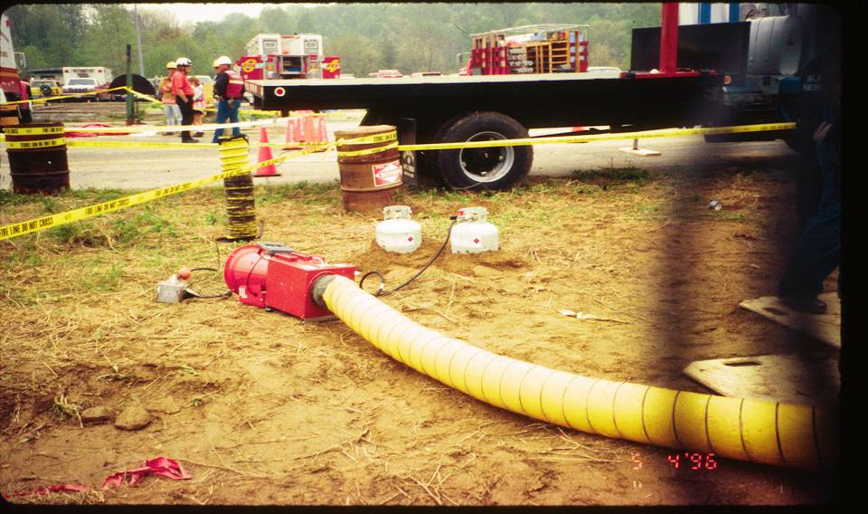
Ventilation Blowers
Notes:
Propane system for heated ventilation

Slide 53
Emergency Rescue Equipment
Rescue equipment
  Breathing equipment
  Safety harness and line or basket stretcher
  Must be readily available
  Must be attended
  Bell-bottom pier holes, deep and confined footing excavation shall wear a harness with a lifeline securely attached to it

Slide 54
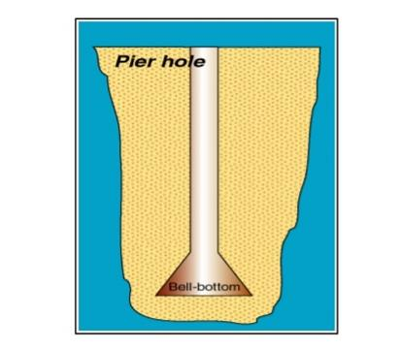
BELL BOTTOM PIER HOLE
A tubular shaft with a wider bell shaped cross-section at it’s base for support. Created for foundations and footer construction.

Slide 55
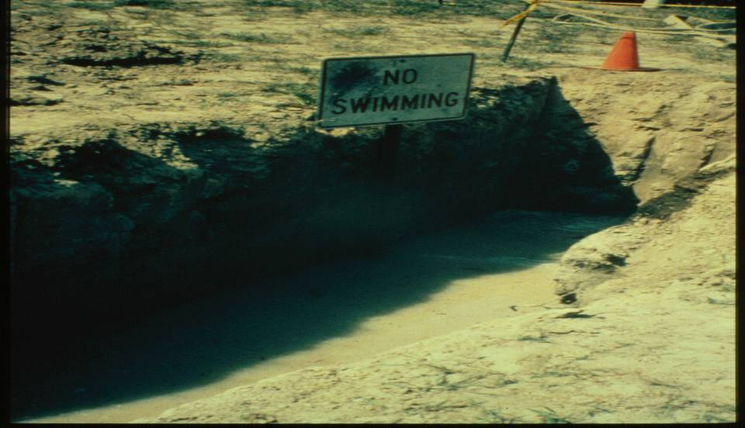
Water Accumulation
Notes:
How much water is to much?

Slide 56
Water Accumulation (CONT.)
Employees shall not work in excavations where there is accumulated water, or where water is accumulating, unless adequate precautions have been taken, to protect employees.
Must take adequate precautions to protect employees
  Accumulating water
  Varies with each situation
  Removal monitored by competent person
  Run off from heavy rains requires inspection by competent person

Slide 57
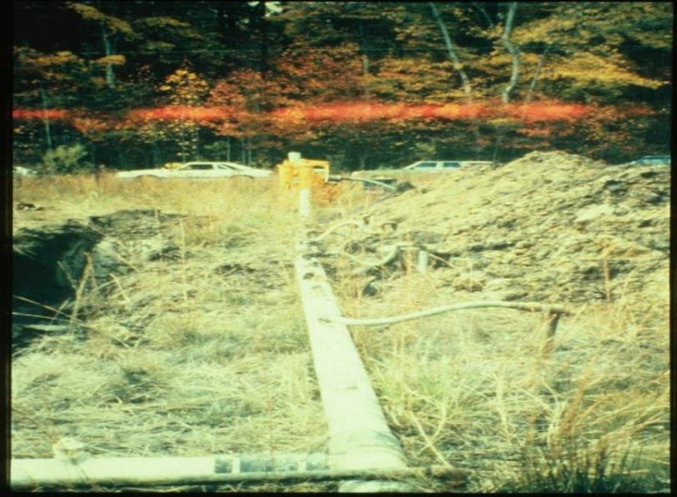
Water removal from trench
Notes:
Well point system to lower ground water, pipes placed in ground to pump out water

Slide 58
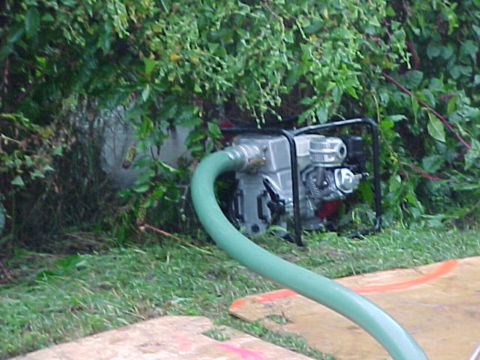
Water removal equipment
Notes:
Trash pump, watch were discharged water goes

Slide 59
Stability of adjacent structures
Where stability is endangered by excavation operations
Support systems such as shoring, bracing or underpinning shall be provided
Sidewalks, pavement and appurtenant structures shall not be undermined unless support systems are used to protect employees

Slide 60
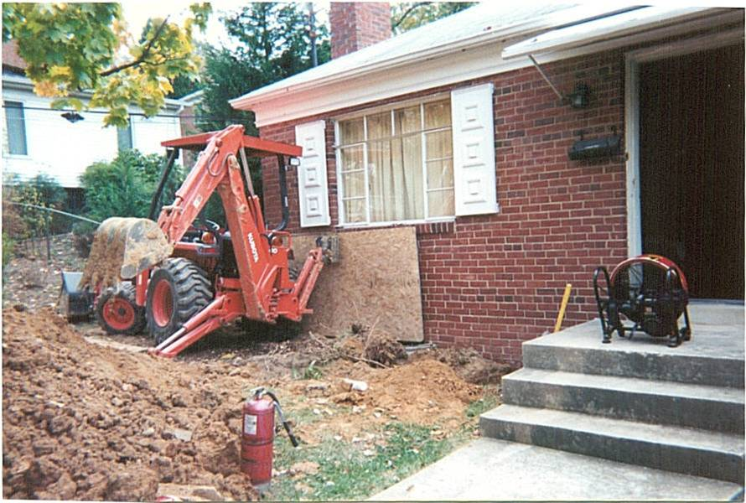
No support provided to prevent structural failure
Notes:
Is the backhoe supporting the house or the house supporting the backhoe

Slide 61
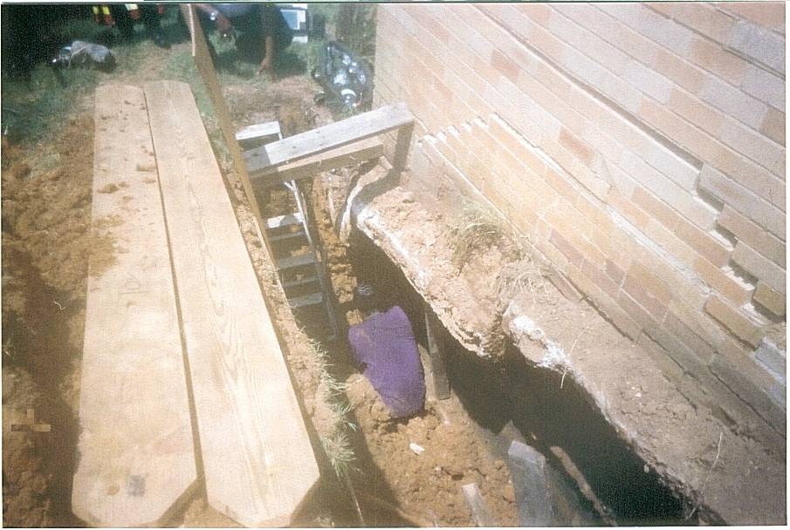
Support provided under the ground level
Notes:
Worker buried up to his waist, beneath concrete and brick veneer collapsing

Slide 62
Protection from loose rock and soil
Hazard from falling or rolling from excavation face
  Scaling to remove loose materials
  Installation of protective barricades
  Other means (retaining devices)
  2 feet from edge of excavation

Slide 63
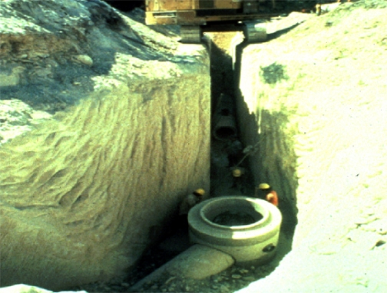
Trench
Notes:
How many things are wrong here?

Slide 64
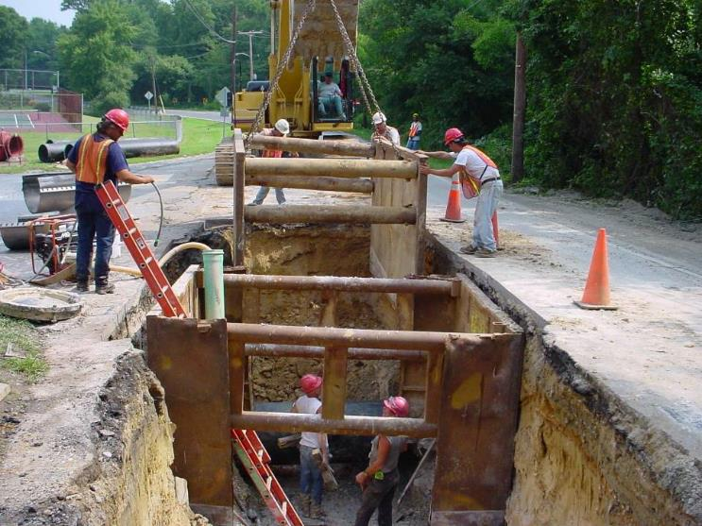
What’s good?
WHAT’S NOT SO GOOD?
Notes:
Good – protective system in place, ladder, water removal, no one under moving load.

Slide 65
WHO IS Competent Person
One who is capable of identifying existing or predictable hazards in the surroundings which are unsanitary, hazardous or dangerous to employees & who has authorization to take prompt corrective measures

Slide 66
Competent Person
Has specific training in and be knowledgeable about soil analysis, use of protective systems and the requirements of the standard

Slide 67
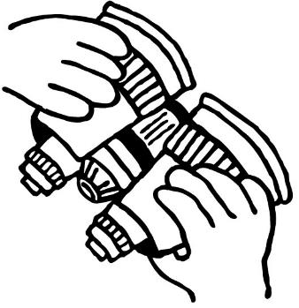
COMPETENT PERSON MUST BE AWARE OF:
Falling loads or equipment
Hazardous atmospheres
Weather conditions and forecast
Stability of adjacent structures.

Slide 68
THE COMPETENT PERSON MUST BE AWARE OF:
Surface and overhead encumbrances
Underground utilities
Access and egress
Vehicular traffic
Continuation of trade activity

Slide 69
Inspections
Daily and before start of work
As needed throughout the shift
After snowstorms, windstorms, thaw, earthquake
Soil classification
Any hazard increasing occurrence
Employees shall be removed until precautions have been taken

Slide 70
Inspections (CONT.)
When fissures, tension cracks, sloughing undercutting, water seepage, bulging at the bottom
Change in size, location or placement of the spoil pile
Indication of movement in adjacent structures

Slide 71
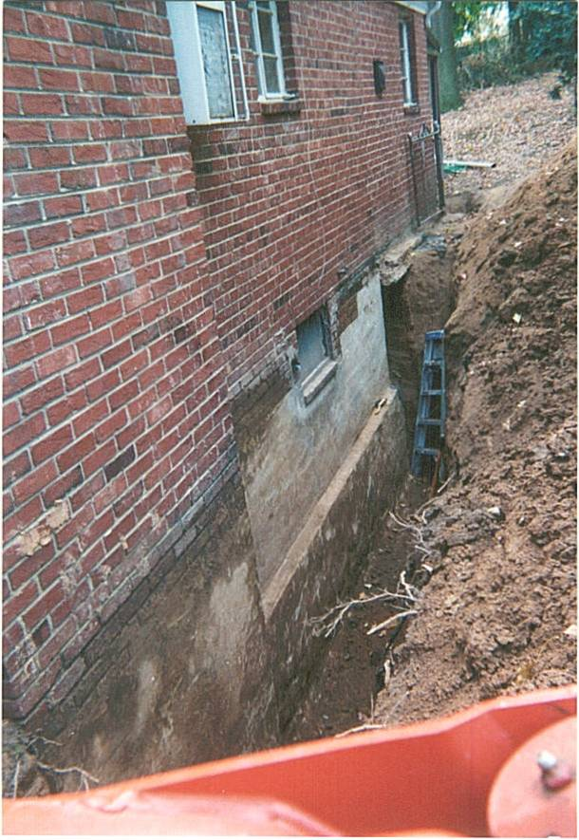
Hazard
Notes:
Who inspected this trench? Ladder to short, no protective system, soil pile to close

Slide 72

Training, knowledge and experience as demonstrated through responsible action makes a person “competent.”

Slide 73
Fall protection
If walkway provided
  Where employees permitted to cross, guard rails provided where 6 feet or more above lower levels
  Fall protection standard
Notes:
This refers to guard rails (1926.502(b)

Slide 74
Requirements of
Protective Systems
1926.652
Employees shall be protected from cave-in by an adequate protective system except;
  Entirely in stable rock
  Less than 5 feet in depth with no indication of cave-in

Slide 75
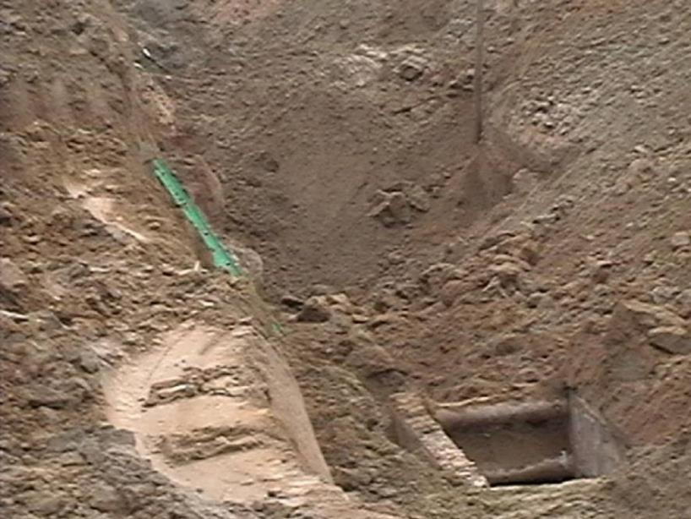
No proper protection
Notes:
The proper use of a protective system? 10 ft trench box in a 26ft deep hole, a fatality happened here.

Slide 76
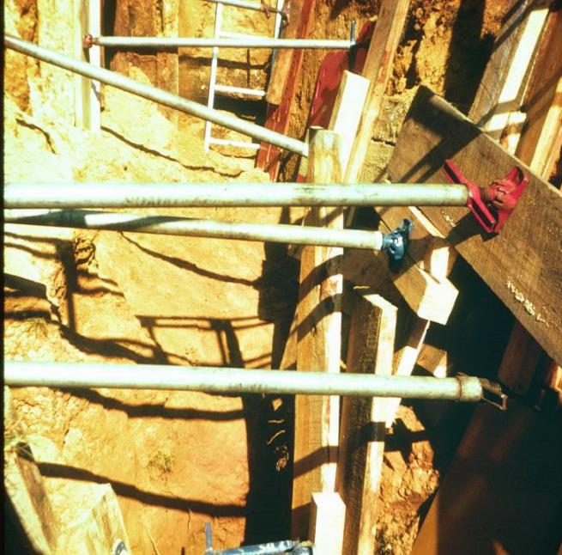
PROPER SHORING
Notes:
How many laws are broken here? Screw Jack used for cross member must be in trench to install

Slide 77
Designs using
Manufacturers Data
Deviation will only be allowed after manufacturer issues specific written approval
Written form at the job site during construction

Slide 78
Materials and Equipment
Free of damage and defects
Maintain in manner consistent with manufactures data
Examined by competent person & evaluated for continued use
Removed from service until approved by registered professional engineer

Slide 79
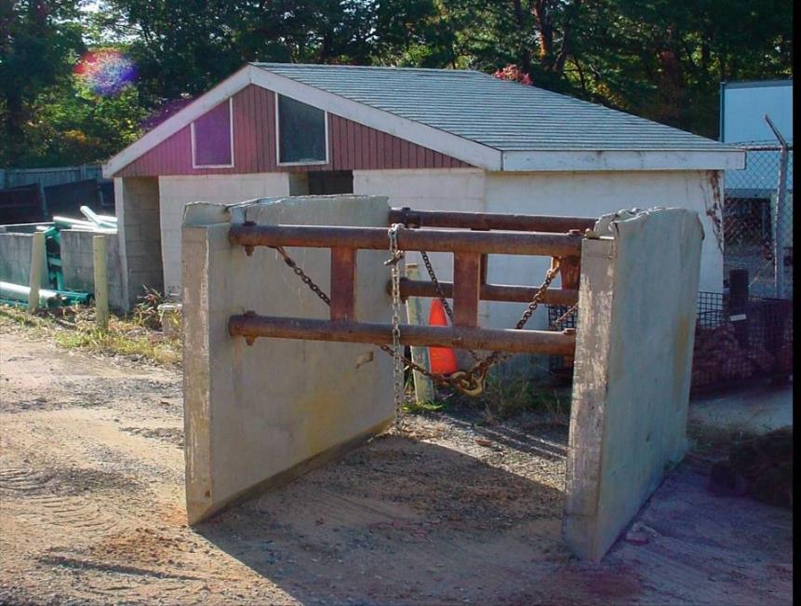
Trench box
Notes:
How much abuse can you do to a shield before it fails?

Slide 80
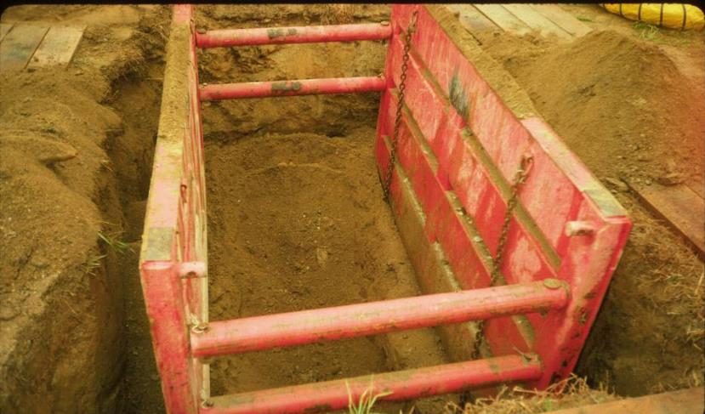
Trench Boxes
Notes:
Make sure all cross members and safety pins are used when necessary

Slide 81
Installation & Removal
Members securely connected
  Prevent sliding, falling, kick outs
  Other predictable failure
Members shall not subjected to loads exceeding those which were designed
Members removed from bottom first
Back fill with removal of support system

Slide 82
Installation & Removal (CONT.)
Excavate to no greater than 2 feet below – only if system is rated at full depth and there are no indications of a loss of soil from behind or below the support system
Employees are not permitted to work below other employees unless adequately protected from falling, rolling, sliding material
Employees are not allowed in shields when installed, removed or moved vertically

Slide 83
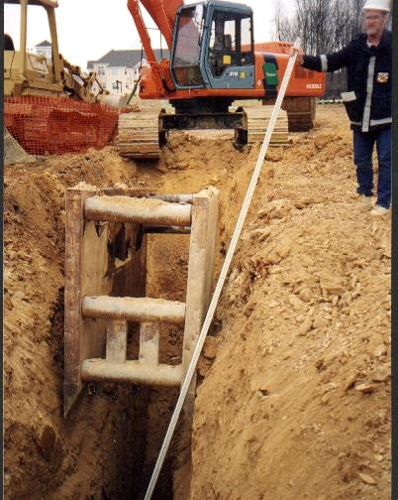
Removal of trench box
Notes:
When an inspector is doing this something bad has happen.

Slide 84
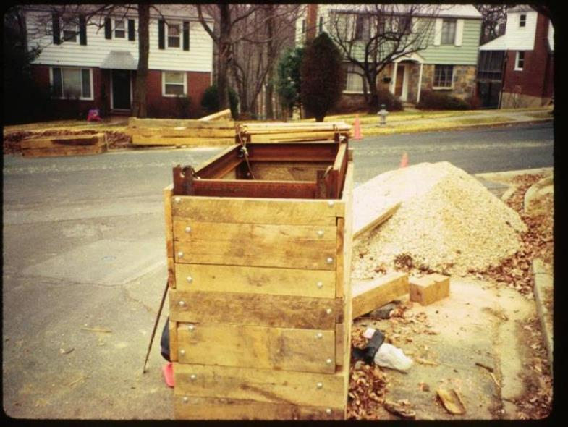
PICTURE OF Trench
Notes:
Not a certified trench box. Made by laborers on site

Slide 85
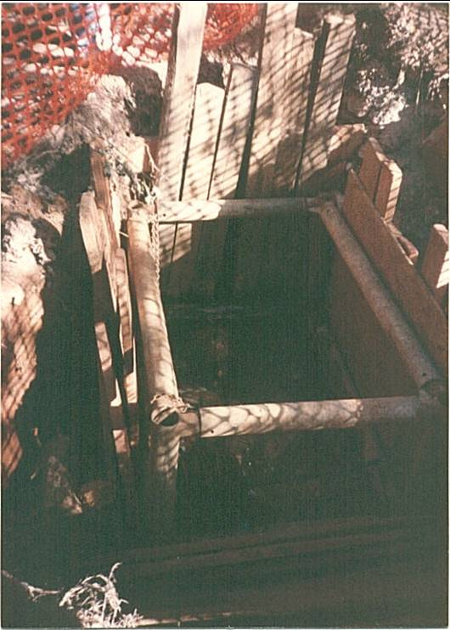
PROPER Trench box
Notes:
Safe or not?

Slide 86
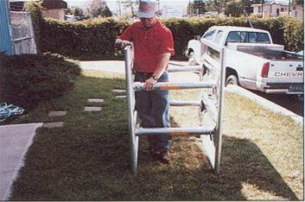
Shield testing
Notes:
Nice system for shallow trenches 130 lbs overall weight

Slide 87
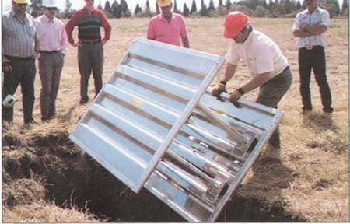
Shield testing by competent person

Slide 88
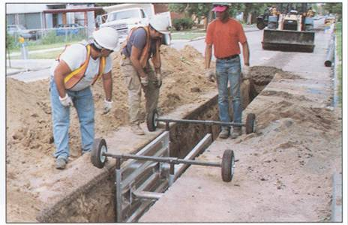
GUESS
WHAT’S GOOD?
WHAT’S NOT SO GOOD?
Notes:
Unsupported utilities, no ladder, how much vibration does a freight train make?

Slide 89
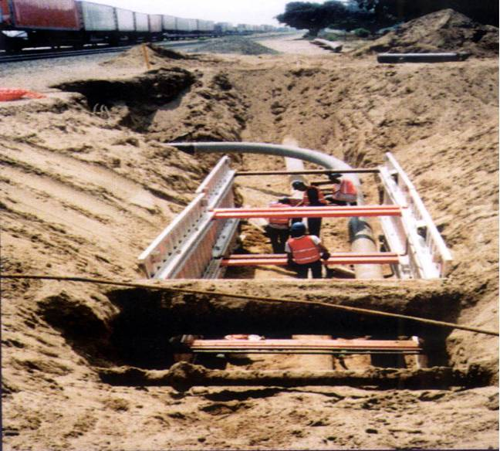
Shield Used with Sloping
Notes:
Unsupported utilities, no ladder, how much vibration does a freight train make?

Slide 90
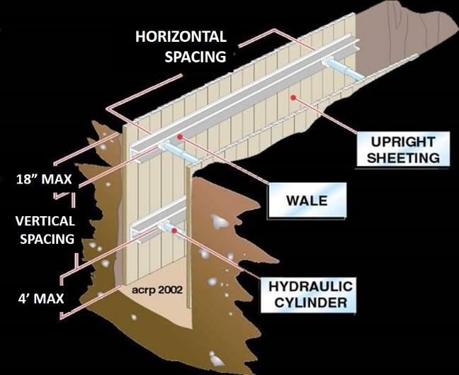
Horizontal Shoring Dimensions
© ACR Publications Used By Permission

Slide 91
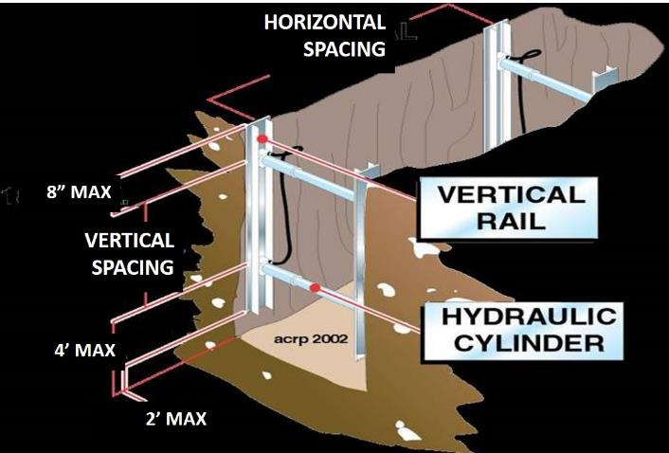
Vertical Shoring Dimensions
© ACR Publications Used By Permission

Slide 92
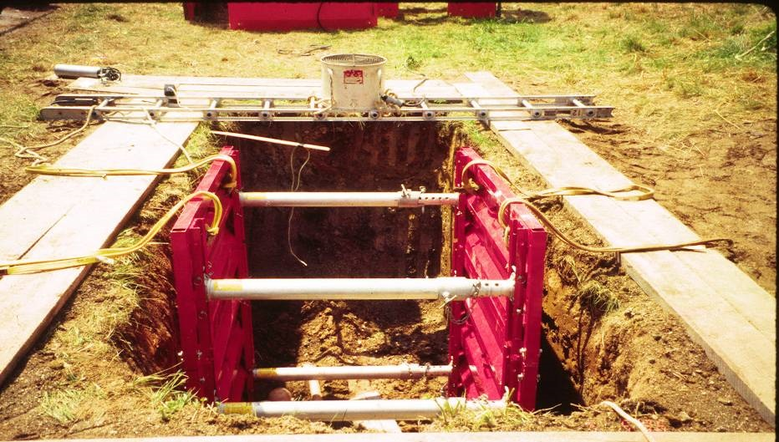
Pneumatic Systems
Notes:
Pneumatic system to mechanical

Slide 93
SHIELD USAGE AND SAFETY
Shields are used to protect workers from cave-ins, not to provide support for the trench.
Manufacturer’s Data must be present at work site.
Top of the shield must extend to the top of the trench.
If used with sloping, top of shield must extend 18 inches above vertical trench walls.
Shields may be stacked, provided the bottom one is rated for the total depth of the trench.
The trench may be dug 2 feet lower than the shield bottom, but the shield must be rated for that depth.
Backfill around the box to prevent lateral movement.
Notes:
Trench boxes must be designed to be stacked.You can put any box on top of another

Slide 94
Soil Classification
1926 Subpart P App A
Cemented soil
Cohesive soil
Dry soil
Fissured
Granular soil
Layered system
Moist soil
Plastic
Saturated soil
Soil classification system
Stable rock
Submerged soil
Unconfined compressive strength
Wet soil

Slide 95
Soil Category: Stable Rock
Natural solid mineral material that can be excavated with vertical sides and remain intact while exposed. Examples are granite and sandstone.
Determining whether a deposit is stable rock may be difficult unless it is known whether cracks exist and whether or not the cracks run into or away from the excavation.

Slide 96
Soil Classifications
Stable rock
Type A
Cohesive soils with an unconfined compressive strength of 1.5 tons per square foot [tsf]
Examples: Clay, silty clay, sandy clay
Notes:
NO SOIL IS A, IF FISSURED, SUBJECT TO VIBRATION,
PREVIOUSED DISTURBED,SEEPING WATER
SOIL TEST VISUAL-
SIDES OF TRENCH FOR LAYERING
EVIDENCE OF WATER
PREVIOUSLY DIETURBED SOIL
TENSION CRACKS, SPALLING, BOILING
MANUAL TEST
PLASTICITY
DRY SRRENGTH
THUMB PRENETRATION

Slide 97
Soil Classifications (CONT.)
No soil is type A if;
  Fissured
  Subject to vibration
  Previously disturbed
  Seeping water
  Part of a sloped or layered system of four horizontal to one vertical

Slide 98
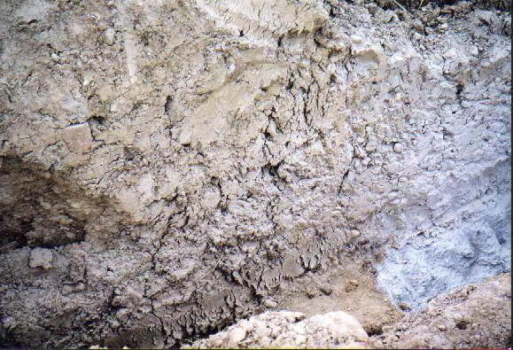
Soil Fissuring
Notes:
How soon will it fail?

Slide 99
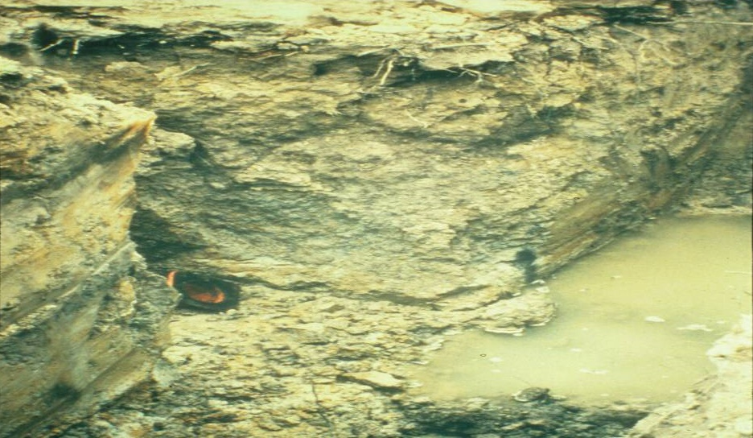
To Much Water?
Notes:
What do you have to do to make this trench safe?

Slide 100
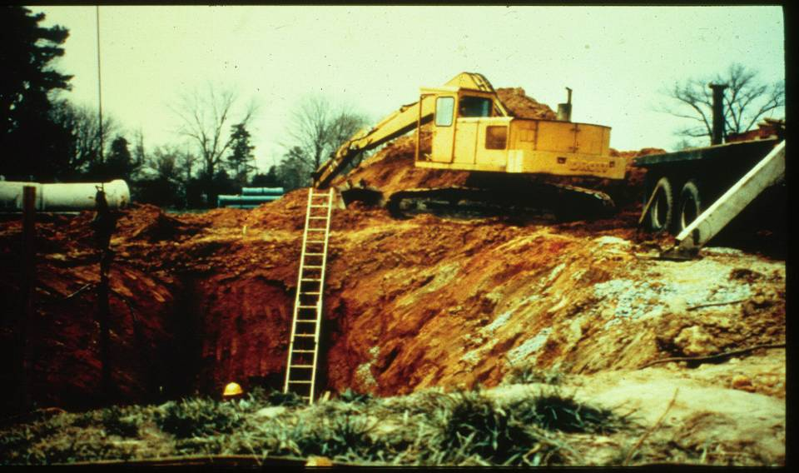
Weight and Vibration
Notes:
How much pressure does it take from an outrigger to make this trench fail

Slide 101
Soil TYPES
Type B
  Cohesive soils with an unconfined compressive strength greater than 0.5 tsf but less than 1.5 tsf
  Silt, silt loam, angular gravel
  Soils that are fissured, or subject to vibration
Notes:
PREVIOUSLY DISTURBED UNLESS CLASSIFIED AS C. Define Silt and Loam type soils

Slide 102
Soil Classification
Type C
Cohesive soils with a unconfined compressive strength of 0.5 tsf or less.
  Gravel, sand, loamy sand, submerged soil, soil from which water is freely seeping

Slide 103
SOIL STRENGTH MEASURE
Unconfined Compressive Strength (UCS)
The amount of pressure in tons per square foot (tsf) required to cause the soil to fail in compression.
OSHA Soil Classification is based on the UCS of the soil.
Notes:
Tests are usually done in the lab.

Slide 104
Basis of classification
The classification of deposits shall be made based on the results of at least one visual and one manual analysis conducted by a competent person

Slide 105
Acceptable visual test
Determine qualitative information on site in general
Soil adjacent to excavation
Soil forming the sides of the open excavation
Soil taken as samples from excavated material
Estimate range of particle sizes

Slide 106
Acceptable visual test CONT.
Observe evidence of surface water
Water seeping from the sides
Location of the level of the water table
Sources of vibration that may affect stability
Evidence of previously disturbed soil

Slide 107
Acceptable manual test
Plasticity
Ribbon and thread test
Dry strength test
Thumb penetration test
Other strength test
Pocket pentrometer
Hand-operated shearvane

Slide 108
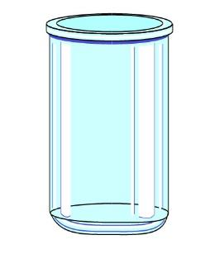
Field Sedimentation Test
Flat bottom container - at least 7 inches high (old olive jar)
One 1/2 to 2 inches of soil
Place soil in the glass jar
5 inches of water on top of soil

Slide 109
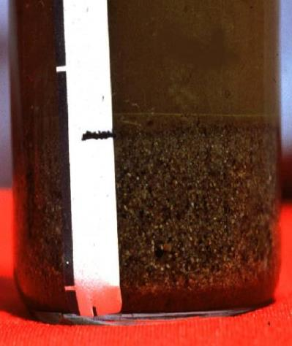
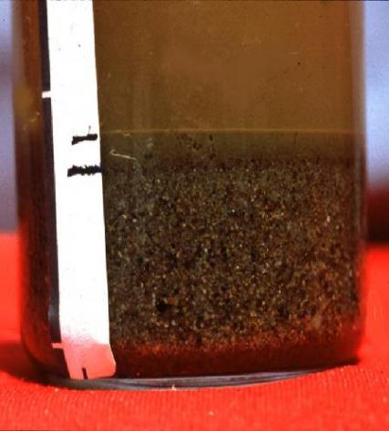
Field Sedimentation Test (CONT.)
After 30 seconds granular sand type material settles at the bottom
After 3 minutes silt type material settles on top of the sand

Slide 110
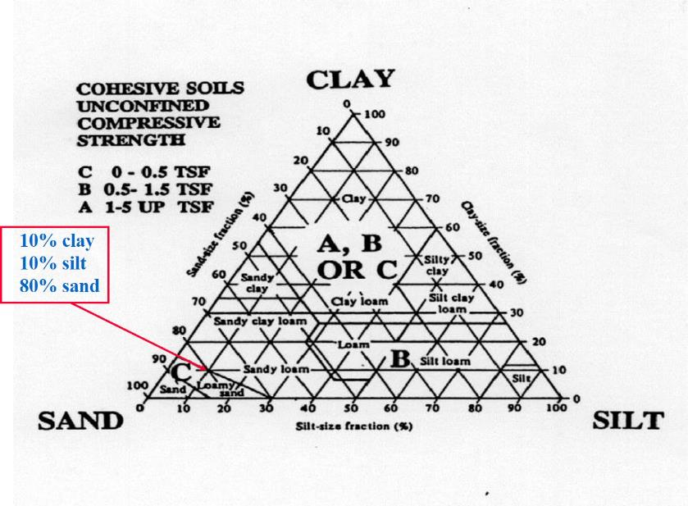
CLAY, SAND AND SLIT

Slide 111
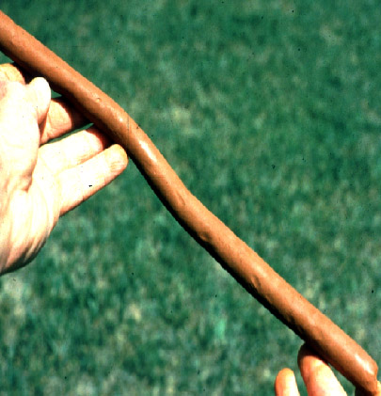
The Ribbon Test step 1
Mix soil + water to make into plastic mass
Roll mass into cylindrical shape 1/2 to 3/4 inch diameter
Lay across palm of hand
Press between thumb and second joint of index finger

Slide 112

The Ribbon Tests
STEP 2
Pass through thumb
Squeeze until it takes the shape of a 1/8 to 1/4 inch thick strip
Allow to hang freely from hand

Slide 113

The Ribbon Test (cont.)
Clay loam will barely ribbon and break easily
Clay = relatively long ribbon 6” to 8” or more
More clay = longer and stronger ribbon
Silt has tendency to produce short ribbon with broken appearance

Slide 114


PENCILING
If a 2 inch or longer thread can be held without breaking, the soil is cohesive.

Slide 115

Shear vane / Torvane
Measures Soil’s Shear Strength

Slide 116

Shear vane / Torvane
Select fresh clod or block of undisturbed soil from spoil pile
Cut a smooth surface on the clod
Insert vanes of device into the soil
Retract vanes to show foot imprint
Set indicator at zero
Hold device firmly against soil and twist in clockwise manner until soil fails in shear

Slide 117

Pocket Penetrometer Test
Device is designed to work on saturated clay soil
Measures unconfined compressive strength of soil
Twice the value of shear strength of same soil
Note machine ring

Slide 118

POCKET PENETROMETER

Slide 119

Pocket Penetrometer Test
To begin test, remove red protective cap, push ring against body so that low side reads “O”
Slowly insert piston until engraved mark is level with soil

Slide 120
Pocket Penetrometer Test
(CONT.)
Read strength in tons/sq ft using low side of ring (side closest to the piston end). Record reading and repeat step #1.
For weak soils, use 1” adaptor foot, multiply by 0.0625

Slide 121

Thumb Penetration Test
The thumb penetration procedure involves an attempt to press the thumb firmly into the soil in question.
Notes:
OSHA TECHNICAL MANUAL – SECTIONV: CHAPTER2

Slide 122
Thumb Penetration Test (CONT.)
If the thumb makes an indentation in the soil only with great difficulty, the soil is probably Type A.
If the thumb penetrates no further then the length of the thumb nail, it is probably Type B soil.
If the thumb penetrates the full length of the thumb it is Type C soil.
The thumb test is subjective and is therefore the least accurate of the tests.
Notes:
OSHA TECHNICAL MANUAL – SETION V: CHAPTER 2

Slide 123
Soil Classifications.
Layered Geological Strata
  where soils are configured in layers
  must be classified on the basis of the weakest soil
  each layer may be classified individually if a more stable layer lies below a less stable layer
  Type C soil rests on top of stable rock

Slide 124
CLASSIFICATION
Look for the following conditions
  Particle size
    Primarily fine grained=cohesive material
    Primarily coarse-grained sand or gravel
    Granular material
  Cohesion
    Remains in clumps=cohesive

Slide 125
Soil Strength is Dependent Upon:
Type of Soil.
Amount of Moisture in the Soil.
Whether the Soil Has Been Previously Disturbed.

Slide 126
If Water is Added
It Brings Additional Weight
  Hydrostatic Pressure
It Erodes the Trench Wall
  Water movement typically moves soil
It Can Freeze and Thaw
  Resulting in cracks & false cohesion
REMOVAL OF GROUND WATER IS CRITICAL

Slide 127
SOIL COMPONENTS
Clay:
  Composed of mineral particles less than 0.002 mm in diameter
Silt:
  Individual mineral fragments that range from 0.002 to 0.05 mm in diameter.
Sand:
  Individual rock or mineral fragments that range in diameter from 0.05 to 2.0 mm in diameter.
Gravel:
  Can be either angular or rounded.

Slide 128
COHESIVE SOIL
Soil with a high clay content which has cohesive strength.
It does not crumble.
It can be excavated with vertical side slopes.
It is hard to break up when dry.
It can be molded.
It exhibits significant cohesion even when submerged.

Slide 129
GRANULAR SOIL
Soils that include gravel, sand, silt.
Very low clay content.
It has no cohesive strength.
Some moist granular soils exhibit apparent cohesion.
It cannot be molded when moist and crumbles easily when dry.

Slide 130

Soil Mechanics
Toppling occurs when the trench’s vertical face shears along the tension crack line and topples into the excavation

Slide 131

TOPPLING
Notes:
Toppling into the trench

Slide 132

SUBSIDENCE
Subsidence and bulging occurs when an unsupported excavation can create an unbalanced stress in the soil which causes subsidence at the surface and bulging of the vertical face

Slide 133

UNSUPPORTED EXCAVATION
Notes:
Can the weight of this crane cause bulge or failure

Slide 134

bulging
Notes:
Where is the crane. Is the gas line supported. What shoring?

Slide 135

Soil Mechanic
Heaving or squeezing is caused by the downward pressure created by the weight of adjoining soil or equipment
Can occur even when shoring or shielding has been properly installed

Slide 136

Forces Acting on a Trench
© ACR Publications Used By Permission

Slide 137

BOILING
Boiling is evidenced by an upward water flow into the bottom of the cut
High water table is one cause
Boiling produces a quick condition even when trench boxes are used

Slide 138

Trench Boiling
Notes:
Boiling and toe failure

Slide 139

TRENCH CRACK
Tension cracks usually form at a horizontal distance of 0.5 to .75 times the depth of the trench
Tension Crack

Slide 140

SLIDING
Sliding or sloughing may occur as a result of tension cracks
Sliding

Slide 141
Sloping and Benching
1926 Subpart P App B
Actual slope
Distress
Maximum allowable slope
Short term exposure
Stable rock
Type A soil
Type B soil
Type C soil

Slide 142
Design of Sloping and Benching
Allowable configurations and slopes
  Not steeper than 11/2 horizontal to 1 vertical
  Designs using other tabulated data
  Shall be in written form
  Must identify limits of use of the data
  Identify the registered professional engineer who approved

Slide 143

IMPROPER Design
Notes:
An attempt at sloping?

Slide 144

IMPROPER Sloping
Notes:
Benching?

Slide 145

Allowable Slopes
Soil Type | Height/ Depth | Slope angle
Stable Rock | Vertical | 90 Degree
Type A | ¾ to 1 | 53 Degree
Type B | 1 to 1 | 45 Degree
Type C | $1{\frac{1}{2}}$ to 1 | 34 Degree
Type A Short term
½ to 1 height/depth and 63 degree slope
Max excavation depth 12 ft

Slide 146

Examples of Sloping for Different Soils

Slide 147


BENCHING
Only to be used on soil types A and B
Type A
Type B

Slide 148

SOIL TYPE A
Type A soil
Supported of shielded vertically sided lower portion
¾ to 1
20 feet max depth
Shield 18 inches above to prevent rollover

Slide 149

SOIL TYPE B
Type B
Soil Supported of shielded vertically sided lower portion
Type B soil
Supported of shielded vertically sided lower portion
1 to 1 sloped
18 inches minimum at top of shield to prevent rollover

Slide 150

SOIL TYPE C
Type C soil supported of shielded vertically sided lower portion
1 ½ to 1
20 feet max depth
18 inches above to prevent rollover

Slide 151

Slope Configurations
Excavations in Layered Soils

Slide 152

Slope Configurations
Excavations in Layered Soils

Slide 153

Excavations in Type A Soils

Slide 154
Timber Shoring for Trenches
1926 Subpart P App C
Basis and limitations of data
  Trenches do not exceed 20 ft in depth
  Each table presents the minimum sizes of timber members to use in a shoring system
  Tables are taken from National Bureau of Standards

Slide 155

EG 1: Timber shoring
Notes:
Timber system being built

Slide 156

EG 2 : Timber Shoring
Notes:
Timber system in place

Slide 157

Timber Shoring

Slide 158
Aluminum Hydraulic Shoring
1926 Subpart P App D
Basis and limitations of data
  Vertical shore rails and horizontal wales
  Meet equivalent strength properties
  2 inch cylinder inside diameter minimum safe working capacity of no less than 18000 lbs compressive load at maximum extension
  3 inch cylinder inside diameter safe working load not less than 30000 lbs axial compressive load
  Vertical shores used must be minimum of 3 spaced equally

Slide 159


Aluminum Hydraulic
Vertical Aluminum Hydraulic Shoring
(Spot Bracing)
Aluminum Hydraulic Shoring Water System
(With Plywood)

Slide 160


STACKED AND TYPICAL Hydraulic
Vertical Aluminum Hydraulic Shoring
(Stacked)
Aluminum Hydraulic Shoring Water System
(Typical)

Slide 161

EG 1: Aluminum Hydraulic
Notes:
Aluminum hydraulic shoring

Slide 162

EG 2: Aluminum Hydraulic
Notes:
Aluminum hydraulic shoring

Slide 163

Spot-bracing Usage
Notes:
Aluminum hydraulic shoring

Slide 164

Hydraulic Shoring Usage

Slide 165



Alternatives to Timber Shoring
1926 Subpart P App E
Pneumatic & Hydraulic Jacks
Screw Jack

Slide 166

Alternatives to Timber Shoring
(CONT.)

Slide 167

HYDRAULIC CYLINDER

Slide 168

aluminum hydraulic shoring
Notes:
Pneumatic shoring with ventilation being used in rescue

Slide 169
Other Factors Influencing Cave-Ins
Intersecting Trenches
Previously Disturbed
Vibration
Surcharged Load
Inclined Layers
Drying / Saturation
Free standing time

Slide 170
1. Fallacies And Misconceptions
At what depth/width do most incidents occur?
  Most utilities found in this area: Between 6-8 ft deep and less than 6 ft wide

Slide 171
2. Fallacies And Misconceptions
Most incidents occur in bad weather
  False
  Good weather
  Crews are more careful in bad weather
Notes:
FREEZING GROUND THAWING
DRYING OUT
WARM TURNING COLD

Slide 172
3. Fallacies And Misconceptions
Clay is the least dangerous soil type
  False
  Clay looks strong but it is very deceptive most fatal trench accidents occur in clay soil

Slide 173

THE TYPICAL CAVE-IN
© ACR Publications Used By Permission

Slide 174
Summary
Excavation laws, regulations, standards
Soil classification
Soil testing
Competent person responsibilities
Hazards associated with trenches
Protective systems

