Slide 1
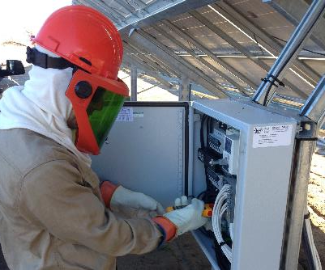
Electrical Hazards
Disclaimer: This material was produced under grant number SH-05027-SH8 from the Occupational Safety and Health Administration, U.S. Department of Labor. It does not necessarily reflect the views or policies of the U.S. Department of Labor, nor does mention of trade names, commercial products, or organizations imply endorsement by the U.S. Government.
Part 1 Slides 1-44
Notes:
Welcome to this lesson on electrical hazards found at ground-mounted PV installation sites
If you have not yet listened to the introductory and site hazards lessons, please go back and do so, as these lesson follow a progressive order.
Again, this course was produced under a Susan Harwood Training Grant through OSHA, the Occupational Safety and Health Administration.

Slide 2
Learning Objectives
Identify how OSHA, NFPA 70E®, and NFPA 70 (the NEC®) relate to electrical safety
Determine electrical hazards on large-scale PV job sites
Identify shock and arc flash hazards and implement protective measures
Define lockout / tagout methods and principles as applied to PV systems
Describe installation, maintenance, and PV testing hazards
Notes:
The learning objectives for this lesson are to:
Identify how OSHA, NFPA 70E, and NFPA 70 (the NEC) relate to electrical safety
Determine electrical hazards on large-scale PV job sites
Identify shock and arc flash hazards and implement protective measures
Define lockout / tagout methods and principles as applied to PV systems
Describe installation, maintenance, and PV testing hazards

Slide 3
Electrical Hazards
Part I: Introduction to Electrical Safety and PV Systems

Slide 4
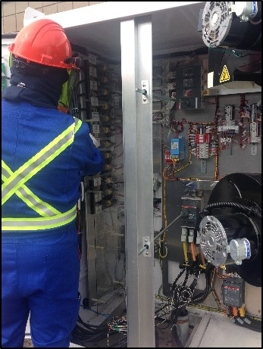
OSHA Electrical Regulations
OSHA provides requirements for “what to do”
Electrical safety
OSHA 1910 Subpart S
OSHA 1926 Subpart K
Personal Protective Equipment (PPE)
OSHA 1910 Subpart I
OSHA 1926 Subpart E
Notes:
OSHA provides requirements on ”what to do”
Electrical safety is covered under OSHA 1910 (General Industry) Subpart S and 1926 (Construction) Subpart K
PPE requirements are covered under 1910 Subpart I and 1926 Subpart E
Explain how the mission of OSHA relates to electrical safety requirements

Slide 5
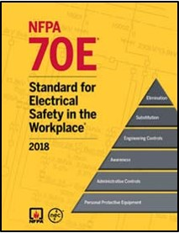
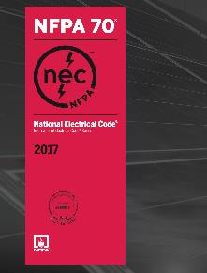
NFPA 70E and NFPA 70
Provide guidance on “how to do it”
NFPA 70E and NFPA 70 are national consensus standards
Recognized by OSHA as providing guidance for worker protection
NFPA 70E – Standard for Electrical Safety in the Workplace
Intent is reduction of exposure to hazards of shock and arc-flash during electrical work
Tailored to fulfill OSHA’s guidelines and be consistent with National Electrical Code
NFPA 70 – National Electrical Code (NEC®)
Standard for safe electrical design, installation, and inspection to protect people and property from electrical hazards
Notes:
Explain how NFPA 70E and NFPA 70 NEC are related to OSHA
NFPA 70E and NFPA 70 provide guidance on “how to do it”
These are national consensus standards recognized by OSHA as providing guidance for worker protections
Explain how NFPA 70E and NFPA 70 NEC apply to electrical safety
70E: Intent is reduction of exposure to hazards of shock and arc-flash during electrical work, tailored to fulfill OSHA’s guidelines and be consistent with National Electrical Code
70 (NEC): Standard for safe electrical design, installation, and inspection to protect people and property from electrical hazards

Slide 6
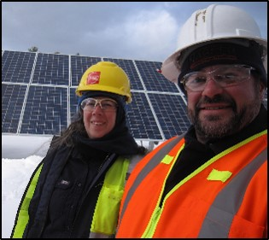
Qualified Persons and Training OSHA 1910.332, NFPA 70E Article 100 & 110
Qualified person
One with skills and knowledge related to construction, operation, and installation of electrical equipment and hazards involved
Training requirements
Safety-related work practices
Distinguishing exposed live parts from other parts of electric equipment
Determining nominal voltage of exposed live parts
Determining approach distances
Selecting and use of correct personal protective equipment (PPE)
Notes:
A ”qualified person” is defined in NFPA 70E as one who has skills and knowledge related to the construction and operation of the electrical equipment and installation and has received safety training on the hazards involved
Explain general training requirements and skills required to be qualified to work safely with electrical equipment

Slide 7
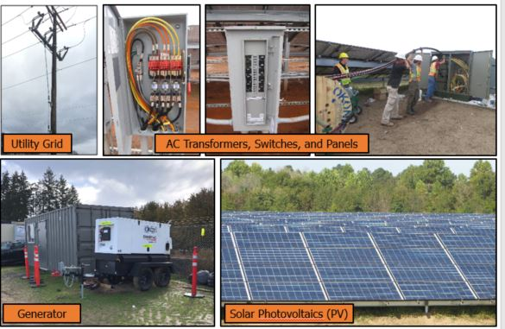
Electrical Hazards May Include, But Are Not Limited To…
Notes:
Common electrical hazards that may be found on the PV job site include:
The utility grid
AC transformers, switches, and panels
Generators
Solar PV
Remember to isolate equipment before performing work!

Slide 8
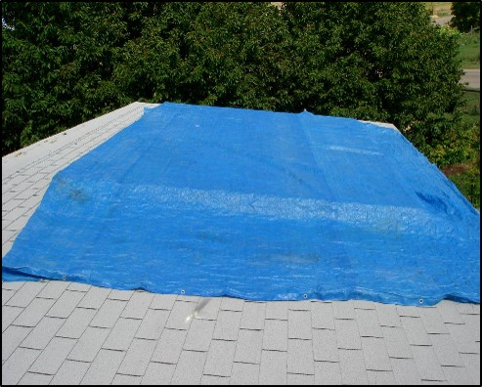
Electrical Hazard: PV Array
Small roof-mounted PV array covered with a blue tarp
Inverter On (operating):
Power: 199 W
Voltage: 161 V
Current: 1.2 A
Inverter Off:
Open circuit voltage: 198 V
Short circuit current: 1.35 A
This small array still can produce hazardous levels of voltage and current!
Values for specific example only, irradiance varied throughout tests
It is impossible to reliably and adequately cover a large ground-mounted PV array!
Treat PV modules/array as live at all times!
And follow documented installation procedures!
Notes:
In this example a blue tarp is used on a sunny day to completely cover the PV array
It is impossible to reliably and adequately cover a large ground-mounted PV array.
In no way is the array, or any downstream conductor, electrically safe to work on
The array still produces a lethal voltage and current level- treat PV modules/array as live at all times!
There is no need to ever be exposed to this hazard during the installation phase, only at final construction phases (commissioning) when power sources are connected and voltages/polarity tested

Slide 9
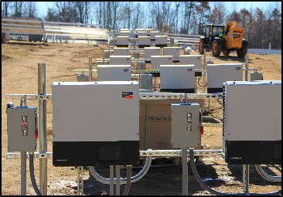
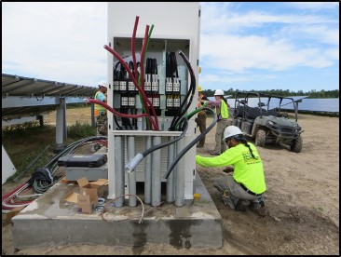
Voltages on Large-scale Solar: DC and AC
PV DC circuits
Up to 1,500 VDC
Depends on system design
Inverter AC circuits
Three-phase up to 690 VAC
“Non-standard” inverter-specific AC voltages
Other AC circuits
Site power using typical service voltages (120/240)
Data acquisition system (DAS)
Increased hazard if power conductors come from directly from MV transformer
Medium voltages (MV) for distribution / connection to utility grid
Notes:
Discuss DC and AC voltages that can be found on large-scale PV sites
PV DC circuits up to 1,500 VDC, dependent on system design (600VDC - 1500VDC)
Inverter 3-ph AC circuits up to 690 VAC
Typically site power provided at 120/240VAC
Data acquisition system (DAS)- DAS power conductors and the voltage reference conductors for metering are often directly connected to the secondary side of the transformer.
Especially since these secondary conductors from the MV TF are extremely dangerous and often casually treated despite some of the highest arc flash ratings
Medium voltages (MV) for distribution (not covered in this course)

Slide 10
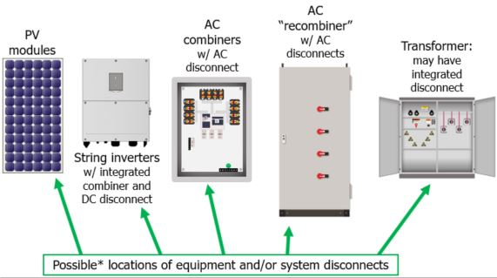
Basic Electrical System Architecture: String Inverters
String
Example
*There are many possible variations including configuration, layout, and equipment options; this is a general diagram – the specific architecture, and associated hazards, must be evaluated for each system.
Notes:
Here is a diagram of the basic electrical system architecture for a large-scale PV system with string inverters
The NEC requires disconnects in PV systems for the PV system, the PV source, and for equipment.
Disconnects can fill one or more of these roles, depending on their location in the system and the overall system layout.
Local regulations, especially those enforced by the utility company, may require additional disconnecting means beyond those required in the NEC.
Note, there are many possible variations including configuration, layout, and equipment options; this is a general diagram – the specific architecture, and associated hazards, must be evaluated for each system.

Slide 11
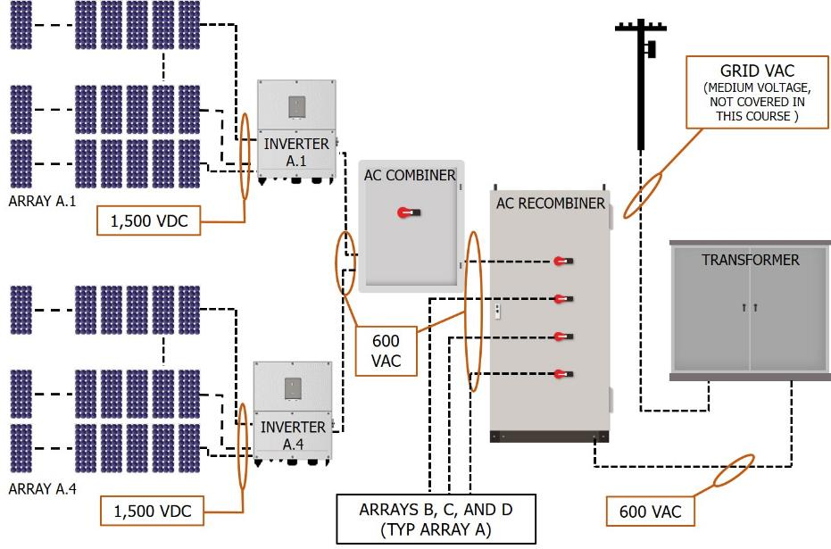
Example Voltages: PV System with String Inverters
String
Example
Notes:
Discuss DC and AC voltages that may be present on large-scale systems with string inverters

Slide 12
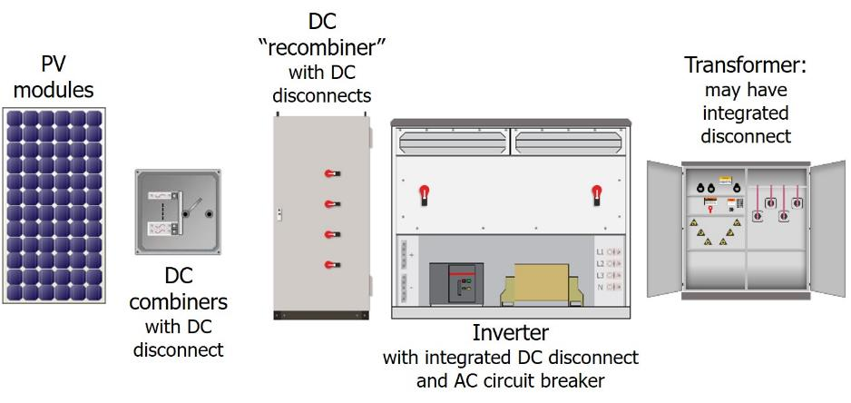
Basic Electrical System Architecture: Central Inverter(s)
Central
Example
Possible* locations of equipment and/or system disconnects
*There are many possible variations including configuration, layout, and equipment options; this is a general diagram – the specific architecture, and associated hazards, must be evaluated for each system.
Notes:
Here is a diagram of the basic electrical system architecture for a large-scale PV system with central inverter(s)
The NEC requires disconnects in PV systems for the PV system, the PV source, and for equipment.
Disconnects can fill one or more of these roles, depending on their location in the system and the overall system layout.
Local regulations, especially those enforced by the utility company, may require additional disconnecting means beyond those required in the NEC.

Slide 13
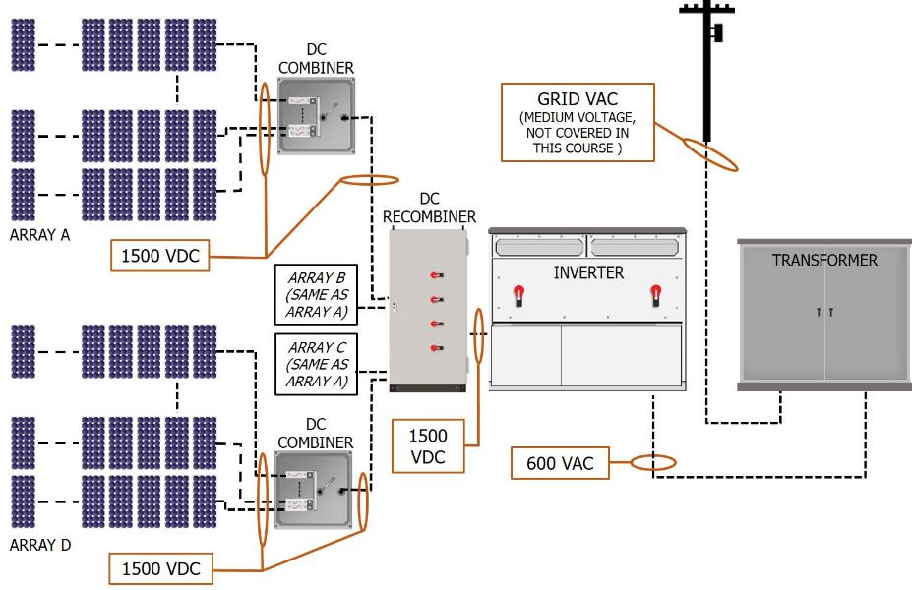
Example Voltages: PV System with Central Inverter(s)
Central
Example
Notes:
Discuss DC and AC voltages that may be present on large-scale systems with central inverter(s)

Slide 14
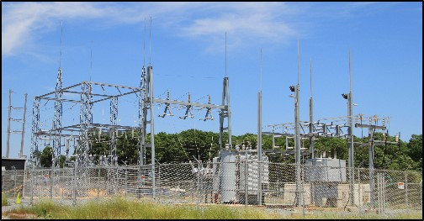
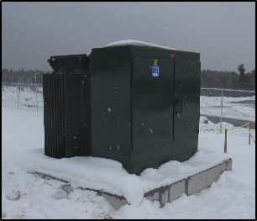
Medium Voltages (AC) on Large-Scale Solar
Not covered in this course
Specialized training required!
AC interconnection to utility grid
Begins at high voltage side of interconnection (step-up) transformers
Sometimes called ”high voltage”
Overhead and/or underground
Exposed and/or enclosed switchgear and overcurrent protection
OSHA 1926 Subpart V and 1910.269
Notes:
Medium AC voltages, sometimes called “high voltage”, are not covered in this course
Specialized training is required
MV begins at the high voltage side of interconnection (step-up) transformers
It is sometimes called “high voltage”
Can be run overhead or underground
Can include exposed and/or enclosed switchgear and overcurrent protection
Covered under OSHA 1926 Subpart V and 1910 Subpart R (Special Industries)- Electrical Power Transmission and Distribution

Slide 15
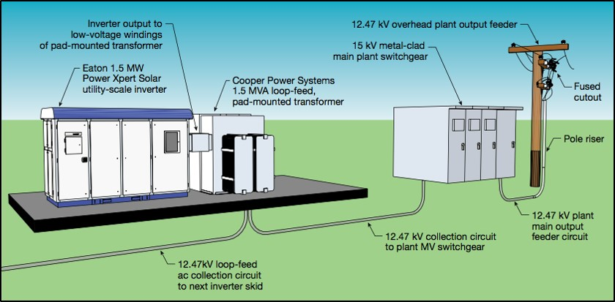
PV System Interconnection Medium Voltage
MV range between 2 and 35 kV AC
Beyond scope of this course
AC to low voltage side of transformer
Inverter
Step up transformer to medium voltage
Source: Eaton Corporation
Notes:
Although PV system interconnection MV is beyond the scope of this course, it’s helpful to provide a visual.
Note: Eaton no longer makes inverters.

Slide 16
Large-Scale PV Voltage Review
DC side
up to 1,500 volts
PV Array to Inverter
AC side
up to 690 volts (or more)
Inverter to Transformer
Notes:
To review, the transition from DC wiring (from the PV array) to AC wiring (to the interconnection) happens at the inverter

Slide 17
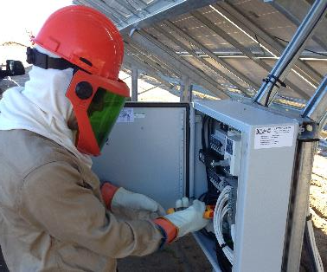
Electrical Hazards
Part II: PV System Electrical Connections

Slide 18
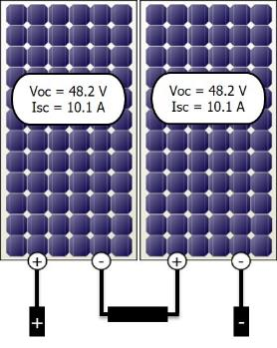
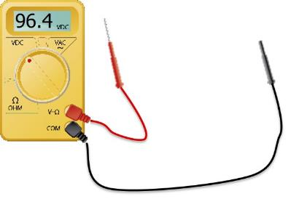
PV Hazard: Series Connections
Negative from one module connects to positive from another
Voltage is additive
Current remains the same (through all parts of circuit)
Modules in series form a “series-string” or PV source circuit
PV source circuits may be designed up to 1,500 VDC (dozens of modules per string)
Open positive and negative module leads are energized at PV open circuit voltage (Voc) when exposed to sunlight
Electrical hazard MUST be isolated
Notes:
Series connections are made between two solar modules when the negative connector of one module is plugged into the positive connector of the other module
In series connections voltage is additive, however current remains the same.
When multiple modules are wired in series they form what is commonly called a “series-string” or Photovoltaic (PV) source circuit per NEC definition
After making the series connection, positive on one module and a negative on the other become the leads (or “homerun” wires) for the PV source circuit. Eventually, they’ll run to a combiner box or DC disconnect.
PV source circuits may be designed up to 1,500 VDC and are a significant electrical hazard that must be isolated
In the example above, the voltage of the two modules is added together, however the current is still equal to that of one module, at all points in the circuit.
Current should only be tested with a clamp on meter, do not short circuit modules!
Voc of this single module is 48.2 VDV, we would expect the multimeter to read 2 x 48.2 = 96.4 VDC (open circuit, assuming STC)
Series and Parallel

Slide 19
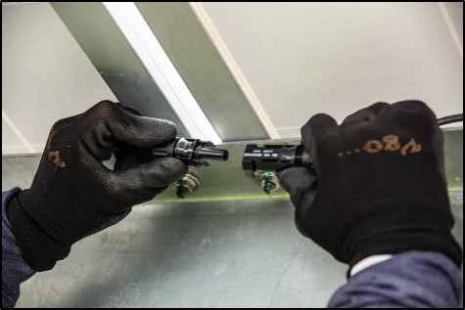
DC Series Connections On Site
Series connections between modules made with factory-installed mating connectors
Non-contact / touch safe, so long as in good condition, no exposed wires
Must only be performed by qualified personnel!
Always follow wiring plan to to avoid hazardous wiring mistakes
Short circuits
Incorrect number of modules per string
Energized wiring of equipment
Notes:
PV modules come with factory-installed quick connects on the wire leads
These connectors are non-contact, ”touch safe”, assuming they are in good condition and there are no exposed wires
Series connections must only be performed by qualified personnel
Qualified person must follow wiring plan to avoid hazardous wiring mistakes, for example short circuits or too many modules per series string

Slide 20
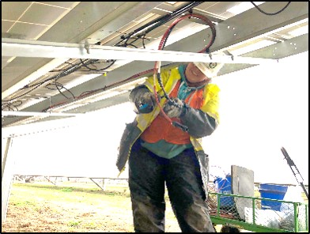
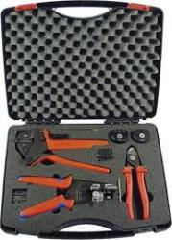
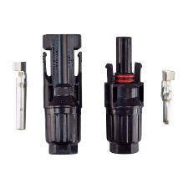
PV Source Circuit (DC) Connections On Site
Connectors may be factory- or field-made
Field crimping of connectors must only be performed by qualified personnel!
Training and proper tools / materials required
Worker performing field crimping should NEVER be exposed to voltage
Never connect source circuit conductors to the array until all have been identified and other end is landed/terminated
Source: Rennsteig
Notes:
While it is possible to purchase factory-made wire lengths with pre-installed connectors, it is far more common to do this in the field.
Field crimping of connectors must ONLY be performed by qualified personnel
Requires proper training along with the proper tools and materials- there are many different connector manufacturers out there and no standard
Improper connections can lead to faults, fires, performance issues, etc.
Field made connectors are a high risk process when performed in the incorrect order. Static voltages, and on the negative bus, is additive.

Slide 21
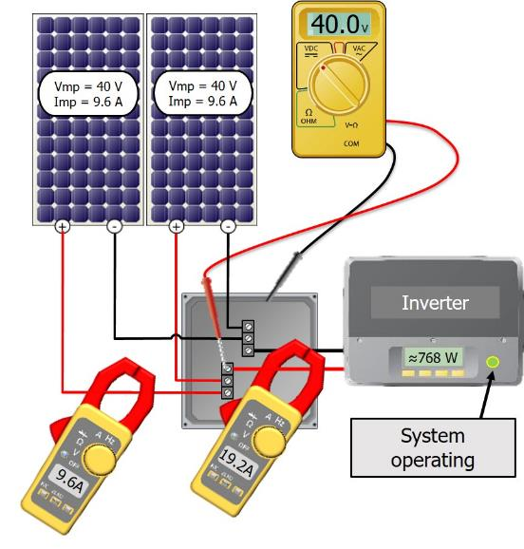
PV Hazard: Parallel Connections
Positive to positive and negative to negative
Current is additive
Voltage remains the same
PV source circuits in parallel form a PV output circuit
Parallel connections increase available fault current!
Notes:
In this slide we are wiring two modules in parallel
The positive (+) from one module connects to the positive (+) of the other at the positive bus bar in the combiner box. This also happens with both negative (-) leads.
When wired in parallel, the current of the modules is additive, while the voltage stays the same.
When modules or strings of modules are connected in parallel, the combined output is called a PV output circuit. This “PV Output Circuit” wire must be sized to handle the higher current.
Here, two PV source circuits of one module each are paralleled to form a PV output circuit (note: on large-scale systems, series strings of modules would be wired in parallel, vs. individual modules)
In this example, the PV output circuit will measure 40.1 volts DC, and produce 19.2 amps of current. The total power is 772 watts. The voltage is half of what it would be if the modules were wired in series, but the current is double.
Notice that the total power of the two modules is the same whether it is wired in series or parallel. In this example we wired the modules in parallel and calculated the power to be 40V x 19.2 A = 768W. If we wired these modules in series the voltage would be additive and the current would remain the same. However the calculated power would be the same because 80V x 9.6A =768W.
Series and Parallel

Slide 22
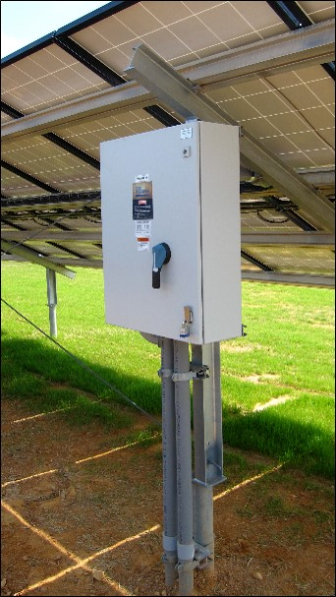
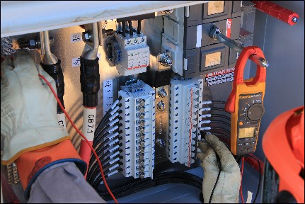
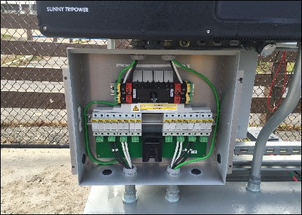
Options for DC Parallel Connections On Site: Combiner Boxes
Disconnect
Fuse holders
May be integrated into string inverter
Notes:
There are different options for where DC parallel connections are made
In the left and upper right photos, we see a disconnecting combiner box with fuses protecting the paralleled circuits
In the bottom right photo, we see the parallel connections happening inside the disconnecting DC combiner integrated into the string inverter
Remember, parallel connections increase available current; refer back to the system architecture slides if needed

Slide 23
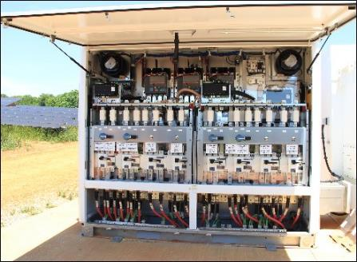
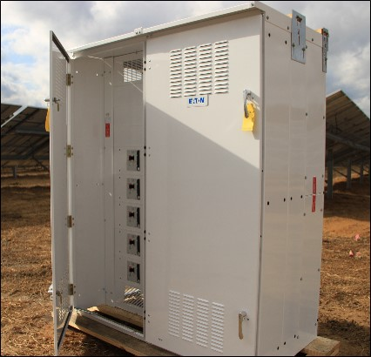
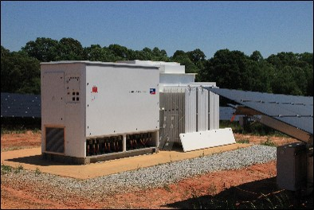
Options for DC Parallel Connections On Site: “Recombiners”
Integrated into central inverter
External enclosure with fuses and switches, or breakers (shown)
Notes:
“Recombiners” are typically placed between DC combiners and the inverter to parallel the output of multiple combiner boxes.
Recombiner options include an external enclosure with fuses and switches, or breakers (as seen in the photo on the left).
Recombiners may also be integrated into a central inverter.
Remember, parallel connections increase available current; refer back to the system architecture slides if needed

Slide 24
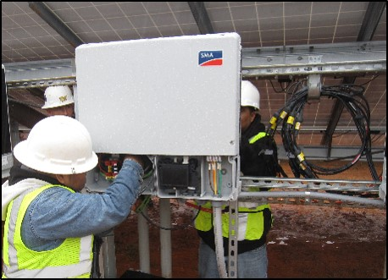
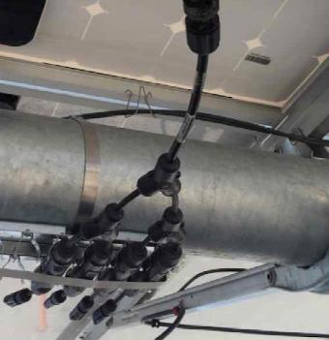
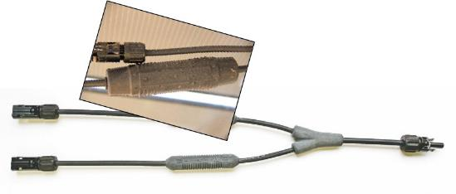
Options for DC Parallel Connections On Site: Harnesses
Harnesses often used in place of or in addition to combiners – they may contain inline fuses as well
Multiple types and points of parallel connection are common on all system architectures
Remember: parallel connections increase available current!
Notes:
Harnesses may also be used for parallel connections.
Some have inline fuses, where needed.
Note: it is not uncommon to have multiple types and points of parallel connection

Slide 25
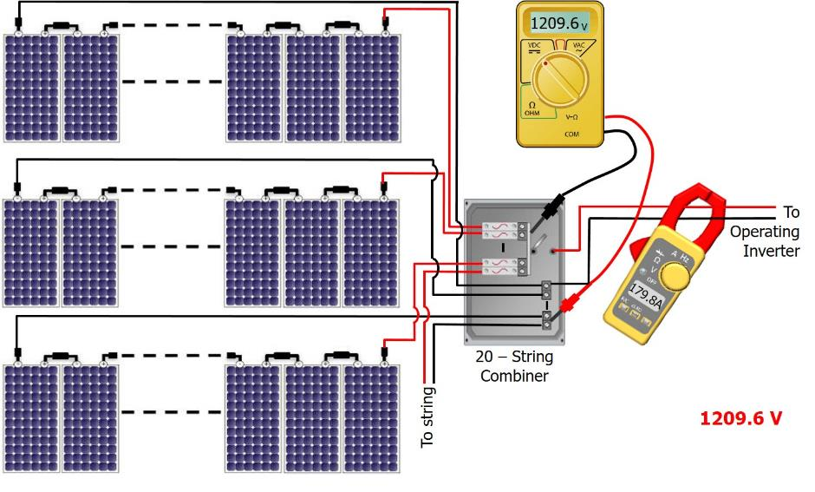
PV Hazard: System Voltage and Amperage 32 Modules in Series x 20 Source Circuits in Parallel
Module Specs:
Voc: 46.2 V
Vmp: 37.8 V
Isc: 9.42 A
Imp: 8.99 A
1478.4 V
System Voc: ________
Operating Vmp: ______
Operating Imp: _______
179.8 A
Note: Actual PV circuit voltage and current are dependent on variables such as temperature and irradiance
Notes:
Here we have a PV system that has 20 source circuits (32 modules per source circuit), wired in parallel.
To wire this system we would want to first make all the series connections within the source circuits. Note that this now increases the voltage to a hazardous level.
It is important to be able to understand how to calculate the expected voltage and amperage of a PV System. In this example we are assuming STC values for temperature and irradiance. In the field, site conditions must be measured and factored into these calculations, however this is an advanced topic and not covered in this course.
Explain the difference between Voc/Vmp and Isc/Imp
System Voc is determined by the number of modules in a source circuit multiplied by the Voc rating of the module.
If we tested the open circuit voltage with a multi-meter of one of these source circuits we would expect this voltage to be 46.2V x 32 Modules = 1478.4V.
Notice that we use the Voc value in this calculation because at this point the circuit is open and not operating.
System Voc should also be tested in the combiner box after all “homerun” leads are landed.
We would expect to see the same System Voc value of 1478V inside the combiner box because here we are making a parallel connection and thus voltage remains unchanged from the source circuit value.
To test the operating voltages and currents of the system, the system must be completely wired and operating. This means that the PV output circuit from the combiner box to the inverter must be connected and the inverter must be running.
To calculate the operating voltage you must use the Vmp of the module. Vmp is always lower than Voc because the circuit is supplying the ”load” of the inverter, ideally at it’s maximum power point. Therefore the operating voltage in this case would be 37.8V x 32 Modules = 1209.6V. This can also be tested within the combiner box using a multi-meter- USE PROPER PPE!
Operating Imp: To calculate an expected Imp we would want to use the Imp value of the module. Since we have 20 source circuits in parallel we would make the following calculation 9.42A x 20 Source Circuits = 179.8 A. The system’s DC operating current could be measured with a clamp-on meter which would clamp around either the positive or negative wire of the PV output circuit.
Do not test current with the probe tips (leads) of the multi-meter! Use clamp on meter rated for DC voltage and current
Series and Parallel

Slide 26
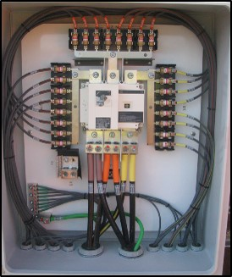
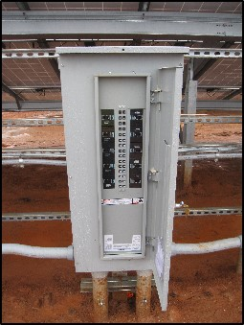
AC Parallel Connections On Site
Current is additive, voltage remains same
Examples
String inverter combiner panel
Central inverter outputs may also be combined in parallel
Varies by system configuration
Higher available fault currents
Greater arc flash risk
Fused AC combiner with disconnect (string inverters)
Panelboard with breakers (string inverters)
Notes:
Just as with DC connections, for AC parallel connections current is additive and voltage remains the same
Examples of where AC parallel connections may occur:
String inverter combiner
Combiner for paralleling central inverters
Combiners may contain fuses (as seen in upper photo) or breakers (as seen in lower photo)
Remember, parallel connections bring higher available fault current, and a greater arc flash risk (we’ll cover shock and arc flash in next slides)

Slide 27
Electrical Hazards
Part III: Shock and Arc Flash Hazards

Slide 28
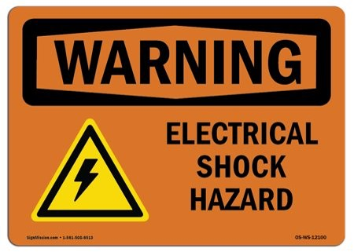
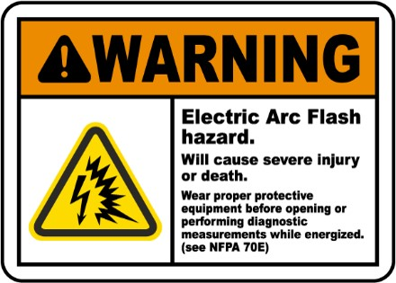
Two Types of Electrical Hazards
Shock
Inadvertent contact with an electrical energy source
Arc flash
An electrical explosion or discharge
Notes:
The passage of electricity through the body is called shock. Effects can range from a tingling sensation to death. A shock that may not be enough to cause injury can nonetheless startle a worker, causing an involuntary reaction that can result in serious injuries or death.
An arc flash definition, according to National Fire Protection Association (NFPA), is “a dangerous condition associated with the release of energy caused by an electric arc.” An electric arc flash occurs during a fault, or short circuit condition, which passes through this arc gap. The arc flash can be initiated through accidental contact, equipment which is underrated for the available short circuit current, contamination or tracking over insulated surfaces, deterioration or corrosion of equipment and, or parts, as well as other causes. An arc flash event can expel large amounts of deadly energy. The arc causes an ionization of the air, and arc flash temperatures can reach as high as 35,000 degrees Fahrenheit. This is hotter than the surface of the sun.

Slide 29
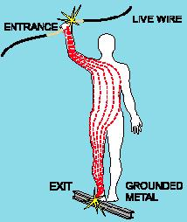
Electrical Shock Hazards
Shock
Risk and severity depend on
Electrical potential (voltage)
Amount, path, and duration of current
Very small current levels can cause damage or death
DC current thresholds:
Source: UL
Notes:
Electrical shocks are one of the major dangers on PV jobsites, causing burns, permanent injury, or even death.
Shock severity depends on the path, duration, and the amount of current.
The resistance of the body determines at what voltage a shock can occur, but varies based on:
The amount of moisture on the skin (less moisture = more resistance)
The size of the area of contact (smaller area = more resistance) The pressure applied to the contact point (less pressure = more resistance)
Muscular structure (more muscle = more resistance)
Very small current levels can cause damage or death
Low voltages can be extremely dangerous because, all other factors being equal, the degree of injury increases the longer the body is in contact with the circuit.
29

Slide 30
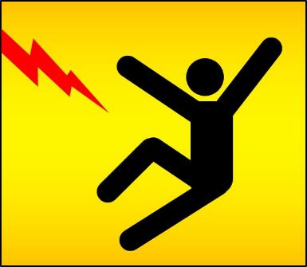
Outcomes of Electrical Shock
Shock
Loss of consciousness
Electrical burns
Fibrillation or cardiac arrest
Can occur hours after the shock
Problems with breathing, swallowing, vision, hearing
Muscle spasms and pain
Death
Injuries common after shock when the worker loses balance and falls
Be aware of hazards and keep a safe working distance
Always use appropriate fall protection
Notes:
Electrical Shock can injure or kill, the outcomes may include:
Loss of consciousness
Electrical burns
Fibrillation or cardiac arrest
Headaches
Problems with breathing, swallowing, vision, hearing
Muscle spasms and pain
Injuries common after shock when the worker loses balance and falls
Be aware of hazards and keep a safe working distance
Always use appropriate fall protection
Use caution when working on ladders- non-conductive side rails only!

Slide 31
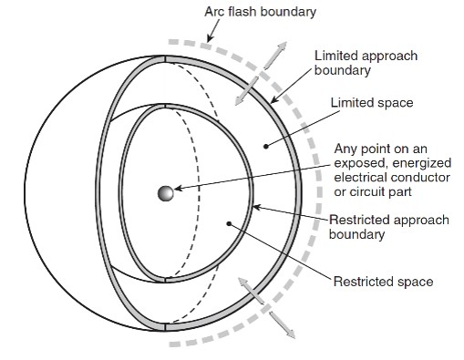
Shock Risk Assessment and Boundaries
Shock
Shock risk assessment
Identify shock hazard
Estimate likelihood and severity of occurrence
Determine protective measures
Shock protection boundaries
Limited approach boundary
Unqualified persons prohibited, except with continuous guidance and escort from qualified person
Restricted approach boundary
Qualified persons only, and must have appropriate personal protective equipment (PPE)
Unqualified persons not permitted
Arc Flash Boundary
Limited Approach Boundary
Limited Space
SHOCK HAZARD!
Restricted Approach Boundary
Restricted Space
Limits of Approach
NFPA 70E Annex C Figure C.1.2.3
Notes:
To prevent shock and hazard, NFPA 70E categorizes the physical space around energized circuits in electrical equipment to limited-approach boundaries and restricted-approach boundaries.
A limited-approach boundary has a greater allowable distance from equipment than a restricted-approach boundary, and only qualified personnel will be allowed within the tighter restricted boundary. Unqualified personnel can work outside of the limited-approach boundary. The actual distance of the boundary varies depending upon voltage levels.
Shock risk assessment
Identify shock hazard
Estimate likelihood and severity of occurrence
Determine protective measures
Shock protection boundaries
Limited approach boundary
Unqualified persons shall not pass, except with continuous guidance and escort from qualified person
Restricted approach boundary
Qualified persons shall not pass, except with appropriate PPE
Unqualified persons not permitted
In summary, unless you are qualified stay outside the limited approach boundary for all electrical hazards!!
There is also an arc-flash boundary to consider, as described in the coming slides

Slide 32
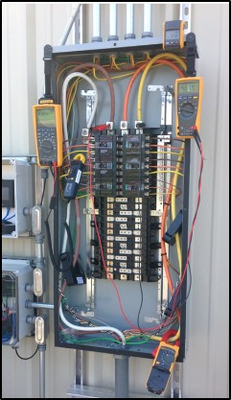
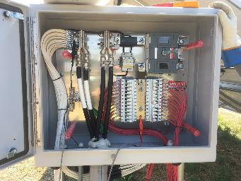
Shock Hazard Boundaries
Shock
NFPA tables based on system voltage
AC circuits - 2018 NFPA 70E Table 130.4(D)(a)
DC circuits - 2018 NFPA 70E Table 130.4(D)(b)
480 VAC Inverter Combiner Panel
Limited Approach Boundary: 3.5 feet
Restricted Approach Boundary: 1 foot
Within restricted approach boundary:
Qualified persons only!
PPE required!
1,500 VDC PV System - DC Combiner Box
Limited Approach Boundary: 5 feet
Restricted Approach Boundary: 1.5 feet
Notes:
Shock hazard boundaries can be determined by using NFPA 70E tables
Note the increased distance at the higher DC voltage
Per NEC, PV Source circuits are limited to 600V for residential systems, but can be designed up to 1500V for some non-residential systems!

Slide 33
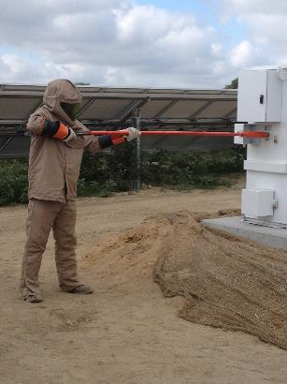
Arc Flash Hazards
Arc flash
A source of possible injury or death due to the release of energy caused by an electric arc
Arc flash - extreme temperatures, blinding light
Arc blast - intense pressure and sound associated with arc flash
Incident energy
Level of thermal energy generated from an electrical arc
Determined by
Fault current available during short circuit
Overcurrent protection device(s)
Fault clearing time
Notes:
An arc flash is an additional danger that is presented by the utility grid and from PV systems with high DC current
Arc flash hazard
A source of possible injury or death due to the release of energy caused by an electric arc - accidental short circuit, faulty equipment, faulty installation.
An arc flash fed by high current can result in an explosive blast and intense heat. This can vaporize copper and aluminum conductors and sear surrounding metal, fabric, and flesh as it expands outwards. Often victims are blasted across the ground, left unconscious, and on fire.
Arc flash - extreme temperatures, blinding light
Arc blast - Intense pressure and sound associated with arc flash
Incident energy
The level of thermal energy generated from an electrical arc
Determined by fault current available during short circuit condition, overcurrent protection device(s), and fault clearing time
PV arrays are current-limited, meaning a module or group of modules can only produce a certain amount of current. The utility grid, however, can provide nearly unlimited fault current. Both are extremely dangerous and must be treated with caution.

Slide 34
Arc Flash Risk Assessment and Boundaries
Arc flash
Arc flash risk assessment
Identify arc flash hazard
Estimate likelihood and severity of occurrence
Determine protective measures
Arc flash boundary
Distance at which a worker could be exposed to incident energy ≥ 1.2 cal/cm²
Minimum 2nd degree burns
PPE required within arc flash boundary
Arc Flash Boundary
Limited Approach Boundary
Limited Space
SHOCK HAZARD!
Restricted Approach Boundary
Restricted Space
Limits of Approach
NFPA 70E Annex C Figure C.1.2.3
Notes:
Arc flash risk assessment
Identify arc flash hazard
Estimate likelihood and severity of occurrence
Determine protective measures
An arc flash boundary
The distance within which a worker could be exposed to the danger of second degree burns or worse
Determined by the amount of available incident energy as known as “available fault current” - The largest amount of current capable of being delivered at a specified point of the system during a short circuit condition
Stay outside the arc flash boundary unless you have specific training and PPE; and deemed by the safety person that you are qualified for a specific location/risk.

Slide 35
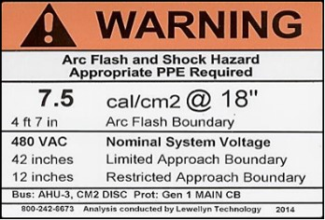
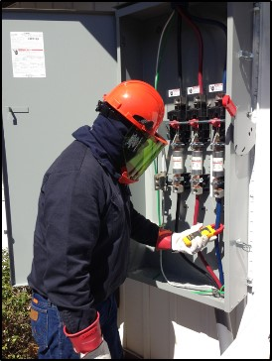
Arc Flash Boundary & PPE
Arc flash
Determined based on
Incident energy analysis method
NFPA 70E Annex D calculations used to determine incident energy available
Analysis by engineer may be required
PPE selected based on incident energy level
Or
Arc flash PPE category method
NFPA 70E 130.7(C)(15) Tables used to determine exposure level and PPE
Task must correspond to one of the categories
Does not address all DC PV circuit configurations, voltages, and current levels
Notes:
NFPA 70E provides two options for determining fault current available:
Incident energy analysis method
NFPA 70E Annex D calculations used to determine incident energy available
Analysis by engineer may be required
PPE selected based on incident energy level
Arc flash PPE category method
NFPA 70E Tables used to determine exposure level and PPE
Task must correspond to one of the categories
Does not address all PV circuit configurations, voltages, and current levels
Unfortunately, the NFPA 70E does not sufficiently address PV system DC circuits - professional engineering assistance may be required to determine appropriate PPE

Slide 36
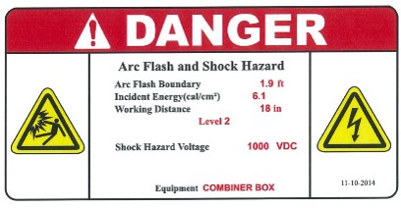
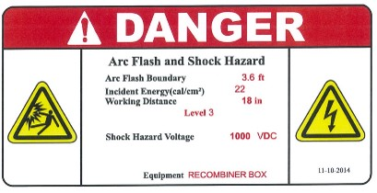
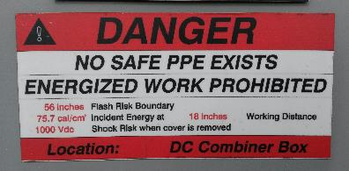
Arc Flash Hazard on DC Systems
Arc flash
Varies significantly based on size and configuration
Risk proportional to electrical characteristics of PV power in enclosure
Larger system = greater risk
Especially a concern with central inverters
Many parallel PV strings
Combiner boxes
Recombiners
See plan set or labels for values
Segment array to reduce hazard level
Isolate inverters, combiners, and portions of array into lower power segments
Notes:
The arc flash hazard present on the DC side of the system will vary significantly based on the system size and configuration
The risk is proportional to the electrical characteristics of PV power in the enclosure
A larger system = great risk
Arch flash hazards are especially a concern with central inverter systems, where you will have many parallel strings from combiner and recombiner boxes
Always consult your plan set or equipment labels for calculated values
To reduce the hazard level, segment array into lower power segments

Slide 37
Electrical Hazards
Part IV: PPE

Slide 38
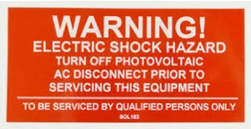
Creating an Electrically Safe Work Environment
Job Hazard Analysis (JHA)
Task-based
Identify then eliminate or mitigate hazards!
Standard operating procedures (SOPs)
‘Live’ work only performed during testing, commissioning, troubleshooting
Tools/equipment/meters, PPE, and documentation
Qualified persons only
Follow lockout / tagout (LOTO) procedures
Notes:
Steps to take to create an electrically safe work environment include:
Perform a JHA for each task
Follow SOPs- ‘live’ electrical work is only performed during testing, commissioning, and troubleshooting; properly maintain tools/PPE; document!
Electrical work only for qualified persons
Follow LOTO procedures

Slide 39
Energized Circuits
No need to work on them during installation!
Electricians only access energized circuits during
Testing
Commissioning
Troubleshooting
By following proper installation procedures, nearly ALL electrical work (except testing, commissioning, and troubleshooting) can be done while de-energized
Notes:
There is no need to work on energized circuits during PV system installation!
Must follow proper installation procedures
Access to energized circuits is only needed during testing, commissioning, and troubleshooting
If you are working on an energized circuit during installation, you are likely doing something wrong!

Slide 40
Personal Protective Equipment (PPE) 2018 NFPA 70E 130.4 and 130.5(F)
Electrical PPE depends on the task and the system. It may include, but is not limited to:
Protective equipment
Face shield
Hard hat
Safety glasses or safety goggles
Hearing protection
Leather footwear
Insulating PPE
Gloves, sleeves
Arc-rated (AR) clothing
Long-sleeve shirt
Pants
Coveralls
Suit hood
Jacket, parka, rainwear, or hard hat liner
Balaclava
Notes:
Make sure you have the proper PPE for the work you may be doing at any site - consult NFPA 70E and/or a professional engineer as needed
As mandated by NFPA 70E, when working on energized equipment within the arc-flash boundary and shock hazard boundary, arc-rated clothing and protective equipment must be worn
Do not performed the work if you are not a qualified person!

Slide 41
Shock Hazard PPE: Rubber Insulating Gloves
When working in restricted approach boundary
Qualified person must be insulated or guarded from hazard
Insulating gloves are considered insulation only from energized parts being worked on
Gloves must be rated for appropriate voltage
Class 00 = 750 VDC, 500 VAC
Class 0 = 1,500 VDC, 1,000 VAC
Treat with care
Must be visually inspected and air tested before use
Inspect for holes before each use
Keep out of sun, away from sharp objects
Get them recertified
Typically every 6 months for in-service gloves
Only use when needed: they’re not “work gloves”
Always use leather protectors
Notes:
Rubber gloves and leather protectors are the most common personal protective equipment used for shock protection. These must be adequate to protect the workers from electrical shock. The rubber gloves must have been tested and certified. Class 0 and Class 00 gloves must be air-tested and visually inspected for damage and adequacy immediately before each use.
Class 0 and 00 rubber gloves must be regularly tested and certified to ensure that they can withstand the voltages for which they are rated, once every six months, if they are in service. Workers must also be trained in the proper use, care, and storage of rubber gloves and leather protectors.
Working in restricted approach boundary
Qualified person must be insulated or guarded from hazard
Insulating gloves are considered insulation only from energized parts being worked on
Never use without protective leathers!
Rated for AC & DC voltage
Class 00 = 750 VDC, 500 VAC
Class 0 = 1,500 VDC, 1,000 VAC
Treat with care
Inspect for holes before each use
Keep out of the sun, away from sharp objects
Bag them correctly
Only use when needed: they’re not “work gloves”
Get them recertified
Typically every six months for in-service gloves

Slide 42
Other Considerations 2018 NFPA 70E 130.6(D) and 130.7(D)
NFPA 70E
130.6(D): No conductive articles worn inside restricted approach boundary
Watchbands, bracelets, rings, key chains, necklaces, metal headgear, metal frame glasses, etc.
130.7(D): Insulated tools and equipment
Where unintentional contact may occur
Must be properly rated
Notes:
NFPA 70E 130.6(D) Conductive Articles Being Worn. Conductive articles of jewelry and clothing (such as watchbands, bracelets, rings, key chains, necklaces, metalized aprons, cloth with conductive thread, metal headgear, or metal frame glasses) shall not be worn within the restricted approach boundary or where they present an electrical contact hazard with exposed energized electrical conductors or circuit parts.
NFPA 70E 130.7(D) Insulated Tools and Equipment. Employees shall use insulated tools or handling equipment, or both, when working inside the restricted approach boundary of exposed energized electrical conductors or circuit parts where tools or handling equipment might make unintentional contact. Insulated tools shall be protected from damage to the insulating material.

Slide 43
When an Arc Flash Hazard Exists, Appropriate PPE is Required
NFPA 70E Table 130.5(G) example:
Calculated incident energy = 6.1 cal/cm²
Arc-rated clothing ≥ 6.1 cal/cm²
Long sleeve shirt and pants, coverall, or arc flash suit, and outerwear as needed
Face shield and balaclava, or arc flash suit hood
Leather gloves (arc flash boundary only), or insulating gloves with leather protectors (shock and arc flash protection)
Safety glasses or goggles
Hearing protection
Leather footwear
Note: An incidental amount of elastic used on non-melting fabric underwear or socks shall be permitted
Notes:
Here is an example of the required PPE based on the calculated incident energy

Slide 44
When an Arc Flash Hazard Exists, Appropriate PPE is Required
NFPA 70E Table 130.5(G) example:
Calculated incident energy = 22 cal/cm²
Arc-rated clothing ≥ 22 cal/cm²
Long sleeve shirt and pants, coverall, or suit, and outerwear as needed
Arc-flash suit hood
Arc rated gloves (arc flash boundary only), or insulating gloves with leather protectors (shock and arc flash protection)
Safety glasses or goggles
Hearing protection
Leather footwear
Note: An incidental amount of elastic used on non-melting fabric underwear or socks shall be permitted
Notes:
Here is an example of the required PPE based on the calculated incident energy

Slide 45
Electrical Hazards
Disclaimer: This material was produced under grant number SH-05027-SH8 from the Occupational Safety and Health Administration, U.S. Department of Labor. It does not necessarily reflect the views or policies of the U.S. Department of Labor, nor does mention of trade names, commercial products, or organizations imply endorsement by the U.S. Government.
Go to Part 2 Slides 45-87

Slide 46
Electrical Hazards
Disclaimer: This material was produced under grant number SH-05027-SH8 from the Occupational Safety and Health Administration, U.S. Department of Labor. It does not necessarily reflect the views or policies of the U.S. Department of Labor, nor does mention of trade names, commercial products, or organizations imply endorsement by the U.S. Government.
Part 2 Slides 45-87
Notes:
Go to Part 2 to view slides 45-87

Slide 47
Electrical Hazards
Part V: LOTO

Slide 48
Electrical Safety Principles
Do NOT work on energized circuits during installation!
Identify and isolate ALL power sources
Utility grid, PV circuits, energy storage, generators, other
Place all switches in the open / off position
Remove fuses when possible
Apply lockout / tagout
PPE is your last line of defense. First identify, eliminate, and/or mitigate hazards!
Notes:
Do not work on energized circuits during installation!
Identify and isolate all power sources
Power source may include the utility grid, PV circuits, batteries, generator, or other
Leave all switches in the open / off position
Remove fuses as needed
Apply Lockout / Tagout - we will look at application option in the next slides

Slide 49
Lockout / Tagout (LOTO) Principles OSHA 1910.147, 1910.333(b)(2), 1926.417, & NFPA 70E Article 120
Equipment or circuits that are de-energized for work to be performed
Shall be rendered inoperative
Shall have lock and tag at each disconnecting means
Tags placed to identify the equipment or circuits being worked on
Statement to prohibit unauthorized operation and removal
Notes:
OSHA and 70E require LOTO to isolate hazard from location where work is being performed
Equipment or circuits that are deenergized for work to be performed:
Shall be rendered inoperative
Shall have lock and tag at each disconnecting means
Tags placed to identify the equipment or circuits being worked on
Statement to prohibit unauthorized operation and removal

Slide 50
Employer LOTO Responsibilities OSHA 29 1910.333(b)(2), NFPA 70E Article 120
Establish, document, and implement LOTO program
Provide equipment necessary to execute LOTO
Provide training to employees
Retraining every three years or less
Audit procedures for improvement opportunities and completeness
Annually audit execution of the procedures
Notes:
Employer LOTO Responsibilities:
Establish, document, and implement LOTO program
Provide equipment necessary to execute LOTO
Provide training to employees
Audit execution of the procedures
Audit the procedure for improvement opportunity and completeness
Employer should encourage a safety culture by having zero tolerance for de-energized circuits not being locked and tagged out.

Slide 51
LOTO: Padlocks
Ensure no one else can remove LOTO device
Each employee has a unique
lock & key
Each lock has employee’s name & phone number
Notes:
Padlocks are a very common lock out method used to ensure the circuit stays isolated by the person who applied the lock
Most disconnects, service panel covers, PV inverters, and PV combiner boxes have a location where a lock can be easily applied
Each employee should have their own key and lock to ensure it can not be removed without their knowledge
Each lock should have employee's name and phone number so they can be easily contacted

Slide 52
LOTO: Hasps
Can be used by multiple technicians
Attaches to disconnects and other equipment
Notes:
Hasps are used so multiple technicians can apply their own lock to a single lock out point
In order for the lock out to be removed, all technicians must have knowledge of it
Most disconnects, service panel covers, PV inverters, and PV combiner boxes have a location where a hasp can be easily applied

Slide 53
LOTO: Circuit Breakers, Plug Connects, and Other Equipment
Follow manufacturer instructions!
Notes:
Circuit breaker lock outs are available in numerous sizes and fit options
It is good to carry a variety of types in LOTO pouch
Available for both single and multi-pole breakers
Be sure to follow manufacturers instructions for application

Slide 54
Grid Connected: LOTO Considerations
Grid-direct PV system (no energy storage)
Inverter is not a power source
Utility grid must be present for inverter to operate: no AC power from inverter when grid is isolated
No grid = No inverter AC power output
DC power source
Not a power source
AC power source
Notes:
The most common PV system configuration is the grid-direct system.
Energy goes straight from the PV array into the inverter, which changes the DC electricity into AC electricity.
This AC electricity then flows into an AC service panel to operate any active loads, extra energy is exported onto the utility grid.
When the amount of energy being produced by the PV system is less than the total AC load, electricity from the grid is used to make up the difference.
When the PV system is not producing anything, such as at night, all of the electricity comes from the utility grid.
A grid-direct system eliminates the batteries and associated maintenance and cost, but requires the grid to be present to function.
When the grid goes down (a utility failure, brownout, or blackout) the grid-direct inverter is designed and listed to shut off instantly in order to ensure that no electricity will be sent out onto the utility lines where it could endanger linemen.
In order to have electricity when the grid is down, a system must have a back-up loads panel and energy storage equipment
Isolate all power sources before performing work - may include PV array, utility grid, or other

Slide 55
Follow Proper LOTO Procedures NFPA Article 120, CFR 29 OSHA 1910.147
Identify all power sources
Consider stored electrical energy
Inverter capacitors (read manual)
Notify affected employees
Isolate (open disconnecting device)
Apply lockout/tagout (LOTO) devices
Verify meter on known voltage source
Verify circuit is de-energized (no voltage)
Re-verify meter on known source
Notes:
Follow proper LOTO procedures
Identify all electrical energy sources
Notify affected employees
Isolate (open disconnecting device)
Consider stored electrical energy
Inverter capacitors, read manual
Apply lockout/tagout (LOTO) devices
Verify meter on known voltage source
Verify each circuit is de-energized (no voltage)
Re-verify meter on known source

Slide 56
PV Source Circuit Lockout / Tagout
Apply LOTO to PV source circuits to prevent energizing equipment during construction / installation
PV module with quick connectors
Notes:
LOTO procedures are also applied to the PV array.
Each PV source circuit must be safely isolated to ensure equipment “downstream” is not energized during the installation
The application of LOTO must happen in coordination with the wiring of each PV source circuit
Extension cord type lock-out devices can be applied to positive and negative “homeruns” to ensure series strings cannot get plugged in without the key holder for that lock being present to unlock AND plug together the quick-connects.

Slide 57
PV Source Circuit Tagout OSHA 29 CFR 1910.333, NFPA 70E 120.4
When terminating PV source circuits in a combiner or string inverter
LOTO on source circuit leads and array-side end of homeruns prevents circuits from being energized
Fuses removed to prevent paralleling circuits until ready for testing /commissioning
Diagram LOTO plan and follow it!
Option: tagout without lock
Permitted by OSHA if lock cannot be applied, or if employer can demonstrate tag provides safety equivalent of a lock
Additional safety measures required
Removal of isolating fuses
Opening additional isolating disconnect
LOTO applied to PV source circuits to perform de-energized wiring of DC combiner
Dummy quick-connect with tag
Notes:
Another option to isolate PV source circuits, without using a lock, is to make ‘dummy’ quick-connect plugs with a tag on them— the tag will remind the PV installer that they cannot plug in the homeruns until all personnel are finished with their related work.
Application of Tagout without lock is only permitted by OSHA if lock cannot be applied or if employer can demonstrate the tag provides safety equivalent of a lock
Additional safety measure required if applying tagout only
Removal of isolating fuses
Opening an additional isolating disconnect

Slide 58
JHA
LOTO Applied:
PV Source Circuit Management
Install PV modules & make series connections
Apply LOTO to isolate the PV power source
Note: Applies to all PV source circuits, whether connected to a combiner box (central inverter), string inverter, or wiring harness
Notes:
This simplified schematic (grounding conductors are not shown) is used to demonstrate the application of LOTO applied to the PV array
Note that lock and tag are applied to the homeruns going to the combiner box to ensure the worker is not exposed to the PV array power source.
Also lock and tag are applied to the energized side on the PV array to prevent wiring mistakes, such as short circuit.
Prewiring homeruns to a locked out disconnect (possibly integrated into a combiner box) is another option for larger systems where multiple PV source circuits must be installed and safely managed
Wiring

Slide 59
LOTO Applied: Grid-direct System with String Inverters
Once properly verified, the LOTO renders it safe to terminate conductors and perform other work inside the inverter and the AC combiner. However, the AC recombiner may be energized – whether or not it is LOTO’d and de-energized upstream is not shown.
Notes:
Review simplified schematic (no grounding shown) of a large-scale grid-direct PV system using string inverters
LOTO applied to PV source circuit homeruns, both positive and negative
LOTO installed with pad lock on DC disconnect and AC combiner
LOTO is also applied AC recombiner circuits
It is critical that LOTO be applied to the correct locations to ensure equipment being working on is de-energized, this can vary depending on system specifics and task being performed.
Once properly verified, the LOTO renders renders it safe to terminate conductors and perform other work inside the inverter and the AC combiner. However, the AC recombiner may be energized – whether or not it is LOTO’d and de-energized upstream is not shown.
Wiring

Slide 60
LOTO Applied: Grid-direct System with Central Inverters
With all the power is off to the inverter, even DC combiner disconnects locked-out, DC with the PV source circuits connected
With the low voltage side of the transformer locked-out, AC power is off to the inverter
When PV source circuit LOTO is removed & homeruns plugged in:
DC conductors become energized up to the busbars in DC combiners
Note: disconnect switches integrated into inverter do not remove power source from inside the inverter cabinet when “off”
Notes:
Review simplified schematic (no grounding shown) of a large grid-direct PV system with a central inverter and multiple DC combiners
LOTO applied to PV source circuit homeruns, both positive and negative
LOTO installed at DC combiners
LOTO applied to disconnect switches in inverter
LOTO applied to low voltage side of transformer
It is critical that LOTO be applied to the correct locations to ensure equipment being working on is de-energized, this can vary depending on system specifics and task being performed.
Wiring

Slide 61
Electrical Hazards
Part VI: Installation and Best Practices

Slide 62
Mechanical Execution of Electrical Work
Concrete work
Cutting steel or aluminum for equipment mounting
Installing inverters, disconnects, other balance of system (BoS) components
Knock out punching
Conduit bending
Manual or mechanical benders
PVC heater blankets
Pipe threading
Wire pulling / feeding
Notes:
There are several mechanical tasks associated with electrical work which may be performed on a PV site, including (but not limited):
Concrete work
Cutting steel or aluminum for equipment mounting
Installing inverters, disconnects, other BOS components
Knock out punching
Conduit bending- using manual or mechanical benders or PVC heater blankets
Pipe threading
Wire pulling / feeding
Note that some of this work may be performed by authorized/non-qualified persons, based on site and company-specific requirements.

Slide 63
Electrical Installation Tasks
Performed ONLY by qualified personnel – as defined by the local jurisdiction
Installing raceways / wire trays
Wire pulling / feeding
Securing / labeling homerun wiring
“Plugging in” modules
Grounding system
Crimping mating connectors on homerun wires
Terminating conductors in equipment
Combiner boxes, disconnects, inverters, switchgear, etc.
Insulation, voltage, polarity testing
Note: Order, SOP, and JHA will vary by task, project, and company
Notes:
Electrical tasks which must ONLY be performed by qualified persons include:
Installing raceways and wire trays
Securing and labeling homerun wiring
Plugging in modules
Grounding
Crimping mating connectors on homerun wires
Terminating conductors in equipment, such as combiner boxes, disconnects, inverters, switchgear, etc.
Insulation, voltage, and polarity testing
Note, the order of tasks, standard operating procedures, and JHA will vary by task, project, and company

Slide 64
Connecting Modules Together
Notes:
Again, series connections of PV modules must ONLY be performed by qualified persons!
Always wear proper PPE
Non-contact / touch safe, so long as in good condition, no exposed wires
While connecting modules might seem like an “easy” task, it is essential that the wiring plan be followed to avoid wiring mistakes, such as too many modules per string, short circuits, or energized wiring of DC combiners, disconnects, etc.
Best system design matches mechanical layout with electrical layout of module strings

Slide 65
JHA
Notes:
Article 110.1 (I) states that if the proposed NFPA 2018 changes are implemented, a qualified person will also need to complete a Job Safety Analysis (JSA) before work or troubleshooting is performed. That JSA would require such "qualified person" to:
Identify all tasks associated with the performance of the job
Identify all specific hazards with each task
Determine the severity and likelihood of unintentional injury for each task
Identify what control measures can be used to reduce injuries
JSA used interchangeably with JHA

Slide 66
Common PV Array Installation Errors
Series and parallel wiring mistakes
Plan and layout homeruns before module installation
Do not short circuit PV array!
Inadequate equipment grounding
NEC and equipment manufacturer grounding requirements
Improper wire type / management
Suitable for the application
USE-2 or PV Wire
Secured and supported
Protect against physical damage
Notes:
Some common PV array installation errors include:
Series and parallel wiring mistakes
Plan and layout homeruns before module installation
Do not short circuit PV array!
Test for correct voltage and polarity
Inadequate equipment grounding
NEC and equipment manufacturer grounding requirements
Wire management
Suitable for the application
USE-2 or PV Wire
Secure and Support- per 2017 NEC:
Article 334, Nonmetallic-Sheathed Cable: Types NM, NMC, and NMS (NM is often referred to by the trade name Romex), states in 334.30: “…cable shall be supported and secured by staples, cable ties, straps, hangers, or similar fittings designed and installed so as not to damage the cable, at intervals not exceeding 1.4 m (4½ ft) and within 300 mm (12 in.) of every outlet box, junction box, cabinet, or fitting. Flat cables shall not be stapled on edge.
Changing in NEC 2020 to…
Protect against physical damage

Slide 67
Safe Array Wire Management
There should be a plan – follow it!
Notes:
These photos show examples of good wire management within the PV array
Clips and coated steel ties secure the conductors to the modules and mounting rails, keeping all the conductors secured and within the array.
The conductors aren’t susceptible to movement caused by snow, ice, rain or wind, which could cause damage to the conductors by causing them scrape over sharp surfaces.
Good wire management means foreseeing and avoiding situations that can compromise the conductor insulation, which can lead to faults and possibly fires.

Slide 68
POOR Array Wire Management
Notes:
These photos show some examples of poor array wire management.
Many conductors are not properly supported
Some conductors are running behind sharp pieces of metal without proper protection of the conductor insulation
In the photo on the top right side, the conductors are just coiled up and hooked onto a purlin/mounting rail. They are not secured or supported, and are resting against potentially sharp metal edges that can cut through insulation. Additionally, the wires are likely to droop over time, increasing the likelihood of damage.
The bottom right photo also shows PV source circuits that are not properly supported. The conductors are likely going to swing around during storms and eventually the insulation on the PV source circuits will fail. At best, this will mean reduced output; at worst, this is how arc-faults, ground-faults and fires occur.

Slide 69
Equipment Grounding
Equipment Grounding
Bonding all non-current-carrying, exposed metal parts of an electrical system to ground
Grounding bus bar in an enclosure
Lay-in lug on array rack
Equipment grounding is required in all systems!
Equipment Grounding Conductor (EGC)
A conductor or conductive path installed to connect normally non-current-carrying metal parts of equipment together to ground
Notes:
Equipment grounding is absolutely necessary on all PV systems.
Equipment grounding conductors (EGC) are wires or conductive paths used to bond together all non-current-carrying, exposed metal parts of the entire PV system to ground, including:
Metal frames of PV modules
Metal racking and array mounting components
The metal chassis of equipment such as inverters, disconnects, and meters
Metallic junction boxes, combiner boxes, and metal conduit
Any other exposed metal that could become energized in a fault situation but would not normally carry current.
Under normal conditions, there’s no current in the equipment grounding conductor or the components to which it’s connected. The only time EGC carries current is when there’s a fault, when it provides a low resistance path to ground for the fault current. This provides protection from shock caused by a ground fault and is required in all PV systems.
The equipment grounding conductor must never be fused, switched, or interrupted in any fashion. It must provide electrical continuity, but can be joined on bus bars or spliced with other suitable connectors.
PV modules with metal frames need to be connected to the EGC. One way to do this is with traditional tin-coated copper “lay-in” lugs as shown here. These are bolted with the appropriate (stainless steel) hardware to the marked equipment grounding location on each module. Because of the possibility of corrosion between different types of metal— the aluminum of module frames and copper wire in particular— it’s very important to use the correct type of lug and hardware to ensure long-lasting, reliable connections.

Slide 70
Rack Integrated Equipment Grounding: Always Follow the Plan and Manufacturer’s Instructions
Lay-in lugs bond each row of modules to equipment grounding conductor (1 per rail), which is connected to the grounding system
Hardware bonds mounting structure
Mid clamps
bond modules to rails
Grounding washer may be used to bond modules to rail instead
Notes:
Integrated equipment grounding reduces material and labor costs
Mechanical connections of the rack also become electrical connections (bonding metal parts together).
Typically accomplished by the use of module clips or grounding washers that have “pins” that pierce the module frames, bonding them to racking rails. Rack rails are bonded together through similar connections, or are connected via lugs and copper wire to the rest of the equipment grounding system.
Be sure to follow the installation instructions and use listed products, and keep in mind that the goal is to make all the exposed metal into one “piece” – so separate rows may need to be bonded to each other and an equipment grounding conductor (EGC) will have to be installed alongside the current carrying circuit conductors from the array to the other equipment of the system.

Slide 71
Crimping Connectors at Array
JHA Example
For PV source circuit “homeruns” or jumpers between rows
Notes:
Field crimping of connectors must ONLY be performed by qualified personnel
Requires proper training along with the proper tools and materials- there are many different connector manufacturers out there and no standard
Improper connections can lead to faults, fires, performance issues, etc.
Field made connectors are a high risk process when performed in the incorrect order. Static voltages, and on the negative bus, is additive.
Installing quick connects on HRs can be quite hazardous. The order of operations must be followed. Never make up quick connects while other end of wire is landed in combiner.(chance of PV power being in there!) LOTO could be on combiner door keeping HRs from being energized while the crimps are installed. LOTO could be on both ends of module string, but this isn't an option for very large systems. Safety is maintained by adhering to strict order/sequence of wiring array.

Slide 72
JHA
Notes:
Installing quick connects on HRs can be quite hazardous. The order of operations must be followed. Never make up quick connects while other end of wire is landed in combiner.(chance of PV power being in there!) LOTO could be on combiner door keeping HRs from being energized while the crimps are installed. LOTO could be on both ends of module string, but this isn't an option for very large systems. Safety is maintained by adhering to strict order/sequence of wiring array.
These are made after wires are 'toned' to identify them correctly on both ends

Slide 73
Landing PV Source Circuits in Combiner Box
JHA Example
PV source circuit homeruns are LOTO’d and NOT plugged together – there are no power sources connected to this combiner while being wired.

Slide 74
JHA
Notes:
Homerun wires from array MUST be properly LOTO’d before wires can be safely terminated in combiner box.
No energized work performed; qualified persons only

Slide 75
Electrical Hazards
Part VII: Meters, Testing, and Faults

Slide 76
Meter Category (CAT) Ratings
CAT I and II
Not acceptable for PV system use
CAT III
Permanently installed loads
Distribution panels
Feeders and short branch circuits
CAT IV
Utility transformers, meters and primary overcurrent protection
Service entrances
Any exterior conductor runs
Source: Fluke Corporation
In general, look for meters rated:
CAT III 1000V / CAT IV 600V
Selection of CAT IV 1000V and CAT III or IV 1500V meters is limited
Notes:
CAT ratings indicate to what extent the meter’s circuitry has been designed to protect the user from voltage transients, which are commonly found in electrical environments and can carry high currents.
Currently, there are four CAT ratings, CAT I – IV, the higher the CAT rating, the more resistant to higher transients. The CAT ratings also correlate to different electrical distribution categories, such as those outlined in the slide.
CAT IV is for ‘any exterior conductor runs.’ This includes PV source or output circuits outside – whether on a roof, in conduit on the side of a building, or buried.
CAT IV meters should be used when checking voltage at the service entrance (for example, in the main service panel at a house on the line side of the service disconnect).
Voltage ratings must also be considered depending on the system being tested
While the CAT IV 600V rating is sufficient for residential PV systems (because they are limited to 600V), many commercial and utility scale systems are now up to 1500 V. These CAT IV 600V meters are NOT the correct meters when working on PV systems over 600V!
Be sure to have properly rated meters and tools for higher voltage PV systems.

Slide 77
Meter Safety Check
Inspect before each use!
Look for
Cracked or oily case
Worn probe wire insulation
Loose or broken probe tips
Other considerations
Proper voltage and safety rating
Fused leads
Manufacturer approved replacement fuses
Proper storage and care
Use quality meters from reputable brand
Notes:
Any meters being used must be in good condition and be appropriate for the job at hand. Before using a meter it should be examined for:
Cracked or oily case
Worn probe wire insulation
Loose or broken probe tips
If any of these conditions are found, get new parts, or replace the meter. Always replace meter parts with the appropriately rated components, as recommended by the manufacturer.
Other considerations
Proper voltage and safety rating
Fused leads
Manufacturer approved replacement fuses
Proper storage and care
Use quality meters from reputable brand

Slide 78
Safe Meter Testing Procedures
Testing is the most dangerous electrical activity for PV technician
Use appropriate PPE
Before testing - confirm correct meter setting and probe sockets
Start testing from power sources and work back to inverter
Know the expected value
Check AC voltage at all locations as applicable
Line-to-line
Line-to-grounded conductor
Line-to-equipment ground
Always check for current in circuits before operating non-load-break rated devices
Notes:
During construction and installation, all energized circuits should be locked out/tagged out. The only time PV installers and technicians should be working with energized circuits is during testing procedures. As a result, testing procedures are among the most dangerous electrical tasks.
Use appropriate PPE
Before testing - confirm correct meter setting and probe socket - 80% of the reported multimeter accidents result in critical injuries to the victim
Check for current in all circuits before operating non-load-break rated devices
It is critical to always use a clamp-on meter to check for current before opening any fuses or non-load break rated connectors or devices such as tip-out fuse folders or PV module connectors. If current is flowing where or when it shouldn’t be, opening non-load break rated devices under load can result in arcing fires.
Test DC voltage and polarity in each piece of equipment before
Performing work
System commissioning
Closing switches
Installing fuses
If you are testing a circuit and don’t know what value you expect to get, how can you know if the value is correct? Always calculate expected values to compare against measured values, using correct system and environmental conditions.

Slide 79
Voltage Testing
Three point method
Test known circuit / voltage source
Measure target circuit
Re-test known circuit / source
Test DC voltage and confirm correct polarity in each piece of equipment before
Performing any work
System commissioning
Closing switches
Installing fuses
Notes:
The recommended three point method for voltage testing (to ensure safe functionality of testing equipment) involves:
Test a known circuit/voltage source
Measure the target circuit
Re-test known circuit/source
Always test the DC voltage and confirm correct polarity in each piece of equipment before:
Performing any work
System commissioning, for instance closing switches and installing fuses

Slide 80
Clamp-on Meter Use
To confirm that no current is present before disconnecting a non-load-break rated device
Fuse holders, module quick-connects, bolted or terminal screw connections
To confirm that the expected amount of current is present in an operating circuit
Notes:
Make sure the meter is appropriately rated for the systems you are testing. We will cover more on meter ratings later in the course.
Before opening a non-load-break rated device—such as module quick connects or touch-safe fuse folders—verify there is no current on the conductor by using a clamp-on meter.
Steps for clamp on meter use:
1. Select amps (DC or AC)
2. Place jaws close to conductor being measured and zero out meter
3. Open the jaws and place clamp around conductor
4. Record the reading from the display.

Slide 81
What is a DC Ground fault?
PV circuit conductor makes contact with
Grounding conductor
Metal enclosure
Racking system
Metal conduit
PV module frame
Notes:
A DC Ground Fault occurs when a current carrying PV circuit conductor inadvertently makes contact with one of the following:
Grounding conductor
Metal enclosure
Racking system
Metal conduit
PV module frame

Slide 82
What Causes a Ground-fault?
Damaged conductor insulation
Nicked or chaffed wires
Pinched wires between module frames and mounting structure
Thermal movement – expansion and contraction
Improperly supported conduit
Sharp wire bends
Sharp edges
Junction box or conduit filling with water
Possible future ground-fault
Normally non-energized equipment may be energized if ground fault is present!
Notes:
There are many possible causes of ground-faults - ground fault are typically due to a design or installation error
Damaged conductor installation
Nicked or chaffed wires
Pinched wires between module frames and mounting structure
Thermal movement – expansion and contraction
Improperly supported conduit
Sharp wire bends
Sharp edges
Junction box or conduit filling with water
Ground-fault protection (GFP) must be provided per NEC by a ground-fault detection and interruption device (GFDI)

Slide 83
Ground Fault Hazard
Shock hazard
Exposure to voltage where unexpected
Grounded metal surfaces could be energized
Open circuit voltage (Voc) between one DC conductor and metal

Slide 84
What is an Arc-fault?
A current-carrying conductor has a high resistance failure point that current arcs across, or
Inadvertent connection between current-carrying conductors
An arcing DC fault is:
A fire hazard!
A personnel hazard!
Post-fault, a shock hazard!
Notes:
Arc-faults are different than ground-faults. There are two types of arc-faults – series and parallel.
A series arc-fault occurs when a high-resistance point occurs in a current-carrying circuit
The connection loses good continuity but the flow of current isn’t stopped – rather it arcs across the failure point, generating enormous amounts of heat very quickly.
Because the current in the circuit is not different than normal, overcurrent protection devices don’t help, nor does ground-fault protection, since the fault isn’t to ground.
As a result, undetected arc-faults are very likely to cause a fire.
In some cases the arc will burn itself open, consuming the conductor so much that a gap is formed and the arc extinguished. Unfortunately, even if the conductor does burn open, there is the possibility of a fire continuing.
Parallel arc-faults occur between two current-carrying conductors. In many cases it is much like a short circuit, except that there is an arc (and the intense heat it creates) involved.

Slide 85
What Causes an Arc-fault? Resistance Due to:
Poorly treated connectors
Mud and moisture infiltration
Improper connections
Loose PV quick connectors
Incorrectly made crimps
Manufacturing defects
Loose wire terminations
Torque terminals to specification!
Notes:
Common causes of arc faults include:
Loose wire terminations
Torque terminals to specification!
Improper connections
Loose PV quick connectors
Incorrectly made crimps
Manufacturing defects
Arc-fault protection is required per NEC for most PV Systems
Introduced in 2011 Code cycle, so most older systems do not have it
Many existing large (MW) systems do not have
With a central inverter, an arc-fault detecting combiner box is a good option. Some inverter manufacturers have their own arc-fault detecting combiner boxes which they have tested with their central inverter.

Slide 86
JHA
Notes:
So here’s the job hazard analysis form again
See the list of applicable hazards during racking installation- sun and heat exposure, working with flashing, falling objects, overhead power lines and the hazard control methods to eliminate or mitigate those hazards to an acceptable risk level

Slide 87
JHA
Notes:
So here’s the job hazard analysis form again
See the list of applicable hazards during racking installation- sun and heat exposure, working with flashing, falling objects, overhead power lines and the hazard control methods to eliminate or mitigate those hazards to an acceptable risk level

Slide 88
An Overview of How to Construct PV in an Electrically Safe Manner
Review the plan and JHA, then execute them both
ALL terminations MUST be made while all circuits de-energized!
PV source circuits “strings”
Make series connections between modules; LOTO (+) and (–) leads from each string
Terminate the non–string-side end of homerun on fuse holder, terminal, or connector
Crimp and LOTO string-side homerun connectors
Only remove LOTO & plug strings into homeruns when ready to energize & test the system
PV output circuits (combiner to recombiner – central inverter)
LOTO all disconnects and equipment until ready to energize & test the system
Terminate both ends of all circuits/conductors before plugging strings into homeruns
Inverter AC output circuits
LOTO all disconnects and equipment until ready to energize & test the system
Terminate both ends of all circuits/conductors before plugging strings into homeruns, and before connecting to AC power source/grid
Prior to removal of LOTO and connection of power sources, visually inspect installation and preform any required testing
Proceed to system energization and commissioning!

Slide 89
Additional Resources
Home Power issue #175
Working Safely with Electrical Systems
NECA NFPA 70E Lockout Tagout Guide
OSHA factsheet: Lockout Tagout
Fluke
ABCs of Multimeter Safety
ABCs of Clamp Meters
Ten Dumb Things Smart People do When Testing Electricity

