Slide 1
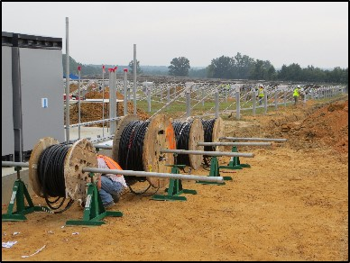
Site and Mechanical Hazards
Disclaimer: This material was produced under grant number SH-05027-SH8 from the Occupational Safety and Health Administration, U.S. Department of Labor. It does not necessarily reflect the views or policies of the U.S. Department of Labor, nor does mention of trade names, commercial products, or organizations imply endorsement by the U.S. Government.
Notes:
Welcome to this lesson on site and mechanical hazards found at utility-scale PV installation sites
If you have not yet listened to the introductory lesson, please go back and do so, as these lesson follow a progressive order.
Again, this course was produced under a Susan Harwood Training Grant through OSHA, the Occupational Safety and Health Administration.

Slide 2
Learning Objectives
Identify common hazards workers are exposed to when installing ground- mounted PV arrays
Describe control methods to eliminate or mitigate hazards
Determine safe working practices and PPE requirements
Notes:
The learning objectives for this lesson are to:
Identify common hazards that workers are exposed to when installing ground-mounted PV arrays
Describe ways to mitigate those hazards
Determine safe working practices and PPE requirements for different tasks

Slide 3
Site and Mechanical Hazards
Part I:
Overview of PV Site Hazards

Slide 4

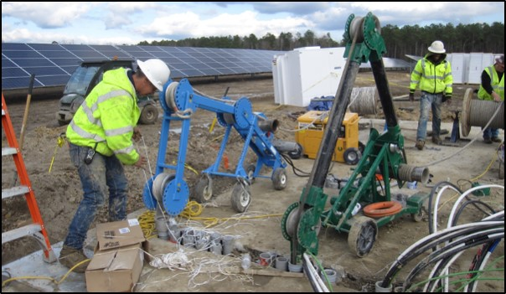
PV Site Hazards include, but are not limited to:
Environmental exposure
Chemical hazards
Overexertion
Slips, trips, falls (STF)
Caught in / struck by
Trenching / excavations
Electrical (covered in next lesson)
All hazards are site & task-specific!
Notes:
In this lesson, we’ll go through some of the hazards that may be present during PV installation work and how to eliminate or control these hazards
Environmental exposure- solar installers can be exposed to some extreme conditions- in the summertime, days are long and companies try to get a lot done.. It’s common that crews will work 4 10-hour days or even more. Also, some of the most popular solar markets are in really sunny dry places.
Respiratory/noise: dusty, heavy machinery
Overexertion: Solar modules and other equipment can be really heavy and awkwardly sized, wire pulling, repetitive tasks
Slips, trips, falls: opportunities all over the jobsite (doesn’t just have to be a fall off of a roof- you can still fall off of a stepladder, into a trench, etc. This image clearly demonstrates this.)
Caught in machinery or tool
Struck by: an object- impact creates injury
Compressed or crushed between objects
Electrical hazards- covered in depth in next lesson
And then just a reminder that hazards are site and task specific!

Slide 5
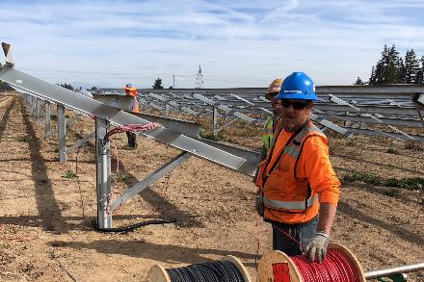
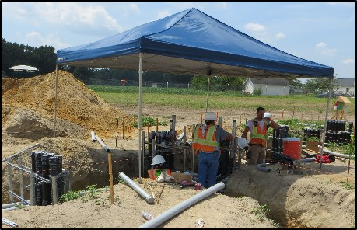
Heat Stress
Environmental
Know the signs of heat exhaustion and heat stroke!
Risk factors
Prevention
Establish a heat illness prevention program – water, rest, shade!
  Frequent breaks
  Large water jugs
    Minimum 1 pint per hour, per worker
Never work alone
Be mindful of sun exposure!
  Use sunscreen, reapply as necessary
Weather: temperature, humidity, direct sun exposure, lack of breeze or wind
Heavy physical labor
No recent exposure to hot workplaces
  Not acclimated
Low liquid intake
Waterproof clothing
Notes:
Exposure to heat can cause illness and death. The most serious heat illness is heat stroke. Other heat illnesses, such as heat exhaustion, heat cramps and heat rash, should also be avoided.
There are precautions that can be taken any time temperatures are high and the job involves physical work.
Risk factors for heat illness include high temperature and humidity, direct sun exposure, no breeze or wind, heavy physical labor, no recent exposure to hot workplaces, low liquid intake, waterproof clothing (remember, conditions can change quickly and workers may not always take the time to adapt)
Symptoms of heat exhaustion include: headache, dizziness, or fainting, weakness and wet skin, irritability or confusion, thirst, nausea, or vomiting
Symptoms of heat stroke include: may be confused, unable to think clearly, pass out, collapse, or have seizures (fits), may stop sweating
To prevent heat illness: establish a complete heat illness prevention program, provide a lot of cool water to workers close to the work area (remember, an adequate amount of potable water must be supplied by the employer- at least one pint of water per hour is needed for each worker), provide training about the hazards leading to heat stress and how to prevent them, provide a lot of cool water to workers close to the work area, modify work schedules and arrange frequent rest periods with water breaks in shaded or air-conditioned areas, gradually increase workloads and allow more frequent breaks for workers new to the heat or those that have been away from work to adapt to working in the heat (acclimatization), designate a responsible person to monitor conditions and protect workers who are at risk of heat stress, consider protective clothing that provides cooling.
OSHA has a great publication available called “Protecting Workers from Heat Stress” (included as a resource with this lesson) that identifies heat-related risk factors, symptoms and steps you can take to prevent injuries.
General Duty Clause, Section 5(a)(1) of the Occupational Safety and Health Act (OSHA) of 1970, employers are required to provide their employees with a place of employment that "is free from recognizable hazards that are causing or likely to cause death or serious harm to employees.“ This includes heat related stress and injury risk.
It is not effective to escape the heat by using the shade of the modules, as it is typically even hotter under the modules than the ambient air temperature

Slide 6
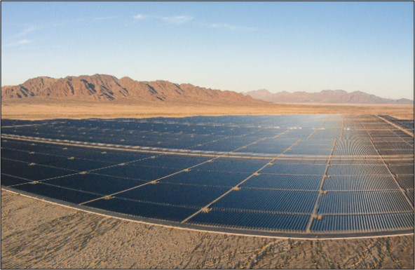
Solar Installation Fatality
In 2013, an electrician working on a large solar installation in Desert Center, CA died on the job; the death was considered heat-related.
Notes:
Death: in 2013, an electrician working on a large solar installation in Desert Center, CA died on the job; the death was considered heat-related
https://www.osha.gov/pls/imis/accidentsearch.accident_detail?id=202686689
Injury: In October, 2017, Employee #1, employed by a solar energy company via a temporary labor agency, was working in a solar field and installing solar panels. He became dizzy and over-exerted from working outdoors in the heat. After twice informing his supervisor of feeling ill, Employee #1 was allowed to go home. Employee #1 was transported by a relative to the hospital, where he was treated for heat exhaustion and, after 20 hours, discharged.
https://www.osha.gov/pls/imis/accidentsearch.accident_detail?id=104475.015

Slide 7
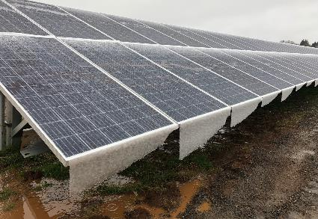
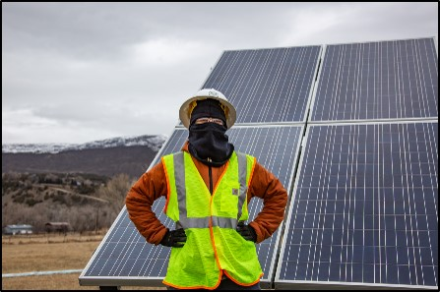
Cold Stress
Environmental
Risk factors
Prevention
Dressing improperly
Wet clothing / skin
Wind
Exhaustion
Your employer should
  Train you on hazards and prevention
  Provide engineering controls
  Monitor workers, schedule warm breaks
You should
  Know the symptoms, monitor yourself
  Drink warm, sweet fluids
  Dress properly
Layers of loose fitting clothing
Insulating jacket, gloves, and hat (waterproof, if necessary)
Insulated and waterproof boots
Notes:
Cold temperatures and increased wind speed (wind chill) cause heat to leave the body more quickly, putting workers at risk of cold stress. Anyone working in the cold may be at risk, e.g., workers in construction.
Hypothermia
Normal body temperature (98.6°F) drops to 95°F or less.
• Mild Symptoms: alert but shivering.
• Moderate to Severe Symptoms: shivering stops; confusion; slurred speech; heart rate/breathing slow; loss of consciousness; death.
Frostbite
Body tissues freeze, e.g., hands and feet. Can occur at temperatures above freezing, due to wind chill. May result in amputation.
Symptoms: numbness, reddened skin develops gray/white patches, feels firm/hard, and may blister.
Trench foot (immersion foot)
Non-freezing injury to the foot, caused by lengthy exposure to wet and cold environment. Can occur at air temperature as high as 60°F, if feet are constantly wet.
• Symptoms: redness, swelling, numbness, and blisters.
Employers: plan ahead! Is there any indoor work that crews can do during especially cold days? Provide hand and foot warmers; ensure workers get breaks to warm up
Engineering controls includes things like radiant heaters, warm spaces, etc.
OSHA has a great publication available called “Protecting Workers from Cold Stress” (included as a resource with this lesson) that identifies cold-related risk factors, symptoms and steps you can take to prevent injuries

Slide 8
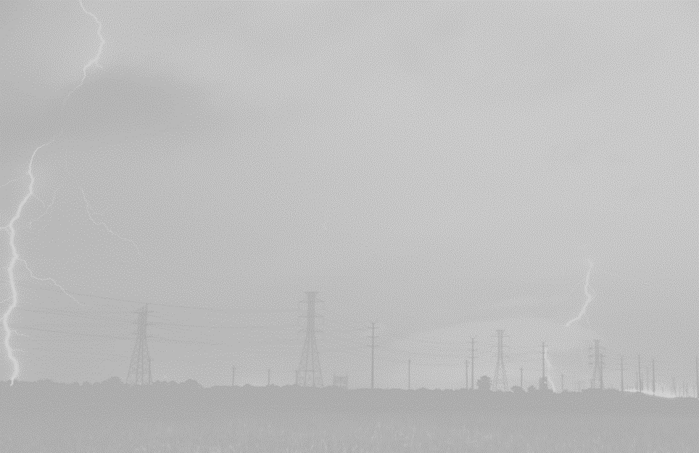
Weather Event Responses
OSHA 1926.35
Environmental
Have a written Emergency Action Plan (EAP)
Check weather daily before starting work
  Monitor conditions throughout the day
Lightning / thunder - “30/30 rule”
  < 30 seconds between lightning / thunder – lightning poses a threat
  Shelter in fully enclosed building or hard-top vehicle until 30 minutes after last thunder heard
    Some companies may end work for the day
  Notification systems available, strike data available on weather apps
Wind as a hazard
  Could blow employee or equipment from elevated location
  Exposes employees to other hazards
  Cause loss of control of a module
    30 mph typical maximum when material handling
Notes:
During the past 30 years, about 50 people have been killed by lightning strikes in the U.S. every year
It must be recognized as an occupational hazard!
Employers should have a Emergency Action Plan (EAP), as outlined in 29 CFR 1910.38 or 29 CFR 1926.35. The EAP should include a written lightning safety protocol for outdoor workers. This lightning safety protocol should:
Inform supervisors and workers to take action after hearing thunder, seeing lightning, or perceiving any other warning signs of approaching thunderstorms.
Indicate how workers are notified about lightning safety warnings.
Identify locations and requirements for safe shelters
Indicate response times necessary for all workers to reach safe shelters.
Specify approaches for determining when to suspend outdoor work activities, and when to resume outdoor work activities.
Account for the time required to evacuate customers and members of the public, and
High wind. A wind of such velocity that one or more of the following hazards would be present:
The wind could blow an employee from an elevated location,
The wind could cause an employee or equipment handling material to lose control of the material, or
The wind would expose an employee to other hazards not controlled by the standard involved.
Note to the definition of "high wind": The Occupational Safety and Health Administration normally considers winds exceeding 64.4 kilometers per hour (40 miles per hour), or 48.3 kilometers per hour (30 miles per hour) if the work involves material handling, as meeting this criteria, unless the employer takes precautions to protect employees from the hazardous effects of the wind.
https://www.osha.gov/Publications/OSHA3863.pdf LIGHTNING SAFETY

Slide 9

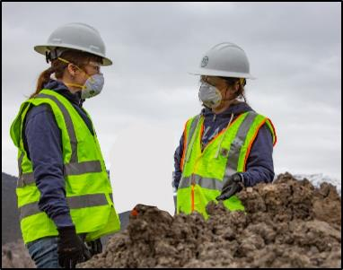
Dust and
Soil Borne Hazards
Environmental
Dust from disturbed soil
Valley Fever
  Fungal infection common in southwest U.S.
  Risk comes from soil
    Digging, driving, wind
  Prevention
    Control dust
    Wear N95 rated mask
Source: CDC
Citation
Cal/OSHA cited six employers over $240,000 for exposing solar workers to Valley Fever
Notes:
People can get Valley Fever by breathing in the microscopic fungus (coccidioidomycosis) from the air in these areas.
Mention how this is prevalent in many of the sunniest areas of the US (which are also popular ground-mounted solar sites), as image shows
https://www.dir.ca.gov/dosh/valley-fever-home.html
https://www.dir.ca.gov/DIRNews/2017/2017-108.pdf
https://www.bakersfield.com/news/health/state-fines-six-employers-for-exposing-workers-to-valley-fever/article_ee258742-cf14-11e7-887f-3711764e556c.html
Title 8, sections 342 (Reporting Work-Connected Fatalities and Serious Injuries),
3203 (Injury and Illness Prevention),
5141 (Control of Harmful Exposures),
5144 (Respiratory Protection) and
14300 (Employer Records-Log 300).

Slide 10
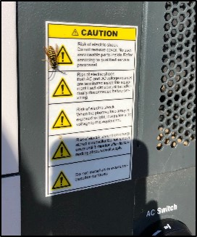
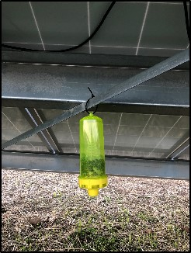
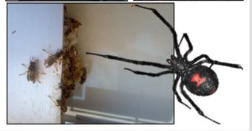
Bees, Wasps, Spiders, Ants, and Other Pests
Environmental
Nests in ground, trees/shrubs, equipment
  Inspect ground holes for evidence of bees
Use caution when opening enclosures
Visual check before work begins
Use traps
If stung or bitten
  EPI pen if allergic
  Get medical attention
    Attempt to identify pest if possible
Notes:
Nests can be located in the ground, in trees/shrubs/equipment: racking, module frames, inverters, etc.
Always do a visual check before work begins, and always use caution when opening enclosures!
Good idea to set up traps during construction
Injury example: At 8:00 a.m. on August 10, 2017, Employee #1, employed by a construction company, was clearing land at a job site. Employee #1 unearthed a bee hive. He was stung in the face over 100 times. Emergency services were called, and Employee #1 was transported to the hospital. He was admitted and treated for the bee stings: https://www.osha.gov/pls/imis/accidentsearch.accident_detail?id=102286.015

Slide 11
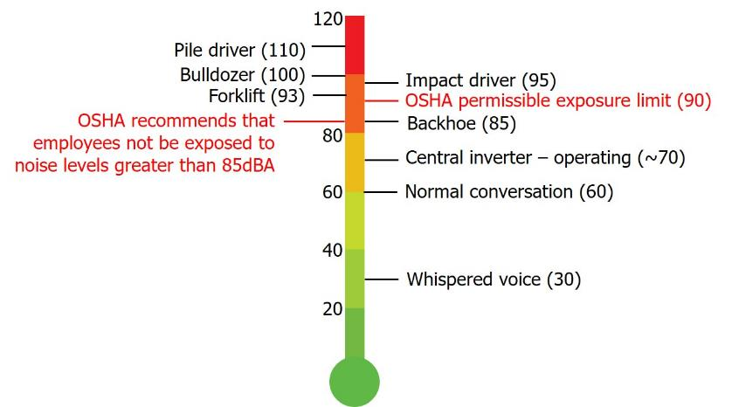
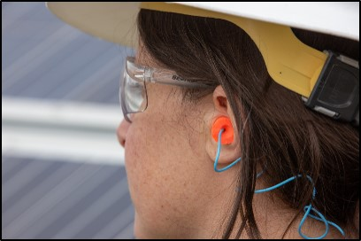
Noise Exposure
OSHA 1926.52
Environmental
OSHA 1926.101 provides guidance for hearing protection
Notes:
OSHA sets legal limits on noise exposure in the workplace. These limits are based on a worker's time weighted average over an 8 hour day. With noise, OSHA's permissible exposure limit (PEL) is 90 dBA for all workers for an 8 hour day.
The OSHA standard uses a 5 dBA exchange rate. This means that when the noise level is increased by 5 dBA, the amount of time a person can be exposed to a certain noise level to receive the same dose is cut in half.
The National Institute for Occupational Safety and Health (NIOSH) has recommended that all worker exposures to noise should be controlled below a level equivalent to 85 dBA for eight hours to minimize occupational noise induced hearing loss. NIOSH has found that significant noise-induced hearing loss occurs at the exposure levels equivalent to the OSHA PEL
NIOSH also recommends a 3 dBA exchange rate so that every increase by 3 dBA doubles the amount of the noise and halves the recommended amount of exposure time.

Slide 12


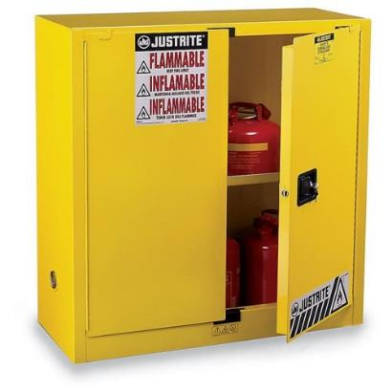


Chemical Hazards
OSHA 1926.152
Chemical
All chemicals brought on site added to Chemical Inventory List
  Include Safety Data Sheets (SDS)
Flammable chemicals kept in Flammable Cabinet
Notes:
All chemicals brought on site will need to be added to the Chemical Inventory List and an SDS needs to be filled with all the other SDS’s.
All flammable chemicals are kept in the Flammable Cabinet (Flam Cab).
Flammable examples on a PV site include hydraulic oil, striping paint, insect spray, adhesive spray, PVC cement, gas, diesel, etc.
Non flammable chemical examples: cutting fluid, joint compound, conductor termination compound, anti-seize high temp lubricant, etc.
OSHA 1926 Subpart F Fire Protection and Prevention

Slide 13
Site and Mechanical Hazards
End of Part I:
Overview of PV Site Hazards

Slide 14
Site and Mechanical Hazards
Part II:
Mechanical and Physical Hazards

Slide 15
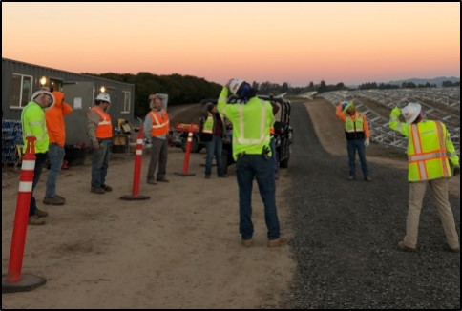
Overexertion
Mechanical/ Physical
Protect your body
  Begin each day with ‘stretch and flex’
  Know your limits
  Stay hydrated
  Take frequent breaks
  Use proper lifting techniques
    Use lifting equipment whenever possible
    2+ people to lift heavy objects
Notes:
Overexertion means working beyond your exertion abilities/physical limits
Lifting, pushing, pulling, holding, carrying, throwing
Lifting/mounting heavy equipment- modules, inverters
Repetitive motions- many modules, pulling wire
Can lead to strains, sprains, tears, soreness, pain= back injuries are most frequent.
These injuries can happen to anyone!
Again, eliminate or control the hazards whenever possible. As a member of a PV crew, know your limits and don’t try to prove anything. You’ll be a way more valuable team member if you’re healthy and consistent. Stretch before work, stay hydrated, take lots of breaks, and practice proper lifting techniques.
-Do not attempt to lift by bending forward. Bend your hips and knees to squat down to your load, keep it close to your body, and straighten your legs to lift.
-Never lift a heavy object above shoulder level, especially by yourself
-Avoid turning or twisting your body while lifting or holding a heavy object.
Then there are the control methods- equipment to lift the modules
Use 2 people to carry heavy equipment such as modules whenever possible. This will help to prevent overexertion as well as trips and fall hazards.

Slide 16
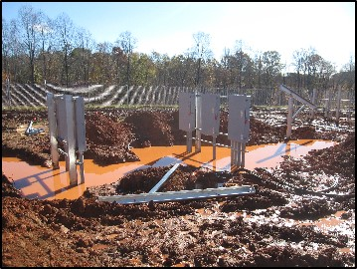
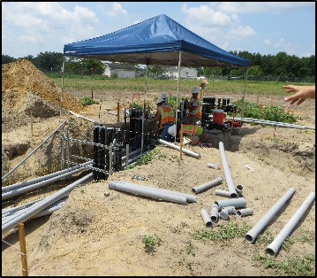
Slips, Trips, and Falls (STF)
OSHA 1910.22.30
Mechanical/ Physical
Slips
  Water, mud, oil, ice, unstable/uneven ground, etc.
Trips
  Equipment, tools, materials
  Concrete forms, rebar, conduit, clutter
  Open trenches and holes
Falls (to a lower level or the same level)
  Ladders
  Open trenches and holes
Notes:
Slips are when a contaminant (water, ice, moss, mud, etc.) covers a walking or climbing surface and causes it to become treacherous. SO be careful when working in inclement weather!
Trips are when a person’s foot contacts unexpected obstacles, causing a loss of balance. On a PV installation, there can be all sorts of tripping hazards
Falls result from a loss of balance. You can fall off a ladder, into an open trench, into a hole
In lower pic, it’s nice that they’ve erected a canopy structure for shade, but watch out for all those loose pieces of conduit next to the trench!

Slide 17
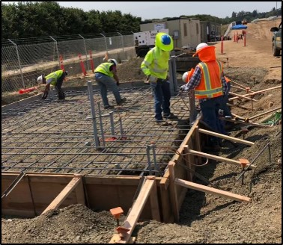
Protecting Against
Slips, Trips, and Falls
Mechanical/ Physical
Always maintain clean & well-organized work site
  Includes materials, tools, personal gear
Consider weather and uneven terrain
Engineering controls
  Rebar caps
  Trench covers
Be aware of your surroundings
  Trenches, ruts, holes, obstacles
  Never walk backwards
  Communicate!
Use proper PPE
  Safety vest, hardhat, footwear
Notes:
So what can you do- well remember, the first step is to always eliminate hazards- keep your work site clean and organized, secure tools. This will help with efficiency.
Also consider the weather and any uneven terrain
Then there are engineering controls like rebar caps and trench covers
And then safe work practices- be aware of your surroundings, don’t walk backwards, communicate with co-workers
And then there’s your PPE- the last line of defense. Remember from the intro lesson that PPE is totally necessary but it’s your least effective form of hazard control effectiveness.

Slide 18
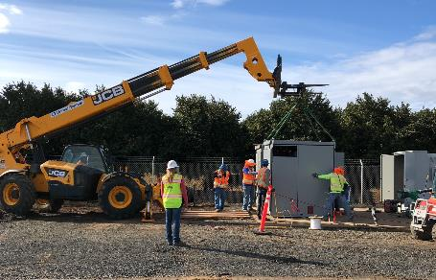
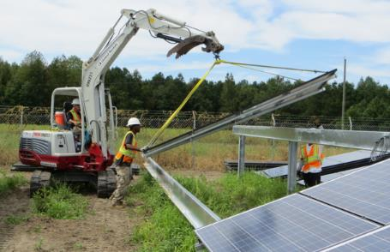
Struck By Hazards
Mechanical/ Physical
Flying objects
Falling objects
Swinging objects
Other people
Power tools
Heavy equipment
Notes:
On a PV installation site, there’s also the hazard of being struck by something- a flying object like aluminum particles, something falling off a ladder; something swinging, or struck by PV equipment like a central inverter being lowered down, or struck by the heavy machinery, or maybe you just run into another person on a chaotic job site.

Slide 19
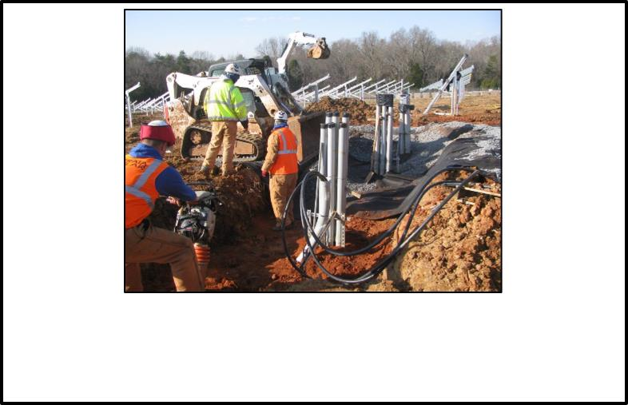
Struck By Hazards
Mechanical/ Physical
Did you know?
One in four "struck by vehicle" deaths involve construction workers – more than any other occupation
Approximately 75% of “struck-by” fatalities involve heavy equipment
Source: www.osha.gov
Notes:
https://www.osha.gov/SLTC/etools/construction/struckby/mainpage.html

Slide 20
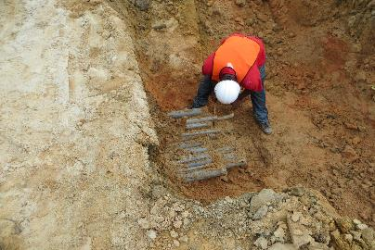
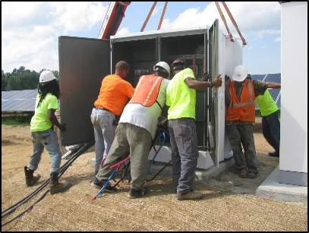

Caught In/Between
Mechanical/ Physical
Person or body part is crushed, squeezed, or pinched in between or under object
  Tools (especially if misused)
  Trenching (cave-ins)
  Heavy equipment
  Wire pulling / feeding
    Often ‘field engineered’
  PV equipment
    Trackers – moving parts
Notes:
You can also get caught in or between or under an object, this includes getting hazards of lifting equipment like a crane, or getting your sleeve caught in a drill if you’re not paying attention, getting your hand caught under a module, etc.
On these sites, you can get caught in moving parts of trackers, caught in a trench, caught between heavy equipment, get your hands caught in wire pulling equip, etc.

Slide 21
Site and Mechanical Hazards
End of Part II:
Mechanical and Physical Hazards

Slide 22
Site and Mechanical Hazards
Part III:
Hazard Controls and PPE

Slide 23
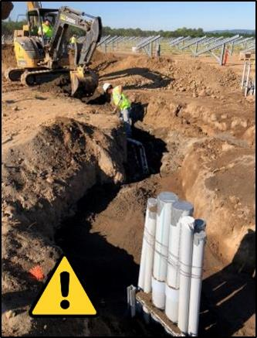
Hazard Identification
Collect existing information about hazards
Inspect the workplace for hazards
Identify hazards
Identify hazards associated with emergency and atypical situations
Characterize the nature of identified hazards and prioritize the hazards for control
Notes:
Upon arriving on site all employees of all contractors get together in a huddle to discuss the Plan Of the Day (POD). This can provide important information related to safety, for example, you may learn another sub on the site will have trucks delivering rock all day or a crane will place gear that day. Then the designated safety person for your site will go over any specific issues they are seeing on the site or potential issues.
Hazard identification is the foundation of a safe workplace. At its most basic level, hazard identification is simply looking at a job, task, or situation and asking “is there anything here that could hurt someone or damage something?”
A workplace hazard is any practice, behavior or physical condition that has the potential to cause injury, illness, damage to property, damage to the environment, or loss to a process.
Everyone at the work site shares in the responsibility to identify and control hazards. A hazard cannot be controlled (eliminated, reduced, or managed) until it has been identified.
Hazard identification tools include inspection checklists, PPE assessment forms, pre-task planning, and job hazard analysis

Slide 24
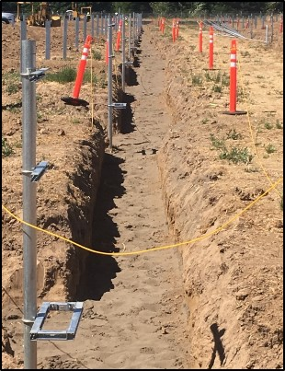
Hazard Controls
Identify control options
Select controls
Develop and update a hazard control plan
Select controls to protect workers during atypical operations and emergencies
Implement selected controls in the workplace
Follow up to confirm that controls are effective
  Take corrective action if controls are found to be ineffective
Notes:
After hazards are detected, all current and potential hazards must be prevented, corrected or controlled. Systems used to prevent and control hazards include:
Engineering Controls
Administrative Controls
Personal Protective Equipment (PPE)
Systems to Track Hazard Correction
Preventive Maintenance Systems
Emergency Preparation
"PLAN-DO-CHECK-ACT is a good mantra for a good safety and health management system"

Slide 25
Control Effectiveness
Most effective
Control Type | Examples
Elimination or substitution | Mechanical lift instead of ladder
Engineering controls | Trench plates, tool guards
Warnings | Signs, labels, caution tape, barriers
Training & procedures | Standard operating procedures (SOPs)
Personal Protective Equipment (PPE) | Hardhat, hard toe boots, safety glasses
Least effective
Notes:
Remember this hierarchy of control, or control effectiveness, from the intro lesson
When dealing with a particular hazard, it’s way more effective to eliminate the hazard altogether, or use a substitution method- for example, a mechanical lift instead of a ladder.
Next most effective are engineering controls like trench plates or tool guards to mitigate the hazard, followed by safe work practices and administrative procedures.
When working on these PV sites, essential to follow standard operating procedures!
Notice that personal protective equipment, or ”PPE” is considered the least effective form of hazard control- it’s really the last line of defense.
This might be confusing, since there will be minimum PPE requirements on all job sites. But just remember, PPE should be used IN ADDITION to some of these other more effective control methods.

Slide 26
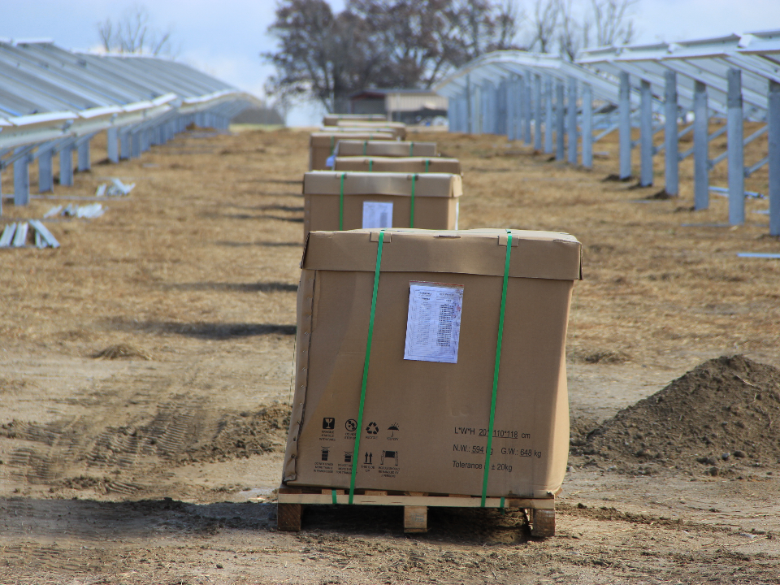
Hazard Control Effectiveness
Example: Staging Pallets of Modules
Eliminate or substitution
  Stage pallets while with no other workers are on site
Engineering
  Erect fencing to prevent unauthorized access
Warning
  Caution tape around area of staging
Training and procedures
  People and material lift never in same row
Personal Protective Equipment (PPE)
  Hardhats, reflective vests / jackets, protective toe footwear
Most effective
Least effective
Notes:
Here is an example from a large ground-mounted PV site, for the task of staging pallets of modules around the site. There could be hundreds, even thousands, of module pallets staged on site, and doing so creates some hazards to other workers on site.
So here, the most effective control measure to avoid injury to other workers is to stage pallets while no other workers are on site- therefore you’re eliminating the hazard
Next most effective would be engineering controls such as fencing to prevent unauthorized access
Next would be warning signs, for instance caution tape around the staging area.
Next, you could set training and operating procedures so that workers and the material lift were never working in the same row
Finally, the least effective measure would be PPE-so how to mitigate injury in the instance that someone did come close to getting hit.
Here, you can see how the control methods become less and less effective as you move down!

Slide 27

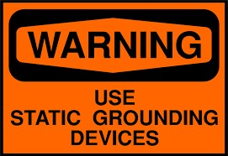

Signs and Tags
OSHA 1910.145 / ANSI Z535
Shall be used in major hazard situations where an immediate hazard presents a threat of death or serious injury to employees
May be used to represent a hazard level between ‘Caution’ and ‘Danger,’ provided that they have a signal word of ‘Warning,’ and an appropriate message
Shall be used in minor hazard situations where a non-immediate or potential hazard or unsafe practice presents a lesser threat of injury
Notes:
The specifications in 1910.145 apply to the design, application, and use of signs or symbols that indicate and, insofar as possible, define specific hazards that could harm workers or the public, or both, or to property damage. These specifications are intended to cover all safety signs except those designed for streets, highways, and railroads. These specifications do not apply to plant bulletin boards or to safety posters.
Danger signs shall be used in major hazard situations where an immediate hazard presents a threat of death or serious injury to employees.
Notice the red color, black, white used
Warning signs may be used to represent a hazard level between ‘Caution’ and ‘Danger,’ provided that they have a signal word of ‘Warning,’ and an appropriate message
Notice the orange and black
Caution signs shall be used in minor hazard situations where a non-immediate or potential hazard or unsafe practice presents a lesser threat of injury
Notice the yellow and black

Slide 28
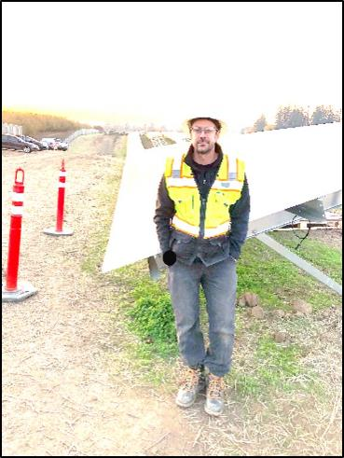
Recommended Minimum PPE for Non-Electrical Hazards
Long sleeves, pants
High visibility safety vest
Safety glasses
Hard hat
Cut-resistant gloves
ANSI-approved protective footwear
Hearing / respiratory protection as necessary
Notes:
Contractor requirements may differ, but SEI recommends the following MINIMUM PPE for work involving non-electrical hazards:
Long sleeves, pants
High visibility safety vest
Safety glasses
Hard hat
Cut-resistant gloves
ANSI-approved protective footwear
Hearing/respiratory protection as necessary
Note: Typical PPE requirements on a construction site are hard hats, safety glasses, high visibility wear, sturdy work boot, gloves depending on task. OSHA rules required PPE to be worn when there is a hazard, but many contractors establish minimum PPE requirements for any person who is present on the site. This usually leads to more uniform compliance that is easier to monitor than the “on again, off again” approach

Slide 29


PPE: Eye Protection
OSHA 1926.102 / ANSI Z87.1
Ability to protect against specific hazards
Eye protection must
  Fit properly & be reasonably comfortable
  Provide unrestricted vision & movement
  Be durable (impact resistant) & cleanable
“ANSI Z87” must be printed on frame
Safety spectacles
Safety goggles
Standard sunglasses or corrective lenses
(without over the glasses protection)
Notes:
-Ordinary glasses do not provide proper protection. Per ANSI standards, eye protection must protect against specific hazards, fit and be reasonably comfortable, provide unrestricted vision and movement, and be durable, impact resistant, and cleanable
-Safety spectacles are typically made of plastic or metal, have impact-resistant lenses, side shields available
-Safety goggles completely cover the eyes, eye sockets and the facial area immediately surrounding the eyes and provide protection from impact, dust and splashes. Some goggles will fit over corrective lenses.

Slide 30
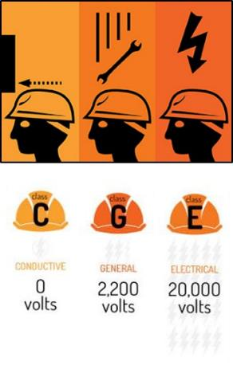
PPE: Head Protection
OSHA 1926.100 / ANSI Z89.1
Must be worn when
  Required on job site
  Possibility of contact with fixed objects
  Objects might fall from above
  Possibility of head contact with electrical hazards
    Overhead power lines
Class E hard hats
  Protection from impact and penetration from falling objects
  High-voltage shock and burn protection
Notes:
It’s a good idea to wear a hard hard during all phases of a PV installation; hard hats not only protect from falling or fixed objects, but depending on the rating can also protect against electrical hazards like an overhead power line.
ANSI ratings for both type and class of hard hat:
Hard Hat Types: The two types of hard hats are defined by the area of the head that is protected.
Type I offers protection to the top of the head and is commonly used in the United States
Type II offers protection to the top and sides of the head and is commonly used in Europe
Hard Hat Classes: The three classes are based on the level of protection they provide from electrical hazards.
Class G (General) hard hats are rated for 2,200 volts
Class E (Electrical) hard hats are rated for 20,000 volts
Class C (Conductive) hard hats do not offer electrical protection
-Hard hats must be replaced if they show signs of damage (dents, cracks, penetration, or fatigue due to rough treatment). It is essential to inspect hard hats for damage and signs of fatigue each time they are used. In addition to visual inspections, another way to test a hard hat is to grasp it in two hands and apply force by squeezing the hat. If you hear creaking or other unusual sounds, it is time to replace the hard hat.
-While OSHA has no specific provision for an expiration date, manufacturers are allowed to determine if their equipment expires on a specific calendar date. In lieu of an expiration date, a generally accepted rule is to replace the support strap yearly and to replace the hard hat every five years. Harsh chemicals and extreme temperatures can make a hard hat degrade more quickly. Be sure to check with the manufacturer for guidelines on hard hat replacement and maintenance.

Slide 31


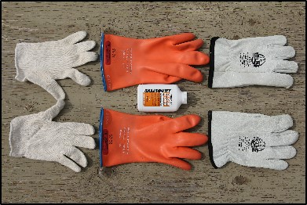
PPE: Gloves
Leather or synthetic gloves
  Commonly used for PV site work
  Allows dexterity
  Cut and abrasive-resistant
  Resistant to some chemicals
  Do not protect against electrical hazards!
Insulating rubber gloves
  OSHA 1926.97 / ASTM D120-09
  For electrical safety
  More in next lesson on PV electrical hazards!
Notes:
Shown in the first picture are nitrile gloves, commonly used by PV installers. They allow for good mobility and dexterity, provide some protection against sharp objects and abrasive surfaces, but do not be fooled- they don’t provide protection against electrical hazards.
To provide electrical safety, you need something entirely different- insulating rubber gloves, which are classified by the level of voltage and protection they provide. Can wear leather protector gloves over the top to provide mechanical protection.
More on electrical safety gear in the next lesson!! (we just want to be sure you recognize the difference here)
From OSHA: Rubber insulating equipment meeting the following national consensus standards is deemed to be in compliance with the performance requirements of paragraph (a) of this section: American Society for Testing and Materials (ASTM) D120-09, Standard Specification for Rubber Insulating Gloves.

Slide 32
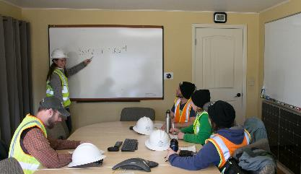
Employer Responsibilities: PPE
1910.132 General Requirements
Employer responsibilities
  Hazard analysis
  Select PPE to protect employees from hazards
  Communicate required PPE to employees
  Provide proper fitting PPE for each employee
  Provide training to those required to use PPE
    When PPE necessary
    What PPE necessary
    Limitations of PPE
    Proper care, maintenance, useful life and disposal of PPE
Notes:
Again, it is your employer’s responsibility to…
Ensure a designated competent person conducts a hazard analysis
Ensure employees have the proper PPE to protect them from identified hazards
Ensure each employee has PPE that properly fits
Provide training on proper use and maintenance of PPE

Slide 33
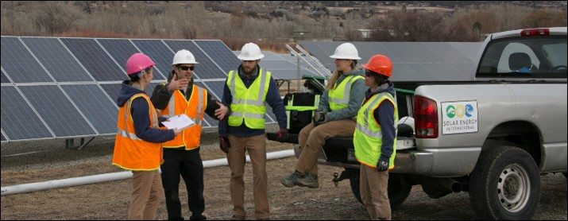
Employee Responsibilities: PPE
Follow Standard Operating Procedures (SOP)
Report any workplace hazards
Attend all safety meetings
Follow JHAs and wear appropriate PPE for task
Maintain PPE in good, clean condition
Notes:
You, the worker, must also play a part!
It is essential for all employees to:
Follow Standard Operating Procedures
Report any workplace hazards
Attend all safety meetings- remember to sign off!
Follow JHAs and wear appropriate PPE for the task
Maintain that their PPE is in good, clean condition; notify employers if it gets damaged or compromised in any way

Slide 34
Site and Mechanical Hazards
End of Part III:
Hazard Controls and PPE

Slide 35
Site and Mechanical Hazards
Part IV:
PV Installation Tasks and Best Practices

Slide 36
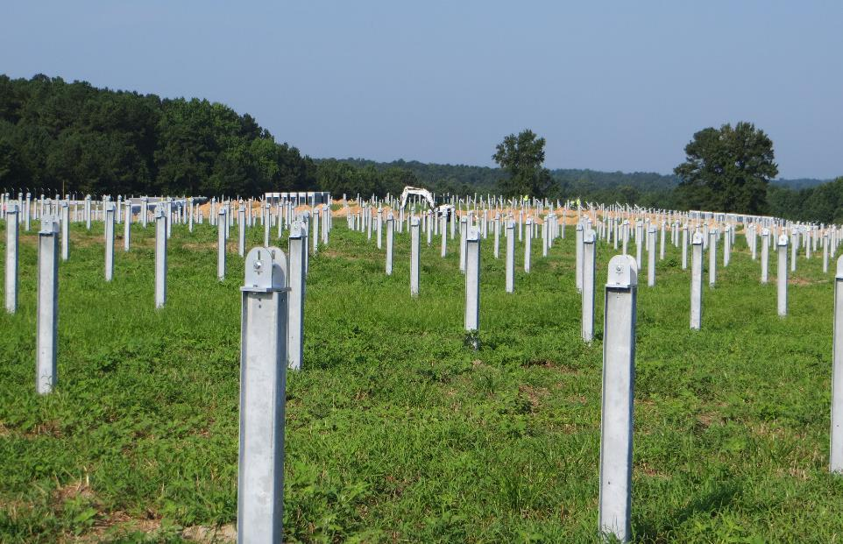
Common Ground-mount
Installation Tasks
Pile driving and racking installation
Trenching, horizontal directional drilling (HDD), and conduit installation
Forming and pouring concrete pads
Inverter and BOS installation
Module installation
Note: Many of these tasks are addressed in the following slides
Notes:
This next section focuses on common ground-mount installation tasks and potential hazards which may be encountered
Note that this is certainly not an all-inclusive list of installation tasks
Note in this lesson we will cover the physical installation of BOS equipment and PV modules; electrical hazards associated with wiring are covered in the next lesson

Slide 37
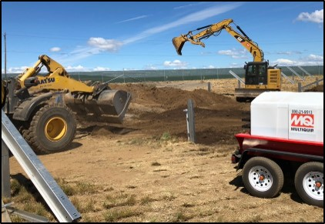
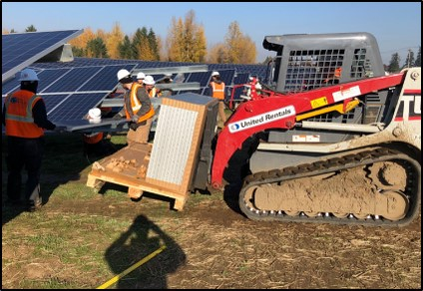
Typical Machinery and
Heavy Equipment on PV Installs
All-terrain utility vehicles
Pile drivers
Excavators, skid steers
Forklifts
Cranes
Horizontal directional drilling equipment (HDD)
Tractor trailers
Notes:
Many different types of heavy equipment can be found on large-scale ground mounted PV installations, including
ATVs (to get across site)
Pile drivers
Excavators and skid steers
Forklifts
Cranes
HDD
Tractor trailers
If vehicle safety practices are not observed at your site, you risk being pinned or struck by construction vehicles. To avoid hazards:
Wear seat belts that meet OSHA standards, except on equipment that is designed only for standup operation, or that has no rollover protective structure. [29 CFR 1926.601(b)(9)]
Check vehicles before each shift to assure that all parts and accessories are in safe operating condition. [Vehicle Inspection]
Do not drive a vehicle in reverse gear with an obstructed rear view, unless it has an audible reverse alarm, or another worker signals that it is safe.
Drive vehicles or equipment only on roadways or grades that are safely constructed and maintained.
Make sure that you and all other personnel are in the clear before using dumping or lifting devices.
Lower or block bulldozer and scraper blades, end-loader buckets, dump bodies, etc., when not in use, and leave all controls in neutral position.
Set parking brakes when vehicles and equipment are parked, and chock the wheels if they are on an incline.
All vehicles must have adequate braking systems and other safety devices. [Brake Systems]
Haulage vehicles that are loaded by cranes, power shovels, loaders etc., must have a cab shield or canopy that protects the driver from falling materials.
Do not exceed a vehicle's rated load or lift capacity.
Do not carry personnel unless there is a safe place to ride.
Use traffic signs, barricades or flaggers when construction takes place near public roadways.
Workers must be highly visible in all levels of light. Warning clothing, such as red or orange vests, are required; and if worn for night work, must be of reflective material.
Additional information:
29 CFR 1926 Subpart G, Signs, signals, and barricades. OSHA Standard.
1926.201, Signaling
29 CFR 1926 Subpart O, Motor vehicles, mechanized equipment, and marine operations. OSHA Standard.
1926.601, Motor Vehicles

Slide 38
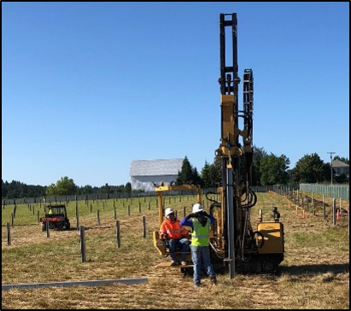
Pile Drivers
OSHA 1926.603
Use outriggers, guys, or counterbalances to provide stability
Keep all employees clear when piling is being hoisted into the leads
Keep hands and feet away from pile driver
Never go under pile driver!
Use jigs when driving piles
Stage materials and tools
Use proper PPE
Get training!
Notes:
All workers on a pile driving jobsite should wear the correct PPE, and that equipment should be inspected before each shift or when resuming work after a break.
Workers who will perform welding, cutting, grinding, or similar tasks should also wear suitable eye and face protection.
Anyone working directly with cement or other potentially irritating materials should wear the correct gloves, such as canvas gloves coated with neoprene.
Although pile driving can be a complicated process, general safety rules that should be familiar to every worker will provide the greatest protection. Workers should have safety training for any task they perform. Piles should be lifted only with the appropriate slings or similar equipment, and workers should maintain a safe distance while piles are being hoisted. (Works should never stand below a hammer or core.)
As pile locations are being pre-excavated or jetted, operators must be careful not to undermine the rig or any nearby structures. When augers are withdrawn, rocks and chunks of earth should be removed before they are inserted. If the piles are not going to be placed in the holes immediately, they should be covered to ensure that workers and equipment cannot fall into them.
While driving is underway, the operator should maintain light pressure on the hammer drum brake to keep the hammer under close control, and stop immediately if the pile breaks or otherwise malfunctions. He should also pay close attention to the hammer hose to ensure that it doesn’t get caught in any moving parts. If pipes are cut to be flush with the ground, cover the heads to protect them from collecting foreign matter and to ensure that nobody steps into the pile.
Finally, regular inspections of the work area and equipment are vital to ensuring everyone’s safety. At the very least, the site and all equipment, including the controls, should be checked by supervisors at the site, and any deficiencies must be addressed before work resumes.
Currently, 18 states require pile-driver operators to have a crane license because these states classify pile-drivers as cranes.
https://www.osha.gov/pls/imis/accidentsearch.accident_detail?id=80303.015
https://www.osha.gov/pls/imis/accidentsearch.accident_detail?id=68930.015
https://www.osha.gov/pls/imis/accidentsearch.accident_detail?id=200624526

Slide 39
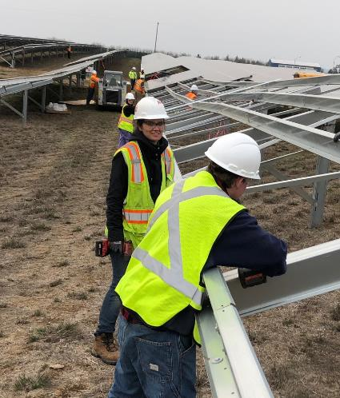
Hazards While Constructing Racking
Environmental exposure
Sharp edges
Overhead power lines
Slips, trips, and falls
Struck by
Caught in/between
Heavy machinery
Notes:
Working with racking materials presents several hazards, including:
Environmental exposure
Sharp edges
Overhead power lines: these are typically long (20+’) sticks of aluminum, includes when you are unloading them/transporting around site
Slips, trips, and falls
Struck by
Caught in/between
Heavy machinery : see in photo the module mounting crew behind them with forklift

Slide 40
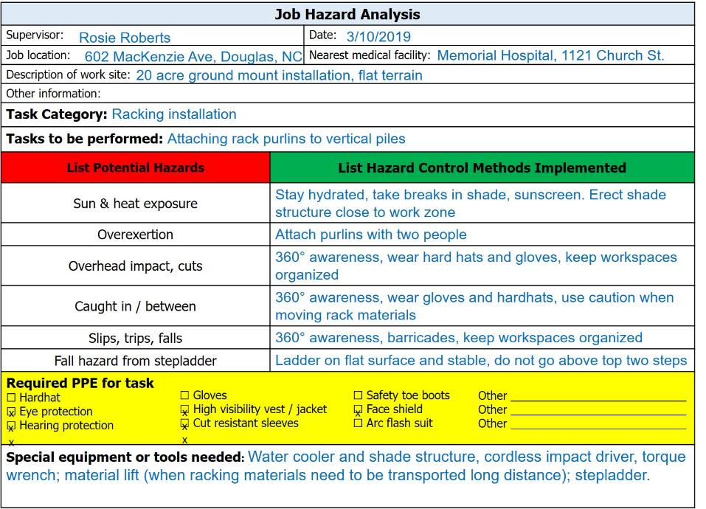
Job Hazard Analysis
Notes:
Here we see the job hazard analysis form filled out for the task of attaching rack purlins to vertical piles.
See the list of applicable hazards and control methods used
Remember, PPE is the last line of defense!

Slide 41
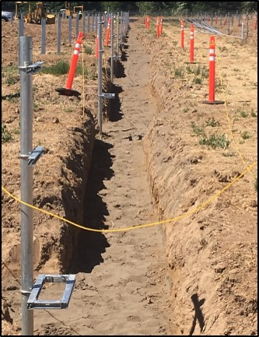
Excavation Requirements
OSHA 1926.651
Determine location of underground utility installations prior to any excavation work
  Gas
  Water, sewer
  Electric
  Communications
Locate stairway, ladder, ramp, or safe means of egress in trenches ≥ 4’ deep
Protect employees from loose rock or soil
  Hazard = materials or equipment falling or rolling into excavations
  Keep materials and equipment ≥ 2’ from edge of excavations
Trenches ≥ 5’ deep require shoring
Notes:
OSHA 1926.651 (Subpart P: Excavations) details specific excavation requirements
1926.651(b)(1) The estimated location of utility installations, such as sewer, telephone, fuel, electric, water lines, or any other underground installations that reasonably may be expected to be encountered during excavation work, shall be determined prior to opening an excavation.
1926.651(c)(2)Means of egress from trench excavations. A stairway, ladder, ramp or other safe means of egress shall be located in trench excavations that are 4 feet (1.22 m) or more in depth so as to require no more than 25 feet (7.62 m) of lateral travel for employees.
1926.651(c)(1)(i)Structural ramps that are used solely by employees as a means of access or egress from excavations shall be designed by a competent person. Structural ramps used for access or egress of equipment shall be designed by a competent person qualified in structural design, and shall be constructed in accordance with the design.
1926.651(f)Warning system for mobile equipment. When mobile equipment is operated adjacent to an excavation, or when such equipment is required to approach the edge of an excavation, and the operator does not have a clear and direct view of the edge of the excavation, a warning system shall be utilized such as barricades, hand or mechanical signals, or stop logs. If possible, the grade should be away from the excavation
1926.651(j)(1)Adequate protection shall be provided to protect employees from loose rock or soil that could pose a hazard by falling or rolling from an excavation face. Such protection shall consist of scaling to remove loose material; installation of protective barricades at intervals as necessary on the face to stop and contain falling material; or other means that provide equivalent protection.
1926.651(j)(2)Employees shall be protected from excavated or other materials or equipment that could pose a hazard by falling or rolling into excavations. Protection shall be provided by placing and keeping such materials or equipment at least 2 feet (.61 m) from the edge of excavations, or by the use of retaining devices that are sufficient to prevent materials or equipment from falling or rolling into excavations, or by a combination of both if necessary

Slide 42
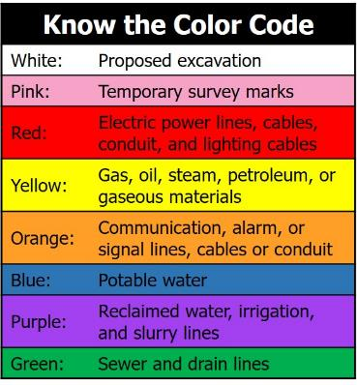
Underground Utility Location
Call 811 before you dig
Reference existing site plans with actual marked locations
Look for site evidence
  Drains, manholes, junction boxes, valves
Request locations from utilities
Safely determine precise locations of utilities when excavation approaches approximate location
Protect, support, or remove existing utilities as appropriate while excavations are open
Notes:
Failing to locate underground utilities is not only an OSHA violation- it brings the very real possibility of injury, death, damage to property
It is essential to know the color codes
In addition to requesting locations from utilities, practice general awareness- look for evidence of nearby utilities
“Before arriving at the job site, you must have all underground utilities located,” says Stacy Long, product safety engineer with Ditch Witch. “This includes any privately owned utilities, such as sewer lines. Not all utilities are members of the one-call service and those utilities must be contacted as well.”
This certainly applies to residential/commercial ground-mounted systems!

Slide 43
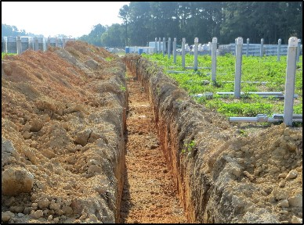
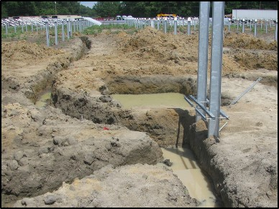
Excavations:
Inspection and Water Accumulation
Inspections
  Employers must have a competent person inspect trenches daily and as conditions change to ensure elimination of hazards
Protection from hazards associated with water accumulation
  Employees shall not work in excavations where there is accumulated or accumulating water
  …unless adequate precautions have been taken to protect employees
Notes:
1926.651(k)(1)Daily inspections of excavations, the adjacent areas, and protective systems shall be made by a competent person for evidence of a situation that could result in possible cave-ins, indications of failure of protective systems, hazardous atmospheres, or other hazardous conditions. An inspection shall be conducted by the competent person prior to the start of work and as needed throughout the shift. Inspections shall also be made after every rainstorm or other hazard increasing occurrence. These inspections are only required when employee exposure can be reasonably anticipated.
1926.651(h)(1)Employees shall not work in excavations in which there is accumulated water, or in excavations in which water is accumulating, unless adequate precautions have been taken to protect employees against the hazards posed by water accumulation. The precautions necessary to protect employees adequately vary with each situation, but could include special support or shield systems to protect from cave-ins, water removal to control the level of accumulating water, or use of a safety harness and lifeline.

Slide 44
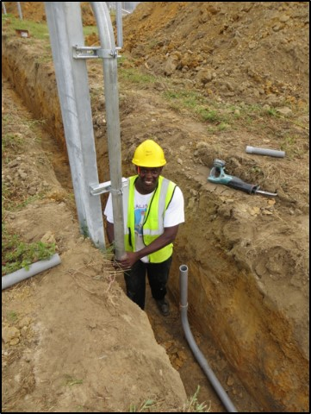
Working In & Around Trenches
Never enter a trench unless
  It has been properly inspected by a competent person
  There is a safe way to enter and exit
  Equipment and materials are away from the edge
  It is free of standing water and atmospheric hazards
  Cave-in protection measures are in place
Keep materials, debris, and heavy equipment away from trench edges!
Notes:
Remember, you the worker play a big part in ensuring your safety. Practice site awareness! Never enter a trench unless:
It has been properly inspected by a competent person (competent person will fill out a daily trenching log)
There is a safe way to enter and exit
Equipment and materials are the min distance away from the edge
It is free of standing water and atmospheric hazards
Cave-in protection measures are in place
Prevent trench collapses:
• Trenches 5 feet deep or greater require a protective system.
• Trenches 20 feet deep or greater require a protective system designed by a registered professional engineer. Protective systems for trenches:
• SLOPE or bench trench walls by cutting back the trench wall at an angle inclined away from the excavation.
• SHORE trench walls by installing aluminum hydraulic or other types of supports to prevent soil movement.
• SHIELD trench walls by using trench boxes or other types of supports to prevent soil cave-ins.

Slide 45
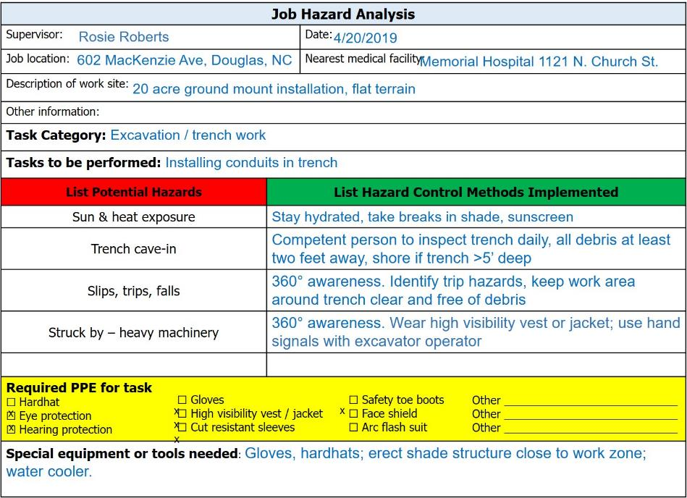
Job Hazard Analysis
Notes:
Here is another example of the JHA form for the task of installing conduits in a trench

Slide 46
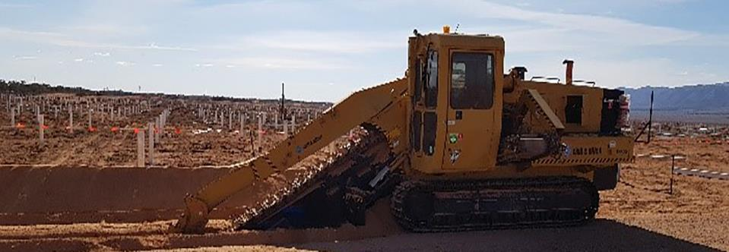
Solar Installation Fatality
Contractor pinned under trenching machine and killed
Emergency services were dispatched to a solar farm site at 10:07 a.m. Upon arrival, they located a male subject pinned underneath a trenching machine. He was pronounced dead at the scene. The victim may have tripped or his clothing got caught on the machine and pulled him under. There were no witnesses to the accident.
Be aware of your surroundings and hazards at all times, and never work alone!
Notes:
Unfortunately, accidents can and do happen at solar installations
In October 2017 a contractor was killed at a solar farm site near Covington, OK
56 year old Davis Knox was pinned underneath a trenching machine and killed. Investigators think he may have tripped or his clothing got caught on the machine and pulled him under. There were no witnesses to the accident.
Be aware of your surroundings, and never work alone!!

Slide 47
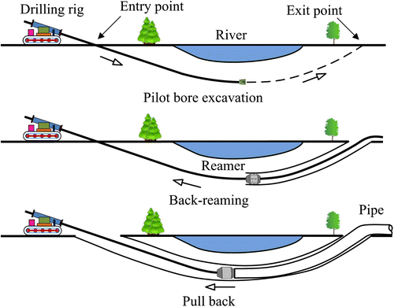
Horizontal Directional Drilling (HDD)
Trenchless method for installing conduit underground
Also known as “directional boring”
Often performed by independent contractor with trained crew
Notes:
From OSHA safety and information bulletin:
HDD is a trenchless technology that uses surface-launched equipment to drill underground horizontally and install pipes, conduits, and cables. HDD is used in several industries, such as utilities and telecommunications, at sites with limited space (e.g., dense, urban areas) or where traditional vertical excavations are too hazardous (e.g., under lakes and rivers). Although HDD technology is thought to take less time, require fewer workers, and cause less surface damage compared to traditional open trench excavations, it is more difficult to avoid utility lines when using HDD because of the limited visibility inherent to the process.
Installing underground utility lines safely using horizontal directional drilling (HDD) equipment prevents the drill from hitting and breaking existing underground utility lines (i.e., electrical, water, sewage, gas, steam, chemical). If the drill contacts underground electrical wires, the operator may be electrocuted. Striking natural gas lines with the drill may cause gas leaks at the worksite or down the line in surrounding areas, potentially causing an explosion
How HDD equipment works:
Drill the Pilot Bore: The HDD machine operator, makes a pilot bore by running the drill stem and head through the entire drill path, from the entry point to the exit point in the reception pit. The "tracker," uses a hand-held tracking device and the potholes to ensure that the operator is drilling along the predetermined path and avoiding underground utility lines. Drilling fluid is pumped through the drill head to reduce friction, make the bore stable, and remove cuttings. Workers may change or add drill rods to extend the drill stem, as needed. (See Figure 1.)
Enlarge the Bore: Once the pilot bore reaches the reception pit, the drill head is removed and a back reamer is attached to the drill stem. HDD machine operators pull the back reamer from the exit point through the pilot bore to the entry point, making the bore hole larger. The back reamer is designed with cutters and has nozzles to eject drilling fluid. (See Figure 2.)
Install Conduit/Casing. Concurrent with the bore-enlarging operation, conduit or casing (i.e., product pipe) is attached to the back reamer and pulled into the bore until it is pulled to the entry point, where the drill stem and back reamer are removed. During the entire operation, the tracker continues to monitor with the handheld device and the potholes to ensure that no utilities or obstacles are hit. (See Figure 3.)

Slide 48
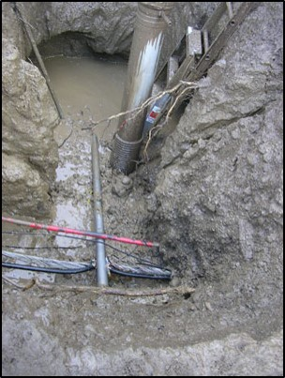
Directional Drilling Hazards
Striking underground utilities
  Gas, electric, water, communications
    Call 811“before you dig”
    Plan and map bore route
    Expose utilities before drilling
      OSHA CFR 29 1926.651
      Depth and Exact locations can vary from marks
Caught in / between drill equipment
Struck by unraveling pipe
Slips, trips, and falls
Notes:
To verify and avoid underground utility lines when using HDD:
Visually inspect the entire planned digging path for structures that indicate potential underground utilities (e.g., gas meters and manhole covers).
Underground service locators typically cannot provide depth information for utility lines. Employers must implement safe work practices that always verify the depth of utility lines near the planned drill path to prevent hitting them.
Review drawings and contact utility companies directly, whenever possible, to verify underground utility locations.
Compare findings with surface markings (discussed below) to identify any missed utility.
Employ potholing and other safety precautions described below to further identify and avoid lines in the drill path.
One common industry practice is to call 811, the "Call Before You Dig" number, to establish the location of any underground utility installations in the work area.

Slide 49
Site and Mechanical Hazards
End of Part IV:
PV Installation Tasks and Best Practices

Slide 50
Site and Mechanical Hazards
Part V:
PV Installation Tasks and Best Practices, Continued

Slide 51
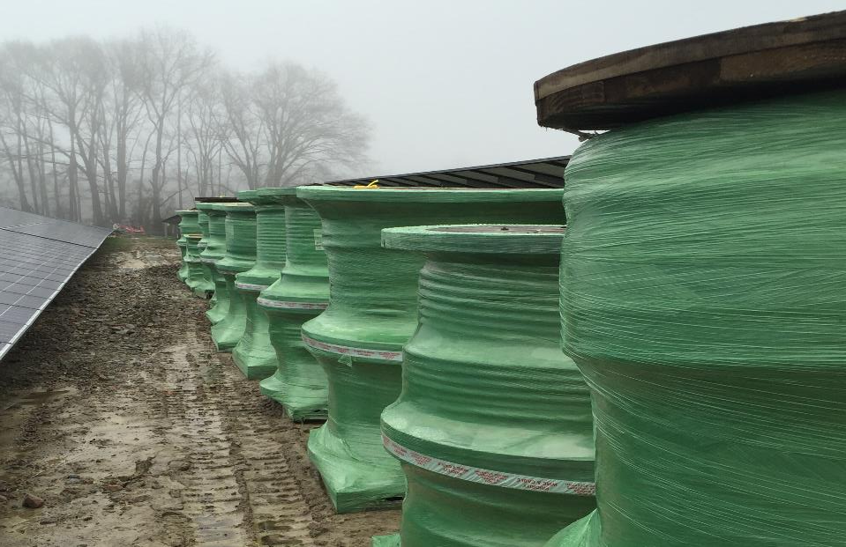
“Non-electrical” Electrical Tasks
There are some tasks associated with electrical work that non-electricians may perform
  Concrete work
  Cutting steel or aluminum for equipment mounting
  Installing inverters, disconnects, other balance of system (BoS) components
  Punching knock-outs
  Conduit bending
    Manual or mechanical benders
    PVC heater blankets
  Wire pulling / feeding
Notes:
Licensing requirements for who is qualified to do certain tasks will vary by state
There are some tasks associated with electrical work that non-electricians may perform, such as:
Concrete work
Cutting steel or aluminum for equipment mounting
Installing inverters, disconnects, other balance of system (BoS) components
Punching knock-outs
Conduit bending
Manual or mechanical benders
PVC heater blankets
Wire pulling / feeding
NOTE: Presenter- mention variability in requirements for who can do these tasks- state to state, company, etc.

Slide 52

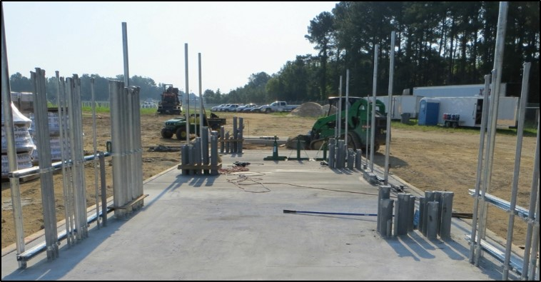
Concrete Pads
OSHA 1926.701
Rebar, form work, and conduit sticking out = Trip and impalement hazards
  Guard all protruding reinforcing steel, onto and into which one could fall
  Protruding conduit should have similar protection
Cords, tools, pipes, people
  STF hazards
Impalement hazards!
Trip hazards!
Notes:
OSHA 1926 Subpart Q Concrete and Masonry Construction
1926.701(b)Reinforcing steel. All protruding reinforcing steel, onto and into which employees could fall, shall be guarded to eliminate the hazard of impalement.
Per OSHA interpretation, “whether conduit would be sufficiently stiff to pose an impalement hazard would depend on various factors, such as the projection's length, whether it was projecting from hardened concrete, and whether it was surrounded by other objects”.
However, remember the General Duty Clause: “each employer shall furnish to each of his employees employment and a place of employment which are free from recognized hazards that are causing or are likely to cause death or serious physical harm to his employees”
https://www.osha.gov/laws-regs/standardinterpretations/2006-04-24-0
At 7:30 a.m. on August 21, 2017, Employee #1, employed by a construction company, was working at a multiemployer construction project for a parking garage. He was involved in reconfiguring components of a shoring system used to brace a newly poured floor. Employee #1 stepped down from a horizontal brace positioned 39 inches from the ground and sat on a piece of exposed Number 5 Rebar that was not covered by a protective cap. The piece of rebar was protruding 41 inches out of the floor. Emergency services were called, and Employee #1 was transported to the hospital. He was admitted and treated for an impalement injury of his right buttock
https://www.osha.gov/pls/imis/accidentsearch.accident_detail?id=102492.015

Slide 53




Concrete Pad Installation Hazards
Notes:
These photos show the many hazards which may be present during concrete pad installation:
Impalement
Feet and hands crushed
Struck by
Overexertion
Etc.
We don’t have a JHA for this one, but you can imagine what it would look like

Slide 54


String Inverter Installation
Hazards
  Slips, trips, falls
  Struck by
  Sharp edges
  Caught in / between
  Overhead impact
  Overexertion
Control methods
  Keep work zone clean
  Communication
  One task at a time
  Proper lifting techniques
  Wear proper PPE
Notes:
Many hazards exist when mounting string inverters, including:
STF
Sharp edges
Caught in / between
Overhead impact
Overexertion
Just as with any tasks, it’s essential to first identify hazards, then identify control methods to eliminate or mitigate those hazards.
Keep work zone clean
Communication
One task at a time
Proper lifting techniques- use 2 people or a lift
Wear proper PPE (hard hat, vest, gloves, eye protection, safety boots, cut-resistant sleeves, etc.)

Slide 55

Job Hazard Analysis
Notes:
Here is a completed JHA for the task of unpacking string inverters and mounting them to the strut structure.
See potential hazards and control methods

Slide 56


Transformer and Central Inverter Installation
Hazards
  Slips, trips, falls
  Struck by
  Heavy machinery
  Caught in / between
  Overhead impact
  Overexertion
Control methods
  Keep work zone clean
  Communication!!
    Designated signaler
  Use mechanical lifts
  Wear proper PPE
    Steel toed boots are critical!
Notes:
When it comes to the installation of heavy transformers and central inverters, the hazards are similar to string inverters but greatly magnified.

Slide 57

Reach Forklifts
OSHA 1910.178
Used to lift equipment and materials
  Pallets of modules, racking members, inverters to safe staging locations
  Not people!
    Unless specifically designed
Establish eye contact with driver
  Wait until driver acknowledges before proceeding into path
Wear proper PPE
  High-vis vest / jacket, hardhat
Notes:
Reach forklifts requirements are located in OSHA 29 CFR 1920.178. Materials Handling and Storage (considered a “powered industrial truck”)
Reach forklifts are designed to lift equipment and materials. They can be used to move BOS equipment, pallets of modules around a job site or even lift “panels” of modules onto racking
If the manufacturer indicates the forklift is approved to lift people, then it can as long as there is a proper platform attached to the forks and the operator is in the seat.
They are operated from the ground and can navigate rough terrain on a jobsite
When working around forklifts, be sure to maintain eye contact with the driver. Forklifts weren’t originally designed to transport loads, only to lift and lower them. For this reason, forklifts traditionally have very limited fields of clear vision. Most of the time, a driver’s field of vision is obstructed by the mast structure of the lift, by the load itself, or by dusty, or misty driving conditions. Additionally, drivers are often focused on load stability and making sure it arrives in one piece.
Typically a weekly forklift inspection form will need to be filled out

Slide 58


Forklift Safety: Operator training
OSHA 1910.178
Follow manufacturer instructions
  Do not exceed load limits
Operators must
  Be properly trained & certified
    Including refresher training
  Watch for hazards
    Overhead power lines, open trenches, uneven terrain, etc.
Designated signaler communicates with driver
  Workers must know stop signal
Notes:
Always follow manufacturer’s instructions and pay special attention to load limits of the equipment.
Operators must be properly trained and certified to operate this equipment.
Since there is more flexibility and options for movement, this increases the risk from overhead hazards such as powerlines. Make sure proper safety procedures are in place to keep the crew safe.

Slide 59

Cranes
OSHA 1926.1400
Typically used to place large inverters, transformers, and/ or skids
Must understand crane signals and load capacity
Recognize caught in/between and struck by hazards
Avoid overhead powerlines
  Electrocution hazard!
Source: niosh
Source: mysafetysign.com
Notes:
If using a crane additional training is required that is outside the scope of this training.
The regulations for cranes for OSHA fall under 29 CFR Subpart CC ‘Cranes and Derricks’.
With this specialized equipment, you must hire a licensed crane company to operate the unit. Many states now require rigging training and certification to connect loads to cranes. A poorly rigged load can mean death.
All workers on the site should understand crane signals and load capacity to ensure the proper use of the equipment.
As with the other types of machinery, job hazard forms should include provisions to avoid caught-in-between injuries and plans to avoid contact with overhead power lines.

Slide 60

Job Hazard Analysis
x
x
Notes:
Here is a completed JHA for the installation task of lifting and setting a 13k lb. transformer using a crane
Note- on many sites a specialized Lift Planning and Control form will need to be filled out, which would include:
Authorized workers
Characterizing the load- length, width, height, diameter, load weight
Characterizing the task (very descriptive directions for lifting, rotation, flipping, speeds, and travel)

Slide 61



Wire Pulling / Feeding
Larger wires require greater effort
  Can strain hands, arms, shoulders, and back
Take regular breaks
Rotate employees between pulling and feeding
Required equipment / helpful aids
  Wire puller, pullies, spool rollers, larger conduit, lube
  Pull in the “power zone”
Source: OSHA
Notes:
From https://www.osha.gov/SLTC/etools/electricalcontractors/installation/pulling.html:
Potential hazards:
Due to increased weight and stiffness, pulling larger gauge wire requires greater effort than pulling smaller gauge. This increased effort can stress the hands, arms, shoulders, and back.
Unwinding wire from spools may be strenuous when wire spools are large and heavy (Figure 1).
Manually pulling or feeding wire through long runs of conduit may take a great deal of time, requiring highly repetitive forceful exertions involving muscles of the hands, arms and back.
Contact stress and cuts on hands- use gloves!
Possible solutions:
Use a mechanical wire puller
Use properly positioned portable pulleys
Use spool rollers that allow spools to rotate in place and release wire smoothly without twisting
Employees should be provided with platforms, scaffolds, or lifts so that they can raise themselves to do pulling tasks within easy reach and minimize overhead or low-location pulls. Pulling should be done in the power zone.
Lubricate wires
Use platform ladders which provide a work surface where employees may stand and turn to face the direction of work when pulling. This allows employees to exert force in ergonomically correct postures improving efficiency and reduces fatigue.

Slide 62

Mechanical Wire Pullers
Provide the force of several workers
  Reduce risk of overexertion
When using
  Be aware of others
  Communicate!
    Use signals between all employees
  Keep hands away from machine!
    Caught in / between hazard
  Follow manufacturer’s instructions
Notes:
Mechanical wire pullers provide the force of several employees, eliminating the manual effort needed to pull therefore increasing productivity and reducing risk of overexertion.
However, using a mechanical wire puller bring with it some risks, such as caught in/between hazards.
Be aware of others
Communicate- use signals between all employees
Keep hands away from machine
Always follow manufacturer’s instructions

Slide 63



Attaching Modules to Racks
Slips, trips, falls
  Ladder safety
    No higher than second step from top
  Check terrain
  Clear debris
Struck by
  Modules can fall
  Worker can be crushed!
  Heavy machinery
Caught in/between
  Watch for hazards
  Stacked modules
  Heavy machinery
Notes:
There are hazards associated with attaching modules to racks, even if the racks are on the ground (vs. on a roof)
Modules can be mounted individually or in ”panels” using heavy machinery.
Workers can be crushed by falling modules/panels
Never leave modules unsecured
Chances are you’ll need to use a step ladder during this process- these pose fall hazards, especially since the terrain is likely rough and establishing firm footing may be difficult
Follow ladder manufacturer instructions and do not step higher than the second step from the top
Never walk or stand on modules- this not only poses a slip/fall hazard but it can also damage the module, even if the glass doesn’t break- microcracks can occur that impact performance

Slide 64


Caught In/Between Modules
OSHA 1926.250
  OSHA Requirement
  All materials stored in tier shall be stacked, racked, blocked, interlocked, or otherwise secured to prevent sliding, falling, or collapse
Notes:
- Stacking a large number of unsecured modules is actually an OSHA violation- 1926.250 states that all materials must be stacked, racked, blocked, interlocked, or otherwise secured to prevent sliding, falling, or collapse- which could certainly lead to injury or equipment damage

Slide 65

Job Hazard Analysis
Notes:
Here is a completed JHA form for the task of unpacking modules and attaching them to the racking structure

Slide 66


Portable Ladder Duty Ratings
OSHA 1926.1053
Load Rating
Person → ± 200 lbs.?
Tools / Equipment weight → 60 lbs.?
Total → 260 lbs. → Type IA or IAA
Load Capacity | ANSI* Code
200 lbs. / 91 kg | Type III
225 lbs. / 102 kg | Type II
250 lbs. / 113 kg | Type I
300 lbs. / 136 kg | Type IA
375 lbs. / 170 kg | Type IAA
* American National Standards Institute
Notes:
Ladders have a load rating that you can find on the ladder label. This load rating includes the weight of the person (including clothing and PPE), any equipment/tools they may be carrying or may be stored on the ladder. Do not exceed the manufacturer's rated capacity.
ANSI stands for American National Standards Institute. This is a national (USA) standards rating organization that oversees the creation of standards, including ladder ratings standards. See chart on screen for ladder ratings and ANSI codes.
Consider all employees on the jobsite and choose a ladder that is safe for any employee that may use it.
In most circumstances, it is smart to use a Type IA or Type IAA ladder to ensure the rating is not exceeded.
Note that for single-sided step ladders, the duty rating is only for the one side with steps that it’s safe to use. There are also dual-sided, or twin stepladders- for these the duty rating is per side. So if you had a 300 lb. load capacity twin stepladder, that’s 300 lbs. per side.

Slide 67

Stepladder Use and Inspection
OSHA 1926.1053(b)
Only use on stable, level surfaces
  Use shovel to level ground in immediate work area
  Slip resistant feet required on slippery surfaces
Top or top step shall not be used as a step
Do not climb cross-bracing on rear section
Must be inspected by competent person each shift
  If damaged, tag “Dangerous: Do Not Use” and remove from service until repaired or replaced
Notes:
It is important to spend some time placing a ladder- make sure the feet at aligned correctly, that they are solidly on a level surface, and the ladder is secured (if need be). Taking some extra time to ensure you have a solid base will greatly decrease the hazard of working on a ladder. Try to avoid placing ladders on slippery surfaces, but if it can not be avoided, slip-resistant ladder feet can be used and the ladder can be tied off to make it safe to work on.
Ladders are not meant to be placed on top of anything in order to gain height. This creates a very unstable condition.
In order to protect workers, OSHA requires that Ladders are inspected by a competent person for visible defects on a regular basis or if something happens that might affect the integrity of the ladder.
It is helpful to use a ladder inspection checklist to ensure that all parts of the ladder are inspected and the ladder is in good shape to be used
Something that is important to look for when inspecting a ladder is to make sure the steps don’t have any oil or grease on them which could cause a person to slip
If there are any issues with the ladder, it should be tagged with a sign that says “Danger: Do not use” (or similar) and be removed from use. Some examples include:
Broken or missing rungs, cleats or steps
Broken or split rails
Corroded components
It’s important to ensure it is not used until repaired or replaced. If unrepairable, destroy it! You don’t want to risk someone else finding it in the dumpster and deciding to use it. Duct tape is not a good repair for a broken rung!
Any repairs must be done in accordance with the manufacture recommendations.

Slide 68
Ladder Inspection
OSHA 1926.1053(b)
Inspected by competent person each work shift
  Free of oil, grease, and other slipping hazards
  Identify any visible defects
  Replace damaged labels
If structural issue or defect found
  Immediately tag “Dangerous: Do Not Use” or similar language
  Remove from service until repaired or replaced
  If unrepairable, destroy it!
Notes:
In order to protect workers, OSHA requires that Ladders are inspected by a competent person for visible defects on a regular basis or if something happens that might affect the integrity of the ladder.
It is helpful to use a ladder inspection checklist to ensure that all parts of the ladder are inspected and the ladder is in good shape to be used
Something that is important to look for when inspecting a ladder is to make sure the steps don’t have any oil or grease on them which could cause a person to slip
If there are any issues with the ladder, it should be tagged with a sign that says “Danger: Do not use” (or similar) and be removed from use. Some examples include:
Broken or missing rungs, cleats or steps
Broken or split rails
Corroded components
It’s important to ensure it is not used until repaired or replaced. If unrepairable, destroy it! You don’t want to risk someone else finding it in the dumpster and deciding to use it. Duct tape is not a good repair for a broken rung!
Any repairs must be done in accordance with the manufacture recommendations.

Slide 69

Improper Ladder Use
  OSHA Violation:
  No higher than 2 steps from the top
  Solution:
  Use a larger ladder
Notes:
This installer should not be standing on the first step down from the top; they should be using a taller ladder

Slide 70
End of Presentation:
Site and Mechanical Hazards
Disclaimer: This material was produced under grant number SH-05027-SH8 from the Occupational Safety and Health Administration, U.S. Department of Labor. It does not necessarily reflect the views or policies of the U.S. Department of Labor, nor does mention of trade names, commercial products, or organizations imply endorsement by the U.S. Government.
Notes:
Welcome to this lesson on site and mechanical hazards found at utility-scale PV installation sites
If you have not yet listened to the introductory lesson, please go back and do so, as these lesson follow a progressive order.
Again, this course was produced under a Susan Harwood Training Grant through OSHA, the Occupational Safety and Health Administration.

