Slide 1
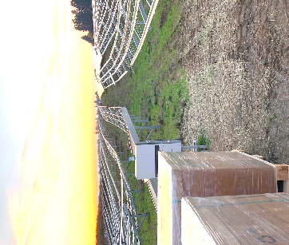
Course Introduction
Disclaimer: This material was produced under grant number SH-05027-SH8 from the Occupational Safety and Health Administration, U.S. Department of Labor. It does not necessarily reflect the views or policies of the U.S. Department of Labor, nor does mention of trade names, commercial products, or organizations imply endorsement by the U.S. Government.
Notes:
Welcome to this online course on large scale ground-mounted solar installation safety, my name is….
This course was produced under a Susan Harwood Training Grant through OSHA, the Occupational Safety and Health Administration; OSHA is an agency of the US Department of Labor.
SEI is thankful that OSHA recognizes the continued rapid growth of the solar PV industry- it’s a relatively high hazard industry- therefore there’s a big need for solar-specific safety training.
Disclaimer: Although this material was produced under a grant from OSHA, this training material does not necessarily reflect the views or policies of the U.S. Department of Labor, nor does mention of trade names, commercial products, or organizations imply endorsement by the U.S. Government

Slide 2
Learning Objectives
Identify the focus of this course
Define OSHA and its mission
List employer safety training responsibilities
Describe the key elements of a job hazard analysis
Explain the effectiveness of hazard control methods
Notes:
The learning objectives for this introductory lesson are to:
Identify the focus of this course
Define OSHA and its mission
List employer safety training responsibilities
Describe the key elements of a job hazard analysis
Explain the effectiveness of various hazard control methods

Slide 3
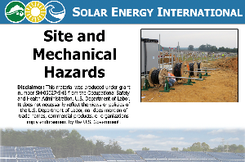
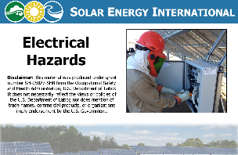
Targeted Topic Training Grant
Focus: Large-scale ground-mounted PV systems
Bring awareness to hazards found at these sites and control methods
OSHA 30-hour construction safety also recommended
This is safety training, not design and installation training!
SEI in-depth courses
PV101: Solar Electric Design and Installation
PV202: Advanced PV System Design and the NEC
PV350: Tools and Techniques for O&M
Notes:
This course focuses on hazards found on large-scale ground-mounted PV installation sites.
Under a previous grant, SEI developed a course on roof-mounted PV installation safety- this course is available as a continuing education course through SEI
Goal is to bring awareness to the hazards found at these sites, and then the various control methods to eliminate or mitigate those hazards
This course is structured as two main lessons- first covers site and mechanical hazards, second covers electrical hazards
This is safety training- this is NOT a design, install, or O&M class. SEI does have those courses available- we encourage you to check these out.
SEI recommends additional safety training- including by not limited to OSHA’s 30-hr construction training

Slide 4
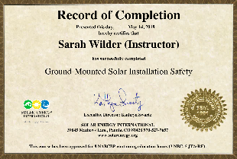
To Pass this Course
Introductory lesson
Presentation
Quiz- graded
Site & Mechanical Hazards
Presentation (5 parts)
Quiz- graded
Field videos
Interactive exercise- not graded
Electrical Hazards
Presentations (7 parts)
Quiz- graded
Field videos
Interactive exercises- not graded
Complete Survey
Print Record of Completion
Additional resources also available for further safety information

Slide 5
What is OSHA?
Occupational Safety and Health Act of 1970 (OSH Act) was passed to prevent workers from being killed or seriously harmed at work
Employers have responsibility to provide safe workplace
Law created the Occupational Safety and Health Administration (OSHA)
Sets and enforces protective workplace safety and health standards
Notes:
The Occupational Safety and Health Act of 1970 (OSH Act) was signed into law by president Nixon, with the goal of preventing workers from being killed or seriously harmed at work
Law acknowledges that the right to a safe workplace is a basic human right
Under the OSH Act, employers have the responsibility to provide a safe workplace-
This law the created OSHA, which sets and enforces protective workplace safety and health standards
Complying with OSHA regulations is the law!

Slide 6
What is OSHA ?
OSHA also provides information, training, and assistance to employers and workers
This course developed under an OSHA Training Grant!
For more information, visit www.osha.gov
Notes:
OSHA not only sets and enforces standards, but they also provide a lot of great information, training, and assistance to employers and workers
A great example is this course, developed under an OSHA Susan Harwood Training Grant
OSHA not only there to provide citations- they’re there to help you be safe on the job site and ensure that the company you work for is providing you with the training and resources you need in order to work safety
For more information about OSHA, visit their website, www.osha.gov
Here, find not only various OSHA standards that we show in course
Also some great educational resources

Slide 7
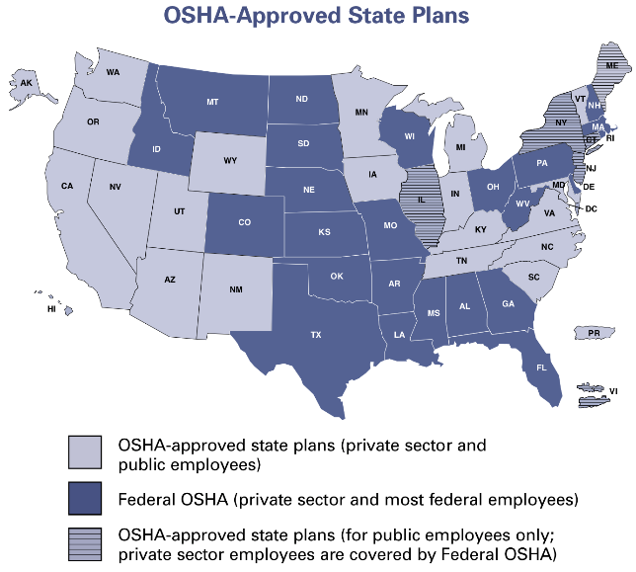
OSHA Federal & State Plans
Source: osha.gov
Notes:
It’s important to note that most private sector employers and workers are going to be covered directly through Federal OSHA or through an OSHA-approved state plan, depending on where you work.
See on this map (covers all 50 states as well as PR and Virgin Islands):
Dark purple- Federal OSHA private sector and most federal employees
Light purple- States with OSHA-approved state plans- private sector and public employees
State plans, which are state-run safety and health programs, must be at least as effective as the Federal OSHA program- many exceed federal requirements
Purple lines- Hybrid states where you have OSHA-approved state plan for public employees, but then private sector employees covered under federal OSHA
In course we focus on federal OSHA standards, but remember- state requirements may exceed federal requirements
We encourage you to visit OSHA’s website to find out more information about the rules in the states or territories you might be working in, including contact information for your regional OSHA office

Slide 8
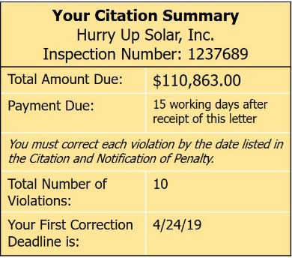
Inspection Priorities & Penalties
Imminent danger
Catastrophes / fatalities
Worker complaints & referrals
Targeted inspections
High injury / illness rates
Severe violators
Follow-up inspections
Type of Violation | Penalty
Serious Other-than-serious Posting Requirements | $12,934 per violation
Failure to abate | $12,934 per day beyond the abatement date
Willful or repeated | $129,336 per violation
Source: osha.gov
Notes:
Here we see OSHA’s inspection priorities- they prioritize reports of imminent danger, fatalities, worker complaints and referrals, companies that have high injury or illness rates, or companies that are severe violators. They also do follow-up inspections.
When you’re on a jobsite with a bunch of different contractors, OSHA could show up at any time for another company. Rather than always keeping watchful eye, just do it right and be safe!
This is a reproduction of an actual citation received by a solar contractor- talk @ details of violations- it’s a bunch of smaller violations- no one needs to get hurt to get a big citation!
Here we see OSHA’s inspection priorities: not necessarily randomly driving around- prioritize reports of imminent danger, fatalities, worker complaints and referrals, companies that have high injury or illness rates, or companies that are severe violators. They also do follow-up inspections.
See in chart here that penalties for OSHA violations can be significant- $12- $130k

Slide 9
Whistleblower Protection Program
Section 11(c) of OSH Act prohibits employers from discriminating against employees for exercising their rights under the Act
Enforces whistleblower provisions of more than 20 whistleblower laws protecting employees who report violations of various workplace safety and health issues
Rights include
Filing an OSHA complaint
Participating in an inspection or talking to an OSHA inspector
Seeking access to employee exposure and injury records
Reporting an injury
Raising a safety or health complaint with employer
Complaints must be reported to OSHA within 30 days following retaliatory action
For more information, visit www.whistleblowers.gov
Notes:
Lastly, OSHA’s Whistleblower Protection Program protects employees who report safety violations- the OSH Act prohibits employers from discriminating against employees for doing so.
As an employee, you have the right to file an OSHA complaint, participate in an inspection or talk to an inspector, seek access to employee exposure and injury records, report an injury, or raise a safety or health complaint with an employer.
If you file a complaint, OSHA keeps your information confidential.
Once thing to note is that if you are discriminated against for exercises your rights under the OSHA act, must report within 30 days following retaliatory action
For more information, visit the www.whiteblowers.gov website.

Slide 10
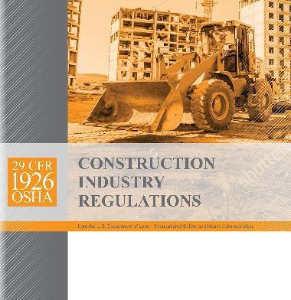
OSHA & PV Installation Safety OSHA 29 CFR 1926
Code of Federal Regulations (CFR) Part 1926, Title 29 applies to construction
30 Subparts, including
C: General Safety and Health Provisions
E: Personal Protective and Life Saving Equipment (PPE)
G: Signs, Signals, and Barricades
I: Hand & Power Tools
K: Electrical
P: Excavations
X: Stairways and Ladders
V: Electric Power Transmission and Distribution
Notes:
While all workplaces must adhere to the minimum standards found in 1910, construction sites default to 1926.
Most solar installation work falls under the Code of Federal Regulations (CFR) part 1926, title 29, which applies to the construction industry. OSHA’s regulations define construction work as “construction, alteration, and/or repair”- so this includes both construction and O&M work
Within it are 30 subparts, including but not limited to the subparts listed here. It depends on the specific installation and equipment being used.
Note that employers could also get cited under OSHA’s general duty clause when no specific standard applies to a serious hazard; general duty clause requires that each employer provide employees with a workplace that is free from recognized hazards that are causing or likely to cause death or serious physical harm.

Slide 11
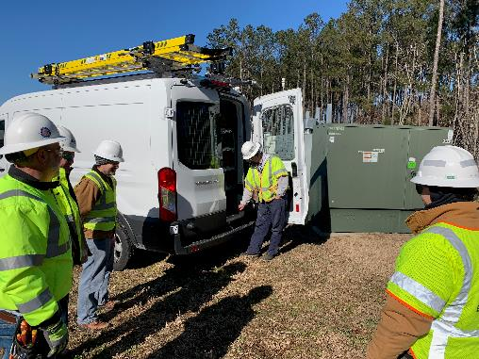
Employer Responsibility OSHA 29 CFR 1926 Subpart C
Employer must instruct each employee on
Recognition & avoidance of unsafe conditions
Applicable regulations and methods to control or eliminate hazards
Employee Safety Program
!
Notes:
Subpart C of Part 1926- General Safety and Health Provisions- states that it’s the employer’s responsibility to instruct each employee on the recognition and avoidance of unsafe conditions, as well as the applicable regulations to control or eliminate hazards
There are several ways to train employees
Perform the training within the business (in-house trainings must be led by a competent person, which we’ll talk about on the next slide)
Send employees to professional training courses such as free classroom training offered by OSHA or first aid training offered by the Red Cross.
Add to training by requiring that employees complete content-specific courses such as this one.
A combination of these options may be the best option
If you’re an employer (or an employee) and you’re thinking that safety training is a waste of time and money, consider what one lost workday injury might cost the company in terms of:
Installation down-time- time lost by injured employees and supervisors helping the accident victim.
Admin cost: paperwork generated by the accident.
Time to hire or train a worker to replace the injured installer until they return to work.
Time and cost for repair or replacement of damaged equipment or materials.
Increased insurance cost
Reduced morale among your employees and perhaps lower efficiency.
OSHA penalties
Create a culture of safety! An embedded part of the job and work environment
Many subparts list additional/specific employer training responsibilities- for instance ladders, excavations, etc.
While it’s the employer’s responsibility to provide safety training, it’s YOUR responsibility to follow standard operating procedures and use appropriate PPE!!!

Slide 12
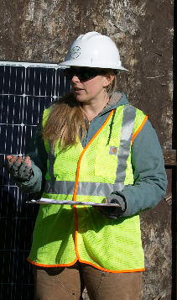
Authorized, Competent, Qualified
Authorized | A person approved or assigned by the employer to perform a specific type of duty or duties or to be at a specific location or locations at a jobsite
Competent | One who is capable of identifying existing and predictable hazards in the surroundings or working conditions which are unsanitary, hazardous, or dangerous to employees And who has authorization to take prompt corrective measures to eliminate them
Qualified | One who, by possession of a recognized degree, certificate, or professional standing, or who by extensive knowledge, training, and experience, has successfully demonstrated their ability to solve or resolve problems relating to the subject matter, the work, or the project
Notes:
It is important to understand what it takes to become a Authorized/Designated vs. Competent vs. Qualified Person from an OSHA perspective.
OSHA defines an “authorized” person as ”a person approved or assigned by the employer to perform a specific type of duty or duties or to be at a specific location or locations at a job site”.
It is up to the employer to determine who is Authorized (or Designated) to perform specific tasks or be in specific areas. The onus is on the employer to ensure that those employees have the knowledge, skills, personal protective equipment, etc. to perform work in that area safely.
The term “competent” takes on a little higher authority. OSHA defines a competent person as “someone who is capable of identifying existing and predictable hazards in surroundings or working conditions which are unsanitary, hazardous, or dangerous to employees AND who has authorization to take prompt corrective measures to eliminate or control hazards”.
Meeting the first part of the definition has a lot to do with the complexity of the job task involved, the job site itself and the equipment in use. This is met with a combination of appropriate training and experience in performing the task(s) using the tools and equipment involved in the conditions of the job site. Only the employer can judge whether the employee has met the training and experience requirements as well as having the capability of identifying existing and predictable hazards.
Competent person is specifically defined in selected standards as well, by referencing the competence involved. For example, trenching and excavation work is dependent on these specialized (competent) employees because its highly technical nature, as well as its inherent hazards, require a greater level of training and experience than a normal worker would possess.
The second part of the definition of competent person is really important for when we talk about the job hazard analysis. which also needs to be led by a competent person- it’s critical to have someone on the job site that can not only recognize hazards, but has the authority to do something about it. The employer is the only who provides “authority” to an employee.
If there’s an inspection or accident investigation, OSHA inspector will ask who the designated competent person is, to see if other employees know. Absence of competent person among most frequently cited OSHA violations
OSHA is stricter when it comes to “qualified”. OSHA defines a “qualified” person as “one who, by possession of a recognized degree, certificate, or professional standing, or who by extensive knowledge, training, and experience, has successfully demonstrated their ability to solve or resolve problems relating to the subject matter, the work, or the project”.
Again, OSHA may be more specific in a specific standard, for example in Subpart S – Electrical- “Qualified Person” is defined as: “One who has received training in and has demonstrated skills and knowledge in the construction and operation of electric equipment and installations and the hazards involved.”
This is generally reserved for those positions that have the highest potential for injury or death to the worker, other workers, or the general public if things aren’t done exactly right.
Note, NEC 690.14 states that “the installation of equipment and all associated wiring and interconnections shall be performed only by qualified persons”, and refers to the Article 100 definition of Qualified Person “one who has skills and knowledge related to the construction and operation of the electrical equipment and installations and has received safety training to recognize and avoid the hazards involved” .
With multiple contractors on site and multiple tasks happening at the same time, site will have workers with variety of skills/training.
Training, coordination, and communication are critical!

Slide 13
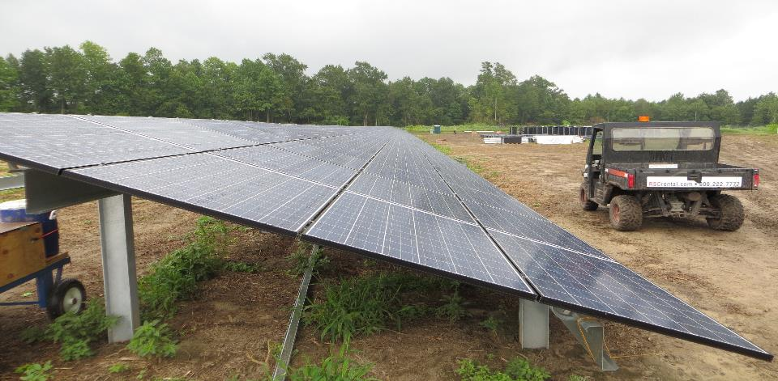
Site Safety Requirements
OSHA provides minimum standards
General contractor requirements may exceed OSHA
Subcontractors must be aware of site-specific requirements
Site safety plan includes
Points of contact
Emergency action plan
Incident notification
Specialized trainings required
Details on safety meetings
Safety meetings performed daily
Site conditions, tasks, and hazards continuously change!
Pre-task hazard analyses
Minimum PPE
Chemicals / waste stream
Equipment handling
Environmental hazards
Notes:
It’s important to remember that OSHA provides MINIMUM workplace safety standards.
When you first arrive on site there will typically be an orientation that will include safety training from the general contractor. After the training you will receive a number for your hard hat so you can be identified by the gate security guard.
If you are a subcontractor, or a temp worker hired by a subcontractor, you may have additional safety training before working on the site.
A site safety plan includes…

Slide 14
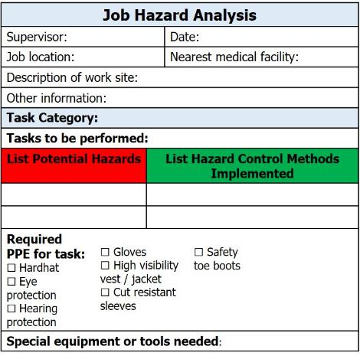
Job Hazard Analysis (JHA)
JHA enables you to identify, eliminate, and control hazards!
Led by competent person
And all participate
Complete before each task
Document each meeting
All workers sign off!
New workers to task zone must read and sign off before entering
Notes:
A job hazard analysis is one component of a company’s broader safety program
A job hazard analysis is a technique that focuses on job tasks as a way to identify hazards before they occur.
Site specific- every installation is different!
It focuses on the relationship between the worker, the task, the tools, and the work environment. Ideally, after you identify uncontrolled hazards, you will take steps to eliminate or control the hazards- meaning reduce them to an acceptable level
Led by the competent person, though everyone on the job site should participate and approach the site with awareness
From this analysis, develop a safety plan and host job briefings at the jobsite to go over job-site specific hazards, safe work procedures, tools and materials and PPE, where to located first aid equipment, location of nearest medical facility.
It’s also critical to document each safety meeting, and have all attendees sign off- not only for participation and buy-in, but also to keep a written record in the event of an accident.
Any new workers entering a specific work zone must also review the JHA and sign off on it.
Talk about the difference between weekly safety meeting, daily JHA, pre-task analysis
Employees must sign off on JHA; if anyone new enters work zone, they must read sign off too
Important not to confuse competent person with qualified person.
OSHA part 1926 defines qualified person as one who “by possession of a recognized degree, certificate, or professional standing, or who by extensive knowledge, training and experience, has successfully demonstrated ability to solve or resolve problems relating to the subject matter, the work, or the project”
Qualified workers might have more technical expertise (design and installation) than those designated as competent, but they would not necessarily have expertise in hazard recognition or the authority to correct identified hazards

Slide 15
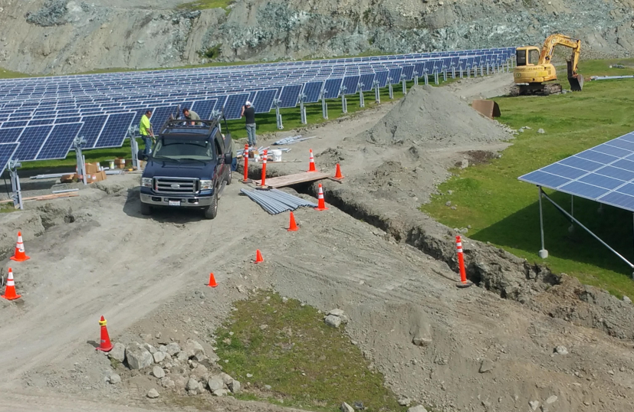
Identify Work Zones
Homerun wiring being completed
Work on trackers / racking
Heavy machinery / sand and soil
Trench & conduit work
Modules being installed
Access to work zones
Notes:
Here is an example of the many work zones that may be present on a large-scale PV site.
Each of the job tasks would require its own JHA.

Slide 16
Identify Hazards
Heavy machinery – caught in/between hazard
Trackers – watch for moving parts!
Sand/soil – uneven terrain – trip hazard
Vehicle very close to trench
Materials very close to trench – slip/trip/fall hazard!
Ground mount – ‘overhead impact’, electrical hazards
Open trenches – watch your step!
Debris – slip/trip/fall hazard!
Notes:
Here you see the multitude of hazards present!

Slide 17
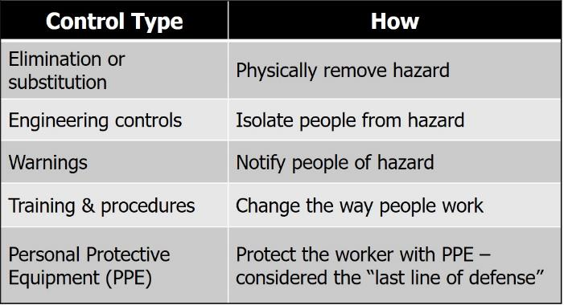
Control Effectiveness
Most effective
Least effective
Notes:
One concept that’s important to understand when implementing safety measures is this hierarchy of control, or control effectiveness.
When dealing with a particular hazard, it’s way more effective to eliminate the hazard altogether than to control it
Next most effective are engineering controls such as tool guards to mitigate the hazard, followed by warnings which notify people of hazards, and then safe work practices and administrative procedures to change the way people work.
Notice that personal protective equipment, or ”PPE” is considered the least effective form of hazard control- it’s really the last line of defense.
When installing PV systems, workers should never have to work on live electrical systems- they still need to wear PPE, but they can also implement these more effective control measures.
Working on live electrical systems should only be necessary during testing and commissioning; in these situations, PPE is the ONLY line of defense

Slide 18
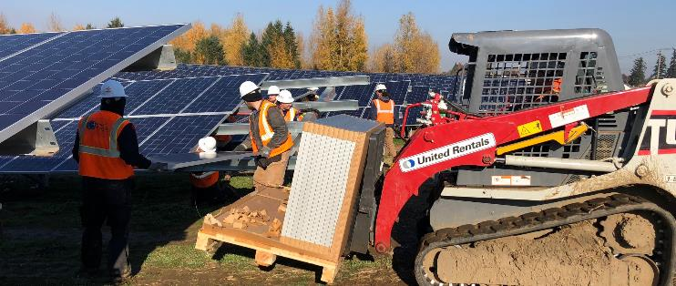
Promote A Culture of Safety
Work mindfully
Work at a safe pace
Think before each step or task
360° awareness at all times
Never work alone
Minimum 2 installers in any work area
Too many people can also be a hazard
Notes:
Again, it’s critical that both employers and employees have buy in to this “culture of safety”
Work mindfully: work at a safe pace
Getting the job done is important, but remember- working in a hurry or under pressure can not only lead to unsafe work practices, it can also lead to poor quality installation work, which will inevitably lead to another truck roll and additional expense some time in the future.
Think before each step- if you don’t take the time to prepare for a specific tasks- what tools, materials, PPE do you need- you’ll waste time walking or driving across the site
Maintain 360 degree awareness at all times- remember, site conditions, tasks, and hazards change continuously!
Also remember that while it’s the employer’s responsibility to provide safety training, it’s YOUR responsibility to follow standard operating procedures and use appropriate PPE.
Finally, never work alone- a buddy system is best for both safety and efficiency, as many tasks are better completed with 2 people, for instance mounting modules.
Too many people on a job site can also be a hazard; on large-scale PV sites with multiple contractors, equipment, tasks, etc. this is critical, so again- 360 degree awareness at all times.

Slide 19
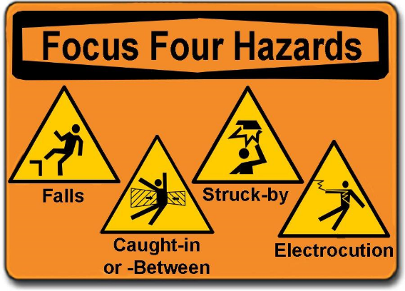
The Focus Four
On large-scale ground-mounted PV sites, workers are commonly exposed to ALL of the focus four hazards!
Notes:
To conclude, why is this solar-specific safety training important?
Solar installation workers are regularly exposed to OSHA’s Focus Four Hazards: falls, struck-by, electrocutions, and caught-in or between; these four hazards alone represented 63.7% of construction fatalities in 2016. These hazards, coupled with the growing number of new workers entering the solar workforce and significant variability in training and licensing requirements for solar workers across the country, make solar-specific safety training more important than ever.
Large ground-mounted solar photovoltaic installations present unique hazards requiring specialized safety training. Hazards include DC circuits operating at up to 1500 volts and hundreds/thousands of amps (vs. 600 Vdc for residential systems), AC circuits up to 690 volts, hazards associated with trenching for electrical conduits, as well as struck-by and caught-in or between hazards from heavy machinery used for foundation work and transporting electrical equipment. These systems commonly require testing of live circuits for commissioning and maintenance procedures, presenting significant arc flash hazards, while untrained workers may be unaware that 1000 to 1500-VDC photovoltaic circuits may be energized when exposed to just a small amount of light. Solar workers at these installations are thus exposed to significant site and electrical hazards that could prove fatal without proper safety training.
Even technically experienced workers may not have received proper safety training,
We hope you enjoy this course and learn from it- not only about minimum safety requirements but about best practices for working safely and doing quality installation work.

