Slide 1
Introduction to
Vertical Bandsaw Safety
This material was produced under Susan Harwood grant number SH-31214-SH7 Occupational Safety and Health Administration, U.S. Department of Labor. The contents in this presentation do not necessarily reflect the views or policies of the U.S. Department of Labor, nor does the mention of trade names, commercial products, or organizations imply endorsement by the U.S. Government.

Slide 2
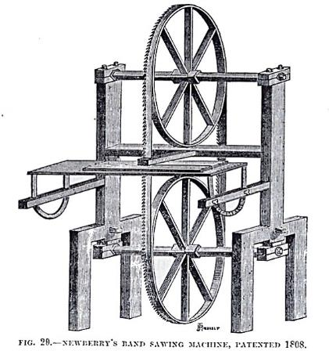
Introduction: What’s a band saw?
The Band Saw was invented by William Newberry in 1808. It is one of the most widely-used wood and metal working machines. Originally for cutting wood, band saws can now cut metal if you change the blade and speed.
An early band saw

Slide 3
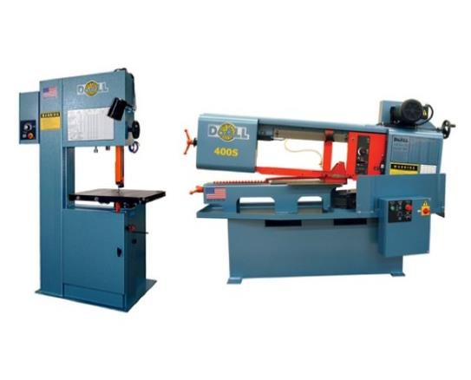
Introduction: Two types of band saw
Here are two common types of Band Saws:
1. Vertical (left)
Used to saw curves, lumber, irregular shapes
2. Horizontal (right)
Use to cut long pieces, tubes
A vertical band saw (left) and horizontal band saw (right)

Slide 4
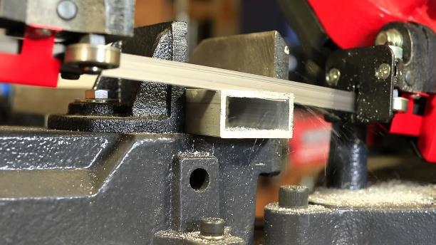
What it Does: What is a band saw used for?
Band Saws are able to cut a variety of materials such as metals, plastics, and wood.
An example of a bandsaw performing a cut

Slide 5
Safety: Who is OSHA?
With the Occupational Safety and Health Act of 1970, Congress created the Occupational Safety and Health Administration (OSHA) to assure safe and healthful working conditions for working men and women by setting and enforcing standards and by providing training, outreach, education and assistance.
OSHA is part of the United States Department of Labor. The administrator for OSHA is the Assistant Secretary of Labor for Occupational Safety and Health. OSHA's administrator answers to the Secretary of Labor, who is a member of the cabinet of the President of the United States.
Notes:
OSHA was started to protect workers in the work place. Before OSHA there was no organization that tracked work place injuries. There were also no safety standards for employers.
OSHA has 2 branches, the Enforcement Branch and the Collaboration Branch.
The Enforcement Branch investigates complaints and serious accidents.
The Collaboration Branch works on education, such as the Susan Harwood Grant.

Slide 6
Safety: Know your rights
Under federal law, you are entitled to a safe workplace.
Your employer must provide a workplace free of known health and safety hazards.
If you have concerns, you have the right to speak up about them without fear of retaliation. You also have the right to:
Be trained in a language you understand
Work on machines that are safe
Be provided required safety gear, such as gloves or a harness and lifeline for falls
Be protected from toxic chemicals
Request an OSHA inspection, and speak to the inspector
Report an injury or illness, and get copies of your medical records
See copies of the workplace injury and illness log
Review records of work-related injuries and illnesses
Get copies of test results done to find hazards in the workplace
Notes:
Read the rights to the trainees and point them to the posters available around the workplace where they can refer to for more information.
Extra resources can be found at https://www.osha.gov/workers/index.html

Slide 7

Hazards: Machine-related injuries
Possible machine-related injuries include:
Crushed fingers or hands
Amputations
Blindness
Blindness is a possible machine-related injury
Notes:
Many accidents result from persons working on, or around, moving machinery. These accidents could have been prevented by the installation and proper maintenance of guarding. The goal of this training is to make the guarding of all equipment as easily understood as possible and re-inforce the safe working procedures that must always be in place around dangerous equipment.
This list of accidents is as long as it is horrifying.
Safeguards are essential for protecting workers from needless and preventable injuries. Where the operation of a machine can injure the operator or other workers, the hazard must be controlled or eliminated.
National Emphasis Program on Amputations*. CPL 03-00-019, (August 13, 2015). Describes policies and procedures for implementing a National Emphasis Program (NEP) to identify and to reduce workplace machinery and equipment hazards which are causing or likely to cause amputations.
Resource: https://www.osha.gov/dte/outreach/construction_generalindustry/gi_outreach_tp.html
https://safetyresourcesblog.com/2014/08/16/osha-quickcards-download-here-all-free-englishspanishother/

Slide 8
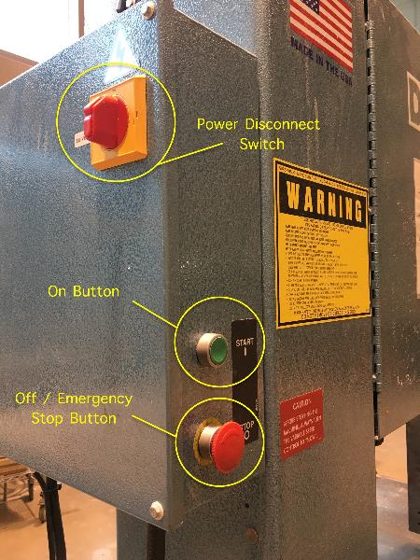
Hazards: Operating controls
The Operating Controls of the Vertical Band Saw house the Emergency Stop button which is used to shut the machine off in an emergency of if something goes wrong.
The green “On” button is pushed to start the saw.
The Power Disconnect Switch is used to completely shut the power off to the machine.
The operating controls on a vertical band saw
Notes:
Review the function of these buttons and switches. When ready to use the saw make sure that the power disconnect is on and that the emergency stop button is released. Then press the green start button.

Slide 9
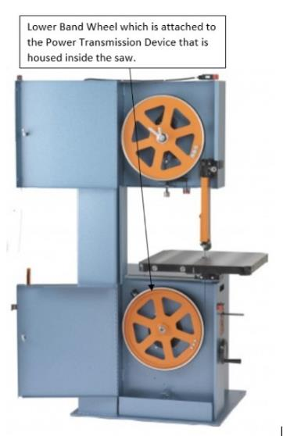
Hazards: Power transmission device
The Power Transmission Device on the Vertical Band Saw is its motor. It turns the lower band wheel which makes the saw band move.
The Power Transmission device of the Vertical Band Saw is housed inside the saw frame and does not present a risk unless the access panel has been removed.
The power transmission device inside a band saw
Notes:
The Band Wheels are what drive the blade. The saw blade tension is adjusted by turning the Saw Band Tension Knob. Reference the Saw Band Tension Indicator for the proper blade tension.

Slide 10
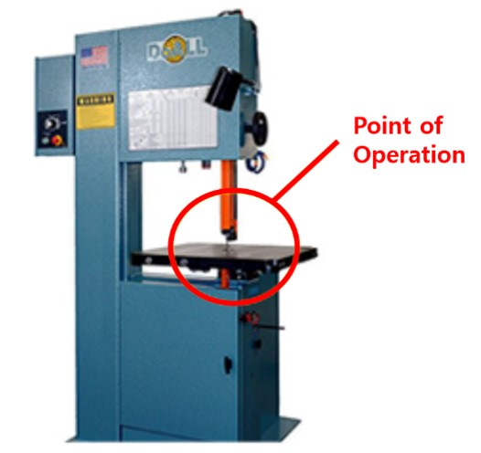
Hazards: Point of operation
The point of operation is the area on a machine where work is actually performed on the material being processed.
On the Vertical Band Saw, the point of operation is either at the point where the saw blade meets the machine table or where the saw blade meets the part being cut.
The point of operation on a band saw
Notes:
These hazards exist on the Vertical Band Saw and they need to be guarded.
Explain that the Point of Operation is where the work is being done on the machine. In this case it is where the band saw blade contacts the work material or at the machine table.
Nip Points exist at the saw blade and table interface and at the blade drive wheels inside the saw doors.
Chips may fly up or fall to the floor.

Slide 11
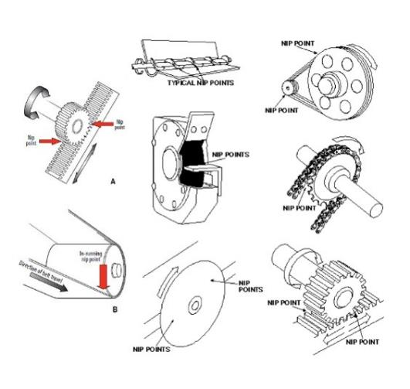
Hazards: Nip points and rotating parts
In-running nip points are commonly found among rotating or reciprocating parts. They
occur in two scenarios:
When machine parts move
toward each other
When machine parts run past a
stationary object
Examples of nip points in different mechanisms
Notes:
In-running nip points are commonly found among rotating or reciprocating parts. They
occur in two scenarios:
When machine parts move
toward each other
When machine parts run past a
stationary object

Slide 12
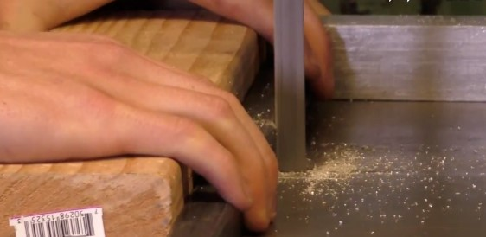
Hazards: Flying chips and wood dust
Cutting material on the vertical band saw can cause chips, sparks and wood dust to fly in different directions.
An example of wood dust generated by cutting
Notes:
Chips may fly up or fall to the floor.

Slide 13
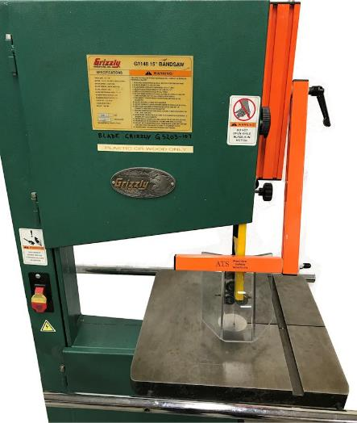
Hazards: What is machine guarding?
Machine guarding is a means of shielding users from moving or flying parts and preventing them from accidentally coming into contact with moving pieces of equipment. Here is a sample of a guard for the Vertical Band Saw (orange in the image).
The orange and clear machine guarding of a band saw
Notes:
Simply put, machine guarding protects the worker from the hazard. Machine guarding should not impede the lubrication or operation of the machine.

Slide 14

Hazards: Preventing injuries and amputations
To prevent injury:
Be trained
​​​​​​​Identify ON/OFF and EMERGENCY switch
Use a blade of an appropriate size and type
Set the guard (open wide enough) to clear stock/workpiece
Use push stick, jig or fixture to adjust workpiece
The operating controls on a vertical band saw
Notes:
If an adjustment needs to be made or a blade needs to be changed press the emergency stop button and turn the power disconnect switch off. This in conjunction with the door interlocks gives the user 3 levels of disconnection from the power source.
To release the emergency stop button turn it clockwise and let it pop out.
Do not remove any guards from the machine. If there is a problem with the guards let the shop staff know.
Always make sure that the workpiece is placed securely on the table.
Always make sure that the machine is off before reaching in to grab the work piece or reaching around the blade.
If a problem arises on the saw alert the shop staff. They are the only people that can assess maintenance issues.

Slide 15
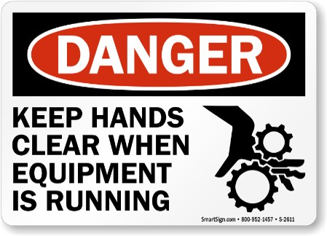
Hazards: Hazard Signage
To prevent injuries, be aware of hazard signages next to the machinery.
An example of hazard signage
Notes:
To prevent injuries, be aware of hazard signages next to the machinery.

Slide 16
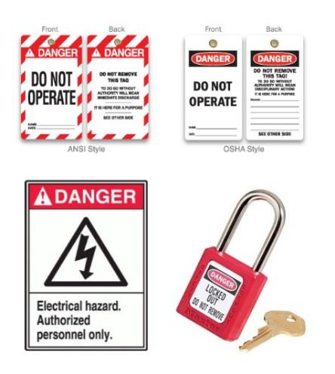
Hazards: Lockout/Tagout
Lockout/tagout procedures are safeguarding methods to prevent injury due to hazardous energy sources. If you see the machines with the signs featured in the image or that are under lock and key, please stay away and do not touch or attempt to start it.
Examples of Lockout/tagout equipment
Notes:
Lockout/tagout procedures are safeguarding methods to prevent injury due to hazardous energy sources. If you see the machines with the signs featured in the image or that are under lock and key, please stay away and do not touch or attempt to start it.

Slide 17
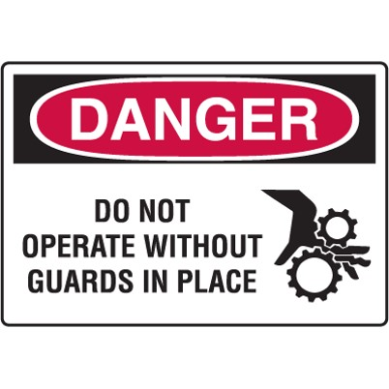
Hazards: Best practices
Set the guard to clear stock/workpiece
Wear Personal Protective Equipment (PPE) at all times
Clean up and clear work area
An example of hazard signage
Notes:
Personal Protective Equipment may be a bit uncomfortable or bulky, but needs to be worn to protect the user from injury.

