Slide 1
Hazardous Materials Safety & Security Awareness Training Section IV
Initiating Protective Actions

Slide 2
Funding Acknowledgement
This material was produced under grant number SH-31200-SH7 from the Occupational Safety and Health Administration, U.S. Department of Labor. It does not necessarily reflect the views or policies of the U.S. Department of Labor, nor does mention of trade names, commercial products, or organizations imply endorsement by the U.S. Government.

Slide 3
Section IV Objectives
List the four Routes of Exposure
Identify Safety Levels of Protection
Identify the four levels of chemical Personal Protective Equipment (PPE)
List two lengths of time for health hazards

Slide 4
Vessel/Facility Emergency Plans
Reference Documents
Vessel Response Plans (VRP)
Facility Response Plans, (FRP)
Maintain Awareness
Know your facility hazards
Know your role in defensive actions
Know security for the vessel/facility

Slide 5
Health Hazard
Immediate health hazard - acts on contact (Ex. acid burns)
Delayed health hazard - reaction may take hours, days, months, or years (Ex. certain poisons)
Chemicals may have both immediate and delayed reactions

Slide 6
Types of Exposures
Acute - one time; short duration
Sub-acute - series of acute intervals over time
Chronic - long-term; repetitive exposures
Effects of exposure depend on
Length of exposure
Concentration
Route of exposure
Characteristics of the chemical

Slide 7
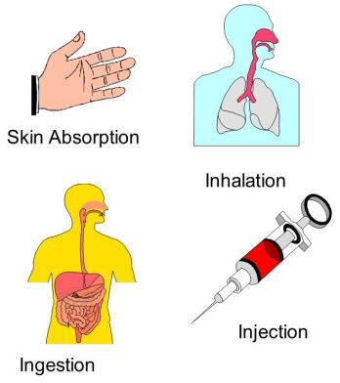
Routes of Exposure
Inhalation - contact with respiratory tract
Ingestion - contact with digestive tract
Absorption - contact with skin/eyes/ears
Injection - enters a break in the skin

Slide 8
Protection Options
Initial Isolation/Protective Action
First action is to isolate area
Strategies for public protection
Evacuation
Shelter in Place
Mark the Area

Slide 9
Evacuation
Physical relocation of people who are threatened by an incident
Correct action when:
Incident will last a long time
Severe hazard
Population is susceptible

Slide 10
Evacuation (Cont.)
Begins by warning people they must go
Provide people time to get ready
Provide people with a place to go/stay
Takes time
Causes confusion
May cause ill-will

Slide 11
Shelter In Place
Close up (button up) the structure
Shut off equipment that can pull outside air into facility
Remain in-place until informed that hazard has passed
Communication

Slide 12
Reasons to Shelter in Place
Evacuation will expose individuals to hazardous atmospheres
Protect disabled
Critically ill
Critical service personnel

Slide 13
Reasons NOT to Shelter in Place
Threat of massive fire
Threat of explosion
Long duration
Large release

Slide 14
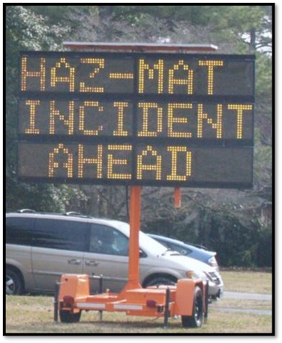
Mark the Area
Identifies that the area has been evacuated or is limited access
Barrier tape
Cones
Security personnel

Slide 15
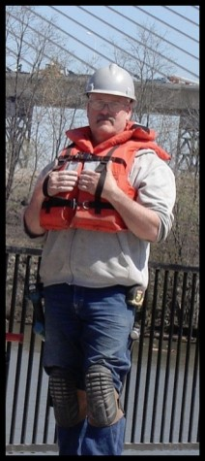
Daily Personal Protective Equipment (PPE)
Used for daily work duties
Provides little or no chemical protection for the wearer from vapor, splash, or dust
No respiratory protection

Slide 16
Respiratory Protection Requirements
Initial training in use, care, and handling
Fit testing/certification required
Protection can vary from dust mask up to SCBA and SAR
Awareness level personnel are non-intervention and may not require PPE

Slide 17
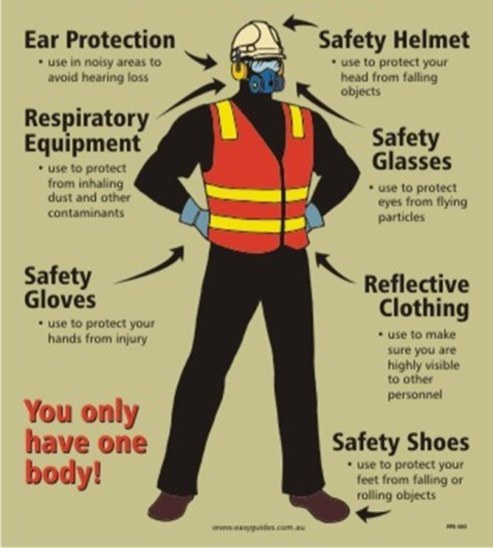
Chemical Protection

Slide 18
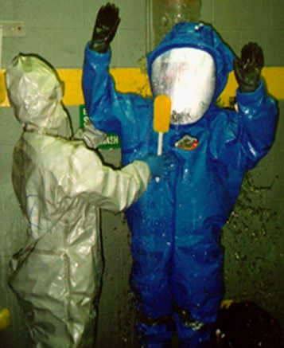
Chemical Protective Equipment
4 levels of protection (EPA)
Level A
Level B
Level C
Level D
Awareness Level

Slide 19
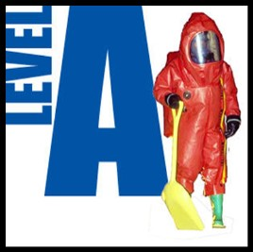
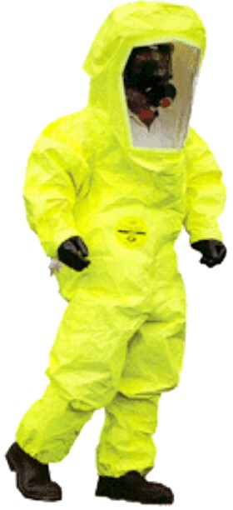
Level A
Highest protection
Chemical splash
Chemical vapor
Fully encapsulates wearer in air tight seal

Slide 20
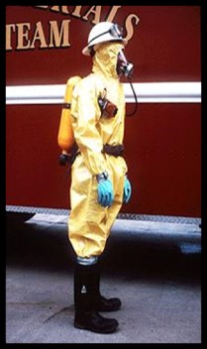
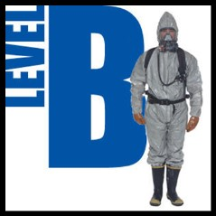
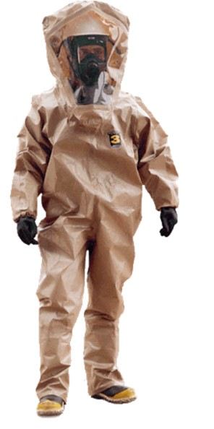
Level B
Chemical splash protection
No vapor protection
Respiratory protection with SCBA or SAR

Slide 21
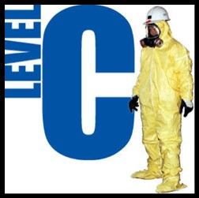
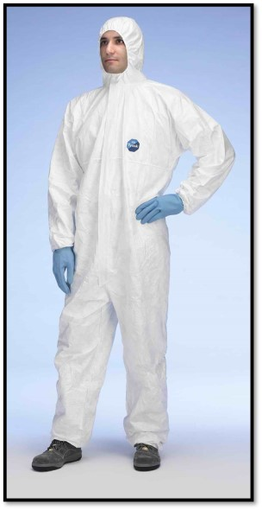
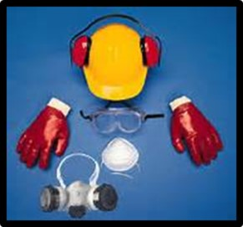
Level C
Limited chemical protection
Limited respiratory protection with use of APR, SCBA, or SAR

Slide 22
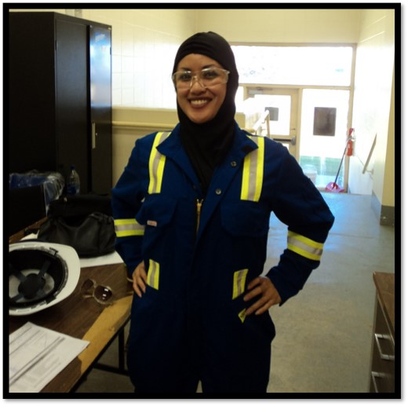
Level D
Lowest level PPE
Awareness level

Slide 23
Summary
Health Hazards
Routes of Exposure
Safety Levels of Protection
Four levels of chemical PPE
Level A
Level B
Level C
Level D

