Slide 1
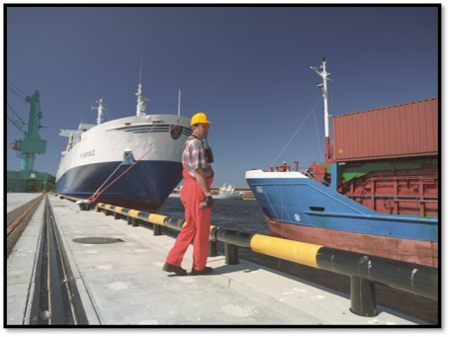
Hazardous Materials Safety & Security
Awareness Training

Slide 2
Funding Acknowledgement
This material was produced under grant number SH-31200-SH7 from the Occupational Safety and Health Administration, U.S. Department of Labor. It does not necessarily reflect the views or policies of the U.S. Department of Labor, nor does mention of trade names, commercial products, or organizations imply endorsement by the U.S. Government.

Slide 3
Course Administration
  Instructor and Participant Introductions
  Registration & Sign-In
  Pre-Test
  Restrooms and Break Area
  Tobacco Use and Smoking Area
  Life Safety Announcement
  Agenda Review
  Facilities
  Cell Phone

Slide 4
Course Materials
  PowerPoint presentation slides
  Activity 1.1 Worksheet
  Other reference materials
    DOT Chart 15
    DOT Emergency Response Guidebook (ERG)
    Florida Small Quantity Generators of Hazardous Waste

Slide 5
Course Objectives
At the end of this course, students will be able to:
Recognize, identify, and understand hazardous substances and the risks they present
Understand the potential outcomes of, and learn to prevent, a hazardous material incident
Understand the role of the first responder (“first on scene”) and how to utilize the U.S. DOT ERG
Recognize the need for additional resources and how to notify those resources

Slide 6
Course Outline
Section I: Introduction to Hazardous Materials/WMD
Section II: Utilizing the Emergency Response Guide
Section III: Gathering and Analyzing Information
Section IV: Initiating Protective Actions
Section V: Criminal and Terrorist Events

Slide 7
Section I
Introduction to Hazardous Materials/WMD

Slide 8
Section I Objectives
  Define a hazardous material
  Compare the difference between Hazardous Material Response and Daily Operation
  List the four Awareness-level responsibilities
  Know the Workers’ Rights guaranteed by the Occupational Safety and Health Act of 1970 (OSH Act)

Slide 9
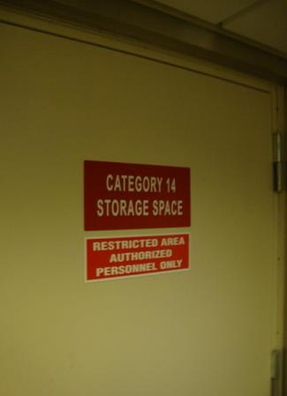
Purpose of Training
  Awareness
  Safety
  Notification
  Compliance with Code of Federal Regulations (CFR)
    OSHA/EPA/USCG

Slide 10
Role of Local Government
First line of defense regarding
  Hurricanes
  Tsunamis
  Tornadoes
  Hazardous Materials Incidents
  Prevention of Terrorist Incidents

Slide 11

Role of Local Government
  Responsible for NIMS
  Emergency Management System
  Effective/Timely Response
  Intra-agency Coordination
  Security
  Preparedness

Slide 12

Chemicals in Society
ALL people utilize products made from hazardous materials.
Many of these chemicals are:
  Extremely toxic
  Reactive
  Flammable

Slide 13
Chemicals in Industry
Industrial chemicals are often safely utilized without incident.
Common causes of incidents include:
  Human error
  Package/Container failure
  Incidents/Accidents in deployment
  Heavy weather

Slide 14

Hazardous Materials (Hazmat)
Any substance (solid, liquid, or gas) capable of causing harm to people, property, and the environment.

Slide 15
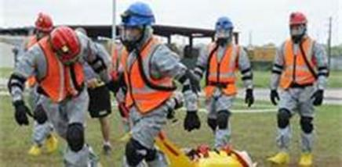
Hazmat Emergencies
  Hazmat Emergencies differ from Daily Operation
  Chemical properties require:
    Protective equipment
    Skills
    Attitudes
    Preparedness

Slide 16
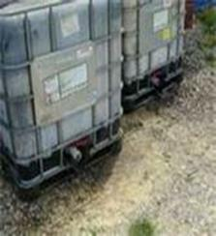
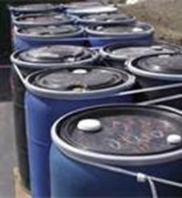
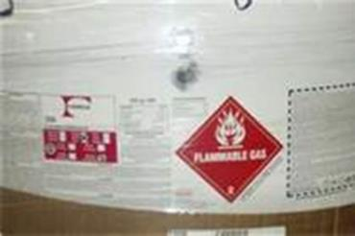
Hazmat Incidents
  Chemical breach of containers
  Not all incidents are emergencies

Slide 17
Nature of Chemical Incidents
  We underestimate potential Hazards
  Fail to recognize potential hazards
  Lack of knowledge can be lethal
  Heighten your personal awareness
  Adopt a safety mentality and culture
“I am going home tonight.”

Slide 18
Awareness Level Worker
  Persons who, in the course of their normal duties, could encounter an emergency involving hazardous materials/weapons of mass destruction (WMD)
  Persons who are expected to recognize the presence of a hazardous materials/WMD, protect themselves, call for trained personnel, and secure the area

Slide 19
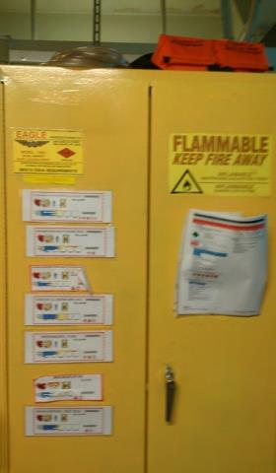
Awareness Level Worker
Includes:
  Maritime Workers
  Port Employees
  Shipboard personnel
  Venders
  Fire Service
  Law Enforcement
  Port/Waterfront Facilities

Slide 20
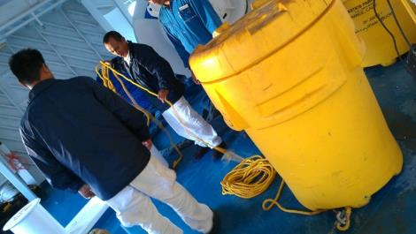
Awareness Level Worker
Includes:
  Vessel Crew/Staff
  Facility Operators/Staff/Industry Personnel
  Support Contractors/Venders
  Security Awareness

Slide 21
Awareness Level Worker Responsibilities
Recognition/Identification
Notification
Isolation
Protection
Work is done in a non-intervention mode!

Slide 22

1. Recognition/Identification
  Recognize the presence of hazardous materials
  Identify if possible
  Gather information

Slide 23
2. Notification
  Vessel Protocol/VRP Procedures
  FRP procedures
  Safety Zones
  Medical
  Provide Updates

Slide 24
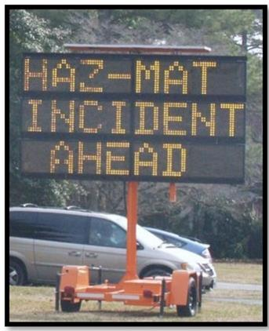
3. Isolation
  Your safety!
  Your security!
  Safety of others!
  Security of others!
  Evacuate/Safety Zones/ Deny entry

Slide 25
4. Protection
  Initiate defensive actions
  Inform/Protect passengers and coworkers
  Inform adjacent facilities
  Protect/Inform First Responders
  Initiate Incident Command System (ICS)

Slide 26

History

Slide 27
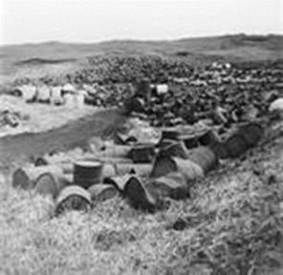
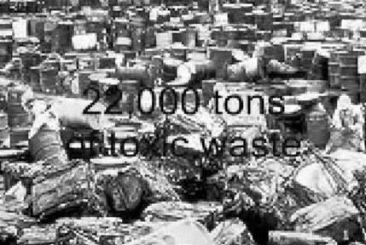
Love Canal - Niagara Falls, NY 1978
  Originally a canal around Niagara Falls
  Purchased by Hooker Chemical in 1942
  Used as a waste disposal site
  1942-1954 estimated 22,000 tons of waste

Slide 28
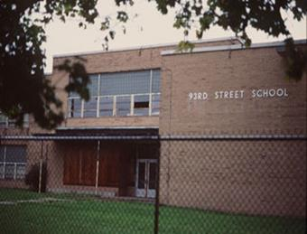
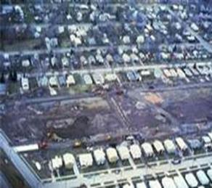
Love Canal - Niagara Falls, NY 1978
  1953 school district purchased for $1.00
  1978 news reported health issues
  Led to the development of Comprehensive Environmental Response, Compensation and Liability Act (CERCLA)

Slide 29
Texas City, Texas - April 6, 1947
  French ship “Grandcamp” caught on fire
  Cargo of cotton, twine, tobacco and ammonium nitrate fertilizer
  Fire started from a deckhand who was smoking
  Ship explosion killed 27 firefighters and 34 crew member
  Caused additional fires and explosions inland
  Events killed 550 people, 3,000 + injured

Slide 30
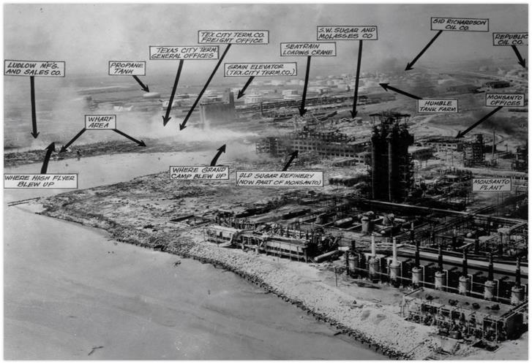
Texas City, Texas - April 6, 1947

Slide 31
Legislative Acts
  Clean Water Act of 1970
  Comprehensive Environmental Response, Compensation, and Liability Act of 1980
  Resource Conservation and Recovery Act, 1976
  Superfund Amendments and Reauthorization Act of 1986

Slide 32
Hazard Communication (HAZCOM)
  2012 Updates
  Comply with Global Harmonization System (GHS)
  Improve employee safety
  Enhance workers comprehension of chemicals
  Standardize Safety Data Sheets (SDS)

Slide 33

Global Harmonization System (GHS)
  Globally used system
  Defines chemical characteristics
  Chemical classification system
  Labels
  Safety Data Sheets (SDS)

Slide 34
Chemical Classification
By Regulatory Agencies
  Department of Transportation (DOT)
  Environmental Protection Agency (EPA)
  Occupational Safety & Health Administration (OSHA)
  Global Harmonization System (GHS)

Slide 35
Hazardous Material
“Any substance … exposure which results or may result in adverse affects on the health or safety of employees…”
Occupational Safety and Health Administration

Slide 36
Hazardous Material
“Any substance or material which has been determined to be capable of posing an unreasonable risk to health, safety, and property when transported...”
Department Of Transportation

Slide 37
Hazardous Material
“Any waste material which is ignitable, corrosive, reactive, or “toxic” which pose a potential hazard to human health and safety and to the environment when improperly managed….”
Environmental Protection Agency

Slide 38
OSHA 29 CFR 1917 & 1918
  Specifically address maritime industry
    29 CFR 1917 - Marine Terminals
    29 CFR 1918 - Longshoring
  Each has a section for dealing with hazardous materials and emergency response plans

Slide 39
NFPA 472 (2008 ed.)
Professional Competency for Hazmat responders
  Original basis for 1910.120
  Exceeds EPA and OSHA requirements
  Expanded levels of competence
  Standard established for Fire Service
  Many industries also follow this standard

Slide 40
NFPA 473
  Standard for competencies for EMS personnel responding to Hazardous Materials Incidents
  Addresses EMS competence
  Identifies levels of training

Slide 41
Levels of Training
  Awareness
  Operations
  Incident Commander
  Technician
  Specialist

Slide 42
Awareness Level
  Training level of this course
  Non-Intervention Activities
    Personal safety
    Safety of others
    Notification
    Activate Facility Response Plan (FRP)
    Activate Vessel Response Plan (VRP)

Slide 43
Operations Level
  Defensive activities
    Initial response
    Protect people, property, environment
    May control product spread from safe distances

Slide 44
Incident Commander Level
  Commands level above Operations level
  Training to the operations level plus incident commander
  May be any individual who may have to assume command

Slide 45
Technician Level
  Offensive Activities
    Active role in leak control
    Comes in contact with product to stop further release
    Greatest potential for exposure
    Supervisory and technical role in response

Slide 46
Specialist Level
  Offensive Activities
    More in-depth knowledge than Technicians
    Team leaders or industrial responders
    Specific knowledge
    Chemical transportation and process

Slide 47
Hazardous Materials Officer and Safety Officer
Hazardous Materials Officer
  Incident Commander selects
  Directs and coordinates all operations
Hazardous Materials Safety Officer
  Operates the Incident Management System
  Hazardous materials branch/group

Slide 48
Workers Rights
Occupational Safety and Health Act of 1970 (OSH Act)
  Employers must provide their employees with working conditions that are free of known dangers
  Workplace safety and health standards are set and enforced by OSHA

Slide 49
OSH Act Gives Workers’ Rights to:
  File a confidential complaint with OSHA
  Receive information and training about hazards, harm prevention, and the OSHA standards that apply to their workplace
  Review records of work-related injuries and illnesses that occur in their workplace

Slide 50
OSH Act Gives Workers’ Rights to:
  Receive results from tests and monitoring done to find and measure hazards in the workplace
  Get copies of their workplace medical records
  Participate in an OSHA inspection and speak in private with the inspector

Slide 51
OSH Act Gives Workers’ Rights to:
  File a complaint with OSHA if they have been retaliated against by their employer
  File a complaint if punished or retaliated against for acting as a “whistleblower”
  For additional information: www.whistleblowers.gov

Slide 52
Summary
  First line of defense
  Awareness-level in a non-intervention mode
  Responsibilities:
    Recognize and Identify
    Notify
    Isolate
    Protect
  Agencies who define Hazmat and their definitions
  Different levels of training

Slide 53
References
  OSHA 29 CFR 1910.120
  EPA 40 CFR 311
  OSHA 29 CFR 1910.1200
  NFPA 472

