Slide 1
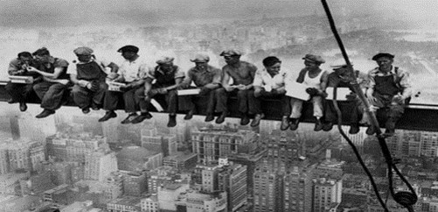
Entrenamiento en protección de caídas OSHA - beca de formación Susan Harwood

Slide 2
Bienvenidos
Favor de firmar la hoja de asistencia
Tome un folleto
Responder la prueba número 1

Slide 3
ubicacion
Salidas de Emergencia
Escaleras de Emergencia
Ubicación de los baños
Ubicación de los bebederos

Slide 4
responsabilidad
Este material fue producido bajo la concesión número SH-31201-SH7 de la Administración de Seguridad y Salud Ocupacional, Departamento del Trabajo. No refleja necesariamente las opiniones o políticas del Departamento del Trabajo, ni la mención de nombres comerciales, productos comerciales, o de organizaciones implica la aprobación por el gobierno de Estados Unidos.

Slide 5
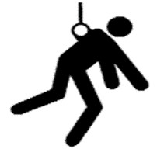
Agenda del dia
Bienvenida
Introducción a OSHA
Derechos de los trabajadores
Introducción a la protección contra caídas
Reconocimiento de los riesgos de caídas
Principios de prevención de caídas básicas
Principios de protección de caídas básicas
Breve revisión de las normas
Descanso

Slide 6
Agenda cont.
Controlar el peligro de caídas
Jerarquía de controles
Refrenan
Componentes
Espacio libre de caída
Inspecciones
Rescate
Entrega de certificados

Slide 7
Introducción a OSHA
Resumen de disposiciones contra las represalias, derechos de empleados, responsabilidades del empleador, leyes y procedimientos de la investigación de queja de OSHA

Slide 8
¿Por qué es importante OSHA?
OSHA se inició porque, hacia 1970, no había ninguna ley nacional para prevenir riesgos de seguridad y salud.
En promedio 12 trabajadores mueren cada día por lesiones de trabajo
El número de muertes de trabajadores en Estados Unidos ha bajado en promedio, de aproximadamente 38 muertes de trabajadores al día en 1970 a 12 diarios en 2013.
MUERTES DE TRABAJADORES
4.836 trabajadores murieron en el trabajo en el año 2015
Las caídas representan 364 de 937 total de muertes en la construcción en el año 2015 CY (38.8%)

Slide 9
Preguntas para la discusión
¿Durante su experiencia de trabajo, cuando fue la primera vez que escuchó sobre OSHA?
¿Qué pensaste sobre OSHA entonces?
¿Qué crees que es el trabajo de OSHA?

Slide 10
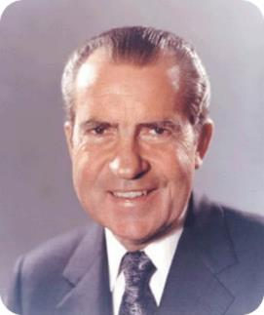
Historia de OSHA
OSHA es la Administración de Seguridad y Salud, depende del Departamento del Trabajo
La responsabilidad de OSHA es la protección de la seguridad y la salud del trabajador
El 29 de diciembre de 1970, Presidente Nixon firmó el acta de OSH
Esta ley creó OSHA, la agencia formalmente entró en vigor el 28 de abril de 1971

Slide 11
Mision de osha
Salvar vidas
Prevenir accidentes
Proteger los empleados

Slide 12
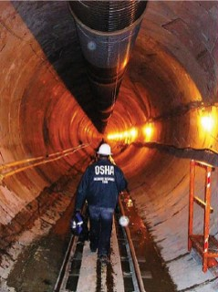
Estrategias para reducir lesiones y muertes
Fuerte, justa y eficaz aplicación de la ley.
Asistencia del cumplimiento de los deberes, difusión y educación de las reglas.
Asociaciones y otros programas cooperativos.

Slide 13
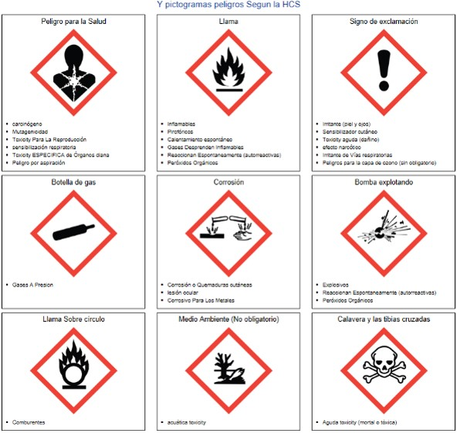
Etiquetas para sustancias peligrosas en su lugar de trabajo

Slide 14
Inspecciones de OSHA
La ley OSH autoriza a los oficiales de seguridad y salud para llevar a cabo las inspecciones de trabajo en horarios razonables.
OSHA realiza inspecciones sin previo aviso, excepto en circunstancias excepcionales (por ejemplo, peligro inminente)
De hecho, quien le avise a un empleador de una inspección de OSHA por adelantado puede recibir multas y cárcel.

Slide 15
Proceso de las inspecciones
Una inspección típica de OSHA incluye cuatro etapas:
Presentación de credenciales del inspector.
Una conferencia inicial.
Una inspección a pie alrededor del lugar de trabajo.
Conferencia de clausura.

Slide 16
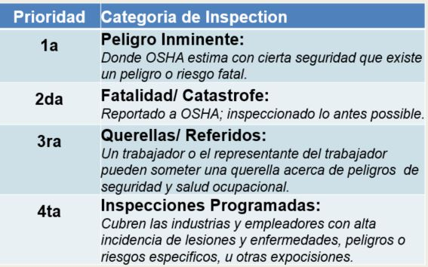
Prioridades de inspección de la OSHA

Slide 17
Investigaciones de queja de OSHA
OSHA evalúa cada queja para determinar cómo se puede manejar mejor: una investigación fuera del sitio, o una inspección in situ
Antes de iniciar una inspección, el personal de OSHA debe poder determinar a partir de la denuncia si hay motivos razonables para creer que existe una violación de una norma de OSHA o un peligro de seguridad o de la salud.
Si OSHA tiene información que indique que el empleador está consciente del peligro y está dispuesto a corregirlo, la Agencia no necesariamente va a conducir una inspección después de obtener la documentación necesaria del empleador.

Slide 18
Derechos como denunciante
Empleado puede presentar una queja con OSHA bajo sección 11(c), si su empleador toma represalias contra usted al tomar cualquier acción desfavorable en su contra porque usted realizó actividades relativas a la salud y seguridad en el trabajo.
OSHA requiere que las quejas deben ser presentadas dentro de 30 días después de la supuesta venganza.

Slide 19
Derechos como denunciante
Su empleador puede encontrarse que tomó represalias contra usted, si toma acción desfavorable en contra suya por ejercer su derecho a tener un lugar seguro de empleo. Tales acciones pueden incluir:
Despedir
listas negras
degradar
Negando horas extras o promoción
disciplinar
Denegación de beneficios
El fracaso de contratar o recontratar
Intimidación / acoso
hacer amenazas
Reasignación que afecta a las perspectivas de promoción
La reducción de salario o horas

Slide 20
¿Preguntas sobre OSHA?

Slide 21
Introducción a la protección contra caídas

Slide 22
Objetivos
Reconocer, evitar y prevenir riesgos de caídas en la construcción
Identificar los peligros de caídas
Describir los tipos de riesgos de una caída
Protegerse de los peligros de una caída
Reconocer los requisitos del empleador para proteger a los trabajadores de los riesgos de caída

Slide 23
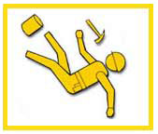
Caídas en la construcción
¿Sabía usted? Un tercio de las muertes en la construcción se deben a caídas?

Slide 24
Caídas en la construcción
LAS CAÍDAS SON LA CAUSA PRINCIPAL DE MUERTE EN LA CONSTRUCCIÓN.
En el año 2015, ocurrieron 350 caídas fatales a un nivel más bajo, de 937muertes de construcción (datos del BLS).
Estas muertes pueden ser evitadas.

Slide 25
Caídas en la construcción
Es importante que los programas de seguridad y salud contengan disposiciones para proteger a los trabajadores por caídas en el trabajo.
Los siguientes riesgos causan la mayoría de las lesiones provocadas por caídas:
Lados sin protección, aperturas de la pared y agujeros en los pisos
Barras de acero salientes sin protección
Construcción incorrecta de los andamios
Mal uso de escaleras portátiles

Slide 26
Reglamentos de OSHA sobre protección contra caídas
Industria general:
Protección contra caídas cuando se está trabajando a 4 pies sobre el nivel inferior
Industria de la construcción:
Protección contra caídas cuando se está trabajando a 6 pies sobre el nivel inferior
Notes:
Discuss who OSHA is and its purpose.
OSHA's Mission:
“With the Occupational Safety and Health Act of 1970, Congress created the Occupational Safety and Health Administration (OSHA)* to assure safe and healthful working conditions for working men and women by setting and enforcing standards and by providing training, outreach, education and assistance.”
Organization
“OSHA is part of the United States Department of Labor. The administrator for OSHA is the Assistant Secretary of Labor for Occupational Safety and Health. OSHA's administrator answers to the Secretary of Labor, who is a member of the cabinet of the President of the United States.”
Explain that most workers will be covered under one of two sets of regulations, although there are exceptions (with work at marine terminals, shipyards, and in mines being one of the major ones).
OSHA “Parts” (1910 & 1926) can be thought of as “books,” and “Subparts” can be thought of as “chapters” within those books. Each book has a dedicated “chapter” (or, in the case of GI, two) dedicated to issues related to FP.
Explain that they will only fall under one set of regulations and need to follow what is laid out therein

Slide 27
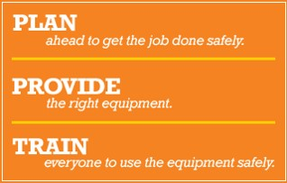
OSHA campaña de prevención de caídas

Slide 28
campaña de prevención de caída De OSHA
PLANIFICAR con antelación y hacer el trabajo con seguridad
Cuando se trabaja desde alturas, tales como escaleras, andamios y techos, los empleadores deben planificar proyectos para asegurar que el trabajo se realice con seguridad
PROPORCIONAR el equipo adecuado
Los trabajadores que están seis pies o más por encima de los niveles más bajos están en riesgo de lesiones graves o la muerte si se cae.

Slide 29
campaña de prevención de caída De OSHA
CAPACITAR a todos los empleados cómo utilizar el equipo de seguridad
Las caídas pueden prevenirse cuando los trabajadores entienden la forma correcta y segura de usar un equipo

Slide 30
Seguridad en los techos
Los empleados deben ser entrenados para evitar riesgos de caída de un techo incluyendo medidas de seguridad como:
Asegúrese de que el arnés se ajusta y no está defectuoso cuando se use
Mantenerse siempre conectado
Garantizar la seguridad de todos los puntos de anclaje
Tapar todos los agujeros, aberturas y tragaluces
No sentarse o caminar en claraboyas u otros orificios

Slide 31
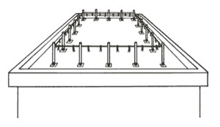
Líneas de advertencia
conjunto de 4 caras de líneas en el lugar para advertir a los trabajadores del peligro de borde
No es una baranda
Distancia del borde:
6’ - General
10’ – “Equipo mecánico”
Permit work inside w/ no PFAS
Notes:
One of the first important points to be made on warning lines is they are what the name implies: lines that are suspended around the work area that will warn the unsuspecting worker as they back up that they are approaching an exposed edge; if a worker falls into them, they will fall over, but they are of sufficient distance from the edge to prevent a fall, so they are effective in a different way from guardrails.
The rules on distance are as follows:
In roofing activities, they need to be at least:
6’ from the edge when mechanical equipment is not being used;
10’ from the edge in the direction of travel when mechanical equipment is being used.
“Mechanical equipment” is “all human propelled wheeled equipment used for roofing work, except wheelbarrows and mopcarts.”
Unsupervised workers will often put lines up and move them closer to the edge than these specified distances, making an easy violation to spot, when they are doing roofing work that is going to take them towards the parapets.
This will be the case if they are laying felt paper or shingling, for example, on an entire roof.
Thus, a plan needs to be in-place (i.e. use of a PFPS or Safety Monitor) needs to be prepared ahead-of-time and spelled out for when this is to happen.
The beauty of these systems is that they permit work inside the lines with no need for guardrails or a PFPS, thus making mobility and setup time much faster.
OSHA permits two options for access into and egress out of a set of warning Lines: (a) barricade and (b) offset lines.
An offset access is generally the better way to go since it takes human error (i.e. not putting a chain gate back up once passing through it) out of the equation.
Ask why OSHA would want lines to be marked every 6’. (Visibility for Workers)
Note that the specified line heights are different than those that are laid-out for guardrail systems.
As is discussed in the manual, and will sometimes be asked in class, employers may want to know if painted lines around the perimeter of the roof at the prescribed distances will work. OSHA, through LOI, however, has said that they will not. In cold climates where it will snow, these lines will do not good when covered. And at night in all climates, the line will become obscured by darkness.
The “tip force” noted on this page is the force that one of the posts needs to be able to withstand without falling over.
This resistance is mainly so that posts aren’t constantly falling over when the wind blows on them.
Sites could use store-bought systems or sink posts in five-gallon buckets filled with concrete.
In regards to line strength, OSHA clearly sets out a minimum requirement. It is not difficult at all to find a site where they are attempting to demonstrate use of warning lines where you will see yellow caution tape (which doesn’t have a 500 lbs. breaking strength) right at the edge of the rooftop, thus violating two rules.
With the prevention of slack buildup clause, the idea is part of the system sags to ground level and someone can easily step over it with or without noticing, the system has lost its ability to protect.

Slide 32
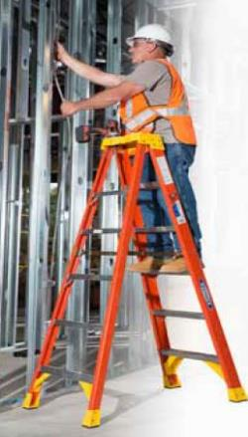
escaleras
¿Donde se encuentran las normas de uso de escalera?
1910 – Sub-parte D
1926 – Sub-parte X
¿Cuándo es necesario protección de caídas?
La recomendación sería utilizar protección siempre que sea posible.
Notes:
First, note in this picture which was taken from a Werner Ladders product catalog that 3-points of contact are not being maintained in normal use.
Now, turn the learners’ attention to the fact that safety requirements for ladders are found in a different location than all those discussed up to this point for fall protection.
Once pointing this out, ask whether or not a worker up on a ladder is required to have fall protection in the form of a Personal Fall Arrest System.
The answer is that they are not required to have it, no matter the height at which they are working. OSHA has affirmed this through letters of interpretation, pointing out that the regulations themselves are separate from those for fall protection and do not require fall protection. Also note that ladder manufacturers generally don’t require fall protection on temporary ladders as part of their safe use instructions.
This is not to say that it is not a recommended practice to have fall protection. In fact, the recommendation should be to utilize FP whenever possible even if the law doesn’t require it.

Slide 33
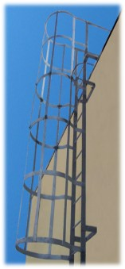
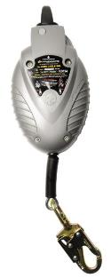
Escaleras fijas
OSHA require protección en escaleras fijas:
20’ – Actualmente Sub-parte D / 24’ propuesto
24’ – Construcción
Opciones:
Pobre: Cajón
Mejor: Auto-retractable
Mucho mejor:Linea vertical
Notes:
One of the most common ways that workers will reach elevated locations is by climbing a fixed ladder. Here we will see that fixed ladders carry their own set of regulations that do not mesh with the 4 and 6 foot rules previously discussed.
Both sets of regulations as the currently stand, in their exact wording, are listed below:
1910.27(d)(1)(ii)
Cages or wells (except as provided in subparagraph (5) of this paragraph) conforming to the dimensions shown in figures D-7, D-8, and D-9 shall be provided on ladders of more than 20 feet to a maximum unbroken length of 30 feet.
1926.1053(a)(18)
Fixed ladders shall be provided with cages, wells, ladder safety devices, or self-retracting lifelines where the length of climb is less than 24 feet (7.3 m) but the top of the ladder is at a distance greater than 24 feet (7.3 m) above lower levels.
1926.1053(a)(19)
Where the total length of a climb equals or exceeds 24 feet (7.3 m), fixed ladders shall be equipped with one of the following:
1926.1053(a)(19)(i)
Ladder safety devices; or
1926.1053(a)(19)(ii)
Self-retracting lifelines, and rest platforms at intervals not to exceed 150 feet (45.7 m); or
1926.1053(a)(19)(iii)
A cage or well, and multiple ladder sections, each ladder section not to exceed 50 feet (15.2 m) in length. Ladder sections shall be offset from adjacent sections, and landing platforms shall be provided at maximum intervals of 50 feet (15.2 m).
Thus, although they read a little bit differently, the key point to take away is that fall protection requirements kick in at new activation points of either 20 or 24 feet, depending on the standard.
Also of note is that Proposed Subpart D harmonizes with the 1926 regulations, calling for one of the forms of fall protection described at 24’.
When discussing the options, the following points can be made:
Although least effective and most costly to install on a ladder, cages and wells are the most common form of fall protection seen on ladders in industry today. Unfortunately, they give workers a false sense of security when, really, their main benefit is as a place to rest one’s back when climbing. They, however, can be used as the sole form of fall protection as noted above.
SRLs mounted at the top of the ladder are the next best option. In reality, they are probably the cheapest option to implement provided that an adequate anchorage point can be found / mounted. That said, the worker will still have up to a 54” Maximum Arrest Distance and could hit the ladder fairly hard when they come to a stop using an SRL.
The best system when climbing a fixed ladder is a fixed vertical lifeline. With these systems, which can be made of regular galvanized components or stainless steel, allow a short connection (9”) to the front of the worker’s harness to a front D-ring on the chest strap and will arrest the fall in a matter of inches. Also, a built-in energy absorber will absorb the shock of the fall should the climber slip off and engage the system.
As is shown with VLL Components at the bottom, these systems can be quite varied, consisting in a flexible cable (most common) or a rigid rail that is sometimes called the “carrier” onto which a rope / cable / or bargrab is connected to arrest the fall.
Note that this is the only fall arrest situation where OSHA permits connection to the front of the harness. Otherwise, the connection must always be made to the Dorsal D-ring of the harness.

Slide 34
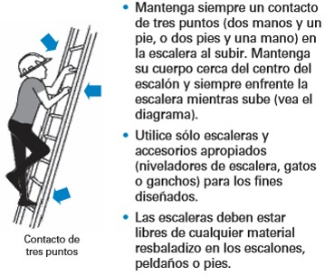
uso de Escaleras portátiles

Slide 35
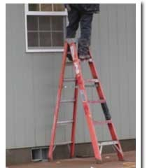
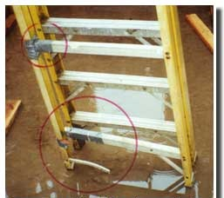
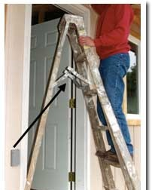
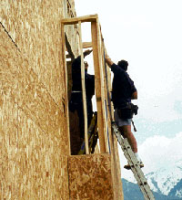
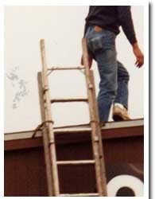
Mal uso de Escaleras portátiles
Está asegurada
¡Esta se ve bien!

Slide 36
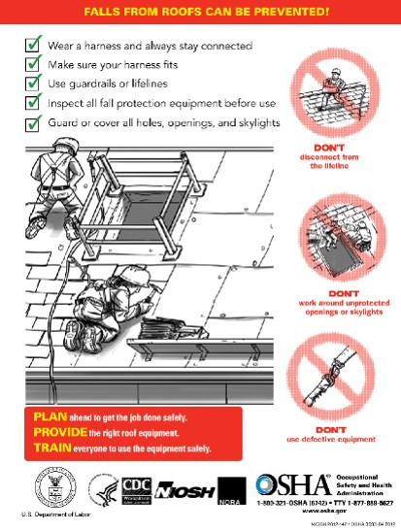
Planifique-proporcione-adiestre

Slide 37
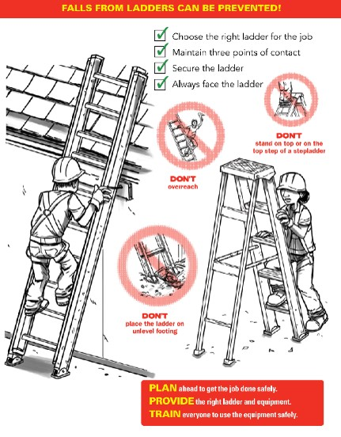
Planifique-proporcione-adiestre

Slide 38
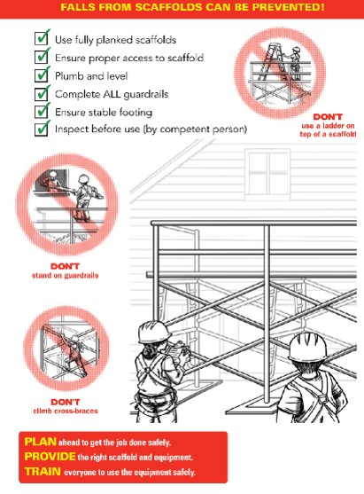
Planifique-proporcione-adiestre

Slide 39
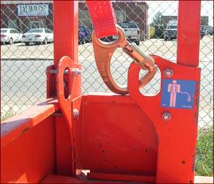
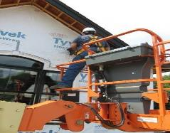
Protección en plataformas
¿Se requiere protección contra caídas?
¿Dónde se debe conectar?
¿Qué pasa fuera de la canasta?
¿Qué pasa con las barandas?
En general se prohíbe:
Mover la plataforma largas distancias con la canasta elevada
Pararse sobre las barandas
Notes:
Ask the students whether or not fall protection is required in one of these lists, per the first bullet point. The answer is “yes,” to which you should ask “why.”
The answer to the second question is that these lifts are notorious for being able to bounce a worker out of the basket, much like a catapult, if they are driving them too fast and hit an obstruction with the boom lowered or if they are at heights and, even more slowly, hit an object on the ground, causing the extended boom to flex and jettison the worker.
There are a number of videos on YouTube that can be found showing exactly this occurring.
This instructor once took a class at JLG’s Train-the-Trainer school with its lead instructor who commented that he once saw a worker fatality case where the unconnected victim was thrown higher than a utility pole.
The correct place to attach in an aerial lift is to the manufacturer-specified point(s) in the basket, as illustrated in the photo at the top of the slide. Generally these will be on a guardrail upright post somewhere inside the basket or on the floor and will have a label indicating their purpose toward this end.
As an answer to the other questions below the correct place to attach, outside the basket is generally prohibited by OSHA unless the worker is transferring out of the basket practicing 100% connection; in this case connection outside the basket will only be temporary while transition takes place.
A February 2, 2004 LOI to a Mr. Michael P. Kurtgis, states OSHA’s concerns with a worker who is attached outside the basket to an adjacent structure:
“Section 1926.453(b)(2)(v) states that fall protection is required for persons working from an aerial lift, and that the fall protection system must be attached to the boom or basket of an aerial lift. The purpose of this requirement is to protect employees from being bounced out of the aerial lift or placing themselves in a position from which they could be exposed to a fall by leaning over the basket. Further, §1926.453(b)(2)(iii) prohibits tying off fall protection to an adjacent pole, equipment or structure. This prohibition addresses, among others, the hazard of such an adjacent pole / structure failing and pulling the attached worker from a bucket. This may occur where, for example, a pole has rotted and fails while work is done to equipment attached to it, or where a traffic accident occurs in which a vehicle strikes the pole. These provisions reflect a concern that the type of "adjacent" structures typically associated with work done from aerial lifts are unreliable with respect to their condition (and so their ability to withstand loads imposed on them while work is being done) and vulnerability to traffic accidents.
…
However, limited situations may exist where an adjacent structure poses no reasonably foreseeable risk of failure. For example, such an instance might arise where the adjacent structure is a completed building or a completed (i.e., fully bolted-up) skeletal steel structure. In those instances, OSHA would consider the violation of §1926.453(b)(2)(iii) to be de minimis² and no citation would be issued.”
Attaching to aerial lift guardrails is like attaching to any other guardrails: impermissible. They were not designed for this purpose and shall not be used for it, especially when it is considered that attachment points will have been provided.
Students may have questions on the strength of anchorage points in aerial lifts.
In general, the statement can be made that if the vehicle meets ANSI / SIA A92.2 or A92.5 requirements it will be able to withstand a minimum force of 3,600 pounds (which will work for fall arrest).
Scissor lift anchorages, to be discussed shortly, have no such requirement and often may just be rated for restraint loads. In the case that the information is not provided, the company shall contact the manufacturer to determine what type of anchorage has been provided.
In regards to the connector, each of the options have benefits and limitations. A document called “Statement of Best Practices of Personal Fall Protection Systems for Aerial Work Platform Equipment” gives some guidance as to each of these options:
Restraint Lanyard
Per the above article, “In the case of a boom lift, the forces from the “catapult effect” would not cause the occupant to be thrown from the platform but rather remain within the confines of the work platform.”
A limitation with restraint lanyards is that they don’t allow mobility. When it is considered that it is fall arrest as soon as the worker’s CoG could go over the guardrails in any possible orientation, it isn’t hard to see that a really short lanyard will often be needed. The problem, however, becomes that if the worker is connected to such a short “leash,” they become tempted to disconnect at times to do work or simply have a much harder time doing their job.
One situation where this becomes less of an issue is with bucket trucks where no movement is possible anyhow.
Energy-Absorbing Lanyard
The article calls this “Fall Restraint / Arrest Using a Lanyard with an Adjuster.” This is a much more common practice where the idea is that when the worker is low to the ground moving the lift from one location to another (and don’t have hardly any clearance to fall), they keep their lanyard short. When they get to heights that give them adequate clearance, they can then adjust out for fall arrest.
A variant of this is “Fall Restraint / Arrest Using a Double-Leg Lanyard.” The only difference here is that one leg is long and one is short so that the worker doesn’t have to adjust. This method is, perhaps, a step above the former because it now makes it so that the worker doesn’t have to keep adjusting his lanyard in and out, something which many of them will neglect to do. When they are traveling at ground level, they use the short leg and when they get to heights, they can use the long leg.
PFL
This option really is a preference of many users. The benefit is that the PFL permits movement when necessary but locks off when it feels a quick jerk, as happens when the device tries to catapult the victim out. Often, with small PFL of 6’ length the worker’s feet will barely leave the floor of the basket before the device activates, stopping them from ever going over the guardrails.
Note that MSA has an article (on its FP Page on the main website where the products are shown) that permits use of the Workman Mini PFL for such a use in an aerial lift. The main stipulation that it sets out is that if this is to be done, the worker shall wear the unit with the energy absorber to their back (instead of the housing) to reduce forces to the line if it bites into the rail if the worker falls over it.
In regards to prohibitions,
The first prohibition is an issue both because it is very hard to see the ground (and obstructions that could be run over from great heights, causing the boom to flex) and because of the amount of flex / catapult action created when the boom is extended out far. Thus, it is much safer to move an aerial lift when the basket is close to the ground.
In regards to standing on the guardrails, the practice, like elsewhere, isn’t permitted. They simply can’t provide the protection they were meant to provide if the worker is standing on them.
As a note to this, often safety people on construction sites will note where workers have a board in the basket with them that seems to have nothing to do with the work task. Often, when no one is around, workers will put this board across the midrails to serve as a work platform. This, obviously, is not an okay practice.

Slide 40
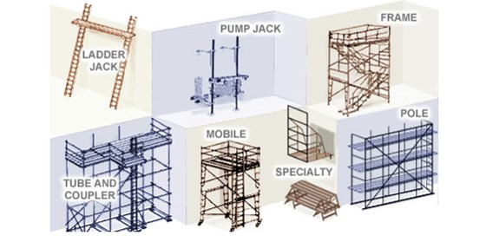
Tipos de andamio - soportados

Slide 41
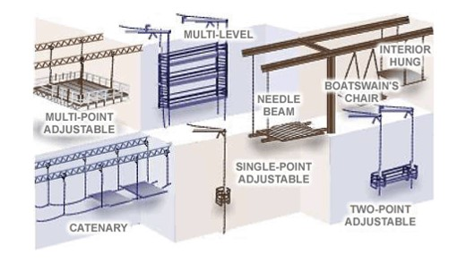
Tipos de andamio - colgantes

Slide 42
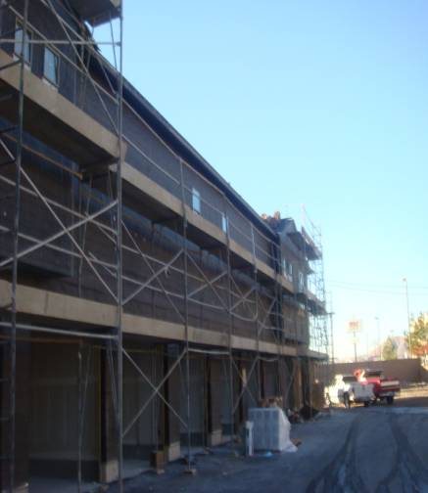
Andamios en la construcción
Evitando riesgos
Siga las instrucciones del fabricante.
Instalar barandas a lo largo de todos los lados abiertos y extremos de las plataformas.
Protección contra caídas debe utilizarse en andamios de más de 10 pies de altura.
Notes:
Height of the scaffold should not be more than four times its minimum base dimension unless guys, ties, or braces are used.

Slide 43
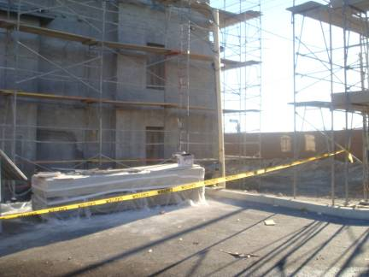
Andamios en la construcción
Caída de objetos:
Usar cascos
Colocar barricadas en el área debajo del andamio
Notes:
Toe board is the board used at the bottom side edge of the scaffold. If the material is stacked above it, there is a possibility that the materials will fall below and can hurt the workers worker below the scaffold.

Slide 44
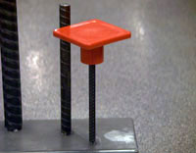
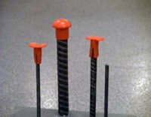
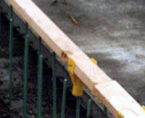
Tapas para barras de acero
Sólo tapas para barras diseñadas para proporcionar protección de empalamiento, tales como ésos con refuerzo de acero, deben utilizarse.
Este tipo de tapa coloca un 2 x 4 sobre la varilla expuesta y ha sido aprobado por la OSHA de California.

Slide 45
¿Qué hace la prevención de caídas?
Atrapar la caída
Detener/Prevenir la caída
Fall Arrest
Restraint/Positioning
Safety Nets
Guardrails
Warning Lines
Catch Platforms
Controlled Access Zones
Controlled Decking Zones
Safety Monitors
Notes:
Explain what each of the items in the boxes means.

Slide 46
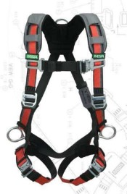
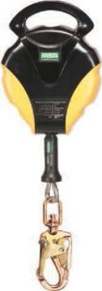
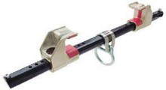
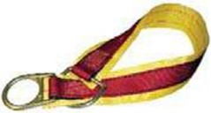
Definición de protección de caída
Protección contra caídas es un término amplio que se utiliza para describir varios tipos de equipos, [sistemas], y las políticas que ayudan a minimizar el potencial de accidente de los trabajadores al realizar tareas por encima del nivel del suelo. Las empresas utilizan una combinación de equipos de seguridad y capacitación de personal en cómo usarlo.

Slide 47
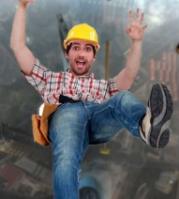
Resultados de una caída
La caída fatal promedio es sólo de 6 pies
Una caída de 6' pies genera más de 3.200 libras de fuerza – que es el peso aproximado de un coche de tamaño mediano promedio
Una caída de 10 pies tiene una probabilidad de 4 sobre 5 de causar muerte o lesiones permanentes
Una caída de 11 pies tiene un
8.5 sobre 10 de posibilidades de
causar la muerte

Slide 48
Planificación contra caidas
Un plan de prevención de caídas identifica los lugares donde los métodos tradicionales como barandas no pueden ser utilizados
Estos lugares se conocen como Áreas de Acceso Controlado
Se deben implantar sistemas de monitoreo en las áreas de acceso controlado
Notes:
Give examples of safety monitoring systems.

Slide 49
Reglamentos de OSHA sobre protección de caídas
Industria General:
Se requiere protección contra caídas cuando se trabaja 4 pies por encima del siguiente nivel
En Construcción:
Se requiere protección contra caídas cuando se trabaja 6 pies por encima del siguiente nivel
Las operaciones de la gran mayoría de las empresas se encuentran en estos dos sectores
Notes:
Discuss who OSHA is and its purpose.
OSHA's Mission:
“With the Occupational Safety and Health Act of 1970, Congress created the Occupational Safety and Health Administration (OSHA)* to assure safe and healthful working conditions for working men and women by setting and enforcing standards and by providing training, outreach, education and assistance.”
Organization
“OSHA is part of the United States Department of Labor. The administrator for OSHA is the Assistant Secretary of Labor for Occupational Safety and Health. OSHA's administrator answers to the Secretary of Labor, who is a member of the cabinet of the President of the United States.”
Explain that most workers will be covered under one of two sets of regulations, although there are exceptions (with work at marine terminals, shipyards, and in mines being one of the major ones).
OSHA “Parts” (1910 & 1926) can be thought of as “books,” and “Subparts” can be thought of as “chapters” within those books. Each book has a dedicated “chapter” (or, in the case of GI, two) dedicated to issues related to FP.
Explain that they will only fall under one set of regulations and need to follow what is laid out therein

Slide 50
Planificación contra caídas
Los sistemas de prevención y protección contra caídas deben estar instalados antes de comenzar los trabajos
Estos sistemas deben estar revisados por una persona calificada
El plan de trabajo debe estar disponible en el área de trabajo
Una persona competente debe revisar el plan
Notes:
Discuss what makes a person “qualified.”

Slide 51
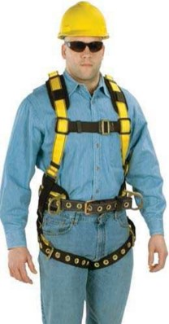
Persona autorizada
Persona autorizada:
Una persona aprobada o asignado por el empleador para realizar un tipo específico de deber o deberes o para estar en una ubicación específica en el sitio de trabajo.
Este es el "usuario" del equipo.
Saben lo que necesitan saber para poder realizar su trabajo particular
Notes:
The idea of “authorization” has nothing to do with whether or not someone works for a company. When one walks up to a door and sees a sign that says “no unauthorized personnel,” this means that only those who are properly trained, not anyone who is an employee, may enter. The same is true for fall protection.
At a basic level an authorized person is someone who knows what they need to know in order to be able to perform a particular job.
If that simply means knowing how to inspect FP equipment and utilize it in an aerial lift, then they must be trained on that (and not on the entire broad spectrum of everything fall protection-related).
Most workers are simply “authorized persons” who have been trained on how to use specific fall protection equipment in specific situations.

Slide 52
Persona competente
Persona competente:
(1) que es capaz de
identificar peligros
[a] existentes y
[b] previsibles riesgos en un entorno o condiciones de trabajo que son antihigiénicas, riesgosas o peligrosas a los empleados, y
(2) que tiene autorización para tomar medidas correctivas para eliminarlos.
Notes:
Go through the definition piece-by piece:
Identifying “existing” hazards is easy enough (in most cases). Once knowing the 4’ or 6’ number (with the exceptions already discussed), it is fairly easy to pick out many FP hazards that may be present on a site.
“Predictable” hazards are addressed through doing “pre-task planning.” The majority of incidents that result in injury or a fatality happen either because of improper (or lack of) planning (as was the case with “Big Blue”) or because a plan that was established wasn’t followed (as was the case with the young worker who fell through the roof of the sports arena).
The third key part to the definition is that this person has “authorization” to take prompt corrective measures.
Essentially, this is where the job of a competent person could stop (at least per OSHA regulations). They simply need to be able to identify the issue and, then, make sure that the job process is stopped until the issue can be resolved.
However, in many cases it will be them that helps to fix the issue, but the main responsibility is to stop hazardous situations from existing until they are addressed. To do this, they need to be knowledgeable about:
The scope of the hazard;
The regulations in-place pertaining to it;
The controls set-out for them to deal with issues that arise;
The equipment that is available to control hazards, including:
Inspection Points;
Proper Use (such as donning);
Use Limitations

Slide 53
Persona calificada
Persona calificada:
Alguien que por la posesión de un
[i] reconocido grado,
[ii] certificado o
[iii] profesional permanente, o
(2) que por experiencia, formación y amplio conocimiento ha demostrado exitosamente su habilidad para resolver problemas relacionados con la materia, el proyecto o la obra.
Notes:
The Qualified Person complements the work of the Competent Person. In regards to fall protection, they get involved principally in two main situations:
In cases where the fall arrest anchorage point is questionable in the eyes of the person who is selecting it (i.e. they are not sure that it can meet Option A: 5,000 pounds), this person must get involved in order to help establish whether or not they can meet Option B: Safety Factor of 2 Determined by a Q.P.
The regulations also say that this person must be involved in the design and installation of horizontal lifelines. (Although these haven’t been discussed up to this point, the instructor can quickly touch on what they are just so that the students have an idea. HLLs will be addressed again once getting to the section on “anchorage connectors.)
It should be pointed out that although the OSHA definition technically doesn’t mandate that this be a structural engineer, it will be hard for other types of workers to meet the requirements stipulated.

Slide 54
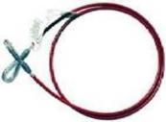
Análisis de riesgos de caída
Antes de encontrar una solución el peligro debe ser evaluado.
¿Cuáles son las condiciones a tener en cuenta?
¿Cuáles son los riesgos del área de trabajo?
¿Cuán alta es la zona de trabajo?
¿Hay agujeros o aberturas alrededor del área de trabajo?

Slide 55
Requisito de la protección de caída
Lados desprotegidos y bordes. Cualquier empleado caminando/trabajando en una superficie con un lado desprotegido o borde que está 6 pies (1,8 m) o más sobre un nivel inferior debe estar protegido de caer por el uso de sistemas de barandas, sistemas de red de seguridad o sistemas personales de detención de caídas.
En andamios, la protección contra caídas se requiere a 10 pies.

Slide 56
Evitar riesgos de caída
Construir todas las cubiertas de agujeros en el piso que efectivamente soporten dos veces el peso de los empleados, equipos y materiales que puedan ser impuestos en la cubierta en cualquier momento.
En general, es mejor usar sistemas de prevención de caídas, tales como barandas, sistemas de protección de caída, tales como redes de seguridad o dispositivos de detención de caídas, ya que proporcionan medios de seguridad más efectivos.

Slide 57
Barandas
3 Componentes:
(1) Baranda Superior
42” or 42” +/- 3”
¿Fuerza?
(2) Baranda Intermedia
A medio camino entre el riel superior y la tierra (pantallas / malla de una opción)
(3) Baranda de piso
¿objetivo? ¿altura?
Notes:
Guardrail construction is not a topic to discuss at any great depth, other than pointing out some of the principal requirements that they must meet. There are sections in the regulations that go through details on proper construction beyond what is presented on this slide (intended for those who are in-charge of building and / or installing them), but the point here is simply to address common G.I. and Construction parameters that need to be known and that are easily spotted by OSHA if not met.
Starting with the first component, the blue 42” is meant to indicate that the height of guardrails in General Industry is well-defined as needing to be 42 inches.
When it comes to variance from this height in G.I., OSHA has sent mixed signals. First an article titled “”General Industry Fall Protection Can be a Real Challenge” from OH&S Magazine, describes the issue thusly,
“Under 1910.23(e)(1), OSHA says that a guardrail must have a vertical height of 42 inches nominal from the upper surface of the top rail to floor, platform, runway, or ramp level. "Nominal" simply means that 42 inches has been established as the de facto standard for guardrail height. OSHA allows for variance, however. Standard Directive 1-1.10 says existing guardrails must consist of a top rail, intermediate rail, and posts, or equivalent, and have a minimum vertical height of 36 inches to 44 inches.”
That said, the most recent version of Proposed Subpart D has the following to say on the issue:
“OSHA notes that the two previous proposals on walking-working surfaces included a ‘‘grandfather provision’’ permitting a guardrail height of 36 inches, rather than the proposed 42 inches, for guardrails installed within 60 days of the effective date of the final rule. (See proposed § 1910.28(b)(3),
55 FR 13360 (April 10, 1990) and 68 FR 23528 (May 2, 2003).) The 36-inch grandfather provision is not included in this proposal, nor does OSHA consider it to be equally safe to the ‘‘42 inches nominal’’ height currently required under existing § 1910.23(e).
Therefore, to the extent that any previous OSHA letters of interpretation characterized a 36-inch guardrail height as a de minimis violation because of the grandfather provision in the two previous proposals, those interpretations are hereby superseded. (See, e.g., 08/ 27/2008 Letter to Bryan Cobb and 03/08/1995
Memorandum from John Miles to Byron Chadwick.)”
All of this said, the slide shows what the current rule for OSHA Subpart D is. Proposed D, however, allows for the same variation (+/- 3”) from 42” as the construction regulations do.
For Construction activities, per Subpart M, there is more leniency in regards to toprail height. Here, the rail could be as low as 39” from the work surface or as high as 45” from it.
In regards to midrails, the instructor can ask what the point of them is. (They are in-place to provide a barrier underneath the toprail so that the worker cannot fall underneath it.)
OSHA notes in Subpart M that instead of using a midrail an employer may choose to use a screen or a mesh that runs from the toprail all the way to the floor for the entire length of the railing system. This is seen as a good option especially in areas where there is a concern of objects being dropped into spaces where they could be a hazard for people below. This type of netting is commonly seen in-use in skyscraper construction / renovation in cities where space is tight and construction companies must work above the heads both of their own workers and of the general public.
The toeboard is mainly in-place as a form of falling object prevention. The concept is that it is a barrier at floor level at least 3 ½” tall (2” x 4” nominal boards are often used in construction) or 4” (in general industry) that is in-place at floor level to impede the ejection of a tool or other object from a floor work surface should it be kicked or otherwise displaced.
A couple more notes on guardrail construction are:
The need to not having railings overhang due to the projection hazard mentioned as well as a lack of support.
The fact that certain materials—i.e., steel or plastic banding utilized for securing items to pallets for transport—are not permitted to be utilized as guardrails.
The question sometimes comes up as to whether or not chains are allowed as rails. This answer was covered in the same OH&S article previously mentioned:
“Sometimes the installation of a guardrail isn't feasible or practical. One solution frequently considered is the use of safety chains, but are they allowed by OSHA? Even though the agency does not specifically address the use of chains in the Walking-Working Surfaces Standard, the agency has issued two LOIs on the issue that provide further guidance.
In the first letter, dated Feb. 12, 1982, OSHA makes mention of chains with regard to safety gates by saying, "if in fact the safety chains used for top and intermediate rails afford employees protection 'at least as effective as' the swinging gate, the safety chains would be adequate and noted as a de minimis violation."
This is further supported by a June 3, 1983 LOI, which says that "the anchoring of posts and installation of chains for railings must be of such construction that the completed structure shall be capable of withstanding a load of at least 200 pounds applied in any direction at any point on the top rail."
The bottom line is that if safety chains provide the same level of protection as a standard guardrail, they can be used.”
The final point here is that guardrails come in many permissible forms, provided that they meet all of the requirements previously discussed. While fixed rails are the norm, temporary, removable ones are popular, especially when they are “free-standing,” meaning that they don’t have to be attached to the work surface to be installed. These rails are designed to be easily maneuvered into a workspace and, then, when needed elsewhere moved to that location instead.

Slide 58
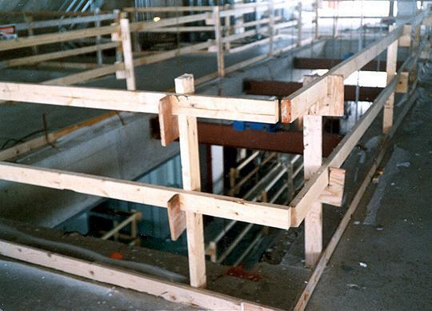
Barandas
Tope
Medio
Piso
Tope 42 +/- 3 in
Piso 3 1/2 in de altura

Slide 59
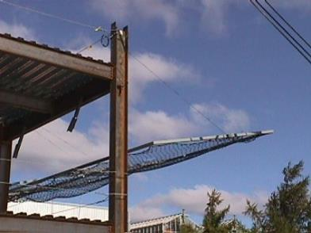
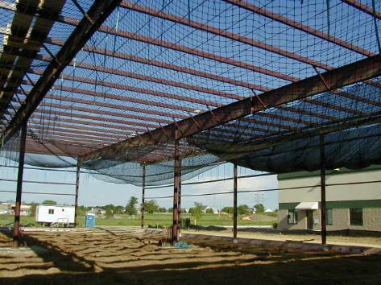
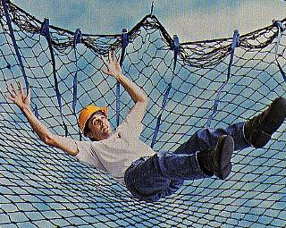
Uso de redes de seguridad
Asume que la caída se producirá
Notes:
The instructor will explain the scenario

Slide 60
Sistemas de red de seguridad
Deben ser inspeccionadas por desgaste, daños y otras alteraciones por lo menos una vez por semana y después de cualquier ocurrencia que puedan afectar la integridad del sistema.
No se utilizarán redes defectuosas y los componentes defectuosos deben ser retirados del servicio.
Los objetos que han caído en la red de seguridad, tales como pedazos de desecho, equipos y herramientas, deben quitarse tan pronto como sea posible de la red y por lo menos antes del siguiente turno de trabajo.

Slide 61
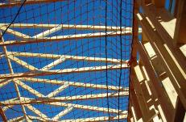
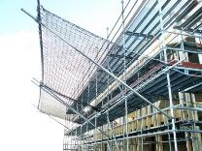
Redes de seguridad
No es para atrapar basura
Esta diseñada para atrapar las caídas de los trabajadores
Forma de protección pasiva
A veces se utiliza en proyectos con puentes o construcción de edificios prefabricados
Safety Net in Residential Construction
SafetyRespect® Safety Net System
Notes:
Safety nets for falling people are, essentially, what can be envisioned: they are put in-place to catch the falling worker much like one in a circus act would.
Although not commonly used in the majority of fall arrest situations, there are places where they are pretty frequently used such the situations shown in the pictures on the slide.
They are somewhat commonly used by iron workers during the construction of “pre-fab” buildings as is the case with the leading edge work being done by the worker in the top photograph. Here, individual components of the building itself may not be strong enough to support fall arrest forces, but a net can be used to spread out forces over the entire structure.
A similar situation can be seen with the safety net set below roof trusses on a residential construction job, again for the same reason that a net was used for the pre-fab building.
Sometimes nets will be seen on the edge of tall buildings to catch workers who may fall over the side, similar to what is shown in the “SafetyRespect” system.
One other common location where these are used would be during bridge construction where a lot of worker movement is needed and a PFAS would be too restrictive.
When going with a safety net system, OSHA spells out a number of requirements for construction. In fact, often the cumbersome nature of all of the requirements and the amount of design / testing that needs to go into their use, is what often dissuades companies from using them. That said, if they are going to be used, OSHA lays out some clear rules that must be met. The rules for Construction where they are commonly used are laid-out @ 1926.502(c).
Proposed Subpart D, at reference 1910.29(c), directs G.I. employers to the Construction regulations above for compliance requirements.

Slide 62
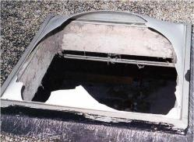
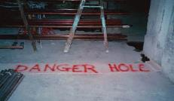
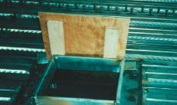
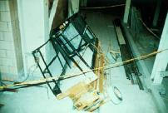
Tragaluces y orificios
Tragaluces y orificios
Tropiezos y caidas;
Areas débiles del techo;
Agujeros escondidos
NIOSH FACE Skylight Fatality
Cubiertas
Deben soportar el peso
Deben estar aseguradas para que no se muevan
Notes:
It should be noted that Subparts D & M consider both regular holes in the floor and “skylights” to be forms of “floor holes,” requiring protection against falling through both.
Floor holes, whether they be cut-out sections of roof / floor or a skylight, actually account for a significant number of fall deaths on an annual basis, both on Construction sites and in General Industry. By far the most common way that workers fall through them is by stepping onto them by accident (backing onto them or stepping on holes covered by an object such as roofing felt that has not been marked to indicate the hazard) or by tripping and simply falling through them.
OSHA lays out requirements for the “covers” that need to go over floor holes in 502 of Subpart M:
Note that requirements for current and proposed Subparts D are essentially the same.
1926.502(i)"Covers."
“Covers for holes in floors, roofs, and other walking/working surfaces shall meet the following requirements:
1926.502(i)(1)
Covers located in roadways and vehicular aisles shall be capable of supporting, without failure, at least twice the maximum axle load of the largest vehicle expected to cross over the cover.
1926.502(i)(2)
All other covers shall be capable of supporting, without failure, at least twice the weight of employees, equipment, and materials that may be imposed on the cover at any one time.
1926.502(i)(3)
All covers shall be secured when installed so as to prevent accidental displacement by the wind, equipment, or employees.
1926.502(i)(4)
All covers shall be color coded or they shall be marked with the word "HOLE" or "COVER" to provide warning of the hazard. Note: This provision does not apply to cast iron manhole covers or steel grates used on streets or roadways.”
The pictures at the bottom show examples of compliance with the regulations laid-out above, except in the case of the third photo where the floor hole couldn’t even support the weight of the load imposed on it, let alone twice it.
Skylight screens are a very common form of fall protection being utilized more and more. Here, although the worker may break the skylight when stepping on it, they will not fall through. An alternative to this is to put guardrails all the way around the skylight, as seen earlier.

Slide 63
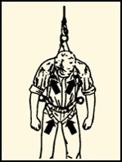
Sistemas de detención de caídas
Incluyen un punto de anclaje, una línea de vida y un arnés

Slide 64
Sistemas de detención de caídas
Una vez que se ha utilizado un sistema Personal de detención en una caída, debe ser retirado del servicio inmediato.

Slide 65
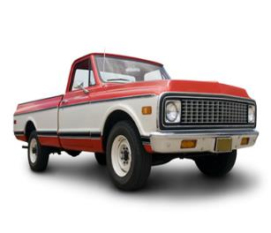
Punto de anclaje
Conectores de anclaje temporal
Conectores de anclaje permanente
Líneas de vida horizontales permanentes
Columnas | Vigas | Concreto | Estructura
OSHA
5,000 lbs.
Notes:
One should begin by explaining that the anchorage, or “anchor,” point is the location to which the worker is going to attach their harnesses to absorb the impact forces of the fall. For that reason, it needs to be a fairly structurally sound member. One way to get workers to begin to understand why anchors need to be as strong as what the law requires (and as will be discussed shortly), is to give a hypothetical scenario.
Give workers the hypothetical scenario that there is a beam that can support 1,000 pounds but which will break if subjected to 1,001 pounds. Tell them that a worker who weighs 310 pounds (their own weight plus tools) will fall into it utilizing a cable connection (no energy absorber) a distance of just six inches. Signal this distance for effect.
Ask whether, at face value, common sense tells them that 310 pounds free falling 6” would be enough to cause the beam to fail.
This test has, in fact, been done and can demonstrate that a drop of 6 inches of a 220 pound rigid weight (once the ANSI suggested equivalent to simulate a 310 human being, (now being 282 pounds instead) will produce a force of nearly 1,300 pounds, which would obviously cause the beam to break.
Students find it interesting that each time they take a step down a set of steps their legs, which are operating to stop “controlled falls,” are absorbing more than a ½ ton of force upon contact with the next step.
Indicate that often anchorage points that will be selected will fall into one of the categories of what is listed in the various bullet points. Occasionally students will wish to be given guidelines as to what measurements on different types of points will make them adequate for fall arrest, but it should be indicated to them that the calculations are not this simple. Much goes into determining the force that different points can support when a qualified person is running the numbers:
What is the size of the anchor?
What is its condition?
What is the distance between its nearest supporting members?
How much load (if it is a roof member, for example) is it already supporting?
And although there are some companies that actually do give guidelines to workers when selecting anchorage points (the pipe must be of such and such diameter with a span between supports of no more than…, for example), this is not the norm nor is it the intent of the class. Instead, the general OSHA requirements will be described and the topic left at that.
When it comes to the OSHA requirements, both Subpart M and Proposed Subpart I give two options. The first of these is that the anchorage point needs to be capable of supporting a straight static load of 5,000 pounds. The law does not require that it actually be tested to this force but, instead, says that a worker should select something that would theoretically be able to support this load.
A common visualization that can be used to determine whether or not a something should be able to support this load is if the worker thinks that the item to which they would like to attach would be able to suspend a regular size truck, such as a Ford F-150 or a Chevy Silverado. If they think that the truck would pull it down, it will not work. On the other hand, if they think that it could support the truck, they would have to be severely mistaken (be off by more than 3,000 pounds) in order to be in danger. This will eliminate connection into many of the small objects into which people connect if they are honestly and truly doing this mental visualization.
The second option that OSHA gives is that the anchor needs to be able to support at least double the forces that will be put into it in a fall, giving a “safety factor of 2.”
Discussing this can be set up by mentioning a French study referred to by ANSI where forces in the range of 2,500 to 2,700 pounds were found to be high enough to cause significant injury to the body due to jarring of internal organs and leading to internal (potentially fatal) bleeding.
Thus, both the US and Canada have determined that systems shall be designed to stay well away from this force, arriving at what is known as a “Maximum Arrest Force” permitted of 1,800 pounds. The key point here to note is that in most fall arrest system setups, especially simple ones where the worker is attached to a rigid structure via harness and lanyard or SRL), the force that is imposed on the worker is the same that will be imposed on the point itself.
From this, many engineers (being qualified persons) will take the 1,800 force indicated as the maximum force imposed on the worker’s body on a fall and double it for what the anchorage must be able to hold. This determination, however, is very simplistic and can vary from situation to situation, serving simply as an example that is often used for anchorage points that may not be able to meet the 5,000 pound requirement but which can be certified to a safety factor of 2.
A few further notes on the two options can be spelled out at this point:
First, “Option A” is the most common one that is utilized, most likely because it doesn’t specify who has to make the determination. Essentially, any authorized person out on the job site can make the determination of whether or not they think the point into which they would like to connect could theoretically hold the required force. For this reason, this type of anchorage point is known as a “non-certified” anchor.
By contrast, Option B spells out that the determination needs to be done by a Qualified Person. These types of anchorage points are much less common, but they are preferred by some safety people because at least someone has analyzed the point and determined it to be safe for fall arrest forces (something which cannot always be said about points selected to meet Option A). Often, these anchorages will be tagged or color-coded to indicate that they have been analyzed and determined to be used for fall arrest purposes only. These anchorages are known as “certified” ones.
Regardless of which is selected, the requisite force needs to be multiplied by the number of workers attached to it. Therefore, if two workers are attached to the same beam and utilizing the 5,000-pound option, the beam needs to be able to now hold a static load of 10,000 pounds to meet the requirement. (This would go for Option B, too.)
A final note to discuss here is that the law talks about “Maximum Arrest Force,” something some people sometimes call “Maximum Allowable Force.” It could be pointed out that in the past many pieces of equipment used to say “Maximum Arrest Force” with a number of 900 lbs. and not 1,800 pounds. This meant that when using the equipment properly it would only subject the worker to ½ the limit that the law permits. However, when ANSI went from the 220 lb. test weight to the 282 lb. one, labeling of this type went out the window. Some points can be taken from this:
There was a time when some equipment was designed using Option B with a safety factor of 2 multiplying 900 lbs. times 2, for a total strength of 1,800 lbs. Granted, not a lot of engineers were comfortable with this, but it was technically legal.
Now, equipment will often say “Average Arrest Force (AAF),” listing a number of 900 lbs. in many cases. This means that we know that on average the force will be at 900 lbs., but there will likely be a peak above this (due to the heavier weight and greater resultant force in a 6’ drop). Thus, engineers cannot go by the 900 number any longer because they have to double the maximum arrest force, not the average arrest one. Thus, 1,800 pounds is the one number that we know will not be surpassed when equipment is correctly used.

Slide 66
Conexiones temporales
Notes:
These anchorage connectors are used in a temporary fashion, only to be removed to other work locations once finished in a particular spot.
This is a mandatory slide just to show some of the types of anchorage connectors available through MSA and Latchways. The preference is to have as many of these as possible in kits to hold up physically and show to the class, but these slides can be utilized as a basic supplement if none are available, just to put a picture to what is being talked about.
In addition, a booklet of user guides for MSA’s different products will be put together. This is something that should be studied at a high level to come to understand some of the main requirements for different pieces of equipment. It is relatively rare, for example, to be asked for strength requirements of the concrete into which a MEGA Swivel will be connected, but the more the instructor knows about these pieces of equipment the better.
Information on the actual pieces shown here is as follows:
Double D-Ring Anchorage Connector Strap
Standard lengths of 3 ft., 4 ft. and 6 ft.
Comes with an integral wear pad
Anchorage Connector Strap w/ Sewn Hoop on End
Here, the strap is choked through a web loop as opposed to passing a small D-ring through a big one to make the connection.
There are different versions of this strap, but the common length suggested in the catalog is 5’.
Thermatek Anchorage Connector Strap
Kevlar webbing and stitching
Includes a replaceable wear pad to protect webbing from abrasion
Is heat and burn resistant
Anchorage Connector Chain
Useful near sharp edges or in high-heat environments
Not Included (but in Catalog)
Suretyman Anchorage Sling -
1” nylon tube webbing sewn into a continuous loop
Available in 2 ft., 4 ft. and 6 ft. lengths
Can be hitched to an anchorage point using various configurations
Anchorage Cable Sling -
Standard lengths of 2’, 4’ and 6’ or custom
Vinyl coated
¼” Galvanized Cable
This one, per engineering, is only recommended when utilized overhead or with a HLL so as to keep a load on it at all times. This is because the carabiner or snaphook (a large one is suggested) connect in a “basket” fashion to the Flemish eyes. What can happen is that in other configurations (where there is slack) the eye can actually work to open a carabiner gate or put force on a snaphook gate in a fall.
Anchorage Connector Extension
Vinyl coated
¼” Galvanized Cable
Standard 5’ length
Here, the cable is wrapped around the anchorage point, connecting the snaphook of the device into the round ring. Then, the worker connects their connecting device snaphook to the round ring as well. (This may be the only product where MSA allows two snaphooks connecting into the same ring at the same time…but it is the prescribed use.)
Workman FP Stryder
Low friction wear pads with Teflon® enable effortless gliding along beam flange
An integral load indicator alerts the user if the unit has been exposed to a fall
Is designed to mount either overhead or at the worker’s feet. (It, however, cannot be used in a vertical fashion.)
There are rough and fine adjustment tabs on the Stryder.
The “rough” adjustment notches should be adjusted first and, then, the fine adjustment ones on the opposite side to ensure proper fit and connection onto the beam flange.
400 lb. working capacity
Workman® Reusable Roof Anchor
Fits up to a 12 x 12 roof pitch
Removable Concrete Anchors & MEGA Swivel Hybrid
RCA
Quickly and easily removed and reinstalled in another location
Durable stainless steel and aluminum construction
400-lb capacity
2 models:
5,000 lb. version (5K)
10,000 lb. version (10K)
The latter is larger than the other
The 10,000 lb. version can be used to anchor MSA Dyna-Line or Sure-Line HLLs as well as Gravity HLLs
MEGA SWIVEL HYBRID
Max capacity: 10,000 lbs. (44 kN)
Designed for repeated use; durable and 100% retrievable

Slide 67
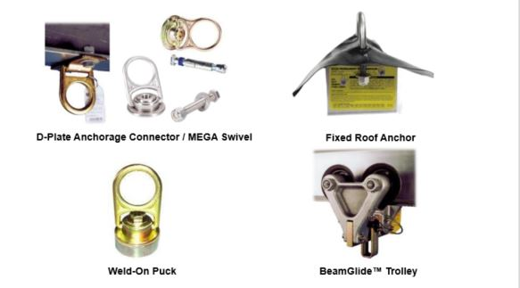
Conexiones permanentes
Notes:
This is a mandatory slide just to show some of the types of anchorage connectors available through MSA. The preference is to have as many of these as possible in kits to hold up physically and show to the class, but these slides can be utilized as a basic supplement if none are available, just to put a picture to what is being talked about.
In addition, a booklet of user guides for MSA’s different products will be put together. This is something that should be studied at a high level to come to understand some of the main requirements for different pieces of equipment. It is relatively rare, for example, to be asked for strength requirements of the concrete into which a MEGA Swivel will be connected, but the more the instructor knows about these pieces of equipment the better.
Information on the actual pieces shown here is as follows:
D-Plate Anchorage Connector
Bolts to beams or columns
Also available with 8” x 8” back-plate made of black anodized aluminum, galvanized steel, or stainless steel for attachment to concrete walls
If going this route, the piece shown is connected to the 8” by 8” back plate, which has 4 holes in it (with one in each corner). The Q.P. for the site then has to determine the method of affixing it to concrete from this point.
10K Mega Swivel (Silver)
Max Capacity: 10,000 lbs. / 44 kN
Requires PN 10144955 (bolt) to connect to steel or PN 10144956 (expansion bolt) to connect to concrete.
5K MEGA Swivel (Steel) (Gold-Colored)
Max Capacity: 5,000 lbs. / 22 kN
Two models: concrete (expansion bolt) & steel (regular bolt)
Permanent Roof Anchor
All-steel construction
Fits all pitches of roof trusses or rafters
BeamGlide™ Trolley
Provides horizontal mobility, keeping anchorage point directly overhead
Sizing to fit all beams

Slide 68
Conexión de dispositivos
Notes:
This and the slides that follow it, like anchorage connectors, are best left just to catch items missed during a hands-on visual demonstration of a lanyard for the class at the front of the room. As with a harness, a lanyard should be selected and discussed piece-by-piece.
Start by discussing the snaphooks of the lanyard, explaining that they come in a variety of materials (carbon steel w/ zinc chromate plating, stainless steel, aluminum) as well as sizes (³/₄" & 2 ¼” openings). The larger snaphooks are known by many different names, including “rebar hooks,” “pelican hooks,” and “ladder hooks,” among others.
Note that the large rebar hooks are made to connect onto larger objects, with rebar being a prime example of what they were originally designed for but also being used in many other applications where the smaller sized snaphook would not fit such as over the tube on tube and coupler scaffolding for scaffold builders / those working on a scaffold where part of the railing has been approved as a connection point.
Although not officially noted in MSA literature, the rebar hook should not be attached to the dorsal D-ring of a worker’s harness.
Snaphook compatibility discussions are a good place to discuss the OSHA requirement for double-action locking mechanisms on all snaphooks and carabiners.
Discuss how prior to 1998 non-locking snaphooks were available and simply had a spring loaded gate.
Using a “compatibility simulator” the instructor can hook up to an incompatible connection point (a simulated eyebolt) and explain that the students should, for a moment, assume that the anchorage is good for 5,000 pounds, the snaphook itself is rated for 5,000 (as the body itself was), and the line on the snaphook is good for more than that.
Then, having twisted the snaphook so as to have it oriented so that force can be put on the gate, pull down and demonstrate how “roll out” could occur where the snaphook could easily come off. (There have been anecdotal stories of workers in aerial lifts who were attached and working at the opposite side of the lift, pulling on their lanyard, only to have it come off in this way prior to the OSHA law changing. Thus, they’d become disconnected from their anchorage point and not even know it.)
Discuss how OSHA now requires an auto-locking feature (this prohibits screw-lock carabiners) on both snaphooks and carabiners, which means that at least two deliberate actions will need to be taken to open the connector.
Put an OSHA-compliant snaphook on the incompatible eyebolt, twist it, and show that it will not come off. But, ask if there is still a problem.
Try to see if you can get the students to see that pressure is still being put on the gate and see if anyone questions how strong an OSHA-compliant gate is.
Generally, they are strong enough to withstand 220 pounds from the front and 350 pounds exerted on them from the side.
Seeing that fall arrest systems won’t even begin to dissipate fall forces until reaching around 900 pounds and that high forces are generated in even a 6” drop, this strength will not be sufficient to hold if such forces are imposed. Thus, the issue that arises is what is known as “burst-out” where the snaphook gate simply fails due to the high forces.
Indicate that the issue was not one of locking versus non-locking but, rather, one of compatibility. There are three ways to determine compatibility:
First, a general rule is that if the snaphook or carabiner is bigger than the connector to which it will be connected and will not pass through inside of it, it is not compatible.
A second rule is that when the snaphook or carabiner is connected to the closed connector (with a D-ring probably being the most common example), one should not be able to cause the body to touch the opposite side of the connector by pushing on it.
Perhaps the most important way to determine compatibility or not is to attach the snaphook / carabiner to the connector and see if there is any orientation where it could sit / lay / be pushed where the gate could be loaded in the case of a fall. If so, it is incompatible. If, however, no amount of twisting or maneuvering could put force on the gate, it is compatible.
Indicate that MSA also has a whitepaper on compatibility that states the following:
“This technical brief is intended to address the question of compatibility of MSA fall protection products with fall protection products of alternate brands. MSA user instructions may state that any mixing of different brands must be approved in writing by MSA. The stance described in this technical brief supersedes the requirement for written approval by MSA.
It is acceptable to mix fall protection equipment of different brands provided the following
requirements are met:
All fall protection equipment used by an individual must meet the same industry standard or government regulation; either ANSI, CSA, EN or other applicable standard or regulation.
The fall protection equipment selected must be third party certified or independently verified to comply with the standard / regulation.
The competent person designated by the user’s organization or a qualified person must evaluate the components and determine that they are compatible for use based on capacity, size, strength, and shape of connecting elements.
Contact MSA with any additional questions regarding compatibility of equipment.”
A topic that ties in nicely at this point is snaphooks and carabiners that meet the ANSI Z359.1-2007 standard that requires that the gates be able to withstand a 3,600 pound force in any direction.
Describe how this is more than sufficient to hold in the case of a fall where the gate is loaded (seeing that maximum arrest forces shall not be more than 1,800 pounds when an appropriate fall arrest system is used correctly) but that it is still not a license to hook to incompatible anchorage connectors. Instead, describe it as a second line of defense for the case where a user makes a mistake or a bad decision.
Snaphooks and carabiners that meet this standard are easy to identify as they have the 3,600 pound strength marked on the gate.

Slide 69
conectores
Sistemas auto-retractables
Trabajan como un cinturón de seguridad
PFL
Web SRL
Notes:
This is another area where demonstrating with physical examples is more useful than a slide, but having the slide helps to show some real-world examples.
SRLs depend on “pawls” on the inside that are held in-place by small springs. When the drum is spun fast enough, the retention force of the small springs is overcome and the pawls are allowed to flip out, locking into the housing of the unit and activating its deceleration / braking mechanism.
Many people are under the false impression that when it locks off, that is where the unit will stop paying out line. This, however, is not the case. Instead, depending on the unit, some energy absorbers will be visible on the outside in the form of a pack and others will be internal, utilizing brake pads like on a car on which the drum will turn or a more simple system of where the internal parts of the unit will compact down, absorbing force and paying out additional line. Latchways, as will discussed shortly, has still even more technologies to accomplish the same feat.)
The concept of “PFL” versus “SRL” needs to be discussed.
When “self-retracting lifelines” (SRLs) first came out they were big and bulky and, thus, were meant to be hung from an anchor point with the line hung down to the worker to connect into the back of their harness.
However, with time smaller and smaller units were designed and the concept of actually wearing them on one’s back like a lanyard was developed, thus creating the concept of a “personal fall limiter,” (“PFL”).
With these devices, the idea is that they can simply be worn at all times like a lanyard but they give the benefits of only having the needed line extracted when in use, thus limiting how far the worker goes in a fall (as opposed to a fixed length lanyard).
It should be noted that PFLs can also be turned around and utilized as regular SRLs should the user so desire, as it will not affect how they function at all.
SRLs go by various names including, “retractables,” “blocks,” and “Yo Yo’s,” among others.
The idea with the picture of the rope is to indicate that when SRLs are hung overhead, there are two major rules that must not be violated:
First, when the line is not being used, it must not be tied at the base of a ladder, for example, so that it is easily retrieved by the next worker who needs to climb the ladder later on.
This is not only because (a) the line will be left and possibly exposed to harsh elements but also (b) because tension will be kept on the internal retraction spring of the unit, thus weakening it over time due to the constant pressure on it; if this practice continues over time, eventually the unit will not retract line.
For this reason, when the system is not in-use a “tag line” must be used (attached at the snaphook and taken off when in-use) to pull the snaphook down out of the housing of the SRL to ground level where it can then be attached to the worker’s harness.
The second thing to discuss is that when allowing line back into the unit it should be done slowly as opposed to just allowing the line to shoot back up into the unit under spring power. If the user just lets go of the line instead of feeding it back in slowly with the tag line, it will cause the drum to accelerate enough that in some cases it will continue to spin once the snaphook has reached the housing, “backlashing” the spring and effectively making the unit useless.
Backlashing is where the connection between the drum of the SRL and the spring, which is a tab from the spring going into a “drum axle,” basically bend and break apart, thus disengaging the spring and making its retraction function not work anymore.

Slide 70
Lineas horizontales permanentes
Notes:
Latchways is perhaps best known worldwide for its engineered, permanent horizontal lifeline systems. Latchways designs and builds all of the equipment to be installed. It then relies on a select group of regionally based contracted installers (who are thoroughly vetted and trained on installation of the system in all types of situations and who can fall back on a broad resource library at Latchways for technical information when needed) to do the actual (1) initial analysis, (2) design, (3) installation, and (4) certification of the system.
Below is information taken from Latchways website on its engineered systems:
Latchways ManSafe systems provide the total solution for all horizontal safety at height industrial applications. The system’s versatility and ease of use makes it ideal for protecting workers as they go about day-today activities such as maintenance, cleaning, access and inspection.
Systems can be designed for up to five simultaneous users.
The user, wearing a full body harness and energy-absorbing lanyard, is continuously attached to the system with a Transfastener™, which rotates allowing it to pass through the intermediate cable supports.
Fixes to virtually all types of structure and roofing systems.
Follows the contours of the building by going around bends and up and down inclines.
Can be extended to include vertical sections.
The unique Latchways “Transfastener” allows workers to travel the full length of the system without having to detach and re-attach.
Normally incorporates the unique Latchways Constant Force post for assured fall arrest protection and simplified installation.
Where the Constant Force post is not applicable, in-line shock absorbers or a Constant Force energy absorber can be incorporated for equal safety assurance.
System testing must be conducted annually by suitably qualified installers to ensure that system certification is maintained. Key system checks such as deployment of shock absorbers, swage tests and torque checks are part of this process.
Latchways’ components are manufactured in marine-grade stainless steel and are individually numbered to allow complete traceability.
For systems on inclines over 15° a ClimbLatch device is required instead of the Transfastener.
User Instruction
Only attach to the system by means of a retractable fall arrest lanyard and full body harness conforming to the appropriate safety standards.
Always check pre-tension before use.

Slide 71
Lineas vertcales

Slide 72
Puntos de anclaje
Consideraciones
Ubicación
Por encima del anillo del arnés
Rescate
Notes:
Two final points of significant importance in regards to anchorage points are shown here.
First, with location, it can be stated at this time quite simply that “anchor points that are located above and vertically in-line with the worker are the best kinds.” State that further discussion will be had on why above is the best place later on in the class, but ask why it being vertically inline is important:
The answer to the question is that an anchorage point that is not vertically above the worker will lead to a “swing fall” where the worker could violently hit something on the way down. It has been said that a worker can swing and hit objects sideways with as much force as what they would have hit if they had just fallen straight down. Regardless, the main point to make is that it is easier to control the trajectory of a straight-down fall than it is one where the worker is swinging.
Probably the most common time that workers violate the rule of putting themselves into a situation where swing fall is possible is with SRLs. Especially with units that have larger amounts of line, workers will often lay them at ground level and walk out horizontally. And beyond the swing fall issue, there are a number of problems with this:
The majority of these units were not designed or tested for this purpose, instead requiring to be mounted overhead.
Since they were not designed for this purpose, when their line runs over a sharp edge during a fall there is a very good chance that it will sever. There are units known as SRL-LE devices designed for this purpose (although they won’t help if the worker puts themselves in a swing fall situation) that are emerging on the market, but for now the general rule is to anchor above and vertically inline.
The other consideration when it comes to the anchorage point is whether or not the worker can be safely rescued from it in a safe period of time. This is a point that should be made several times in the class in order to stress its importance, and this is a good location to touch on it again.
OSHA’s stance on rescue is not very well spelled out. Some key points to understand / discuss include:
In all of its regulations on fall protection, OSHA dedicates a single sentence to the topic of rescue, saying that employers shall ensure that employees can self-rescue or that rescue be “prompt.”
Although OSHA has been asked through letter of interpretation to put a time period on what it means by “prompt,” it has declined to do so stating that what will meet the requirement will vary in different situations depending on what the cause of the fall was (electrical shock vs. slip or trip). Essentially, what OSHA is saying is that the employer needs to be able to get to the worker in time after the fall to be able to help them / prevent their condition from worsening due to hanging for an extended period of time.
In regards to the risks involved, many workers will have a decent idea of the risks associated with hanging in suspension for too long. Some will suggest that the issue ties back to cutting off circulation to the legs (which, in part it does), but the larger issue known as “suspension trauma” is more tied to the following sequence of events:
When in a vertical position, the heart needs assistance to pump the blood back to it and, then, on to the brain. This is due to the fact that gravity pulls on the blood in the body just as it does the outer parts of the body itself. What normally happens is that the veins of the legs intertwine with leg muscles and when the worker moves, the muscles will actually help keep the blood circulating by pushing on the veins. When the worker is hanging in suspension, however, this no longer occurs and the blood starts to settle in the legs.
With time, more and more blood will settle in the legs and less will get to the brain.
Once this happens, ask the students what won’t be getting to the brain. (Oxygen)
Ask students what will happen when they don’t get enough O2 to the brain. (They will pass out.)
Visually show the students what will happen to the position of the head when the person passes out in a hanging position. (Their head will slump forward, thus partially cutting off their airway if breathing through the mouth.)
Ask the students how long a person can live without breathing. (3 to 5 minutes)
Indicate that it is hard to pinpoint for sure how long it will take a person to pass out in harness, as that will vary depending on the severity of the fall, their conditioning, and how well they tolerate their particular harness, but that a general rule of thumb for getting them down is that it should take place within 15 minutes from the time of the incident.
Indicate that this is part of the reason for the harness suspension activity that will be coming up. The point will be to show them just how uncomfortable it is to hang in a harness in order to hopefully drive home the need to (1) adjust it properly and (2) to have a good rescue plan in-place before starting work.

Slide 73
Arnés de cuerpo
Los arnés de cuerpo están diseñados para minimizar las fuerzas de estrés en el cuerpo de un empleado en caso de una caída, mientras que proporciona la suficiente libertad de movimiento para permitir el trabajo a realizar.
No use arneses de cuerpo para levantar materiales.

Slide 74
Inspeccion

Slide 75
material
Las cuerdas y correas utilizadas en líneas de soporte, cordones y componentes de arnés de deben estar construidas de fibras sintéticas resistentes.

Slide 76
Conectores

Slide 77
Sistemas de proteccion
Retiene
Posiciona
Notes:
This is a transition slide that introduces two other uses of the equipment utilized in fall arrest but not discussed up until this point: restraint and positioning.
Here, note that a difference in terminology is now used.
As opposed to “PFAS,” now “PFPS” is utilized because neither of these systems, although they all incorporate ABC components, is designed for fall arrest.
With Restraint (also known as “Travel Restraint”), the worker cannot get to the edge to fall in the first place.
With Positioning, the worker could potentially fall, but a common best practice is to have a harness on (although not required in all cases) that permits the worker to first connect with a fall arrest system to their back and, then, connect their positioning system at waist level to allow them to work hands-free.

Slide 78
retiene
Evita que llegue al borde
Notes:
Start out by holding up a restraint lanyard, having one person hold it, and illustrating the concept of not being able to reach a location to illustrate the concept that this setup is one where the worker is working as if they were a “dog on a leash.”
Indicate that this is considered to be a better form of fall protection than fall arrest, asking the students why.
They should indicate that this is so because the worker is unable to get to the fall hazard in the first place to be able to fall. Direct the students to the picture on the right side of the slide to indicate what “restraint” looks like at the most basic level.
Sometimes workers will ask how close a worker is allowed to get to the fall hazard and still be able to call it restraint. The answer to this question is that the worker can be allowed to go right to the edge, provided that their Center of Gravity (CoG) cannot pass over the edge; once the worker gets into a setup or a situation where they can fall, it goes from being a situation of restraint to one of fall arrest.
The picture on the left illustrates how companies will typically attempt to do fall restraint, and several points should be made about it:
First, the worker is using what is known as a vertical lifeline with a ropegrab (connected by a short lanyard which has to be 3 feet in length or less) to his back. Very frequently, this ropegrab is of the automatic / trailing variety that is used for when workers need fall protection on a vertical plane (i.e., climbing a ladder, utilizing a swing stage scaffold). In fact, many manufacturers sell roofing systems with this type of ropegrab. However, the most adequate grab for this type of situation is what is known as a “manual ropegrab.” Utilizing a short line of rope that should be available to all instructors with an example of each, the instructor should be shown the difference between the two:
With an automatic / trailing ropegrab, the device will go up or down with the worker without them needing to put their hand on it based on upward pull that is put on the connection ring and, ultimately, the cam device on the inside. The instructor should demonstrate function and installation at this time.
By contrast, a manual ropegrab only moves on the lifeline when squeezed. Thus, the worker can squeeze it to get to their work position, let go, and rest assured that it will stay where positioned on the line.
Going back to the picture, point out that the worker has the ability to select where to lock off the ropegrab and ask whether or not the students see any problem with this setup.
They should indicate that what will often happen is that the worker will adjust so that there is slack in the system (as it is somewhat uncomfortable to work this way), thus eliminating the restraint setup and turning it into a fall arrest one. For this reason, indicate that fixed length lanyards should be utilized whenever possible.
A third point that can be made here deals with the height of the anchorage. The point was made earlier that the worker can be allowed to get as close to the edge as needed and still be in restraint as long as the CoG cannot pass over the edge, but this can sometimes be tricky.
A very important activity do demonstrate this is to have a worker take a restraint lanyard and hold the snaphook on the ground at a location that would be considered to be an “anchorage point” with their foot. Position the other end right at the edge of an object such as a table or a chair.
Now, ask whether or not this is a situation of restraint.
Once students have answered, lower the worker end of the lanyard to the floor, showing them that it now has passed beyond the edge where it could just barely reach before.
Students will be surprised by this.
Point out (and show) that only with an anchor point that is at the height of the worker’s back D-ring or higher will the worker not be permitted to go over the edge no matter what they do if they originally did not have enough slack to get their CoG past the edge.
A final key point here on restraint is that in cases where a fall may be possible if the worker makes a poor decision or isn’t paying attention, a fall arrest device (specifically one for a 12’ free fall or an SRL-LE) should be used to deal with the possibility to (1) provide for restraint but also (2) prepare the worker for a fall should they actually get in a position where they can fall and do so.
A common question when it comes to restraint is whether or not an EAL or an SRL, if they limit the worker from getting to the edge in all possible scenarios can be used.
The MSA stance is that this is ok since they both ultimately have the strength of a restraint lanyard even if they aren’t being used how they are normally intended.
A major caution, however, needs to be that if this is done, it is guaranteed that no worker can reach the edge…as falling with either of these devices could result in high forces and / or cutting of the line. Thus, if even the remote possibility exists of getting close to the edge at all, a device suitable for the particular setup (12’ FF lanyard, SRL-LE, for example) needs to be used

Slide 79
posiciona
Coloca al empleado en posición para trabajar
A veces se confunden los términos
Notes:
Begin by explaining that “positioning” takes place when the worker utilizes three points of contact (2 feet and the connecting device from the hips) to be able to work on a vertical work surface.
Explain that the worker needs to have specific waist D-rings on their harness (they are not there for the purpose of being tool holders or a place to store the unused leg of a lanyard) as well as a specific type of lanyard in order to be able to perform this type of work.
Here the worker is “tying rebar” on a wall where forms will eventually be placed in order to pour concrete around the rebar.
Point out that in addition to being connected for Positioning, he is additionally connected for fall arrest. This is a VERY IMPORTANT practice.
Other situations where positioning comes up would be when workers have to labor on a transmission or broadcast tower as well as when a maintenance worker may need to stop and work on a fixed ladder to perform some type of work.

Slide 80
Distancia de caida
Márgen de seguridad: 3’
Notes:
Explain that there will always be two steps to calculating fall clearance for an energy-absorbing lanyard.
The first step is to measure from the ground (or closest obstruction below) to the bottom of the anchorage point and get a number.
For this chart, say that they have done so and come up with 20’. This tells them how much clearance is available for the fall.
The second step is to add the variables that are shown on the right side.
Indicate that in this diagram a D-ring anchorage connector is being used and, thus, its length hanging below the bottom of the anchorage point being negligible has been left off.
That said, ask if they think they’d need to add 2’ for a cross-arm strap that hangs down two feet below the beam. (The answer is yes.)
To this, add the length of the lanyard (which is usually 6 feet but, which, can vary), its elongation (another variable), the height of the worker (another variable, although 6’ is the common number suggested to use by MSA), and an additional safety margin of 3’.
Ask why they think the safety margin is necessary. Responses should include:
Stretch in the harness (which they will have seen during the lift exercise);
Possible errors in calculations
Once everything is totaled, in this case the worker’s system requires 18 ½ feet so that he won’t hit.
Tell the students that as long as the measurement that was done on the left (from the ground / nearest obstruction below to the anchor) comes up with a bigger number than the addition of the variables to the right, they are fine for clearance.
Next, to see if they really have the concept, ask the students how clearance would change if the worker were to use the same attachment point but climb atop his anchorage and his current work platform were to disappear.
Some students will say that more clearance will be needed while others will stay that it should stay the same. Help them understand the concept that more clearance is not needed by asking the following questions:
Has the distance from the ground to the anchor changed? (No)
Is the length of the lanyard different? (No)
Will the deceleration distance be longer from one traditional, OSHA-style 3 ½’ rip-out lanyard to another? (No. It cannot be. They will go all the way through the energy-absorber and hit into the back-up strap, but will only go a negligible amount further.)
Ask them if the height of the worker has changed. (No)
Ask if the safety margin has changed. (No)
Then, you can say, “When it comes to calculating fall clearance, the height of the worker is not important. What is important is the height of the…” (and they almost unanimously are able to say “anchorage point”).
Note that some workers will recognize that the worker standing atop the beam will see higher free fall and fall forces because of this setup. Acknowledge that this is an issue of significant concern, but that it is not a fall clearance issue.
Activity Suggestion:
A very good way to demonstrate this is to lay indicate an “anchor point” on the floor, lay out a completely deployed lanyard, and measure out an additional 8 ½ feet with a tape measure just to show just how much distance this really is.

Slide 81
Distancia de caida
Ejemplo
MAD = 4 ½ Feet (1.37 m) + 39” (1 m) márgen de seguridad ------------------------------------- D = 7’9” Feet (2.4 m)
Max Arrest Distance
Fall Clearance
Safety Factor of 39”(1 m)
Notes:
Explain that fall clearance with an SRL or with a PFL is figured out differently from the process that was followed with lanyards.
Here, we often don’t know the length of the payout of the line, especially in the case that a large SRL is being used; it may have a total length of 17 or 20’, for example, and we may not know what the exact length is.
Here as new way to calculate fall clearance was created where instead of measuring from the ground to the bottom of the anchor we simply measure from the ground to the work surface, thus eliminating the need to know the length of the connecting device as well as the height of the worker.
Now, in a best case scenario where the worker is anchored above them and is standing, we simply need to know the labeled MAD and the safety factor, here for a grand total of 7’8”.
Note that some workers will have a difficult time understanding why the worker’s height doesn’t need to be considered.
This can be explained by discussing how if they were to step off the beam instead of falling they would simply go the distance allowed by the SRL / PFL. Thus, at a maximum, they would only go 4 ½ feet before coming to a stop after having left the work surface.
Explain that since the measurement was from the ground to the work surface, nothing above the work surface needs to be measured.
If necessary, demonstrate with a ruler or pen up against the project screen to fill in for the roll of the falling person.
Not all situations will be best case scenario, however. Remind workers that if their anchor point is not elevated but is, for example, at the height of their back D-ring, they will have to add the length of the SRL / PFL as an additional “free fall” variable on top of the MAD.
Note that on all MSA SRLs and PFLs, MSA puts a limit on allowed free fall to 2 feet.
The only exception to this rule when it comes to any retractable is with the MSA Mini PFL, which allows anchorage up to a maximum of 5’ below the worker’s back D-ring.
Another issue is if the worker is to kneel down or lie on their stomach.
In these cases such as this, it is the MSA stance that the worker needs to add an additional 3’ for the worker who is kneeling and their height if they are on their stomach. This is because now their body is starting from a different position and will straighten out vertically when they fall, thus requiring the additional clearance.
Again, this may be a difficult concept for students to visualize. If so, take a pen / ruler and put it up on the screen and indicate the starting position of the fall, how the body will straighten out, and how this will now require taking into account the unfurling of the body.

Slide 82
Protección contra caídas - Plan de rescate
Necesita un plan de rescate
Equipo
Tiempo de rescate

Slide 83
Equipo de rescate

Slide 84
Procedimientos de rescate de caída
Proteger al personal de rescate durante las operaciones de rescate
Administrar los primeros auxilios si es necesario.
El plan de prevención de caídas debe incluir disposiciones para el rescate rápido.

Slide 85
¿preguntas?

Slide 86
Disclaimer and Copyright Information
This material was produced under grant # SH-31201–SH7 from the Occupational Safety and Health Administration, U.S. Department of Labor. It does not necessarily reflect the views or policies of the U. S. Department of Labor, nor does mention of trade names, commercial products, or organizations imply endorsement by the U. S. Government. The U.S. Government does not warrant or assume any legal liability or responsibility for the accuracy, completeness, or usefulness of any information, apparatus, product, or process disclosed.
This material is the copyrighted property of Florida International University. By federal regulation, OSHA reserves a license to use and disseminate such material for the purpose of promoting safety and health in the workplace. Florida International University hereby authorizes employers and workplace safety and health professionals to use this material, distributed by or through OSHA, in their workplaces or practices in accordance with the guidance contained in the material.
To this end, permission is granted to use such copyrighted material solely for non-commercial, instructional, personal, or scholarly purposes. The material may be used and incorporated into other workplace safety and health programs on the condition that no fee may be charged for the subsequent use of the material. Use of the material for any other purpose, particularly commercial use, without the prior, express written permission of the copyright owner/s is prohibited. Furthermore, any modification to the material is prohibited without the prior, express written permission of the copyright owners.

Slide 87
Supplementary material

Slide 88
Una caída con un cordón de 1,8 m (6 pies)
Tiempo | Respuesta | Distancia | Velocidad
0.1 sec | No se da cuenta | 5.1 cm (2 in) | 1.0 m/s (3.3 ft/s)
0.2 sec | Se da cuenta | 20.3 cm (8 in) | 2.13 m/s (7 ft/s)
0.5 sec | Se empieza a mover | 1.22 m (4 ft) | 4.88 m/s (16 ft/s)
0.61 sec | Se mueve ligeramente | 1.83 m (6 ft) | 5.97 m/s (19.6 ft/s)
0.7 sec | Impacto | 2.41 m (7.9 ft) | 7.01 m/s (23 ft/s)
0.9 sec | Rebote | 3.96 m (13 ft) | 8.84 m/s (29 ft/s)
1.0 sec | Suspendido | 4.9 m (16 ft) | 9.75 m/s (32 ft/s)

Slide 89
Redes de seguridad

Slide 90
Opciones

Slide 91
Sistemas de prevencion de caídas
Rescate
Notes:
-This is simply an introductory slide to show that there are three components to the system itself, each of which will be covered in their own turn, plus the element of rescue that always must be considered but is often neglected during the planning phases of using the PFPS (Personal Fall Protection System). This is a good time to stress for the first time that if one is going to take the time to put all of the other components together and use them correctly they still must consider this 4th, extremely important aspect. A question that can be asked in this regard is, “When is the right time to plan for rescue?” The answer should always come back that it is “prior to the work beginning in the first place.” If it cannot be determined how the rescue will be carried out, work should not even start in the first place.

Slide 92
Ubicación del accesorio
La sujeción del arnés para el cuerpo debe encontrarse en el centro de la espalda, cerca del nivel del hombro o por encima de la cabeza.

Slide 93
Bodywear
The Body Harness
Holds the person in it during the fall
Will only work if worn correctly
Distributes fall forces to specific locations
Prior to 1998 another type of “bodywear” was permissible. What was it?
Is NOT “one size fits all.”
Notes:
The first point to make here is that the harness, obviously, is designed to hold the person in it during a fall but that it will only be able to do so if it is worn correctly:
Ask what will happen if people walk around with their leg straps undone as is sometimes the case.
The answer is that they could easily fall out of the harness.
Ask if a loose chest strap is an issue. (If it is too loose, this “shoulder strap retainer” will allow the shoulder straps to slide off the shoulders and in a head-first fall the person could, theoretically, come out of their harness, especially if they are of a smaller build.)
Explain that this is a major reason why proper harness fitting will be discussed before doing the lift exercise.
The second major point with harnesses is that they are designed to put forces on the body where it is best able to take them: (1) upper thighs, (2) pelvis, (3) chest, & shoulders.
Start the discussion by asking if they remember the bodywear that people used to use.
The bodybelt was permitted for Fall Arrest purposes until 1998.
Tell them that the bodybelt was outlawed by OSHA for fall arrest purposes starting in January of 1998 because it directly put forces where we don’t want to see them: the abdominal region.
Additionally, it would cause a falling worker’s body to bend in ways very detrimental to their body.
Ask where fall forces will be put on a worker with a FBH.
They should be able to guess, but explain that the main impact forces will be on the fat part of the legs / major leg muscles or, in the case of a head-first fall, on the shoulders.
Ask where the forces will be imparted if the leg straps are loose, as is VERY common. (This can cause very major injury for a male worker, as is evidenced by photos that can be found online of workers who have suffered major testicular injury due to straps that either started in a bad position or which rode up in a fall.)
Another way to make an important point stand out for students has to do with harness capacity.
Ask the class, by show of hands, to indicate how many of them have their harness. If many indicate that they do, ask how many of them think that they know it fairly well. (Most of the same hands will remain up.)
At this point, ask who can tell you what the capacity is on their particular harness. (Don’t be surprised if no one actually knows the capacity…or even that there was one.) Ask them where they might find this information…
Direct them at this point to the harness tag.
Points to stress with capacity are the following:
Different harnesses have different capacities. This is also true of all PFAS equipment, including anchorage connectors and connecting devices.
Explain that capacity is the max that the person and their tools can weigh and safely use the piece of equipment.
Once you tell them that most harnesses nowadays have capacities of 400 lbs., ask what they think the capacity is on a lanyard
Occasionally you’ll get an answer of 5,000 pounds. You will need to explain here that this is the required minimum ultimate breaking strength of most components, but it is not what capacity is referring to.
More frequently you’ll get a guess of 400 pounds since that was what the harness was for. Indicate that actually most other equipment is only rated to 310 pounds and that specialty equipment (lanyards / SRLs) will need to be acquired to deal with heavier workers.
When students say that they have someone who exceed the 400 pounds, it needs to be indicated that since the equipment has not been designed or tested for these heavier weights that they will be violating manufacturer requirements (and, thus, be in violation of OSHA rules) as a result if they allow the heavier worker to work in the equipment.
Show the workers the sizing chart shown here for the EVOTECH® harness. Explain that in the case of MSA there are different sizing charts for different harness lines that are based on height and weight. Point out where you, as an instructor, would fall on the chart and indicate that buying the wrong size harness will either lead to incorrect fit or lack of / too much adjustment strap for fitting.

Slide 94
Bodywear
Notes:
The next three slides should really only be used in the rare case that physical examples of harnesses aren’t available for physical demonstration. A place that lends itself well to discussing all of these parts and pieces is to the time when harness pre-use inspection is being discussed prior to donning and, then, the lift.
A couple notes that should be noted here for that discussion are as follows:
The subpelvic strap is designed to impart fall arrest forces on the pelvis in the case of a fall. When fitting the harness, it must be ensured that it is located below the butt of the wearer. If it is not, typically adjustment to lower it is done with the friction buckles on the front of the harness, allowing slack through them so that the bottom of the harness drops down.
In regards to inspection, webbing failures would include any of the following:
Any amount of cut, tear, or fray. (Tests have demonstrated that even an 1/8” cut can reduce the strength of the webbing in half.
Any burns or burn holes;
Any regular holes that are not part of the design of the harness;
Grommets would be an example of holes designed to be in the harness, either on leg straps or belts.
Any permanent discoloration (due to chemical splash on a particular location or UV degradation);
Note that UV damage will be harder to spot since most of the webbing will have changed color, but it can be found by looking for areas where the webbing was protected (such as under padding) and comparing it to that which was exposed.
Any permanent user modifications, such as cutting off the ends of webbing where there was excess, sewing (yes, students seem to like to suggest that sewing as an answer to the question of “what modifications might someone might make), or poking extra holes where they shouldn’t be.
One permanent modification that is permitted is writing on the webbing with a Sharpie by Sanford marker. This is because other markers have solvents in them that could cause deterioration to the webbing.
That said, even if the worker wrote on the webbing with a Sharpie marker, it will not be able to be tested / verified in any way. Thus, it is best either not to write on the webbing at all or to find a place such as a plastic piece or a pad cover on which to write so that it can be ensured that no load-bearing parts of the harness have been affected.
In regards to the fall arrest indicator, most equipment (although not all) will come with one. Students need to know that it is designed to rip out when the equipment has experienced fall arrest forces (whether in an actual fall or when they got to the last rung of a ladder, forgot that they were still connected to an overhead SRL, thus causing it to catch and both pop its pin and the harness stitch to rip out) to indicate that the equipment is no longer safe for use.
Loads that it will take to cause the indicator to deploy vary, but will be somewhere in the 500 pounds range for a harness and closer to 900 lbs. for an SRL load pin.

Slide 95
dispositivos
Notes:
In regards to tags, the first thing to point out is that they must be present and legible. If they have been ripped free (or are even partially missing), it constitutes a failure of the equipment.
Also, if even one word is not legible, it constitutes a failure (which is why manufacturers like MSA are better protecting harness tags with covers such as the one illustrated on the slide.)
When starting a competent person inspection (one done by someone other than the user on either an annual or twice-annual basis), this is a good place to start because if it fails everything else does as well.
A good place to start a pre-use, worker harness inspection (including the one done in the pre-use inspection activity and although it is actually listed last here among inspection points chronologically in the PPT and manual) is with the dorsal D-ring, having undone all of the buckles and letting the untangled straps hang down.
Hardware inspection points include:
There shall be no cracks in hardware.
No deep pitting shall be evident.
No grooves shall be worn into the hardware.
It shall not be bent in any way.
It shall not be corroded with red rust.
MSA does have a statement where it allows a light amount of red rust provided that it can be gently brushed off, bringing the hardware back to a rust-free condition.
Other connectors besides D-rings need to be checked for the same things in addition to the following:
Anywhere there is a connection between hardware and webbing, the webbing will need to be checked closely for cuts, tears, and / or frays due to the rubbing potential.
Some connector buckles, such as quick connect versions, will have springs on either side that operate “ears” that allows the buckle to be locked into place and unlocked when depressed. The ears may seize up over time or a spring may break. Each much be checked to make sure that full range of movement is free.
Buckles shall also be checked for functionality. They should be pushed into place to make sure that will lock into place correctly and, then, unlock.
In regards to adjuster buckles (such as with friction buckles with a metal bar that goes across and springs underneath), all of the above applies inspection-wise as well as checking that each spring on either side of the bar that holds the webbing in-place is in good condition. If even just one side is corroded / broken / missing, the entire harness must fail due to the fact that an adjustment will not be able to be maintained.

Slide 96
ANSI Z359.14 – 2014
Clase A SRL
“Distancia máxima” = 24”
Fuerza Promedio= 1,350 lb. (1,800 lb. peak)
Clase B SRL
“Distancia máxima” = 54”
Fuerza promedio= 900 lb. (1,800 lb. peak)
Recertificación de fábrica
Depende de la fecha de fabricación
Notes:
-MSA manufactures SRLs that meet either the Class A or B requirements of the ANSI standard listed at the top of the slide. Basically, with a small PFL (the only unit that we have that will meet “A” is the Mini PFL) the unit will lock off and bring the worker to a stop in no more than 24” once it has entered the “activation” phase where line is paying out. How much of that space involves “activation distance” and how much of it is “deceleration distance” is variable and does not need to be known.
-Class B SRLs are the norm. Here, the same info from above applies but the “MAD” changes and the “AAF” is also different.
-MSA is currently working on what it calls a “Leading Edge” SRL. “LE-SRL” comes from the ANSI standard. Here the concept is that when a line is run over a 90 edge (say on top of a roof), it has a very good chance of catching on the edge, whether it be of synthetic webbing or cable. When it catches, there is a very good possibility that it could sever into two pieces because the energy absorber is unable to function as normal (being in the housing, up and away from the worker), allowing more payout of line. Thus, with an LE-SRL, there is an energy-absorbing pack between the snaphook that goes into their harness and the beginning of the line that comes out of the unit. With these units, when the line catches on the edge of the roof, the shock pack will open up, reducing force put on the line to around 900 pounds and protect it from cutting.
-In regards to factory recertification, there was a period of time that the standard discussed here had a best practice recommendation for factory authorized service center (not competent person) recertification that was based on frequency of use and how rugged the environment is. ANSI, however, eventually reversed this stance, instead simply calling for competent person inspections based on frequency of use and the ruggedness of the environment. As of the writing of this version of the program, MSA’s stance will continue to follow the old ANSI chart in regards to a suggested factory recertification (although the information has yet to be published in MSA manuals).
Note 1: As opposed to MSA, Latchways products for use in the U.S. will have the same suggestions as the updated ANSI chart that has eliminated the last column calling for factory / service center recertification.
Note 2: In Canada, currently Z259.2.2-98 has three types of Self-Retracting Lifelines:
Type 1 (SRL)
A Type 1 device shall be classified as a self-retracting lanyard (SRL). An SRL shall have a work ing length of between 1.5 and 3.0 m.
Type 2 (SRL)
A Type 2 device shall be classified as a self-retracting lanyard (SRL). A Type 2 SRL shall generally have a working length of more than 3.0 m.
Type 3 (RSRL)
A Type 3 device shall be classified a self-retracting lanyard with retrieval function (RSRL). An RSRL shall have a working length of more that 3.0 m and be fitted with a retrieval device.
Under this old standard, Type II and Type III SRLs must be sent in for mandatory factory recertification (unless needed sooner due to damage) after the first two years of use, then annually thereafter. However, a new version of the standard has been released very similar in format to the retracted ANSI standard described above that will require factory recertification based on use and harshness of the environment. At the time of this writing, though, there still is no capability to test to the new standard and, thus, companies continue to follow the old regulation.

Slide 97
Ejemplos de defectos
Daño por calor

Slide 98
Ejemplos de fallas
La costura está rota

Slide 99
Ejemplos de fallas
Corte en tope
Corte en lado

Slide 100
Ejemplo de fallas
Daños por calor
Nudos

Slide 101
Ejemplos de fallas
Quimicos y pinturas

Slide 102
Tipos de andamio
Andamio suspendido

Slide 103
Tipos de andamio

Slide 104
Tapas para barras de acero
Sólo tapas para barras diseñadas para proporcionar protección de empalamiento, tales como ésos con refuerzo de acero, deben utilizarse.
Este tipo de tapa coloca un 2 x 4 sobre la varilla expuesta y ha sido aprobado por la OSHA de California.

Slide 105
¿Es esto un riesgo de caída?
Si
Los empleados pueden caerse al subir o bajar
Se deben instalar escaleras.
Photos in this presentation are from the OSHA Region 4 National Photo Archive and OSHA Region 5.
Notes:
TRAINER NOTE: Your options are to use:
this presentation as developed to prompt hazard recognition classroom discussions; or
the presentation as developed along with the alternative activity approach to encourage student note taking regarding hazard recognition (see “Falls_HazRec_AltActivity” folder provided); or
your own photos to cover the hazard recognition component.
PHOTO: Workers are climbing on the shoring structure during set up and removal.

Slide 106
¿Es esto un riesgo de caída?
Si
Los trabajadores están expuestos a caídas de más de 6 pies
Los empleados deben estar protegidos contra caídas
Notes:
Worker working above ground level.

Slide 107
¿Es esto un riesgo de caída?
si
Hay lados descubiertos a más de 6 pies de altura
Se requieren barandas, redes, o sistemas de protección

Slide 108
¿Es esto un riesgo de caída?
si
Están instalando un techo sin protección.
NOTE: Remember that ladders must extend 3 feet above the landing area.
Notes:
Workers are installing a new metal roof.

Slide 109
¿Es esto un riesgo de caída?
si
Parece que hay mucho peso sobre el andamio
No hay protección contra caidas
Los empleados están a 35 pies y hay materiales que pueden caer y hacer daño
Notes:
Workers on fabricated frame scaffolds stacking blocks.

Slide 110
¿Puedes identificar los peligros?
si
La escalera debe estar 3 pies por encima del destino
La escalera no es suficientemente alta.

Slide 111
¿Es esto un riesgo de caída?
si
Nunca se pare en el tope de la escalera
El trabajador está en el tope de la escalera
Notes:
Worker is working off of the top of a step ladder.

Slide 112
¿Puedes identificar los peligros de caída?
Si
El trabajador dentro del edificio está cerca del borde se puede caer
Un trabajador esta sobre un andamio inestable.
No hay acceso adecuado a la plataforma
El trabajador que está abajo puede caerle algo desde arriba
NOTE: A competent person must supervise as scaffolds are erected, moved and taken apart.

Slide 113
¿Es esto un riesgo de caída?
Falls in Construction Re-Roofing
Notes:
Worker working on an 8:12 pitch roof with the lifeline tied to his waist as fall protection.

Slide 114
YES
Worker working on an 8:12 pitch roof with only the lifeline tied to his waist as fall protection.
Employer must provide full body harnesses.
Notes:
Employer must provide full body harnesses.

Slide 115
Is This a Fall Hazard?
Notes:
Workers were working at heights greater than 10 feet.

Slide 116
YES
Scaffold was not erected with guardrails in areas where workers were working at heights greater than 10 feet.
Notes:
The scaffold was not erected with guardrails in areas where workers were working at heights above 10 feet.

Slide 117
Fall Prevention Needed
Excavations
Guard excavations more than 6 feet deep
In addition to needing guarding, this excavation is not properly shored
Notes:
Reference 1926.501(b)(7)
Employees at the edge of an excavation 6 feet or more deep shall be protected from falling by guardrail systems, fences, barricades, or covers.
If walk-ways are used to permit workers to cross over excavations, guardrails are required on the walkway if the fall would be 6 feet or more to the lower level.

Slide 118
Lados sin protección, aperturas de la pared y piso
Casi todos los sitios de trabajo tienen bordes sin protección, aberturas de la pared o agujeros del piso en algún momento durante la construcción. Si estos lados y aberturas no están protegidas, puede ocasionar heridas por caídas o caída de objetos, que van desde contusiones la muerte.

Slide 119
Sistemas de detención de caídas
Los cinturones corporales no son aceptables como parte de un personal sistema de detención de caídas

Slide 120
¿Es esta una buena baranda?

Slide 121
soportes

Slide 122
Seguridad en andamios
Los empleados deben ser entrenados en seguridad y uso de andamios, esto incluye medidas de seguridad como:
Durante la instalación: colocar todos los tablones, colocar todas las barandas, asegurar condiciones estables y que esté a nivel
Garantizar el adecuado acceso a los andamios
Una persona competente debe inspeccionar el andamio antes de usarlo
Subir por las escaleras no por los lados
No se pare en las barandas
No utilice una escalera sobre un andamio

Slide 123
Construcción incorrecta de andamio
Construir todos los andamios según las instrucciones del fabricante.
Instalar barandas a lo largo de todos los lados abiertos y extremos de las plataformas.
Utilizar al menos uno de los siguientes para andamios de más de 10 pies por encima de un nivel inferior:
Barandas
Sistemas de detención de caídas
Proporcionar un acceso seguro a las plataformas del andamio.
No suba por los lados como medio de acceso.

Slide 124
Andamios en la construcción
Evitando riesgos
La altura no puede ser más de 4 veces el ancho de base salvo cuando se amarre a la estructura
No trabajar durante tormentas o con vientos fuertes
Notes:
Height of the scaffold should not be more than four times its minimum base dimension unless guys, ties, or braces are used.

Slide 125
Andamios en la construcción
Andamio adecuado con una baranda y sistema anticaídas

Slide 126
Andamios en la construcción
¿Cuándo ocurren los accidentes en los andamios?
-Al armar o desarmar el andamio
-Al subir o bajar del andamio
-Al trabajar en andamios sin protección
-Cuando faltan las plataformas o tablones

Slide 127
Andamios en la construcción
Deben construirse sobre una superficie plana y estable
Mala
Instalación
Notes:
The scaffold is not erected on an even base.

Slide 128
Andamios en la construcción
Acceso adecuado
Deben proporcionar maneras especiales para subir y bajar al andamio cuando las plataformas están a más de 2 pies por encima o por debajo de un punto de acceso.
Notes:
2 feet above or below a point of access made clear from the next slides

Slide 129
Acceso adecuado
Mal
Mejor
Notes:
Adequate, safe access must be provided when elevation changes more than 2 ft on scaffolds. Climbing cross braces is specifically disallowed, and can be very dangerous. The photo on the left shows wrong way of accessing the scaffolds. The photo on right shows the correct way of accessing the scaffold, when the they are above 2 ft above the access point

Slide 130
Andamios en la construcción
¿Cuántas cosas están mal aquí?
Notes:
In correct scaffold construction
Incorrect ladder use
No use of Personal Fall Arrest System
Working very dangerously

Slide 131
Andamios en la construcción
Evitar las líneas de corriente eléctrica

Slide 132
What happened?
José, un trabajador de la construcción, se cayó a de un andamio desde una altura de 20 pies. Él había estado ayudando a instalar marcos de metal en la pared exterior de un edificio cuando ocurrió el incidente. El andamio no estaba bien instalado, y mientras que José estaba trabajando, el andamio se movió. José cayó al suelo golpeando su cabeza en el segundo piso y murió.
¿Cómo pudo esto haberse evitado?

Slide 133
Fall Prevention Needed
Excavations
Guard excavations more than 6 feet deep
In addition to needing guarding, this excavation is not properly shored
Notes:
Reference 1926.501(b)(7)
Employees at the edge of an excavation 6 feet or more deep shall be protected from falling by guardrail systems, fences, barricades, or covers.
If walk-ways are used to permit workers to cross over excavations, guardrails are required on the walkway if the fall would be 6 feet or more to the lower level.

Slide 134
Plan-Provide-Train

