Slide 1
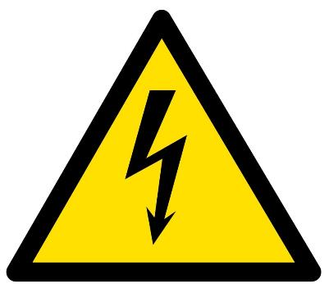

ELECTRICAL HAZARDS Training
OSHA - Susan Harwood Training Grant

Slide 2
Welcome
Please sign the attendance sheet
Take one handout
Answer the pre-test

Slide 3
location
Emergency Exits
Emergency Stairs
Location of restrooms
Location of water fountains

Slide 4
Disclaimer
This material was produced under grant number SH-05015-SH8 from the Occupational Safety and Health Administration, U.S. Department of Labor. It does not necessarily reflect the views or policies of the U. S. Department of Labor, nor does mention of trade names, commercial products, or organizations imply endorsement by the U. S. Government.

Slide 5
Agenda
Welcome
Introduction to OSHA
Worker’s rights
Introduction to Electrical Hazards
  What is electricity? How it works?
  Preventing Electrocution
Common Electrical Hazards
Electrical Protective Equipment
Exercises
Certificates

Slide 6
Introduction to osha
Overview of anti-retaliation provisions, employee rights, employer responsibilities, whistleblower laws, and OSHA’s complaint investigation procedures

Slide 7
Why is OSHA Important to You?
OSHA began because, until 1970, there were no national laws for safety and health hazards.
On average, 12 workers die every day from job injuries
Worker deaths in America are down–on average, from about 38 worker deaths a day in 1970 to 12 a day in 2013.
WORKER FATALITIES
4,836 workers were killed on the job in 2015
Falls — 364 out of 937 total deaths in construction in CY 2015 (38.8%)

Slide 8
Discussion Questions
When, during your work experience, did you first hear about OSHA?
What did you think about OSHA then?
What do you think OSHA’s job is?

Slide 9

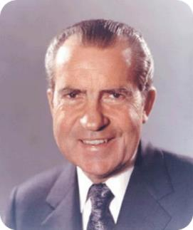
History of OSHA
OSHA stands for the Occupational Safety and Health Administration, an agency of the U.S. Department of Labor
OSHA’s responsibility is worker safety and health protection
On December 29, 1970, President Nixon signed the OSH Act
This Act created OSHA, the agency, which formally came into being on April 28, 1971

Slide 10

OSHA’s Mission
To save lives
To prevent injuries
To protect America’s workers

Slide 11
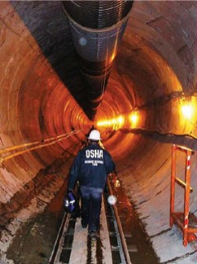


Strategies to Reduce Injuries and Deaths
Strong, fair, and effective enforcement.
Outreach, education, and compliance assistance.
Partnerships and other cooperative programs.

Slide 12
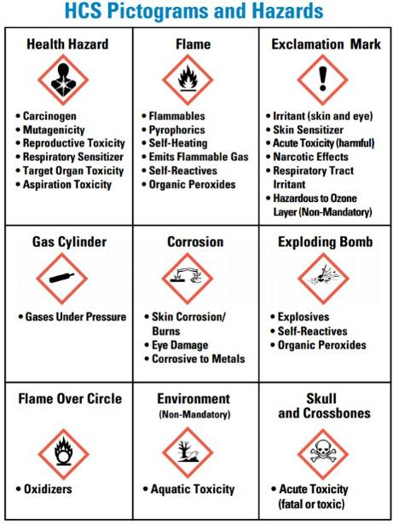
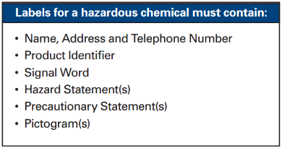
HCS Pictograms and Hazards
Labels for hazardous substances in your workplace

Slide 13
OSHA Inspections
The OSH Act authorizes OSHA compliance safety and health officers (CSHOs) to conduct workplace inspections at reasonable times.
OSHA conducts inspections without advance notice, except in rare circumstances (e.g. Imminent Danger)
In fact, anyone who tells an employer about an OSHA inspection in advance can receive fines and a jail term.

Slide 14
Inspections Process
A typical OSHA on-site inspection includes four stages:
Presentation of inspector credentials.
An opening conference.
An inspection walk-around.
A closing conference.

Slide 15
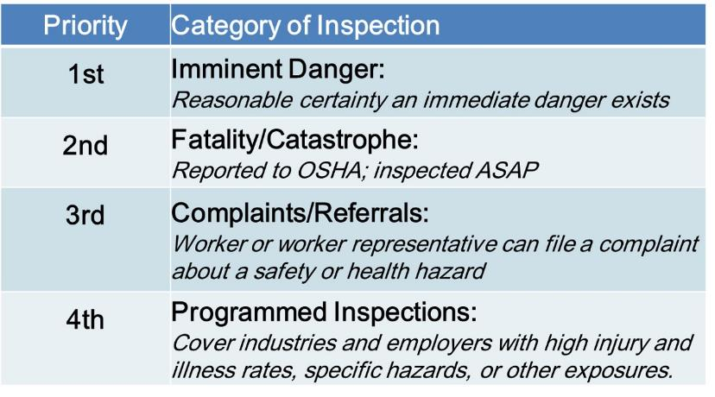
OSHA’s Inspection Priorities

Slide 16
OSHA’s Complaint Investigations
OSHA evaluates each complaint to determine how it can be handled best--an off-site investigation or an on-site inspection
Before beginning an inspection, OSHA staff must be able to determine from the complaint that there are reasonable grounds to believe that a violation of an OSHA standard or a safety or health hazard exists.
If OSHA has information indicating the employer is aware of the hazard and is correcting it, the agency may not conduct an inspection after obtaining the necessary documentation from the employer.

Slide 17
Rights as a Whistleblower
Employee may file a complain with OSHA under Section 11(c) if your employer retaliates against you by taking unfavorable personnel action because you engaged in protected activity relating to workplace safety and health.
OSHA requires that complaints must be filed within 30 days after the alleged retaliation.

Slide 18
Rights as a Whistleblower
Your employer may be found to have retaliated against you if your protected activity was a contributing or motivating factor in its decision to take unfavorable personnel action against you. Such actions may include:
  Firing or laying off
  Blacklisting
  Denying overtime or promotion
  Disciplining
  Denying benefits
  Failing to hire or rehire
  Intimidation
  Reassignment affecting promotion prospects
  Reducing pay or hour

Slide 19
Questions about OSHA?

Slide 20
Objectives
Given current OSHA and industry information regarding construction worksite illnesses, injuries and/or fatalities, the participant will be able to recognize electrocution hazards in construction.
  Identify major electrocution hazards
  Describe types of electrocution hazards
  Protect him/herself from electrocution hazards
  Recognize employer requirements to protect workers from electrocution hazards

Slide 21
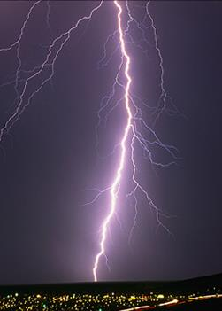
Electricity
Electricity is a natural energy force.
Electricity is also a man made energy force.
It is essential to modern life and taken for granted everyday.

Slide 22
Electricity
How many tools, equipment, artifacts work with electricity?
Some people make a living working with electricity, most people just around electricity
Out of 3,945 worker fatalities in private industry in calendar year 2012, 775 or 19.6% were in construction. Electrocutions 66 (9%) of all on-the-job fatalities that year, according to the Bureau of Labor Statistics.

Slide 23
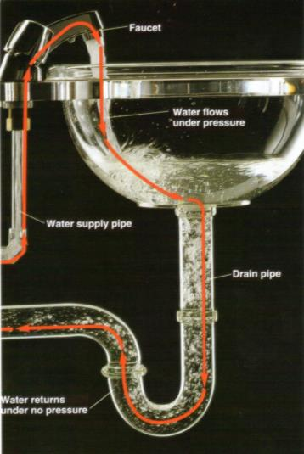
Understanding Electricity
Understanding Electricity

Slide 24
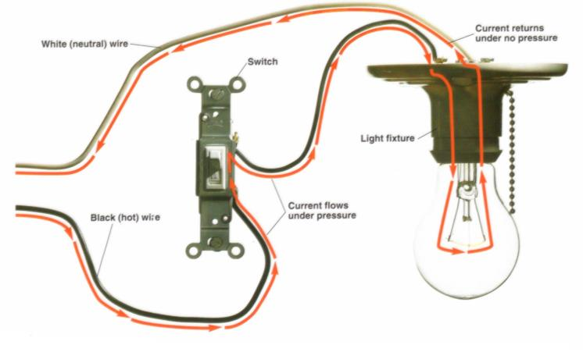
Understanding Electricity
Understanding Electricity

Slide 25
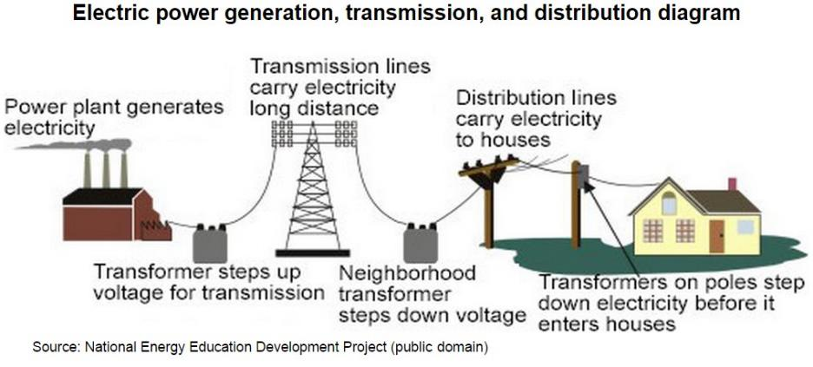
Electricity distribution
69,000 - 765,000V
22,000V
4,160 - 34,000V
600, 480, 277, 240, 208, 120V

Slide 26
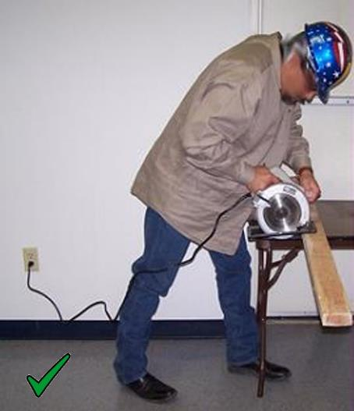
How Electricity Works
When electrical tools are working properly a complete circuit is maintained between the tool and the energy source.
Notes:
As shown in this picture, electricity comes from the outlet on the wall, through the wire, and then to the saw. Then following the path, the electricity goes through the saw, through the wire again and back to the outlet. This is what is referred to as a “Complete Circuit.” For an electrical tool to properly function it must have a complete path or circuit.

Slide 27
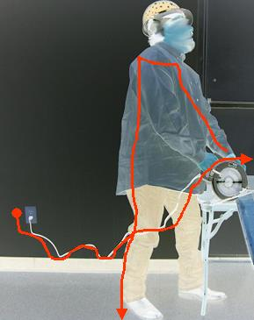
How Electricity Works
However, if the tool is damaged the person may come in contact with the electricity and can become a path for the current.
The person will be shocked!
Notes:
If you have a defective tool, frayed wire, bad outlet or other electrical hazard, you may come in contact with the electrical current.
When you contact electrical current, the results may be deadly. You may receive an electrical shock, be burned by the electricity or by thermal contact, or be electrocuted and die.
An electric shock can result in anything from a slight tingling sensation to immediate cardiac arrest and the severity depends on the following:
the amount of current flowing through the body,
the current’s path through the body,
the length of time the circuit or path remains in the body, and
the current’s frequency.
Remember, electrical current will take the path of least resistance. That path can start with your hand if you handle a defective tool or frayed or broken wire that has electrical current going through it. So please be extremely careful when using power tools.

Slide 28
definitions
CIRCUIT
A continuous loop of electrical current flowing along wires or cables.
CURRENT
The movement of electrons along a conductor.
AMPERE ( or amp)
Refers to the rate at which electrical power flows to a light, tool, or appliance.
VOLTAGE ( or volts)
A measurement of electricity in terms of Pressure.

Slide 29
Definitions
WATTAGE (or watt)
A measurement of electrical power in terms of total energy consumed. Watts can be calculated by multiplying the voltage times the amps.
CONDUCTOR
Any material that allows electrical current to flow through it. Copper wire is an especially good conductor.
INSULATOR
Any material, such as plastic or rubber, that resists the flow of electrical current. Insulating material protect wires and cables.

Slide 30
OSHA Standards
OSHA’s general industry electrical safety standards are published in Title 29 Code of Federal Regulations (CFR), Part 1910.302 through 1910.308 —Design Safety Standards for Electrical Systems, and 1910.331 through 1910.335 — Electrical Safety-Related Work Practices Standards.

Slide 31
OSHA Standards
OSHA’s Construction industry electrical safety standards are published in Title 29 Code of Federal Regulations (CFR) 1926 Subpart K. Part 1926.400 through 1926.499

Slide 32
What is an electrocution hazard?
Electrocution results when a person is exposed to a lethal amount of electrical energy.
An electrical hazard can be defined as a serious workplace hazard that exposes workers to the following:
  Burns
  Electrocution
  Shock
  Arc Flash/Arc Blast
  Fire
  Explosions
BE SAFE

Slide 33
BE SAFE
B = Burns:
A burn is the most common shock-related injury. Burns from electricity are one of three types: Electrical, Arc/Flash or Thermal Contact.
E = Electrocution:
Electrocution is fatal; it means to kill with electricity. Electrocution results when a human is exposed to a lethal amount of electrical energy.
S = Shock:
Shock results when the body becomes part of the electrical circuit; current enters the body at one point and leaves at another. Electrical shock is defined as a reflex response to the passage of electric current through the body.

Slide 34
BE SAFE
A = Arc Flash/Blast:
An arc flash is the sudden release of electrical energy through the air when a high-voltage gap exists and there is a breakdown between conductors. An arc flash gives off thermal radiation (heat) and bright, intense light that can cause burns. Temperatures have been recorded as high as 35,000 °F. High-voltage arcs can also produce considerable pressure waves by rapidly heating the air and creating a blast.
F = Fire:
Most electrical distribution fires result from problems with "fixed wiring" such as faulty electrical outlets and old wiring. Problems with cords (such as extension and appliance cords), plugs, receptacles, and switches also cause electrical fires.
E = Explosions:
An explosion can occur when electricity ignites an explosive mixture of material in the air.

Slide 35
What are the major types of electrocution hazards in construction?
contact with power lines,
  specially with overhead or buried
contact with energized sources,
  could cause electrical shock and burns or death
faulty extension cords,
improper grounding of equipment
overloaded circuits
wrong use of PPE and/or tools
wet/damp areas in the vicinity of electrical sources

Slide 36
Commonly Cited Violations
1910.305(b)(1): Unused openings
1910.303(g)(2): Exposed live parts
1910.305(b)(2): Missing covers
1910.304(f): Defective Ground
1910.305(g)(1)(iii): Prohibited uses of flexible cords.
Notes:
1 - 1910.305(b)91): Conductors entering boxes not protected against abrasions. Unused opening in boxes not effectively closed. {611}
2 - 1910.303(g)(2): Exposed live parts {553}
3 - 1910.305(b)(2): Electrical boxes missing covers {485}
4 - 1910.304(f)(4): Grounding path not permanent and continuous {454}
5 - 1910.305(g)(1)(iii): Prohibited uses of flexible cords and cables.
Prohibited uses include:
Used in place of fixed wiring.
Run through walls, doorways, windows or similar.
Attached to building surfaces.
Concealed behind building walls, ceilings, or floors.

Slide 37
Commonly Cited Violations
1910.303(f): Unlabeled disconnects
1910.305(g)(2)(iii): Strain relief
1910.303(b)(2): Listed & labeled
1910.303(b)(1): General Duty Clause
1910.303(g)(1): Access & working space.
Notes:
6 - 1910.303(f): Unlabelled disconnects {440}
7 - 1910.305(g)(2)(iii): No strain relief on flexible cords {370}
8 - 1910.303(b)(2): Listed / labeled equipment was not used in accordance with instructions included in listing/labeling {325}
9 - 1910.303(b)(1): Equipment not free from recognized hazards {238}
10 - 1910.303(g)(1): Sufficient access and working space was not provided and maintained about all electric equipment {210}
0-150VAC: 3’
151-600VAC: 3’
3.5 if live parts on one side and grounded on other
4 if live parts on both sides

Slide 38
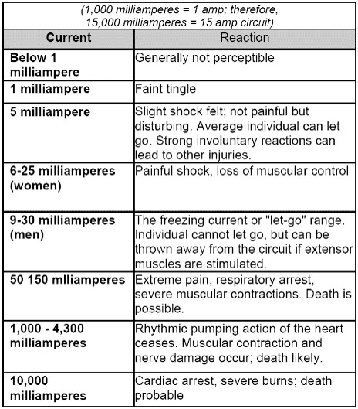
Body reaction to electricity

Slide 39
How does water affect the flow of electricity?
Pure water is a poor conductor. But small amounts of impurities in water like salt, acid, solvents, or other materials can turn water itself and substances that generally act as insulators into conductors or better conductors.
Dry wood, for example, generally slows or stops the flow of electricity. But when saturated with water, wood turns into a conductor. The same is true of human skin. Dry skin has a fairly high resistance to electric current. But when skin is moist or wet, it acts as a conductor. This means that anyone working with electricity in a damp or wet environment needs to exercise extra caution to prevent electrical hazards.

Slide 40
What causes shocks?
Electricity travels in closed circuits, normally through a conductor. But sometimes a person’s body — an efficient conductor of electricity — mistakenly becomes part of the electric circuit. This can cause an electrical shock. Shocks occur when a person’s body completes the current path with:
  both wires of an electric circuit;
  one wire of an energized circuit and the ground;
  a metal part that accidentally becomes energized due, for example, to a break in its insulation; or
  another “conductor” that is carrying a current.
When a person receives a shock, electricity flows between parts of the body or through the body to a ground or the earth.

Slide 41
Improper use of extension and flexible cords
Because they are exposed, flexible, and unsecured, they are more susceptible to damage than fixed wiring. Hazards are created when cords, cord connectors, receptacles, and cord- and plug connected equipment are improperly used and maintained.
To reduce hazards, flexible cords must connect to devices and to fittings in ways that prevent tension at joints and terminal screws.

Slide 42
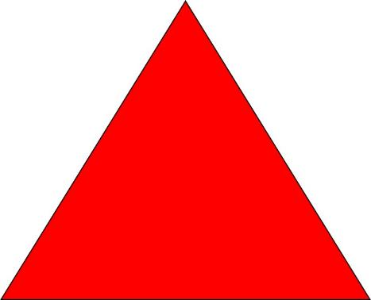
Electrocution Triangle
Electricity
Path
Time

Slide 43
Protective Triangle
keep away
Grounding
GFCI

Slide 44
How can I protect myself from electrocution hazards?
A. Maintain a safe distance from overhead power lines
B. Use ground-fault circuit interrupters (GFCI)
C. Inspect portable tools and extension cords
D. Use power tools and equipment as designed
E. Follow lockout/tagout procedures

Slide 45
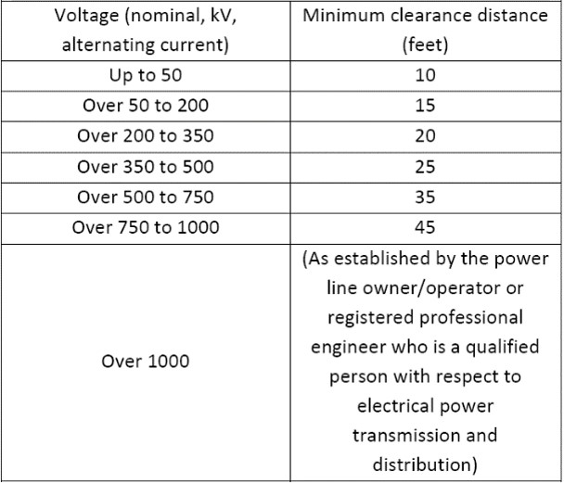
Minimum clearance distances

Slide 46
How can I protect myself from electrocution hazards?
Before work begins, be sure that the:
  Equipment/activity is located within a safe working distance from power lines
  Utility company has de-energized and visibly grounded the power lines or installed insulated sleeves on power lines
  Flagged warning lines have been installed to mark horizontal and vertical power line clearance distances
  Tools and materials used are nonconductive

Slide 47
How can I protect myself from electrocution hazards?
Verify the height of power lines and their proximity to cranes and lifting equipment
Use non-conductive ladders and retract them before moving them
Call utility companies before excavating
Hand dig within 3 ft of any cable location. More than one underground cable may be buried in area of locator markings

Slide 48
How can I protect myself from electrocution hazards?
Use ground-fault circuit interrupters (GFCI)
A "GFCI" is a ground fault circuit interrupter that is designed to protect people from severe and sometimes fatal electrical shock. A GFCI detects ground faults and interrupts the flow of electric current, and is designed to protect the worker by limiting the duration of an electrical shock.
There are three types of GFCI: receptacle, temporary/portable, and circuit breaker

Slide 49
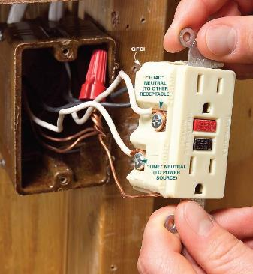
How can I protect myself from electrocution hazards?
1) Receptacle GFCI: Often found on construction work sites, outdoor areas and other locations where damp conditions do or could exist. The receptacle GFCI fits into the standard outlet box and protects users against ground faults when an electrical product is connected to the GFCI protected outlet

Slide 50
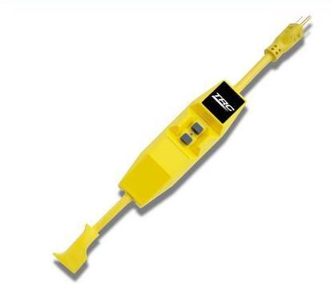
How can I protect myself from electrocution hazards?
2) Temporary/portable GFCI: AP portable GFCI is an extension cord combined with a GFCI. It adds flexibility in using receptacles that are not protected by GFCls. Extension cords with GFCI protection incorporated should be used when permanent protection is unavailable.

Slide 51
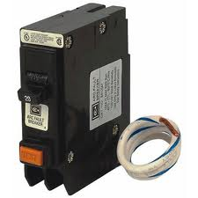
How can I protect myself from electrocution hazards?
3) Circuit Breaker GFCI: The GFCI circuit breaker controls an entire circuit, and is installed as a replacement for a circuit breaker on the main circuit board. Rather than install multiple GFCI outlets, one GFCI circuit breaker can protect the entire circuit. At sites equipped with circuit breakers, this type of GFCI might be installed in a panel box to give protection to selected circuits.

Slide 52
How can I protect myself from electrocution hazards?
Inspect portable tools and extension cords Workers need to inspect extension cords prior to their use for any cuts or abrasion. Extension cords may have damaged insulation. Sometimes the insulation inside an electrical tool or appliance is damaged.
When the insulation is damaged, exposed metal parts may become energized if a live wire inside touches them. Electric hand tools that are old, damaged, or misused may have damaged insulation inside.

Slide 53
How can I protect myself from electrocution hazards?
Use power tools and equipment as designed
Workers using power tools and equipment should follow tool safety tips to avoid misusing equipment.

Slide 54
How can I protect myself from electrocution hazards?
Tool safety tips
  Never carry a tool by the cord
  Never yank the cord to disconnect it
  Keep cords away from heat, oil, and sharp edges
  Disconnect when not in use and when changing accessories such as blades and bits
  Avoid accidental starting. Do not hold fingers on the switch button while carrying a plugged-in tool
  Use gloves and appropriate footwear
  Store in a dry place when not using
  Don’t use in wet/damp environments
  Keep working areas well lit
  Ensure that cords do not cause a tripping hazard
  Remove damaged tools from use
  Use double-insulated tools

Slide 55
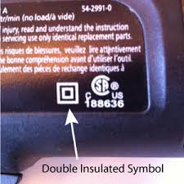
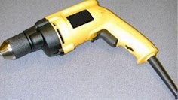
Double-insulated tools
Hand-held tools manufactured with non-metallic cases are called double-insulated. If approved, they do not require grounding under the National Electrical Code. Although this design method reduces the risk of grounding deficiencies, a shock hazard can still exist.

Slide 56
How can I protect myself from electrocution hazards?
Follow lockout/tagout procedures
Lockout/tagout is an essential safety procedure that protects workers from injury while working on or near electrical circuits and equipment. In addition, lockout/tagout prevents contact with operating equipment parts such as, blades, gears, shafts, etc.
Also, lockout/tagout prevents the unexpected release of hazardous gases, fluids, or solid matter in areas where workers are present.

Slide 57
Performing lockout/tagout on circuits
Identify all sources of electrical energy for the equipment or circuits in question
  Disable backup energy sources such as generators and batteries
  Identify all shut-offs for each energy source
  Notify all personnel that equipment and circuitry must be shut off, locked out, and tagged out (Simply turning a switch off is not enough)
  Shut off energy sources and lock switch gear in the OFF position. Each worker should apply his/her individual lock and keys kept with the worker
  Test equipment and circuitry to ensure they are de-energized. This must be done by a qualified person
  Deplete stored energy (for example, in capacitors) by bleeding, blocking, grounding, etc.
  Apply a lock or tag to alert other workers that an energy source or piece of equipment has been locked or tagged out
  Make sure all workers are safe and accounted for before equipment and circuits are unlocked and turned back on. Only a qualified person may determine when it is safe to re-energize circuits.

Slide 58
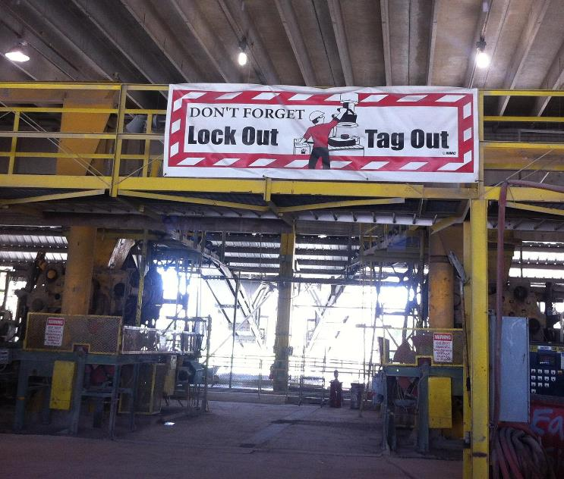
Lockout/Tagout

Slide 59
What is an employer required to do to protect workers from electrocution?
A. Ensure overhead power line safety
B. Isolate electrical parts
C. Supply ground-fault circuit Interrupters (GFCI)
D. Ensure proper grounding
E. Ensure power tools are maintained in a safe condition
F. Ensure proper guarding
G. Provide training
H. Enforce a LOTO (locked out, tagged out) safety- related work practices
I. Ensure Proper Use of Flexible Cords

Slide 60
Guarding
(Isolate electrical parts)
Guarding involves locating or enclosing electric equipment to make sure people don’t accidentally come into contact with its live parts.
Effective guarding requires equipment with exposed parts operating at 50 volts or more to be placed where it is accessible only to authorized people qualified to work with it.
Recommended locations are a room, vault, or similar enclosure; a balcony, gallery, or elevated platform; or a site elevated 8 feet (2.44 meters) or more above the floor. Sturdy, permanent screens also can serve as effective guards.

Slide 61
Guarding
(Isolate electrical parts)
Conspicuous signs must be posted at the entrances to electrical rooms and similarly guarded locations to alert people to the electrical hazard and to forbid entry to unauthorized people. Signs may contain the word “Danger,” “Warning,” or “Caution,” and beneath that, appropriate concise wording that alerts people to the hazard or gives an instruction, such as “Danger/High Voltage/Keep Out.”

Slide 62
What is an employer required to do to protect workers from electrocution?
OSHA ground-fault protection rules and regulations have been determined necessary and appropriate for worker safety and health. Therefore, it is the employer's responsibility to provide either:
(a) ground-fault circuit interrupters on construction sites for receptacle outlets in use and not part of the permanent wiring of the building or structure; or
(b) a scheduled and recorded assured equipment grounding conductor program on construction sites, covering all cord sets, receptacles which are not part of the permanent wiring of the building or structure, and equipment connected by cord and plug which are available for use or used by workers.

Slide 63
What is an employer required to do to protect workers from electrocution?
1926.404(b)(1)(i)
General. The employer shall use either ground fault circuit interrupters as specified in paragraph (b)(1)(ii) of this section or an assured equipment grounding conductor program as specified in paragraph (b)(1)(iii) of this section to protect employees on construction sites. These requirements are in addition to any other requirements for equipment grounding conductors.

Slide 64
What is an employer required to do to protect workers from electrocution?
1926.404(b)(1)(ii)
Ground-fault circuit interrupters. All 120-volt, single-phase 15- and 20-ampere receptacle outlets on construction sites, which are not a part of the permanent wiring of the building or structure and which are in use by employees, shall have approved ground-fault circuit interrupters for personnel protection. Receptacles on a two-wire, single-phase portable or vehicle-mounted generator rated not more than 5kW, where the circuit conductors of the generator are insulated from the generator frame and all other grounded surfaces, need not be protected with ground-fault circuit interrupters.
1926.404(b)(1)(iii)
Assured equipment grounding conductor program. The employer shall establish and implement an assured equipment grounding conductor program on construction sites covering all cord sets, receptacles which are not a part of the building or structure, and equipment connected by cord and plug which are available for use or used by employees. This program shall comply with the following minimum requirements:
1926.404(b)(1)(iii)(A)
A written description of the program, including the specific procedures adopted by the employer, shall be available at the jobsite for inspection and copying by the Assistant Secretary and any affected employee.
1926.404(b)(1)(iii)(B)
The employer shall designate one or more competent persons (as defined in 1926.32(f)) to implement the program.

Slide 65
What is an employer required to do to protect workers from electrocution?
The employer needs to ensure that all power tools and equipment are maintained in a safe condition to:
  Ground power supply systems, electrical circuits, and electrical equipment
  Frequently inspect electrical systems to insure path to ground is continuous
  Ensure workers understand to inspect electrical equipment prior to use
  Ensure ground prongs are not removed from tools or extension cords
  Ground exposed metal parts of equipment

Slide 66
What is an employer required to do to protect workers from electrocution?
Provide training
Workers need be trained in and familiar with the safety-related work practices that pertain to their respective job assignments. Train workers working with electric equipment in safe work practices to:
  De-energize electric equipment before inspecting or repairing
  Use cords, cables, and electric tools that are in good repair
  Lockout/Tagout recognition and procedures
  Use appropriate protective equipment

Slide 67
Wire insulation
Before connecting electrical equipment to a power source, it’s a good idea to check the insulation for any exposed wires for possible defects. Insulation covering flexible cords such as extension cords is particularly vulnerable to damage.
The insulation that covers conductors in non-construction applications is regulated by Subpart S of 29 CFR 1910.302 through 1910.308, Wiring Design and Protection.
Subpart S generally requires insulation on circuit conductors. It also specifies that the insulation used should be suitable for the voltage and conditions. Conductors used in construction applications are regulated by Subpart K of 29 CFR 1926.402 through 1926.408

Slide 68
Ladders and Electrocution
1926.1053(b)(12)
Ladders shall have nonconductive side rails if they are used where the employee or the ladder could contact exposed energized electrical equipment, except as provided in § 1926.955(b) and (c)
Conductive ladders. Portable metal ladders and other portable conductive ladders may not be used near exposed energized lines or equipment. However, in specialized high-voltage work, conductive ladders shall be used when the employer demonstrates that nonconductive ladders would present a greater hazard to employees than conductive ladders. part.
Ladder and Electrocutions

Slide 69
TOOLS
Hand tools are tools that are powered manually. Hand tools include anything from axes to wrenches. The greatest hazards posed by hand tools result from misuse and improper maintenance.
Some examples include the following:
  If a chisel is used as a screwdriver, the tip of the chisel may break and fly off, hitting the user or other employees.
  If a wooden handle on a tool, such as a hammer or an axe, is loose, splintered, or cracked, the head of the tool may fly off and strike the user or other employees.
  If the jaws of a wrench are sprung, the wrench might slip.
  If impact tools such as chisels, wedges, or drift pins have mushroomed heads, the heads might shatter on impact, sending sharp fragments flying toward the user or other employees.
The employer is responsible for the safe condition of tools and equipment used by employees. Employers shall not issue or permit the use of unsafe hand tools. Employees should be trained in the proper use and handling of tools and equipment.

Slide 70
Prevent hazards associated with the use of power tools
Workers should observe the following general precautions:
  Never carry a tool by the cord or hose.
  Never yank the cord or the hose to disconnect it from the receptacle.
  Keep cords and hoses away from heat, oil, and sharp edges.
  Disconnect tools when not using them, before servicing and cleaning them, and when changing accessories such as blades, bits, and cutters.
  Keep all people not involved with the work at a safe distance from the work area.
  Secure work with clamps or a vise, freeing both hands to operate the tool.
  Avoid accidental starting. Do not hold fingers on the switch button while carrying a plugged-in tool.
  Maintain tools with care; keep them sharp and clean for best performance.
  Follow instructions in the user’s manual for lubricating and changing accessories.
  Be sure to keep good footing and maintain good balance when operating power tools.
  Wear proper apparel for the task. Loose clothing, ties, or jewelry can become caught in moving parts.
  Remove all damaged portable electric tools from use and tag them: “Do Not Use.”

Slide 71
Electrical Hazards
The following is a list of a common electrical hazards found on construction sites:
Damaged insulation
Overloaded circuits
Wet conditions
Damaged tools and equipment
Improper grounding
Exposed electrical parts
Inadequate wiring
Overhead power lines
Notes:
In order to reduce the risks of contacting electrical current, you must learn to recognize and identify electrical hazards. Once a hazard has been identified, it must be corrected. If you do not have the knowledge, skills or abilities to correct the hazard, then you must report the hazard to your foreman, supervisor or someone who can get the hazard corrected.
The purpose of this program is to show you common hazards so that you recognize them and get them corrected. Hazard recognition is the key. It is better to recognize electrical hazards before they can harm you or a fellow worker.
We will be discussing each of the following common electrical hazards found on constructions sites:
Improper grounding
Exposed electrical parts
Inadequate wiring
Overhead power lines
Damaged insulation
Overloaded circuits
Wet conditions
Damaged tools and equipment

Slide 72
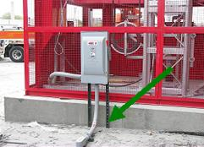

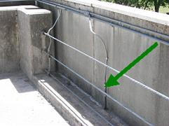
Improper Grounding
Grounding is the process used to eliminate unwanted voltage.
A ground is a physical electrical connection to the earth.
Notes:
Grounding is the process used to eliminate unwanted voltage. A ground is a physical connection to the earth. This allows leakage voltage to dissipate to the ground instead of going through the worker and possibly causing an injury.

Slide 73
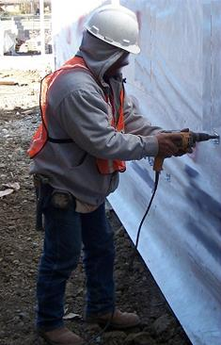
Improper Grounding
Electrical equipment must be properly grounded.
Grounding reduces the risk of being shocked or electrocuted.
Notes:
When a power tool is not grounded properly, a hazard exists because unwanted voltage cannot be safely eliminated. The metal parts of an electrical wiring system that we touch (switch plates, ceiling light fixtures, conduit, etc.) should be grounded and at 0 volts. If the system is not grounded properly, these parts may become energized. If you contact a defective electrical device that is not grounded (or grounded improperly), the electrical current will take the path of least resistance which will be YOU and you will be shocked.
The most common OSHA electrical violation is improper grounding of equipment and wires.

Slide 74
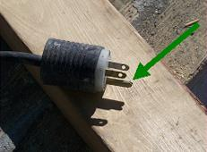
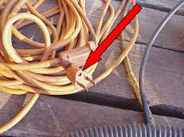
Improper Grounding
The ground pin safely returns leakage current to ground.
NEVER remove the ground pin.
Notes:
The ground pin in a flexible extension cord is designed to return leakage current back to ground. The path from the pin to the ground must be continuous in order to dissipate leakage current. If an extension cord has a broken ground pin or plug it may not provide a continuous path to ground. This is an electrical hazard and should be corrected immediately.
Many times the ground pin is removed so the plug will fit into a two hole outlet. Other times the pin is damaged due to rough handling. Without the pin, the path to ground does not exist and you are at risk of receiving an electrical shock. Never remove the ground pin from a flexible extension cord.

Slide 75
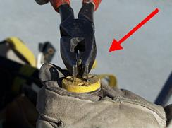
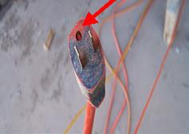
Improper Grounding
Removing the ground pin removes an important safety feature.
You can get shocked!
Notes:
When you remove the ground pin, you have removed one of the most important safety features built into the flexible extension cord. Without the direct path to ground, any leakage current has the potential to shock and injure you!
NEVER use an extension cord or electric tool that has a broken or missing ground pin!

Slide 76
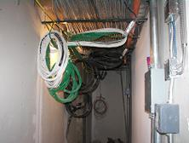
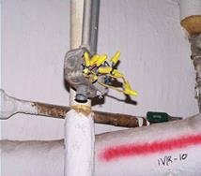
Exposed Electrical Parts
Exposed wires or terminals are hazardous.
Report these conditions to your supervisor.
Notes:
When covers of electrical panels or equipment are broken, incomplete, or missing this creates a serious hazard. Some electrical hazards to lookout for are:
Wires or other electrical parts that are exposed.
Cover removed from a wiring or breaker box.
Missing breaker from a panel box exposing the wires or terminals.
Overhead wires coming into the jobsite that may be exposed.
Exposed electrical terminals in motors, appliances, and electric equipment.
Older equipment that may have exposed electrical parts.
If you contact exposed live electrical parts, you will be shocked and possibly injured severely.
You need to recognize that an exposed electrical component is a hazard. If you see these conditions, report them to your supervisor immediately.

Slide 77
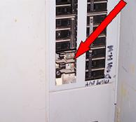
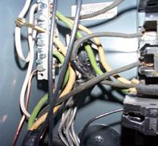
Exposed Electrical Parts
This electrical panel has missing circuit breakers.
Never use a panel that has exposed wires.
Notes:
In this example an electrical panel has exposed wires due to missing circuit breakers. Never use a panel that has exposed wires.

Slide 78
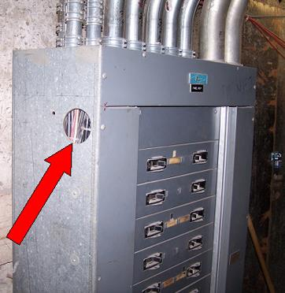
Exposed Electrical Parts
All openings must be closed.
Notes:
Openings in panel boxes, junction boxes, and any other electrical boxes must be closed. The openings expose electrical parts and are electrical hazards.
In this picture, there is an opening in the electrical panel exposing the internal wires – very hazardous!

Slide 79
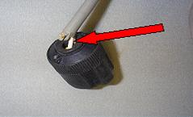
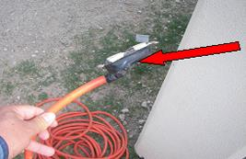
Exposed Electrical Parts
Outer insulation on electrical cords must be intact.
Notes:
Outer insulation on electrical cords must be intact. When the outer insulation pulls away from the plug, the inner wires are exposed. This can expose the internal wires to abrasions, breakage, and environmental conditions. The insulation should enter the plug completely, covering and protecting the inner wires.

Slide 80
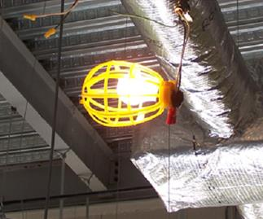
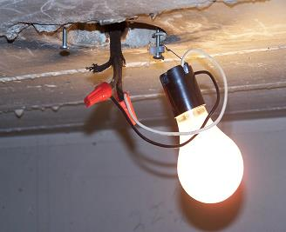
Exposed Electrical Parts
On construction sites, temporary lighting must be properly guarded and protected to avoid contact with broken bulbs and avoid potential shocks.
Notes:
Temporary lighting has to be done with safety in mind. Light fixtures should be properly grounded, with a cage around the bulb, and wires dressed properly. In the unsafe example, this bulb is exposed and could cause a serious eye injury or cuts if hit by an object. The bulb socket is also not properly grounded and could also cause a more serious injury if touched by a worker. You must always keep safety in mind when working near electricity.

Slide 81
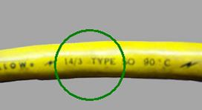
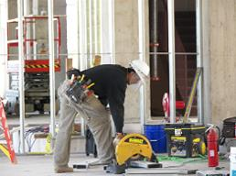
INADEQUATE WIRING
INADEQUATE WIRING
Use properly rated extension cords.
Make sure your power tools are being used with a properly rated extension cord.
Notes:
An electrical hazard exists when the gauge of the wire is too small for the current it will carry.
Normally, the circuit breaker is matched to the wire size. When the gauge of a wire is too small for the current it is supposed to carry, the wire will heat up. The heated wire could cause a fire.
Make sure to use properly rated extension cords when working with power tools. When you use an extension cord, make sure the gauge of the wire you are placing into the circuit is not too small for the equipment. Even if the circuit breaker is the right size, if the gauge of the wire is too small, you are creating an electrical hazard. A tool plugged into the extension cord may use more current than the cord can handle without tripping the circuit breaker. This could damage the tool in addition to causing a fire. Always make sure that any extension cord you are going to use is properly rated for the equipment you are going to plug into it.

Slide 82
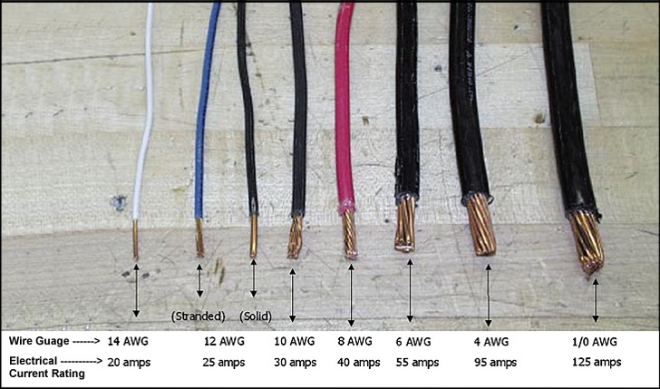
Inadequate wiring
INADEQUATE WIRING
Notes:
Electrical hazards result from using the wrong size or type of wire. You must avoid such hazards and create a safe work environment. You must choose the right size wire for the amount of electrical current expected in a circuit. The wire must be able to handle the current safely without heating up or tripping the circuit breaker. The wire’s insulation must be appropriate for the voltage and tough enough for the environment. Connections need to be reliable and protected.

Slide 83
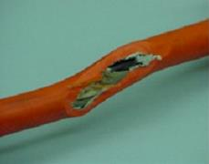
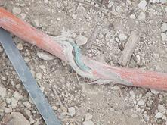
Damaged Insulation
Defective or inadequate insulation is a hazard.
Insulation prevents conductors from contacting each other or you.
Notes:
Insulation that is defective or inadequate is an electrical hazard. Usually, insulation is made of a plastic or rubber covering over the wires. Insulation prevents conductors from coming in contact with each other or people. Insulation also protects the wires from getting damaged due to the environment.
Electrical hazards can occur in many different ways and you should be aware of the possible situations. When insulation is damaged, exposed metal parts may become energized if a live wire inside touches them. Extension cords may have damaged insulation or the insulation inside an electrical tool may be damaged. Electric hand tools that are old, damaged, or misused may have damaged insulation inside. If you touch damaged power tools or other equipment, you will receive a shock. You are more likely to receive a shock if the tool is not grounded or not double-insulated. Double-insulated tools have two insulation barriers and no exposed metal parts.

Slide 84
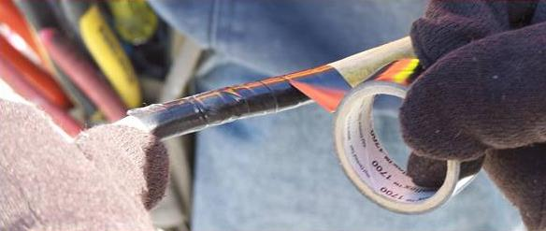
Damaged Insulation
Never attempt to repair a damaged cord with tape.
Notes:
When a flexible extension cord is damaged, it should be removed from service and replaced immediately. Most methods of repairing an extension cord do not maintain the original integrity of the insulation. Get a new cord.

Slide 85
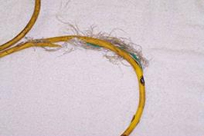
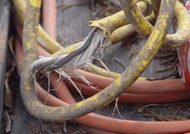
Damaged Insulation
Never use tools or extension cords with damaged insulation.
Notes:
This flexible extension cord has damage to the outer insulation exposing the inner wires. The inner wires have also received damage to the insulation. Never use a tool or an extension cord in this condition.

Slide 86
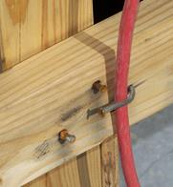
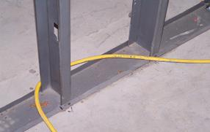
Damaged Insulation
Never hang extension cords from nails or sharp objects.
Notes:
When using flexible extension cords, be careful to not damage the insulation. Follow these three basic cautions:
Do not hang a cord from a nail or other sharp object that may damage the insulation.
Do not run cords through areas that may have sharp edges that can damage the cord.
Do not hang or drape an electrical cord on conductive objects. If they damage the cord, or if it is already damaged, the conductive surface may become energized and shock you or another worker.

Slide 87
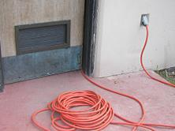
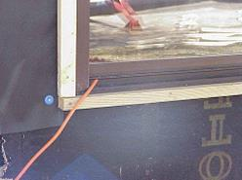
Damaged Insulation
Do not run extension cords through doors or windows.
Notes:
Do not run extension cords through windows, doors, walls or other areas where they could be cut, pinched or otherwise damaged. When a cord is pinched or cut, damage may occur to the inner wires without evidence on the outside.

Slide 88
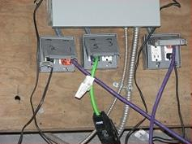

Overloaded Circuits
Overloaded circuits can cause fires.
Use proper circuit breakers.
Notes:
Overloads in an electrical system are hazardous because they can produce heat, arcing or even a fire. Wires and other components in an electrical system have a maximum amount of electrical current they can carry safely. If too many devices are plugged into a circuit, the electrical current will heat the wires to a very high temperature. If any one tool uses too much current, the wires will heat up also.
In order to prevent too much electrical current in a circuit, a circuit breaker or fuse is placed in the circuit. If there is too much current in the circuit, the breaker “trips” and opens like a switch. If an overloaded circuit is equipped with a fuse, an internal part of the fuse melts, opening the circuit. Both breakers and fuses do the same thing = open the circuit to shut off the electrical current. If the breakers or fuses are too big for the wires they are supposed to protect, an overload in the circuit will not be detected and the current will not be shut off. Overloading leads to overheating of circuit components (including wires) and may cause a fire.

Slide 89


Overloaded Circuits
Never overload an outlet.
Notes:
Never overload an outlet by plugging too many cords into the same receptacle. Too much current will be pulled, the wires can overheat and may cause a fire!
The worse part of all is that sometimes the fires occur inside the walls. Because of that, sometimes it’s too late to stop the fire from spreading. So be very careful not to overload outlets or extension cords.

Slide 90


Overloaded Circuits
Do not use power strips or surge protectors on construction sites.
Use a 3-way extension with a GFCI instead.
Notes:
Do not use power strips or surge protectors on a construction site, they are not designed for that use. Power strips are usually designed for home use and cannot be used with power tools on a construction site.
Power strips are very hazardous if used in wet areas.

Slide 91

Damaged Tools and Equipment
Do not use electric tools that are damaged.
You may receive a shock or be electrocuted.
Notes:
Do not use electrical tools that are damaged. If you use tools that are damage you may be shocked. Conductors may energize the tool and when you use it, the electrical current may pass through you. Be careful, if you suspect a tool is defective report it to your supervisor or use another tool that you know properly works.
Tag the one that is damaged or remove it from the area so nobody else uses it by mistake.

Slide 92

Damaged Tools and Equipment
Double insulated tools are labeled.
It will be marked “Double Insulated”.
It will have the following symbol:
Notes:
Whenever possible use double insulated tools. These tools are designed with a greater level of safety for the user.
In this picture, the outside case is plastic and keeps the worker insulated from the electrical parts.
You can tell if a tool is double insulated by looking at the label. It will be marked “Double Insulated” and have the “square inside a square” symbol.

Slide 93


Wet conditions
Wet conditions are hazardous.
Damaged insulation increases the hazard.
Notes:
Anyone working with electricity in a damp or wet environment needs to exercise extra caution to prevent injury.
Working in wet conditions is hazardous because you may become an easy path for electrical current. If you touch a live wire or other electrical component—and you are well-grounded because you are standing in a small puddle of water—you will receive a shock and probably be either knocked out or killed.
Damaged insulation, equipment, or tools can expose you to live electrical parts. A damaged tool may not be grounded properly, so the housing of the tool may be energized, causing you to receive a shock.
Improperly grounded metal switch plates and ceiling lights are especially hazardous in wet conditions. But remember: you don’t have to be standing in water to be electrocuted. Wet clothing, high humidity, and perspiration also increase your chances of being electrocuted.

Slide 94


Wet conditions
Always avoid using tools in wet locations.
Water increases the risk of electric shock.
Notes:
Always avoid using electric tools in wet locations. Any water or humidity will increase your risk of receiving an electric shock.
Remember, electrical current will always take the path with least resistance. That path is usually YOU -- especially if you’re standing in a puddle of water. So be extra careful and try to avoid working in these type of areas.

Slide 95


Overhead Power Lines
Survey the site for overhead power lines.
Never store materials or equipment under overhead power lines.
Notes:
When working on a construction site, you should always survey the site to look for overhead power lines. Always look up!
Most people do not realize that overhead power lines are usually not insulated. More than half of all electrocutions are caused by direct contact by workers with energized power lines. This situation is the most serious electrical hazard. It could cost you your life if you’re not careful and aware of overhead power lines.
Never store materials and equipment under or near overhead power lines.

Slide 96


Overhead Power Lines
Maintain a distance of at least 10’ between tools and equipment and overhead power lines.
Shocks and electrocutions occur where physical barriers are not in place to prevent contact with the wires.
Notes:
Today, most electrocutions involving overhead power lines are caused by failure to maintain proper work distances. Shocks and electrocutions occur where physical barriers are not in place to prevent contact with the wires. When dump trucks, cranes, work platforms, or other conductive materials (such as pipes and ladders) contact overhead wires, the equipment operator or other workers can be killed.
The minimum distance for voltages up to 50kV is 10 feet. For voltages over 50kV, the minimum distance is 10 feet plus 4 inches for every 10 kV over 50kV.
When working around overhead power lines and using ladders, be sure to use ladders made of non-conductive materials. Wood and plastic are materials that are “Non-Conductive.”

Slide 97


Overhead Power Lines
Maintain safe distances between scaffolding and overhead power lines.
Notes:
When working with scaffolding, you must stay clear of power lines - including when they are erected, used, dismantled, altered, or moved. Contact the power company and have the power shut-off to those lines while working near them. If that is not possible, have the power company insulate the lines. Always maintain the minimum safe distance of 10’ from the lines.
Make sure that any conductive materials, such as ladders, conduit, long handled tools, and any other conductive material, used on the scaffolding do not come near the power lines.

Slide 98


Overhead Power Lines
Overhead power lines are very dangerous.
Never attempt to contact an overhead power line.
Notes:
Because overhead power lines are very dangerous, you must always be extra careful when working near them. Remember, power lines carry higher voltage on them. If you or your equipment comes in contact with them you could risk electrocution and possibly death.

Slide 99

Accident Prevention
A willing, positive attitude towards safety will help make a safer work environment.
Notes:
A willing, positive attitude towards safety in the workplace will help make a safer environment. You must recognize potential hazards around you and make every effort to avoid and reduce hazards.

Slide 100



Accident Prevention
Always consider these safety precautions:
  Personal protective equipment (PPE),
  Inspect tools,
  Ground fault circuit interrupters (GFCIs),
  Lock-out/tag-out.
Notes:
Electrical accidents can be extremely dangerous and often result in serious injury or death. When working with electricity always consider some of these safety precautions:
Personal protective equipment (PPE)
Inspect tools
Ground fault circuit interrupters (GFCIs)
Lock-out/tag-out

Slide 101

Personal Protective Equipment (PPE)
PPE for electrical hazards include:
  hardhats
  rubber or insulating gloves
  insulating clothing
NEVER use damaged PPE!
Notes:
When exposed to possible electrical hazards Personal Protective Equipment (PPE) can be used for an additional measure of safety. Such PPE includes hardhats, rubber or insulating gloves, and insulating clothing. It is important to use the proper PPE when protecting yourself from electrical hazards. NEVER use damaged PPE.

Slide 102

Personal Protective Equipment (PPE)
Use appropriate rubber insulating gloves.
Make sure the gloves fit properly.
Make sure the glove rating matches with the work to be performed.
Not all gloves can be used to prevent electric shock.
Notes:
When performing work that may bring you in contact with electrical energy you should use the appropriate rubber insulating gloves. However, not all gloves can be used when working with electricity. The glove rating must match the work to be conducted.
You must be trained in the use of specific types of gloves before working with electricity.

Slide 103

Personal Protective Equipment (PPE)
Hard hats offer protection.
Hard hats are rated for certain uses.
Metal hard hats SHOULD NOT be used when working close to electrical lines.
Notes:
Hard hats offer protection so you do not contact electric current with your head. Hard hats are rated for certain uses. Be sure to use the appropriately rated hard hat. Never use a metal or fiber-metal hard hat like the one in this picture when working with electrical equipment.
If you’re not sure about the material of the hard hat, don’t use it, find one that is properly marked. Remember, you can become a very good conductor if you wear a metal hard hat, and that could be fatal.

Slide 104


Inspect tools and chords
Inspect tools and cords completely before using for:
  cracks
  damaged insulation
  broken ground pins
  frayed line cord
  loose parts
  any other damage
Notes:
As an everyday routine at work or home, before using any electrical tool or extension cord, be sure to inspect it completely for:
cracks
damaged insulation
broken ground pins
frayed line cords
loose parts
any other damage
Being aware of electrical hazards can prevent serious injuries and possibly save your life!

Slide 105

GFCI
OSHA requires the use of GFCIs on all construction sites.
Notes:
OSHA ground-fault protection rules and regulations are necessary for employee safety and health. Therefore, it is the employer’s responsibility to provide either: (a) GFCIs on construction sites for receptacle outlets in use and not part of the permanent wiring of the building or structure; or (b) a scheduled and recorded assured equipment grounding conductor program on construction sites, covering all cord sets, receptacles which are not part of the permanent wiring of the building or structure, and equipment connected by cord and plug which are available for use or used by employees.
The employer is required to provide approved GFCIs for all 120- volt, single-phase, 15- and 20-ampere receptacle outlets on construction sites that are not a part of the permanent wiring of the building or structure and that are in use by employees. If a receptacle or receptacles are installed as part of the permanent wiring of the building or structure and they are used for temporary electric power, GFCI protection shall be provided. Receptacles on the ends of extension cords are not part of the permanent wiring and so the cord’s receptacle must be of the GFCI type whether or not the extension cord is plugged into permanent wiring. These GFCIs monitor the current-to-the-load for leakage to ground.

Slide 106

GFCI
A GFCI is a fast-acting circuit breaker.
It senses small imbalances in the circuit caused by current leakage to ground.
Notes:
A GFCI is a fast-acting circuit breaker that senses small imbalances in the circuit caused by current leakage to ground and, in a fraction of a second, shuts off the electricity.

Slide 107

GFCI
It continually matches the amount of current coming and going to an electrical device.
The GFCI looks for a difference of approximately 5 milliamps.
Notes:
The GFCI continually matches the amount of current going to an electrical device against the amount of current returning from the device along the electrical path. Whenever the amount “going” differs from the amount “returning” by approximately 5 milliamps, the GFCI interrupts the electric power within as little as 1/40 of a second.
When using a GFCI it is important to test the GFCI and make sure it is working properly. Just press the button marked “Test” and it will trip the device. No electricity will pass. Secondly press the button marked “Re-set” and the device is ready for use.

Slide 108

Lock-out/Tag-out
Workers must ensure electricity is off and “locked-out” before work is performed.
Notes:
Using a lock-out/tag-out program is another way to keep workers safe when working with electricity. Before any work is performed on electrical systems, workers must ensure that the equipment is turned off and “locked-out”. The following is an overview of the Lock-out/Tag-out program.
When working with electricity, turning the equipment off is not enough. Someone could turn the equipment back on unaware to the worker. To prevent this, the power switch must be locked in the off position.

Slide 109

Lock-out/Tag-out
The switch must be tagged.
The tag lets others know why the switch is off.
Notes:
Once the on/off switch is securely locked out, the switch must be tagged. The tag serves as a warning to let others know why the switch has been turned off.

Slide 110

Lock-out/Tag-out
Locks and tags are warning signs.
You must be trained in lock-out/tag-out procedures.
Notes:
The lock and the tag are warning signs. If you see equipment that is locked and tagged do not touch it. It is locked and tagged for a reason.
If you are required to work on electrical equipment you must be trained in lock-out/tag-out procedures specific for that site.

Slide 111
Major hazards summary

Slide 112

Blocked Electrical Panels

Slide 113

Strain on Conductors

Slide 114

Inadequate Strain Relief on Cord

Slide 115

Exposed Live Parts
Employee’s cap is hung on power strip energized to 120VAC

Slide 116

Exposed Live Parts

Slide 117

Exposed live parts
Missing breakers inside of circuit breaker panel

Slide 118

Ungrounded Cords
Ground pin missing on extension cord

Slide 119

Damaged Faceplate

Slide 120

Utility Boxes
Utility boxes are not approved for usage as extension cords.

Slide 121

Receptacles in Wet Locations
Receptacles in wet or damp locations need covers.

Slide 122

Receptacles in Wet Locations
Receptacles in wet or damp locations need covers.

Slide 123

Damaged Faceplate

Slide 124

Portable Electric Tools
Inspect before usage.
Remove from service tools with damaged cords.
Use grounded or double insulated tools.
Check continuity of tool.

Slide 125
Hazard Assessment
Employers are required to assess the workplace to determine if hazards that require the use of personal protective equipment are present or are likely to be present.

Slide 126
Personal Protective Equipment
Head protection - overhead hazards
Eye protection - grinding, chipping, or sawing operations.
Hearing protection - noisy environments
Respiratory protection - exposure levels exceed permissible exposure limits.
Foot protection - falling, rolling, or sharp object.

Slide 127

Rubber Gloves
Must be air tested daily before usage.
Must be electrically tested every 6 months or replaced.
Before issuance gloves may be stored for up to 1 year without being tested.

Slide 128
Electrical
Protective Equipment

Slide 129
Design Requirements 1910.137(a)
Manufacture and Marking
  Class of equipment (0, 1, 2, 3, or 4)
  Type of equipment (I or II)
Notes:
Class:
00 - 0.5kV (not addressed by standard)
0 – 1kV Use Voltage, 5kV Test voltage
1 – 7.5kV Use Voltage, 10kV Test voltage
2 – 17kV Use Voltage, 20kV Test voltage
3 - 26.5kV Use Voltage, 30kV Test voltage
4 - 36kV Use Voltage, 40kV Test voltage
Type:
I - Natural materials
II - Man-made materials

Slide 130

Class Label
Class 4 - Designed to insulate up to 40,000 volts.
Type II - Is molded from man-made materials.

Slide 131

Rubber Insulating Matting
Notes:
Rubber matting for floor covering around electrical apparatus

Slide 132

Rubber Insulating Blanket
Notes:
Look for Identification & test markings
Black blankets are Type I – natural rubber (For Bashlin only)
Orange blankets are Type II – Ozone Resistant synthetic (For Bashlin only)

Slide 133

Blanket Clamps

Slide 134

Rubber insulating sleeves

Slide 135

Rubber insulating sleeves
Identification markings

Slide 136

Rubber insulating sleeves
Test markings

Slide 137

Rubber insulating gloves
Identification markings

Slide 138

Rubber Insulating Glove
Test Sticker

Slide 139
In-service Care and Use 1910.137(b)
Maximum use voltage to conform to Table I-5.
Equipment damage inspection:
  No holes, tears, cuts, or punctures; no ozone cutting or checking; no embedded foreign objects; no swelling, softening, hardening, etc.
Notes:
Class:
00 - 0.5kV (not addressed by standard)
0 - 1kV Use Voltage, 5kV Test voltage
1 - 7.5kV Use Voltage, 10kV Test voltage
2 - 17kV Use Voltage, 20kV Test voltage
3 - 26.5kV Use Voltage, 30kV Test voltage
4 - 36kV Use Voltage, 40kV Test voltage

Slide 140

Ozone Damage
Severe ozone damage caused by stretching over top of primary

Slide 141

Ozone Damage
Damage caused when gloves are kept in an inside-out position for a long period of time

Slide 142

Cut in blanket
Sharp gaffs often cause crescent-shaped cuts in blankets

Slide 143

Air Testing of Rubber Gloves
1910.137(b)(2)(ii)
Notes:
Rubber glove air test demonstration

Slide 144


Air Testing of Rubber Gloves
1910.137(b)(2)(ii)

Slide 145

Rubber Insulating Equipment Test Intervals 1910.137(b)(2)(viii)
Notes:
* Before first issuance

Slide 146


Glove Protector
Notes:
ASTM Specifications, the minimum distance between the edge of the lineman’s glove cuff and the protector glove is 1”/10KV
Minimum gap distance between glove & protector, by Class:
0 – 1” (1kV Use Voltage, 5kV Test voltage)
1 – 1” (7.5kV Use Voltage, 10kV Test voltage)
2 – 2” (17kV Use Voltage, 20kV Test voltage)
3 - 3” (26.5kV Use Voltage, 30kV Test voltage)
4 - 4” (36kV Use Voltage, 40kV Test voltage)

Slide 147

Leather Protector
Leather Protector glove worn without rubber gloves.

Slide 148

Rubber Glove Storage

Slide 149

Rubber Glove Liners
Notes:
These cotton linemen’s glove liners warm the hand in the winter and absorb summer perspiration.

Slide 150

Glove Dust
Notes:
Lubricates while it absorbs moisture & perspiration. It will not damage natural rubber.
Petroleum products like vaseline will destroy natural rubber.

Slide 151

Rubber Blanket Field Testing
Field testing of rubber blanket with cover gear & tools on tarp.

Slide 152

Insulating Line Hoses
Notes:
Top picture: Type II Ozone resistant line hoses in straight & connector end designs.
Bottom picture: Line hose connectors.

Slide 153

Insulator Cover

Slide 154
Exercises

Slide 155

Recognize Any Hazard(s)?

Slide 156

Yes
No employer shall permit a worker to work in such proximity to any part of an electric power circuit that the worker could contact the electric power circuit in the course of work

Slide 157

Recognize Any Hazard(s)?

Slide 158

Yes
Crossing electrical line must be supported, protected or removed to safeguard workers

Slide 159

Recognize Any Hazard(s)?

Slide 160
Yes
Spliced electrical extension cords. Extension cords should be marked DO NOT USE. Also, bad housekeeping, trip hazard and unprotected hole in photograph

Slide 161

Recognize Any Hazard(s)?

Slide 162
YES
1. No GFCI
2. System not grounded
3. Openings where conductors entered not closed
4. No cover on boxes
5. Panel boards were not dead front

Slide 163

Recognize Any Hazard(s)?

Slide 164
YES
Electric drill flexible cord was spliced to a non-flexible conductor with damaged insulation

Slide 165

Recognize Any Hazard(s)?

Slide 166
Yes
Scaffold was erected 4 ½ feet from 7.2 kV power lines

Slide 167

Recognize Any Hazard(s)?

Slide 168
YES
Continuous path to ground not maintained; multiple cords used for fixed equipment

Slide 169

Recognize Any Hazard(s)?

Slide 170
YES
Employer was operating a stand fan without grounding protection

Slide 171

Recognize Any Hazard(s)?

Slide 172

Yes
Conductors entering boxes, cabinets, or fittings shall be protected from abrasion.
Openings through which conductors enter shall be effectively closed

Slide 173

Recognize Any Hazard(s)?

Slide 174
Yes
Flexible cords and cables may pass through doorways or other pinch points, if protection is provided to avoid damage

Slide 175

Recognize Any Hazard(s)?

Slide 176
Recognize Any Hazard(s)?
YES!
No PPE
No Fall Arrest System, just a body belt
Very close to high voltage cables

Slide 177
Post test
The End

