Slide 1
ADVANCED RIGGING PRINCIPLES
Hoisting Applications Using Synthetic Rope
U.S. Department of Labor - OSHA
Susan Harwood Grant
SH-05018-SH8
Notes:
{PLAN ON 20MIN FOR INTRO AND SECTION 1 ~ 9:00-9:20}

Slide 2
Acknowledgement
This material was produced under a 2018 Susan Harwood Training Grant (SH-05018-SH8) from the Occupational Safety and Health Administration (OSHA), U.S. Department of Labor. It does not necessarily reflect the views or policies of the U.S. Department of Labor, nor does mention of trade names, commercial products, or organizations imply endorsement by the U.S. Government.
Notes:
Instructor:
Acknowledge that funding for the development of this training and delivery of the training was provided by the Department of Labor through a Susan Harwood Grant.

Slide 3
Advanced Rigging Principles
Course Organization
The training is organized into six sections. The following sections and topics are covered in this training:
    Section 1: Introduction to OSHA
    Section 2: State of the Industry
    Section 3: Primary Regulations, Codes, Standards, and Policies
    Section 4: Synthetic Rope
    Section 5: Rigging Forces and Lift Systems
    Section 6: Hoisting Operations, Execution and Communication

Slide 4
Pancake is to Griddle, as Hamburger is to?
Lettuce
Grill
Bun
Ketchup

Slide 5
What is your age?
18-24
25-34
35-44
45-54
55-64
65 and up

Slide 6
What is the size of your employer?
I don’t know
2-10 employees
11- 50 employees
51 - 100 employees
More than 150 employees

Slide 7
Does your company directly perform on-site construction?
Yes
No

Slide 8
Do you create rigging plans?
Yes
No

Slide 9
What primary sector do you service?
Wireless
Broadcast
Wireless and Broadcast
Utilities
Public Safety

Slide 10
What is your primary responsibility for construction activities?
Office support
Field tech
Safety officer
Not directly involved

Slide 11
Section 1
Introduction to OSHA
Notes:
{PLAN ON 20MIN FOR INTRO AND SECTION 1 ~ 9:00-9:20}

Slide 12
Topics
Introduction to OSHA
Importance of OSHA
Responsibilities of the employer under OSHA
Employee rights under OSHA

Slide 13
About OSHA
On December 29, 1970, President Nixon signed the Occupational Safety and Health Act of 1970 (OSH Act) into law. The OSH Act created the Occupational Safety and Health Administration (OSHA) to assure safe and healthful working conditions for working men and women by setting and enforcing standards and by providing training, outreach, education and assistance.
Notes:
Instructor:
Talk about OSHA being established during Nixon Administration after Congress passed the OSH Act.

Slide 14
What Does OSHA Do?
Works with employers and employees to reduce workplace hazards through partnerships and alliances;
Introduces new or improves upon existing safety and health programs;
Utilizes consensuses standards through an agreement with ANSI;
Educates on safety and health rules that are designed to protect workers;
Enforces the rules through inspection and citations;
Monitors job-related injuries and illnesses through electronic records and reporting;
Conducts a variety of inspections to include: accidents, fatalities, complaints and programmed inspections.
Notes:
Instructor:
Note that OSHA (the Occupational Safety and Health Administration) is a regulatory agency of the federal government that has been established to ensure that the Law is adhered to by regulating employers. This is accomplished by developing standards consistent with the law, educating employers and employees and enforcing the standards on employers.

Slide 15
Workers Have the Right To:
Safe and healthful working conditions;
File a confidential complaint with OSHA to have their workplace inspected;
Review records of work-related injuries and illnesses;
Receive training regarding the OSHA standards that apply to their workplace;
Report any injury or illness without retaliation or discrimination;
Obtain copies of test results done to find hazards in the workplace; and
Obtain copies of their medical records.
Source: OSHA 3021-09R 2011, www.osha.gov/workers.html
Notes:
Instructor:
Describe this protection in simple terms or by example. This provision advocates for workers who report complaints which provide a hazard in the environment in which they work. The protection protects them from each of the bulleted points.

Slide 16
Employers Must:
Provide a workplace free from recognized hazards and comply with standards, rules and regulations issued under the OSHA Act;
Eliminate or reduce hazards by making feasible changes in working conditions;
Not discriminate against employees who exercise their rights under the Act;
Inform employees of hazards through training, labels, alarms, etc.;
Train employees in a language/vocabulary employees can understand; and
Keep accurate records of work-related injuries and illnesses.
Source: OSHA 3021-09R 2011, www.osha.gov/workers.html
Notes:
Instructor:
Point out the responsibilities employers have to protect their employees.

Slide 17
OSHA Whistleblower Protection
Visit www.osha.gov/workers.html or call 800-321-OSHA
Be prepared to provide specific details regarding your company and the type of hazard or discrimination being reported
Keep a confidential record of all details
Once a complaint is filed or reported, an investigation is normally warranted (see criteria on website)
Source: OSHA 3021-09R 2011, www.osha.gov/workers.html
Notes:
Instructor:
Can outline the Whistleblower Protection protocol for employees to follow with OSHA. The website and phone number should be emphasized on this slide to educate workers on how to report this information.
Being fired or laid off
Being blacklisted
Demotion
Being denied promotion or overtime
Pay reduction
Reassignment
Benefits denial

Slide 18
Section 1 Review Questions
SECTION 1
REVIEW QUESTIONS

Slide 19
OSHA’s Whistleblower statutes are design to provide employees the freedom to report violations and protect employees from the following acts of retribution?
Being blacklisted
Demotion
Being denied promotion or overtime
Pay reduction
All the above
Notes:
Answer: E (All of the Above)

Slide 20
Employees can report hazards and violations to OSHA through which mediums?
By Phone: 800-321-OSHA
By Website: osha.gov/workers.html
All the above
None of the above
Notes:
Answer: C (All of the Above)

Slide 21
Section 2
State of the Industry
Notes:
{PLAN ON 20MIN FOR SECTION 2 ~ 9:20-9:40}

Slide 22
Topics
Industry Statistics
Incident Review
Rigging Failures and Near Misses
Notes:
Instructor:

Slide 23
Industry Fatality Statistics
Year | Fatalities
2003 | 15
2004 | 11
2005 | 7
2006 | 19
2007 | 11
2008 | 12
2009 | 5
2010 | 7
2011 | 7
2012 | 1
2013 | 14
2014 | 10
2015 | 4
2016 | 7
2017 | 8
2018 | 5
Total Fatalities | 143
Notes:
Instructor:

Slide 24
CTIA – The Wireless Association
2018 Wireless Snapshot
Over 15 trillion MB carried over U.S. wireless networks last year, which is another annual record
A record 323,448 cell sites were in operation at the end of 2017.
CTIA indicates that today’s average download speed of 22.69 Mbps is a 60% increase from 2014
Source: 2018 CTIA State of Wireless Report: https://api.ctia.org/wp-content/uploads/2018/07/CTIA_State-of-Wireless-2018_0710.pdf
Notes:
Instructor:

Slide 25
Trends and Statistics
  Sample of 35 Reported Rigging Incidents
  2016 – 11
  2017 – 12
  2018 - 13
Notes:
Instructor:
Load Rope Condition
Synthetic rope
Improper inspection/removal criteria
Poor rope storage/maintenance techniques
Excessive Rigging Force
Tagging Forces
Staging Area Selection (tag/hoist locations impacted rigging forces)
Load Manipulation
Capstan Utilization
Removing wraps while load is suspended
Rope Hook not installed
Improper Rigging Equipment
Non-compliant with industry standards
Home made equipment
PPE utilized as rigging equipment
Non compatible equipment – D:d ratios not met
Other
Crane Operation
Material handling
Load Inspection Prior to rigging activity

Slide 26
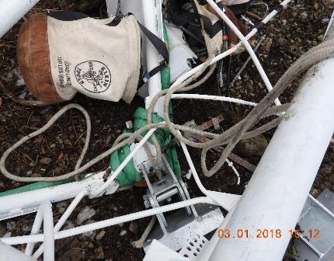
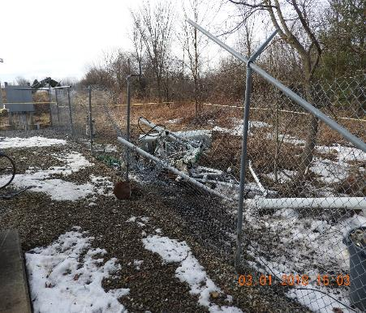
Incident #1
Notes:
Instructor:
Description: On March 1st, 2018, at approximately 10:33 AM, GC was on site performing an antenna and line installation for a carrier. During hoisting activities, the load rope failed causing the load weighing approximately 1100 lbs. to fall approximately 245 feet. GC was utilizing synthetic ropes, a capstan hoist, and one snatch block for hoisting applications. Fortunately there were no documented injuries however there was damage to the carrier equipment, mount and compound fence.
Root Causes: A. Improper reduction of the load rope’s WLL when using a knot. B. Rope Failure due to condition.

Slide 27

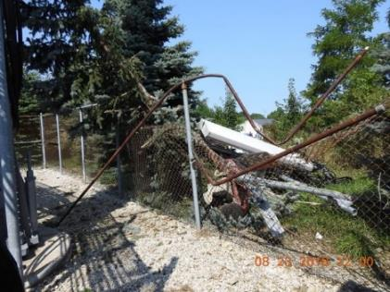
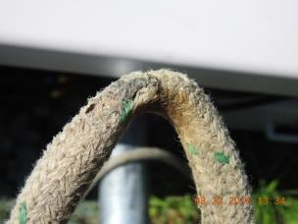
Incident #2
Notes:
Instructor:
Description: On 8/23/18 at approximately 12:03 PM, the GC on site for a carrier antenna and line installation called to report a boom fell from approximately 98 Feet. This occurred while performing Class III Rigging. The GC was attempting to raise a boom for the carrier. While the lift was occurring, the load rope snapped and the Carrier Boom fell, struck an un-related carrier Boom at 90' Feet and then fell to the ground below. Nobody was injured, however, the foreman reported the un-related carrier Boom was damaged and they were unsure as to whether or not it was in danger of falling or the extent of the damage to the boom.
Root Causes: A. Load rope condition B. Inadequate Rope Inspection and Retirement Protocols C. Incompatible Rigging Equipment Utilized D. Discrepancies between construction planning and implementation.

Slide 28
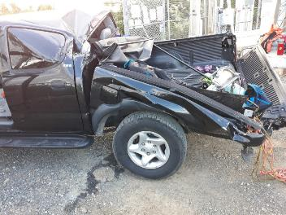
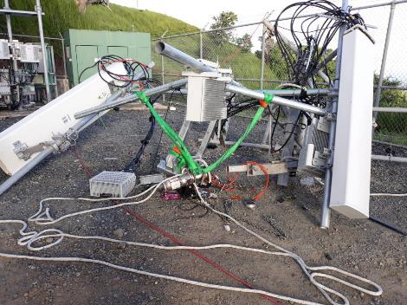
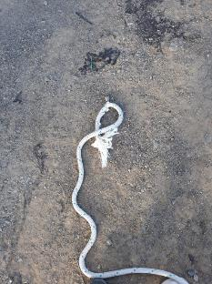
Incident #3
Notes:
Instructor:
Description: On October 31st, 2018 a GC was performing antenna and line construction for a carrier. While hoisting a load of approximately 840 lbs. to the 200 ft. elevation the load rope broke. The load fell the ground and landed on a pickup truck within the compound. One individual sustained minor injuries and the carrier’s sector was offline as a result of this subject incident. There was no recorded damage to the property or the structure.
Root Causes:
Discrepancies between construction planning and implementation,
Significant increase in gross lifted load,
Excessive tagging and load manipulation forces,
Improper rigging equipment utilized,
Rope failed due to excessive tag forces,
Rigging planning and execution was not performed properly.
Commentary: The tag method was attached to both a 3,000-lb. capstan hoist mounted to the hitch of the truck and had two individuals applying tag forces in addition to the 3,000-lb. hoist. The tag force capabilities exceeded 3,000 lbs., which results in a load line force potential of over 5,000 lbs. and a potential resultant force on the structure of 10,000 lbs.

Slide 29
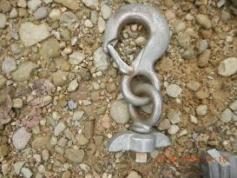
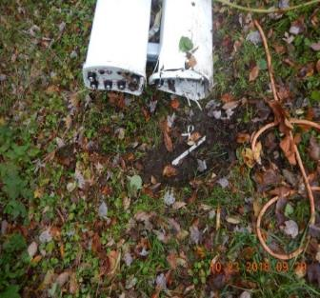
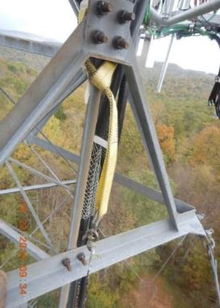
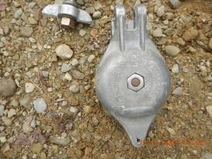
Incident #4
Notes:
Instructor:
Description: On 10/23/18 at approximately 9:40 AM, the GC on site for a carrier line and antenna installation called to report a top block failure while the load was at approximately 60 feet. The load of approximately 220 lb. fell to the ground and landed outside of the compound. This occurred while executing the Class I Rigging Plan. The GC was attempting to raise two antennas to the beta sector for a carrier located at 98’. The carrier equipment dropped was damaged as a result of this subject incident. There were no reported injuries, damage to the structure, or damage to the site compound.
Root Causes:
Non-Compliant Rigging Equipment Utilized,
Discrepancies Between Construction Planning and Implementation.

Slide 30
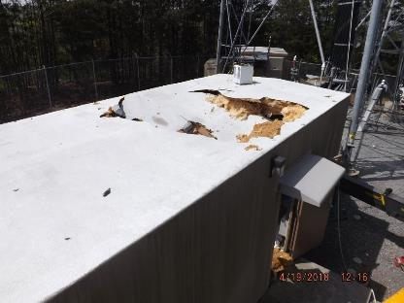
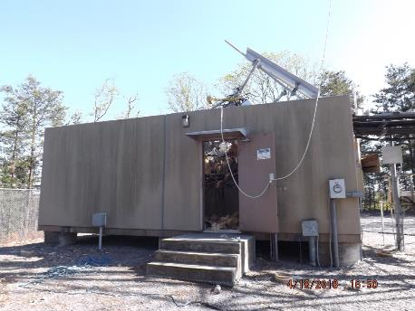
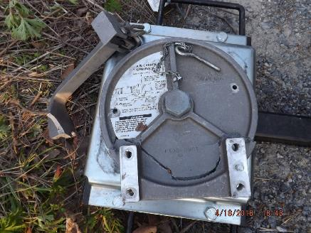
Incident #5
Notes:
Instructor:
Description: At approximately 3:30 PM EST on 04/18/2018 while performing antenna and line construction for a carrier, GC was hoisting loads to the 279' centerline on the structure. During the hoisting activity for leg B, the Capstan Swivel Bracket failed. As a result the load of approximately 1,360 lbs. was dropped approximately 200' and landed on the another carrier's shelter East of leg B and the capstan hoist was propelled across the compound. There were no documented injuries, another carrier was temporarily taken out of service, the dropped carrier equipment was damaged beyond repair, and there were instances of damage to structure.
Root Causes:
Capstan Swivel Bracket failed due to excessive loading.,
Inadequate rigging inspection,
Rigging equipment selection/rigging force validation,
Discrepancies between construction planning and implementation.

Slide 31
Trends and Statistics
  Sample of 35 Reported Rigging Incidents
 | L&A | Structural Mods
2016 | 10 | 1
2017 | 11 | 1
2018 | 12 | 1

Slide 32
Trends and Statistics
Antenna & Line Construction:
Tower Modification Construction:
Approximately 25,000 jobs were sampled for incidents each year
12 reported L&A Incidents for 2018 sample
Reported rigging incidents rates
1 out of 2,083 jobs
Approximately 2,500 jobs were sampled for incidents each year
1 reported Structural Modification Incident for 2018 sample
Reported rigging incidents rates 1 out of 2,500 jobs
Notes:
Instructor:
The number of jobs sampled in L&A vs. tower modification is representative of the spread for the work being performed.

Slide 33



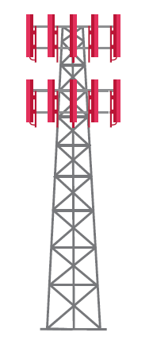





Impacts to the Industry
Tower Owners
Consumer
Regulatory
Public
Carriers
Media
General Contractor
Sub-Contractor
Landowner
Notes:
Instructor: Although incident rate per a job may seem low, it only takes one incident to bruise tarnish reputation.
Customer/Carrier – The customer wants a quiet and enjoyable ride. When their service is lost due to an incident caused by human error they are not happy. There is also the potential that the equipment on the tower provides emergency/safety services. When these instances happen the customer could lose faith and confidence in the owner and/or the contractor hired to perform the work and it may take tremendous efforts to mend that relationship.
Contractor and Subs – If the contractor is at fault, the reputation of that contractor is extremely affected. There is a risk that they could lose the opportunity to do business for that customer or even in the industry as a whole. Aside from future work, there’s also the possibility of paying for fines and losses – cost of construction, cost of materials, cost of service outage, etc.
Landowner – property damage, the use of the property – for instance if a business is located on or near the property they may lose functionality in the midst of an incident and its investigation. This could absolutely effect the future relationships with landowners.
Tower Owners - Reputation. Time, effort, money, & resources to resolve the immediate issue. Potential revenue loss depending on the severity of the issue, if incident ruins a structure, there’s possibility that that revenue source no long exists at that site. Potential for new standards, procedures, safety requirements, etc.
Public/OSHA – incidents give a black eye to the industry – being a tower climber is one of the most dangerous jobs in the world. The more and more incidents happen OSHA may continue to tighten their view on our industry.

Slide 34
Section 3
Primary Regulations, Codes, Standards and Policies
Notes:
{PLAN ON 25MIN FOR SECTION 3 ~ 9:40-10:05 ~ 15 MIN BREAK AFTER SECTION 3}

Slide 35
Topics
  Primary Regulations, Codes, Standards and Policies
  Telecommunications Industry Standards
  Roles and Responsibilities
  A10.48 Construction Classes
  Communications
Notes:
Instructor:

Slide 36
Regulations, Codes, Standards and Policies
  Federal Regulations for General Industry and Construction establish laws set forth by the DOL and represent minimum requirements which must be satisfied to safeguard employee health, safety and welfare.
  State Regulations may build on Federal Regulations to establish more stringent requirements, but may not set forth requirements below those established at a Federal level.
  Building Codes adopted and enforced by one or more government entity and contain collection of evolving standards by direct or indirect reference.
  ANSI Standards represent voluntary guidelines to a given trade or industry developed by a consensus of committee members representing private stakeholders, trade organizations, and professional societies in compliance with the ANSI rules.
  Consensus Standards represent voluntary guidelines to a given trade or industry developed by a consensus of committee members representing private stakeholders, trade organizations, and professional societies.
    Consensus standards can be enforceable when referenced/recognized by Regulations or Codes
  Owner/Company/Customer Policies
Notes:
Federal Regulations
The United States Department of Labor, (DOL) is a cabinet- level department of the US federal government responsible for occupational safety and health. The purpose of the Department of Labor is to foster, promote, and develop the wellbeing of wage earners of the United States; improve working conditions; advance opportunities for profitable employment; and assure work-related benefits and rights.
In carrying out this mission, the DOL administers and enforces more than 180 federal laws and thousands of federal regulations representing minimum requirements, which must be satisfied to safeguard wage earners health, safety and welfare.
State Regulations
OSHA covers most private sector employers and workers in all 50 states, the District of Columbia, and other United Safes jurisdictions – either directly through OSHA or through an OSHA – approved State Plan. State Plans are OSHA – approved job safety and health programs operated by individual states rather than federal OSHA.
State – run safety and health programs must be at least as effective as the federal OSHA program. There are roughly 22 states and/or territories that have approved State Plans.
Some State Plans are more stringent than federal regulations. It is important to know if the state you or your employer is working in has a State Plan and to verify you are in compliance with that States regulations. If you have questions about State Plans contact OSHA for more information at www.osha.gov.
Building Codes
adopted and enforced by one or more government entity and contain collection of evolving standards by direct or indirect reference
Consensus Standards
A consensus standard is a standard developed through the cooperation of all parties who have an interest in participating in the development and/or use of the standards. Consensus requires that all views and objections be considered, and that an effort be made toward their resolution. These standards are voluntary guidelines to be followed. Voluntary standards are standards established generally by private-sector bodies and that are available for use by any person or organization, private or government. The term includes what are commonly referred to as “industry standards” as well as “consensus standards”. A voluntary standard may become mandatory as a result of its use, reference, or adoption by a regulatory authority, or when invoked in contracts, purchase orders, or other commercial instruments.
Owner/Customer Policies
Voluntary standards and/or “other” policies and procedures may become mandatory when invoked in contracts, purchase orders, or other commercial instruments.

Slide 37
Rigging Equipment Standards
Standard Rigging Equipment Used For Lifting and Load Handling Purposes Shall be Specifically Certified for Such Applications in Accordance With Applicable ANSI/ASME B30 Standards
ASME B30.9: Slings
ASME B30.10: Hooks
ASME B30.26: Shackles, Links, Rings, Rigging Blocks, and Load Indicating Devices
Notes:
Instructor:
ASME American Society of Mechanical Engineers.

Slide 38
Applicable ANSI Standards
ANSI/ASSE A10.48 – Criteria for Safety Practices with the Construction, Demolition, Modification and Maintenance of communications structures.
ANSI/TIA 222 – Structural Standard for Antenna Supporting Structures, Antennas and Small Wind Turbine Support Structures
ANSI/TIA 322 – Loading Analysis, and Design Criteria Related to the Installation, Alteration and Maintenance of Communication Structures.
Note: ANSI/TIA-222-H directly references 322/A10.48 (i.e. 2018 IBC consequently indirectly ref 322/A10.48)
Notes:
Instructor:
ANSI – American National Standards Institute
ASSE – American Society of Safety Engineers. NOTE the name has been changed to ASSP American Society of Safety Professionals. Reference is to the ASSE as the standard used is the ANSI/ASSE A10.48.
TIA – Telecommunications Industry Association
IBC – International Building Code

Slide 39
Rope Standards
Cordage Institute CI 2001-04 – Fiber Rope Inspection and Retirement Criteria
Cordage Institute is an international association of rope, twine, and related manufacturers, their suppliers, and affiliated industries.
This is a consensus standard
Notes:
Instructor:
This is a voluntary standard that provides information used by the manufactures and end users of Fiber rope. In the absence of Regulations, ANSI standards this is an sound reference for use, care and retirement of rope.
* Cordage Institute CI 2001-2004 – Fiber Rope Inspection and Retirement Criteria is located in the Appendix section for reference. Cordage Institute has provided permission for the document to be used as a part of this training tool.

Slide 40

A10.48 Standard
Climber Connection Video
https://natehome.com/safety-education/climber-connection/
Notes:
Instructor:

Slide 41
Section 3 Review Questions
SECTION 3
REVIEW QUESTIONS

Slide 42
Which of the following is the most industry specific standard for safe work practices on a communication structure?
ANSI/TIA 322
ANSI/ASME B30.26
OSHA 29 CFR 1926
ANSI/ASSE A10.48
Notes:
Answer: D (ANSI/ASSE A10.48)
The means and methods are governed by ANSI/ASSE A10.48. This standard works hand in hand with the ANSI/TIA 322 and when necessary engineers will use the 322 to provide a review of a rigging plan created via the requirements of the 10.48.

Slide 43
Who is responsible for the onsite execution of a rigging plan per ANSI A10.48?
Tower Technician II
Qualified Person
Competent Rigger
Qualified Engineer
Notes:
Answer: C (Competent Rigger)
While it is the competent rigger it is possible that the qualified person may assist or that the qualified person may also be the competent rigger.
The qualified engineer is only responsible for the review of the rigging plan. It would require a supervising engineer for them to have any execution responsibilities on site. Please see ANSI/ASSE A10.48 and ANSI/TIA 322 for more information about a qualified engineer and a supervising engineer.

Slide 44
Which construction class always requires engagement of a qualified engineer?
Class IV
Class I
Class III
Class II
Notes:
Answer: A (Class IV)
While class IV determined by the requirements of the ANSI/ASSE A10.48 always requires a qualified engineer it is possible that a qualified person may elect input from a qualified engineer for any rigging plan class.

Slide 45
Which standard contains inspection and retirement criteria for synthetic ropes?
ANSI/ASME B30.9
Cordage Institute 2001-04
ANSI/TIA – 222
ANSI/ASSE A10.48
Notes:
Answer: B (Cordage Institute 2001-04)
This consensus standard provides information complied by the manufacturers of rope. It is specific to the rope manufacturers industry and they are as a consensus body seeking to provide accurate data based on: Manufacture, use, care, documentation and retirement of rope.

Slide 46
Section 4
Synthetic Rope
Notes:
{15MIN BREAK ~ 10:05-10:20}
{PLAN ON 70MIN FOR SECTION 4 ~ 10:20-11:30 ~ 45MIN LUNCH BREAK AFTER SECTION 4}

Slide 47
Topics
  Having knowledge of all equipment in your lifting plan is critical.
    Synthetic Rope
    Blocks, Slings, and Shackles
    Selection/Marking, Use, and Maintenance/Inspection
    System Compatibility
Notes:
Instructor:
We are primarily focusing on rope, blocks, slings, and shackles in this presentation.

Slide 48

Kernmantle Rope
  Is ideal for use in rescue, lifelines, ascent/decent rope access work
  Highest Strength/Weight Ratio
  The most frequent kernmantle rope diameters used in telecom is 12mm (1/2”)
Notes:
Instructor:
Kernmantle rope consists of parallel fibers (the kern) surrounded by a tightly braided sheath (the mantle).
With this tight braid, the core fibers provide the majority of the rope’s strength.
Kernmantle rope is frequently split into two categories: static and dynamic.
As the names imply, the amount of stretch which the rope sees when put under load are the defining characteristic.
For professional applications, static kernmantle is preferred. The low-stretch characteristics diminish concerns with fall arrest systems deploying and decrease the risks associated with fall clearance. The most frequent kernmantle rope diameters purchased is 12.5-13mm (~½”).

Slide 49
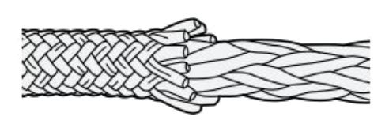
Double Braid Rope
  Most common type of rope used for hoisting is Double Braid
  Double Braid is a braided core surrounded by a braided sheath
  Both braids share the load equally
  Ideal for load rope
Notes:
Instructor:
Most common type of rope used with a capstan as a load line is Double Braid
Double braid is a braided core surrounded by a braided sheath
50% rope strength on inside core, 50% rope strength on outside core
Flexible, and less likely to tangle
Double braid flattens ever so slightly- more than a kernmantle or twisted braid, but significantly less than a hollow braid. This helps improve grip on the drum of a capstan hoist without flattening to the extent of causing excessive inefficiency when passing through the sheave of a block or pulley.
These characteristics make it ideal for a load rope

Slide 50
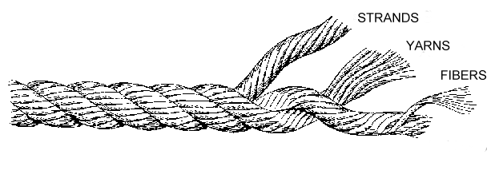
3 Strand Rope
  Most common type of rope used for chase rope
  5/8” is sometimes used as a backup lifeline.
  Remember that life safety ropes can never be used for material handling.
  Allows users to take their primary rope out of service for proper storage and inspection, and easily get back to operation
Notes:
Instructor:
Three-strand twisted ropes have long been a staple in American at-height industry.
Twisted ropes are built by first twisting multiple fibers together (synthetic or natural fiber) and forming a single strand.
From that point three strands are laid together to create a three strand rope.
This is the most common rope construction for general purpose use.
The tightly-twisted fibers feeding the twisted braid ensure a low amount of stretch under load.
That said, this approach does lead to a sacrifice in breaking strength.
To achieve higher MBS strengths, a large rope is required than alternative rope products.
Great application as a chase rope, allowing you to take your primary ropes out of service while away from the job site.

Slide 51
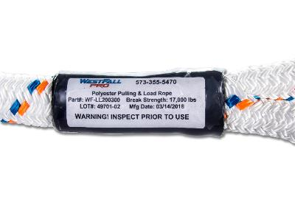
Know Your Rope
  Knowing your rope specifications is critical.
    Type of Rope
    Rope Manufacturer
    Date of Manufacturing
    MBS
  Where can this information be found?
Notes:
Instructor:
It is critical that all rope users know the strength of the rope.
Check the owner’s manual.
These manuals also typically include:
Use, Care, and Inspection Instructions,
Retirement Criteria,
Strength Charts,
Rope Log to document inspections.

Slide 52
Terms for Rigging
  ABS Average Breaking Strength
  MBS Minimum Breaking Strength
  SWL Being Phased Out
  WLL Working Load Limit
    The minimum breaking load of a component divided by an appropriate factor of safety giving a maximum load that can be lifted or be carried.
    (WLL) For Ropes, is 10% of the (MBS) minimum breaking strength
  FS Factor of Safety
    10:1
Notes:
Instructor:
It is important for everyone to know rigging acronyms, and their meaning.
SWL- Safe Working Load and WWL are the same. SWL is being phased out, because of the legal significance placed on the word ‘safe’.
The default safety factor is 10:1, meaning that the maximum load to which a synthetic rope can be subjected is one-tenth (10%) of the manufacturer’s documented minimum breaking strength (MBS).
It is worth noting that the 10:1 safety factor accounts for strength reductions associated with knotting/termination and losses in strength and efficiency as the rope passes through sheaves. This helps to explain why the safety factor exceeds the more common 5:1 factor found regularly in ASME B30 for other rigging components.

Slide 53
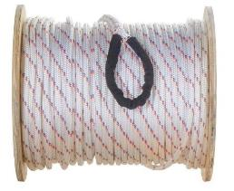
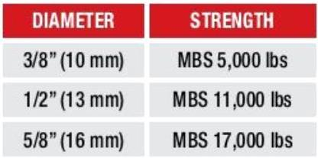
Diameter & MBS
  Breaking Strength of Synthetic Rope must be known
  Below is an example of one manufacturer’s Double Braid
  Each manufacturer’s ratings are different, as different constructions and materials are used.
Example:
Notes:
Instructor:
If you are using a 1,000 pound capstan hoist, could a 3/8” rope be used?- No- does not maintain a 10 to 1.
Similarly, the 5/8” rope would be fine; however, it would not give the user any additional capacity, as the winch would be the limiting factor.
What is the SWL or WLL of ½” rope which has these specs? Answer: 1,100 lbs.

Slide 54
Calculating WLL
  Breaking Strength ÷ Factor of Safety
You have a ½” Double Braid Polyester rope that has a MBS of 11,000 pounds.
What is the WLL that can be safely lifted?
Notes:
Instructor:

Slide 55
Calculating WLL
  Breaking Strength ÷ Factor of Safety
You have a ½” Double Braid Polyester rope that has a MBS of 11,000 pounds.
Answer: 11,000 (MBS) ÷ 10 = 1,100 lbs.
Notes:
Instructor:
Answer: 770 Lbs.
For Ropes, is 10% of the (MBS) minimum breaking strength, 10:1 Factor of Safety.

Slide 56
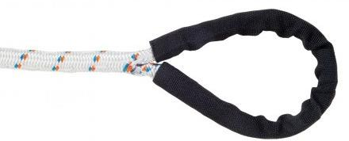
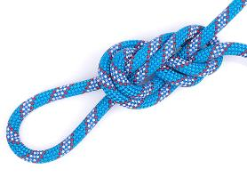

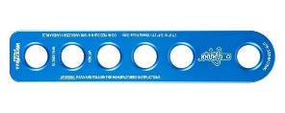
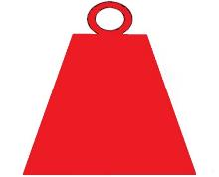
Knots & Terminations
~50-80%
~90%
~98%
Notes:
Instructor:
Factory terminations are the best, normally maintain ~98% of the ropes capacity.
Knots may reduce rope capacity by ~50%.
The additional friction and twisting at the point of the knot reduce the MBS of the rope.
The decrease in strength can be irreversible, depending on the stress applied to the twisted fibers. This provides even more reason for a thorough inspection of your ropes before each use.
Ropes terminated with a Termination Plate de-rates capacity by 10-15%.

Slide 57
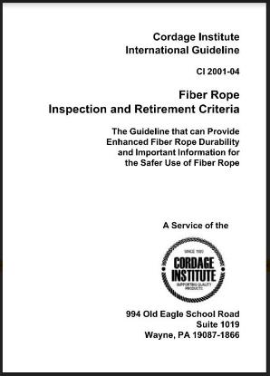
Cordage Institute
  Cordage Institute is an international association of rope manufacturers, nearly 100 years old, that creates uniform rope standards
  CI 2001-04
  Fiber Rope Inspection & Retirement Criteria
Notes:
Instructor:
* CI 2001-04 Fiber Rope Inspection & Retirement Criteria located in Appendix for reference.

Slide 58
CI 2001-04 Guidelines
  Of particular interest to our industry is Section 4
  Inspection & Retirement Programs
  The following sections present the requirements for an effective inspection and retirement program.
Notes:
Instructor:

Slide 59
CI 2001-04 Guidelines
  4.1.1 The user is responsible to establish a program for inspection and retirement that considers conditions of use and degree of risk for the particular application.
  A program should include:
      Assignment of supervisory responsibility. The user should assign an individual responsible for establishing the program, for training and qualifying inspectors and preserving records.
      Written procedures
      Training
      Record keeping
      Establishment of retirement criteria for each application.
      Schedule for inspections.
Notes:
Instructor:

Slide 60
CI 2001-04 Requirements
  4.1.2 Ropes that secure or control valuable assets or whose failure would cause serious damage, pollution, or threat to life warrant more scrutiny than ropes in non-critical use. If a fiber rope is used in a highly demanding application, with potentially critical risks, the advice of a qualified person should be obtained when developing the specific inspection and retirement program.
Notes:
Instructor:

Slide 61
CI 2001-04 Requirements
  4.1.3 The user should continue to revise and refine the program based on experience.
Notes:
Instructor:

Slide 62
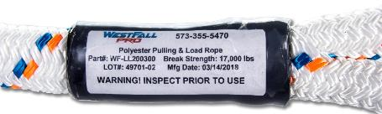
Rope Inspection Log
  CI 2001-4.3
    “An important tool for rope evaluation is a log. This will include data on the type of rope, time in service and description of intended use. The details of every inspection should be entered in the log as to date, location and conclusions. The log should include a regular inspection schedule.”
  CI 2001-5.1.1
    During the inspection, identify the rope with a tag.
    Shrink tube is an inexpensive solution
Notes:
Instructor:
You can’t keep and inspection log if you don’t have a system to identify your ropes. Therefore, rope tags are an important part of your inspection program.
Ropes can be purchased from the factory with a tag, or shrink tube can be used to create your own labeling system.

Slide 63
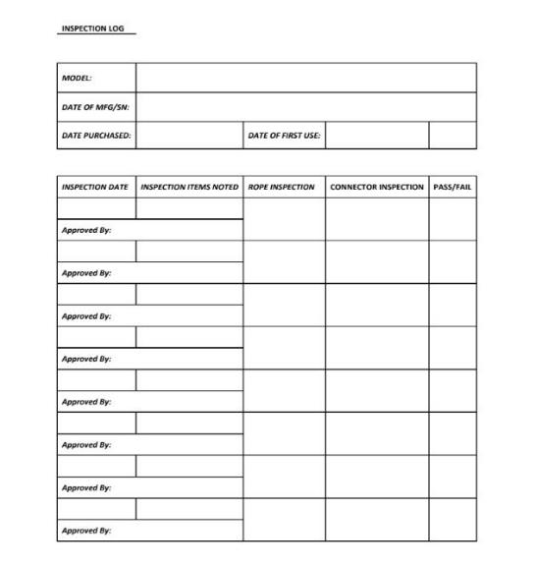
Sample Rope Log
Notes:
Instructor:
Pictured is a sample inspection log. Point out to students the importance of capturing the model number, date of manufacturing, assign a unique serial number, date of purchase, and date of use. This aids in knowing the rope so that the proper of use of the rope can be maintained.

Slide 64
Rope Inspection
  Section 6 outlines common causes of rope damage and describes their effects. These include:
    Excessive Tension / Shock Loading
    Cyclic Tension Wear
    Nicks, cuts, and abrasion damage
    Pulled Strands and Yarns
    Flex Fatigue
    Knots
    Creep
    Sunlight Degradation
    Chemical & Heat Degradation
    Dirt & Grit
Notes:
Instructor:

Slide 65
Rope Inspection
  Take note of factors such as load history, bending radius, abrasion, chemical exposure.
  Inspecting your rope should be a continuous process of observation, during, and after each use.
  Look and feel along every inch of rope length inspecting for cut strands, compression, pulled strands, melted or glazed fibers, discoloration, degradation, inconsistent diameter and abrasion.
  Signs of these may indicate possible loss of strength.
Notes:
Instructor:
You can’t keep and inspection log if you don’t have a system to identify your ropes. Therefore, rope tags are an important part of your inspection program.
Ropes can be purchased from the factory with a tag, or shrink tube can be used to create your own labeling system.

Slide 66
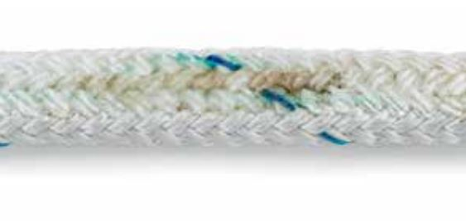
Rope Inspections
  Can this rope be used safely?
Glossy/Glazed: Glossy or glazed areas in rope indicate that it has been exposed to heat damage or compression. Remove affected section. If not possible, retire rope.
Notes:
Instructor:

Slide 67
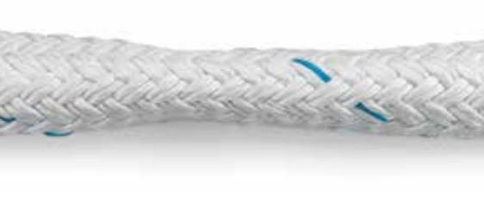
Rope Inspections
  Can this rope be used safely?
Inconsistent Diameter: Look for flat areas, bumps, or lumps in the rope. This can be a sign of core or internal damage from overloading or shock loads. Remove affected section. If not possible, retire rope.
Notes:
Instructor:

Slide 68
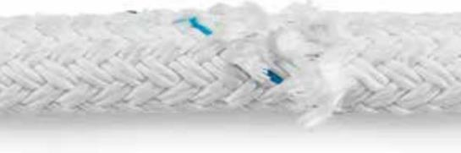
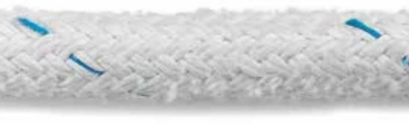
Rope Inspections
  Can this rope be used safely?
Wear: Any kind of burns, cuts, nicks, broken yarns, or excess wear (50% on double braid) on the sheath is also a sign that the rope needs to be removed from service.
Notes:
Instructor:

Slide 69
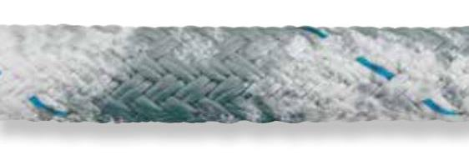
Rope Inspections
  Can this rope be used safely?
Discoloration: Ropes get dirty, but if the discoloration is from excess sun exposure or chemicals, the rope should be removed from service. Determining if discoloration is from dirt and grime or something more like sun exposure or chemicals is much easier if you regularly clean your rope.
Notes:
Instructor:

Slide 70
Rope Care & Maintenance
  Washing
    Dirt and grease causes internal fiber abrasion, and shortens its life. Wash by hand in a bath with non-bleaching, non-detergent soap.
    Drying
    Dry your rope in a clean, dry area out of the sun.
  Recording
  Record the cleaning in your rope log.
Notes:
Instructor:
Take care of your rope.
Proper use, care, and storage of your rope prolongs its use.
Don’t let your rope touch the ground.

Slide 71
Rope Storage
  Storage
    Store your rope in a cool, clean, dark, dry environment.
    Excess humidity will damage your rope.
Notes:
Instructor:
Ropes should be stored away from dirt, moisture, and sunlight.
Introducing excessive sediment into your ropes imparts additional friction points which speed up fiber degradation and can contribute to strength reduction.
Excessive moisture can result in mold.
The risk of this varies by textile, but avoidance is a best practice unless the rope was intended for extended use in wet environments.
UV rays degrade fiber strength over time. Storing your ropes out of the sun will extend their lifetime.

Slide 72
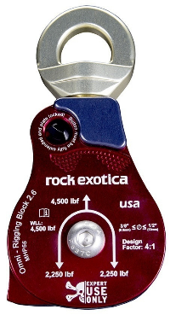
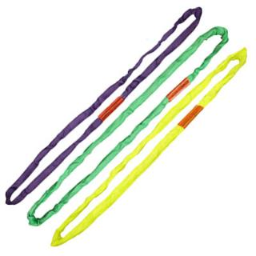
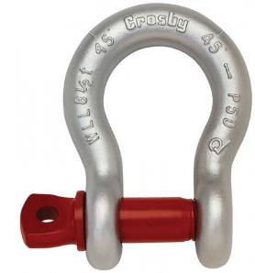
Other Components
  ANSI B30 Compliant Blocks, Shackles, Slings
Notes:
Instructor:

Slide 73


Blocks
  ASME B30.26
  Safety Factor SF 4:1
  Only use blocks designed to be used with synthetic rope
  Blocks must have sufficient ductility to permanently deform before losing the ability to support the load
Notes:
Instructor:
ASME B30, Chapter 26 defines standards for Shackles, Turnbuckles, U-bolts, and Blocks.

Slide 74

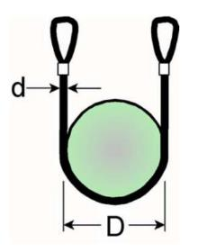
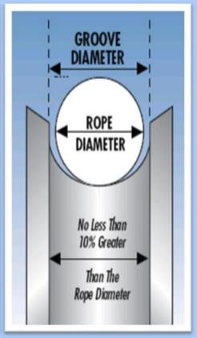
Blocks
  Block sheave and block groove must be compatible to rope size
Notes:
Instructor:
The diameter of the sheave effects the WLL of the rope.
The A10.48 requirement for double braid and kernmantle rope is 6:1, while the requirement for three-strand ropes is 10:1.
The measure used to evaluate compatibility is the diameter:diameter (D:d) ratio.
It is important to note that this is not a comparison between the inner diameter of the sheave and the diameter of the rope.
The ratio is based on the measurement from center of synthetic rope to center of synthetic rope when dropping from a 90 degree angle over the sheave.
A synthetic rope block/pulley which is compliant with the ASME B30.26 standard is required to visibly display rope diameter capacity as pictured above.
Sheaves which have roller bearings, and are sealed, are the best. Don’t require greasing, lower friction.
Block groove should be designed for use with rope, and not be less than 10% greater than the rope diameter. Improper groove profiles will damage your rope.

Slide 75
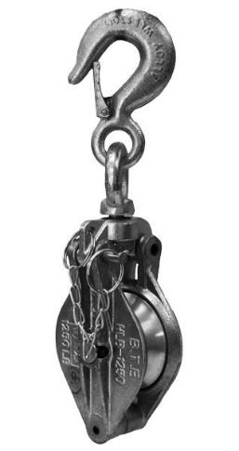
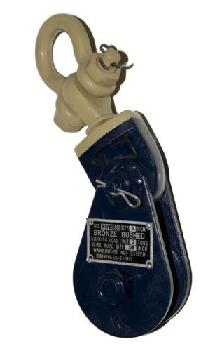

DO NOT USE
Notes:
Instructor:
Do not use any of the following-
Handline blocks are not ASME B30 compliant, and are not to be used when lifting loads with a capstan.
Import blocks that are designed to be used with wire rope, not synthetic rope.
Any block that does not meet ASME B30 marking requirements.

Slide 76
Block Marking Requirements
  Blocks must have the following durable markings
    Name or trademark of manufacturer
    Rated load (WLL)
    Rope size capacity
  Identification must be maintained by the user so as to be legible throughout the life of the block
Notes:
Instructor:
In addition to the above, when using synthetic rope, it is important to only use blocks designed for synthetic rope. Blocks that are designed for synthetic rope will clearly say this on the label.

Slide 77
Block Inspections
  Inspections should be performed by a designated person
  Any perceived deficiencies must be examined by a qualified person to determine whether they constitute a hazard
  A visual inspection shall be performed each shift before the block is used
  Periodic inspection by a qualified person with a frequency not less than once per year, consult ASME B30.26-5.8.4 in order to determine the frequency necessary for your application
Notes:
Instructor:

Slide 78
Block Retirement
  Rigging blocks shall be removed from service if conditions such as those included in, but not limited to, the list below are present
    Missing/illegible identification
    Misalignment or wobble in sheaves
    Excessive sheave groove wear
    Loose more missing hardware
    Indications of heat damage including weld patter or arc strikes
    Excessive pitting or corrosion
    Bent, cracked, twisted, distorted, stretched, elongated, or broken load bearing components
    A 10% reduction in catalog dimension at any point
    Evidence of unauthorized modifications
    Visible damage that cause doubt as to the continued use of the block
Notes:
Instructor:

Slide 79

Sling Marking Requirements
  Per ASME B30.9, each synthetic web sling shall have:
  Tag must be present
  Tag must identify
    Manufacturer
    Chocked, vertical and basket configuration
    Sling Material
    Date
    Serial Number
Notes:
Instructor:
Prior to each rigging application, ensure that the sling matches your lifting requirements by double checking the strength in the applicable configuration.

Slide 80
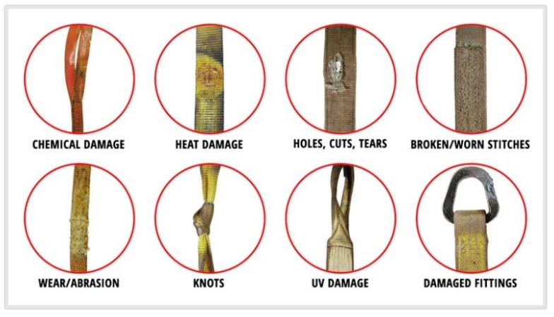
ASME B30.9 Sling Inspections
Notes:
Instructor:
Users must carefully read the manufacturer's recommendations for use, care, and inspection.
Remove from service if any of the following are visible
A rated capacity tag is missing or illegible,
Exposure of red core warning yarn (for slings with red core yarn),
Broken or worn threads in the stitch patterns,
Knots in any part of the sling,
Chemical or heat damage,
Holes, cuts, or tears are present,
Any other visible damage which causes doubt as to the sling strength.

Slide 81
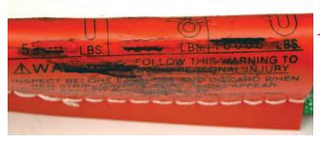
Sling Inspections
  Can these slings be used safely?
Notes:
Instructor:
Illegible or Missing Tags – The information provided by the sling tag is important for knowing what sling to use and how it will function.
WHAT TO LOOK FOR: If you cannot find or read all of the information on a sling tag, the sling shall be taken out of service.
TO PREVENT: Never set loads down on top of slings or pull slings from beneath loads if there is any resistance. Load edges should never contact sling tags during the lift. Avoid paint or chemical contact with tags.

Slide 82
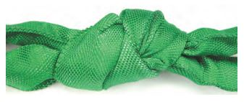
Sling Inspections
  Can these slings be used safely?
Notes:
Instructor:
Knots compromise the strength of all slings by not allowing all fibers to contribute to the lift as designed.
WHAT TO LOOK FOR: Knots are rather obvious problems as shown here.
TO PREVENT: Never tie knots in slings and never use slings that are knotted.

Slide 83
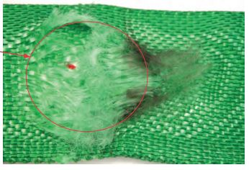
Sling Inspections
  Can these slings be used safely?
Notes:
Instructor:
Abrasion exposing internal core yarns.
WHAT TO LOOK FOR: Areas of the sling that look and feel fuzzy indicate that the fibers have been broken by being subject to contact and movement against a rough surface. Affected areas are usually discolored.
TO PREVENT: Never drag slings along the ground. Never pull slings from under loads that are resting on the sling. Use wear pads between slings and rough surface loads.

Slide 84
Inspection Requirements
  Three types of inspection:
    Initial Inspection- When you first receive it
    Frequent Inspection- Each time used, Prior to use and prior to change in application
    Periodic Inspection- Annual inspection
  Inspect it by pulling the sling through your hand and looking for visible signs.
  If you feel something, or see something that causes doubt, REMOVE FROM SERVICE
Notes:
Instructor:

Slide 85
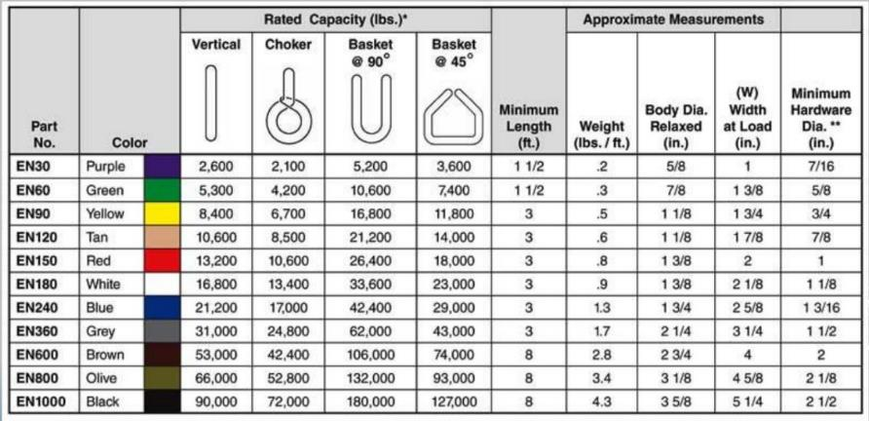
Endless Synthetic Sling Chart
The outer jacket of the sling is for protection of the material that is actually providing the sling’s capacity
Notes:
Instructor:

Slide 86
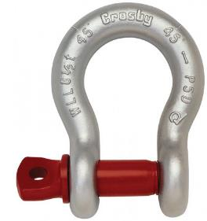
Shackle Marking Requirements
  Per ASME B30.26, each shackle shall have:
  Safety Factor SF 5:1
  Shackle must have sufficient ductility to permanently deform before losing the ability to support the load
      Markings on Shackle Body
      Name or trademark of manufacturer
      Rated load
      Size
  Marking on Shackle Pin
    Name or trademark of manufacturer
    Grade, material type, or load rating
Notes:
Instructor:

Slide 87
Shackle Inspections
  Inspections should be performed by a designated person
  Any perceived deficiencies must be examined by a qualified person to determine whether they constitute a hazard
  A visual inspection shall be performed each shift before the shackle is used
  Periodic inspection by a qualified person with a frequency not less than once per year, consult ASME B30.26-1.8.4 in order to determine the frequency necessary for your application
Notes:
Instructor:

Slide 88
Shackle Retirement
  Shackles shall be removed from service if conditions such as those included in, but not limited to, the list below are present
    Missing/illegible identification
    Indications of heat damage, including weld splatter
    Excessive pitting or corrosion
    Bent, twisted, distorted, stretched, elongated, cracked or broken load bearing components
    Excessive nicks or gouges
    A 10% reduction in catalog dimension at any point
    Incomplete pin engagement
    Excessive thread damage
    Evidence of modification
    Visible damage that cause doubt as to the continued use of the shackle
Notes:
Instructor:

Slide 89
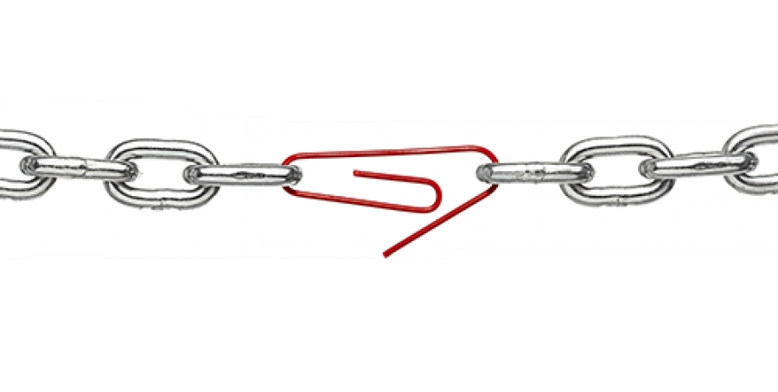
System Compatibility
  Your system is only as strong as its weakest link
  What parts you need to consider?
    Rope Size/Manufacturer
    Rope Termination
    Rope Care/Maintenance
    Block for proper use
    Block Size & Construction
    Appropriate Slings & Shackles
    Etc.
Notes:
Instructor:

Slide 90
Section 4 Review Questions
SECTION 4
REVIEW QUESTIONS

Slide 91
What information must be durably marked on the rigging block?
Working load limit
Rope Length
Date of manufacture
Part number
Notes:
Answer: A (Working load limit)
ASME B30.26 requires the following markings:
*Name or trademark of manufacturer
*Rated load
*Rope size capacity
Also, Identification must be maintained by the user so as to be legible throughout the life of the block.

Slide 92
What is the WLL of a synthetic rope with a MBS of 11,000 lbs.?
2,200 lbs.
5,500 lbs.
11,000 lbs.
1,100 lbs.
Notes:
Answer: D (1,100 lbs.)
(WLL) For Ropes, is 10% of the (MBS) minimum breaking strength

Slide 93
The best place to store rope not in use is?
The bed of a truck
A Moist location
Clean, dark, dry location
The ground
Notes:
ANSWER: C (Clean, dark, dry location)
Proper storage of your rope is critical for its continued lifespan. Store your rope in a cool, clean, dark, dry environment. Excess humidity will damage your rope.

Slide 94
The standards group which has developed a standard for the inspection and retirement of rope is?
American Society of Mechanical Engineers
Cordage Institute
TIA (Telecommunications Industry Association)
OSHA
Notes:
ANSWER: B (Cordage Institute)
The Cordage Institute is an international association of rope manufacturers, nearly 100 years old, that creates uniform rope standards.

Slide 95
It is important to regularly clean your rope because?
A clean rope is a good rope
It protects it from the sun
Prevents rope tangling
Dirt causes internal friction and weakens rope
Notes:
Answer: D
Dirt causes internal friction and weakens rope. Keep your ropes clean, and free from debris.

Slide 96
What information should be included in a rope inspection log?
Date of Manufacturing
Storage Method
Country of Manufacturing
Temperature
Notes:
Answer: A (Date of Manufacturing)
It’s important to capture the following on a rope log: the model number, date of manufacturing, assign a unique serial number, date of purchase, and date of use. This aids in knowing the rope so that the proper of use of the rope can be maintained. Refer to the sample rope log.

Slide 97
What is the weakest link in this hoisting system?
1,000 lbs. Capstan Hoist
3/8” Double Braid Rope with 5,000 MBS
Block (2 tons)
½” Shackle (2 tons)
Notes:
Answer: B (3/8” Double Braid Rope with 5,000 MBS)
Your system is only as strong as its weakest link. A 3/8” rope with a 5,000 MBS would have a WLL of 500 lbs.

Slide 98
Section 5
Rigging Forces and Lift Systems
Notes:
{45MIN LUNCH BREAK ~ 11:30-12:15}
{PLAN ON 2HR&45MIN FOR SECTION 5 ~ 12:15-3:00 ~ 15MIN BREAK AFTER SECTION 5}

Slide 99
Topics
  Typical Lift Configurations
  Sling Forces
  Block Forces
  Line Forces
  Worked Examples
Notes:
Instructor:
Emphasize this section covers how rigging forces are developed and transferred between components of the rigging system.
This section does NOT address the strength or applicable work load limits of the individual rigging components.
For strength considerations, refer to the 2018 Rigger Awareness Training.

Slide 100
Calculation Notes
  Calculated rigging forces provided in this presentation are intended for synthetic rope hoisting operations using typical 1,000 lbs. capstan hoists
  Calculations are based upon the following assumptions:
    Block and Sling Forces assume constant line tension through the system (no friction and no reduction for fall line weight)
    Line pull demands seen at hoist include compensation for fall line weight and friction in the reeved sheave assemblies
    NOTE: Additional considerations may be required for more complex lifting systems including, but not limited to, line parts of 3 or more, 3 or more reeved sheaves, and/or gin pole applications.
Notes:
Instructor:
Emphasize calculations presented in this section are intended for lightweight lifting applications using synthetic rope with 1,000 lbs. capstan hoists.
Consult with a Qualified Person if you are unsure if a certain lifting arrangement requires additional considerations.

Slide 101

Typical Lift Configurations
  Four Standard Lifting Block Arrangements:
    Top Block Only With Straight Tag
    Top And Heel Blocks With Straight Tag
    Integrated Trolley (aka Self-Trolley)
    Dedicated Trolley
Notes:
Instructor:
Refer back to 2018 Rigger Awareness Training for further information regarding these lifting configurations.
This training only introduces the basic rigging arrangements for these systems in order to identify the methods for evaluating the resulting rigging forces.

Slide 102
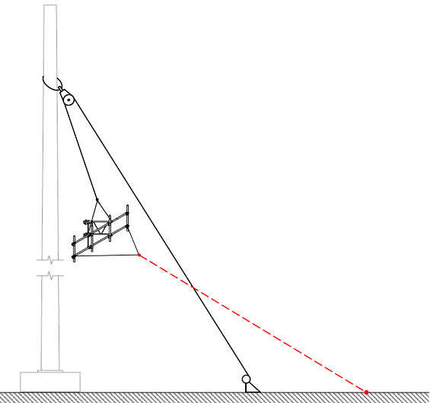
Typical Lift Configurations
  Straight Tag With Top Block Only:
  PROS:
    Simple system incorporating only one block
    Easy to setup
  CONS:
    Tag line must be kept away from load line
    Load line can act as a visual obstruction
    Difficult for hoist operator to visually identify clearance issues during hoisting
    Applies vertical load to hoisting unit (must ensure mounting unit is rated for vertical loading)
    Less overall load control
    Increased tendency for shock/impact loads
    Increased tendency for developing high imposed rigging forces due to tag forces
Notes:
Instructor:
Identify general pro’s and con’s for this lifting system and discuss as a group potential scenarios where this would be a good choice or poor choice for the lifting system.

Slide 103

Typical Lift Configurations
  Straight Tag With Top and Heel Blocks:
  PROS:
    Provides added control to lead line and removes visual obstruction
    Allows more diverse hoist setup options
  CONS:
    More difficult to employ on towers with multiple obstructions/equipment below working elevations (may require reeving through obstructions)
    Increased tendency for shock/impact loads
    Increased tendency for developing high imposed rigging forces due to tag forces
Notes:
Instructor:
Identify general pro’s and con’s for this lifting system and discuss as a group potential scenarios where this would be a good choice or poor choice for the lifting system.

Slide 104
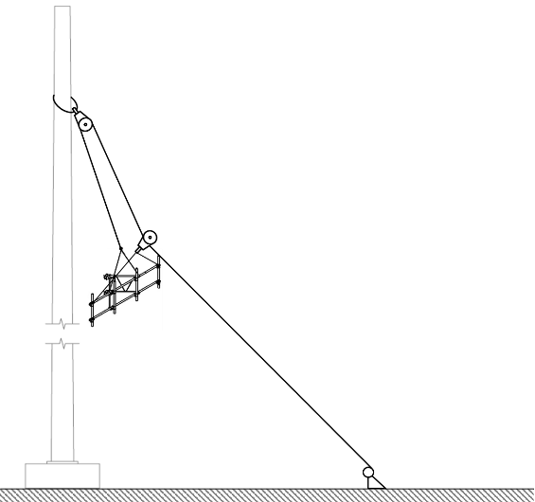
Typical Lift Configurations
  Integrated Trolley (aka Self-Trolley):
  PROS:
    Simple system incorporating only one block
    Easy to setup
    Uses single line for both lifting and control
    Provides good load control
    Predictable rigging forces in load line
  CONS:
    Limits hoist setup locations
    Clear distance from structure/obstructions cannot be easily manipulated during lift (issue for obstructions and multiple work elevations)
    Applies vertical load to hoisting unit (must ensure mounting unit is rated for vertical loading)
    Load angle and load line clear distance reduces as load is raised, and is significantly less during lowering operations due to sheave friction
Notes:
Instructor:
Identify general pro’s and con’s for this lifting system and discuss as a group potential scenarios where this would be a good choice or poor choice for the lifting system.

Slide 105
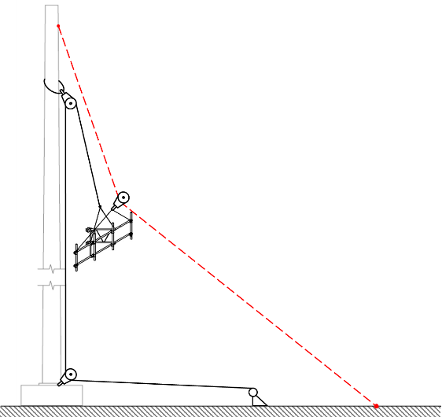
Typical Lift Configurations
  Dedicated Trolley:
  PROS:
    Provides added control to lead line and removes visual obstruction
    Allows diverse hoist setup options
    Superior load control
    Tag induces least force onto load
    Predictable rigging forces in load line
  CONS:
    Requires additional rigging attachments which requires additional crew members to properly monitor
    More difficult to employ on towers with multiple obstructions/equipment below working elevations (may require reeving through obstructions)
Notes:
Instructor:
Identify general pro’s and con’s for this lifting system and discuss as a group potential scenarios where this would be a good choice or poor choice for the lifting system.

Slide 106

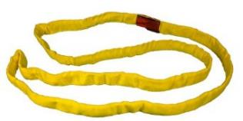
Sling Forces
  To determine Sling Force, must know:
    Applied Load
    Sling Hitch Configuration
    Sling Angle
Notes:
Instructor:
For typical hoisting scenarios, slings are utilized for attaching the rigging blocks to the supporting structure or anchorage point (e.g. rigging lugs at tower base).
For block attachments, the applied load will equal the Block Force which will be covered later in this presentation.

Slide 107




Sling Forces
  Types of Hitches:
Vertical Hitch
Choker Hitch
Basket Hitch
Bridle Hitch
Multiple Slings
Notes:
Instructor:
Vertical, choker, and basket hitches consist of a single sling configured as shown.
Bridle hitches utilizes two or more slings with the individual slings configured in either vertical, choker, or basket hitch arrangements.

Slide 108


Sling Forces
  Vertical and Choker Hitches:
$$Sling Leg Force=Applied Load$$
APPLIED LOAD
APPLIED LOAD
ANCHORED END
ANCHORED END
Notes:
Instructor:
Direct force transfer from loaded end of sling to anchored end of sling.
NOTE: The sling force should NOT be confused with sling strength. The sling’s strength is reduced for choker hitches due to the sharp bend at the choked point.

Slide 109



Sling Forces
  Symmetrically Loaded Basket Hitches & 2-Leg Bridle Hitches:
$$Sling Leg Force=\left(\frac{Applied Load}{2}\right)×Angle Factor$$
APPLIED LOAD
ANCHORED ENDS
ANCHORED END
APPLIED LOAD
Notes:
Instructor:
Note, this presentation is focused on normal hoisting operations, and the equation given only covers symmetrically loaded 2-leg bridle hitches (asymmetrically loaded bridles and bridles with 3 or more legs are not covered).
Applied load is shared between the two sling legs formed around the wrap.
For symmetrical basket hitch wrapped around a single member (e.g. tower leg or monopole shaft), the force transferred from loaded ends of the sling eyes to anchored end still equals the applied load as the resulting force components acting perpendicular to the applied load cancel.

Slide 110

Sling Forces
  Sling Angle:
    Acute angle between sling leg and the plane perpendicular to the direction of the applied load
    For lifting applications, angle measured from horizontal to sling leg while accounting for incline in the rendered plane
Notes:
Instructor:
For lifting applications, the sling angle is measured from horizontal to the sling leg while accounting for incline in the rendered plane.
Can measure from either horizontal DOWN to sling leg, or from horizontal UP to sling leg ~ congruent angles.

Slide 111

Sling Forces
Exponential Relationship
CRITICAL POINT:
At 30° Sling Angle, Load Factor = 2.0
Linear Relationship
Notes:
Instructor:
Relationship between sling angle and resulting sling force transitions from linear to exponential at 30°. This inflection point results in an Angle Factor of 2.0.

Slide 112
Sling Forces
  Sling Angle Factors:
Critical Angles To Remember:
60°: Recommended Min Angle per ANSI/ASSE A10.48
45°: Min Angle per ANSI/ASSE A10.48 ~ Below 45° Requires Special Approval
30°: Min Angle per ASME B30.9 ~ Below 30° Requires Special Attention
Notes:
Instructor:
Standard references:
ANSI/ASSE A10.48, Section 13.5.2, recommends a sling angle of 60 degrees as the goal, with 45 degrees representing the minimum where special attention is required.
ASME B30.9, Section 9-1.10.1 (i) sets the minimum sling angle at 30°. Below 30° requires approval from the sling manufacturer or a qualified person.
Recall previous slide depicting inflection point at 30° ~ this corresponds at the minimum angle setting under B30.9 without special review/approval.
Note, while steeper sling angles reduce the force carried by the sling legs, they also result in less lateral stability for lifted loads. In general, sling angles should be set at 75° down to 45° to provide the greatest combination of strength and stability.

Slide 113


Block Forces
  To determine Block Force, must know:
    Line Tension
    Block Included Angle
Notes:
Instructor:
Rigging blocks used in a lifting system are generally categorized as a top/crown block, heel/base block, or diverter/fairlead block.
The forces developed on each type of block are calculated in the same manner.

Slide 114
Block Forces
$$Block Force=Line Tension×Angle Factor$$
  Included Angle, ϴ:
    Angle formed between legs of line
    e.g. Straight vertical lift ~ ϴ=0°
  Angle Factor, AF:
    Multiplication factor based on Included Angle
BLOCK FORCE, F
INCLUDED ANGLE, ϴ
TENSION IN LINE, P
TENSION IN LINE, P
Notes:
Instructor:

Slide 115
Block Forces
Two Key Standard Angle Factors To Remember:
Top Block Angle Factor: During lift and setting the load, ϴ_{min}=0° → AF ~ 2.0
Heel Block Angle Factor: ϴ typically ranges from 85°-95° → AF ~ 1.5
Notes:
Instructor:

Slide 116
Line Forces
  To determine Line Forces, must know:
    Gross load weight
    Tag method
    Number of line parts
    Sheave frictional resistance
    Load position and tag angles
Notes:
Instructor:
Determining line forces is not necessary complicated, but it does require several more variables to be established

Slide 117

Line Forces
Load Side
  Gross Load, WT:
  WT = Lifted Load + Rigging Weight on Load Side
Load Line Weight
Do not need to include fall line weight to hoist
Rigging Weight
Overhaul ball/weight, slings, shackles, etc.
Fall Line
(To Hoist)
Load Weight
Tag Line Weight
Only include for Straight Tag configurations
Notes:
Instructor:
Extremely important to define the total Gross Load weight.
The Gross Load weight is one factor used to define the Minimum Construction Classification when evaluating lifts utilizing rigging systems attached to the structure (ref A10.48, Sec 4.8).
All rigging force calculations presented in this training along with those contained in the A10.48 are based on the Gross Load weight (ref A10.48, App A-13(f)).

Slide 118
Line Forces
  Tag Method:
  Straight Tag
  Trolley Tag
    Integrated Trolley (aka Self-Trolley)
    Dedicated Trolley
Notes:
Instructor:
Straight Tag:
Tag line is directly attached to load resulting in direct transfer of tag line force to load line.
For a 1-part configuration, the resulting load line force will ALWAYS exceed the lifted Gross Load, and increases exponentially once the load position and tag angles exceed 10° and 70° respectively ~ this relationship is covered further in the presentation.
Trolley Tag:
Incorporates a travelling trolley block which guides the hoisted load along the path of the trolley line.
Both types of trolley arrangements are covered further in this section.

Slide 119
Line Forces
  Straight Tag:
  Tag Line force is directly transferred into the Load Line
  Increased tendency for developing excessive forces in the Load Line
  Increased tendency for shock/impact loading
  Provides simple means for controlling the load with minimal attachments
Notes:
Instructor:
Tag line is directly attached to the load resulting in direct transfer of tag line force to load line.
For a 1-part configuration, the resulting load line force will ALWAYS exceed the lifted Gross Load, and increases exponentially once the load position and tag angles exceed 10° and 70° respectively ~ this relationship is covered further in the presentation.

Slide 120
Line Forces
  Trolley Tag:
  Tag Line force is NOT transferred into the Load Line
    During active lifting, the tag line actually relieves force from the load line; however, the Load Line ultimately supports the full Gross Load during the initial lift and final landing
  Predictable Load Line force
  Provides superior load control
    More so for Dedicated Trolley Configurations
  Requires additional attachments which must be monitored during hoisting operations
Notes:
Instructor:
Incorporates a travelling trolley block which guides the hoisted load along the path of the trolley line.
Both types of trolley arrangements (integrated and dedicated) are covered further in this section.

Slide 121

Line Forces
  Number of Line Parts:
  Single Part
  2-Part
Fall Line
(To Hoist)
Fall Line
(To Hoist)
LOAD
LOAD
Notes:
Instructor:
This training will only cover single and 2-part configurations which are most prominent in hoisting applications using synthetic rope.
In addition, the training will focus on 2-part configurations where the dead-end is attached away from the top block as most common rigging blocks used for lifting in this industry are not fitted with a becket lug and attaching away from the block helps reduce the applied force at the block’s rigging attachment.

Slide 122
Line Forces
  Line Parting Principles:
  Multi-parting the line provides a mechanical advantage for hoisting operations
    2-parting the line is most common for hoisting applications with synthetic rope
  Results in loss of load travel speed
  Increases frictional resistance of the hoisting system
  Important to consider attachment anchorage location for dead-end
    If attached to rigging block becket, the additional line tension must be added to the resulting block force
Notes:
Instructor:
As number of line parts increase, so does the overall complexity of the lifting system which adds additional attachments that must be monitored/controlled to prevent fouling of the line and proper rendering of the rigging components.
Slower load travel speeds adds additional control.
Primary frictional resistance is attributed to sheave bearings.

Slide 123
Line Forces
  Line Parting Principles:
  2-Part Hoisting Configuration
    Provides up to a 2:1 mechanical advantage not accounting for block angles and friction
    Actual mechanical advantage typically ranges from around 1.5-1.9:1 for most common configurations
  System Components:
    Blocks
    Dead-End
    Parts of Line
Dead-End
Stationary
Block
Dead Line
(To Dead-End)
Return Line
Fall Line
(To Hoist)
Travelling
Block
LOAD
Notes:
Instructor:
Note, this presentation is intended for typical hoisting operations using synthetic rope and therefor only covers typical 2-part configurations with the dead-end anchored away from the top rigging block.
Again, if dead-end is attached back to a becket on the top block, the additional line tension must be added to the resulting block force.
2:1 mechanical advantage ~ can theoretically lift up to 2 times the line pull tension.
Mechanical advantage losses attributed to travelling block included angle and frictional resistance from sheave bearings.
Multi-part hoisting configurations will always utilize a travelling block that moves/travels as load is hoisted.
Re-emphasize importance of selecting proper anchor attachment location for both the Stationary Block and Dead-End.

Slide 124
Line Forces
  Mechanical Advantage for Typical 2-Part Arrangements:
  Must account for bearing type and total reeved sheaves in the system
  Losses attributed to sheave friction results in less mechanical advantage
NOTE:
Typical 2-Part arrangement with top and heel blocks will have a minimum of 3 reeved sheaves ~ heel block, top block, and travelling block
Each additional diverter/fairlead must be considered, and ultimately decreases the systems mechanical efficiency
Notes:
Instructor:
Using standard plain bearings and adding diverter/fairlead blocks ultimately results in greater frictional resistance in the lifting system thus reducing the mechanical advantage.
Note, use of diverter/fairlead blocks many times greatly improves the overall line control as well as directing the line away from obstructions and towards the work location required.
Simply remember to account for the added friction when used ~ covered further in the next slides

Slide 125
Line Forces
  Sheave Frictional Resistance:
Notes:
Instructor:
The frictional resistance attributed to the sheave bearings is a function of the number of line parts, total number of reeved blocks, and sheave bearing constant.

Slide 126
Line Forces
  Load Position and Tag Angles:
  Angles and resulting line forces CHANGE throughout the various stages of the lift based on the tag force applied to create the horizontal clear distance needed to keep the load a safe distance from the structure and other obstructions
  Must consider ENTIRE lifting operation from ground level to uppermost position to properly assess the maximum line forces created in the Load Line and Tag Line
Notes:
Instructor:
Angles and resulting forces imposed through the rigging and back to the supporting structure CHANGE as loads are hoisted.
Must review the ENTIRE lift to properly determine the maximum forces developed.

Slide 127


Line Forces
  Load Position and Tag Angles:
$$\frac{RISE}{RUN}$$
  RISE
  Ø
^{Ex.} For a top block rigged at 250 feet with the load positioned at 50 feet from the tower base, the $\frac{RISE}{RUN}$ would equal $\frac{250}{50}$ or 5.0, which equates to Load Position Angle, θ, of between 11°-12°
α
  RUN
Notes:
Instructor:
Page (FILL IN) of the handbook provides a full copy of the table shown which can be used to quickly convert the ratio of RISE OVER RUN to the corresponding angles used for determining critical load and tag angles.
Once you know your setup distances, this table can be used to easily assess the resulting angles relative to either the horizontal or vertical axis.

Slide 128
Line Forces
  At minimum, resulting angles must be considered at the following lift positions:
    Ground Level
    Any Obstruction(s)
    Uppermost Lift Position
  For most operations, it is best practice to base your line force calculations using the Maximum Load Position Angle and Maximum Tag Angle
Notes:
Instructor:

Slide 129

Line Forces
  Load Position Angle, Ø:
    Angle between true vertical and the rendered Load Line
    Best practice is to limit to 5° or less
    Once you exceed 10° on Straight Tag configurations, Load Line force can become excessive
  “RISE”
  Headroom
  Ø
  NOTE:
    Standoff distance at 5° equals a RISE/RUN ratio of 11.4
    Standoff distance at 10° equals a RISE/RUN ratio of 5.7
  “RUN”
  Standoff
Notes:
Instructor:
Angle assumes straight line ~ do not adjust for sag in the line.

Slide 130



Line Forces
  Always Determine Maximum Load Position Angle, Ø:
  Ø
  Ø
  Ø
At Ground Level
At Tower Obstruction
At Top Position
Notes:
Instructor:
Max angle usually occurs at one of the critical positions shown above.
At Top Position: Generally occurs when load has to be manipulated away from the tower to place the load at elevation or to remove a load which is stood off the structure.
At Tower Obstruction: Generally occurs when load has to clear a tower mounted appurtenance or component such as another carrier’s array, a platform level, or a torque arm.
At Ground Level: Generally occurs work area near the tower base is obstructed with common obstacles such as transmitter buildings, transmission line bridges, fences, etc.

Slide 131

Line Forces
  Tag Angle for Straight Tag Configurations, α:
    Angle between horizontal and the rendered Tag Line
  NOTE:
  Maximum Tag Angle occurs at uppermost position of lift
  “RISE”
α
  “RUN”
Notes:
Instructor:
Angles assumes straight line ~ do not adjust for sag in the line.

Slide 132

Line Forces
  Tag Angles for Dedicated Trolley Configurations, Ø_{T} & α_{T}:
    Must identify BOTH angles to determine resulting Tag Line Force
  Ø_{T}: Angle between true vertical and the rendered Tag Line on tower side of trolley block
  α_{T}: Angle between horizontal and the rendered Tag Line on opposite side of trolley block
  “RISE”
Ø_{T}
  “RUN”
  “RISE”
α_{T}
  “RUN”
Notes:
Instructor:
Angles assumes straight line ~ do not adjust for sag in the line.
Note, for integrated trolley systems the load line also serves as the control/tag line.

Slide 133

Line Forces
CRITICAL POINT:
10° Load Angle & 70° Tag Angle, Load Factor = 2.0
“10/70” Rule
Exponential Relationship
Load Line Multiplier
Linear Relationship
Maximum Tag Angle
Notes:
Instructor:
The chart depicted represents the Load Line Multipliers for Straight Tag Configurations staged Load Position Angles of 5°, 10°, 15°, 20° and 25° with varying Tag Angles shown on the horizontal axis and the corresponding Load Line Multiplier given on the vertical axis.
Relationship between load and tag angles and resulting load force transitions from linear to exponential at 10°/70°. This inflection point results in an Line Multiplier Factor of 2.0.
Note direct relationship between critical inflection point occurring at a 30° angle for slings.
Remember the “10/70 Rule” when utilizing Straight Tag Configurations. When exceeded, consult a qualified person.

Slide 134

Line Forces
Notes:
Instructor:
The chart depicted represents the Tag Line Multipliers for a Dedicated Trolley Tag Configuration with a Load Position Angle of 10° and staged Tag Angles of 60°, 65°, 70°, 75° and 80° with varying Tag Position Angles shown on the horizontal axis and the corresponding Tag Line Multiplier given on the vertical axis.
Note the critical inflection points in force escalation occurring at multipliers of 1.0, and then the sharp rise at 2.0.
Refer to color coded Line Multiplier Table A6.10 in Handbook for comparison.

Slide 135


Line Forces
  Line Forces at Load:
$$Load Line Force at Load, P=\left(\frac{WT×PM}{NP}\right)$$
$$Tag Line Force at Load, T=\left(\frac{WT×TM}{NT}\right)$$
  Where:
  P = Load Line Force at Load
  T = Tag Line Force at Load
  WT = Gross Load Weight
  PM = Load Line Multiplier (Refer to Handbook)
  *NOTE: For Trolley Tag Arrangements, Set PM=1.0 for Uppermost Position
  TM = Tag Line Multiplier (Refer to Handbook)
  N_{P} = Number of Line Parts in Load Line
  N_{T} = Number of Line Parts in Tag Line
Notes:
Instructor:

Slide 136
Line Forces
  Load Line Pull at Hoist:
$$Load Line Pull at Hoist, PH=\text{(}\text{P}\text{ − }\text{FLW}\text{)}×SFF×AM$$
  Where:
  P_{H} = Load Line Pull at Hoist
  P = Load Line Force at Load
  FLW = Fall Line Weight
  SFF = Sheave Friction Factor
  AM = Additional Multipliers (i.e. Additional Angle/Safety Factors, Etc.)
Notes:
Instructor:

Slide 137


Line Forces
  Trolley Block Force:
$$Max Trolley Block Force ≅T×1.5$$
  ;Conservative Estimate
  Trolley Block
  Where:
  T = Tag Line Force at Load
  (or Load Line Force at Load, P, for Integrated Trolley Systems)
Notes:
Instructor:
Remember, for both trolley systems, you also need to determine the resulting force in the travelling trolley block attachment.
Use the Load Line Force, P, in place of the Tag Line Force, T, for Integrated Trolley Systems.
This provides a conservative estimate and is based upon a minimum block included angle of slightly less than 85° ~ refer back to Block Angle Factors.
Corresponds to the load at ground level.
Conservative because max tag force is almost always seen when load is well above grade (i.e. included angle well above 90°), and the only time the included angle would go below 85° is if the hoisting unit was located well ABOVE the load (e.g. hoist located atop a hill.)

Slide 138
Worked Examples
  Refer to the loose Straight Tag Example and forms provided in your Handbook
  Turn to Page 98 of your Handbook to locate the Tables we’ll be using for this example
Notes:
Instructor:

Slide 139



Straight Tag Example
  Refer to Loose Handouts in the back of your Handbook for the STRAIGHT TAG EXAMPLE:
Notes:
Instructor:
Take time to introduce each page of the 3 page loose handout that will be used for working the Straight Tag Example problem
NOTE: A Dedicated Trolley Example problem is also provided; however, due to time constraints we will not be able to work this together, but can be used for future reference purposes.
Page 1 provides the STRAIGHT TAG EXAMPLE problem that will be worked
Page 2 titled “Lifted Load Rigging Forces” provides the organized from we’ll be filling out together to determine the applicable rigging forces in the lines, blocks, and slings
Page 3 provides the critical distances needed to determine the resulting load position and tag angles

Slide 140

Straight Tag Example
Notes:
Instructor:
For this example, we will determine the Load and Tag Line Forces, Block Forces, and Sling Forces
Please turn to page 98 of your Handbook to locate the Tables we’ll be using for this example

Slide 141

Straight Tag Example
  STEP 1) Determine the Gross Load Weight
Notes:
Instructor:
Start by establishing the total Gross Load Weight

Slide 142

Straight Tag Example
  STEP 1) Determine the Gross Load Weight
400 lbs
20 lbs
20 lbs
25 lbs
0
0
465 lbs
20 lbs
130 ft
Load Line Weight:
145 ft x 0.14 plf = Approx. 20 lbs
Tag Line Weight:
145 ft x 0.14 plf = Approx. 20 lbs
GROSS LOAD WEIGHT:
400 + 20 + 20 + 25 = 465 lbs
Fall Line Weight, FLW:
145 ft x 0.14 plf = Approx. 20 lbs
Notes:
Instructor:
Step through weights for the example

Slide 143
Straight Tag Example
  STEP 2) Determine the Maximum Load Position and Tag Angles
Notes:
Instructor:
Refer to the last page in your loose handout for the Load Position and Tag Angle form
Please note, this form is simply being used to highlight the critical distances needed to identify the corresponding Load Position and Tag Angles

Slide 144

Straight Tag Example
  STEP 2) Determine the Maximum Load Position and Tag Angles
Notes:
Instructor:
We’ll start with identifying distances “A” and “B” to determine the Load Position Angle

Slide 145

Straight Tag Example
  STEP 2) Determine the Maximum Load Position and Tag Angles
“B”
“A”
Notes:
Instructor:
Distance “A” = Top Block to Load Headroom (Rise) = 12 ft
Distance “B” = Top Block to Load Standoff Distance (Run) = 2.5 ft

Slide 146

Straight Tag Example
  STEP 2) Determine the Maximum Load Position and Tag Angles
12 ft
2.5 ft
4.80
$$\frac{RISE}{RUN}=\frac{12}{2.5}=4.80$$
Notes:
Instructor:
The corresponding RISE/RUN ratio equals 4.80

Slide 147


Straight Tag Example
  STEP 2) Determine the Maximum Load Position and Tag Angles
$$\frac{RISE}{RUN}=\frac{12}{2.5}=4.80 \sim Results in Load Position Angle of 12°$$
Notes:
Instructor:
Using Table A4 from you Handbook on page 100, we can now determine the resulting Load Position Angle as measured from the True Vertical Axis ~ Remember to round up to the nearest 1 degree increment
RISE/RUN Ratio of 4.80 therefore rounds up to a 12 deg Load Position Angle

Slide 148
Straight Tag Example
  STEP 2) Determine the Maximum Load Position and Tag Angles
12 ft
2.5 ft
4.80
12
Notes:
Instructor:
Next we’ll determine the Tag Angle by defining distances “C” and “D”

Slide 149
Straight Tag Example
  STEP 2) Determine the Maximum Load Position and Tag Angles
“C”
“D”
Notes:
Instructor:
Distance “C” = Tag Attachment to Ground Tag Height (Rise) = 128 ft
Distance “D” = Tag Attachment to Ground Tag Distance (Run) = 47 ft

Slide 150

Straight Tag Example
  STEP 2) Determine the Maximum Load Position and Tag Angles
12 ft
2.5 ft
4.80
12
128 ft
47 ft
2.72
$$\frac{RISE}{RUN}=\frac{128}{47}=2.72$$
Notes:
Instructor:
The corresponding RISE/RUN ratio equals 2.72

Slide 151

Straight Tag Example
  STEP 2) Determine the Maximum Load Position and Tag Angles
$$\frac{RISE}{RUN}=\frac{128}{47}=2.72 \sim Results in Tag Angle of 70°$$
Notes:
Instructor:
Again using Table A4 from you Handbook on page 100, we can now determine the resulting Tag Angle as measured from the Horizontal Axis ~ Remember to round up to the nearest 5 degree increment
RISE/RUN Ratio of 2.72 therefore rounds up to a 70 deg Load Position Angle

Slide 152
Straight Tag Example
  STEP 2) Determine the Maximum Load Position and Tag Angles
12 ft
2.5 ft
4.80
12
128 ft
47 ft
2.72
70
Notes:
Instructor:
With the Load Position and Tag Angles now established, we can move to the next step of determining the applicable Load Line and Tag Line Multipliers

Slide 153

Straight Tag Example
  STEP 3) Determine the Corresponding Load and Tag Line Multipliers
X
55 ft
12 deg
70 deg
N/A
Notes:
Instructor:
Now we can continue to fill out page 2 in your loose handout packet to calculate the Lines Forces

Slide 154


Straight Tag Example
  STEP 3) Determine the Corresponding Load and Tag Line Multipliers
Notes:
Instructor:
Refer to Table A5 on page 101 of your Handbook for the Load and Tag Line Multipliers for Straight Tag Lift Arrangements
Lining up the 12 deg Load Position Angle with the 70 deg Tag Angle provides the “PM” and “TM” Multipliers of 2.458 and 1.494 respectively

Slide 155
Straight Tag Example
  STEP 3) Determine the Corresponding Load and Tag Line Multipliers
12 ft
2.5 ft
4.80
12
128 ft
47 ft
2.72
70
2.458
1.494
2.458
1.494
Notes:
Instructor:
Please note, for this example we are only focusing on the load at its maximum elevation.
To fully assess, we would always want to ensure the Line Multipliers for the load at ground elevation and at any obstructions do not govern. In general, we simply want to define where the Maximum Load Position Angle is formed to ensure we are properly assessing the maximum line forces developed in the lift.

Slide 156

Straight Tag Example
  STEP 4) Determine the Load and Tag Line Forces
2.458
1
1,143 lbs
1.494
1
695 lbs
Load Line Force, P:
P = (WT x PM) ÷ N_{P} = (465 x 2.458) ÷ 1 = 1,143 lbs
Tag Line Force, T:
T = (WT x TM) ÷ N_{T} = (465 x 1.494) ÷ 1 = 695 lbs
Notes:
Instructor:
The Line Forces at the Load are then calculated using the Line Multipliers multiplied by the Gross Load Weight and divided by the number of parts in the lines. For this example we’re assuming standard single part load and tag line arrangements.

Slide 157


Straight Tag Example
  STEP 4) Determine the Load and Tag Line Forces
Load Line Configuration → 1-Part
EXAMPLE
Example States Plain Bearings in all Sheaves
Total Number of Reeved Sheaves = 2
Sheave Friction Factor, SFF = 1.188
Notes:
Instructor:
To determine the acting Load Line Force at the Hoist, we must account for the frictional resistance in the block sheaves using Table A3 on page 99 of your Handbook
The Load Line is configured in a 1-Part
For this example we have specified Plain Bearings in all sheaves.
And we are reeved through a total of 2 Sheaves (i.e. top and heel blocks)
The corresponding Sheave Friction Factor (SFF) is then determined to be 1.188

Slide 158

Straight Tag Example
  STEP 4) Determine the Load and Tag Line Forces
1.188
N/A
1,334 lbs
Line Pull at Hoist, PH:
P_{H} = (P - FLW) x SFF x AM = (1143 - 20) x 1.188 = 1,334 lbs
Notes:
Instructor:
The Load Line Force at the Hoist then equals the Line Force at the Load (P) minus the Fall Line Weight (FLW) multiplied by the Sheave Friction Factor (SFF) and any additional multipliers that may apply (AM). For this example, we’ll assume only the sheave frictional resistance applies. Examples of other multipliers includes steel on steel contact when jumping gin poles.

Slide 159

Straight Tag Example
  STEP 5) Determine the Block Forces
Top Block Min Included Angle = 0° when setting load
Top Block Angle Factor, AF = 2.000
EXAMPLE
Heel Block Min Included Angle = 90°
Heel Block Angle Factor, AF = 1.414
Notes:
Instructor:
Now that we have the line forces calculated, we can use Table A2 on page 99 to determine the Block Angle Factors

Slide 160

Straight Tag Example
  STEP 5) Determine the Block Forces
X
145 ft
5 ft
0° (When Setting Load)
2.000
2,286 lbs
90°
1.414
1,616 lbs
N/A
N/A
N/A
Top Block Force, FTB:
F_{TB} = P x AF_{TB} = 1143 x 2.000 = 2,286 lbs
Heel Block Force, FHB:
F_{HB} = P x AF_{HB} = 1143 x 1.414 = 1,616 lbs
Notes:
Instructor:
We can now use the Block Angle Factors determined from Table A2 to calculate the resulting Block Forces in the Top and Heel Blocks

Slide 161

Straight Tag Example
  STEP 6) Determine the Sling Forces
Top Block Sling → Single Basket Hitch With Sling Angle of 75°
Top Block Sling Angle Factor, AF = 1.035
EXAMPLE
Heel Block Sling → Single Choker Hitch (Sling Angle of 90°)
Heel Block Angle Factor, AF = 1.000
Notes:
Instructor:
Finally, we can continue to trace the rigging forces from the Lines, through the Blocks, and into the Slings attached to the supporting structure
The first step will be to determine Sling Angle Factors using Table A1 on page 98 of your Handbooks

Slide 162

Straight Tag Example
  STEP 6) Determine the Sling Forces
X
2
75°
1.035
1,183 lbs
X
1
90°
1.000
1,616 lbs
Top Block Sling Leg Force, FSLTB:
F_{SLTB} = (F_{TB} x AF_{STB}) ÷ N_{STB} = (2286 x 1.035) ÷ 2 = 1,183 lbs
Heel Block Sling Leg Force, FSLHB:
F_{SLHB} = (F_{HB} x AF_{SHB}) ÷ N_{SHB} = (1616 x 1.000) ÷ 1 = 1,616 lbs
Notes:
Instructor:
We can now use the Sling Angle Factors determined from Table A1 to calculate the resulting Sling Leg Forces at the Top and Heel Block Attachments

Slide 163
Straight Tag Example
1,143 lbs
695 lbs
1,334 lbs
2,286 lbs
1,183 lbs
1,616 lbs
1,616 lbs
Remember where we started:
Notes:
Instructor:
We now have all force demands acting from the Lines, through the Blocks, and into the individual Slings attached to the supporting structure
Please pause and take time to emphasize how these forces relate to the original 400 lbs boom mount being hoisted. This example which again assumed 12 ft of headroom with only a 2.5 ft load standoff distance resulted in a Load Position Angle of 12° and Tag Angle of 70° (Exceeds the critical 10/70 Rule where forces can increase exponentially). This has in turn developed Load Line and Hoist Pull force demands well above 1,000 lbs which would overcome most typical hoist and line WLL ratings.

Slide 164

Straight Tag Video
Rigger Awareness
https://natehome.com/safety-education/susan-harwood-grant-courses/rigger-awareness-training-resources/
Notes:
Instructor:
Play video ~ roughly 10min long

Slide 165
Section 5 Review Questions
SECTION 5
REVIEW QUESTIONS

Slide 166
What is the angle factor for a sling set at 60 degrees?
1.414
2.000
1.155
1.000
Notes:
ANSWER: C (1.155)

Slide 167
What is the sling force in each sling leg for the straight vertical bridle hitch configuration shown below?
934 lbs.
1,566 lbs.
1,200 lbs.
783 lbs.
50°
1,200 lbs.
Notes:
ANSWER: D (783 lbs.)
$$\left(\frac{1200}{2}\right)×1.305=783$$

Slide 168
What is the heel block force for the configuration shown below with a hoist line pull of 450 lbs.?
664 lbs.
900 lbs.
714 lbs.
578 lbs.
BLOCK FORCE
85°
450 lbs.
450 lbs.
Notes:
ANSWER: A (664 lbs.)
$$450×1.475=664$$

Slide 169
For a load set at 205 feet with the tag positioned at 75 feet away, what is the approximate tag angle when the load is set?
50°
20°
60°
70°
  205 feet
α
  75 feet
Notes:
ANSWER: D (70°)
$$\left(\frac{RISE}{RUN}\right)=\left(\frac{205}{75}\right)=2.73 \sim Approx. 70°$$

Slide 170
For a load located 10 feet below the top block and tagged out 4 feet, what is the approximate load position angle, Ø?
22°
8°
14°
68°
  10 feet
Ø
  4 feet
Notes:
ANSWER: A (22°)
$$\left(\frac{RISE}{RUN}\right)=\left(\frac{10}{4}\right)=2.5 \sim Approx. 22°$$
Discuss the potential concerns with the Load Position Angle ~ far exceeds 10° where resulting line forces can quickly far exceed the Gross Load Weight.

Slide 171
What is the line force at the load for the configuration shown below, assuming no friction factor and no tag?
650 lbs.
717 lbs.
1,434 lbs.
1,300 lbs.
65°
LOAD
LINE FORCE
1300 lbs.
Notes:
ANSWER: B (717 lbs.)
2-Part configuration with line legs at the top attachments set to a 65° angle from the horizontal
$\left(\frac{Gross Load}{Number of Line Parts}\right)×Angle Factor=\left(\frac{1300}{2}\right)×1.103=717$

Slide 172
Section 6
Hoisting Operations, Execution and Communication
Notes:
{15MIN BREAK ~ 3:00-3:15}
{PLAN ON 60MIN FOR SECTION 6 ~ 3:15-4:15}

Slide 173
Topics
  Hoisting
    Capstan Hoist
    Anchorage
    Testing, Monitoring, Controls
  Communication
    Planned vs. Changed Condition
Notes:
Instructor:
This section will cover the most common hoisting mechanism utilized with synthetic rope.
Will review what makes up an anchorage; and what sort of tests can be done in the field to verify the operations of the planned lifting system
We’ll then pull it all together with a review of how effective communication can be used to modify a plan.

Slide 174

Hoist
  Capstan Hoist
    Generally used for moderate lifting and tag applications
    Most units are rated from 1,000 to 3,000 lbs. WLL
    Requires trained operator
    Daily inspection prior to use
    Always follow guidelines of
    Operator’s manual
Notes:
Instructor:
Read Slide.
Capstan Hoists are used for synthetic rope applications.
Always follow manufacturer’s instructions for assembly, inspection, maintenance, and operation.
Next we’ll look at some features of the hoist, requirements, and limitations.

Slide 175


Capstan Hoist
Not Allowed For Personnel Lifting
  Must be equipped with Deadman Switch and Safety Bar
Rope Lock
(Best Practice)
Rope Hook
(Required)
Foot Control
(Required)
Notes:
Instructor:
Restrictions:
A Capstan hoist must never be used for personnel lifting.
No rope splices are allowed to come into contact with the drum.
Requirements:
Safety Bar – a safety bar is required and prevents the rope from slipping from the drum.
Deadman Switch – a deadman switch is required for operational control of the capstan.
Best Practices:
Rope Grab – this feature allows for a means of tying off the load at any point during operation. If no rope grab is being used an alternate method to tie off the load should be included in the plan.
Rope Collection – Use a bucket or a bin to store the fall line. This helps to prevent the rope from coming into contact with dirt or contaminates that will add wear and tear to the rope.
Load line should always be positioned toward the drive unit for best control and to prevent fouling.
Operator is responsible for the load during operations, clear line of sight to the load itself should be maintained.
Use of hand signals or alternate communication methods should be determined prior to performing work

Slide 176

Hoist Anchorages
  What makes up the hoist anchorage in this example?
  How can we verify it?
Notes:
Instructor:
Ask Question on Slide and get feedback from audience.
Answer: The hoist anchorage is everything that resists the loading on the capstan from Twisting, Sliding and Sliding Resistance.
This includes:
Review load path in Capstan
capstan / capstan mount / receiver hitch / truck / truck contact with ground
Ask How can we verify the anchorage?
Answer: Two Methods, details on next slide

Slide 177
Anchorage Verification
Truck
Capstan Mount
Tires to Ground
Hitch Receiver
  Engineered method incorporates a minimum factor of safety (FOS) of 2.0 for the WLL of all anchorage components. Method also assumes a maximum coefficient of friction of 0.20.
  Proof load method of 1.5 times the maximum anticipated hoist load.
Notes:
Instructor:
Identify and review the Anchorage items: Capstan Mount, Hitch Receiver, Truck and Contact to Ground (Tires).
The Engineered method utilizes calculations based upon anticipated load, a minimum factor of safety and some baseline assumptions.
The proof load method utilizes a larger than anticipated force against the system in a controlled setting to provide an inspection point for part of the system.
Some Key points about the Capstan Mount to keep in mind as part of the Hoist Anchorage.
Hitch Mount must be approved by the hoist manufacturer or designed by an engineer. “Homemade” mounts without documented engineer’s review/rating shall not be used.
Must be assembled and installed per design and direction of manufacturer.
Some hitch mounts may not be rated for forces in the vertical direction, in these cases inclusion of a heel block to the lifting system may be required.
Identify Section 8.17 in A10.48 as reference for additional information.

Slide 178

Field Verification Methods
  Proof Loading and Load Testing
  All field testing should be done in controlled conditions
  Monitoring devices help eliminate unknowns during testing
  Did you know, that during load testing the FOS for synthetic rope may be reduced to 7.0?
  Example:
  Typical Use: 11,000 lbs. [MBS] ÷ 10.0 = 1,100 lbs. WLL
  Testing Only: 11,000 lbs. [MBS] ÷ 7.0 = 1,570 lbs. WLL
Notes:
Instructor:
Proof Loading and Load Testing are two methods of field testing to make confirmations about the lifting system.
In either test scenario, the work shall be done in controlled conditions similar to those expected during construction activity operations:
Ex. Calm wind,
Loads shall not exceed the WLL of any rigging component.
Devices such as load cells and transits, can aid with providing measured confirmations for load forces and deflections that the system is supporting. When using a load cell in a lifting system ensure that manufacture’s guideline for use are followed and that like any other component forces are kept within it’s WLL.
Read the Did you know question? Ask if anyone knows why you may need to do this?
Answer – Oftentimes synthetic rope may be the controlling component in your rigging system for a planned lift, meaning it has the lowest WLL. In the setting of a controlled case like load testing you may need to increase the forces within the lifting system to validate other components. This reduction to the synthetic rope FOS facilitates these field testing needs.
REMINDER – The FOS determination is also subject to the condition and inspection of the rope itself.
Next we’ll look at the differences between Proof load testing and Load testing.

Slide 179
Proof Loading
  Confirms Capabilities
  Typically involves loading some component beyond 100% of the anticipated load during planned operations.
    Does not mean beyond 100% WLL for components!
  Ex. Hoist anchorage proof loading = 1.5 x Load line force applied to anchorage.
  Used when circumstances or variables may not be predictable.
Notes:
Instructor:
Proof Loading is utilized to confirm the capability of some component of the system or the system it self.
Read Slide.
Proof Loading is considered a best practice, particularly in the cases of hoist anchorages. Example, Capstan with hitch mount; vehicle parked on uneven ground, or varying ground conditions, dirt, sand, asphalt.
Proof Loading should always be performed under the expected site conditions for the planned lift.

Slide 180
Load Testing
  Confirms Operation
  Representative of actual conditions of load during planned operations
    100% of gross load
    Model load position(s) that result in maximum anticipated lifting system forces
    Required when utilizing a Capstan hoist per A10.48
  Monitoring for deflections, anchorage and capstan control, line rendering.
Notes:
Instructor:
Read Slide.
Summarize intent:
The load test is a best practice requirement, where everything comes together. This is the best opportunity to validate the system prior to executing the work at height.

Slide 181
Load Testing
  More generally a load test shall include:
    Raise and lower a load to verify moving parts functionality
    Verify deflections under load are within allowances
    Once load has been lowered inspect all components and anchorage for proper arrangement and working condition
    Verify supporting structure or individual structure members do not have unacceptable twist, rotation or deflection
Notes:
Instructor:
Regardless of lifting system type these are guidelines for a complete Load Test
Read Slide.

Slide 182
Question and Answer
We’ve covered a lot of details and concepts, how do you ensure all the requirements are met on the job?
We put the information in the Rigging Plan
Notes:
Open discussion question.
Click for Answer:
We put the information in the Rigging Plan

Slide 183
Question and Answer
What’s the purpose of the Rigging Plan?
To communicate intent based on the expectations of scope, methods and job characteristics
Notes:
Open discussion question.
Click for Answer:
To communicate intent based on the expectations of scope, methods and job characteristics.

Slide 184
The Plan
  Planned condition
    What content should be in the plan?
      Determine the lift path: Structure, Obstructions, Equipment placement, component placement, anchorage
      Components/Equipment being used in the system
      Expected lifting system and system forces
      Who’s doing What
Notes:
Instructor:
Planned Condition
Review summary of items that are required information for the rigging plan.
ASK – How are your plans currently being put together?
Does the crew lead do it? The CM? Some office staff member?
Is that okay?
Who all reviews a plan as it is being put together?
What’s the importance of identifying the Who’s doing What in the field?
– Because the Competent Rigger OWNS the plan.
Yes, it is okay if the plan is produced using multiple resources; but a CRITICAL component to the communication is that the Competent Rigger not only understands the plan, but endorses the plan, will follow the plan, and has the competency, which means training and experience, to use the means and methods the plan calls for.

Slide 185
Question
How many of you are reviewing/using the planned rigging plan?
Notes:
Open discussion question.
Probe familiarity with plans and processes used to generate plans.
Ask how roles and responsibilities are covered.
Ask who owns the plan at the time showing up on site.

Slide 186
Inspect your Expectations
  Pre-rigged conditions
  Rigged condition not under load
  Proof Loading
  Load Test
    Operational test rigged condition under load
Notes:
Instructor:
A rigging plan should improve project efficiency by helping you to Inspect what you Expect.
The working and access areas.
The lifting system used and component placement.
Expected rigging forces and component needs.
Operation testing.

Slide 187
Question and Answer
What happens when you can’t follow the plan Rigging Plan?
You change it!
Notes:
Open discussion question.
Click for Answer:
Meaning the Stakeholders collaborate on viable solutions and document the updates.

Slide 188
Changing the Plan
    When do you change the plan?
    Changed condition
    What are some examples of changes that warrant additional communications/approvals?
    Who needs to be involved in the approval and why?
Notes:
Instructor:
Changed Condition Examples:
Planned load path unachievable:
Appurtenances on the tower that were not known about, need to change tag-out, need to change crown block placement.
Hoist and Anchorage can’t go in planned location; new ground equipment, sloping terrain, LL access restrictions.
Examples of primary changes
Lifting Configuration Change – Forces change.
Change in classification – minimum responsibility, may need to engage additional personnel e.g. Qualified Person or Engineer.
New / Additional components – redirect block.
Change in Gross Load – Verification of forces and components.
Who is involved:
All Stakeholders that may be affected by the change in means, methods or sequence: Competent Rigger, Qualified Person (if app), Qualified Engineer (if app).

Slide 189
Question
How many of you have encountered changed conditions requiring you to modify the rigging plan?
Notes:
Instructor:
Follow on Questions:
Q: What was the process you used?
Q: Who all did you communicate with?

Slide 190
Question
Do you feel you have a better grasp on what goes into the plan and the steps you can take to accommodate changed conditions?
Notes:
Instructor:
Probe for opportunity to address any open questions.

Slide 191
Question
How do you typically learn about industry standards?
Notes:
Instructor:
Ask what communication paths lead to audience learning about A10.48 Standard? Industry Organization participation? NATE, State Wireless Associations? Customers, Competitors, etc.? Encourage awareness and participation.

Slide 192
Section 6 Review Questions
SECTION 6
REVIEW QUESTIONS

Slide 193
What force should be applied to the hoist anchorage to proof load it?
  The load line force for the system is calculated to be 650 lbs.
  1,300 lbs.
  975 lbs.
  925 lbs.
  650 lbs.
Notes:
Answer: B (975 lbs.)
Hoist Anchorage utilizes a proof load of 1.5 x force on hoist. 1.5 x 650 = 975 lbs.

Slide 194
Which of the following is not required for Capstan Hoist Operation?
  Foot Control
  Load Test
  Rope Hook
  Rope Lock
Notes:
Answer: D (Rope Lock) is not required, but is considered best practice.
Reminder – when a Rope Lock isn’t used, there still needs to be an effective means to suspend and support a load.

Slide 195
  Rigging to mount using a redirect block with a tower mounted crown. What rigging class would this be?
  Class I
  Class II
  Class III
  Class IV
Notes:
Answer: D (Class IV)
Class IV Rigging Plan would be required. The classification system based on gross lifted load when the lifting system is connected to the supporting structure. Utilizing an appurtenance such as a mount for part of the rigging system requires that the mount be analyzed to carry the forces applied during the operational condition.

Slide 196
  When a rigging plan moves from Class II to a Class III plan, which role at a minimum must now be involved?
  Qualified Engineer
  Qualified Person
  Competent Rigger
  Supervising Engineer
Notes:
Answer: B (Qualified Person)
Class III plans require as the minimum level of responsibility a Competent Rigger and Qualified Person. A Class II plan requires a Competent Rigger at a minimum so the new role required in Class III is the Qualified Person. Additionally, the Qualified Person and Competent Rigger may be the same individual, but capable of serving the needs of both roles. Ref A10.48 Section 4.8.3

Slide 197
Who may be affected by the means and methods of a rigging plan and need to be included in communication regarding a change to the plan?
  All of the Below
  Competent Rigger
  General Contractor
  Carrier
  Tower Owner
  Landowner
  Public
Landowner
General Contractor
Tower Owners
Carriers
Public
Notes:
Answer: A (All of the Below)
It’s important to remember that the means and methods while controlled by the Competent Rigger and General Contractor, have the ability to affect the property of others. All effected stakeholders or those authorized to represent those interests should be engaged for the sake of successful completion of the scope of work.

Slide 198
Last slide
Thank You!

