Slide 1
Hazard Communication

Slide 2
Chemical Hazards
An employer must assemble information on the hazards of the chemicals they use. (most will get this data from their chemical suppliers who are under OSHA mandate to supply the information.)

Slide 3
OSHA Hazard Communication Standard
1910.1200 – HAZCOMM, or HCS, or Right to Know

Slide 4
Written Program
Employers are then required to establish a written program that communicates these hazards to their workers. HCP

Slide 5
HAZARD Communication
Chemical hazards must be communicated to employees through the HAZCOMM triangle of
A] training,
B] labeling, and
C] employee access to Safety Data Sheets [SDSs}

Slide 6
HCP Training
HCP training is to cover the following:
Operations and work
activities that involve
exposure to chemical hazards
How exposure can occur
and how it can be minimized
(e.g. precautions during handling and use)
Explanation and
identification of hazards of
chemicals in the work area.

Slide 7
Measures
Ca
.
Measures adopted to protect workers. (engineering controls, work practices , PPE)
Unforeseen hazards while performing non-routine tasks.
Details of site's HCP program (e.g., labels and containers and connection to SDSs and HCP;
how to read labels, and how to get a Safety Data Sheet).

Slide 8
Labels
Labels. The HAZCOMM rule states that each hazardous chemical container must be labeled or tagged to identify the chemical, and include a hazard warning.
(As of June 1, 2015, all labels will be required to have pictograms, a signal word, hazard and precautionary statements, the product identifier, and supplier identification. \

Slide 9
Labels
Labels should clearly
identify the substance and hazards.
If chemicals are in a process, sealed containers or pipes, then it is
sufficient to post a placard
or use a process sheet to inform those workers.
(In cases where an employee transfers a
substance from a labeled container to a smaller
container for his/her own
use, then the smaller
container need not have a label).

Slide 10
Safety Data Sheets. A cornerstone of all chemical hazard regulation is the Safety Data Sheet (the SDS). cornerstone
OSHA requires employers to obtain and maintain SDSs for chemicals they use.

Slide 11
Safety Data Sheets
SDS> <Label> <Container in HCP
Name of the substance (names of ingredient if a mixture)
Physical and chemical characteristics
Vp, flpt, vdensity,

Slide 12
Hazards
Hazard Pictograms
Signal Word
'Danger'
Hazard Statement
'Highly flammable liquid and vapor.
May cause liver and kidney damage.'

Slide 13
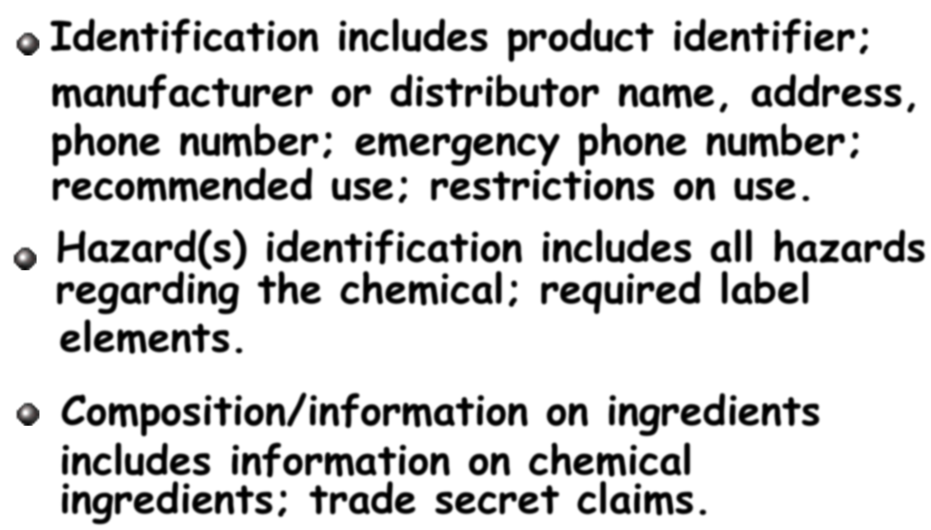
azards

Slide 14
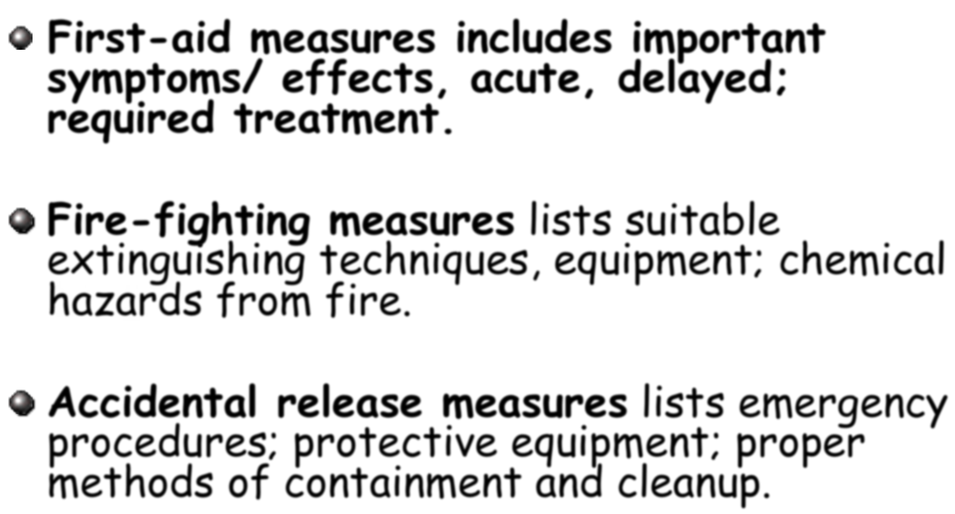
Measures

Slide 15
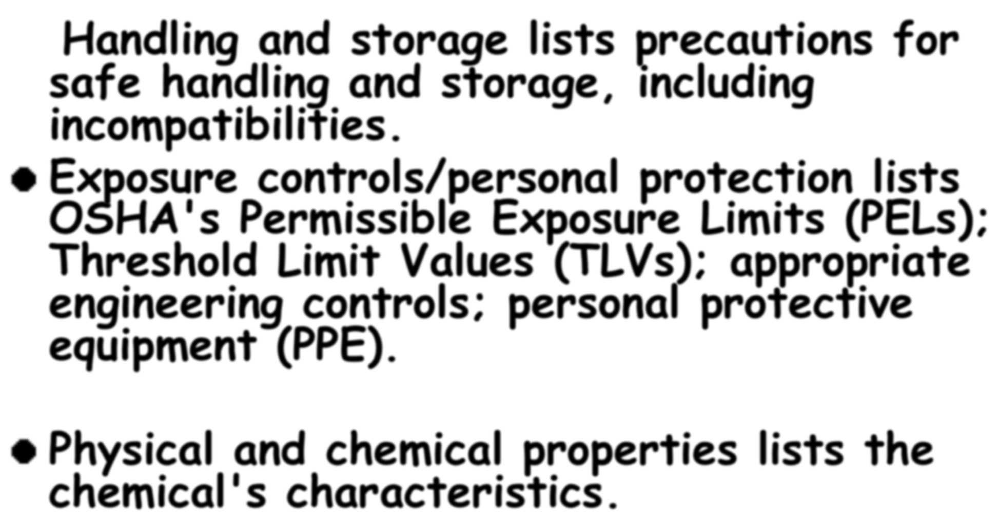
Information

Slide 16
Information

Slide 17
Under the OSHA Haz Comm rule employees have the right to examine and copy SDSs.

Slide 18
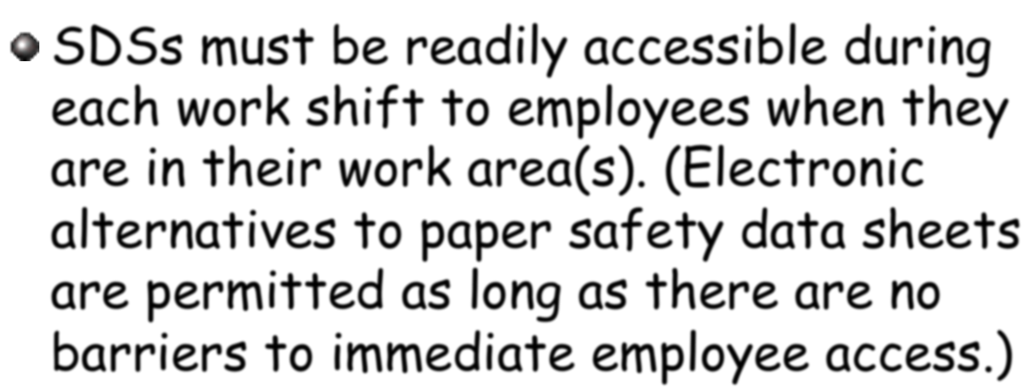
SDSs

Slide 19
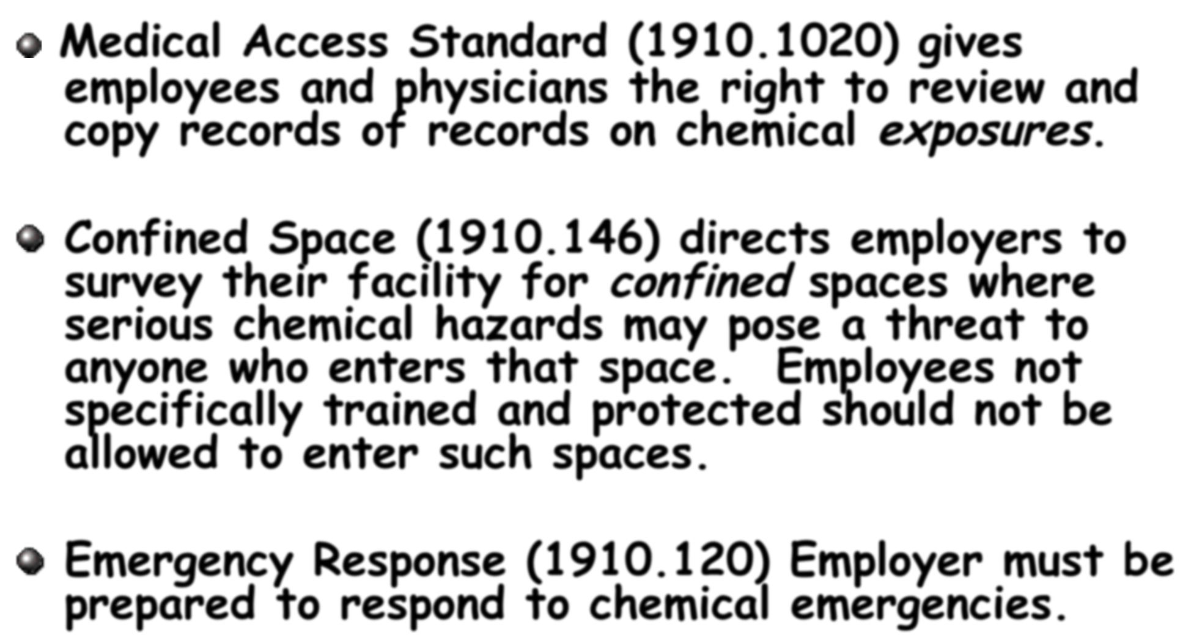
Standards

Slide 20
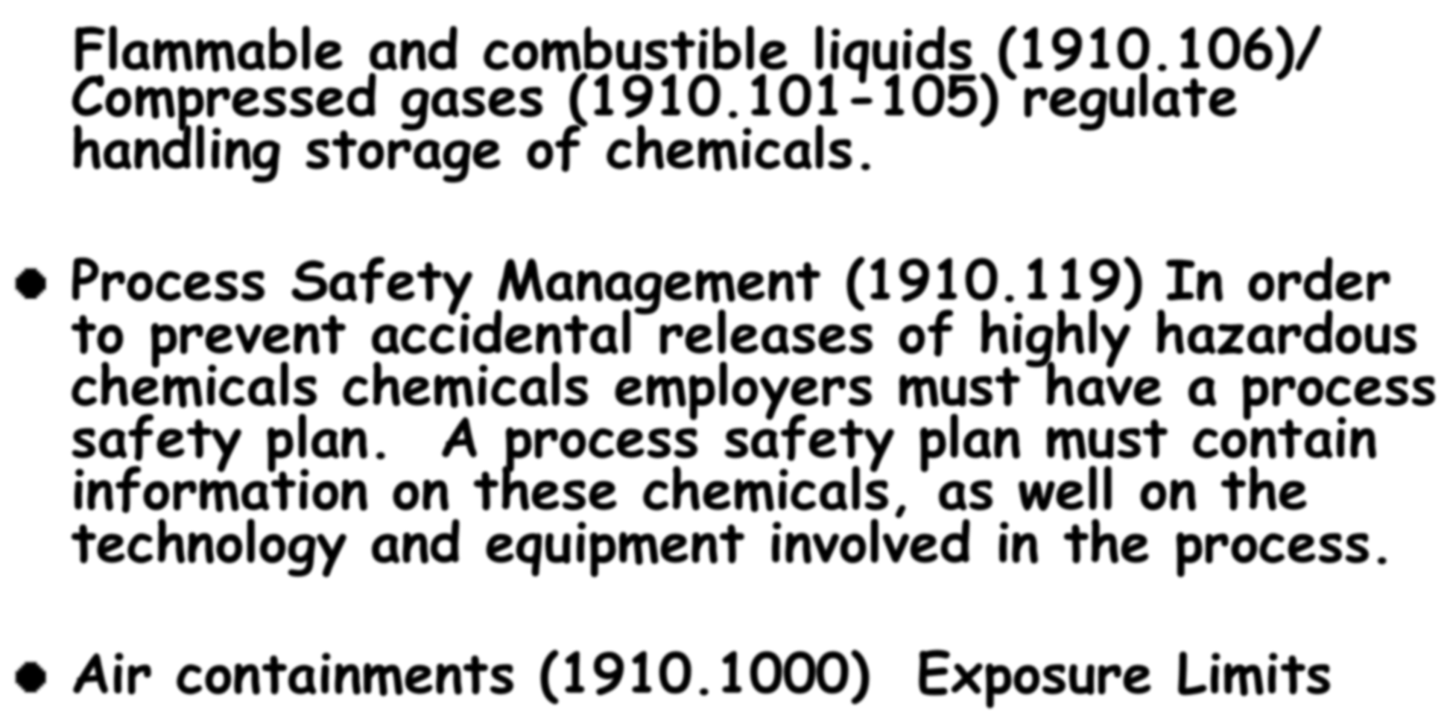
Standards

Slide 21
Thank you for your Attention
This material was produced under grant number SH-26285-SH4 from the Occupational Safety and Health Administration, U.S. Department of Labor. It does not necessarily reflect the views or policies of the U.S. Department of Labor, nor does mention of trade names, commercial products, or organizations imply endorsement by the U.S. Government.

