Slide 1
Reducing the Risk of Adverse Pregnancy Outcomes and Perinatal Illness for Female Agricultural Producers
Notes:
Introduction Slide- Reducing the Risk of Adverse Pregnancy Outcomes and Perinatal Illness for Female Agricultural Producers
Presenter: Knesha Rose- Davison, MPH
Health communications director
AgriSafe Network
Reducing the Risk of Adverse Pregnancy Outcomes and Perinatal Illness for Female Agricultural Producers
Adverse: Preventing Success of Development; harmful; unfavorable.
Perinatal: relating to the time, usually a number of weeks, immediately before and after birth. The perinatal period is defined in diverse ways. Depending on the definition, it starts at the 20th to 28th week of gestation and ends 1 to 4 weeks after birth.
The perinatal period commences at 22 completed weeks (154 days) of gestation and ends seven completed days after birth. Perinatal and maternal health are closely linked. ( World Health Organization, WHO)

Slide 2
Our Funder
This material was produced under grant number SH-05068-SH8 from the Occupational Safety and Health Administration, U.S. Department of Labor. It does not necessarily reflect the views or policies of the U.S. Department of Labor, nor does mention of trade names, commercial products, or organizations imply endorsement by the U.S. Government.
Notes:
Our Funding is provided on behalf of Department of Labor- Occupational Safety and Health Administration, Susan G Harwood Training grant.

Slide 3

Protecting the peopl who feed the world
copyright@2018
Notes:
How we Protect:
1. Ongoing needs assessment of Ag producer needs (following Total Farmer Health)
2. Train rural health professionals across the nation
3. Establish partnerships with NIOSH Ag Centers, rural research centers, and other NPOs
4. Maintain a culture of readiness and organizational expectation to
protect and respond

Slide 4

Goals
Upon completion of this presentation, participants will be able to:
Identify unique exposures/risks associated with farm tasks.
Identify at least four reproductive health and safety issues for women.
Locate three current evidenced based resources in the field of
agricultural health.
Select appropriate PPE for farm tasks to reduce or eliminate exposures and or risks.
©
Notes:
Upon completion of this presentation, participants will be able to:
Identify unique exposures/risks associated with farm tasks.
Identify at least four reproductive health and safety issues for women.
Locate three current evidenced based resources in the field of agricultural health.
Select appropriate PPE for farm tasks to reduce or eliminate exposures and or risks.

Slide 5
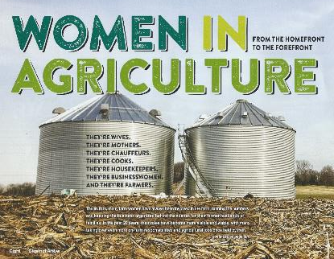
From the Home Front to the Forefront
They’re Secondary Operators
They’re Mothers
They’re Agricultural board/advisory council members
They're Sustainable Ag literacy advocates
They're Farm Managers,
They’re Animal husbandry experts
They’re Entrepreneurs
They’re Bookkeepers
They’re Family Mediators
They're Businesswomen
And They're Farmers
Notes:
Source: Channel Arrow – public AG publication
Women are taking on greater roles in the field of agriculture they include
They’re Secondary Operators
They’re Mothers
They’re Agricultural board/advisory council members
They're Sustainable Ag literacy advocates
They're Farm Managers,
They’re Animal husbandry experts
They’re Entrepreneurs
They’re Bookkeepers
They’re Family Mediators
They're Businesswomen
And They're Farmers

Slide 6
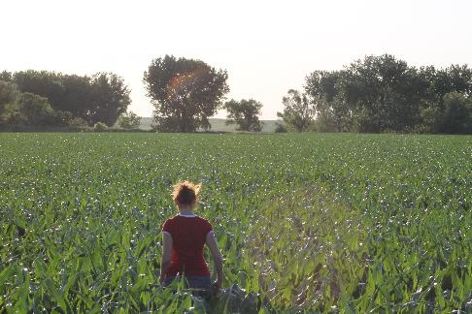
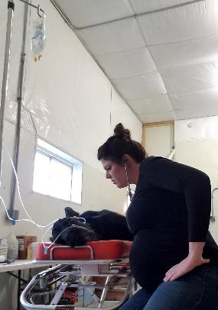
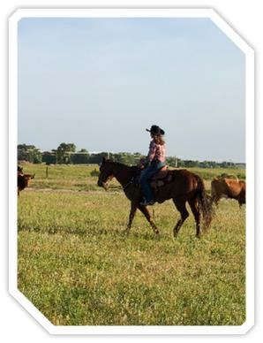
Profile of Female Agriculturists
Notes:
Examples of the various roles women engage on the farm and ranch. Row Crop Operations, Ranching, working with Large and Small Animals ( veterinarian)
Linda Emanual, Ag Producer and RN Nebraska ( Left)
Women riding a horse news cows ( middle)
Dr. Bailey Lammers, DVM
Owner of Gavins Point Veterinary Services out of Crofton, NE. Practice some small animal, and mainly food animal medicine with an emphasis of cattle reproduction and cow/ calf management. (right) Image of Vet with sick animal.

Slide 7
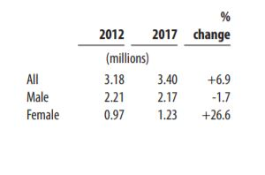
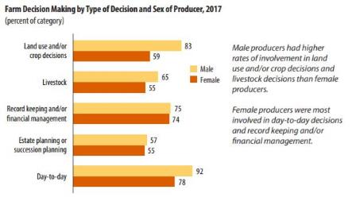
2017 Census of Agriculture
Total Producers
Farm Decision Making by Type of Decision and Sex of Producer

Slide 8
Farms and Farm Operators
More than a third of farms have multiple operators, and larger farms are more likely to have multiple generations of farm operators.
Most secondary operators on small farms are the spouse of the principal operator.
Multiple-generation enterprises are most common among large scale family farms and non-family farms (20-25 percent).
Source: America’s Diverse Family Farms 2017
Notes:
Farms and Farm Operators
More than a third of farms have multiple operators, and larger farms are more likely to have multiple generations of farm operators.
Most secondary operators on small farms are the spouse of the principal operator.
Multiple-generation enterprises are most common among large scale family farms and non-family farms (20-25 percent).
Source: America’s Diverse Family Farms 2017

Slide 9

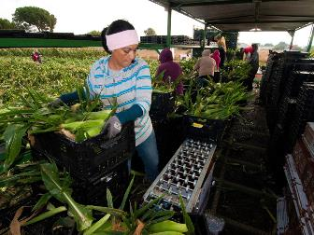
Migrant Workers
Estimates between 1 and 2.7 million hired farmworkers in the US, including migrant, seasonal, year-round, and guest program workers.
(Migrant Clinicians Network, 2018)
  79% Men; 21% women; Avg. age 33 years
  HRSA defines as at least 51% of income is derived from agricultural employment at any time within the past 24 months or prior to retirement or disability.
  Migrant- (moves for employment and provides temporary home for purposes of employment).
  Seasonal – Does not move for employment, works seasonally not year round.
Photo Credit- Agri-Pulse Feb 14, 2018 Simon Schuster
Notes:
A migrant farmworker is defined as an individual who is required to be absent from a permanent place of residence for the purpose of seeking remunerated employment in agricultural work. “Migrant farmworkers” are also called “migratory agricultural workers” or “mobile workers”. Seasonal farmworkers are individuals who are employed in temporary farmwork but do not move from their permanent residence to seek farmwork; they may also have other sources of employment.
https://www.migrantclinician.org/issues/migrant-info/migrant.html
Resources: Migrant Clinicians Network
Rural Women’s Health Project
Concern for this population Reproductive Health Effects on Pesticides
Tool kits

Slide 10
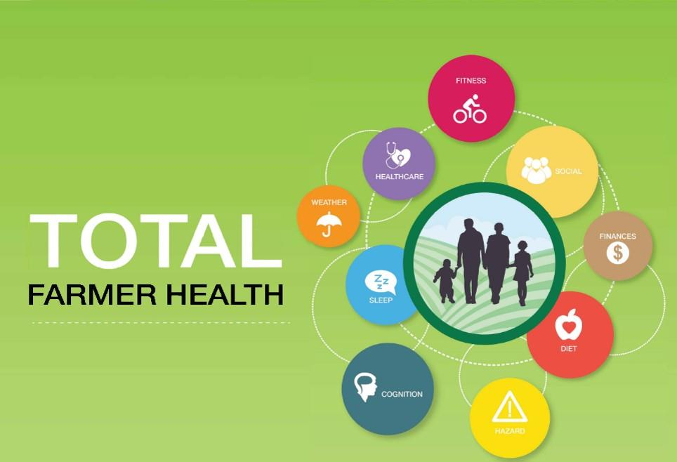
Total farmer health
Adaptation of Total Worker Health® to Agriculture
SM
Notes:
CDC/NIOSH Total Worker Health Affiliate since August 2017
This is AgriSafe’s platform to share information to producers on where they work and live and how it impacts their health. Cover a couple of examples.
Hazard
Farmworkers are at high risk for fatal and nonfatal injuries, work-related lung diseases, noise-induced hearing loss, skin diseases, and certain cancers associated with chemical use and prolonged sun exposure. Variety of exposures in agriculture result in multiple hazards:
Dusts (organic: bacteria, endotoxin, fungal spores; pesticide residues)
Pesticides and chemicals
Gases (Anhydrous ammonia, hydrogen sulfide, welding)
Vapors (fumigants, gasoline, diesel)
Confined space (oxygen deficient atmosphere)
Flying objects (cutting, grinding, sawing, drilling, mowing)
Noise (machinery, livestock, tools)
Hazardous equipment and machinery
Livestock
Off Road Vehicles
Sleep
Sleep plays a critical role in immune function, metabolism, memory, learning, and other vital functions. It is more difficult to take in new information following a night of inadequate or disturbed sleep.
It is just as important to get a good night’s sleep after learning something new in order to process and retain the information that has been learned.
Healthcare
Health insurance coverage places a significant financial burden on farm families.
Farmers are more likely than their rural counterparts to purchase in the individual insurance market which had limitations in care benefits.
Farmers are at high risk to be underinsured.
Finances
Financial health is a term used to describe the state of one's personal financial situation. There are many dimensions to financial health, including the amount of savings you have, how much you are setting away for retirement and how much of your income you are spending on fixed or non-discretionary expenses.
In farming, your financial health is impacted greatly by your business- the two are inherently connected.

Slide 11

Prevalence
The range of farm activities compound the problem of assuring a safe worksite for farm women who have their own inherent contraindications.
The National Institute for Occupational Safety & Health (NIOSH) lists numerous women’s safety and health issues related to an agricultural job including:
acute and chronic pesticide exposures,
chronic bronchitis among nonsmoking farm women,
pregnancy related risks,
farm work-related injuries,
exposures to inhaled substances in the workplace and
risk factors for female infertility in an agricultural region.
Notes:
Prevalence- How common a fact or condition occurs.
The range of farm activities compound the problem of assuring a safe worksite for farm women who have their own inherent contraindications.
The National Institute for Occupational Safety & Health (NIOSH) lists numerous women’s safety and health issues related to an agricultural job including:
acute and chronic pesticide exposures,
chronic bronchitis among nonsmoking farm women,
pregnancy related risks,
farm work-related injuries,
exposures to inhaled substances in the workplace and
risk factors for female infertility in an agricultural region.

Slide 12

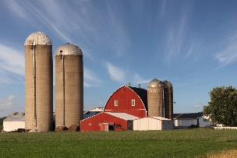
Cultural Considerations
Each farm family has its own set of values that are influenced by the family's ethnicity, socioeconomic status, level of education, and cultural traditions
These values influence the division of labor on farms, and women's potential exposure to multiple roles, factors contributing to occupational illness, stress, fatigue, and agricultural injuries. ( Weinert & Burman, 1994)
Notes:
Cultural Considerations
Each farm family has its own set of values that are influenced by the family's ethnicity, socioeconomic status, level of education, and cultural traditions
These values influence the division of labor on farms, and women's potential exposure to multiple roles, factors contributing to occupational illness, stress, fatigue, and agricultural injuries. ( Weinert & Burman, 1994)
Source: (Weinert & Burman, 1994)

Slide 13

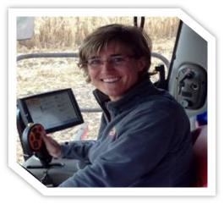
The Dance
Challenges
“I try to stay above/ahead of the farm. If I let myself get too deep in the minute-by-minute, I miss key decisions that should have been made, or opportunities to be more efficient.”
“This operation requires a delicate dance as we appreciate our heritage and embrace changes to ensure the legacy continues”
  Tracy (age 47) Principal operator family farm
Notes:
Source: Interviews with farm women. Permission to use quotes.

Slide 14

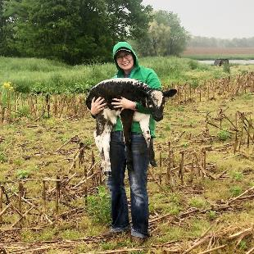
Diversification of an Optimist
Laney 28yrs, entrepreneur female producer
“I see our generation moving back to diverse farming operations. I love telling our farms story and I think a lot to women do!”
“I think my leadership roll on our farm is peer mediator and eternal optimist. I like to be the person to find bright sides and solutions.”
Notes:
Source: Interviews with farm women. Permission to use quotes.

Slide 15
Health Disparities – Rural Women
Poorer Health Outcomes
Less Access to Care than Urban Women
Limited numbers of Health Care Providers (Women’s Health)
Comparisons
  ↑ Ischemic Heart Disease (fatalities)
  ↓ Preventive Screening Services (Breast & Cervical Cancer)
Source: Health Disparities in Rural Women;
ACOG Committee Opinion
Committee on Health Care for Underserved Women
February 2014
Notes:
Comparisons include increased Alcohol Consumption
Triple Duty – Family Farm and off-farm careers ( health insurance and pensions) self-employed

Slide 16
Occupational Exposures
Occupational Exposures
  Livestock related injuries/fatalities
  Falls (Women Over 60 Years of Age)
  Machine Related nonfatal injuries/fatalities
  “Triple Duty” – Increased Risk of Stress and Agricultural Injury
  Pesticides/Chemicals/ Herbicides Exposures ( mixing and applying)
  Agricultural Dust Exposures
  Confinement (Hog) Gas Exposures
  Zoonotic Infections
Notes:
Agromedicine pages 44-48
Data from Finland….
Livestock related injuries –
Cow (agent of injury)
Crushed or stricken by an animal (women 15-59)
Women over 60 years (Falls)
Machine Related nonfatal injuries/fatalities
Tractors (most common agent of death for adult women)
Tractor run-overs
“Triple Duty” – Increased Risk of Stress and Agricultural Injury
Pesticide Exposures
Triple Duty – Family Farm and off-farm careers ( health insurance and pensions) self-employed

Slide 17
Reproductive Health
copyright@2018
Notes:
Within the framework of WHO's definition of health as a state of complete physical, mental and social well-being, and not merely the absence of disease or infirmity, reproductive health addresses the reproductive processes, functions and system at all stages of life. Reproductive health, therefore, implies that people are able to have a responsible, satisfying and safe sex life and that they have the capability to reproduce and the freedom to decide if, when and how often to do so.
Preconception health is a woman's health before she becomes pregnant. It means knowing how health conditions and risk factors could affect a woman or her unborn baby if she becomes pregnant. For example, some foods, habits, and medicines can harm your baby — even before he or she is conceived. Some health problems, such as diabetes, also can affect pregnancy.
Interconception health involves helping a woman understand the importance of being healthy between pregnancies and the need to wait at least 18 months before becoming pregnant again to help optimize birth outcomes.

Slide 18
Risk of Adverse Pregnancy Outcomes
Work Related Exposures
  Herbicides
    Dicambia, Glyphosate, Phenoxy Acetic Acids, Thiocarbamates)
  Carbon Monoxide
  Nitrate Toxicity (Formula Fed Infants)
  Livestock Production Hormones- Needlesticks
    Oxytocin
    Prostaglandin
  Zoonotic Infections
      Brucellosis, Q Fever, Listeria (cause abortion)
Notes:
Work Related Exposures
Herbicides: lower rates of fertility, (20%); when women on farms did not report these same exposes fertility rates were higher.
Exposures: Mixing and Applying herbicides and fungicides up to 2 years before attempting conception association w observed lower fertility
Carbon Monoxide- a toxic gas encountered in livestock buildings, fossil fuel heating units or high pressure washers powered by internal combustible engines. Risk to women is small; risk to unborn fetus, due to level of exposure (2x higher 20% carboxyhemoglobin LBW, slowed mental development)
Nitrate Toxicity- Young infants who are formula fed made up with water high in nitrate concentrations (>10 mg/L) have the potential to be poisoned. The most common cause of blue baby syndrome is water contaminated with nitrates. After a baby drinks formula made with nitrate-rich water, the body converts the nitrates into nitrites. These nitrites bind to the hemoglobin in the body, forming methemoglobin, which is unable to carry oxygen. Blue baby syndrome is rare in industrialized countries, but it does occasionally occur in rural areas.
Livestock Production Hormones – Needle sticks
Oxytocin – Can cause abortion in pregnant women who may be accidentally inoculated, more likely to cause abortion in later stages of pregnancy. Assists uterine contractions and milk let down.
Prostaglandin – Used in Cattle and Swine to terminate pregnancy early. May cause abortion at any time during pregnancy in pregnant women. Used to induce parturition, terminate pregnancy, or stimulate and synchronize estrous)
Zoonotic Infections ( next slide more details)
Brucellosis, Q Fever, Listeria (cause abortion)

Slide 19
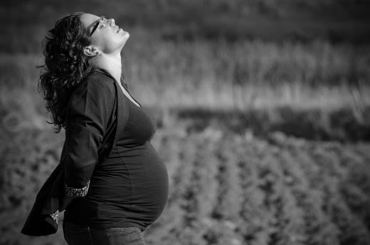
Zoonotic Disease
Q fever
Chlamydiosis
Toxoplasmosis
T. Gondii
Listeriosis
Leptospirosis
Brucellosis
Notes:
Zoonotic Infections
Quote from Animal Veterinarian- "I stayed away from kidding and lambing small ruminants, even if they had a normal pregnancy and no abortions," she explains. "Q fever can be shed at normal parturition and can be aerosolized, so I stopped doing small ruminant C-sections/dystocias. Any aborting animal, I think, would be a risk.“- Christine Navarre, DVM, MS, Dipl. ACVIM, Louisiana State University
Brucellosis, Q Fever, Listeria (cause abortion)
https://www.drovers.com/article/zoonoses-and-pregnancy
Women who are pregnant and have been exposed to brucellosis should consult with their obstetricians/healthcare provider for evaluation. Laboratory tests and a short course of antibiotics also known as post-exposure prophylaxis (PEP) may be recommended.
https://www.cdc.gov/brucellosis/transmission/index.html
Prompt diagnosis and treatment of brucellosis during pregnancy can be lifesaving for the fetus.
While rare, human-to-human transmission from lactating mothers to their breastfed infants has been reported.
If you have been diagnosed with brucellosis, please consult with your obstetrician/healthcare provider for healthy nursing options.
Q fever is caused by Coxiella burnetii and can cause reproduction problems in livestock and severe respiratory (lung) and liver disease in humans. People usually get Q fever by breathing contaminated barnyard dust or by direct contact with infected animals while assisting with the delivery of newborn animals.
In pregnant women, infections can cause premature delivery, abortion and infection of the placenta. Veterinarians should avoid contact with the placenta, birth tissues, fetal membranes and aborted fetuses of sheep, cattle and goats. If you are assisting the delivery of newborn animals, wear gloves, masks and eye protection. Pregnant women should be especially careful around pregnant sheep, cattle and goats.
Listeriosis from Listeria monocytogenes can be shed by infected animals in the feces, milk and uterine discharges. It is also found in aborted fetuses and occasionally in the nasal discharges and urine of symptomatic animals. Listeria can spread via ingestion, inhalation or direct contact. A majority of the cases are due to specific populations consuming unpasteurized milk but direct contact with an infected animal can spread the disease.
Infections are transmitted either transplacentally or from an infected birth canal. Humans can also be infected by direct contact with infected animals during calving, lambing or necropsies. Cases have been reported after contact with sick birds or the carcasses of asymptomatic poultry. Pregnant women may experience either a mild, flu-like syndrome with fever, chills, headache, slight dizziness or gastrointestinal signs, or an asymptomatic infection. This may be followed in a few days to weeks by abortion, stillbirth, premature birth or septicemia in the newborn. Newborns may be infected either in in utero or from bacteria found in the vagina during delivery.

Slide 20
Rates of infant, neonatal and post neonatal mortality in the U.S. from 2013 to 2015 by urbanization level (per 1,000 live births)
Notes:
Infant- The term "infant" is typically applied to young children under one year of age; however, definitions may vary and may include children up to two years of age.
Neonatal- 27 days
Infant, Newborn. A newborn infant, or neonate, is a child under 28 days of age. During these first 28 days of life, the child is at highest risk of dying.
Post neonatal- 28 days and 11 months or 1 year.

Slide 21
Pesticide Management
EPA - Recognition and Management of Pesticide Poisonings
Women who are pregnant or planning a pregnancy, especially those currently performing farm work, should be informed of the implications of exposure before, during and after pregnancy, and assisted in making decisions that are appropriate for their individual work and home situations .
Reproductive Health Effects of Pesticide Exposure
Issues for Farmworker Health Service Providers
Migrant Clinicians Network
Pamela Rao PhD
Farmworker Justice
Notes:
Further recognition:
Providers should encourage mothers to avoid exposure that might contaminate breast milk without unduly alarming them, perhaps by associating it with the importance of not smoking or drinking alcohol during pregnancy and nursing .
Breast feeding should continue to be strongly encouraged since all evidence indicates that the known benefits far outweigh the potential risks.
Source: Reproductive Health Effects of Pesticide Exposure
Issues for Farmworker Health Service Providers
Pamela Rao PhD, Farmworker Justice
Migrant Clinicians Network
Documented health effects include a wide variety of illnesses and diseases,
from eye irritation, skin rashes and respiratory problems to neurological damage, birth defects, cancer
and death. The risk for and severity of adverse health effects from pesticide exposure varies significantly
depending on many factors, including individual characteristics such as age and health status, the
specific pesticide, and exposure circumstances. Exposure to pesticides at certain developmental stages
of life can result in irreversible damage to organ structure and function. Of particular concern is the
effect of exposure at during the reproductive cycle, from preconception to breast feeding, because of
the possibility of poor birth outcomes, congenital anomalies, developmental deficits, and possibly
childhood cancer
EPA - Recognition and Management of Pesticide Poisonings
Reproductive Health Effects of Pesticide Exposure
Issues for Farmworker Health Service Providers
Migrant Clinicians Network
Pamela Rao PhD
Farmworker Justice

Slide 22

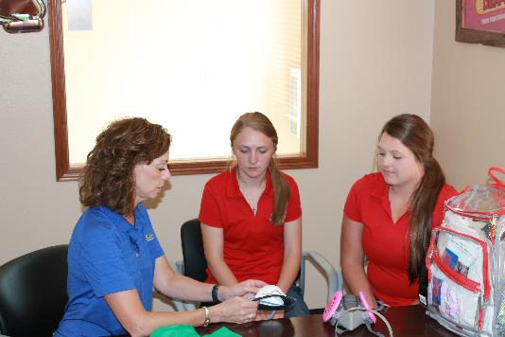
Pesticide Safety Mantra
Read the label
Wear appropriate PPE
Find PPE that fits
  Gloves
  Goggles
  Clothing protection
  Respirator
Notes:
Photo Property of AgriSafe Network

Slide 23
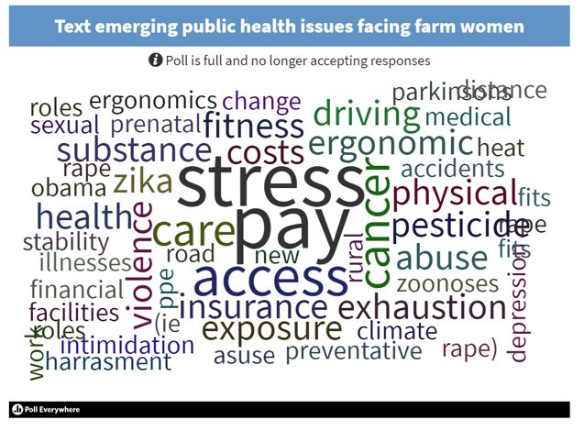
AgriSafe Think Tank Feedback

Slide 24

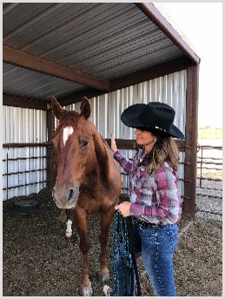

Stress On and Off the Farm
Women in Agriculture – Multiple roles
    Off farm work
    Live with risk every day
    Work life & family life intersect 24/7
    Lack of mental health providers
Review of literature supports women in farming work in multiple roles.
  “A farm woman with an off farm job faces very difficult demands in addition to being the traditional nurturer for the rest of the family”. (Moolgaard and Miller, 1996)
      Much has not changed in 20 years

Slide 25
Employee Rights and Responsibilities
You have the right to:
  A safe and healthful workplace
  Know about hazardous chemicals
  Information about injuries and illnesses in your workplace
  Complain or request hazard correction from employer
Notes:
Review Employee Rights www.osha.gov

Slide 26
Employee Rights and Responsibilities cont.
You have the right to:
  Training
  Access to hazard exposure and medical records
  File a complaint with OSHA
  Participate in an OSHA inspection
  Be free from retaliation for exercising safety and health rights
Notes:
Review Employee Rights www.osha.gov

Slide 27

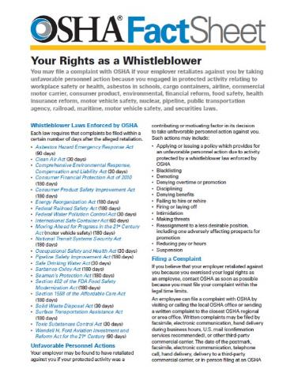
Whistleblower Protection Program

Slide 28
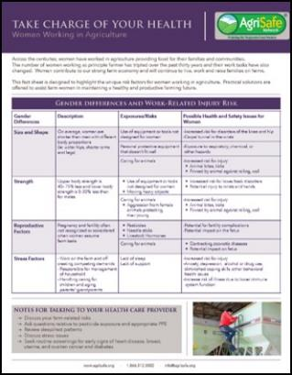
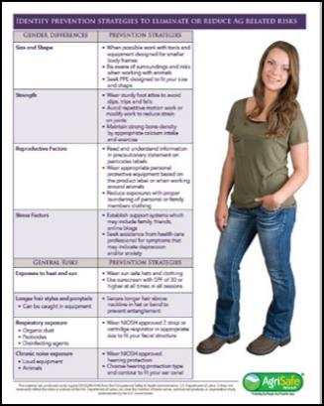
Women’s Health Resource

Slide 29
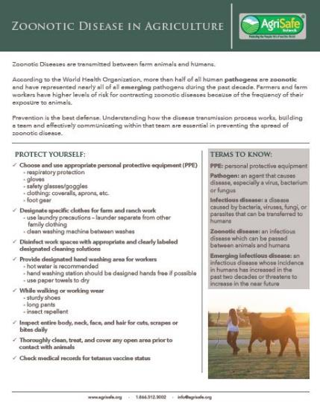
Zoonotic Disease Resource

Slide 30
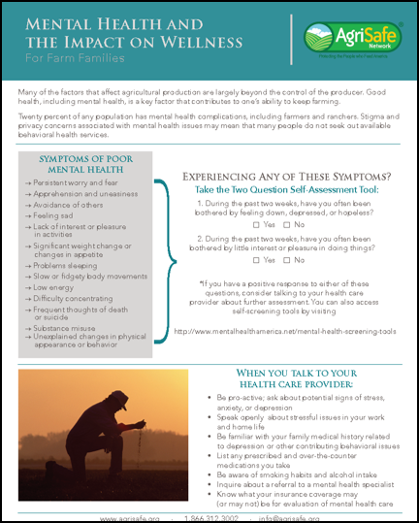
AgriSafe Mental Wellness Resource

Slide 31


Agrisafe pilates and yoga

Slide 32
Clinician Approach
Agricultural Health Risk Assessment
Clinical assessment to determine signs of injury that may be related to agricultural work
Research the possibility of fitting tools and tasks to the persons performing them in such a way that the strengths of the human body and psychology are maximized and exposure of weaknesses to stressors is minimized.

Slide 33

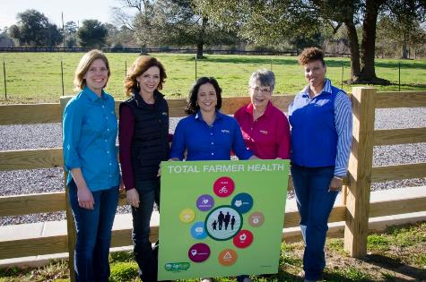
Thank You!
This material was produced under grant number SH-05068-SH8 from the Occupational Safety and Health Administration, U.S. Department of Labor. It does not necessarily reflect the views or policies of the U.S. Department of Labor, nor does mention of trade names, commercial products, or organizations imply endorsement by the U.S. Government.
Notes:
Thank you! Image of AgriSafe Staff Team holding Total Farmer Health Sign.

