Slide 1
Ergonomic Safety & Health for Women
…A Look at the Issues
…Are There Solutions?

Slide 2
This material was produced under a grant (SH-05068-SH8) from the Occupational Safety and Health Administration, U.S. Department of Labor. It does not necessarily reflect the views or policies of the U.S. Department of Labor, nor does the mention of trade names, commercial products, or organization imply endorsement by the U.S. Government
Notes:
Recognize the funding and professional support from OSHA

Slide 3


Why talk about it?
Women are playing an increased role in production agriculture. They account for about one-third of the management, ownership and work on farms, ranches and in crop production. Over 20% of migrant and seasonal farmworkers are women.
A major challenge continues to be access to protective equipment that meets the ergonomic needs of women. This program is intended to help women in rural/agricultural communities identify ergonomic issues leading to musculoskeletal injuries in farm and ranch work and discover resources to aid in injury prevention.
M. Kelley, J. Flocks, J Economos, L McCauley. Female Farmworker’ Health During Pregnancy – Health Care Providers’ Perspectives AAOHN, Inc. 2013
Notes:
Source: www.usda.gov
USDA documentation identifying the issue of women's safety & health in agriculture

Slide 4

Focus Areas:
At the end of the webinar, participants will be able to:
1. Identify work site hazards and potential musculoskeletal injuries.
2. Identify wellness initiatives aimed at reducing risks related to musculoskeletal injuries.
3. Locate three current evidenced based resources in the field of agricultural health and safety that address ergonomic safety.
4. Utilize the individual AgHRA to look at current exposures and preventive methods for daily farm tasks.
Notes:
Focus areas / objectives of program

Slide 5

Literature
“Women on farms are exposed to a multitude of biologic, chemical, physical, and mechanical agents while performing farm tasks. It is evident that women will be an increasing force in agriculture” (Ann K. Carruth, Carrie A. McCoy and Deborah Reed; Women in Agriculture: Risks for Occupational Injury within the Contexts of Role, and Haddon's Injury Model)
Donham and Thelin describe similar risk areas for women in agriculture with inclusion of livestock related injuries, fatigue, risk for cancer and depression. Agricultural Medicine – Rural Occupational & Environmental Health, Safety, and Prevention. Donham, K. & Thelin, A.
2016 Wiley Blackwell
Notes:
This is an excellent text and reference publication

Slide 6
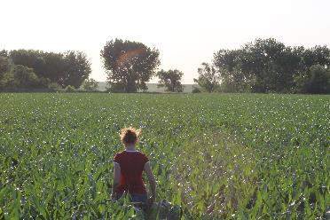
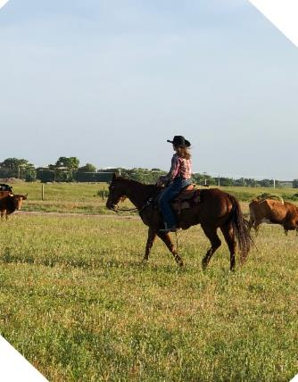
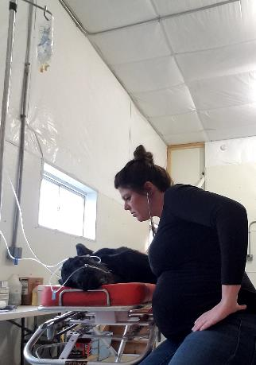

Profile of Female Agriculturists

Slide 7
Characteristics of Women Farmers and their Farms
Women-owner operators
Increase from 121, 600 to 306,200 (1982 -2007)
Nearly half specialized in grazing livestock
Notes:
In this report, “women-operated farms” are defined as those whose principal operator—the individual
most responsible for the day-to-day decisions of the farm (or ranch)—is a woman. Based on this definition,
results of the analysis were as follows:
• Women-operated farms increased in all sales classes. Between 1982 and 2007, the number
of women-operated farms grew from 121,600 to 306,200, with increases in all sales classes
(measured in 2007 dollars). In contrast, the number of men-operated farms declined by 220,800,
with only the largest and smallest sales classes ($500,000 or more and less than $1,000) experiencing
growth. Some of the increase in the lower sales classes, however—for both womenand
men-operated farms—was due to extensive methodological changes in the Census of
Agriculture, introduced over time to include more small farms.
• Most women-operated farms are very small. Since 1982, a majority of women-operated
farms have had annual sales of less than $10,000. Most of the growth in the number of womenoperated
farms occurred in that sales class, increasing from three-fifths of all women-operated
farms in 1982 to three-fourths by 2007. In both years, the share of women-operated farms with
sales less than $10,000 was about 20 percentage points more than the share of men-operated
farms with sales that low.
• Five percent of women-operated farms (15,400 farms) had sales of $100,000 or more in
2007. Most of these farms specialized in grains and oilseeds, specialty crops, poultry and eggs,
beef cattle, or dairy. The poultry and egg specialization alone accounted for roughly half of
women-operated farms with sales of $1 million or more.
• Nearly half of farms operated by women specialized in grazing livestock. In 2007, 45 percent
of women-operated farms specialized in raising beef cattle other than in feedlots (23 percent),
horses and other equines (17 percent), or sheep and goats (6 percent). Most of these farms, however,
were very small, accounting for only 16 percent of sales by all women-operated farms.

Slide 8
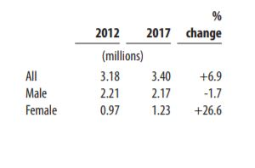
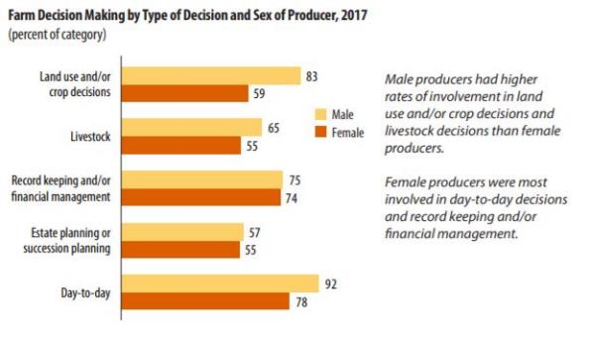
2017 Census of Agriculture
Total Producers
Farm Decision Making by Type of Decision and Sex of Producer
Notes:
Updated Ag Census Date from 2017.

Slide 9
Ergonomics
Ergonomics is a scientific discipline and professional practice
Ergonomics is defined as:
  The study of how people work in their environment
  Designing the job to fit the worker
Musculoskeletal disorders (MSDs):
  Affect muscles, nerves, and tendons.
  Work related MSDs are one of the leading causes of lost time injury and illnesses
- Occupational Safety & Health Administration
Notes:
It is important to understand the definition of ergonomics and the terminology used.

Slide 10
Incidents are Under Reported
Agriculture consistently ranks in the top three occupations for disabling injury and death
The Appropriations Act exempts small farming operations from enforcement of all rules, regulations, standards or orders under the Occupational Safety and Health Act. A farming operation is exempt from all OSHA activities if it:
Employs 10 or fewer employees currently and/or anytime during the last 12 months; and/or has not had an active temporary labor camp during the proceeding 12 months.
Paul Leigh, PhD, UC Davis: BLS surveys miss nearly 45% of non-fatal occupationally injuries in agriculture…unreported injuries
Leigh, J. Paul. Economic Burden of Occupational Injury and Illness in the United States. Milbank Quarterly Vol. 89 Issue:4
Notes:
The A large number of agricultural injuries are not reported

Slide 11
Survey Numbers from Green Heron Tools
The owners of Green Heron tools, with support of the U.S. Department of Agriculture, spent 8 months surveying and interviewing women livestock farmers across the U.S. (32 states & the U.S. Virgin Islands.
What they found:
  Experience across the continuum from beginning farmer to over 50 years of experience
  40% of survey respondents – ages 17 – 76 reported having experienced an injury and/or chronic condition that interfered with ability to perform daily activities
  Of the 40%, 86% reported the injury or condition was a musculoskeletal disorder
Notes:
Source: Green Heron Tools https://www.greenherontools.com/staying-healthy/introduction/
This organization is an example of one that shares information on ergonomic safety for women

Slide 12
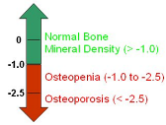
Contributing Factors to Injury
Physiological & Social Factors
  Working alone
  “Shift time” varies frequently and is seldom an 8-hour day
  Age
  Hearing acuity
  Visual acuity
  Arthritis
  Osteoporosis / Osteopenia
Notes:
There are many contributing factors to injury in agriculture

Slide 13


Contributing Factors to Injury –
Occupational Exposures
  Livestock related injuries/fatalities
  Falls (Women over 60 years of age)
  Machine related nonfatal injuries/fatalities
  “Triple Duty” ( home/family, farm & ranch work, off farm job) – increased risk of stress and agricultural injury
  Agricultural dust exposures including chronic bronchitis (coughing/sneezing/watery eyes can impact stance and posture)
  Zoonotic infections
Notes:
Agromedicine pages 44-48
Data from Finland….
Livestock related injuries –
Cow (agent of injury)
Crushed or stricken by an animal (women 15-59)
Women over 60 years (Falls)
Machine Related nonfatal injuries/fatalities
Tractors (most common agent of death for adult women)
Tractor run-overs
“Triple Duty” – Increased Risk of Stress and Agricultural Injury
Pesticide Exposures
Triple Duty – Family Farm and off-farm careers ( health insurance and pensions) self-employed

Slide 14
Contributing Factors to Injury
Environmental & Engineering Factors
Weather frequently changes
Extreme heat or cold
Humidity
Slippery surfaces
Uneven surfaces
Dusty conditions
Higher elevation work site
Poorly lit travel areas and walkways
Steps or walkways in poor repair
Ladders not in optimal condition i.e.: ladders on bins loose or rusty
Distraction by other activity – weather, animals , crops, loud or unfamiliar noise
Others?
Notes:
More contributing factors that affect ergonomic safety & health

Slide 15
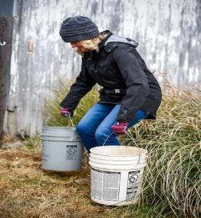
Contributing Factors to Injury
Personal or Habitual Factors
Running
Carrying objects that are too heavy or cumbersome
Distraction by other individuals or groups of people
Not using handrails when present
Improper ladder/equipment dismount
Improper rope/ harness/lead & lunge line use
Clothing entanglement dangers
Cleaning or working on equipment with tools placed out of reach
Exiting moving equipment or equipment designed for only one person
Mobile device conversations/texting (illegal in some states when operating vehicles on roadways)
Notes:
Human Factor contribution factors are the largest cause for injury

Slide 16
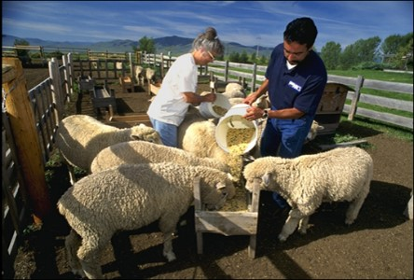
Contributing Factors to Injury cont.
Same level or Low-level falls: (also referred to as slips & trips) refer to falls under 10 feet .These account for about 60% of falls & represent a higher level of frequency - but typically* lower level of severity
  Steps / curbs
  Fence climbing
  Uneven surfaces
  Slippery surfaces (water, oil spill, ice)
  Objects in walk path (shovels, rakes, rope, cords, boxes)
  Trip over small or shorter animals (pets, young pigs, etc.)
  Struck by animals
  Falls from horses – extremely dangerous as they are usually in motion!
  * Even low-level falls can result in severe head and spinal injury, serious fractures, or the loss of vision (i.e.: upturned rakes)
Notes:
OSHA and the National Safety Council identify low level falls as those under ten feet.

Slide 17
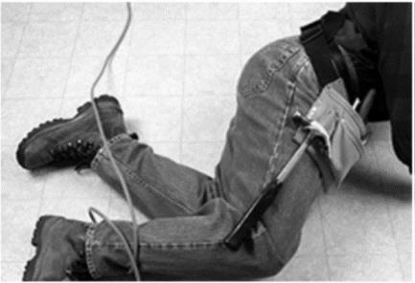
Major Contributing Factor to Injury
Tripping over equipment in a walkway can result in anything from minor sprains or scrapes to severe head and musculoskeletal injuries – upturned rakes & shovels have potential for internal injuries, puncture wounds, eye injuries
Notes:
Tripping hazards abound in agriculture

Slide 18
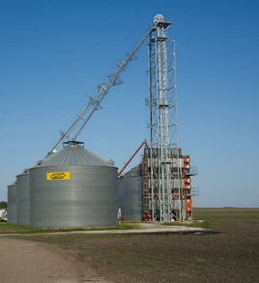
Contributing Factors to Injury cont..
Elevated/ High Level Falls: Falls that are over 10 feet are of lower frequency but higher level of severity
    Ladders
    Machinery
    Tractors
    Barn roofs
    Silos
    Grain bins
Notes:
Source: National Safety Council- www.nsc.org

Slide 19
Contributing Factors to Injuries cont…
Slips from machinery can cause a worker to fall into or against dangerous or moving equipment resulting in severe lacerations, amputations, or fatalities including suffocation
Combine heads
Grain Augers
Gears / belts
PTO (Power Take Off)
Others
Notes:
Moving parts and rapid rpm are potential for severe injury and death

Slide 20
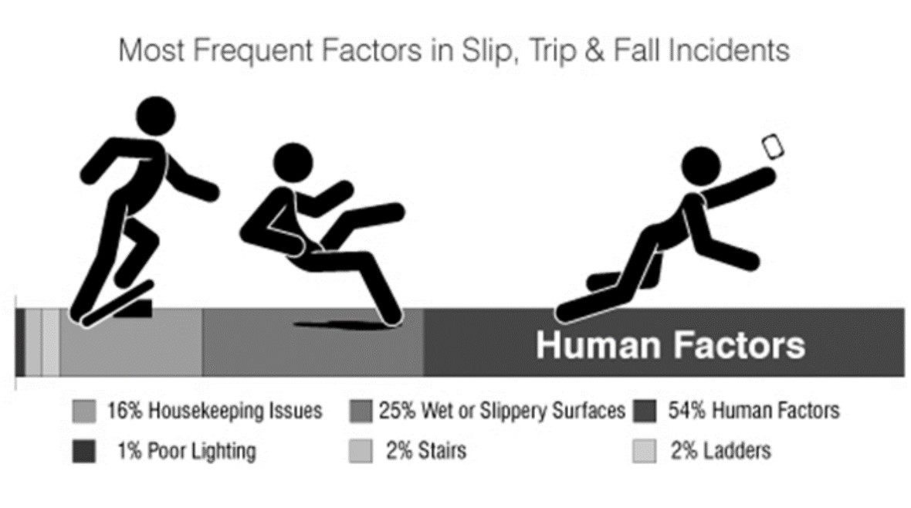
Most frequent factors in slip, trip, and fall incidents
Notes:
Courtesy of University of Iowa & the Great Plains Center for Agricultural Health: Nate Fethke, PhD, CPE (nathan-fethke@uiowa.edu)
Diane Rohlman PhD (diane-rohlman@uiowa.edu)

Slide 21
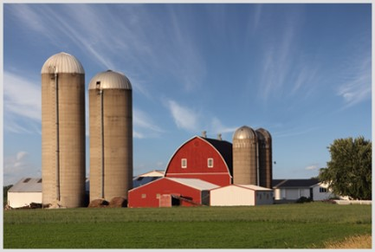

Contributing Factors to Injuries
Lifting objects that are too heavy
Repeated reaching overhead
Awkward working positions and body postures
Continual repetition of a specific work process
Vibration from hand tools
Static load on arms and upper body muscles
Inadequate design or size of hand tools
Notes:
Summary of additional issues causing ergonomic injury

Slide 22
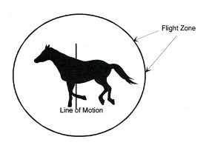
Contributing Factors to Injuries – Animal Handling
Slips in an animal space will startle and /or agitate an animal into running or charging a human …
Trampling will result in severe or debilitating injuries or death
Moving or working in the kicking/flight zone of a large animal can result in injury
Improper rope / harness handling can potentially result in a fall or arm and shoulder injury
A fall from a horse can result in boots caught in stirrups, dragging, head injuries, spinal injuries, fractures
Notes:
Animal handling injuries can be severe and deadly

Slide 23

Vibration Injuries
Neck – cervical spine misalignment; nerve paths become trapped
Static effort increases pressure on muscles and ligaments, tendons, soft tissue and reduces blood flow to tissue
Gripping hand tools – compression of soft tissue in hand and fingers can obstruct circulation and cause numbness & tingling
Vibration from heavy tools (chip hammers) can produce carpal tunnel pain, HAVS(hand-arm vibration syndrome)…Reynaud’s syndrome
Rotator cuff area in shoulders can become inflamed or result in tissue tears and ruptures. Permanent tissue and nerve damage can result
Notes:
Vibration issues continue to be studied and researched in relation to acute and long term injury potential

Slide 24
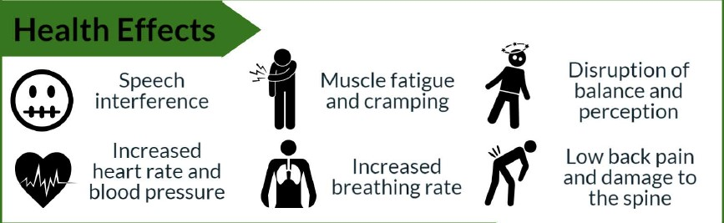
Whole Body Vibration
Notes:
Courtesy of University of Iowa & the Great Plains Center for Agricultural Health: Nate Fethke, PhD, CPE (nathan-fethke@uiowa.edu)
Diane Rohlman PhD (diane-rohlman@uiowa.edu)

Slide 25
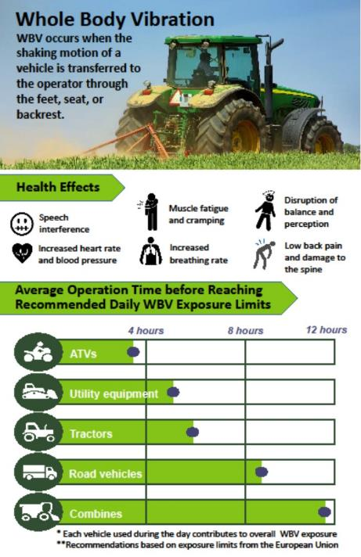
Whole Body Vibration
Courtesy of University of Iowa &
the Great Plains Center for Agricultural Health
https://gpcah.public-health.uiowa.edu/outreach-2/topics/whole-body-vibration/

Slide 26
Physical Factors –
Research shows…
Muscle fatigue reduces sensation and control of the joints
  - joints become more susceptible to injury*
Balance is affected by a generalized fatigue of trunk muscles and lower-extremity muscles
Fatigue also increased the attention demands needed to focus on balance tasks
Changela et al.International Journal of Scientific and Research Publications, Volume 2, Issue 3, March 2012 1 ISSN 2250-3153
Baierle et al. BMC Musculoskelet Disordv.14; 2013PMC3852398
Notes:
Muscle fatigue is prevalent in agriculture

Slide 27
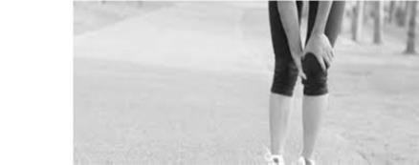
Physical Factors – Previous Injury or Illness
Low back pain can affect balance
Impacts posture and balance
Knee pain can affect balance
  i.e.: ACL tears, arthritis
Ankle injuries affect balance
  i.e.: sprains, edema, arthritis
Notes:
A large number of agricultural workers have sustained injuries to lower back and joints

Slide 28
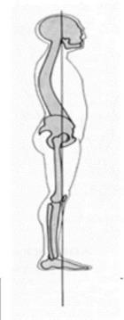
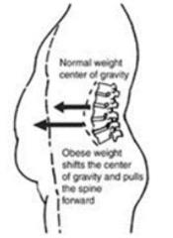
Physical Factors –
Body Mass Index (BMI )Impacts Balance Ability
Normal weight- Line of gravity
• Through jaw
• Front of shoulder joints
• Through or behind hip joints
• Front of knee and ankle joints
Obesity: Line of
gravity shifts
forward,
causing all
posterior
muscles to work
harder
Notes:
Deborah Lechner,deborahlechner@ergoscience.com www.ergoscience.com
Biomechanical Effects of Obesity on Balance HANNAH C. ,International Journal of Exercise Science. 2012

Slide 29

Contributing Factors:
Prescription and OTC Medications
Analgesics
Antidepressants
Anti-anxiety medications
Antihistamines
Blood pressure and other heart medications
Diabetes – altering medication routine
Energy boosters
Sleep inducing drugs
Change in prescriptions or dosages
Opioid use
Notes:
Medication use needs to be strictly monitored for anyone working around equipment or animal or operating a vehicle

Slide 30

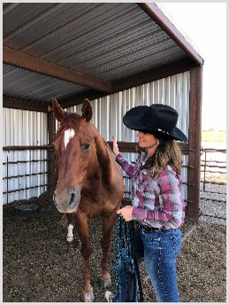

Stress On and Off the Farm
Women in Agriculture – multiple roles
    Off farm work
    Live with risk every day
    Work life & family life intersect 24/7
    Lack of mental health providers
Review of literature supports women in farming work in multiple roles.
  “A farm woman with an off farm job faces very difficult demands in addition to being the traditional nurturer for the rest of the family”. (Moolgaard and Miller, 1996)
      Much has not changed in 20 years
Notes:
Stress, both physical and mental/emotional can impact potential for ergonomic injury

Slide 31
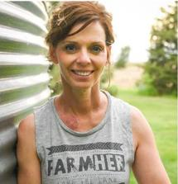
Ergonomic Differences
Women have anatomical and physiological differences that may place them at risk for farm injuries (Engberg, 1993).
Females are, on average, shorter than men and have more adipose tissue. Females also have narrower shoulders, wider hips and proportionally have shorter legs and arms than their male counterparts (Mackay, & Bishop, 1984).
On average upper body strength is 40% - 75% less in females than in males, while lower body strength is 5% - 30% less in females (Falkel, Sawka, Levine, Pimental, & Pandolf., 1986).
Men have an average of 26 lbs. (12 kilograms) more skeletal muscle mass than women. Women also exhibited about 40 percent less upper-body strength and 33 percent less lower-body strength, on average
  (Journal of Applied Physiology, 1993,2003,2006)
Notes:
Not true of everyone but overall evidence from multiple researchers

Slide 32

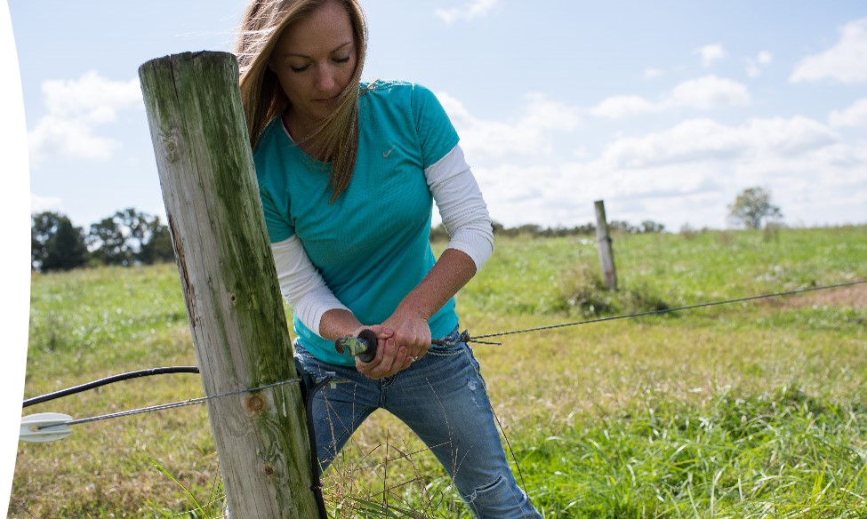
Farm & ranch work requires upper and lower body strength as well and involves repeated twisting and turning
Notes:
Photo property of AgriSafe- Broad Stance wide protective and using core muscles. Overall posture is good.

Slide 33

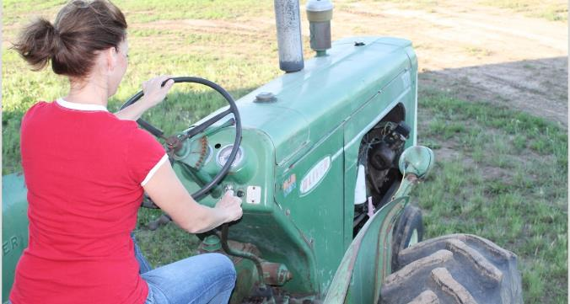
Machinery Build and Women
We know this photo should show a ROPS – but the reality is that women are often using smaller, older tractors to perform farm and ranch chores that are not retro-fitted
The placement of levers and the strength required to move them, may be more suited to the average male. (Carruth et al., 2001).
Notes:
Photo Property of AgriSafe Network- Older tractors, gear shift is harder, shift forward, wrist strength… get leverage to engage the clutch. More difficult overall. Made for men.

Slide 34
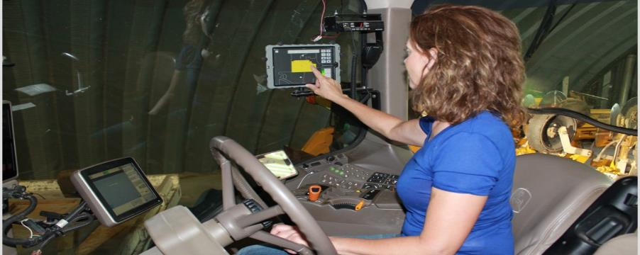
Correlation of Tractor use and Injury
Driving tractors an average of one day a week has been found to increase the risk of nonfatal farm injury(Carruth et al., 2001).
Notes:
Photo Property of AgriSafe Network- New Tractor, within arms reach, however sitting for long periods, LED lights means to work much longer hours and days. Multi sensory, executive function, anti vibration seat versus old spring coil in older tractors.
Solutions Flexing of the foot, stretching of the arms to alleviate shoulder stress etc.

Slide 35
Pregnancy Concerns
Pregnancy – fluid build up around the median nerve can cause pressure, numbness & tingling – symptoms of carpal tunnel syndrome
Center of gravity changes as baby grows
Gait and flexibility can be affected – legs and feet become edematous
Notes:
Women of child bearing age need to be aware of risks- Edema – Edematous ( swelling)

Slide 36
Prevention Strategies – Protecting Muscles, Tendons, & Ligaments
Education on proper lifting and handling techniques – excellent resources are available for healthcare providers and business managers
Promotion of early back care and posture habits
Awareness of the impact arthritis may have on back, hand, joint function
Review of ergonomics in the work sites (include office workspaces)
Notes:
Equators, clinicians, managers, parents, co-workers all can be educators and coaches

Slide 37
Prevention Strategies
Promote and Demonstrate:
Good back posture –standing, walking, sitting
Standing with feet apart at shoulder width, one foot slightly ahead of the other
Turning feet and arms rather than twisting the back
Finding help to lift heavy objects
Bending knees and lifting with leg muscles, keeping head in neutral position
Avoid locking knees -
Carrying objects close to the body, not with arms stretched out
Address the NIOSH conclusions regarding the ‘back belt” issue
Taking stretch breaks
Vary tasks every 20 – 30 minutes whenever possible
Notes:
More prevention strategies that can work to reduce ergonomic related injuries

Slide 38
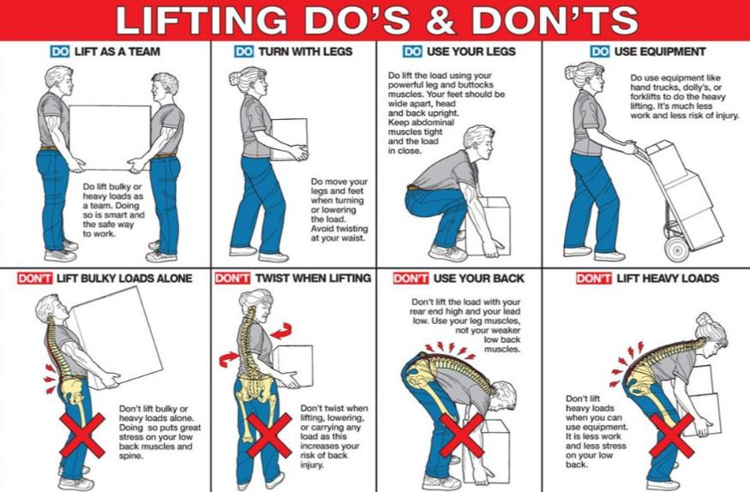
Correct lifting techniques
Correct Lifting Techniques:
Position your body directly in front of the object.
Bend at your hips and knees so that your legs, not your back, perform most of the work.
Keep your back upright and straight throughout the lift.
Turn your feet toward the destination rather than twisting the trunk when lifting heavy loads.
Keep the object as close to your body as possible.
Lift as smoothly as possible.
Throughout the move, the load should be as balanced and evenly distributed as possible.
Mechanical aids (lift tables, hoists, carts, and forklifts) are safer than manual lifting for heavy items.
Lifting above head height presents a high risk of injury and puts increased strain on the back.
Notes:
Courtesy of Texas Agrability project – Texas A & M – Rock back on your heels when you’re lifting, thigh, glutes and hamstrings…. And breathe… exhale as you are lifting.

Slide 39
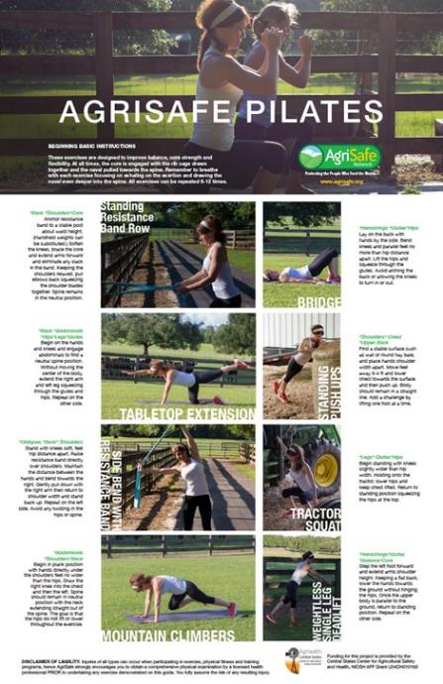
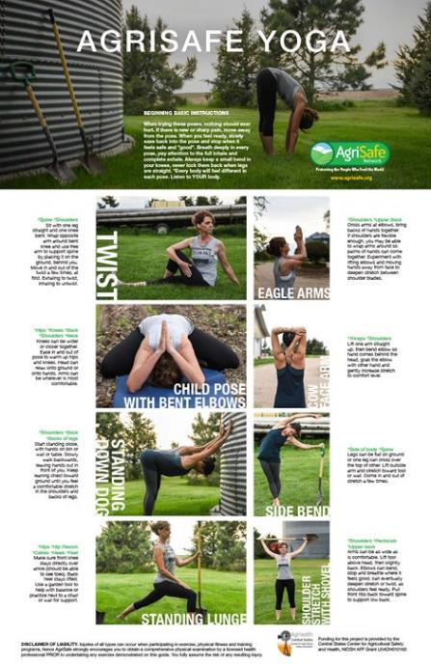
Agrisafe pilates and yoga
Notes:
Photos and posters property of AgriSafe Network

Slide 40
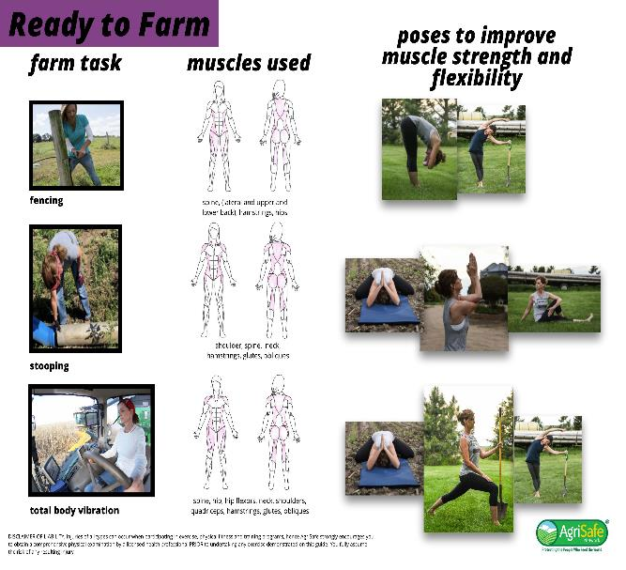
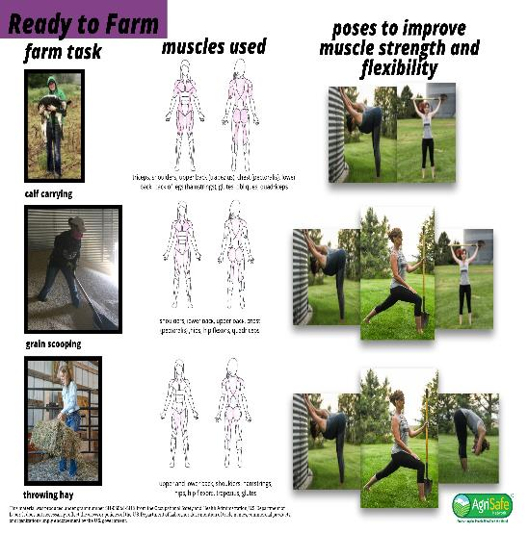
Ready to Farm

Slide 41
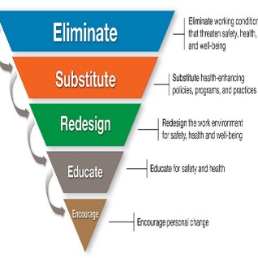
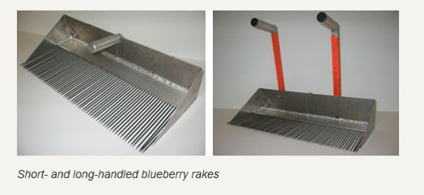
Engineering
Prevention includes
  Engineering out the risk
Adapted model
Photo: Northeast NIOSH Center
Notes:
NEC project – remarkable results- easier on the wrist forearm and the back.

Slide 42
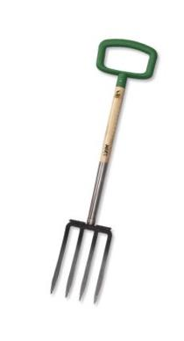
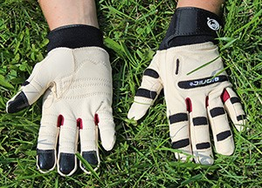
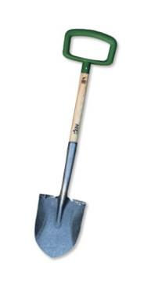

Tools, Gloves, Hats
Notes:
Used with permission Green Heron company owners- Anti vibration gloves are well fitted, hands are slipping inside. All developed by A. Yoder, so the blade of the shovel is tested for penetration of the soil. The grip is D-Grip designed for females. Proprietors OT, Nurse and Occupational Health Nurse.

Slide 43
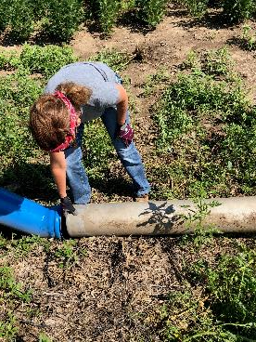
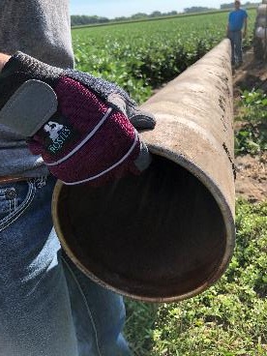
Antivibration, Fatigue gloves
Notes:
Spandex back for flexibility, padded palm and reinforced PVC patch, reflective binding on knuckles,
Reinforced finger tips, Velcro down at wrist for snug fit- By Rosie’s Work wear… difficult to find workwear for women.

Slide 44
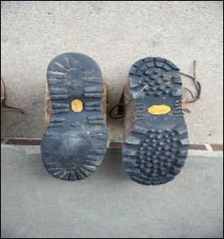

Prevention Strategies cont.
Well worn footwear will not have necessary traction on damp or uneven surfaces – resulting in a variety of hazardous slipping injuries
NSI Standard 1-75 C-25
Nitrile rubber compound on soles of shoes
Appropriate grooves to channel water
Large flat soles
No heel (with exception of riding and horse work boots)
Poor grip = slipping hazard
Much better grip on this shoe
Notes:
Look for ANSI Standard information on footwear - No flip flops!! Photo property of AgriSafe Network

Slide 45

Prevention Strategies cont..
Eyewear:
Sunglasses: remove when entering low lit areas
Wear approved impact resistant safety glasses or goggles
(ANSI Standard Z87)
Regular eye exams will assure visual acuity
Get used to bifocals prior to wearing in work areas
Gloves:
Secure grips and good fit to prevent slippage when reaching
Good fitting gloves can prevent ergonomic related injures
Clothing:
avoid ragged or torn legs and sleeves to prevent catching in equipment
Notes:
Eyewear – ANSI standard will be on product

Slide 46
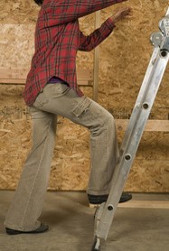
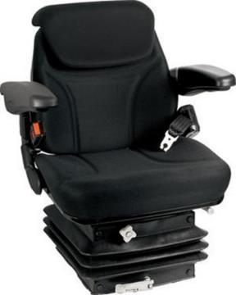

Prevention Strategies cont…
Always face a ladder when climbing
Always utilize a 3-point contact approach
Anti-vibration seats for tractors/combines
Notes:
Standard tractor seats can be replaced with anti-vibration seats- check tractor dealership for details and options.
Fotosearch photo property of AgriSafe

Slide 47
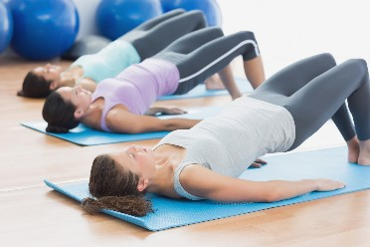
Pelvic Floor Exercises
The pelvic floor is a set of muscles that supports pelvic organs, such as the bladder and bowel. These muscles aid urinary control, continence, and sexual function.
  Kegels
  Squeeze & Release
  Bridge
  Squats

Slide 48
Work Smarter not Harder
Having self awareness-know your strengths and your weaknesses
What is working for someone else – borrow ideas and modify to fit into your work
Cultivate a Culture of Safety
Maximize your efforts – research mechanization
Notes:
Look at better feeding processes a feeding system, using machinery skid loaders and tractors to preserve and protect your body. Males may overlook these factors, females should advocate for their differences in work processes. Should not be lifting over your head routinely using the mechanized equipment on your farm.

Slide 49
Prevention Strategies cont….
Does someone know where you are?
Do you have a communication plan?
Is the cell phone call that urgent ?
If an injury occurs, is there a first aid kit nearby?
Are you familiar with emergency service numbers in your community?
Are you on an Enhanced 911 grid? Do your family members/ workers know your coordinates (Road address numbers & letters ?
Poison Control: 800-222-1222
Notes:
This can be part of an action plan:
Emergency numbers: Fire, police, poison control (For a poison emergency, call 1-800-222-1222 from anywhere in the United States, 24 hours a day and 7 days a week.
Because of the information needs of 911 you need to have coordinates so that 911 can locate you.

Slide 50

Action Plan
Action Needed | Barriers to Overcome | How Will I Remove Barriers | Action Taken | Cost of Project
Reduce Clutter in Machinery | Several operators with lack of ownership | Get buy in from operators to take ownership of removing clutter and maintaining clutter free area | Assess machinery in use for clutter – talk with all operators about new process to keep areas clutter free. | $ Labor costs
Improve Ladder Safety | Multiple ladders in various locations in various conditions | Develop plan to assess all ladders and the type of ladder needed in each area. | All ladders assessed and plan made to replace or repair as needed. | $ Labor and ladder repairs / or new ladders
Improve visibility in livestock facility | Cost of installing new lights and repairing existing lights | Obtain accurate evaluation of lighting needs | Worked with local contractor to get accurate quote of cost for project. Prioritize which areas to fix first. | $ 500 - $5000 depending on what needs to be done
Notes:
Action plans can be updated and revised- Crop Farmers and Livestock think about this as a rainy day activity. Taking ownership when you’re done working example workbench, clutter water bottles, tools, etc.

Slide 51
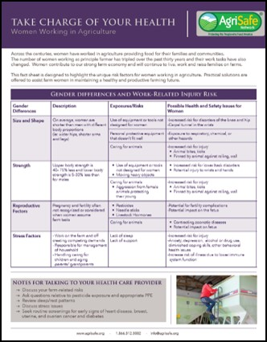
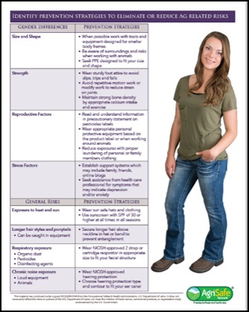

Women’s Health Resource
Notes:
Developed by AgriSafe

Slide 52
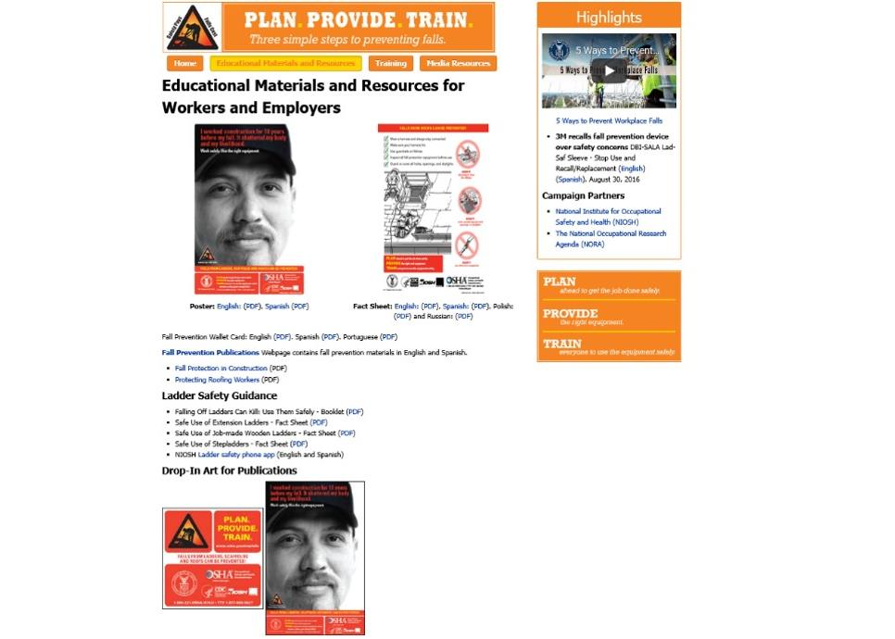
www.osha.gov
Notes:
OSHA Fall Prevention campaign

Slide 53

http://www.agrability.org/
Notes:
National Agrability Project – very useable materials

Slide 54
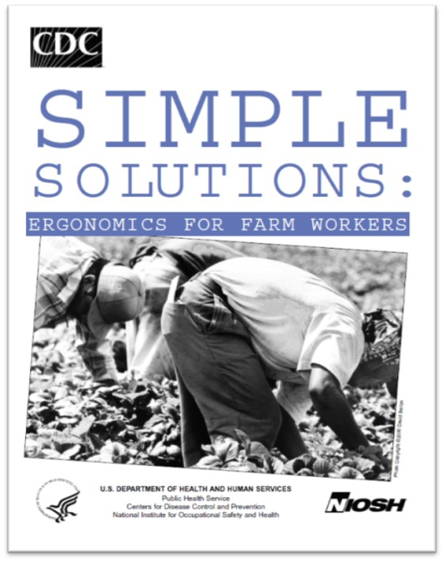
CDC/NIOSH publication
Notes:
CDC/NIOSH publication

Slide 55


Post Time
Please take a minute to complete the post test - the results help us to evaluate and improve our programs
Notes:
Post test

Slide 56


Whistleblower information
Notes:
Whistleblower information www.osha.gov

Slide 57
OSHA Employee Rights & Responsibilities
You have a right to:
A safe and healthful workplace
Know about hazardous chemicals
Information about injuries and illnesses in your workplace
Complain or request hazard correction from employer
Training
Access to hazard exposure and medical records
File a complaint with OSHA
Participate in an OSHA inspection
Be free from retaliation for exercising safety and health rights
Notes:
OSHA – Employees Rights & Responsibilities

