Slide 1
Chemical Safety

Slide 2
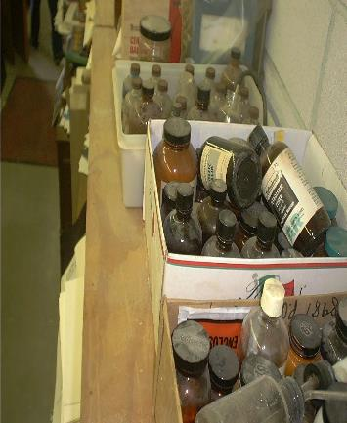
Chemical Hazards
Flammable
Corrosive
Reactive
Toxic

Slide 3

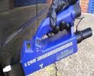

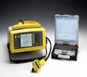
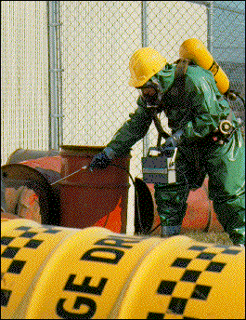
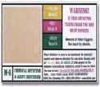
Chemical Hazards
Reference Scales
How flammable?
How Corrosive?
How Reactive?
How Toxic?
Monitoring for Chemical Agents
Meter
CAM
PIDs
ADP 2000
Detection equipment
HAPSITE
portable GG/MS
Combustible Gas Indicator
M8/M9 Tape

Slide 4
Flammable
Fire triangle (tetrahedron)
fuel O2
ignition source
chemical chain reaction

Slide 5
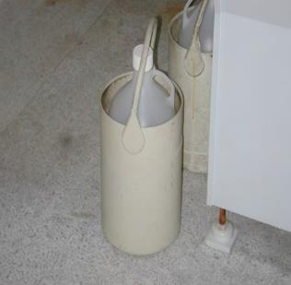
Flammable
Flash pt: minimum temp for combustion (lab) OSHA 100F EPA Haz waste 140F
DOT 100F
Examples:
ether = -40F gasoline -45F
styrene =88F
stoddard solvent 110F cresol=187F

Slide 6
Flammable
Flammable range: range in air that can
support combustion; percent % of flammable in air/ amt of vapor needed to support combustion at a liquid's surface depends on volatility of liquid/vapor pressure
LEL/LFL UEL/UFL
Gasoline 1.4---------------7.6 %
Formaldehyde 7--------73%
Ammonia 15----------28%

Slide 7
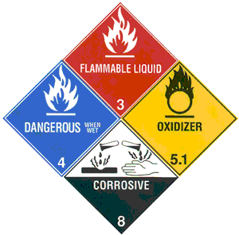
Flammable
Flash point and Flammable range : SDS, NIOSH pocket Guide
Instrument to detect flammable
ranges. {CGI}
Labels and Markings

Slide 8
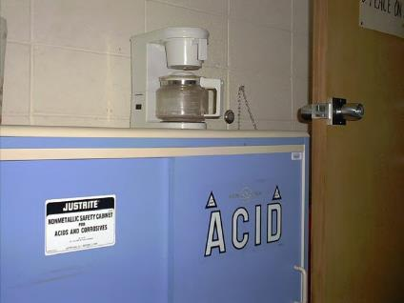
Corrosive
Any compound that can cause rapid damage to human tissues, metals, solids
pH-Hydrogen ion concentration scale 1[strong acids] to
14[strong bases Alkali]

Slide 9
Corrosive
Secondary Problems:
Liberation of flammable toxic vapors
Generate heat
Combustion of other materials O2

Slide 10
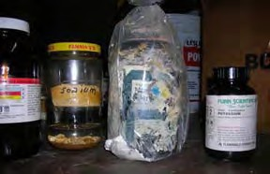
Corrosive
pH paper
Where on pH scale 7=neutral
Labels and Markings

Slide 11
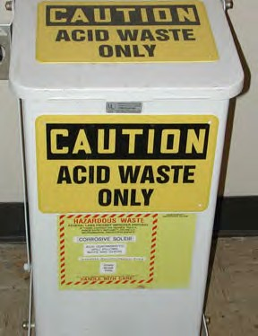
Reactive
Chemical naturally or designed to bring about a chemical reaction
(Molecules align into long chains)
React with other chemicals

Slide 12
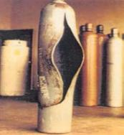
React with
air/light: hydrogen and chlorine reacts with light
Water: sodium, magnesium, strong acids
Self reactive: inherently unstable (heat/ light/ shock/ age)
(Styrene, ethylene as they age decompose creating heat: the hotter they get the more they accelerate a reaction.)

Slide 13
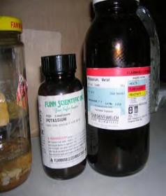
Reactive
No detection instruments or reference scales
Rely on sources: Chemical Dictionary SDS
NIOSH Guide Labels

Slide 14
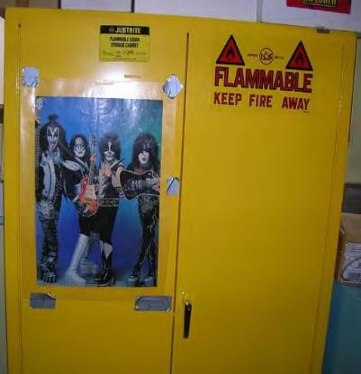
Toxic
Exposure limits
Detection instruments
Reference Sources
Image of a sotra

Slide 15
How Chemicals Behave
Vapor Pressure [tendency to evaporate into air]
Vapor Density [heavier of lighter than air]
Specific Gravity [ sink or float in water]
Provides clues to exposure and methods of control
SDS NIOSH Guide

Slide 16
June 1, 2015 requirements
By June 1, 2015, all labels will be required to have pictograms, a signal word, hazard and precautionary statements, the product identifier, and supplier identification.
Hazard Pictograms
Signal Word
'Danger'
Hazard Statement
'Highly flammable liquid and vapor.
May cause liver and kidney damage.'

Slide 17
Thank you for your attention.
This material was produced under grant number SH-26285-SH4 from the Occupational Safety and Health Administration, U.S. Department of Labor. It does not necessarily reflect the views or policies of the U.S. Department of Labor, nor does mention of trade names, commercial products, or organizations imply endorsement by the U.S. Government.

