Slide 1
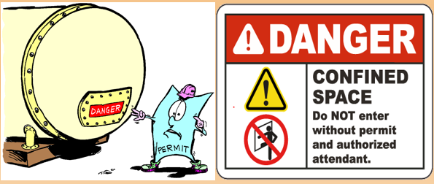
OSHA SUSAN HARWOOD PROGRAM 2016-17
Confined Space Safety Training

Slide 2
Disclaimer
This training is conducted under the OSHA Susan Harwood training grant #SH-29667-SH6 from the U.S. Department of labor. It does not necessarily reflect the views or policies of the U. S. Department of Labor, nor does mention of trade names, commercial products, or organizations imply endorsement by the U. S. Government.

Slide 3
Agenda
As a result of this training Participants will be able to:
  OSHA New rule for Confined Spaces
  Know what a confined space is.
  Identify and understand Permit-Required Confined Spaces.
  Identify and understand non-Permit Confined Spaces.
  Understand the hazards associated with Confined Spaces.
  Understand the roles associated with confined space entry.
  Have an awareness understanding of the types of PPE that may be required for entry into confined spaces.

Slide 4
OSHA New Rule
On May 4, 2015, OSHA issued a new standard for construction work in confined spaces, which became effective August 3, 2015. The new standard, Subpart AA of 29 CFR 1926 will help prevent construction workers from being hurt or killed by eliminating and isolating hazards in confined spaces at construction sites similar to the way workers in other industries are already protected.
The NEW rule requires employers to determine what kinds of spaces their workers are in, what hazards could be there, how those hazards should be made safe, what training workers should receive, and how to rescue those workers if anything goes wrong. Previously the only requirement for confined spaces in construction was training

Slide 5
What is a Confined Space?
A space that:
Is large enough and so configured that an employee can enter bodily and perform work;
Has limited or restricted means of entry or exit;
Is not designed for continuous human occupancy.

Slide 6
Examples of Confined Spaces
Tanks
Manholes
Boilers
Furnaces
Sewers
Silos
Hoppers
Vaults
Pipes
Trenches
Tunnels
Ducts
Bins
Pits

Slide 7
Potential Hazards in Confined Spaces
Oxygen Deficiency
<19.5% or >23.5% oxygen concentration
Combustibles
Methane
Hydrogen
Acetylene
Propane
Gasoline fumes
Toxic Materials
Carbon Monoxide
Hydrogen Sulfide
Welding fumes
Corrosives
Electricity
Mechanical Hazards
Mixers
Crushers

Slide 8
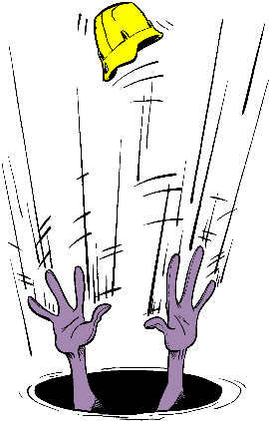
ENTRY
The act by which a person intentionally passes through an opening into a permit required confined space.
Any part of the body passing through the opening is considered entry.

Slide 9
IDLH
IMMEDIATELY DANGEROUS TO LIFE OR HEALTH
Any condition which poses an immediate threat to the health of life on an entrant, or;
Would cause irreversible adverse health effects, or;
Would interfere with an individual’s ability to escape unaided from a permit space.

Slide 10
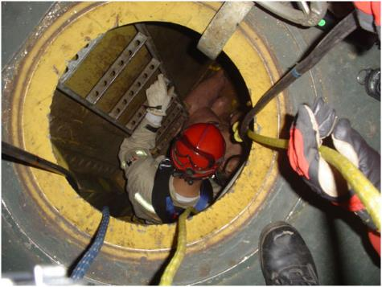
ENTRANT
The employee who will physically enter the confined space to perform the work.

Slide 11
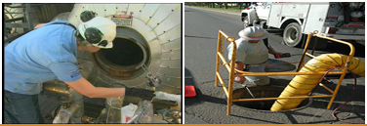
ATTENDANT
The employee who remains outside the confined space and monitors the entrant(s); guards the space against unauthorized entry; warns the entrants of any unusual conditions; and summons the rescue personnel if needed.

Slide 12
Permit-Required Confined Space
A Permit-Required Confined Space is confined space that has one or more of the following characteristics:
Contains or has the potential to contain a hazardous atmosphere;
Contains a material that has the potential for engulfing an entrant;
Has an internal configuration such that an entrant could become trapped or asphyxiated; or
Contains any other serious safety or health hazard.

Slide 13
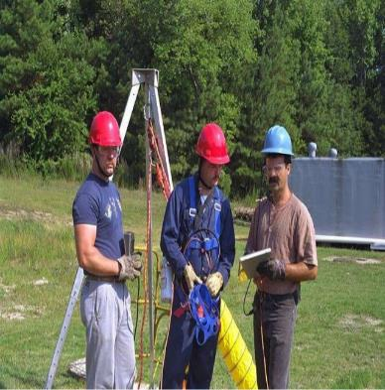
Entry Supervisor
The employee responsible for coordinating the entry into the confined space. This must be a team leader or foreman.

Slide 14
Responsible Person
The person directly responsible for the work being performed in the confined space. This can be the Team Leader, Foreman, journeyman, or other person qualified by training and experience.

Slide 15
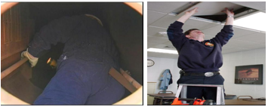
Non-Permit Confined Space
A confined space that does not contain or, with respect to atmospheric hazards, have the potential to contain any hazard capable of causing death of serious physical harm.

Slide 16
Two Options for Entering Confined Spaces:
Permit-required confined space entry
  For hazardous or potentially hazardous confined space work
Examples of Permit Required Confined Spaces:
Manholes going into sewers
Grain Silos
Trenches
Non-permit confined space entry
  For non-hazardous confined space work
Examples of a Non-Permit Required Confined Space:
Drop ceiling
Motor control cabinets

Slide 17
Permit-Required Confined Space Entry Procedure
Isolate the space
Ventilate the space
Conduct Tailboard
Complete permit
Test the atmosphere
Enter the space

Slide 18
Isolate the Space from all hazards
Close Valves
  Double block & bleed, or
  Blank flange
Empty the Space
  Depressurize, vent & drain
Lockout/Tagout Equipment
  Electrical sources
  Rotating/reciprocating parts
  Hazardous materials
Clean residue from the space

Slide 19
2. Ventilate the Space
Use mechanical ventilation
  Fans
  Air horns
Ventilate at the rate of at least four (4) volumes per hour
  Larger spaces require more ventilation
Make sure air supply is not contaminated
  Ventilation air supply must be from fresh air uncontaminated with flammables, toxins, etc.

Slide 20
3. Conduct a Tailboard Briefing
Entire crew must attend
  Attendants, entrants, entry supervisor
Review hazards of entry and work
Review PPE
Review procedure for contacting rescue
  verify rescue available
Complete permit

Slide 21
4. Complete Entry Permit Form
Permit must be correctly and completely filled out prior to entry.
Permit must be activated by Entry Supervisor’s signature to be valid.
No entry is allowed without a valid permit.
Permits are valid for up to 12 hours.
When work is completed, permit and tailboard form should be returned to safety.
Canceled permits must be kept on file for at least one year.

Slide 22
5. Test the Atmosphere
In this following order
Check for Oxygen Content:
            At least 19.5% and less than 23.5%
Check for Combustibles:
            Less than 10% of the LEL (Lower explosive limit)
Check for Toxic Gasses:
            Most commonly carbon monoxide (PEL <35 ppm)
            or any other hazardous materials as determined by the use of the space.

Slide 23
NOTICE:
Any time a limit is exceeded, no matter what the reason, all personnel shall immediately exit the space, and no others shall enter until atmospheric conditions are returned to safe levels.
THERE ARE NO EXCEPTIONS TO THIS!

Slide 24
Atmosphere Testing Shall Be Performed:
Prior to every entry when the space is vacant;
After a 10 minute ventilation period (if ventilation is necessary);
At least hourly for permit-required confined spaces.
More frequently, if conditions or suspicions warrant.

Slide 25
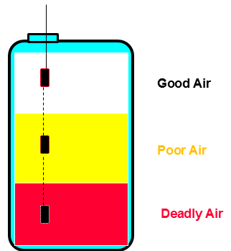
Always test the air at various levels to be sure that the entire space is safe.
Good air near the opening does NOT mean there is good air at the bottom!

Slide 26
6. Enter the Space and Proceed with work:
An attendant shall be posted near the entrance for the duration of the work. He shall be in constant communication with the entrants while the job is in progress.
All entrants shall sign the sign in log when entering the space and sign out when exiting.
The attendant shall maintain the permit and sign in log for the duration of the work.

Slide 27
When the Job is Done:
Remove all personnel, tools, and debris from the space. Sign off the log.
Close the space.
Cancel the permit.
Review the job with the host employer (hazards, problems, other employers, etc.)

Slide 28
Non-Permit Confined Space Entry
Isolate the space
Ventilate the space
Evaluate the space
              Test atmosphere
              Assure justification conditions are met
Conduct tailboard
Enter the space

Slide 29
1. Isolate the Space from all hazards
Close Valves
            Double block & bleed, or
            Blank flange
Empty the Space
          Depressurize, vent & drain
Lockout/Tagout Equipment
            Electrical sources
            Rotating/reciprocating parts
            Hazardous materials
Clean residue from the space

Slide 30
2. Ventilate the Space.
Use mechanical ventilation
                Fans
                Air horns
Ventilate at the rate of at least four (4) volumes per hour
                Larger spaces require more ventilation
Make sure air supply is not contaminated
                Ventilation air supply must be from fresh air uncontaminated with flammables, toxins, etc.

Slide 31
3. Evaluate the Space
Determine that the space meets all the conditions set forth in the non-permit justifications
Conduct atmospheric testing
Evaluation must be certified by Entry Supervisor’s signature
Determine that the confined space does not:
        contain or have the potential to contain a hazardous atmosphere
            Continuous mechanical ventilation not acceptable as good atmosphere
        contain a material with the potential for engulfment
        Has an internal configuration which could trap or asphyxiate, or
        contain any recognized serious safety or health hazard

Slide 32
4,5. Enter the Space and Proceed with work:
If non-permit conditions change during the job, the space shall be immediately evacuated, and reclassified as a permit-required confined space; or conditions shall be returned to non-permit conditions and again certified as such by the entry supervisor.

Slide 33
Contractor Confined Space Entry
Contractors must be informed of the hazards within the space
Contractors must follow their own established confined space entry procedure and use their own permit forms
Contractors must supply their own attendants
        One attendant is acceptable for multiple companies’ entrants
Contractors must supply their own air monitors
Contractors must review entry after completion of job

Slide 34
Attendant Responsibilities
To monitor entrants during the job and during entry & exit to help insure their safety.
The attendant may not abandon his post for any reason while personnel are in the space unless relieved by another qualified attendant.
To monitor atmospheric conditions in the space prior to and during entry.
To control access to the confined space.
To summon emergency assistance as needed.
To assess hazards in and around the space, and take action on the same.
To keep records of confined space work, such as air test results, personnel entry/exit, etc.

Slide 35
Entrant Responsibilities
To assure that the space has been adequately ventilated, isolated, emptied, or otherwise made safe for entry.
To immediately exit a space, without question, upon word of the attendant, no matter what the reason.
To follow all safety rules and procedures that apply to the job.
To be familiar with the work to be performed and the procedures that apply to the job.
To use the appropriate PPE whenever necessary.

Slide 36
Supervisor Responsibilities
To assure adequate protection is provided to the entrants by verifying adequate lockout/tagout and that all hazards are securely isolated.
To support the attendant’s authority in controlling access to a confined space.
To verify that all personnel have exited prior to closing the space.
To assure that all personnel involved are aware of the hazards associated with the space.
To assure that rescue services are available prior to entry.

Slide 37
Information sources
https://www.osha.gov/confinedspaces/faq.html
https://www.osha.gov/confinedspaces/index.html

