Slide 1

Module 2: preventing slips, trips and falls:
A Training Program for Small Businesses
Recognizing Slip, trip and Fall hazards
Notes:
This slide is the introductory slide for module 2 for recognizing slip, trip and fall hazards

Slide 2
Objectives
After completing this module, you will be able to:
Isolate the four risk factor categories for slips, trips, and falls
Detect the key areas in an organization that contain slip, trip and fall hazards
Identify the various tools you can use for identifying slip, trip and fall hazards
Use a checklist to identify slip, trip and fall hazards at your workplace
Recognize the slip, trip and fall hazards at your workplace
Notes:
Objectives that will be covered in module 2: Isolate the four (4) risk factor categories for slips trips and all falls; detect key areas in your organization that contain slip trip and fall hazards; Identify the various tools you can use for identifying slip, trip and fall hazards; Use a checklist to identify slip, trip and fall hazards at your workplace; Recognize the slip trip and fall hazards at your workplace.

Slide 3
Reactive or Proactive
Reactive
Proactive
Responding to incidents when they occur
Putting out fires
Taking corrective action after an incident occurs
Placing blame after an incident
Fixing symptoms
Identifying hazards before they cause an incident
Correcting systems
Taking corrective action before an incident occurs
Finding root causes after an incident
Fixing problems
Notes:
This slide illustrates reactive and proactive options to addressing slips, trips and falls. Reactive: Responding to incidents when they occur; Putting out fires; Taking corrective action after an incident occurs; Placing blame after an incident; Fixing symptoms. Proactive: Identifying hazards before they cause an incident; Correcting systems; taking corrective action before an incident occurs; Finding root causes after an incident; Fixing problems.

Slide 4

First Risk Factor Category - Environment
Risks in the work environment
Notes:
First Risk Factor Category is Environment. Risks in the work environment. Give examples of risks and examples of how to avoid and what to do when identified.

Slide 5
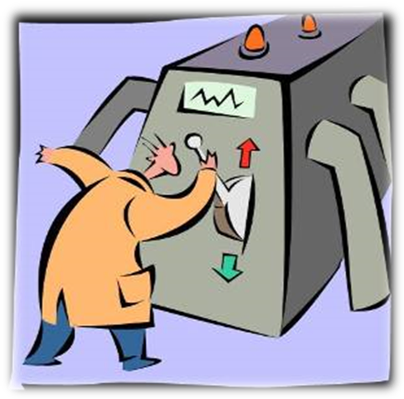
Second risk factor category - equipment
Risks inherent in the equipment employees use
Notes:
Second Risk Factor Category is Equipment. Risks inherent in the equipment employee use. Provide explanation and examples.

Slide 6

Third risk factor category – work practices
Risks that are caused by work requirements
Notes:
The Third Risk Factor Category is Work Practices. Provide explanation and examples.

Slide 7

Fourth risk factor category - individual
Risks are unique to the individual, including inherent characteristics, habits and behavior
Notes:
The Fourth Risk Factor Category is Individual. Risks are unique to the individual, including inherent characteristics, habits and behaviors. Provide examples of characteristics, habits and behavior and solutions and tips tips to avoid.

Slide 8
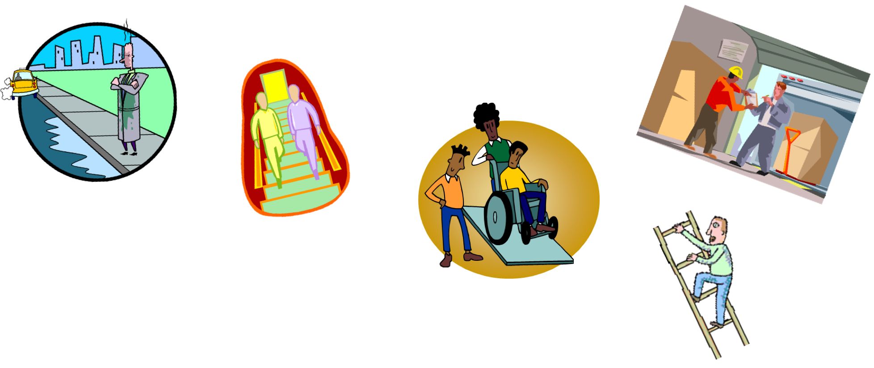
Where do hazards lurk?
Notes:
Where do hazards lurk?

Slide 9
DISCUSSION OF HAZARDS
BREAK OUT INTO GROUPS
ONE PERSON TO WRITE OUT KEY TERMS AND INFORMATION
Notes:
Objectives that will be covered in module 2: Isolate the four (4) risk factor categories for slips trips and all falls; detect key areas in your organization that contain slip trip and fall hazards; Identify the various tools you can use for identifying slip, trip and fall hazards; Use a checklist to identify slip, trip and fall hazards at your workplace; Recognize the slip trip and fall hazards at your workplace.

Slide 10
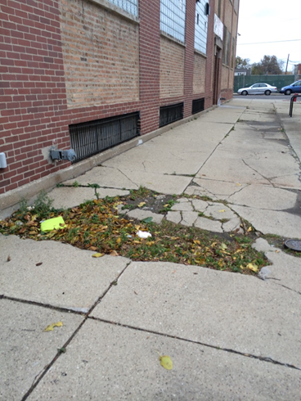
Risk factors (1 of 3)
Notes:
Actual environmental risk factors pictured of uneven and slanting sidewalk. Point out all hazards and explain what can be done to remedy this situation. Allot time to discuss. Time may very depending on class size and participation.

Slide 11
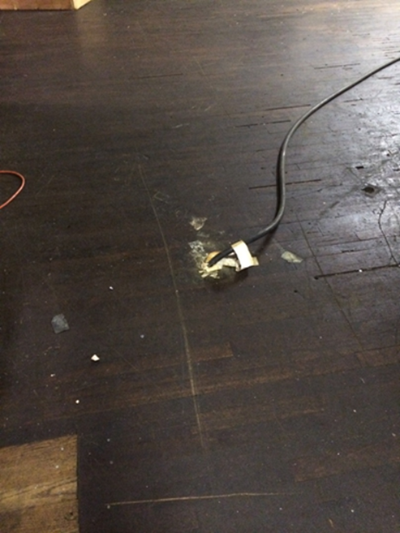
Risk factors (2 of 3)
Notes:
This is an electric cable coming up from the floor, not only is it a trip hazard, but it’s a live electric wire! Point out all hazards and what actions are needed to correct all issues. Note and allot extra time may be needed to discuss each hazard.

Slide 12
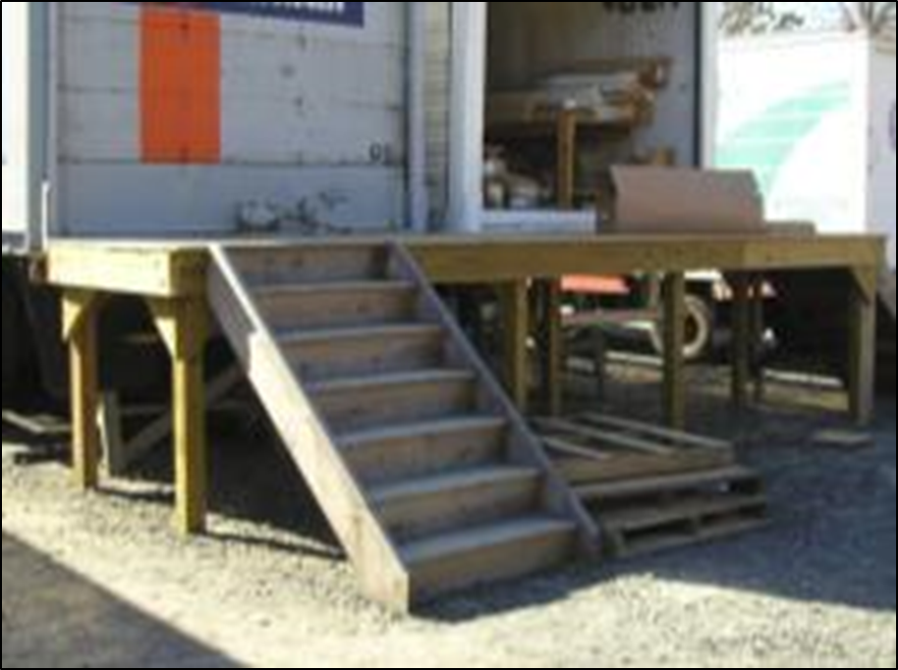
Risk factors (3 of 3)
Notes:
Environmental risk factor pictured. Point out each hazard and how to remedy each one. Note, extra time is needed to allow discussion of each hazard.

Slide 13
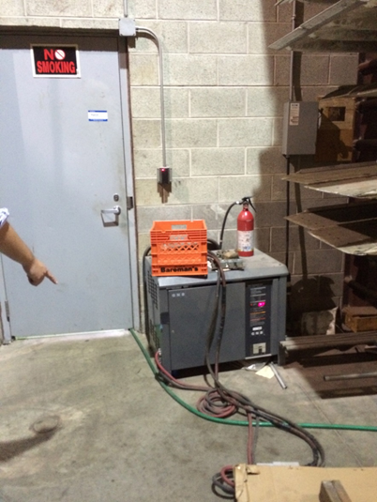
Workplace hazards (1 of 8)
Notes:
Workplace hazards. Photograph shows numerous hazards. Point out each hazard and provide solutions. Note, extra time is needed to allow discussion of each hazard.

Slide 14
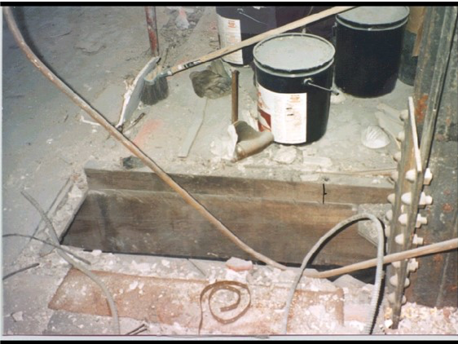
Workplace hazards (2 of 8)
Notes:
Workplace hazards. Photograph shows a hole in the floor and no precautions seen. Describe all precautionary measures for correction action. Note, extra time is needed to allow discussion of each hazard.

Slide 15
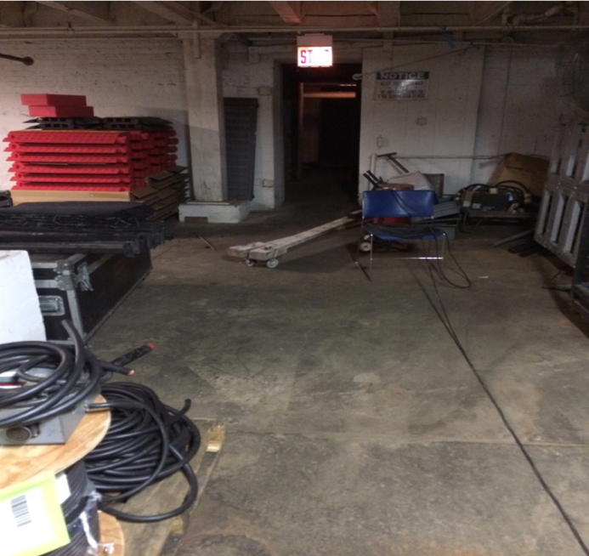
Workplace hazards (3 of 8)
Notes:
Workplace hazards. Explain each hazard in this photograph. There are least four (4) hazards. Provide corrective solutions. Note, extra time is needed to allow discussion of each hazard.

Slide 16
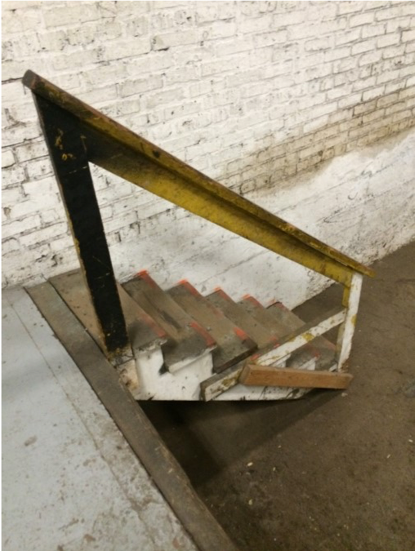
WORKPLACE HAZARDS (4 of 8)
Notes:
Spot all the hazards in the picture with the wooden stairs and note corrections actions. Note, extra time is needed to allow discussion of each hazard.

Slide 17
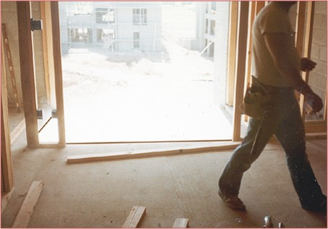
WORKPLACE Hazards (5 of 8)
Notes:
More hazards. This photograph shows a wall opening that lacks fall guarding. Provide all safety measures that should be used in a situation like this. Note, extra time is needed to allow discussion of each hazard.

Slide 18
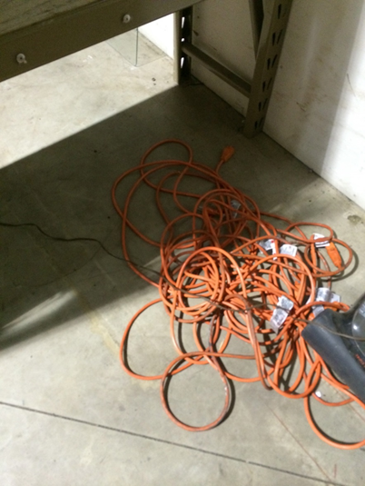
WORKPLACE HAZARDS (6 of 8)
Notes:
This photograph has an electrical cord twisted and another cord wrapped around it. The twisted cord looks to be near a steel ladder. Provide solutions. Note, extra time is needed to allow discussion of each hazard.

Slide 19
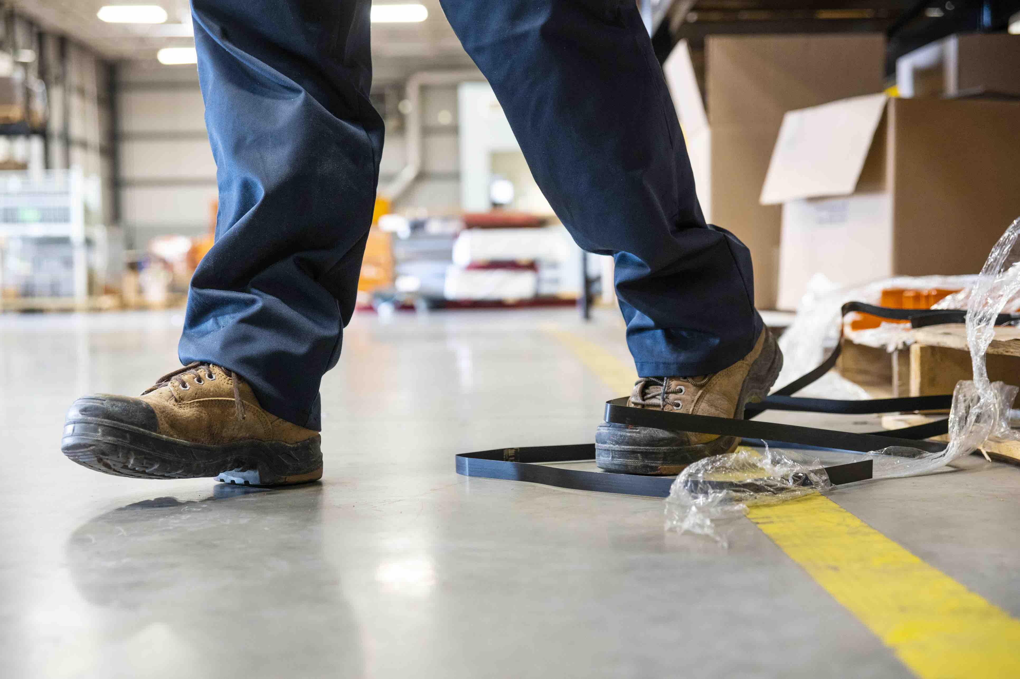
WORKPLACE HAZARDS (7 of 8)
Notes:
This photograph has wrapping and packing material not disposed of properly or re-secured. Be sure to provide all steps that should have been taken to avoid this. Note, extra time is needed to allow discussion of hazard.

Slide 20
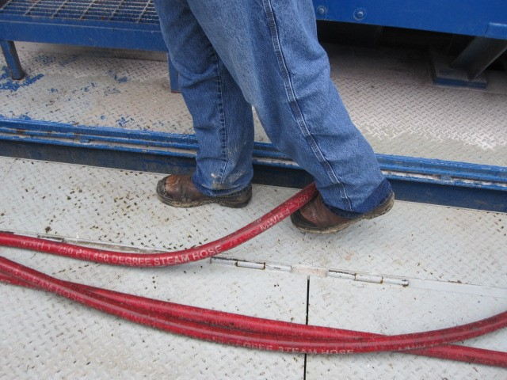
WORKPLACE hazards (8 of 8)
Notes:
Photograph is a tripping hazard of 3 hoses on the ground. Provide all correction actions. Note, extra time is needed to allow discussion of hazard.

Slide 21

How to use the checklist
Use the check lists as is. Cross out the items that do not apply to your organization
Use it as a template/guideline to create a checklist unique to your organization
Notes:
This slide introduces the checklist/guideline and possible uses in the workplace. The checklist handout can be updated by crossing out items that do not apply to your organization. Or use as a guideline and create a checklist unique to your organization.

Slide 22
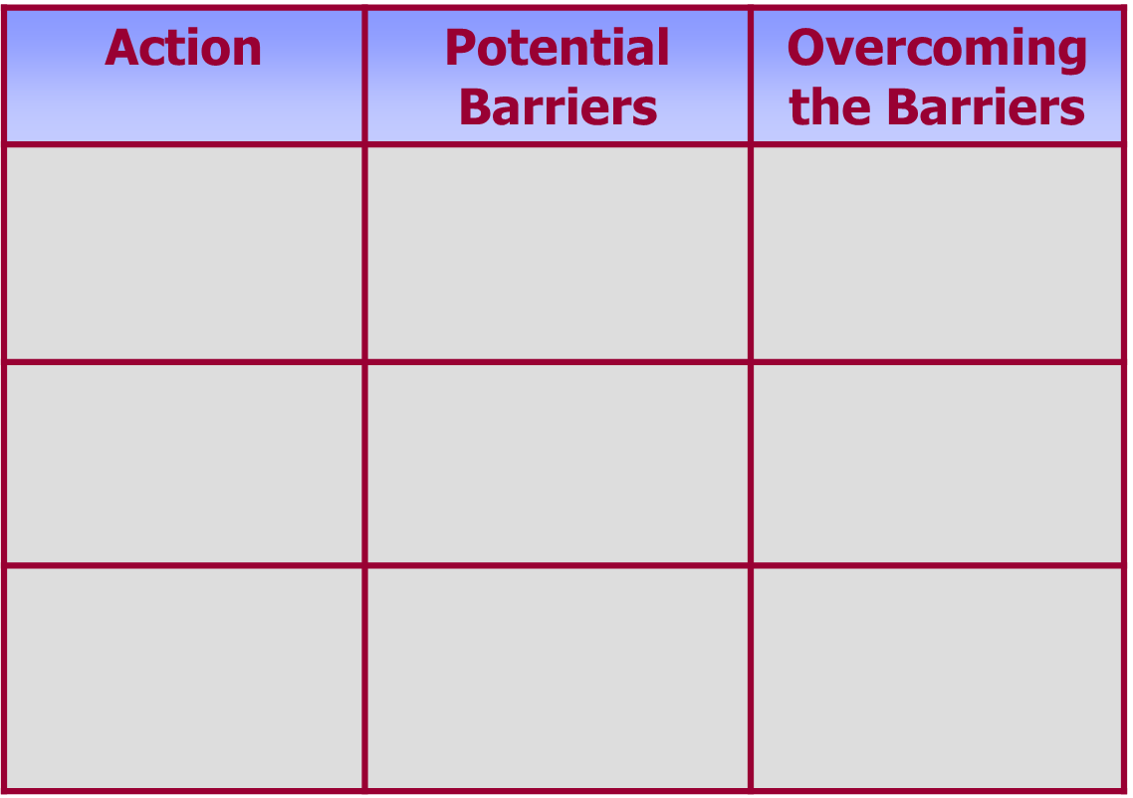
Action plan
Notes:
Action Plan Template, showing a matrix that has an Action column, Potential Barrier column and Overcoming the Barriers column. Explain to students potential issues that could arise, such as push back.

Slide 23
Questions?
Questions?
Notes:
Ask students if they have any questions.

Slide 24
Recommended practices for safety and health programs
A safe workplace is a sound business
osha.gov/shpguidelines/
to view updated guidelines for Safety and Health Programs
Notes:
OSHA has many resources. Please www.osha.gov/shpguidelines for recommended for guidelines and other information for Safety and Health Programs.

Slide 25
Post test
Please take a few moments to complete the post test.
The test is used to evaluate training gained during this course.
Notes:
Post Test. Please complete and return to instructor or facilitator before you leave. Thank you for your participation!

Slide 26

DISCLAIMER
This material was produced under grant number 46EO-HT10 by the National Safety Council and revised under SH-05064-SH8 from the Occupational Safety and Health administration, U.S. Department of Labor. It does not necessarily reflect the views or policies of the U.S. Department of Labor, nor does mention of trade names, commercial products, or organizations imply endorsement by the U.S. government.
Notes:
Disclaimer noted on slide.

