Slide 1

Electrical jeopardy
Electrical Jeopardy
This material was produced under grant SH31244SH7 from the Occupational Safety and Health Administration, U.S. Department of Labor. It does not necessarily reflect the views or policies of the U.S. Department of Labor, nor does mention of trade names, commercial products, or organizations imply endorsement by the U.S. Government.

Slide 2
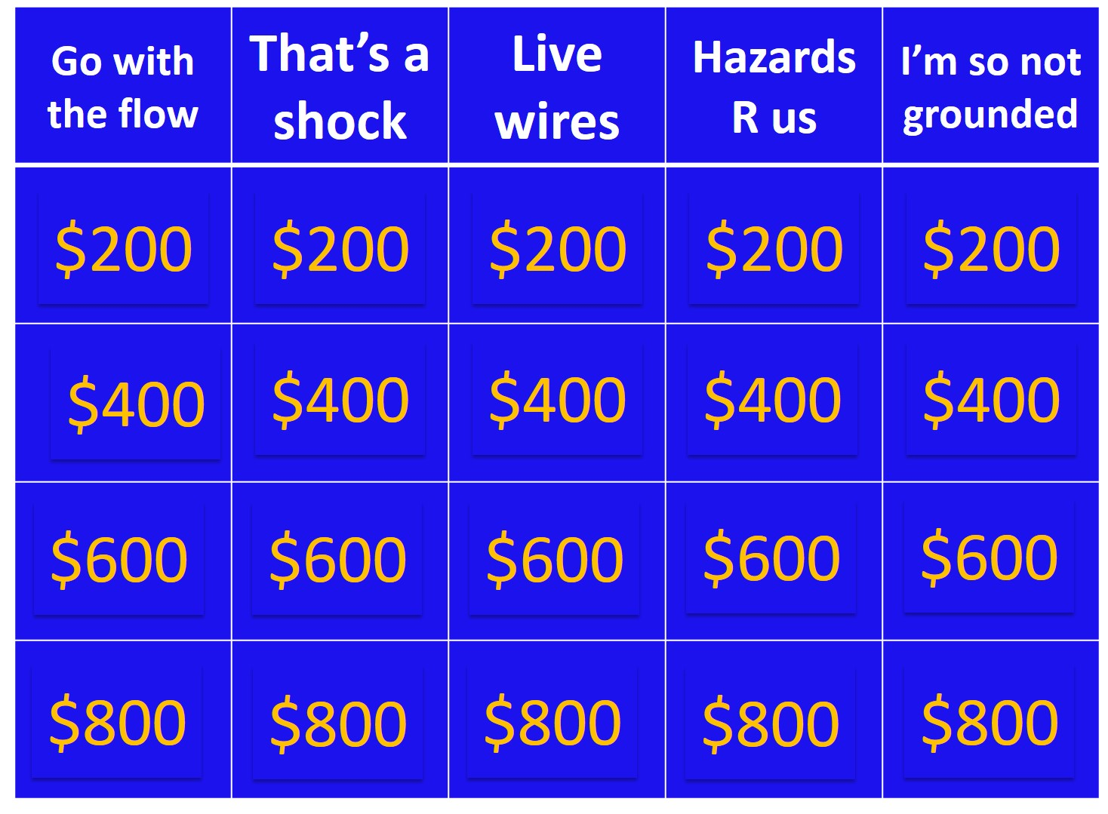
Jeopardy categories

Slide 3
Flow of electrical energy.

Slide 4
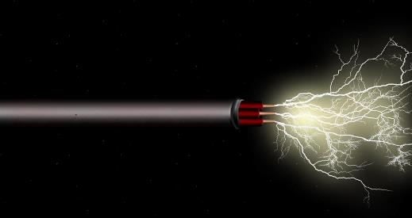
What is current

Slide 5
Material through which current moves easily

Slide 6
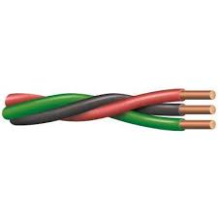
What is a conductor

Slide 7
Glass, rubber, plastic, dry wood, paper, ceramics, and air

Slide 8
What are insulators

Slide 9
Inversely proportional to current; opposition to flow

Slide 10
What is resistance

Slide 11
A fatal electric shock

Slide 12
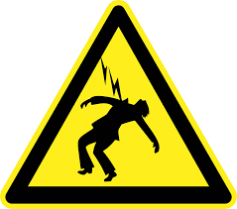
What is electrocution

Slide 13
Accidentally becoming part of this can cause injury or death

Slide 14

What is an energized electrical circuit

Slide 15
The threshold for ventricular fibrillation

Slide 16
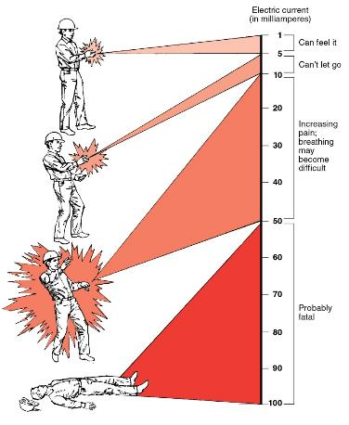
What is 100 milliamps (mA) of current

Slide 17
Three factors that affect the severity of electrical shock

Slide 18
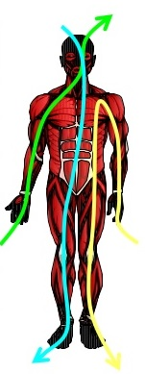
What are: path through body; amount of current; length of time

Slide 19
This is said to “push” current through a conductor

Slide 20
What is Voltage

Slide 21
Measures strength of current flow

Slide 22
What is Amperage

Slide 23
These protect electrical systems and equipment from overcurrent

Slide 24
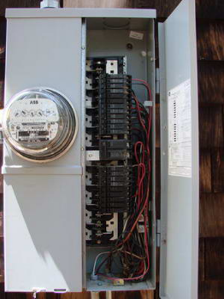
What are circuit breakers and fuses

Slide 25
Luminous electrical discharge through the air

Slide 26
What is arcing

Slide 27
This hazard is the primary source of electrocutions

Slide 28
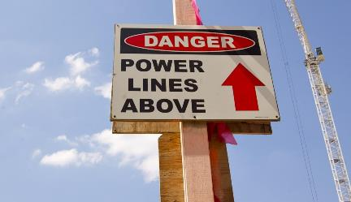
What are overhead power lines

Slide 29
The minimum safe distance to maintain away from power lines ≤ 50,000 V

Slide 30
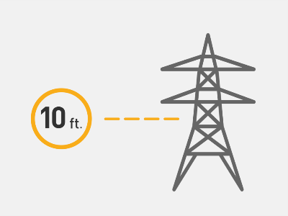
What is 10 feet

Slide 31
The only ladders you may use near energized circuits

Slide 32
What are non-conductive
(fiberglass or wood)

Slide 33
When this shield is worn, frayed or cut, workers are at high risk for shock

Slide 34
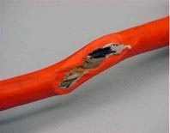
What is the insulation around an energized conductor

Slide 35
A conductor added to circuits to create a low resistive path to neutral or earth

Slide 36
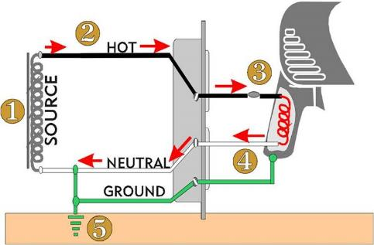
What is a ground wire

Slide 37
A safety device required by OSHA on construction site circuits

Slide 38
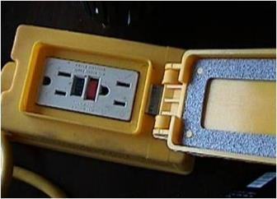
What is a GFCI (ground fault circuit interrupter)

Slide 39
A ground conductor loses its connectivity if this is missing from a plug

Slide 40
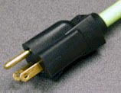
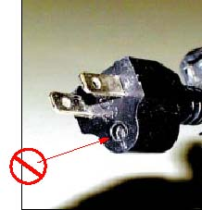
What is the ground prong

Slide 41
“S, ST, SO, STO” for example

Slide 42
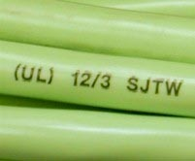
What are extension cord usage rating codes

