Slide 1
Roofing Industry Fall Protection from
A to Z
This material was produced under grant number SH-26317-SH4 from the Occupational Safety and Health Administration, U.S. Department of Labor. It does not necessarily reflect the views or policies of the U.S. Department of Labor, nor does mention of trade names, commercial products or organizations imply endorsement by the U.S. Government.

Slide 2
OSHA State Plan Highlights
OSHA State Plan Highlights

Slide 3

Arizona
Legislatively revised state’s residential FP rules
Used California rules as basis
Federal OSHA may take over residential enforcement

Slide 4
California
“When work is of a short duration and limited exposure, such as minor patching, measuring, roof inspection … these provisions may be temporarily suspended provided that adequate risk control is recognized and maintained.”
Article 30, section 1723
Notes:
-Although the general fall protection height requirement is 7 ½ feet, roofing operations require fall protection at heights greater than 20 feet.
-Slide guard systems (they call them roof jacks) are allowed on shake, shingle, tile and metal roofs up to 7:12 pitches. Safety lines are required at slopes above 7:12. Horizontal intervals between the brackets cannot be more than 10 feet.

Slide 5
California
General fall-protection height requirement for workers is at heights greater than 7½ feet
  Roofing fall-protection height requirement: workers at heights greater than 20 feet (greater than 15 feet on residential tract work)
Notes:
-Although the general fall protection height requirement is 7 ½ feet, roofing operations require fall protection at heights greater than 20 feet.
-Slide guard systems (they call them roof jacks) are allowed on shake, shingle, tile and metal roofs up to 7:12 pitches. Safety lines are required at slopes above 7:12. Horizontal intervals between the brackets cannot be more than 10 feet.

Slide 6
California, 0:12 to 4:12
At heights more than 20 feet, if there is no parapet or a parapet less than 24 inches, employees must be protected by:
  Warning lines and a “qualified person”
  Guardrails
  PFA systems
  Eave barriers
  Scaffold or catch platforms
  When using backward-moving equipment, the parapet must be 36 inches high
This applies to “single-unit” roofing.
Notes:
On commercial roofs higher than 20 feet and with up to a 4:12 slope, where any parapet is less than 24 inches, employees must be protected by warning lines and a safety monitor, guardrails or PFAs. When using equipment like a felt layer where the operator moves backward, the parapet must be 36 inches high.
Single unit roofing includes built-up roofing either asphalt or coal tar, flat seam metal roofs and most likely single ply roofing and SPF

Slide 7
California
Warning lines must be placed at 5 feet and 10 feet from roof edge when mechanical equipment is in use
Warning-line height ― between 34 and 45 inches
Qualified person may be used to supervise workers on narrow or irregular-shaped roofs
Notes:
Warning lines must be placed at 5 and 10 feet with mechanical equipment in use depending on the travel direction of the equipment. Warning line height must be between 34 and 45 inches. Safety monitor alone may be used to warn employees on narrow roofs.

Slide 8
California, slopes greater than 4:12; heights more than 20 feet
24-inch parapet
PFA systems
Scaffold or catch platforms
Eave barriers
Guardrails
This applies to “single-unit” roofing.
Notes:
On commercial roofs higher than 20 feet and with up to a 4:12 slope, where any parapet is less than 24 inches, employees must be protected by warning lines and a safety monitor, guardrails or PFAs. When using equipment like a felt layer where the operator moves backward, the parapet must be 36 inches high.

Slide 9
California
Multi-unit roof coverings (shingles);
slopes 0:12 to 5:12;
heights greater than 20 feet
Roof jacks (slide guards)
24-inch-high parapet
Other method of “equivalent protection”
Notes:
On commercial roofs higher than 20 feet and with up to a 4:12 slope, where any parapet is less than 24 inches, employees must be protected by warning lines and a safety monitor, guardrails or PFAs. When using equipment like a felt layer where the operator moves backward, the parapet must be 36 inches high.

Slide 10
California
Multi-unit roof coverings (shingles);
slopes greater than 5:12;
heights greater than 20 feet
Roof jacks (slide guards) and safety lines
when more than 7:12
24-inch-high parapet
PFA system
Scaffold or catch platform
Eave barriers
Notes:
On commercial roofs higher than 20 feet and with up to a 4:12 slope, where any parapet is less than 24 inches, employees must be protected by warning lines and a safety monitor, guardrails or PFAs. When using equipment like a felt layer where the operator moves backward, the parapet must be 36 inches high.

Slide 11

Kentucky
Requires fall protection in construction activities 10 feet or more above a lower level
Allows use of slide guards in residential roofing
  Eave height of 25 feet or less
  Slopes of 4:12 up to 8:12
  Brackets spaced at 8 feet horizontally
  Additional slide guards vertically up the roof at 8 foot intervals

Slide 12
Michigan
Incorporated the federal construction standards
Michigan OSHA has issued an interpretation relating to holes as being subordinate to the low-slope roofing provisions of 501(b)(10)
Notes:
Michigan has incorporated the federal construction standards. Additionally, Michigan OSHA has issued an interpretation that broadly construes the fall protection requirements of 501(b)(4) relating to holes as being subordinate to the low-slope roofing provisions of 501(b)(10). Meaning that warning lines could be used in roofing work to protect skylights.

Slide 13
Michigan
For fall protection around holes or skylights—in addition to PFA systems, covers and guardrails— roofing warning-line systems may be used.
Notes:
This means that for fall protection around holes or skylights, in addition to PFAs, covers and guardrails, roofing operations may utilize the warning line systems detailed in (b)(10) to meet fall protection demands of the standards in those instances covered by (b)(4).

Slide 14

North Carolina
Follows federal OSHA rules to large extent
When using a warning-line system on low-slope roofs, the safety monitor must be in place at all times—even if no workers are outside the warning line
Slide guards may not be used as the sole fall protection on residential roofing projects
Notes:
Safety monitor is not required if workers are 15 feet from roof edge or other fall hazard like an opening or skylight—uses the logic of the Barry Cole 15-foot Federal LOIs

Slide 15
Oregon
General fall-protection threshold height—10 feet
Around holes, skylights, established floors, balconies, walkways—6 feet
Notes:
General fall protection threshold height is 10 feet.
Around holes or skylights, established floors or balconies and walkways, the requirement for fall protection is mandated at 6 feet or greater.

Slide 16
Oregon
Warning-line systems may be used on roof slopes of 2:12 or less.
  Use of a safety monitor is restricted similarly
Notes:
Warning line system may be used only on roof slopes of 2:12 or less. Use of a safety monitor is restricted similarly.
Slide guards are allowed on roofs with slopes between 3:12 and 8:12 and the slide guard installed at the eave may be no closer than 6 inches to the eave. Brackets must be no more than 8 feet apart horizontally.

Slide 17
Washington
Roofing workers on low-slope roofs must be protected from falls of 10 feet or greater
Protect on steep-slope roofs at heights of 4 feet
Requires a written fall- protection plan when fall hazards of 10 feet or more exist
Notes:
Requires a written fall protection plan when fall hazards of 10 feet or more exist.
Available systems include guardrails, PFAs and the warning line system.

Slide 18
Washington
Warning-line system may not be used on slopes greater than 4:12.
  A warning line must be between 36 and 45 inches from roof surface.
Safety monitor may be used alone on roofs 50 feet wide or less:
  Safety monitor can have no other duties.
  Safety monitor can monitor no more than eight workers.
  Safety monitor must wear a distinguishing vest or other clothing.
Notes:
Warning line system may not be used on roofs over 4:12. Warning line must be between 36 and 42 inches from the roof surface.
Safety monitor may be used alone on roofs 50 feet wide or less. Safety monitor can have no other duties and can monitor no more than 8 employees. Safety monitor must wear a vest or other clothing to distinguish him from other members of the crew.

Slide 19
Washington
A new rule allows for a “safety watch” system of fall protection in which a competent person monitors repair work of
another individual on a low-slope roof without the need for warning lines, PFA system or other forms of fall protection.
Notes:
This rule was approved 4/1/2013 and can be very valuable for repair work in roofing and other service work in other trades.

Slide 20
Subpart H
Subpart H: Material Handling and Subpart T: Demolition

Slide 21
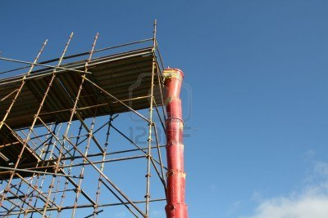
Subpart H—Handling and Disposal
Trash chutes provide one of the safer methods for removing trash from the roof:
Trash chutes required when roofs are more than 20
feet high
Must be secured to the building
Notes:
Material Disposal
Materials need to be disposed of in a safe manner so that the work site is kept as neat and hazard-free as possible. Anytime materials are dropped more than 20 feet outside an exterior wall, an enclosed chute must be used.
Trash chutes provide one of the safer methods for removing trash from the roof:
① Trash chutes are required when roofs are more than 20 ft. high.
② They must be secured to the building
③ A guardrail system should be placed around and behind the chute.
④ Nail a 4” inch thick, 6” high piece of lumber just in front of the opening of the chute to provide a stop for a wheelbarrow. This will make it easier to tip and dump the load.
⑤ A chain should be put across the opening to the trash chute when there is not activity at the chute.
If the materials are being dropped inside the building or structure through a hole in the floor, then barricades at least 42 inches high need to be erected a minimum of 6 feet back from the edges of the hole. Signs warning of falling hazards must be posted, and the debris that has been thrown down must remain where it falls until work on the upper level is completely done for that shift. Debris from all other locations must be gathered as the work progresses. If burning is used to dispose of any debris, local fire regulations must be followed. Finally, all solvent waste, oily rags and flammable liq­uids must be kept in fire-resistant covered containers until they are removed from the work site.

Slide 22
Subpart H—Handling and Disposal
Guardrail system should be placed around and
behind the chute.
Nail a 4-inch-thick, 6-inch-high piece of lumber just in
front of the opening of the chute to provide a stop for
a wheelbarrow. This will make it easier to tip and
dump the load.
A chain should be put across the opening to the
trash chute when there is not activity at the chute.
Notes:
Material Disposal
Materials need to be disposed of in a safe manner so that the work site is kept as neat and hazard-free as possible. Anytime materials are dropped more than 20 feet outside an exterior wall, an enclosed chute must be used.
Trash chutes provide one of the safer methods for removing trash from the roof:
① Trash chutes are required when roofs are more than 20 ft. high.
② They must be secured to the building
③ A guardrail system should be placed around and behind the chute.
④ Nail a 4” inch thick, 6” high piece of lumber just in front of the opening of the chute to provide a stop for a wheelbarrow. This will make it easier to tip and dump the load.
⑤ A chain should be put across the opening to the trash chute when there is not activity at the chute.
If the materials are being dropped inside the building or structure through a hole in the floor, then barricades at least 42 inches high need to be erected a minimum of 6 feet back from the edges of the hole. Signs warning of falling hazards must be posted, and the debris that has been thrown down must remain where it falls until work on the upper level is completely done for that shift. Debris from all other locations must be gathered as the work progresses. If burning is used to dispose of any debris, local fire regulations must be followed. Finally, all solvent waste, oily rags and flammable liq­uids must be kept in fire-resistant covered containers until they are removed from the work site.

Slide 23
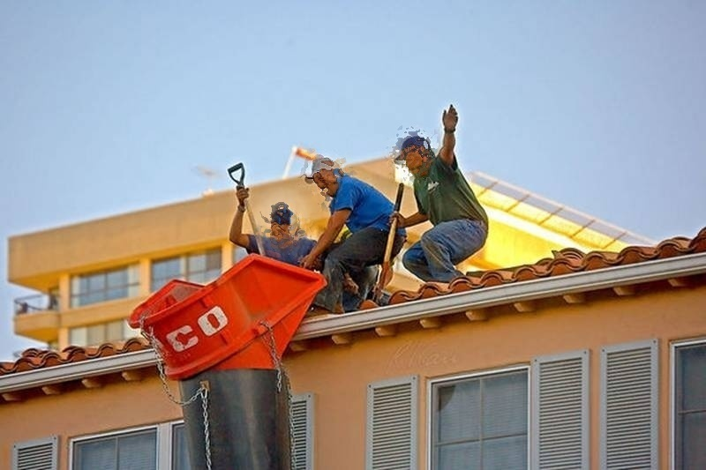
Subpart T—Demolition Fall Protection
Any chute opening into which workers dump debris must be protected by a guardrail 42 inches above the floor or other surface on which workers stand to dump debris.
29CFR1926.852(e)
Workers without fall-protection
Notes:
Explain the requirement, as described on the slide. Ask students to speculate what could happen (the most likely way to fall) for these unprotected workers.

Slide 24
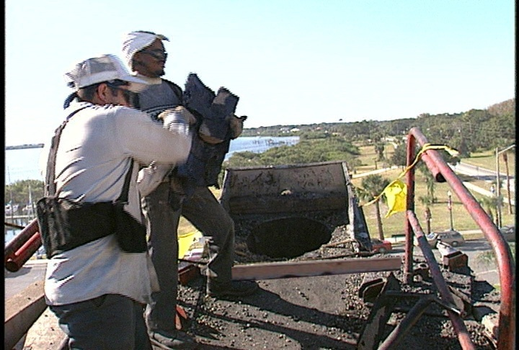
Subpart T—Demolition Fall Protection
Chute opening with guardrail and bumper
Notes:
Explain:
1926.852 (e) Any chute opening, into which workmen dump debris, shall be protected by a substantial guardrail approx. 42” above the floor or other surface on which the men stand to dump the materials. Any space between the chute and the edge of the openings in the floors through which it passes shall be solidly covered over.
1925 (f) When the material is dumped from mechanical equipment or wheelbarrows, a securely attached toe board or bumper, not less than 4” thick and 6” high, shall be provided at each chute opening.

Slide 25

Pop Quiz 1
You are reroofing an enormous warehouse and decide to use an ATV. The decision seems like a good one because the disposal of the tear-off material is going quickly.
What type of fall protection do you need at the point of disposal?
Notes:
Answer: If you're driving the ATV to the edge so that you can tip the load into the chute, you're asking for a citation.
Even if guardrails are erected, they're meant to protect people from falling off the edge not those riding vehicles. To be sure, a call to discuss the situation -with your local OSHA office is a good start.
Ask students if we discussed anything like this earlier in Subpart M? (Hoist areas)
A suggestion is to install warning lines at least 10 feet from the edge and do not let the ATV beyond that point.
Although there are no standards specifically for ATVs, ATVs would be considered powered equipment.
Guardrails are a must at the chute point and--at the least--more warning lines connecting the guardrails to the other warning lines. ATV use on the roof is not regulated in the fall protection regulations.
However, citations are occurring because of the obvious fall potential and as an employer the roofing contractor has a duty to protect against fall hazards.

Slide 26
Subpart X
Subpart X: Ladders and Stairways

Slide 27
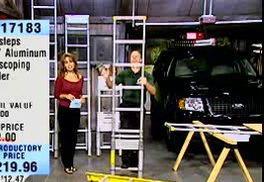
Ladder Video
Notes:
Play this video (#7): This video is an excerpt from video footage from the TV-shopping channel QVC. It’s meant to be a “funny” –but not funny, introduction to the topic of ladder safety. It illustrates what NOT to do.

Slide 28
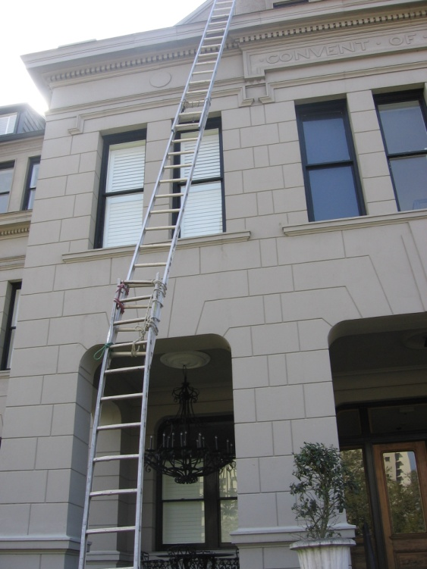
BLS Statistics—Ladder Fatalities
In 2013, 73 workers in the construction industry died in falls from ladders
46 died in falls from
scaffolds
Notes:
2012 BLS

Slide 29
Pop Quiz 2
What type of fall protection does Subpart X require for portable ladders?
Notes:
Answer: None.

Slide 30
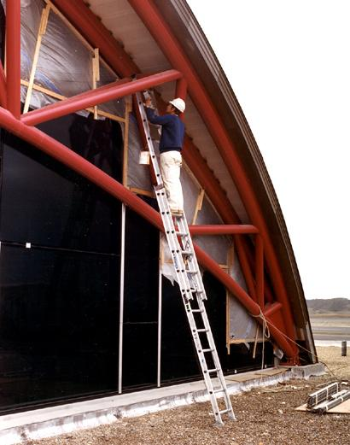
Hazards
Stairways and ladders cause many injuries and fatalities among construction workers.
About half the injuries caused by slips, trips and falls from ladders and stairways require time off the job.
Notes:
Explain:
Stairways and ladders are a major source of injuries and fatalities among construction workers.
Most ladder fatalities occur under 10 feet and were due to the ladder tipping or slipping out from an employee. (like the video)

Slide 31
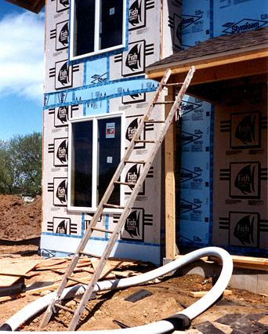
Securing Ladders
Secure ladders to prevent accidental movement caused by workplace activity.
Only use ladders on stable and level surfaces unless secured.
Do not use ladders on slippery surfaces unless secured or provided with slip-resistant feet.
This ladder is not on a stable surface
Notes:
Explain:
Ladders placed in areas such as passage-ways, doorways, or driveways, or where they can be displaced by workplace activities or traffic must be secured to prevent accidental movement, or a barricade must be used to keep traffic or activities away from the ladder.
Explain further:
Portable Ladder: a ladder that can be readily moved or carried.
Slip resistant ladder feet are recommended.
Use of ladders on soft or slippery surfaces is dangerous and ladders should be tied to the structure to hold them in place.
1926.1053(b)(8), (b)(6), (b)(7), and (b)(1)

Slide 32
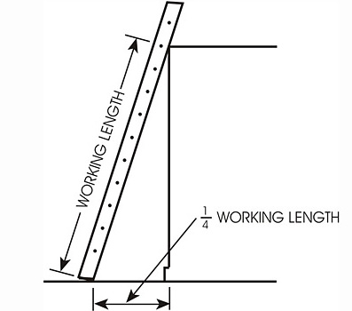
Ladder Angle
Nonself-supporting ladders
(which lean against a wall or other support):
  Position at an angle where the horizontal distance from the top support to the foot of the ladder is 1/4 the working length of the ladder
Notes:
Explain:
The working length of the ladder is the vertical distance between the ground and the top support. In the picture on the slide the working length is 16ft.
1926.1053(b)(5)

Slide 33
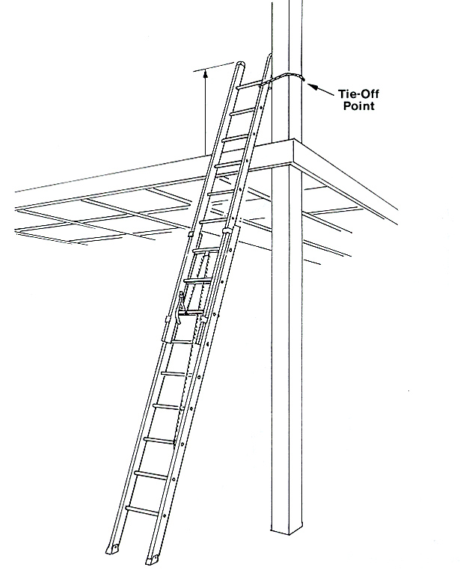
Ladder Rail Extension
When using a portable ladder for accessing an upper landing surface, the side rails must extend at least 3 feet above the upper landing surface—the ladder must be tied-off and a grab rail provided if the 3-foot extension cannot be achieved.
29CFR1926.1053(b)(1)
Notes:
Explain:
When portable ladders are used for access to an upper landing surface, the side rails must extend at least 3 feet above the upper landing surface.
When such an extension is not possible, the ladder must be secured, and a grasping device such as a grab rail must be provided to assist workers in mounting and dismounting the ladder.
A ladder extension must not deflect under a load that would cause the ladder to slip off its support.
1926.1053(b)(1)

Slide 34
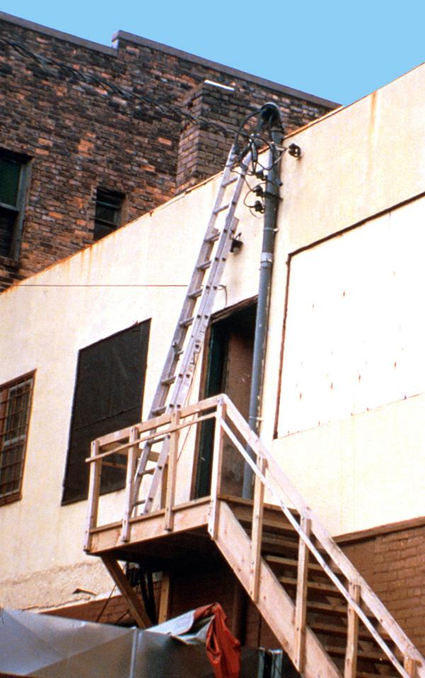
Near Energized Electrical Equipment
If using ladders where a worker or ladder could contact exposed energized electrical equipment, the ladders must have nonconductive side rails such as wood or fiberglass.
This is an unsafe condition
Notes:
Review the points on the slide. Ask students what is unsafe about the photo.
1926.1053(b)(12)

Slide 35
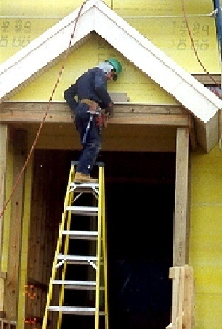
Top Step
Do not use the top or top step of a ladder as a step.
Notes:
Review the point on the slide. Ask students how many have done such a thing. Point out that they “felt unstable” because they were.
1926.1053(b)(13)

Slide 36
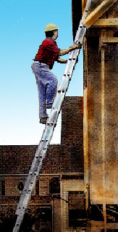
Climbing the Ladder
Face the ladder when
going up or down.
Use at least one hand to
grab the ladder when going
up or down.
Do not carry any object or
load that could cause you
to lose balance.
Notes:
Review the points on the slide.
1926.1053(b)(20),(21),(22)

Slide 37
New Equipment
New Equipment

Slide 38
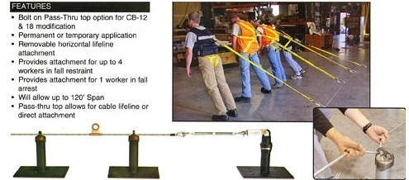
Guardian CB Pass-through System
Bolt on Pass-thru option for CB-12 and 18 modification
Permanent or temporary application
Removable horizontal lifeline attachment
Provides attachment for up to 4 workers in fall restraint
Provides attachment for 1 worker in fall-arrest
Will allow up to 120’ span
Pass-thru top allows for cable lifeline or direct attachment
Notes:
Not intended for flat roofs.
Features:
Removable Horizontal lifeline attachment
Provides attachment for up to 4 workers in a fall restraint or 1 worker in fall arrest
Will allow up to 120’ Span
Pass-thru top allows for cable lifeline or direct attachment
Permanently attached slider passes easily and hands-free through the pass-thru top
One worker may attach to each slider
Permanent or temporary application

Slide 39
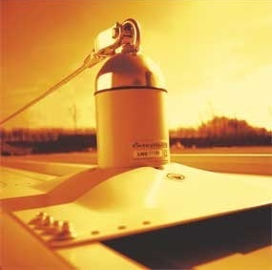
Latch Ways Pass-through System
Notes:
Explain the features prior to showing the video:
Fall restraint system to provide safe access on roof top for 2 users
Applicable to all the major forms of standing-seam roofs
Can be supplied color matched to the roofing sheets.

Slide 40
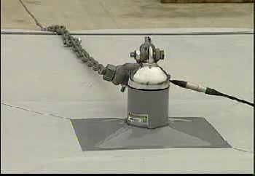
Latchways Pass-through System show a demo video
Notes:
Play the demo video (#8) of Latchways being deployed.

Slide 41
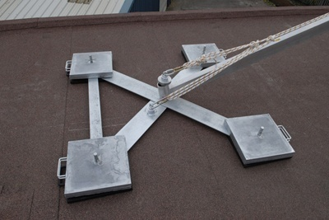
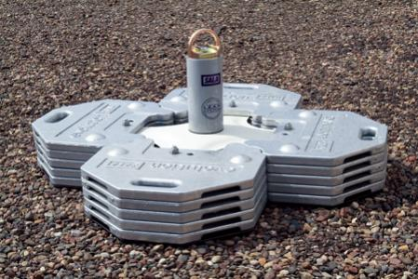
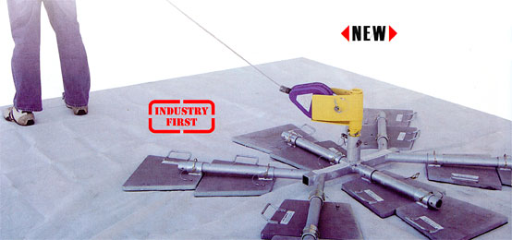
Free-standing Counterweight Anchors
Notes:
Features:
Non penetrating design does not attach to working surface, reducing the possibility of damage.
Built-in shock absorbing post provides added safety to user and structure.
Fall arrest and restraint rated for one worker for jobsite versatility.
Approved for use on these roof types: concrete, single ply membrane, bitumen membrane, asphalt sanded and asphalt stone chippings.
Ideal for use on flat surfaces up to a maximum of 5 degrees slope/pitch
Counterweights are 45 lbs (20.3 kg) and come with an integral carrying handle for easy transport and set up.
Manufactured by DBI; HyGuard; KeeSafety

Slide 42
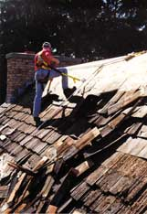
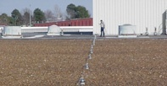
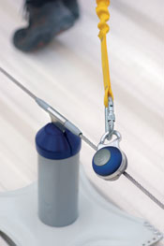
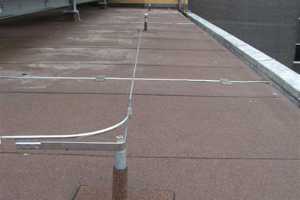
Horizontal Lifeline System
Notes:
Features:
Built-in tensioner for horizontal line tension
Economical system with reusable anchors
Easily installed with no special tools or equipment
Lightweight and extremely portable
Suitable for multi-person use

Slide 43
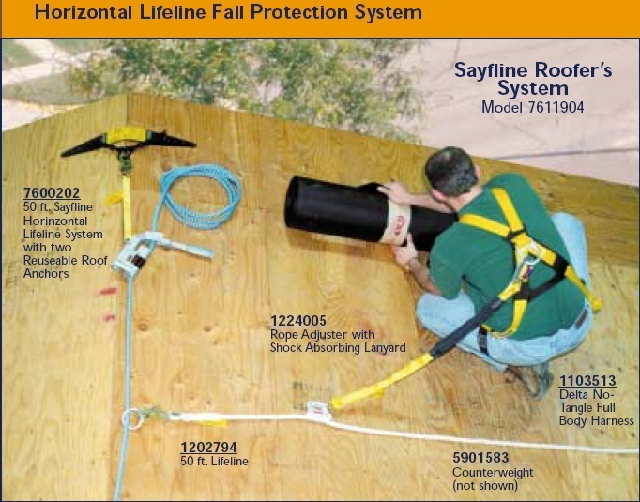
Horizontal Lifeline System
Notes:
Ask students to explain what they see (which they already learned) in the photo.

Slide 44
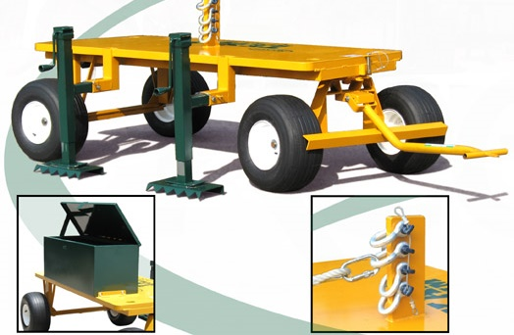
Another Cart System
Notes:
Offered through Great Northern Building Products Company

Slide 45
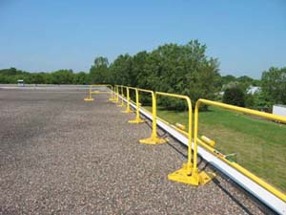
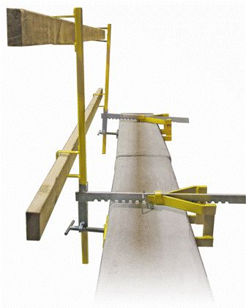
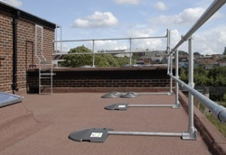
Guardrail Systems Nonpenetrating

Slide 46

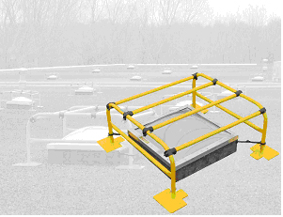
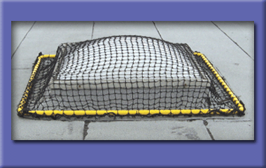
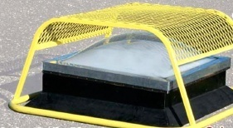
Skylight Protection—Exterior
Notes:
In addition to a variety of covers and cages that are on the market, one manufacturer is developing a universal netting system with integral steel pipe supports located at the perimeter that do not allow a worker to fall through a skylight while working on the roof.

Slide 47

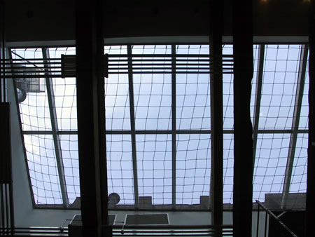
Skylight Protection—Interior

Slide 48
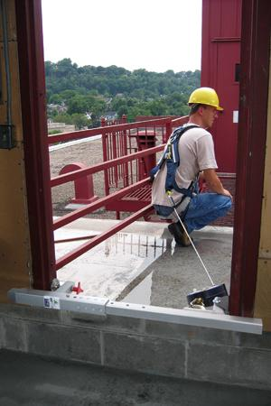
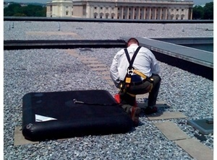
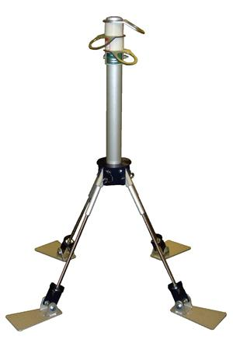

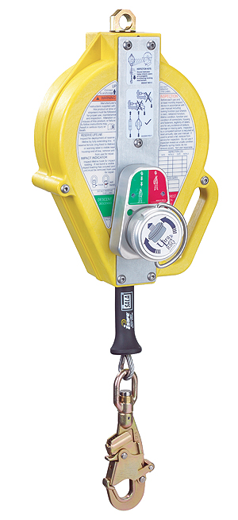
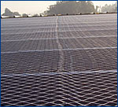
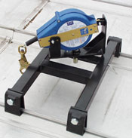
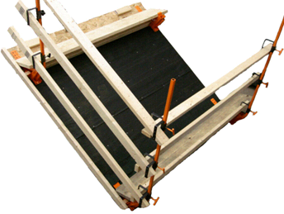
Others
Notes:
Clockwise from top left:
PermaWater bag anchor 430 Liters (113 gallons) water by EcoAnchor; Whirlybird type of anchor that allows multiple worker attachment and keeps lifelines off the ground; Door jamb anchor; Skyweb netting installed over steel structure provides interior-in fall protection—no perimeter or unprotected edge FP; SRL attaches to standing seam; Rescue or first man up pole to attach connector remotely; SRL with twin settings, fall arrest and rescue—in rescue mode, it arrests the fall and then automatically lowers the worker to the ground (50 feet of line).

Slide 49
Subpart L
Subpart L: Scaffolds

Slide 50
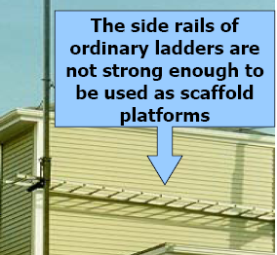
Example of Hazards
Workers could have used a harness or guardrail system along with end rails

Slide 51
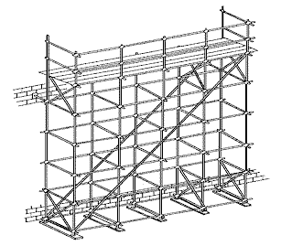
Scaffolds: Fall Protection at Heights > 10 feet
At heights greater than 10-feet, the fall- protection requirement for workers on scaffolds compares to the general construction rule of 6 feet or greater.
29CFR1926.451(g)(1)
Notes:
All employees working more than 10 feet above a lower level or the ground need fall protection.

Slide 52
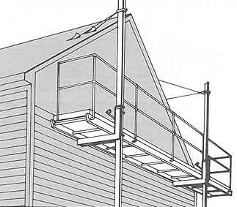
Scaffold Fall Protection Rule Applies to:
Tube and coupler scaffolds
Ladder jack scaffolds
Pump jack scaffolds
Chicken ladder
This pump jack scaffold was erected properly with guardrails and roof brackets for support.
Notes:
Employees working on ladder-jack scaffolds must be protected by personal fall-arrest systems.
Employees working on crawling boards must be protected by personal fall-arrest systems; a guardrail system with a 200-pound minimum top rail capacity; or a 3/4 inch-diameter grab line or equivalent handhold fastened along each crawling board.
Employees working on self-contained adjustable scaffolds, such as pump jacks, must be protected by a guardrail system with a 200-pound minimum top rail capacity.
Employees on scaffold walkways must be protected by guardrail systems with 200-pound minimum top rail capacities installed along at least one side of walkway.

Slide 53
Scaffold Fall Protection Options:
Tube and coupler scaffolds: Guardrails or PFA systems
Ladder jack scaffolds: PFA systems only
Pump jack scaffolds: Guardrails or PFA systems
Chicken ladder: Guardrails, PFA systems or ¾-inch grab line or handhold next to chicken ladder
Tube and coupler scaffolds
Notes:
Guard scaffold platforms that are more than 10 feet above the ground or floor surface with a standard guardrail.
If guardrails are not practical, use other fall protection devices such as safety harnesses and lanyards.
Place the top rail approximately 42 inches above the work platform or planking with a mid rail about half that high at 21 inches.
Install toe boards when other workers are below the scaffold.

Slide 54
Class Exercise
You will need:
A set of photos
Instructions

Slide 55
Course Objectives
By the time you are finished with this class, you should be able to:
Know where to find applicable citations within the OSHA fall-protection standard
Define the regulatory text
Apply fall-protection regulations to jobs
Notes:
Remind students of the four objectives that the day. Ask if they think the objectives were met. If they agree, tell them that the real “test” of this is for them to answer the same 20-question assessment they began with today.

Slide 56
Post-test
Once you complete the test, please complete the evaluation form and Student Information Sheet.
Notes:
Remind them there is no grade or score going back to their employer for this.

Slide 57
Roofing Industry Fall Protection from
A to Z
This material was produced under grant number SH-26317-SH4 from the Occupational Safety and Health Administration, U.S. Department of Labor. It does not necessarily reflect the views or policies of the U.S. Department of Labor, nor does mention of trade names, commercial products or organizations imply endorsement by the U.S. Government.
Notes:
Thank attendees for coming and dismiss on time.

