Slide 1
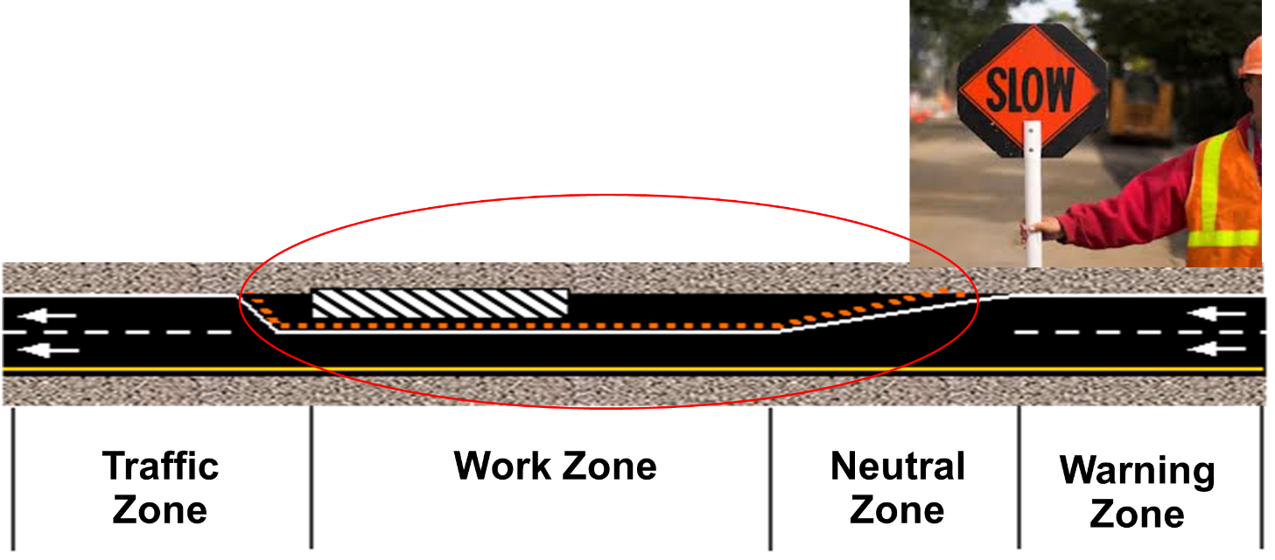

Hazard to struck by vehicles/objects
Work Zone Protection
Workers must be kept at all times within the safe area marked by barriers and signs, indicating the presence of workers in the zone
This material was produced under Susan Harwood grant number SH-31182-SH7 Occupational Safety and Health Administration, U.S. Department of Labor. The contents in this presentation do not necessarily reflect the views or policies of the U.S. Department of Labor, nor does the mention of trade names, commercial products, or organizations imply endorsement by the U.S. Government

Slide 2
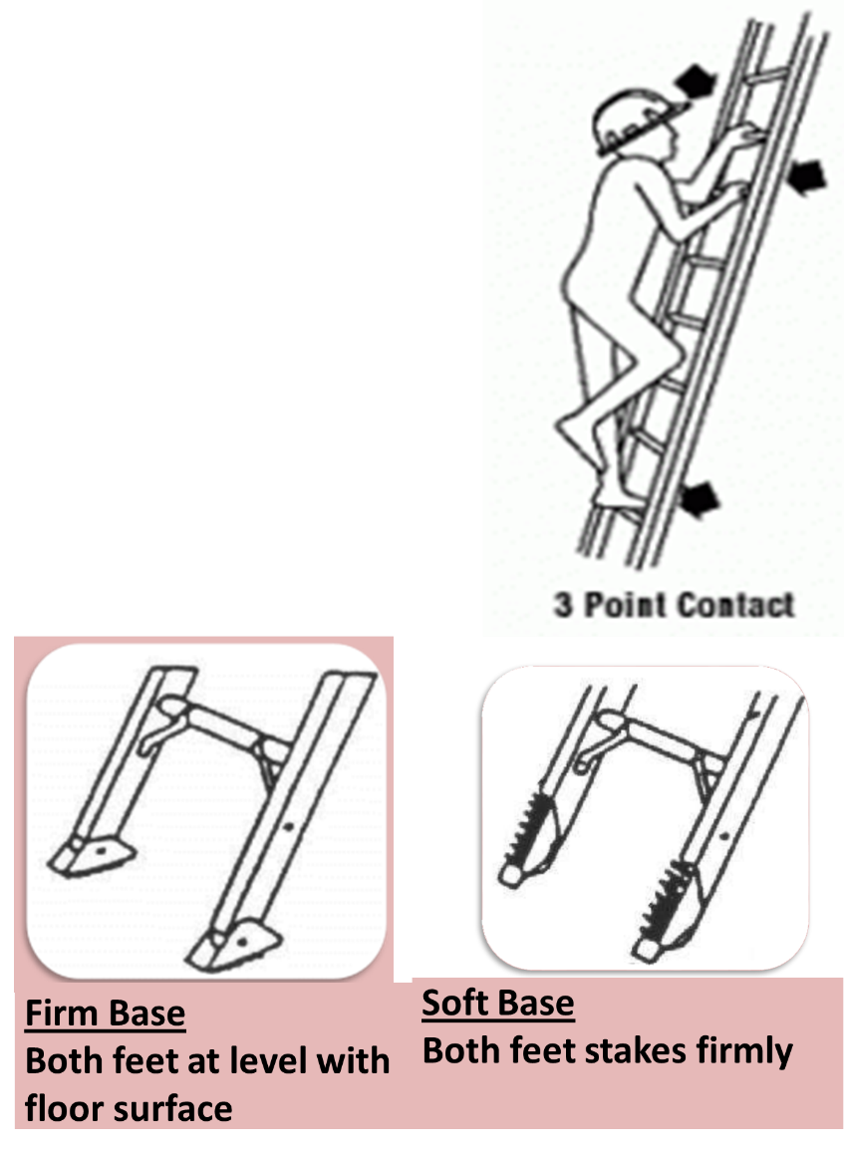
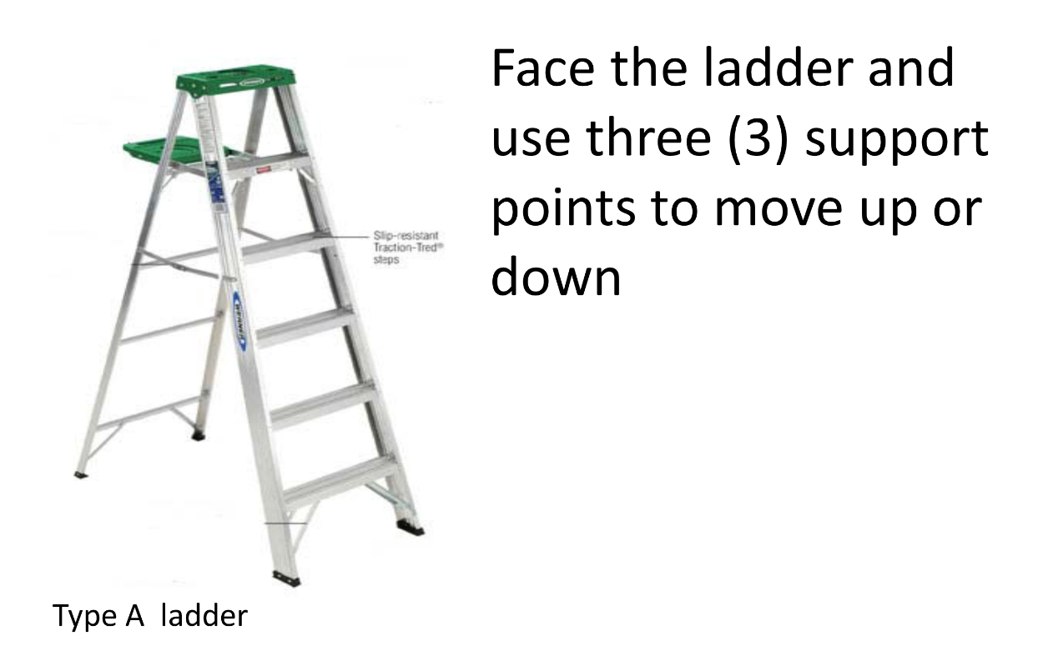
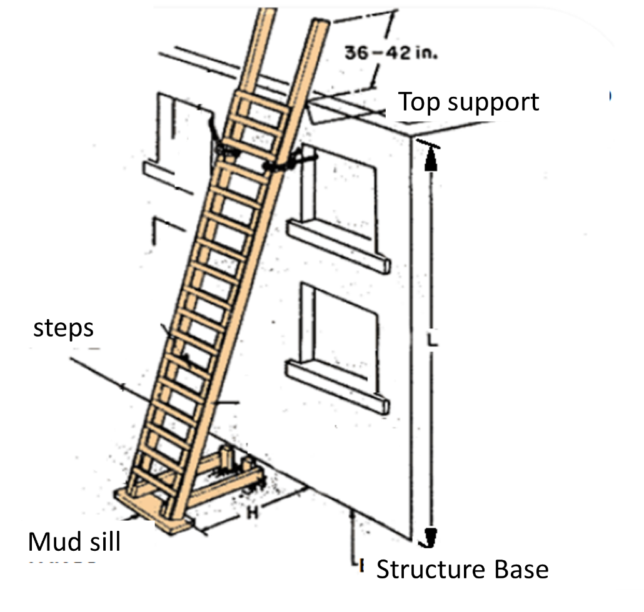
Rules when using ladders
For every four (4) feet of height (L) up to the next level, separate one (1) foot from the base (H) to create a safe working angle. The scale must protrude at least three feet from the point of support of the next level
This material was produced under Susan Harwood grant number SH-31182-SH7 Occupational Safety and Health Administration, U.S. Department of Labor. The contents in this presentation do not necessarily reflect the views or policies of the U.S. Department of Labor, nor does the mention of trade names, commercial products, or organizations imply endorsement by the U.S. Government

Slide 3

Electrical Generator Hazards
Electric Shock
Due to incorrect or inadequate connections
Burns/ Fire
Due to hot surfaces
Exposure to chemical materials (oil, gasoline, LPG gas) and combustion gases
Excessive noise
This material was produced under Susan Harwood grant number SH-31182-SH7 Occupational Safety and Health Administration, U.S. Department of Labor. The contents in this presentation do not necessarily reflect the views or policies of the U.S. Department of Labor, nor does the mention of trade names, commercial products, or organizations imply endorsement by the U.S. Government

Slide 4
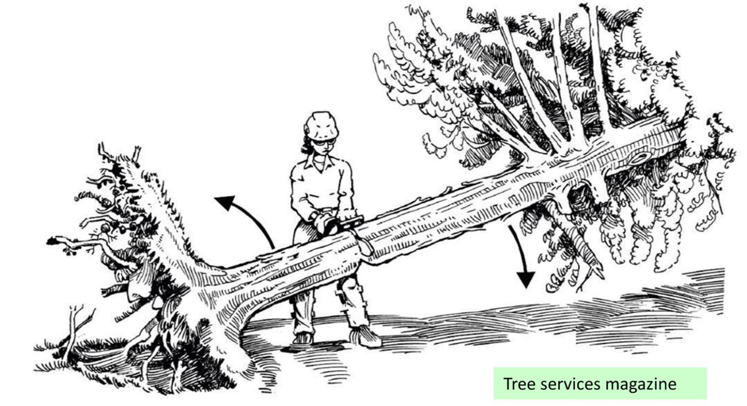
Hazards when using Chainsaws
Chainsaws
Perform the cut carefully and take steps to handle the tension generated by the energy of the tree
Remain in a defensive position
This material was produced under Susan Harwood grant number SH-31182-SH7 Occupational Safety and Health Administration, U.S. Department of Labor. The contents in this presentation do not necessarily reflect the views or policies of the U.S. Department of Labor, nor does the mention of trade names, commercial products, or organizations imply endorsement by the U.S. Government

Slide 5
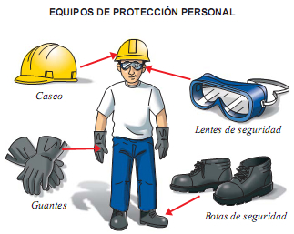
Personal Protection Equipment
Particulate Respirators to protect from dust
NIOSH – N95
Protect ion from particulate matter, pollutant, sprays, impact
applied to goggles, safety glasses, and face shield
Helmets -Protect from top and side shock or bruise
Personal Protection Equipment
Hearing protection protect from noise above 90 decibels. We recommend using earmuffs
Helmets
Clothes
Eye protection
Gloves
Feet protection
Pruning works – use thick fabric/cotton
Debris handling – use leather
Cleaning/ chemicals- use rubber
Cuts – special fibers
Clear cotton clothes for regular jobs
Fabric overalls for jobs where there is dust, paint, or mild splash
Plastic or waterproof overalls for wet jobs
Closed-toe leather shoes to protect from cuts and shock.
For protection of chemical materials must be rubber shoes
This material was produced under Susan Harwood grant number SH-31182-SH7 Occupational Safety and Health Administration, U.S. Department of Labor. The contents in this presentation do not necessarily reflect the views or policies of the U.S. Department of Labor, nor does the mention of trade names, commercial products, or organizations imply endorsement by the U.S. Government

Slide 6

HAZARD: Exposure to mold and diseases
Use personal protection
It is necessary to use at least safety glasses, gloves and N95 respirator to protect yourself from possible splashing and spores
Maintain Good Hygiene
Keep areas clean and free of pests, rodents and insects to help in the control of diseases such as leptospirosis, dengue, or gastrointestinal diseases
Use chemical products to control mold
There are commercial products that are formulated to eliminate the mold.
FOLLOW THE MANUFACTURER'S INSTRUCTIONS WHEN APPLYING
This material was produced under Susan Harwood grant number SH-31182-SH7 Occupational Safety and Health Administration, U.S. Department of Labor. The contents in this presentation do not necessarily reflect the views or policies of the U.S. Department of Labor, nor does the mention of trade names, commercial products, or organizations imply endorsement by the U.S. Government

Slide 7



Health Hazards from contaminated waters, animals and pests
Contagious
Diseases
Tetanus
Leptospira
Arbovirus
Dirty
water
Sharp or cutting objects that are corroded
Runoff water
Contact with contaminated surfaces
Lack of control to mosquitoes breeding sites
This material was produced under Susan Harwood grant number SH-31182-SH7 Occupational Safety and Health Administration, U.S. Department of Labor. The contents in this presentation do not necessarily reflect the views or policies of the U.S. Department of Labor, nor does the mention of trade names, commercial products, or organizations imply endorsement by the U.S. Government

