Slide 1
Shipyard Machinery and Power Toll Safety
This material was produced under grant SH-31243-SH7 from the Occupational Safety and Health Administration, U.S. Department of Labor. It does not necessarily reflect the views or policies of the U.S. Department of Labor, nor does mention of trade names, commercial products or organizations imply endorsement by the U.S. Government.
1
Notes:
1
Machinery and Power Tool Hazards
Machinery and machine guarding hazards, including portable power tool hazards, are likely faced by every single ship yard worker who works on ships and/or in the shop.
These machines are vital when fixing ships, however, the hazards they create can be devastating. Crushed hands and arms, severed fingers, blindness -- the list of possible machinery-related injuries is as long as it is horrifying. There seem to be as many hazards created by moving machine parts as there are types of machines. Safeguards are essential for protecting ship yard workers from needless and preventable injuries.
A good rule to remember is: Any machine part, function, or process which may cause injury must be safeguarded. When the operation of a machine, or accidental contact with it, can injure the operator or others in the vicinity, the hazards must be either controlled or eliminated.
At the completion of this workshop it is expected that all trainees will be able to better identify, evaluate and control hazards associated with Machinery and/or Portable Power Tools.
Note: Some photos are graphic in nature, as is in real life.

Slide 2
Table of Contents
Notes:
Table of Contents

Slide 3
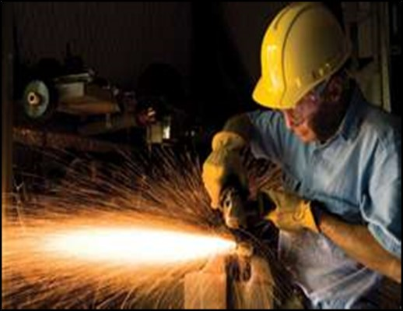
Course Objectives
Notes:
Course Objectives
At course completion it is expected that you will be able to demonstrate:
An understanding of your rights under OSHA including Whistleblower Protection Programs
An understanding of machinery hazards and/or portable power tool hazards
Your knowledge regarding how to protect yourself from machinery hazards and/or portable power tool hazards, including proper guarding

Slide 4
OSHA
Notes:
OSHA and You!
You have rights!
No retribution
Filing a complaint
Review Whistleblower Fact Sheet in front pocket

Slide 5
Recent and Real Machinery Hazards
Notes:
09/27/2017 North Roberts, Idaho
Worker died when clothing became caught in conveyor belt motor drive shaft.
09/01/2017 Columbus, Indiana
Worker fatally crushed by barrel of degreaser machine.
08/02/2017 House Springs, Missouri
Worker died while trying to unclog wood chipper.
06/19/2017 Waverly, Tennessee
Worker fatally crushed by machine.
05/29/2017 Midland, Texas
Worker fatally entangled in winch cable.
05/27/2017 Shiner, Texas
Worker died when clothes became caught in drill mechanism.

Slide 6
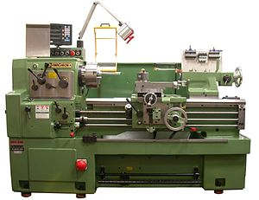
Machinery Hazards Exercise
A lathe is a machine that rotates the workpiece about an axis of rotation to perform various operations such as cutting, sanding, knurling, drilling, deformation, facing, turning with tools that are applied to the workpiece to create an object with symmetry about that axis.
Notes:
Common Shipyard Shop Machines
The following machines are found in many ship repair shops. Check the box next to the machine you use or is used in your immediate work area.
Abrasive Grinders
Band Saws
Shop Saws (circular type)
Drill Presses
Wood Lathes
Planers
Milling Machines
Roll-forming and roll-bending machines

Slide 7
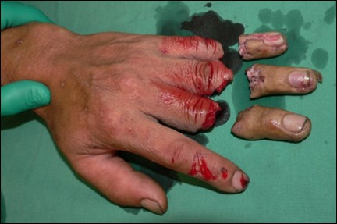
Your Risk Exercise
Notes:
Common (Too Common) Machine Shop Injuries
Check the box next to the potential injuries that you could suffer based on the machines you are exposed to from the previous page.
Crushed
Blinded
Amputations
Asphyxiated
Struck
Lacerations
Bones Broken
Torn Ligaments

Slide 8
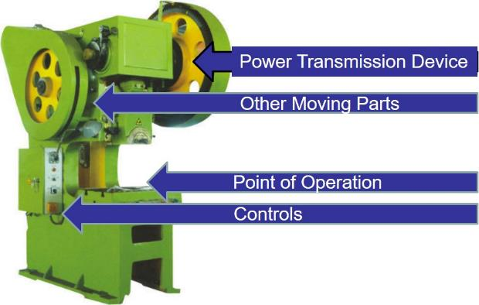
Where Mechanical Hazards Occur
Other Moving Part
Point of Operation
Controls
Notes:
Where Mechanical Hazards Occur
Dangerous moving parts in three basic areas require safeguarding as well as the controls which power and direct the machine.
Point of operation: where work is performed on the material, such as cutting, shaping, boring, or forming of stock.
Power Transmission Device: transmits energy to the part of the machine performing the work. Includes flywheels, pulleys, belts, connecting rods, couplings, cams, spindles, chains, cranks, and gears.
Other moving parts: can include reciprocating, rotating, and transverse moving parts, feed mechanisms, and auxiliary parts of the machine
Operation Controls: Control mechanisms

Slide 9
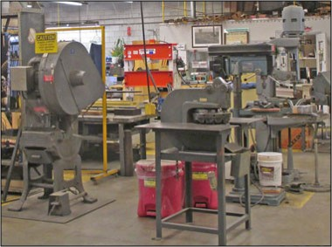
Hazards to be Guarded
Notes:
Hazards to be Guarded
Below are hazards the must be guarded (not all-inclusive):

Slide 10
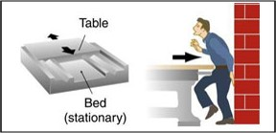
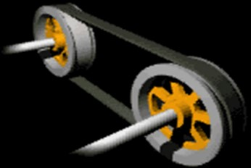
Motions
Rotating - Gears
Reciprocating - Table
Transverse Motion - Belts
Notes:
Rotating Motions
Rotating motion can be dangerous; even smooth, slowly rotating shafts can grip clothing, and through mere skin contact, force an arm or hand into a dangerous position. Injuries due to contact with rotating parts can be severe.
Reciprocating Motion
Reciprocating motion, also called reciprocation, is a repetitive up-and-down or back-and-forth linear motion. It is found in a wide range of mechanisms, including reciprocating saws, engines, tables and pumps.
Transverse Motion
Transverse motion (movement in a straight, continuous line) creates a hazard because a worker may be struck or caught in a pinch or shear point by the moving part.

Slide 11
In-Running Nip Points
Rotating - Gears
Reciprocating - Table
Notes:
In-Running Nip Points
In-running nip points (or pinch points) are a special danger arising from rotating or reciprocating parts. They occur whenever machine parts move toward each other or when one part moves past a stationary object.
In-Running Nip Points can injure you:
Between 2 rotating parts
Between rotating and tangential parts
Between rotating and fixed parts which shear, crush, or abrade
Projecting pieces increase risk

Slide 12
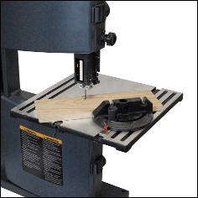
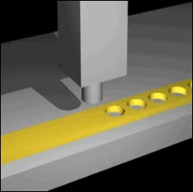
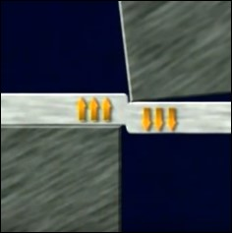
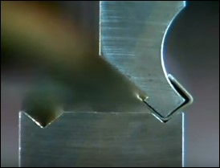
Action
Cutting – Band Saw
Punching – Metal Punch
Shearing – Shearing Machine
Bending – Bending Machine
Notes:
Cutting
Cutting action may involve rotating, reciprocating, or transverse motion. The danger of cutting action exists at the point of operation where finger, arm and body injuries can occur and where flying chips or scrap material can strike the head, particularly in the area of the eyes or face. Such hazards are present at the point of operation in cutting wood, metal or other materials.
Punching
Punching action results when power is applied to a slide (ram) for the purpose of blanking, drawing, or stamping metal or other materials. The danger of this type of action occurs at the point of operation where stock is inserted, held and withdrawn by hand.
Shearing
Shearing action involves applying power to a slide or knife in order to trim or shear metal or other materials. A hazard occurs at the point of operation where stock is actually inserted, held and withdrawn. Shears also commonly have hydraulic hold downs that secure the material before the shearing action occurs. These devices present a crushing hazard and are contacted more frequently than the shear itself.
Bending
Bending action results when power is applied to a slide in order to draw or stamp metal or other materials. A hazard occurs at the point of operation where stock is inserted, held and withdrawn.
.

Slide 13
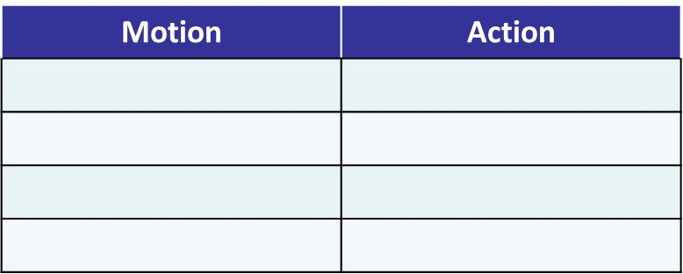
Exercise
Notes:
Each word below is a type of machine hazard (motion or action). Place each “bullet” under the proper category above.
Reciprocating
Punching
Rotating (including in-running nip points)
Shearing
Transverse Motion
Bending
Cutting

Slide 14
Applicable Regulations
1910 Subpart O - Machinery and Machine Guarding
1910.211 - Definitions.
1910.212 - General requirements for all machines.
1910.213 - Woodworking machinery requirements.
1910.214 - Cooperage machinery. [Reserved]
1910.215 - Abrasive wheel machinery.
1910.216 - Mills and calendars in the rubber and plastics industries.
1910.217 - Mechanical power presses.
1910.218 - Forging machines.
1910.219 - Mechanical power-transmission apparatus.
1910 Subpart P - Hand and Portable Powered Tools and Other Hand-Held Equipment
1910.241 - Definitions.
1910.242 - Hand and portable powered tools and equipment, general.
1910.243 - Guarding of portable powered tools.
1910.244 - Other portable tools and equipment.
Notes:
1910 Subpart O - Machinery and Machine Guarding
1910.211 - Definitions.
1910.212 - General requirements for all machines.
1910.213 - Woodworking machinery requirements.
1910.214 - Cooperage machinery. [Reserved]
1910.215 - Abrasive wheel machinery.
1910.216 - Mills and calendars in the rubber and plastics industries.
1910.217 - Mechanical power presses.
1910.218 - Forging machines.
1910.219 - Mechanical power-transmission apparatus.
1910 Subpart P - Hand and Portable Powered Tools and Other Hand-Held Equipment
1910.241 - Definitions.
1910.242 - Hand and portable powered tools and equipment, general.
1910.243 - Guarding of portable powered tools.
1910.244 - Other portable tools and equipment.

Slide 15
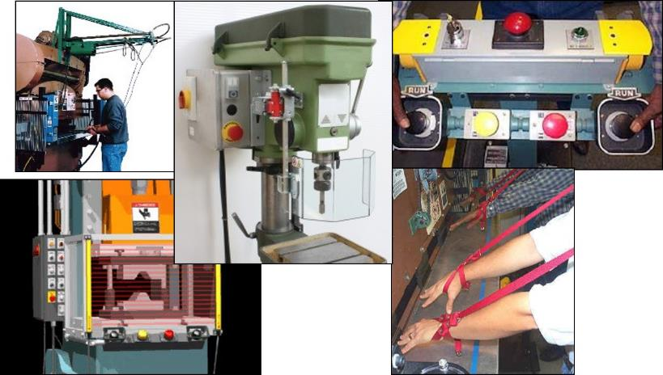
Machine Guards and Devices

Slide 16
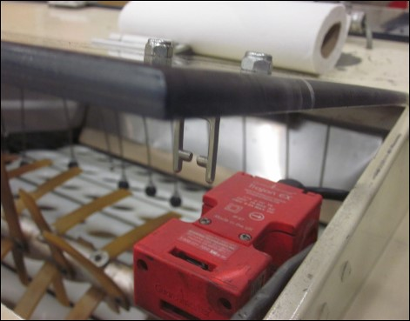
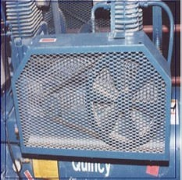
Machine Guards – Fixed and Interlocked
Fixed
Interlocked
Notes:
Fixed and Interlocked Guards
Fixed
As its name implies, a fixed guard is a permanent part of the machine. It is not dependent upon moving parts to function. It may be constructed of sheet metal, screen, wire cloth, bars, plastic, or any other material that is substantial enough to withstand whatever impact it may receive and to endure prolonged use. This guard is usually preferable to all other types because of its relative simplicity. Fixed guards themselves must be evaluated to ensure that they do not create additional hazards during the operation of the machine. I like this example because it shows the mechanism that is being guarded.
Interlocked
When this type of guard is opened or removed, the tripping mechanism and/or power automatically shuts off or disengages, the moving parts of the machine are stopped, and the machine cannot cycle or be started until the guard is back in place. An interlocked guard may use electrical, mechanical, hydraulic or pneumatic power, or any combination of these. Interlocks should not prevent "inching" by remote control, if required. Replacing the guard should not automatically restart the machine. To be effective, all removable guards should be interlocked to prevent occupational hazards.

Slide 17
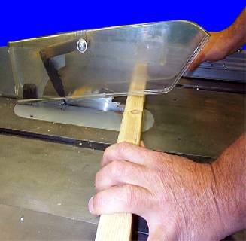
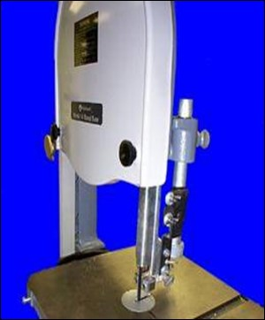
Machine Guards – Adjustable and Self-Adjusting
Circular table saw
Adjustable
Self-Adjusting
Bandsaw blade
Notes:
Adjustable and Self-Adjusting Guards
Adjustable
Adjustable guards are useful because they allow flexibility in accommodating various sizes of stock. Avery common example is the blade guard on a band saw. The trouble with adjustable guards is that they require the operator to adjust them each time the thickness of the stock changes.
Self-Adjusting
The openings of these barriers are determined by the movement of the stock. As the operator moves the stock into the danger area, the guard is pushed away, providing an opening which is only large enough to admit the stock. After the stock is removed, the guard returns to the rest position. This guard protects the operator by placing a barrier between the danger area and the operator. The guards may be constructed of plastic, metal, or other substantial material. Self-adjusting guards offer different degrees of protection.

Slide 18
Exercise
From a safety perspective identify the pros and cons of each type of guard below.
Notes:
Fixed Interlocked
Adjustable
Self Adjusting

Slide 19
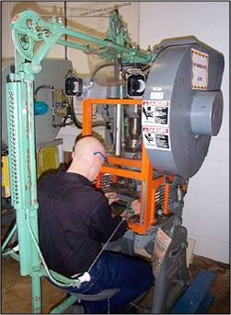
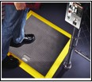
Guarding Devices – Presence Sensing and Pullback
Presence sensing device
Cables attached to operator’s hands or wrists
Removes hands from point of operation during danger period
Pullback
Notes:
Presence Sensing and Pullback Devices
Presence Sensing
Presence Sensing Devices are one of the most common safeguards for automatic feed part revolution clutch presses. They are designed to automatically stop the machine stroke if the sensing field is interrupted. Proper use of presence sensing devices provides protection not only for operators but also for other employees in the area. They also minimize operator resistance to these types of safety devices due to their nonrestrictive design. Presence sensing devices are commonly referred to as “light curtains”. There are many requirements that must be met before light curtains can be installed as point-of-operation safeguards.
Pullback
Pullbacks/pullouts are used as safeguarding devices on both full and part revolution power presses. They are similar to restraints, but pullbacks are designed to pull the operator's hands away from the area of the closing dies (point of operation) during each stroke of the power press. Wrist bands, are secured around both wrists of the operator, and the pullback is adjusted for the particular operator and the particular die installed within the press. When the press stroke begins the pullback device pulls the wrist bands away from the die located within the press.

Slide 20
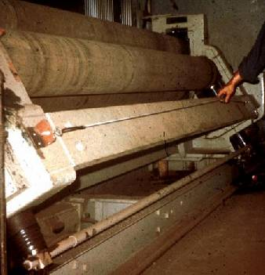
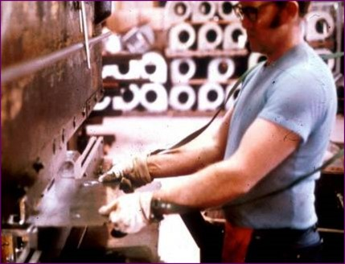
Guarding Devices – Restraint and Safety Controls
Safety Cable
Restraint
Safety Controls
Notes:
Restraint and Safety Controls
Restraint
Restraints are sometimes referred to as "holdouts." They are similar to pullbacks and are appropriate safeguards for both full and part revolution mechanical power presses. When properly anchored, restraints are adjusted so that the operator can never reach the point of operation. The size and type of restraint depends on the size and type of press. Restraints are applied on press brakes that perform long-run jobs. The parts being produced are held by the operator, except in the case of small parts in which a hand feeding tool must be used.
Safety Controls
Device located around the perimeter of or near the danger area. These devices include, but are not limited to, tripwire cables and two-hand controls. When using a safety cable, as shown above, the operator must be able to reach the cable to stop the machine.

Slide 21
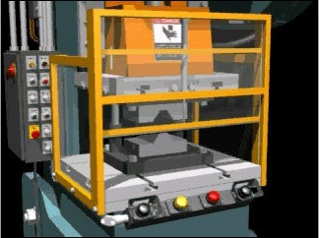
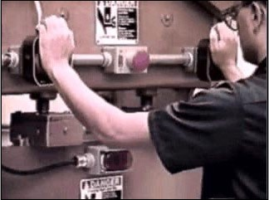
Guarding Devices – Gates and Two-Handed Controls
Gates
Two-Handed Controls
Notes:
Gates and Two-Handed Controls
Gates
Type "A" Gates protect the operator during the entire machine stroke. This means the gate will not open until after the crankshaft rotation is complete (360°) and the machine is stopped at top dead center.
Type "B" Gates protect the operator during the down-stroke only. The gate starts to open before the crankshaft rotation is complete (generally after 180° crankshaft rotation). The gates must open on the upstroke of the machine cycle before the crankshaft rotation is complete.
Two-Handed Controls
Requires constant pressure on both pads to activate the machine. Hands on controls at safe distance while machine is in dangerous cycle.
Two-Handed Controls can be used as safeguarding devices in the single stoke mode of operation on part revolution clutch presses. Similar to the two-hand trip, this device keeps the operators hands away from the point of operation during the entire machine stroke.

Slide 22
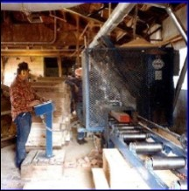
Safeguarding by Location and Distance
Notes:
Safe Guarding by Location and Distance
To consider a part of a machine to be safeguarded by location, the dangerous moving part of a machine must be so positioned that those areas are not accessible or do not present a hazard to a worker during the normal operation of the machine. This may be accomplished by locating a machine so that the hazardous parts of the machine are located away from operator work stations or other areas where employees walk or work. This can be accomplished by positioning a machine with its power transmission apparatus against a wall and leaving all routine operations conducted on the other side of the machine. Additionally, enclosure walls or fences can restrict access to machines. Another possible solution is to have dangerous parts located high enough to be out of the normal reach of any worker. The feeding process can be safeguarded by location if a safe distance can be maintained to protect the worker's hands. The dimensions of the stock being worked on may provide adequate safety. For instance, if the stock is several feet long and only one end of the stock is being worked on, the operator may be able to hold the opposite end while the work is being performed. An example would be a single-end punching machine. However, depending upon the machine, protection might still be required for other personnel.

Slide 23
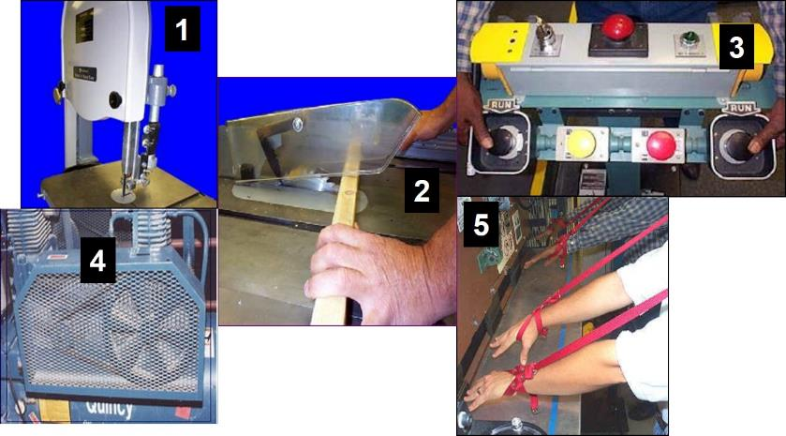
Exercise
Notes:
Identify each of the numbered guard/devices above (left column below) and describe how it works in the right column.

Slide 24
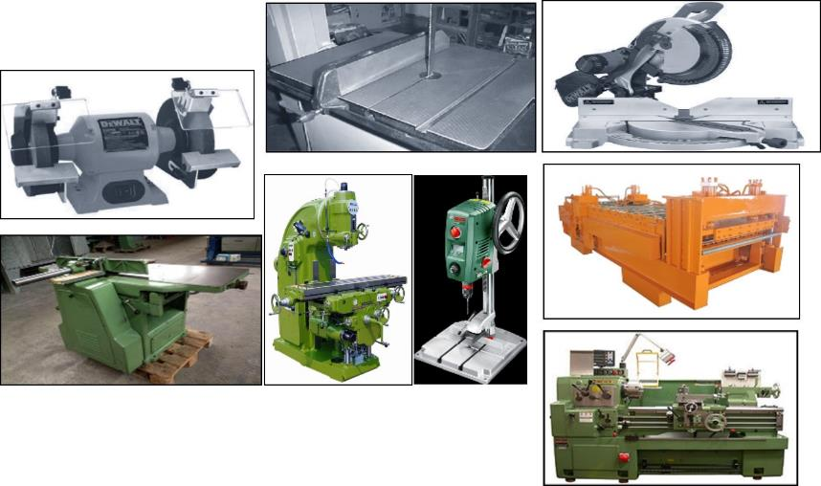
Specific Machines Hazards and Solutions
Notes:
Common Shipyard Shop Machines
The following pages discuss specific hazards and hazard solutions for the following shop machines:
Abrasive Grinders
Band Saws
Shop Saws (circular type)
Drill Presses
Wood Lathes
Planers
Milling Machines
Roll-forming and roll-bending machines

Slide 25
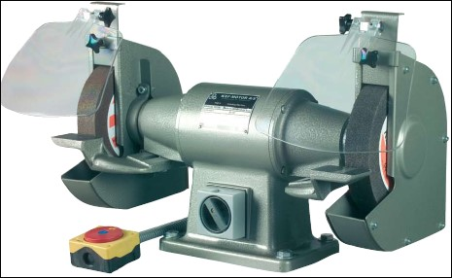
Abrasive Wheel and Grinder
Rotating
(Motion)
Cutting
(Action)
Protective Shields
Notes:
Abrasive Wheel and Grinder
What is the Motion Hazard of an abrasive wheel and grinder?
What is the Action Hazard of an abrasive wheel and grinder?
Abrasive wheels and grinding machines come in many styles, sizes and designs.
Both bench-style and pedestal (stand) grinders are commonly found in many
industries. These grinders often have either two abrasive wheels or one abrasive wheel and one special-purpose wheel such as a wire brush, buffing wheel or sandstone wheel. These types of grinders normally come with the manufacturer’s safety guard covering most of the wheel, including the spindle end, nut and
flange projection. These guards must be strong enough to withstand the effects of a bursting wheel. In addition, a work rest and transparent shields are often provided.
Protective Shields:
Provides protection from flying particles or splashing fluids, however, protection is NOT 100 %.

Slide 26
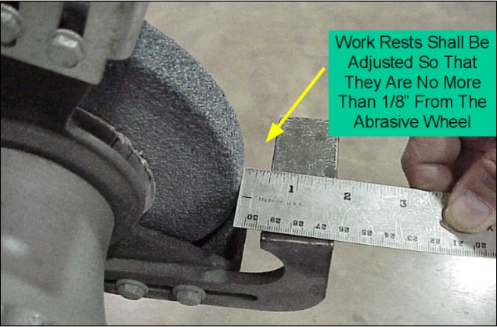
Abrasive Wheel and Grinder Hazards
Notes:
Hazards
Bench-style and pedestal grinders create special safety problems due to the potential of the abrasive wheel shattering; exposed rotating wheel, flange and spindle end; and a naturally occurring nip point that is created by the work rest.
This is in addition to such concerns as flying fragments, sparks, air contaminants, etc. Cutting, polishing and wire buffing wheels can create many of the same hazards. Grinding machines are powerful and designed to operate at high speeds. If a grinding wheel shatters while in use, the fragments can travel at more than 300 miles per hour. In addition, the wheels found on these machines (abrasive, polishing, wire, etc.) often rotate at several thousand revolutions per minute. The potential for serious injury from shooting fragments and the rotating wheel assemblies (including the flange, spindle end and nut) is great. To ensure that grinding wheels are safely used in your workplace, know the hazards and how to control them.

Slide 27
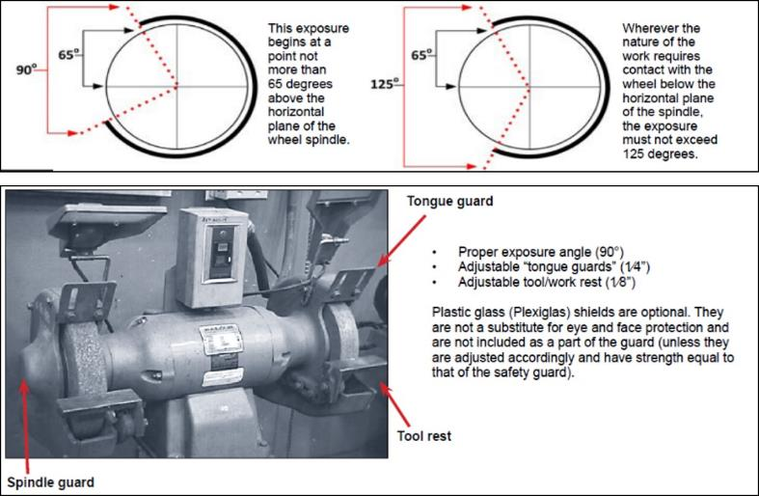
Abrasive Wheel and Grinder Solutions
Notes:
Solutions
Abrasive wheels used on bench and pedestal grinding machines must be equipped with safety guards. The safety guard encloses most of the wheel – covering the flange, spindle end and nut projection – while allowing maximum exposure of the wheel periphery. The exposure of the wheel should not exceed 90 degrees or one-fourth of the periphery (see diagram above).
Because the safety guard is designed to restrain the pieces of a shattered grinding wheel, the distance between the safety guard and the top periphery of the wheel must not be more than 1/4 inch. If this distance is greater because of the decreased size of the abrasive wheel, then a “tongue guard” must be installed to protect workers from flying fragments in case of wheel breakage. This “tongue guard” should be adjustable to maintain the maximum 1/4 inch distance between it and the wheel. An adjustable work rest must also be installed and maintained at a maximum clearance of 1/8 inch between it and the face of the wheel. In addition to offering a stable working position, this small clearance must be maintained to prevent the operator’s hands or the work from being jammed between the wheel and the rest, which may cause serious injury or the wheel to break.

Slide 28
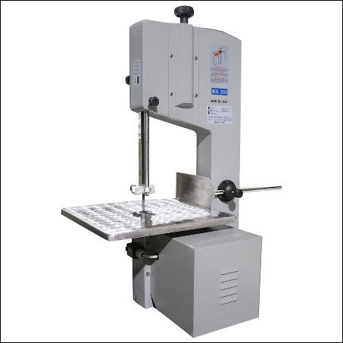
Band Saw
??????
(Motion)
??????
(Action)
Notes:
Band Saw
What is the Motion Hazard of a band saw?
What is the Action Hazard of a band saw?
A vertical band saw uses a thin, flexible, continuous metal band with cutting teeth on one edge. It is a versatile saw used to cut both wood and metal stock and also to cut and trim meat. The blade runs on two pulleys, driver and idler, and through a work table where material is fed manually. In order to cut, the operator is required to hand-feed and manipulate the stock against the blade. The operator must also keep the stock flat on the work table and exert the proper amount of force.

Slide 29
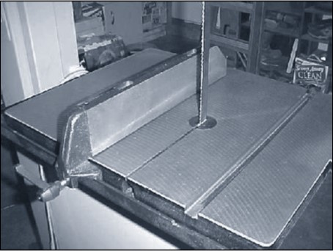
Band Saw Hazards
Notes:
Hazards
Serious cuts or amputations can occur if the operator contacts the blade. Extreme caution is necessary because the operator’s hands may come close to the saw blade and a band saw cannot be fully guarded.
What hazard do you readily see in the photo?

Slide 30
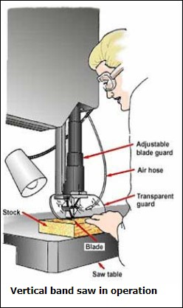
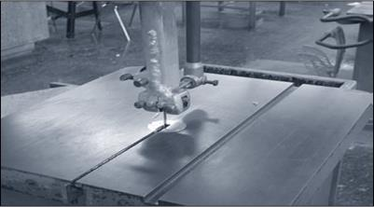
Band Saw Solutions
Properly adjust the blade guide to fit the thickness of the stock and ensure the guard is as close as possible to the stock.
Notes:
Solutions
Guard the entire blade except at the point of operation (the working portion of the blade between the bottom of the sliding guide rolls and the table).
Use an adjustable guard for the portion of the blade above the sliding guide rolls so that it raises and lowers with the guide. Properly adjust the blade guide to fit the thickness of the stock and ensure the guard is as close as possible to the stock.
Band saw wheels must be fully enclosed.
Make sure the saw includes a tension control device to indicate proper blade tension.

Slide 31
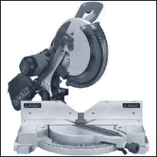
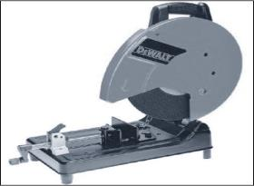
Shop Saw (Cut-Off Saws)
Rotating
(Motion)
Cutting Miter Saw Chop Saw
(Action)
Notes:
Cut-Off Saw
Although there are many specific types of cut-off saws, they are all circular saws designed to cross-cut stock at exact lengths and angles. The following are some of the common cut-off saws used today.
Miter Saw
A miter saw is a versatile circular power saw mounted on a hinged frame and designed to make accurate angle cuts. When the blade is lowered in a chopping motion, the blade cuts through the work piece, passing through a slot in the base.
Chop Saw
A chop saw is a lightweight circular saw mounted on a spring loaded pivoting arm and supported by a metal base. The operator clamps the stock to the fence, pulls the blade through the work piece, and guides the saw back to its upright position. Chop saws typically do not have the cutting capacity of miter saws.

Slide 32
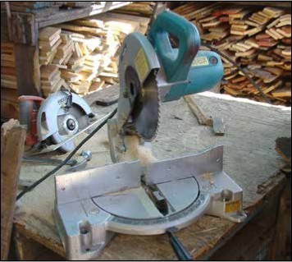
Shop Saw Hazards
Notes:
Hazards
What’s wrong with this picture?
Severe cuts to or amputations of the fingers or hands can occur if they come in contact with the saw blade. If the rotating blade is not properly guarded, exposure can occur during operation or when the saw is idling. Overhead swing saws can pose additional hazards if the return device fails, if the saw bounces forward from a retracted position, or if the saw blade is able to go past the edge of the table, possibly contacting the operator’s body.
Although not as common as with ripsaws, hazardous kickbacks might also occur.

Slide 33
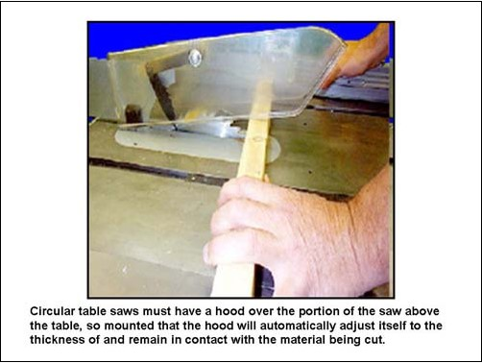
Shop Saw Solutions
Notes:
Solutions
Over table cut-off saws, including miter and chop saws, must be provided with fixed hood guards that enclose the arbor and top half of the saw. These saws also must be equipped with a self-adjusting lower blade guard that automatically adjusts itself to the thickness of the material being cut and provides continuous protection from the blade. Most guards supplied by manufacturers are designed to move out of the way as the blade nears the cut. If a guard seems slow to return to its normal position, adjust or repair it immediately. If a guard seems slow to return to its normal position, adjust or repair it immediately.
Additional Safety Measures
Use only recommended size and RPM rated blades. Maintain sharp blades. Always wear eye and face protection

Slide 34
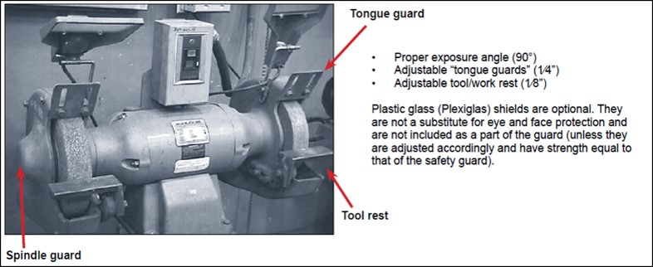
EXCERCISE
Notes:
What does a circular saw have in common with a grinder that it does not have in common with a band saw?
Pick a machine previously discussed, preferably from your work area, and identify hazards and solutions. Do this without referring to your training materials if possible.
Machine: _____________________

Slide 35
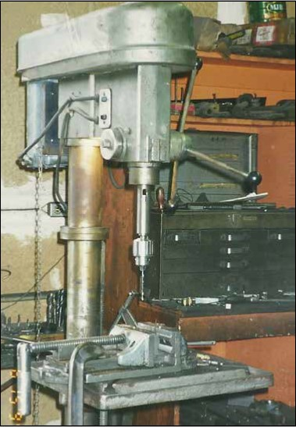
Drill Press
???????
(Motion)
???????
(Action)
Notes:
Drill Press
What is the Motion Hazard of a drill press?
What is the Action Hazard of a drill press?
The drill press is a versatile machine that uses a multiple-cutting-edged drill bit secured in a rotating chuck to bore and drill holes, normally into wood stock. Either in floor or bench-top designs, drill presses are usually arranged vertically, requiring the operator to raise and lower an operating handle in order to control the drill bit. These machines also have variable speeds and some have multiple spindles for gang drilling. The most commonly used drill press is a single-spindle, floor-mounted, belt-driven machine for non-production drilling.
.

Slide 36
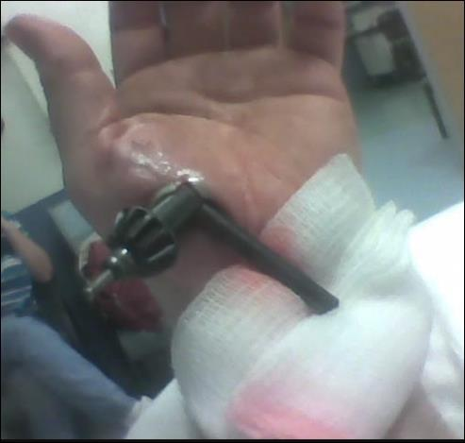
Drill Press Hazards
Notes:
Hazards
Serious lacerations and entanglement can occur if operators contact the rotating bit or chuck, or when operators try to hold the stock by hand when drilling. If not adequately secured, the stock can spin violently and contact the operator and others nearby. Also, injuries can occur from a projected chuck key if it is left in the chuck.

Slide 37
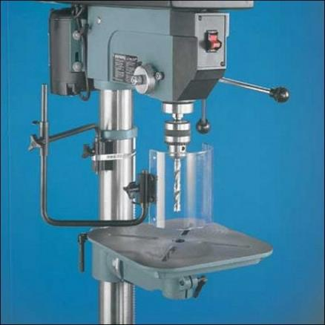
Drill Press Solutions
Notes:
Solutions
Use jigs or fixtures to fasten the stock to the bed and stabilize the work piece. This allows the stock to be secured for drilling and the operator’s free hand to be positioned away from the rotating chuck and drill bit. The drill bit is more likely to grab and twist an unstable work piece. In many repetitive drilling applications, specially designed guards or shields are installed to protect the operator from the potential exposure to rotating drill chucks and drill bits. A fixed universal-type shield can be used on larger gang drills.

Slide 38
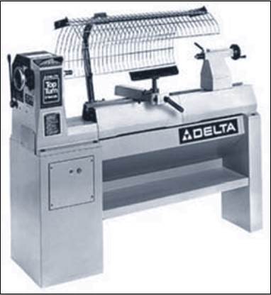
Wood Lathe
???????
(Motion)
???????
(Action)
Notes:
Lathe
What is the Motion Hazard of a lathe?
What is the Action Hazard of a drill lathe?
While most tools rotate or move a blade or bit to cut, the wood lathe moves the work piece being cut. The wood lathe is used to turn stock into round objects by securing the stock between two centers: the headstock and tailstock (spindle turning), or by securing the work to the headstock only with a faceplate (facing). Spindle turning is used for long objects such as table and chair legs, while facing is used for cups, bowls, and plates. The stock rotates rapidly while the operator applies a single-point tool to the wood. The operator holds the tool on a tool rest and advances it along the length of the tool rest to shape the stock as desired.
.
.

Slide 39
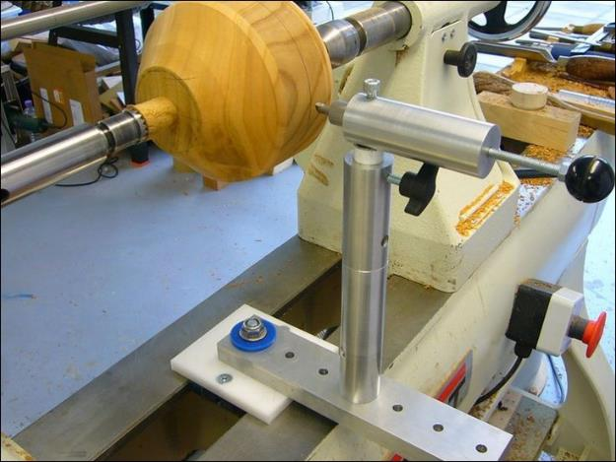
Wood Lathe Hazards
Notes:
Hazards
Due to its unique operation of rotating the stock being cut, the lathe presents several concerns. The primary hazards arise when using a hand tool against the rotating stock and the close proximity of the operator to the rotating parts. Serious injuries can occur if the tool becomes caught between the rest and the rotating stock, bringing the operator’s hands in with it. Also, hands, arms, clothing, hair, or jewelry may be caught on the rotating parts and pulled into the machine simply because of the close distance the operator is from the machine’s components. Projected or broken work pieces can be another hazard if not secured between the centers or if the work piece is defective. Furthermore, chuck keys can eject if left in the chuck. Flying wood chips from the turning operation also can pose a hazard on wood lathes.
What is wrong with this picture?

Slide 40
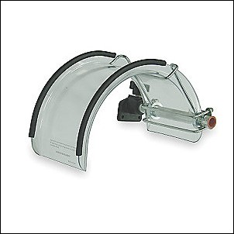
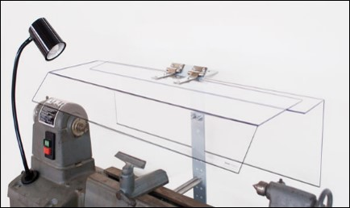
Wood Lathe Solutions
Notes:
Solutions
Cover all rotating parts and points of operation with shields. Cover lathes used for turning long stock with long, curved guards that extend over the top of the lathe. These shields, or guards, must protect the operator if the stock comes loose and is thrown from the machine. Chuck guards are the most common guard on lathes. They cover the chuck which is the part of the machine in which the stock is inserted and held.

Slide 41
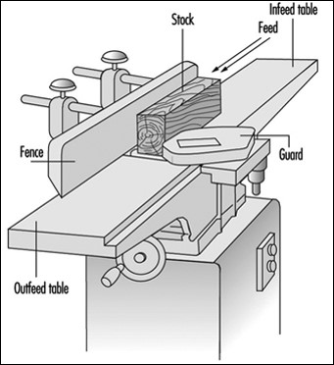
Planer
???????
(Motion)
???????
(Action)
Notes:
Planer
What is the Motion Hazard of a planer?
What is the Action Hazard of a planer?
Planers are most frequently used to produce smooth faces on boards and to mill them to particular thicknesses. Planers are different from jointers because of their capacity to plane wider surfaces and the capability to control thickness. Planers have automatic feed systems that pull the work through the horizontally rotating blades and out the back.

Slide 42
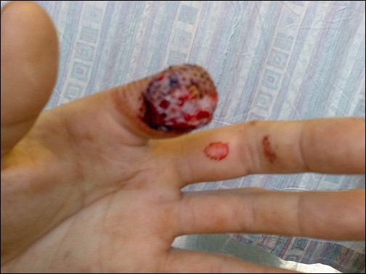
Planer Hazards
Notes:
Hazards
Severe lacerations, amputations, or avulsions (tearing away) can occur if the operator’s hand or arm is fed through the machine and contacts the cutting heads. Serious injury can also occur from kickback. A kickback can occur when lowering the table with the power on and the stock still in the machine, feeding stacked boards or planing boards shorter than the manufacturer’s recommendation.

Slide 43
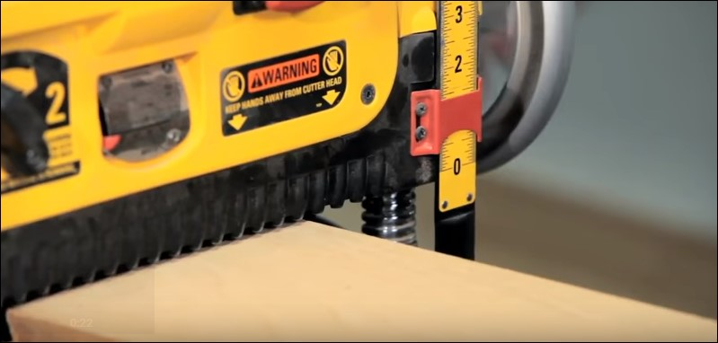
Planer Solutions
Notes:
Solutions
Keep the machine guards in place at all times. Keep your hands out of the machine feeding area and allow the planer to pull the stock through. Never lower the table during operation and never feed stacked boards. Also, follow manufacturer’s recommendations for allowable material dimensions. Keep your body to the side of the stock.
Additional Safety Measures
Wear safety glasses or goggles, or a face shield (with safety glasses or goggles), and use the appropriate hearing protection.
Disconnect the planer from the power supply before making any adjustments to the cutter head or blades.
Ensure switch is in “off” position before plugging in.
Ensure that the blade-locking screws are tight.
Remove adjusting keys and wrenches before turning on power.
Check stock thoroughly for staples, nails, screws, or other foreign objects before using a planer.

Slide 44
What Should Have Been Done Differently? Show appropriate video
Notes:
What should have been done differently?
____________________________________________________________
____________________________________________________________
____________________________________________________________
____________________________________________________________
____________________________________________________________
____________________________________________________________
____________________________________________________________

Slide 45
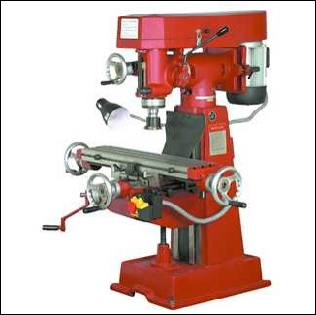
Milling Machine
???????
(Motion)
???????
(Action)
Notes:
Milling Machine
What is the Motion Hazard of a Milling Machine?
What is the Action Hazard of a Milling Machine?
A milling machine removes material from a work piece by rotating a cutting tool (cutter) and moving it into the work piece. Milling machines, either vertical or horizontal, are usually used to machine flat and irregularly shaped surfaces and can be used to drill, bore and cut gears, threads and slots. The vertical mill, or “column and knee” mill, is the most common milling machine found in machine shops today. The general construction of this mill includes the quill, which moves vertically in the head and contains the spindle and cutting tools. The knee moves up and down by sliding parallel to the column. The column holds the turret, which allows the milling head to be positioned anywhere above the table. Hand wheels move the work table to the left and right (X axis), in and out (Y axis), in addition to moving the knee, saddle and worktable up and down (Z axis).

Slide 46
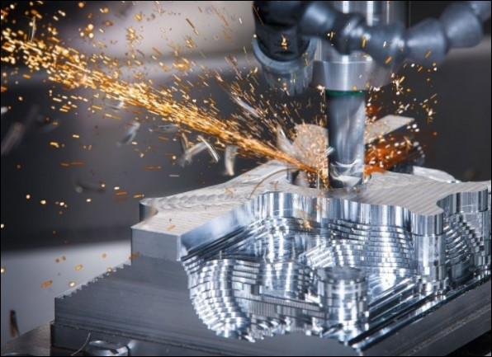
Milling Machine Hazards
Notes:
Hazards
Serious injuries and entanglement can occur if the operator contacts the rotating cutter. Metal shavings and lubricating/cooling fluids might also present a risk from the point of operation area. Material might spin and strike an operator if the material is not secured to the table. Injuries can also occur from a projected wrench if it is left in the spindle.

Slide 47
Milling Machine Solutions
Notes:
Solutions
Secure the work piece, either by clamping it onto the work table or by clamping it securely in a vise that is clamped tightly to the table.
NOTE: Computer numerical controlled (CNC) mills are rapidly replacing manually fed machines, mainly for versatility and production reasons. The increased automation does not normally require the operator to move the hand wheels (like the traditional machines), so operators must always keep their hands away from the point of operation. A guard or shield that encloses the cutter head or milling bed may be considered to protect the operator from the cutting area, flying metal shavings and lubricating or cooling fluids. Make sure the tightening wrench is removed from the mill.
In some cases, a shield can provide an operator protection from the cutter, as well as from metal shavings and metal working fluids. See photo above.

Slide 48
Roll-Forming & Roll-Bending
???????
(Motion)
???????
(Action)
Notes:
Roll-Forming & Roll-Bending Machines
What is the Motion Hazard of a Roll-Forming and Bending Machines?
What is the Action Hazard of a Roll-Forming and Bending Machines?
Conventional metal forming and bending machines, also known as plate bending rolls, produce smooth, circular bends in sheet, strip, or coiled stock. Metal is fed between successive pairs of rolls that progressively bend and form it until the desired shape and cross section is obtained. The radius of the bend can be adjusted by changing the location of the rolls. These machines are normally equipped with instant start, stop and reverse controls.

Slide 49
Roll-Forming & Roll-Bending Hazards
Notes:
Hazards
Severe crushing injuries, amputations and even death can occur if a worker is caught and drawn into the counter-rotating infeed rolls. The risk of injury is high during the initial feeding of the stock. Wearing gloves with fingertips and loose clothing also increase the risk of entanglement. Workers can also be struck by the moving work piece or pinned between it and a fixed structure.

Slide 50
Roll-Forming & Roll-Bending Solutions
Notes:
Solutions
Installing fixed or adjustable barrier guarding at the point of operation is usually not practical, primarily due to the flexibility needed to bend various sizes of stock. Some protection for the operator and anyone near the machine can be provided by using devices such as safety trip cables (emergency stop) and hold-down controls; however, these safety devices do not directly prevent entanglement or entrapment. They are intended to help prevent or minimize injury by stopping the machine quickly. Hold-down button or foot controls are designed to actuate roll movement only when held in the run position. The control should automatically return to the stop position when released. A trip device (bar, tensioned wire/cable or kick panel) is interlocked with the machine’s control circuit and positioned so that it may be easily actuated by any person caught or drawn toward the rolls and will stop the machine before serious injury can occur. It should run the entire length of the machine at the front and in the back. Also, ensure the braking system is adequate. In addition to the measures detailed above, an emergency stop button should be provided at the machine control console and at any remote work station. If more than one person is needed to operate the machine, controls should be furnished for each person. Stock should be held sufficiently far back from the edge being fed to prevent close proximity to the point of operation. Whenever practical, use feed or roller tables. Consider wearing gloves without fingertips or palm protection only. Prohibit loose-fitting clothing. Maintain adequate distance from the work piece to prevent being struck by it.

Slide 51
Machine Guarding Checklists
Notes:
Checklists
Briefly review the Machine Guarding Checklists in the pocket of your training manual. After reviewing please answer the following questions:
Is the checklist valuable? If so, how? If not, why not?
How will I (we) use the checklist?
How often will I (we) use the checklist?

Slide 52
Questions/Comments
Notes:
Questions/Comments
____________________________________________________________________________________________________________________________________________________________________________________________________________________________________________________________________________________________________________________________________________________________________________________________________________________________________________________________________________________________________________________________________

Slide 53
Portable Power Tools
Notes:
When working with power tools, you can get an electric shock, lose a finger, lose an eye or go deaf. It's especially dangerous to use a tool that's defective, that's been modified or that's not designed for the job. Of course, you can also get injured if you use any tool carelessly.
In this section we will discuss general power tool hazards and hazard solutions as well as the specifics for several portable power tools often used when repairing ships.

Slide 54
Power Tool Hazards - Exercise
Notes:
From OSHA’s Website
Above are 19 injuries recorded in the first four months of 2017.
How many were caused by power tools?
What were the power tools?
Of the above, which are tools you use or work around?
What were the injuries?

Slide 55
Applicable Regulations
Notes:
1910 Subpart P - Hand and Portable Powered Tools and Other Hand-Held Equipment
1910.241 - Definitions.
1910.242 - Hand and portable powered tools and equipment, general.
1910.243 - Guarding of portable powered tools.
1910.244 - Other portable tools and equipment.
1926 Subpart I - Tools - Hand and Power
1926.300 - General requirements.
1926.301 - Hand tools.
1926.302 - Power-operated hand tools.
1926.303 - Abrasive wheels and tools.
1926.304 - Woodworking tools.
1926.305 - Jacks-lever and ratchet, screw, and hydraulic.
1926.306 - Air receivers.
1926.307 - Mechanical power-transmission apparatus.

Slide 56
OSHA Precautions
Notes:
From OSHA’s Hand and Power Tool Booklet
To prevent hazards associated with the use of power tools, workers should observe the following general precautions:
Never carry a tool by the cord or hose.
Never yank the cord or the hose to disconnect it from the receptacle.
Keep cords and hoses away from heat, oil and sharp edges.
Disconnect tools when not using them, before servicing and cleaning them, and when changing accessories such as blades, bits and cutters.
Keep all people not involved with the work a safe distance from the work area.
Secure work with clamps or a vise, freeing both hands to operate the tool.
Avoid accidental starting. Do not hold fingers on the switch button while carrying a plugged-in tool.
Maintain tools with care; keep them sharp and clean for best performance.
Follow instructions in the user's manual for lubricating and changing tooling.
Be sure to keep good footing and maintain good balance when operating.
Wear proper apparel for the task. Loose clothing, ties, or jewelry can become caught in moving parts.
Remove all damaged portable electric tools and tag them: "Do Not Use."

Slide 57
More OSHA Precautions
Notes:
More OSHA Precautions
When using power tools:
Operate within design limits
Use gloves and safety shoes
Store in a dry place
Don’t use in wet locations unless approved for that (use GFCI)
Keep work areas well lit
Ensure cords don’t present a tripping hazard

Slide 58
Controls and Switches
Notes:
Operating Controls and Switches (OSHA Quick Takes) The following hand-held power tools must be equipped with a constant-pressure switch or control that shuts off the power when pressure is released: drills; tappers; fastener drivers; horizontal, vertical, and angle grinders with wheels more than 2 inches (5.08 centimeters) in diameter; disc sanders with discs greater than 2 inches (5.08 centimeters); belt sanders; reciprocating saws; saber saws, scroll saws, and jigsaws with blade shanks greater than 1/4-inch (0.63 centimeters) wide; and other similar tools. These tools also may be equipped with a "lock-on" control, if it allows the worker to also shut off the control in a single motion using the same finger or fingers. The following hand-held power tools must be equipped with either a positive "on-off" control switch, a constant pressure switch, or a "lock-on" control: disc sanders with discs 2 inches (5.08 centimeters) or less in diameter; grinders with wheels 2 inches (5.08 centimeters) or less in diameter; platen sanders, routers, planers, laminate trimmers, nibblers, shears, and scroll saws; and jigsaws, saber and scroll saws with blade shanks a nominal 1/4-inch (6.35 millimeters) or less in diameter. It is recommended that the constant-pressure control switch be regarded as the preferred device. Other hand-held power tools such as circular saws having a blade diameter greater than 2 inches (5.08 centimeters), chain saws, and percussion tools with no means of holding accessories securely must be equipped with a constant-pressure switch.

Slide 59
Specific Tool Hazards and Solutions
Notes:
Commonly Used Portable Power Tools Used On Board
The following pages discuss specific hazards and hazard solutions for the following portable power tools:
Abrasive Grinders
Drills
Sawzalls
Needle Guns

Slide 60
Abrasive Grinders
Notes:
Hand Grinders
Hand-held grinders are a common tool in the shipyard. They are primarily used to grind down or cut through metals and other materials.
They are also one of the most abused, or misused tools.
While grinders come in many different shapes and sizes, they require specific handling procedures.

Slide 61
Exercise

Slide 62
Abrasive Grinder Hazards
Notes:
Abrasive Grinder Hazards
When using abrasive wheels, workers can be exposed to serious injuries, such as:
Bodily injury from being struck by the object being cut or grinded.
A body part caught or pulled in by moving parts.
Eye injuries from flying debris (for example, chips, metal particles or a wheel that disintegrates).
Hearing damage from excessive noise while grinding.
Respiratory issues from inhaling dust.
These hazards can lead to workers being hospitalized, suffering permanent disability and in some cases are fatal. Proper guarding, adjustment of tool rests and use of ANSI-approved eyewear and other personal protective equipment helps protect workers from these hazards. Be sure to include these things in your required Accident Prevention Program (APP).

Slide 63
Abrasive Grinder Hazard Solutions
Notes:
Using Portable Grinders Safely
Like all power tools, portable grinders can present safety concerns, including flying particles and electrical hazards. This procedure outlines requirements in the Occupational Safety & Health Administration (OSHA) standards regarding abrasive wheels and tools (29 CFR 1926.303).
1. Preparation
2. Inspection
3. Ring Test
4. Replacing the Wheel
5. Don required Personal Protective Equipment (PPE)
6. Switch Grinder “ON”
7. Grinding
8. Switch Grinder Off
9. Other Precautions
10. Maintenance and Storage

Slide 64
Hazard Solutions - Preparation
Notes:
Using Portable Grinders Safely
Like all power tools, portable grinders can present safety concerns, including flying particles and electrical hazards. This procedure outlines requirements in the Occupational Safety & Health Administration (OSHA) standards regarding abrasive wheels and tools (29 CFR 1926.303).
Preparation
• Remove flammable materials from the work area.
• Ensure work area is clean, free from slip, trip, and fall hazards and well maintained.
• Keep the power cord away from the grinding wheel and the material being ground.
• Have personnel not involved in the immediate work step away a safe distance from the grinding area.
• Secure work with clamps or a vice to free both hands to operate the tool.

Slide 65
Hazard Solutions - Inspection
Notes:
Using Portable Grinders Safely
2. Inspection
• Unplug power cord from power supply before inspecting, adjusting, removing or replacing parts.
• Ensure wheel guard is in place*. see OSHA Guard Removal Exception below
• Check abrasive wheel for cracks or flaws – replace if necessary.
• Verify the maximum RPM rating of the grinder does not exceed the RPM rating on each abrasive wheel.
• When using a grinder that can switch between left-handed and right-handed operation, remember to move the blade guard when you move the handle.
• Tag out grinder if a deficiency is found – do not use grinder until the deficiency has been corrected.
*OSHA Guard Removal Exception only allows the guard to be removed for “internal grinding. The term "internal grinding" is defined as "the precision grinding of the inside surface of the hole in a work piece." This does not include snagging or off hand grinding operations such as grinding the welds inside a box or frame or the concave areas of auto bodies.

Slide 66
Hazard Solutions – Ring Test – Replacing the Wheel
Notes:
Using Portable Grinders Safely
3. Ring Test
Before installing an abrasive wheel, visually inspect it for cracks or flaws and perform a “Ring Test”:
Place your finger through the mounting hole of the new abrasive wheel.
Lightly tap its face with a hammer or metallic object.
A “ring” will sound from a good wheel.
A “dull thud” will sound from a wheel with an internal fracture.
4. Replacing the Wheel
The abrasive wheel should not be forced onto a grinder nor should the mounting hole size be changed.
To control cracking of the abrasive wheel, it must fit freely on the spindle and be tightened to hold the wheel in place without distorting the flange.
The mounting nut should not be tightened excessively.
Run a newly mounted wheel at operating speed for 1 minute before grinding.
Always follow the manufacturer's instructions.

Slide 67
Hazard Solutions – PPE – Switch the Grinder On
Notes:
Using Portable Grinders Safely
5. Don required Personal Protective Equipment (PPE)
• Wear appropriate PPE - safety glasses or goggles, face protection to protect against flying particles, hearing protection to guard against hearing loss.
• Gloves – Caution: Wear snug fitting gloves to avoid snagging on abrasive wheel or wire brush.
• Apron, metatarsal safety boots, and respiratory protection may also be required depending on the work being performed.
• Do not wear jewelry or other items that could get entangled in moving parts.
• Avoid wearing loose clothing or secure loose clothing.
• Tuck or secure long hair.
6. Switch Grinder “ON”
• Stand to one side and switch on grinder.
• Ensure the grinder operates smoothly and does not vibrate. If you notice any unusual vibrations or noises, STOP, re-inspect the grinder and fix the problem immediately.

Slide 68
Hazard Solutions – Grinding – Switch the Grinder Off
Notes:
Using Portable Grinders Safely
7. Grinding
• Use both hands to maintain hold of the grinder.
Use the handle provided with the grinder to maintain better control
• Allow grinder to reach full rpm before grinding.
• Position yourself to avoid overbalancing.
• When grinding avoid placing excessive pressure on abrasive wheels.
• Do not grind objects on sides of grinding wheels.
• Materials may become hot when grinding – use gloves when necessary.
• Clean and service grinders according to manufacturers' information
• Ensure the floor around the work area is clean and dry.
• Do not use wheels that are cracked or those that excessively vibrate.
8. Switch Grinder “OFF”
• Switch off grinder when done.
• Wait until the wheel has stopped turning before placing anywhere.
• Unplug the power cord from the power supply.
• Clean area and dispose of grinder particles.

Slide 69
Hazard Solutions–Other Precautions – Maintenance/Storage
Notes:
Using Portable Grinders Safely
9. Other Precautions:
• Do not use liquid coolants with grinders as this may cause the metal to shatter.
• Do not clamp portable grinders in a vise for grinding hand-held work.
• Do not keep any materials close to the grinding wheel when it is not in use.
• Do not carry a grinder by the power cord.
• Do not pull on the power cord to disconnect it from the power supply.
• Keep cords away from heat, oil and sharp objects or edges.
10. Maintenance & Storage
• Store portable grinders on racks or hooks, not on the floor or ground.
• Clean and service grinders according to the manufacturer's recommendations, including lubricating and changing accessories.
• Keep a written maintenance record on portable grinders.
Place the grinder in the gang box. Do not drop or toss it as the wheel could crack.

Slide 70
Hand Grinder Do's and Don’ts

Slide 71
What Happened?
Notes:
What May Have Caused This?

Slide 72
Exercise

Slide 73
Portable Power Drills
Notes:
Portable Drills
Drills can be used as a screwdriver “on steroids” or to create holes in metal, wood, fiberglass and many other materials. They are an invaluable tool to the shipyard worker. They are high speed and very powerful.
A slight error when using a drill can quickly result in an injury.

Slide 74
Portable Power Drill Hazards
Notes:
Power Drill Hazards
Portable power drills are one of the most useful tools in the ship repair industry, but without the proper safety training they can quickly become one of the most dangerous. According to a study released by the U.S. Consumer Product Safety Commission, more than 2,500 people a year receive hospital treatment for drill press injuries. To prevent injuries associated with power drills, OSHA requires employers to train employees on proper maintenance and safe handling of power drills.
Serious lacerations and entanglement can occur if operators contact the rotating bit or chuck, or when operators try to hold the stock by hand when drilling. If not adequately secured, the stock can spin violently and contact the operator and others nearby. Also, injuries can occur from a projected chuck key if it is left in the chuck.

Slide 75
Exercise

Slide 76
Portable Power Drill Solutions
Notes:
Portable Drill Solutions
To prevent hazards associated with the use of portable power drills, workers should observe the following precautions discussed under the following categories:
Before you pull the trigger
2. While drilling
3. Drilling Don’ts!

Slide 77
Before You Pull The Trigger!
Notes:
Before You Pull the Trigger
Inspect before use.
Ensure bits are sharp, true and in good condition.
Unplug the drill motor before changing or removing bits. The drill motor can turn on with the chuck key in place and cut/rap your hand.
Always mount the chuck key at the end of the power cable just above the plug.
Grip firmly and hold tightly – especially when using larger bits.
Remove the plug from the outlet. Never disconnect the power by pulling on the cord. Be sure the switch is “OFF”.
Plan your task and know what’s on the other side of the hole.
Let the drill bit do the work. Do not apply extra pressure to gain speed.

Slide 78
While Drilling!
Notes:
While Drilling
Maintain your drill and bits (clean and sharp).
Clamp and secure whatever your working on as a general rule.
Mark the center of the hole or use a center punch to mark it. Then place the drill in the center of the hole.
Predrill holes for woodscrews.
Start slowly and slowly increase speed.
Vary the pressure and don’t let the drill bind.
Slower speed for thicker wood and high speed for metals.
Withdraw the bit often while drilling to remove chips.
Brush chips away. Don’t blow on them as they could get in your eyes.

Slide 79
More While Drilling!
Notes:
More While Drilling
Use side handle and hold the drill firmly with both hands.
Wear appropriate safety glasses.
Lubricate drill bit when drilling metal.
Reduce the drilling pressure when the drill begins to break through the workpiece. This prevents drill from pulling into the work.
Keep all cords clear of the cutting area during use. Inspect for frays or damage before each use.
Take your time!!!
Magnetic base drills are very powerful and can cause wrist injuries including fractures when additional pressure is applied. Let the bit do the work!

Slide 80
Drilling Don’ts
Notes:
Drilling Don’ts
Do not wear loose clothing or ties. Roll sleeves above the elbow to prevent them from being caught in revolving parts. Confine long hair.
Do not wear rings, watches or bracelets.
Do not leave chuck key in drill chuck. Make adjustments and remove key immediately.
Do not place hands under the stock being drilled.
Do not stop rotation of chuck and spindle with your hand.

Slide 81
Portable Power Drill Exercise
Notes:
How often should you inspect a drill?
Regardless of the job, should you predrill all holes?
Should you always wear gloves that are loose fitting?
To avoid binding you should you always keep steady pressure on the bit?
Should you use higher speed for thicker wood and slower speed for metals?
Regardless of the material you are drilling should you lubricate the drill bit?
Can a drill motor run with the chuck in place?
Should you always mount the chuck key at the end of the power cable just above the plug?

Slide 82
Sawzalls
Notes:
Sawzalls
A reciprocating saw is a type of machine-powered saw in which the cutting action is achieved through a push-and-pull ("reciprocating") motion of the blade.
The term is commonly applied to a type of saw used in construction, ship work and demolition work. This type of saw, also known as a hognose, reciprocating saw or Sawzall (a trademark of the Milwaukee Electric Tool Company) has a large blade resembling that of a jigsaw and a handle oriented to allow the saw to be used comfortably on vertical surfaces.
Blades are available for a variety of materials and uses. Common types include metal cutting blades, wood cutting blades, blades for composites, for drywall and other materials. Many of these blade types have a variety of tooth designs intended for special purposes, such as tree-limb cutting, demolition work, clean cutting or contaminated materials. Abrasive coated blades are also available for hard materials like tile and stone. The versatility of this saw makes it a popular portable power tool among shipyard workers. It is so common that hazards in using it are often overlooked.

Slide 83
Sawzall Hazards
Notes:
Sawzall Hazards
Below are some of the hazards of using a sawzall:
Cut by saw blade.
Electric shock or burn.
Falls from tripping over extension cord.
Flying particles in eye from materials being cut.
Hit by saw falling or when dropped while being used or carried.
On September 14, 2005, Employee #1 was working on a new residence under construction. He was working alone on an 8-ft scaffold, sawing a wall with a Milwaukee brand reciprocating saw (Sawzall). The saw's power cord was hanging down the side of the scaffold and was connected to a power source located on the floor. Employee #1 set the Sawzall down on the scaffold and continued working. A short time later, he climbed down to the floor, and as he walked past the scaffold, he stumbled over the Sawzall's power cord, which caused the Sawzall to fall off the scaffold and strike him. The blade penetrated the area above his right buttock. He was transported to the hospital for treatment and remained hospitalized for over 24 hours.

Slide 84
Sawzall Solutions
Notes:
Portable Drill Solutions
To prevent hazards associated with the use of portable power drills, workers should observe the following precautions discussed under the following categories:
Before you pull the trigger
2. While sawing
3. Sawing Don’ts!

Slide 85
Before You Pull The Trigger!
Notes:
Before You Pull the Trigger
Wear eye protection and gloves.
Ensure guard/shoe is working.
Place material to be cut on a firm rest.
Be sure the blade is locked.
Be sure you have a proper blade (wood vs. metal vs pvc, etc).
Be sure the blade is sharp.
Be sure you have the blade facing the proper way (up or down).

Slide 86
While Sawing!
Notes:
While Sawing
Avoid damaging the electric cord.
Keep your head away from the path of cut particles.
Brush sawdust away from time-to-time…especially from the guard.
Start faster with wood and slower with metal (use the variable speed).
Wait until the blade stops before lifting

Slide 87
Sawzall Don’ts
Notes:
Sawzall Don’ts
DON’T….
Remove the shoe/guard.
Remove the blade guard with which your unit is equipped.
Carry by the switch trigger with your finger.
Place material or equipment on cords.
Grab the saw by the front metal parts. This can result in electrical shock if you accidentally cut into live electrical wires when sawing into walls or floors.
Use the saw if the handle is cracked or broken. Electrical shock could occur if you touched anything metal that is grounded.
Place materials on your hand, arm or knee.
Use the saw if you or the reciprocal saw are wet or while standing on a damp or wet surface.

Slide 88
More Sawzall Don’ts
Notes:
More Sawzall Don’ts
DON’T…..
Reach under your work while the blade is moving.
Use the unit if the cord shows any sign of damage.
Allow the cord to be too close to the machine.
Use strong solvents, brake fluids, gasoline, or petroleum-based products to clean your reciprocating saw. Using a clean cloth when cleaning will keep the handles dry and avoid a buildup of grease and oil.

Slide 89
Sawzall Exercise
Notes:
Stump the class!
With your partner, write two questions from this section on sawzalls that you believe the rest of the class will be challenged in answering correctly. (Questions must be reasonable! If your instructor can’t answer it doesn’t count!)
Question 1: _________________________________________________________________________________________________________________________________
Question 2: _________________________________________________________________________________________________________________________________

Slide 90
Needle Gun
Notes:
Needle Gun
Surface preparation, paint, and other protective coatings used in shipbuilding and ship repair pose a hazard to workers. Potentially harmful substances can enter the body through inhalation, ingestion and contact with the eyes or skin. Surface preparation requires pre-planning and evaluation of the area for potential hazards before beginning work.
A needle gun scaler, needle scaler, needle hammer gun or needle-gun is a tool used to remove rust, mill scale, and old paint from metal surfaces. The tool is used in metalwork applications during shipboard preservation.

Slide 91
Needle Gun Hazards
Notes:
Needle Gun Hazards
Hazards associated with needle gunning include:
Impact
Respiratory
Loss of hearing
Shock
Hand/arm vibration
Vibration white finger (VWF), also known as hand-arm vibration syndrome (HAVS) or dead finger, is an industrial injury triggered by continuous use of vibrating hand-held machinery. It is a disorder that affects the blood vessels, nerves, muscles, and joints, of the hand, wrist and arm. Its best known effect is vibration-induced white finger (VWF), a term introduced by the Industrial Injury Advisory Council in 1970.

Slide 92
Needle Gun Solutions
Notes:
Needle Gun Solutions
To prevent hazards associated with operating a needle gun, workers should observe the following precautions discussed under the following categories:
Before you pull the trigger
2. While needle gunning
3. Needle running Don’ts

Slide 93
Before You Pull The Trigger!
Notes:
Before You Pull the Trigger
Wear eye protection.
Wear vibration-proof gloves.
Wear other required PPE.
Do not wear loose fitting clothing.
Keep tools in good condition.
Use the right tool for the job.
Examine each tool for damage prior to use.
Properly maintain the tool.
Operate according to manufacturer’s instructions.

Slide 94
While Needle Gunning!
Notes:
While Needle Gunning
Ensure that sparks from the process do not create a hazard to eyes or will ignite the environment.
The operator must check that no bystanders are in the vicinity.
Disconnect the power supply before servicing and changing of needles.
Release control device in case of interruption of energy supply.
Keep firm grip on tool during operation.
Check to see that tool is securely fastened to air hose (pneumatic).
In air hoses larger than 1/2 inch, a safety excess flow valve must be installed at the source to reduce pressure in case of hose failure (pneumatic).
Before operating the tool, see that a safety clip or retainer is installed and working to prevent needles from being ejected from the tool.
Always disconnect the tool from the air supply or shut off and drain the air hose prior to changing needles (pneumatic).
When working in close proximity to other workers, suitable barriers may need to be erected around work areas to protect workers from possible tool ejections or flying pieces from the removal process itself.

Slide 95
Needle Gunning Don’ts
Notes:
Needle Gunning Don’ts
Do not needle gun:
In potentially explosive atmospheres.
Near wires or other possible current carrying sources.
By holding the tool near your body.
Toward your body.
Never:
Carry the tool by the hose.
Yank the hose to disconnect it from the air supply.
Point or direct a tool toward another worker or yourself.

Slide 96
Needle Gunning Exercise
Notes:
Review
With your partner, complete each of the Safety Solutions, by category, to the best of your ability.

Slide 97
Q & A
Notes:
__________________________________________________________________________________________________________________________________________________________________________________________________________________________________________________________________________________________________________________________________________________________________________________________________________________________________________________________________________________________________________________________________________________________________________________________________________________________

