Slide 1
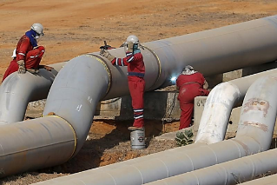
Preventing slips, trips, and Falls in the oil and gas industry
This material was produced under grant number SH-31238-SH7 from the Occupational Safety and Health Administration, US Department of labor. It does not necessarily reflect the views or policies of the US Department labor, nor does mention of trade names, commercial products, or organizations imply endorsement by the US Government
Source: https://www.reuters.com/article/us-venezuela-oil-insight/venezuela-falls-behind-on-oil-for-loan-deals-with-china-russia-idUSKBN15O2BC

Slide 2
Pre-course Assessment Question 1
1. What are the 3 types of fall injuries?
Fall from height, fall at the same level, objects falling on workers
Fall from height, Fall at the same level, Slips without a fall
Falls above 30 feet, Falls between 5 and 30 feet, falls below 5 feet
None of the above

Slide 3
Pre-Course Assessment Question 2
2. What is the best way to prevent fall injuries?
Require tie off practices for all work above 10 feet
Develop, implement, and commit to a fall protection program
Train all workers about fall hazards
Not allow workers to work above 10 feet

Slide 4
Pre-Course Assessment Question 3
3. How many fatalities from falls were reported in the oil and gas industry between 2005 and 2014?
2
28
63
188

Slide 5
Falls
A fall is defined as an event which results in a person coming to rest inadvertently on the ground or floor or other lower level.
Falls are the second leading cause of accidental or unintentional injury deaths worldwide.
Source: http://www.who.int/mediacentre/factsheets/fs344/en/

Slide 6
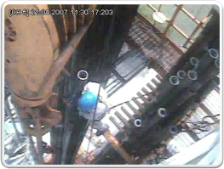
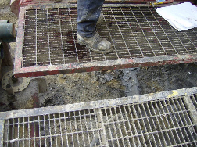
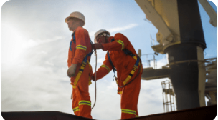
CATEGORIES OF FALLS
There are 3 main categories of falls:
Falls from height
Falls at the same level
Slips or trips without a fall
Source: http://sunnewsreport.com/fall-fatalities-among-oil-gas-extraction-workers/
Source: Photos used with kind permission of Don Linville

Slide 7
How Big of a problem are falls?
Falls are the No. 1 cause of death in the construction industry
Falls are the No. 2 cause of death on the job
$70 billion annually in workers’ compensation and medical costs in the United States
$61 billion per year is spent on disability claims in America
$15.57 billion, or 25.1%, from falls
$10.17 billion, or 65.3% were falls to same level
$5.4 billion, or 34.7% were falls to a lower level
Slips and trips without a fall cost another $2.35 billion, or 3.8%
Source: U.S. Bureau of Labor Statistics 2016

Slide 8
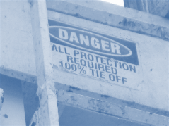
Question / Response
What category of falls cost the most money?
Falls from height
Falls at the same level
Slips or trips without a fall
None of the above
10
Source: Photos used with kind permission of Don Linville

Slide 9
Occupational Fatalities by major event
Source: U.S. Bureau of Labor Statistics 2016

Slide 10
Fall Injuries in Oil and Gas
63 oil and gas extraction workers died from a fall during 2005-2014
Most (52%) fell from a height of 30 feet
Occupations most commonly involved in a fatal fall were derrickmen, working >90 feet
Drilling contractor workers
The largest proportion of fatal fall injuries (38; 60%)
The highest fall-associated fatality rate (4.5 deaths per 100,000 workers)
Fall protection was required for 54 (86%) of the 63 workers, but most (56%) were not wearing it
Among the 24 fatally injured workers who were wearing personal fall protection equipment,
15 (63%) were not attached to an anchor
2 (8%) were not wearing a properly fitted harness
Remaining 7 (29%) had equipment failure
Source: Mason KL,. Retzer KD, Hill R, Lincoln JM. Occupational fatalities resulting from falls in the oil and gas extraction industry, United States, 2005–2014. MMWR Morb Mortal Wkly Rep 2017;66:417–421. DOI: Link to Morbidity and Mortality Weekly Report

Slide 11
Question / Response
What is the most common characteristic of fatal falls in the oil and gas industry between 2005 and 2014?
Falling on the same level
Working as a drilling contractor
Falling to a lower level
Wearing fall protection
Requiring fall protection
10

Slide 12
Risk Factors for a fall
Occupations at elevated heights
Hazardous working conditions
Time constraints/demands
Fatigue
Poor lighting
Alcohol or substance use
Side effects of medication
Physical inactivity
Loss of balance, (esp. older people)
Poor mobility
Poor cognition and/or vision
Unsafe environments
Underlying medical conditions
Neurological
Cardiac
Other disabling conditions
Unsafe acts by worker(s)
Combinations of these factors

Slide 13
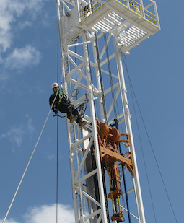
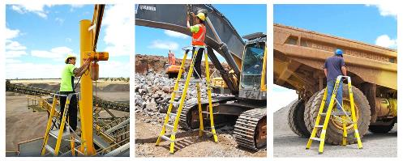
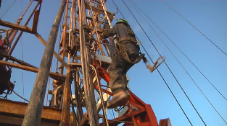
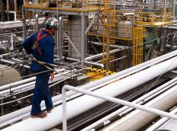
Falls from height
Source: https://www.ntsafety.com/product/work-zone-safety-system/ https://fall-arrest.com/fall-protection-systems/oil-gas-chemical/
https://cdn2.webdamdb.com/310th_sm_JMyRxL2dIL.jpg?1382726796 http://metroforensics.blogspot.com/2017/04/63-oil-and-gas-extraction-workers-died.html

Slide 14
Where do falls from Height happen?
Ladders
Scaffolding
Elevated walkways
Aerial lifts and mobile platforms
Fixed platforms and areas
Climbing on trucks or trailers
Unprotected areas such as piping, equipment, or tanks
Anywhere workers are more than 4 feet off the ground or above openings that are more than 4 feet deep

Slide 15
Fatal Falls from height
Source: U.S. Bureau of Labor Statistics 2016

Slide 16
Question / Response
At what height did most fatal falls occur in 2015?
Less than 15
16-30
>30
Unspecified
10

Slide 17
Distance Rules — Fall Protection Requirements
Under OSHA regulations, fall protection is required when working:
4 feet off the ground with no standard hand rails present (General Industry Standard, applies to "site preparation" of oil and gas sites)
6 feet off the ground with no standard hand rails present (Construction Standard)
Oil and gas drilling fall under the General Industry and/or Construction Standard
Fall Protection should be used as a last choice
Other options are safer

Slide 18
Company-wide Fall Prevention
Develop, implement, and commit to a fall protection program
Provide training on the fall protection program
Evaluate the program on a regular basis
Ensure the program’s effectiveness
Determine whether changes or updates are needed
Where protection is required, select fall protection systems appropriate for given situations
Use proper construction and installation of safety systems
Train workers in the proper selection, use, and maintenance of fall protection systems
Supervise employees properly, using a fall protection competent person in fall protection
Rescue Plan

Slide 19
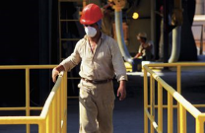
Preventing Falls from Height
Guard or cover any openings or holes as soon as they are created
Construct all floor hole covers so they will effectively support two times the weight of employees, equipment, and materials that may be imposed on the cover at any one time
Guardrail systems (200 # side impact — top rail only)
Safety net systems
Fall arrest systems
Use of aerial lifts (e.g. JLG aerial lifts) instead of ladders or scaffolding
In general, it is better to use fall prevention systems (e.g., guardrails) than fall protection systems (e.g., safety nets or fall arrest devices)
Sources: http://smallbusiness.chron.com/government-agency-osha-fall-under-64161.html and https://www.osha.gov/OshDoc/data_Hurricane_Facts/fall.pdf

Slide 20
Ladder Specific Prevention
Position portable ladders so the side rails extend at least 3 feet above the landing
Secure side rails at the top to a rigid support and use a grab device when 3 foot extension is not possible
Make sure that the weight on the ladder will not cause it to slip off its support
Before each use, inspect ladders for cracked, broken, or defective parts
For portable ladders, use a 4:1 ratio, height to horizontal distance from object that ladder is secured to (i.e., 12 foot climb, set ladder out 3 feet)
Do not apply more weight on the ladder than it is designed to support
Use only ladders that comply with OSHA and ANSI standards
Source: https://www.osha.gov/OshDoc/data_Hurricane_Facts/fall.pdf

Slide 21
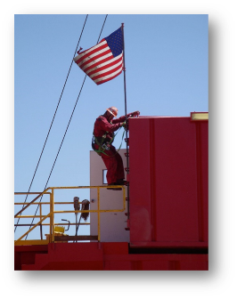
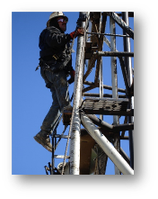
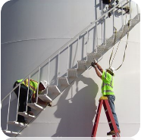
Options for Controlling the Hazard
Eliminate the need to climb where possible
Use control measures (Fall Protection or Prevention)
Protect all those exposed to the hazard

Slide 22
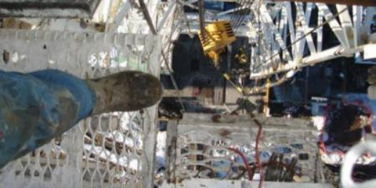
WORKING AT HEIGHTS MAY BE UNAVOIDABLE
Unfortunately, working at height is a necessity in the oil and gas industry.
Some options to eliminate or reduce these hazards:
Installation of equipment
Hand rails
Scaffolding
Covers for openings
Ladder safety training
Fall protection equipment
Fall arrester
Full body harness
Other equipment
Source: Photos used with kind permission of Don Linville

Slide 23
Question / Response
What is the best measure to
prevent falls from height?
Eliminate the hazard
Train workers
As a company develop, implement and commit to a fall protection program
Position portable ladders so the side rails extend at least 3 feet above the landing
Use fall protection
10

Slide 24
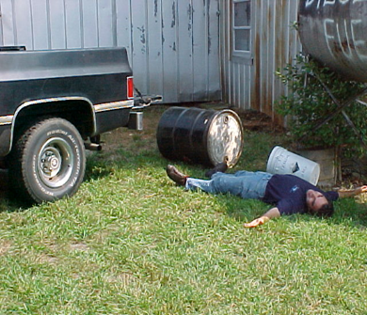
Falls from the same level
A fall from the same level is a slip, trip, or a fall in which the worker impacts
either the surface or an object
at the same level or above the
surface on which he/she is standing.
Source: Photo used with kind permission of Don Linville
Source: https://nfsi.org/nfsi-research/

Slide 25
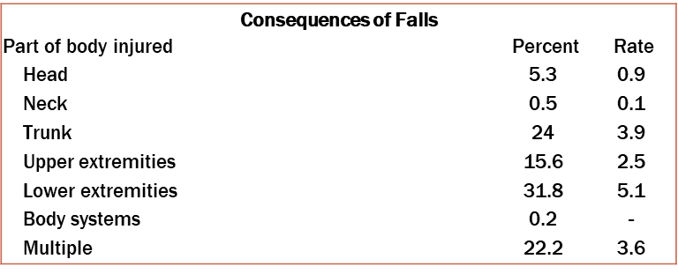
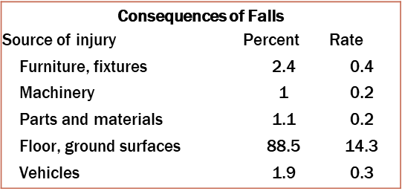
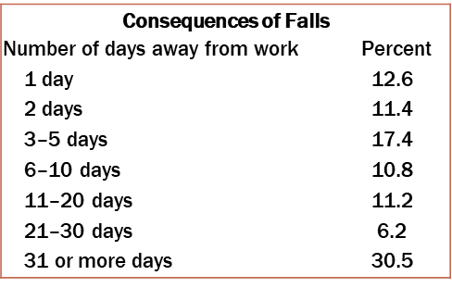
Falls from the same level in 2010
Source: Yeoh, H. T., Lockhart, T. E., & Wu, X. (2013). Non-Fatal Occupational Falls on the Same Level. Ergonomics, 56(2), 153–165. http://doi.org/10.1080/00140139.2012.746739

Slide 26
Standards for slippery floors
Test Method for Measuring Wet Static Coefficient of Friction of Common Hard-Surface Floor Materials (ANSI/NFSI B101.1-2009)
“. . .address the common hard-surfaced flooring materials such as ceramic tile, vinyl floor coverings, and wood laminates, as well as coatings, polishes, etc.”
Source: https://webstore.ansi.org/RecordDetail.aspx?sku=ANSI%2fNFSI+B101.1-2009

Slide 27
Risk Reduction
Provide education and increase awareness
Perform fall risk assessments and implement controls
Organize sustainable housekeeping procedures for inspection, cleaning, and maintenance
Eliminate or minimize the hazards
Provide warning signs for slip hazards
Mark trip hazards
Improve and encourage use of lighting
Discourage carrying of awkward, heavy loads
Avoid rushing and time pressures
Implement risk management protocols for inclement weather (i.e., ice grips for boots, etc.)
Implement risk management protocols for individuals at increased risk of falling
Source: Chang, W.-R., Leclercq, S., Lockhart, T. E., & Haslam, R. (2016). State of science: occupational slips, trips and falls on the same level . Ergonomics, 59(7), 861–883.

Slide 28
Organizational Factors
Require use of suitable footwear
Require use of suitable clothing, including personal protective equipment (PPE)
Implement eye tests and require appropriate use of spectacles
Encourage exercise for strength, coordination, and balance
Adopt occupational health protocols to eliminate or minimize fall risk from prescribed medication
Consider fall risk arising from shift work or unusual work schedules
Source: Chang, W.-R., Leclercq, S., Lockhart, T. E., & Haslam, R. (2016). State of science: occupational slips, trips and falls on the same level . Ergonomics, 59(7), 861–883.

Slide 29
Primary Prevention
Provide slip resistant flooring and surfaces where possible
Design work/activity systems to avoid presence of fall risks (attention to environments, equipment, layouts, tasks, and people)
Cover outside walkways to keep off rain, snow, ice, leaves
Design walkways to exclude trip hazards
Plan pedestrian routes to allow sufficient space between individuals
Separate pedestrians from moving machinery and vehicles
Provide sufficient, convenient space for storage
Avoid need for walking/standing on surfaces that move unpredictably
Install adequate lighting
Design and select environment features to facilitate cleaning and maintenance
Design and select environment features for durability and resistance to damage
Chang, W.-R., Leclercq, S., Lockhart, T. E., & Haslam, R. (2016). State of science: occupational slips, trips and falls on the same level . Ergonomics, 59(7), 861–883.

Slide 30
Question / Response
What can companies do to reduce falls at the same level?
Avoid rushing and time pressures
Provide slip resistant flooring
Mark trip hazards
Install adequate lighting
All of the above
10

Slide 31
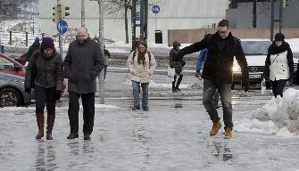
Slips without a fall
Little is known about this cause of injury
Highly litigated
Not well reported or tracked
Presumed to be related to falls at the same level
Prevention measures also presumed to be the same as for falls at the same level
Source: https://yle.fi/uutiset/osasto/news/slip_fall_break_a_leg_-_who_pays/7753944

Slide 32
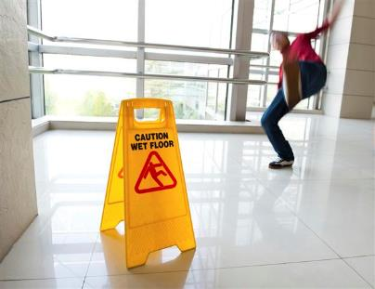
Slips without a fall (Cont.)
Injury types include
Sprains and strains
“Overexertion” type of injuries
Body parts include
Low back
Shoulder
Knee
Other factors include
Carrying objects
Rushing
Environmental factors (wet surface, poor lighting, etc.)
Carelessness or unsafe acts
Source: http://greenshieldfloors.com/uvcoat/

Slide 33
Post-course Assessment Question 1
1. What are the 3 types of fall injuries?
Fall from height, fall at the same level, objects falling on workers
Fall from height, Fall at the same level, Slips without a fall
Falls above 30 feet, Falls between 5 and 30 feet, falls below 5 feet
None of the above

Slide 34
Post-Course Assessment Question 2
2. What is the best way to prevent fall injuries?
Require tie off practices for all work above 10 feet
Develop, implement, and commit to a fall protection program
Train all workers about fall hazards
Not allow workers to work above 10 feet

Slide 35
Post-Course Assessment Question 3
3. How many fatalities from falls were reported in the oil and gas industry between 2005 and 2014?
2
28
63
188

Slide 36
Any Questions?

