Slide 1
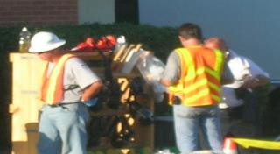
Heat Stress Considerations for workers in the oil and gas industry
This material was produced under grant number SH-31238-SH7 from the Occupational Safety and Health Administration, US Department of labor. It does not necessarily reflect the views or policies of the US Department labor, nor does mention of trade names, commercial products, or organizations imply endorsement by the US Government

Slide 2
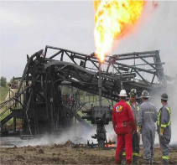
Training pre-assessment
To begin our training on heat stress, let’s consider a few related questions….
True or False?
  Energy drinks are great for avoiding heat stress.
  Conductive heat transfer is usually a site worker’s biggest concern.
  Evaporative cooling rates are never important.
  There is a recommended work-rest regimen.
  Breathable clothing can help reduce heat strain.
Notes:
Much of the oil and gas industry requires outdoor work, this includes Fracking. The hours are typically long, and work days may run 2-3 weeks straight before days off.
Some of the work is strenuous, but much is not, however, there is a lot of moderate exertion throughout the day, such as walking, standing, light lifting, etc.

Slide 3
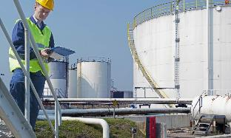
When do heat stress conditions prevail?
Workers experience heat stress when working too hard physically and certain thermal conditions exist — use the right amount of effort for the task at hand.
Find out what thermal conditions exist beforehand
Wear the appropriate personal protective clothing
Keep properly hydrated
Work at the right pace for the job
Notes:
Much of the oil and gas industry requires outdoor work, this includes Fracking. The hours are typically long, and work days may run 2-3 weeks straight before days off.
Some of the work is strenuous, but much is not, however, there is a lot of moderate exertion throughout the day, such as walking, standing, light lifting, etc.

Slide 4
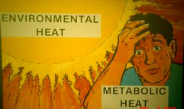
Heat stress versus heat strain
Heat stress is the net heat load to which a worker may be exposed from the combined contributions of:
  Environmental factors
  Metabolic cost of work
  Clothing requirements
  Level of acclimatization
  Overall condition of the worker
Heat strain is the body’s overall response to heat stress, and attempts to dissipate excess heat from the body.
Notes:
Acclimitization is simply “getting used to the temperature”. It works well for hot environments, but not too much for cold.
Acclimitization may require a day or two at the beginning of a work cycle. However, it may be lost in one day of work out of the temperature extreme.

Slide 5
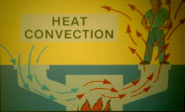
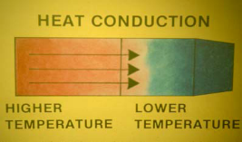
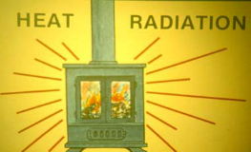
Heat transfer
Heat is always transferred from the object with the higher temperature to the object(s) with the lower temperature, and travels by one or more of three means:
Notes:
Conduction- transfer by touch
Convection- transfer by air movement over a surface
Radiation- transfer by heat waves

Slide 6
Heat stress factors
Environmental factors (external factors):
Temperature: the higher the surrounding temperature, the greater the heat load placed on the body
Humidity: the higher the humidity, the less effective sweat evaporation
Air movement: air movement promotes the evaporation of sweat and convection of heat to the surrounding air
Radiant heat: radiant sources, including the sun, can place additional heat load on the body
Metabolic heat factor (internally generated factor):
Proportional to the intensity of the work performed
Clothing factor:
Different types of clothing can reduce, to varying degrees, the movement of air over the skin’s surface, which impacts heat removal as well as the effects of convection and evaporation
Notes:
Clothing- Oil and gas work typically requires the employee to wear FR (fire retardant) clothing. FR is heavy. It can be loose woven and breathable, but the denim fabrics that most coveralls used in Fracking operations are heavy and not cool.

Slide 7
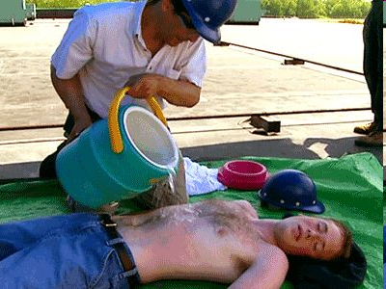
Physiological cooling
Conduction
Convection
Radiation
Evaporation

Slide 8
Question / Response
The transfer of heat by touch is called:
Conduction
Convection
Radiation
Evaporation
10

Slide 9
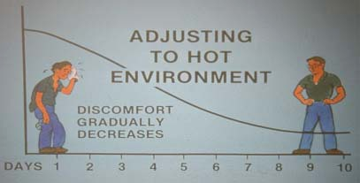
Progression of heat stress issues
Transient heat fatigue
Heat rash
Heat cramps
Heat syncope (fainting)
Heat exhaustion
Heat stroke

Slide 10
Preventing heat stress conditions in the oil/gas industry
Examples of what to avoid:
Heavy and “non-breathable” clothing (if possible)
Working too hard (always work at the rate fit to the task)
Using non-standard work procedures
Not reporting any conditions that could lead to worker heat stress overburden
Improper work-rest regimens
Inappropriate rehydration schedules
WATCH OUT FOR ENERGY DRINKS!

Slide 11
Effects of heat exposure
Sweating, dehydration, salt loss
Loss of ability to work intensively
Loss of hand eye coordination
Increased accident risk
Increased body temperature (>100.4 degrees F)
Heat stroke
Unconsciousness
Death

Slide 12

Warning signs of over-exposure
(Common Signs/Symptoms)
*More Common Signs/Symptoms:
Dizziness
Headache
Nausea
Unsteady walk
Weakness
Muscle cramps
Fatigue
Chills
Immediate Actions:
Remove from heat environment
Allow to rest in shade; fan and spray with water
Loosen clothing
Take sips of water
While doing the above, call for first aid/medic (Medic will monitor temperature and evaluate for mental confusion)
If no medic available, call for ambulance/medical evacuation
*With any signs/symptoms, call for medical evaluation.

Slide 13
Warning signs of over-exposure
(Serious signs/symptoms)
Serious Signs/Symptoms:
Hot body, High temperature
Confusion/Disorientation (mental status assessment)
Vomiting
Involuntary bowl movement
Convulsion
Agitation
Unresponsiveness/Coma
Immediately Call for Medical Evacuation and Perform the Following Actions:
Lay down in shade with feet elevated until medics arrive
Undress as much as possible
Pour cool water over and fan
Cool by best means possible (submerge in water or place on ice packs/sheets)
Give sips of water if conscious
Monitor airways and breathing

Slide 14
Question / Response
Which of the following is typically the most serious form of heat stress?
Heat rash
Heat fatigue
Heat exhaustion
Heat stroke
10

Slide 15
Vulnerability dependent on age
Elderly people and infants are affected more quickly and are the main victims of heat stroke and death
  Focus on mortality in the elderly
Adults working in certain environments are affected: their ability to do work is reduced and their accident risk is increased
  Focus on productivity and economic cost
All ages are affected in their daily activities (e.g., exercise, ability to walk and bicycle)
  Focus on “wellbeing”; interference with daily activities

Slide 16
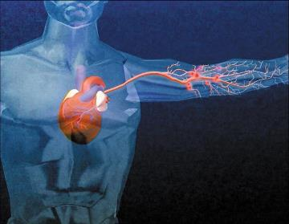
Recognition of heat stroke
The partial or complete failure of the sweating mechanism — the body cannot get rid of excess heat, so the body’s core temperature continues to rise……….
Early Symptoms
High body temperature
Hot, red or flushed, dry skin
Headache or dizziness
Confusion or deliriousness
Advanced Symptoms
Seizure or convulsions
Loss of consciousness
No detectable pulse

Slide 17
Heat disorders – risk factors
The following can increase the possibility of heat disorders:
Physical Factors
Environmental Factors
•Age
•Degree of acclimatization
•Medical conditions such as hypertension
•Weight
•Metabolism
•Type of clothing worn
•Degree of physical fitness
•Use of alcohol or drugs
•Prior heat injury
•Surrounding temperature
•Air movement
•Relative humidity
•Radiant heat
•Conduction

Slide 18
Federal osha standards
There ARE enforceable recommendations under provisions of Section 5 of the OSHAct, or the “General Duty Clause,” which states that each employer:
“...shall furnish to each of his employees employment and a place of employment which are free from recognized hazards that are causing or likely to cause death or serious physical harm to his employees.”

Slide 19
Question / Response
What OSHA standard is used to enforce heat stress issues in the workplace?
Thermal Stress Postulate
General Duty Clause
Ergonomics & Safety Clause
Whistleblower Provision
10

Slide 20

Heat Stress guidelines
American Conference of Governmental Industrial Hygienists (ACGIH) Threshold Limit Value (TLV) for Heat Stress and Heat Strain
Section 2 (screening criteria) — Screening threshold based on Wet Bulb Globe Temperature (WBGT) and work-rest regimen:
  The goal is to never exceed a deep body
  temperature of 38˚C (100.4˚F)
Section 3 (metabolic rate)

Slide 21
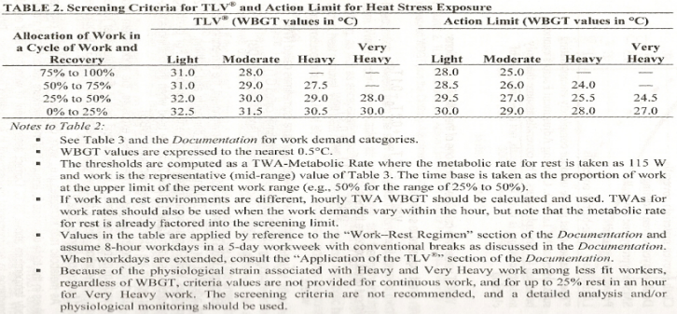
Acgih tlv & action limit for heat stress exposure
(Work-rest regimen)
A proper work-rest regimen ensures some time for recovery

Slide 22
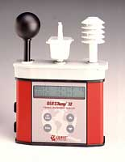
Wbgt heat stress monitor
Digital read-out of:
Dry bulb temperature (T_{db})
Globe temperature (T_{g})
Natural wet bulb temperature (T_{nwb})
Automatically calculates
  WBGT_{in} or WBGT_{out}
  Based upon dial selection
T_{g}
T_{nwb}
T_{db}

Slide 23
Question / Response
What is the deep body temperature that should never be exceeded?
  37 degrees C
  38 degrees C
  39 degrees C
  45 degrees C
10

Slide 24
Wet bulb globe temperature (wbgt)
Accounts for dry bulb (regular temperature), wet bulb (humidity considered), and radiating heat (globe) temperatures
With direct exposure to sunlight:
Your monitored heat stress value is 70% based upon the temperature with humidity considered, 20% based upon the radiating temperature, and 10% based upon the regular air temperature
Without direct exposure to the sun:
Your monitored heat stress value is 70% based upon the temperature with humidity considered and 30% based upon the radiating heat temperature
Notes:
Direct exposure to sunlight will be common for day shift work. The workshift may be 12 hours or more. This will also effect the acceptible exposure.

Slide 25
Acgih tlv for heat stress and heat Strain
(Metabolic rate)
Rest, light work, moderate work, heavy work, and very heavy work activities all have different levels of calories burned and overall metabolic rates
Thus, the allowable heat stress and strain a worker can experience before resting is considered in the calculation
This is how the TLV is established
NOTE: Metabolic rate considerations and calories burned based on activity

Slide 26
Other heat stress guidelines
While the WBGT, work-rest regimens, and established TLVs will be the measure used to determine your exposure to heat stress and strain in our industry, there are other less widely used measures that provide a more individualized assessment of what a worker is experiencing
These are based on additional factors:
  Acclimation
  Sweat
  Physical fitness
  Vital signs
  Hydration

Slide 27
Question / Response
The WBGT monitor measures all of the following except for:
  Dry bulb temperature
  Wet bulb temperature
  Dew point temperature
  Globe temperature
10

Slide 28
Engineering controls
General ventilation is used to cool hot air with water (generally cooler air is brought in from the outside)
Air treatment/air cooling differs from ventilation because it reduces the temperature of the air by removing heat (and sometimes humidity) from the air
Air conditioning is a method of air cooling, but it is expensive to install and operate — an alternative is a chiller
Local air cooling can be effective in reducing air temperature in specific areas (e.g., cool rooms, portable blower with built-in air chiller)
Radiant shielding can be cost-effective in many situations because of the resulting increase in worker productivity
Job redesign to lower worker metabolic rates to reduce heat strain

Slide 29
administrative controls
Alter employee work-rest schedules
Reduce physical activity levels to reduce the amount of metabolic heat internally generated by a worker
Start work shifts earlier (or later) and end work shifts earlier (or later) in the day to avoid work during the hottest part of day
Acclimatize workers
Provide and encourage affected workers to drink fluids to avoid dehydration and encourage them to wear loose-fitting, breathable clothing
Consider shutdown to avoid exposures

Slide 30
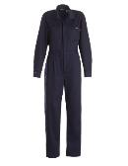
Personal protective equipment/clothing (PPE/PPC)
If possible, wear loose-fitting, breathable clothing
The clothing will typically be determined by your supervisor to fit the job and environment
This is normally the traditional fire retardant clothing (FRC) used in the industry
In all cases, make sure that you always wear all PPE/PPC required for the job!

Slide 31
Question / Response
The use of general ventilation is an example of which type of control?
  Engineering
  Administrative
  Personal protective equipment
  Financial
10

Slide 32
A Comparison Between Traditional
Heat Stress Characterization and a Novel Approach
Problem:
The need for individual-specific heat stress assessments
Current Method of Detection:
Primarily, the Wet Bulb Globe Temperature (WBGT)
Problems with WBGT:
-- Only takes surrounding conditions into account
-- Does not take individual characteristics into account

Slide 33
Importance of individual-specific characterizations
Heat stroke casualties:
  Many people die from heat stroke every year
  Cause of 1,224 deaths in a 7-day period in Chicago, July 1995
  Results in hundreds of emergency room events and hospitalizations per year in the oil and gas industry
Individuals react to thermal stress differently
This impacts everyone (and almost every type of workplace)

Slide 34
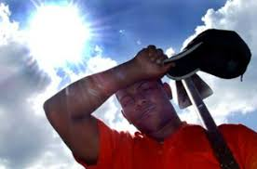
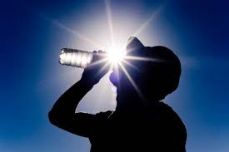
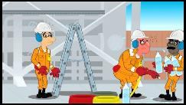
Options for Controlling the Hazard
Eliminate where possible
Use control measures
Protect all those exposed to the hazard

Slide 35
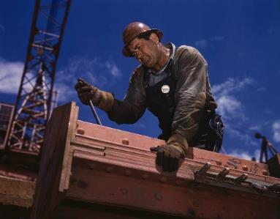
Summary
Unfortunately, working under thermally stressed conditions is a necessity in the oil and gas industry.
Some options to eliminate or reduce these hazards:
  Standard operating procedures
  Proper personal protective clothing
  Appropriate work-rest regimen
  Always stay hydrated
  “Exert for the task….”
  Stay physically fit

Slide 36
Question / Response
All people react similarly to the same level of heat stress.
True
False
10

Slide 37
references
ACGIH. (2017). 2017 TLVs and BEIs. TLV/BEI Publications.
OSHA. Occupational Heat Exposure: Standards. Available at:
OSHA. (2017). Quick Card: Protecting Workers from Heat Stress. Available at: Link to OSHA Quick Card - Protecting Workers from Heat Stress.
OSHA. Occupational Heat Exposure: Heat-related Illnesses and First Aid. Available at: Link to heat-related illnesses and first aid.
link to heat standards.

Slide 38
Any Questions?

Slide 39
Training post-assessment
Now, at the end of our training on heat stress, let’s again consider a few related questions….
True or False?
  Energy drinks are great for avoiding heat stress.
  Conductive heat transfer is usually a site worker’s biggest concern.
  Evaporative cooling rates are never important.
  There is a recommended work-rest regimen.
  Breathable clothing can help reduce heat strain.
Notes:
Much of the oil and gas industry requires outdoor work, this includes Fracking. The hours are typically long, and work days may run 2-3 weeks straight before days off.
Some of the work is strenuous, but much is not, however, there is a lot of moderate exertion throughout the day, such as walking, standing, light lifting, etc.

