Slide 1

Fall Prevention
Susan Harwood Training Grant
Day 2

Slide 2
Disclaimer
This material was produced under grant SH-19506-09-60-F-32 from the Occupational Safety and Health Administration, U.S. Department of Labor. It does not necessarily reflect the views or policies of the U.S. Department of Labor, nor does mention of trade names, commercial products, or organizations imply endorsement by the U.S. Government.
Revisions were made to this material under grant number SH- 31240-SH7 from the Occupational Safety and Health Administration, U.S. Department of Labor.

Slide 3
Test Review-1
Who is primarily responsible for providing employees with a fall protection system?
  The manufacturer of the fall protection system
  The employer
  The employee
  The insurer

Slide 4
Test Review-2
You should report an accident immediately after it occurs so that____
  Someone else can use the machine
  First-aid can be applied if necessary
  Everyone else can see what's going on
  Your supervisor can hide the evidence

Slide 5
Test Review-3
The ultimate responsibility for on-the-job safety rests with______
  You
  Your supervisor
  Human resources
  OSHA

Slide 6
Test Review-4
The most common causes of injury on a construction site are _____
  Fires
  Choking
  Falls
  Faulty equipment

Slide 7
Test Review-5
A floor hole wider than ______ must be protected.
  12 inches
  24 inches
  2 inches
  19 inches

Slide 8
Test Review-6
A fall arrest system is required when a worker is operating at a height of ?
  3 feet or more
  6 feet or more
  10 feet or more
  None of the above

Slide 9
Test Review-7
At what height do open‐sided floors in construction require guardrails?
  1 foot
  2 feet
  4 feet
  6 feet

Slide 10
Test Review-8
An anchorage point for a Fall RESTRAINT system must be capable of supporting?
  5,000 pounds
  1,500 pounds
  12,000 pounds
  3,000 pounds

Slide 11
Test Review-9
When fall arrest equipment is used, employers must assure that _________.
  All equipment is properly inspected before each use
  Users have calculated total fall distance
  A rescue plan is in place to rescue a fallen employee
  All of the above

Slide 12
Test Review-10
What items and/or elements and/or approaches can be legally and safely used to help prevent falls during roof construction activities:
  Guardrails
  Covering holes and openings with sheathing
  Ensuring workers are properly and adequately trained
  All of the above

Slide 13

Lesson Objectives
Fall prevention with scaffolding
Fall prevention with ladders
General review
Rescue planning
Post Test

Slide 14
Scaffolding
An elevated, temporary work platform
3 types of scaffolds
  Supported scaffold : Rigid, load bearing parts, such as poles, legs, frames, and outriggers.
  Suspended scaffold: Suspended by ropes or other non-rigid overhead support.
  Aerial lifts such as “cherry pickers” or “boom trucks”

Slide 15
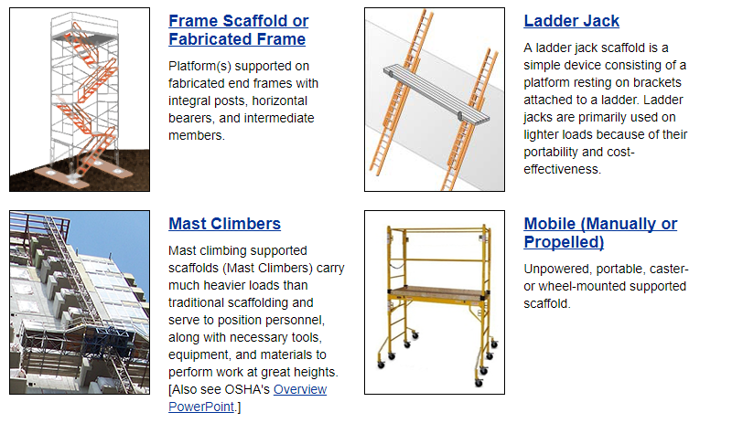
Supported Scaffolding

Slide 16
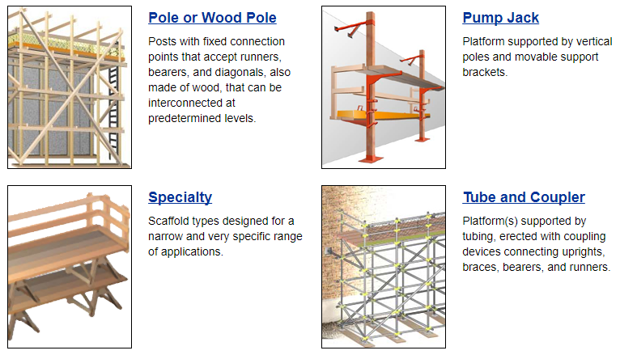
Supported Scaffolding Cont.

Slide 17
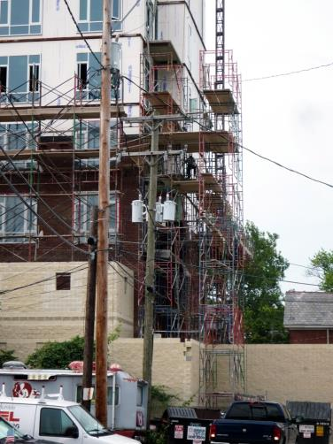
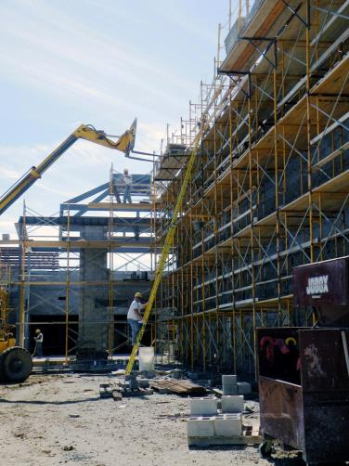
Supported Scaffolding Example

Slide 18
Scaffold Safety Hazards
https:www.youtube.com/watch?v=hJeUbaBdME0
Notes:
Day 2-Slide 18: Fixed Scaffolds-Safety Hazards
Video: https://www.youtube.com/watch?v=hJeUbaBdME0

Slide 19
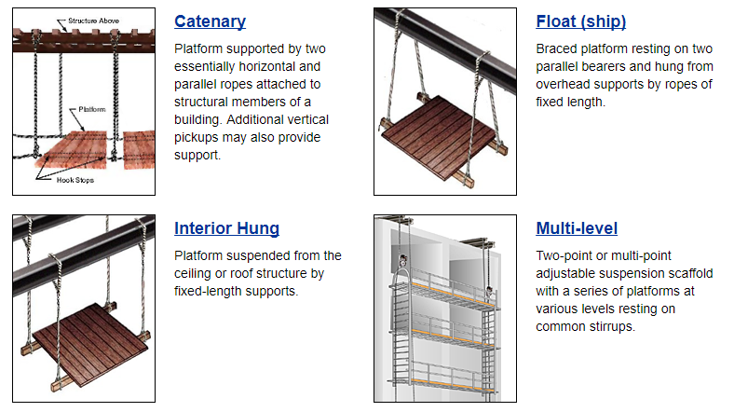
Suspended Scaffolding

Slide 20
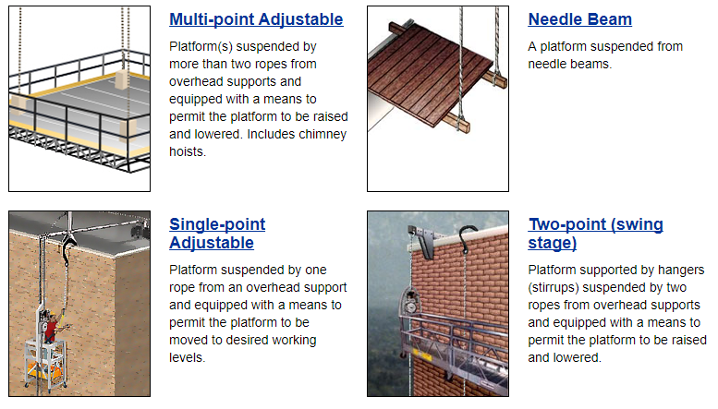
Suspended Scaffolding Cont.

Slide 21
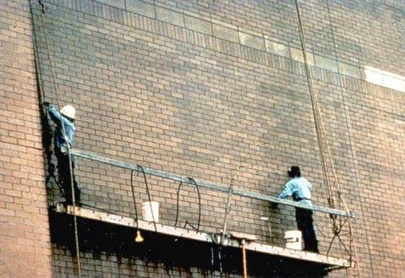
Suspended Scaffold Example-Unsafe

Slide 22
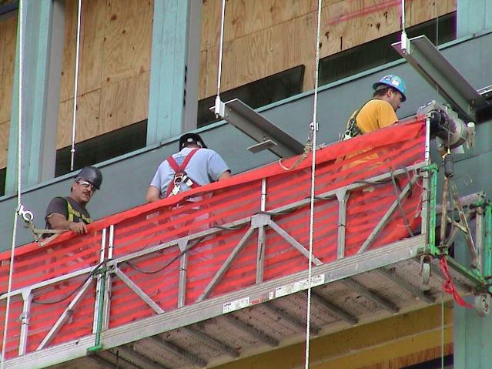
Suspended Scaffold Safe Example

Slide 23
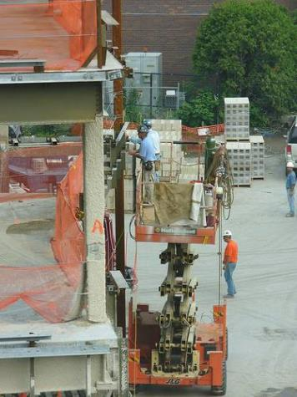
Aerial Lifts
Extendable boom platforms,
Aerial ladders,
Articulating (jointed) boom platforms,
Any combination of the above.

Slide 24
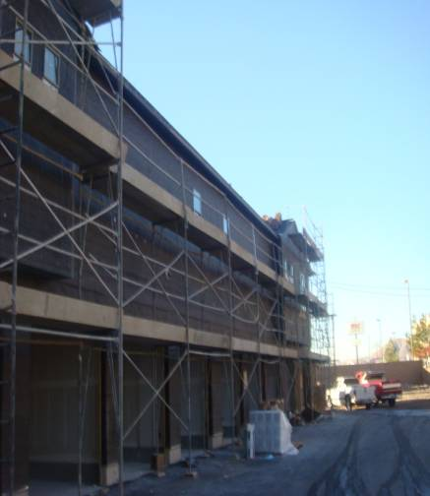
Avoiding Risks
  Always follow manufacturer's instructions
  Install guardrail systems along all open sides and ends of platforms
  Personal fall arrest systems should be used on scaffolds higher than 10 feet
Notes:
Height of the scaffold should not be more than four times its minimum base dimension unless guys, ties, or braces are used.

Slide 25
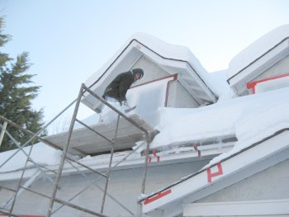
Avoiding Risks Weather
Do not work on snow or ice covered platforms during storms or high winds
Notes:
Height of the scaffold should not be more than four times its minimum base dimension unless guys, ties, or braces are used.

Slide 26
Weather Risks
https://www.youtube.com/watch?v=okS-hXB3jGg
Warning: Video includes inappropriate language
Notes:
Day 2-Slide26: Scaffolding Falling Off Building Downtown Portland, Oregon
Video: https://www.youtube.com/watch?v=okS-hXB3jGg

Slide 27
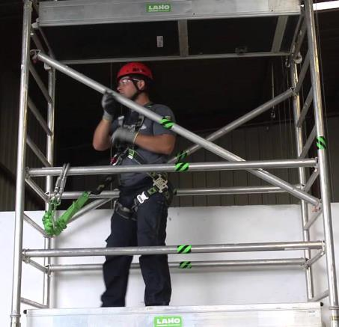
Scaffolding Construction
Proper scaffold with a guard rail and a personal fall arrest system

Slide 28
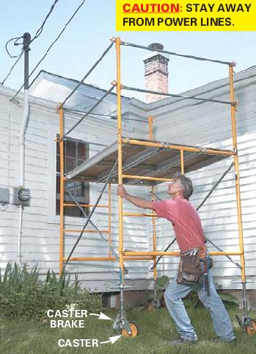
Scaffolding and Power Lines
Improper scaffold: Too close to the power lines

Slide 29
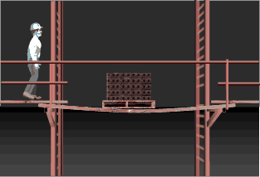
Accidents Waiting To Happen
Inappropriate climbing on or off the scaffold
When working on unguarded scaffold platforms
Not checking platforms or planks for safety

Slide 30
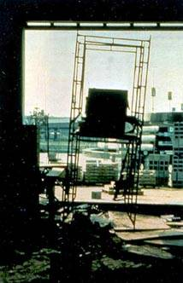
Dangerous Scaffolding!
Should be erected on an even and stable surface
Notes:
The scaffold is not erected on an even base.

Slide 31

Falling Objects
  Wear hardhats
  Barricade area below scaffold
  Use panels or screens if material is stacked higher than the toe board.
Notes:
Toe board is the board used at the bottom side edge of the scaffold. If the material is stacked above it, there is a possibility that the materials will fall below and can hurt the workers worker below the scaffold.

Slide 32
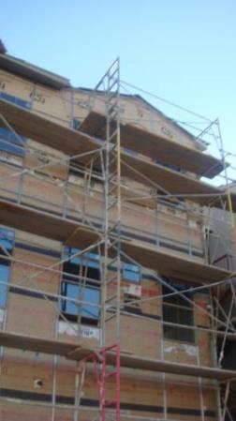
Platforms and Planks
  There are many requirements for construction of a scaffold to reduce your risk of falling
  Planks must be at least 18 inches wide
  Each plank end that abuts another must rest on a separate support surface
  Planks must be made of scaffold grade wood
Notes:
Planks must be at least 18 inches wide.
Each abutted end of plank must rest on a separate support surface
Overlap platforms at least 12 inches over supports, unless restrained to prevent movement.
Only scaffold grade wood is to be used
Each end of a platform, unless cleated or otherwise restrained by hooks, must extend over its support by at least 6 inches.

Slide 33
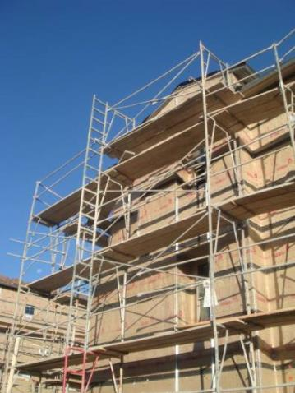
Proper Access
Proper access
  Special ways to get on and off must be provided when scaffold platforms are more than 2 feet above or below a point of access.
  No access by cross braces
  Types of access permitted are:
    Ladders, such as portable, hook-on, attachable, stairway type, and built-ins
    Stair towers
    Ramps and walkways
Notes:
2 feet above or below a point of access made clear from the next slides

Slide 34
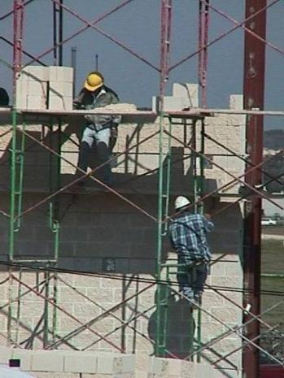
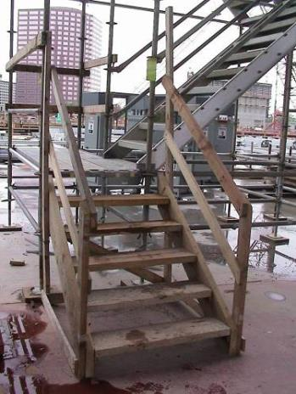
Scaffolding Access
Bad
Better
Notes:
Adequate, safe access must be provided when elevation changes more than 2 ft on scaffolds. Climbing cross braces is specifically disallowed, and can be very dangerous. The photo on the left shows wrong way of accessing the scaffolds. The photo on right shows the correct way of accessing the scaffold, when the they are above 2 ft above the access point

Slide 35
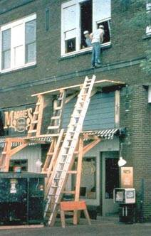
What is wrong with this picture?

Slide 36
Scaffolding and
Fall Prevention Measures
No Sound Video https://www.youtube.com/watch?v=FyD5mpovxaw
Notes:
Day 2-Slide 36: HAKI Universal Suspended Scaffold
Video: https://www.youtube.com/watch?v=FyD5mpovxaw

Slide 37
Scaffolding and PFAS Demo
Video – no sound
https://www.youtube.com/watch?v=w3Pb_FC9AfU
Notes:
Day 2-Slide 37: Energy absorbing fall arrest lanyard on scaffolding
Video: https://www.youtube.com/watch?v=w3Pb_FC9AfU

Slide 38

Ladders
360 deaths every year
151,327 reported injuries per year caused by falls from ladders
Result of careless or improper ladder use
Follow safe practices to work safely

Slide 39
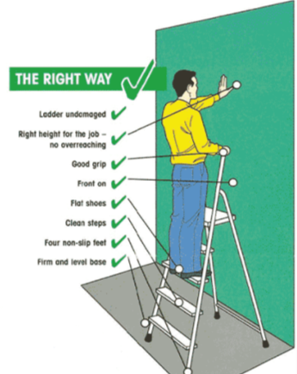
Is it safe enough? Do’s!
Run this quick check on any ladder you are thinking of buying, or using:
  Is it sound? (clean, dry, free from wet paint, oil, mud, etc).
  Are there cracks?
  Are there rungs missing or loose?
  Is it painted?

Slide 40
Is it safe enough? Don'ts!

Slide 41

Are YOU up to the job?
Do not overestimate your physical abilities!

Slide 42
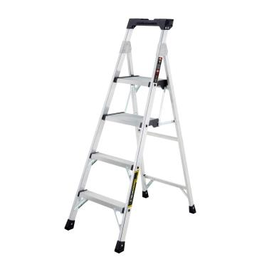
Loads
Foldout and Leaning Ladders:
  Must be able to withstand 4 times the maximum intended load
Extra Heavy Duty or Plastic Ladders:
  Must be able to sustain 3.3 times the maximum intended load

Slide 43

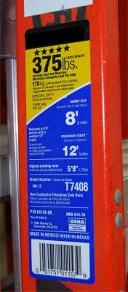
Ladder Labels

Slide 44
Angles
Non Self Supporting Ladders
  Must lean against a wall or other support
  No more than ¼ of the working length of a horizontal distance at the base
Job Made Wooden Ladders
  Angle should equal about ½ of the working length

Slide 45
Angle Demonstration
Day 2-Slide 45: Ladder Safety-How To Use An Extension Ladder Safely
Video: https://www.youtube.com/watch?v=GKNG_Ymf_dk
Notes:
Day 2-Slide 45: Ladder Safety-How To Use An Extension Ladder Safely
Video: https://www.youtube.com/watch?v=GKNG_Ymf_dk

Slide 46
Rungs, Cleats, or Steps
Must be parallel, level, and uniformly spaced
Rungs Spacing:
  Must be 10”-14” apart
  Trestle ladders must be 8”-18” for the base and 6”-12” inches on the extension
Rungs should be shaped so foot does not slide and be slip resistant

Slide 47
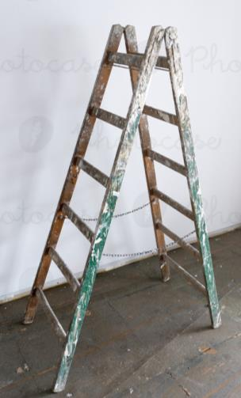
Slipping
Kept free of oil, grease, wet paint, etc
Wood ladders must not be coated with opaque covering
  Except for warning labels on one side

Slide 48
Other Requirements
Fold out or step ladders must have metal spreader or locking device
When using two or more ladders to reach a work area, they must be offset with a landing or platform between ladders
Area around top and bottom of ladders must be kept clear

Slide 49
Portable Ladder Grades
There are 3 grades of portable ladders:
  Type 1 - Heavy-duty construction use
  Type 2 - Medium duty
  Type 3 - Home use, not for construction but contractors like to use them.

Slide 50
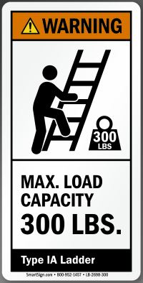
Portable Ladder Type 1
Used for professional services: contractors, public utilities, and construction workers
Lengths of 3 to 20 feet
Has 3 subcategories:
  Type 1-Loads up to 250 lbs
  Type 1A-Loads up to 300 lbs
  Type 1AA-Loads up to 375 lbs
Heavy duty use

Slide 51

Portable Ladder Type 2
Used for commercial services: painters, interior decorators, maintenance workers, electricians.
Lengths of 3 to 20 feet
Loads capacity to 225 lbs
Medium duty type use

Slide 52

Portable Ladder Type 3
Used for household purposes
Lengths of 3 to 6 feet
Load capacity of 200 lbs
Light duty use

Slide 53
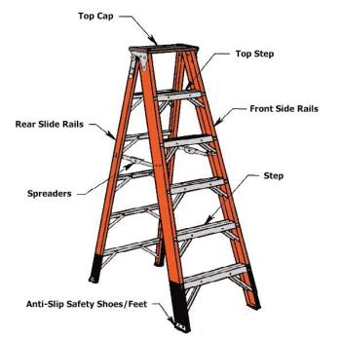
Step Ladders
Self supporting, portable, A-frame

Slide 54
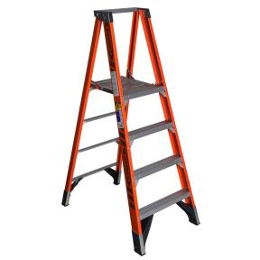
Platform Ladders
Used for Special purposes
Has a large stable platform from which you can work while standing.

Slide 55
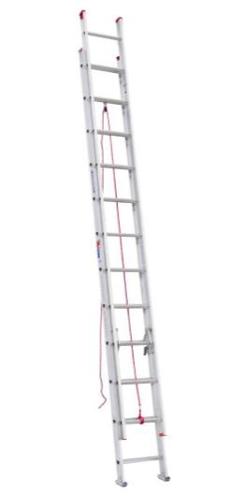
Extension Ladder
Extension ladders are not self-supporting and are adjustable in length.

Slide 56
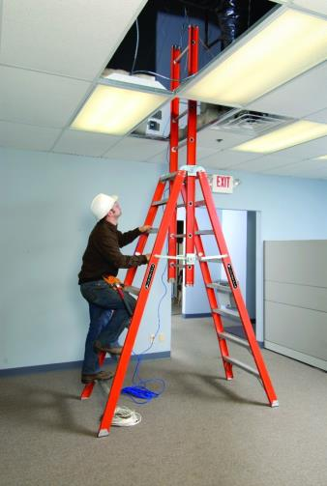
Trestle Ladders
Self-supporting ladders that are not adjustable in length and have two hinged sections at the top so the legs form equal angles at the ladder’s base

Slide 57
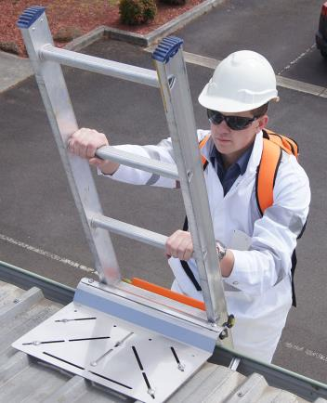
Going Up and Down Ladders
Face ladder at all times
Grasp side rails with both hands
Keep body between side rails
Never climb higher than 3rd rung from the top

Slide 58
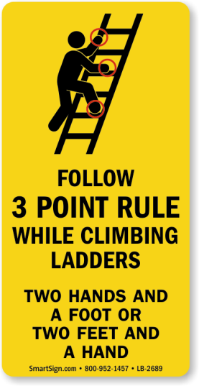
Going Up and Down Ladders Cont.
Raise and lower heavy, awkward loads with a hand line or hoist
Attach light, compact tools or materials to the ladder or to yourself
Use the 3 point rule

Slide 59

Other Ladder Safety
Use nonconductive side rails such as wood or fiberglass when working near energized electrical lines
Avoid setting ladder near exit doors
Avoid using ladder near the path of pedestrian or vehicular traffic

Slide 60
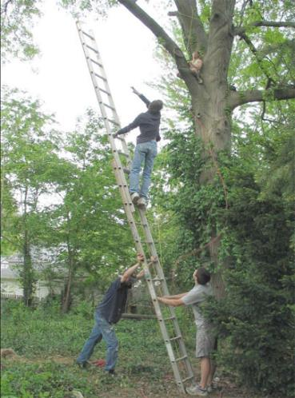
Ladder Don’t

Slide 61
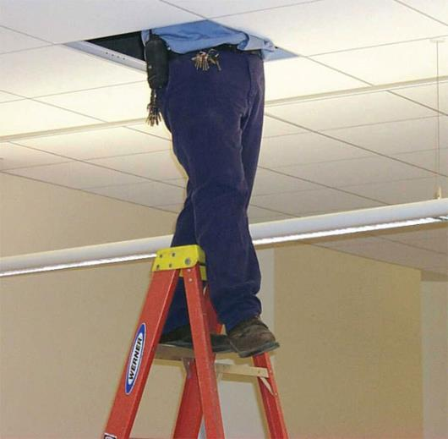
Ladder Don’t Cont.

Slide 62
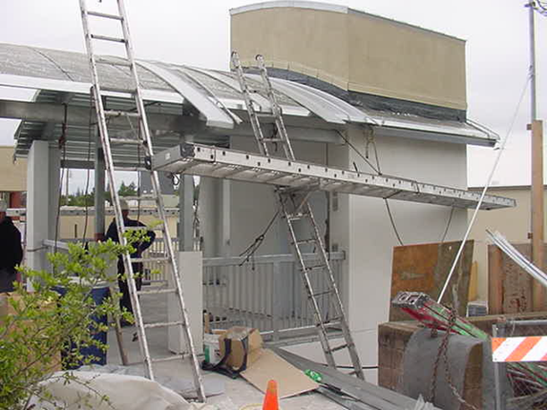
Ladder Don’t Ever

Slide 63
No Safety, Know Pain
https://www.youtube.com/watch?v=Tbr_jjNUAfI
Notes:
Slide 63: People Falling Off Ladders Compilation (Possibly Funny) - Not really
Video: https://www.youtube.com/watch?v=Tbr_jjNUAfI

Slide 64

Fall Prevention Planning
Assess fall hazards in the work area
Fall protection applications employees will use
Correct procedures for use of PFAS
Correct procedures for handling, storage, and securing of tools and materials
Training methods for employees
Rescue plan
Plan must be jobsite specific
Fall protection plan must be available to all employees

Slide 65
Fall Prevention Training
Employers shall provide training for each employee exposed to fall hazards
Each employee shall be trained by a competent person
  Nature of all fall hazards in the work area
  Correct procedures for erecting, maintaining, disassembling, and inspecting FPS
  Use of all fall protection systems
  Role of each employee when systems are being used

Slide 66
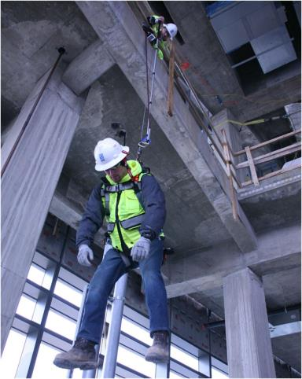
Fall Rescue Planning
Addresses the procedures, equipment, and personnel needed to rescue when a fall occurs

Slide 67

Suspension Trauma
Body weight causes pressure against harness
Reduces blood flow to heart
Worker can lose consciousness within minutes

Slide 68
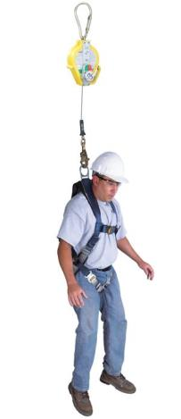
Rescue Techniques
Aided Rescue
Self-Rescue

Slide 69
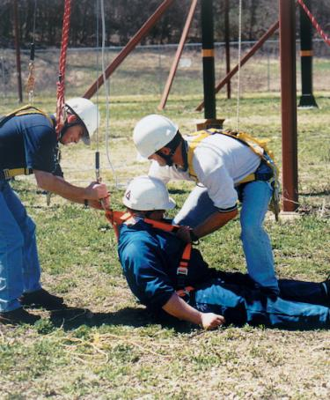
Aided Rescue
Suspended from a lifeline
Will need help from trained rescuers
May need medical attention

Slide 70
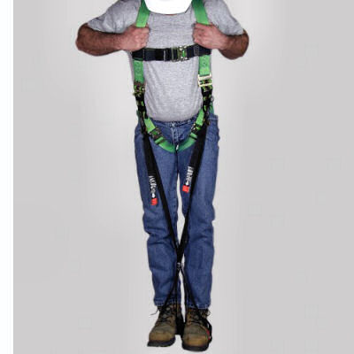
Self Rescue
Worker can take steps to minimize trauma
Temporarily relieve pressure on legs
May attempt to lower themselves to lower level

Slide 71
Self Rescue Demo
Show a self rescue video
Notes:
Show a Harness Self Rescue after fall

Slide 72
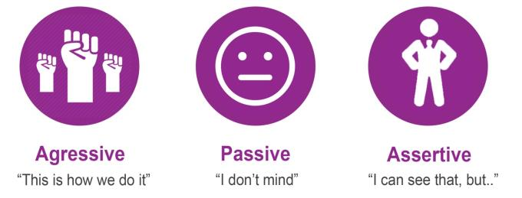
Communication Styles
  Aggressive: Dominating
  Passive: Submissive
  Assertive: Respectful

Slide 73
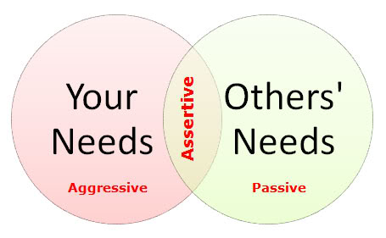
Assertive Communication
Clearly states opinions and feelings
Values and respects themselves and others

Slide 74

Assertive Communication Cont.
Don’t get angry; stay calm
Stick to the facts. (“That task is a fall risk.”)
State your position clearly without raising your voice
Seek compromise if possible

Slide 75
Practice Assertiveness

Slide 76
Fall Prevention Review
If you can fall more than 6 feet, you must be protected.
Use fall prevention on:
  Walkways & ramps, open sides & edges, holes, concrete forms & rebar, excavations, roofs, wall openings, bricklaying, residential construction
Protective measures include:
  Guardrails, covers, safety nets, and Personal Fall Arrest Systems

Slide 77
Test Review-11
Inspections of scaffolds must be conducted?
  By a competent person
  Before each work shift
  After scaffold is erected or modified
  All of the above

Slide 78
Test Review-12
If you are going to step onto a platform or roof, the top of the ladder should extend at least _____ feet above the point where the ladder touches the upper landing surface.
  2
  3
  4
  5

Slide 79
Test Review-13
A type 1A ladder is rated for _____ use.
  200 pounds, light duty/household
  225 pounds, medium duty/commercial
  250 pounds, heavy duty/industrial
  300 pounds, extra heavy duty/professional

Slide 80
Test Review-14
When should ladders be inspected?
  Each day before use
  At least once a week
  At least once a month
  At least once a year

Slide 81

Post Test Time!

Slide 82

Evaluation

Slide 83

THANK YOU!

