Slide 1
EXCAVATION & TRENCHING AWARENESS FOR THE CONSTRUCTION INDUSTRY

Slide 2
Disclaimer
This material was produced under grant number SH-31227-SH7 from the Occupational Safety and Health Administration, U.S. Department of Labor. It does not necessarily reflect the views or policies of the U.S. Department of Labor, nor does mention of trade names, commercial products, or organizations imply endorsement by the U.S. Government.

Slide 3
Objectives
Identify the laws, regulations, and standards as they apply to excavations
Describe soil classification and the testing used to determine type
Describe protective systems used in excavations
Discuss the hazards found in trenches
Describe the role of the competent person

Slide 4
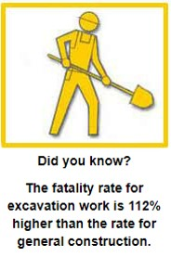
Facts
Excavating is recognized as one of the most hazardous construction operations
Cave-ins can happen without warning
All of the fatalities and injuries could have been prevented

Slide 5
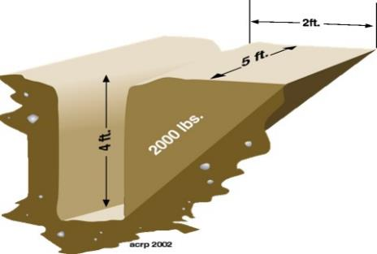
Collapse Forces
24 inches of soil on a person’s chest weighs 750-1000 lb.
18 inches of soil covering a body weighs 1800-3000 lb.
Shear wall collapse speed is 45 mph
1 cubic foot of soil can weigh from 100 to 125 lb.
Notes:
HOW MUCH CAN YOU LIFT, how well can you breathe
HOW MANY BREATHS CAN YOU TAKE
THINK YOU CAN OUT RUN IT
8” WATER MAIN CAN FLOW 19,000 GPM AT 100 PSI
CAN FILL A TRENCH 4X12X25 IN 24 SECONDS
VW HITTING YOU AT 45MPH
PAST PRACTICES
JUMP INTO TRENCH
F/F ARE ACTION ORIENTED
COMPASSION KILLS
INADEQUATE SHORING
CHEAPER TO PAY DEATH BENEFITS
LOCK OUT/ TAG OUT

Slide 6
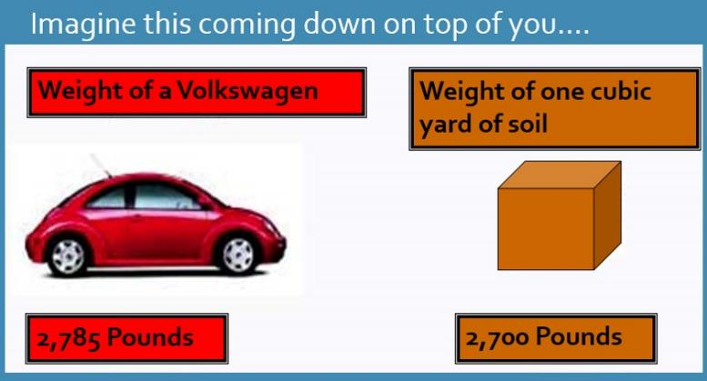
Collapsing Dirt

Slide 7
The Top Five Trenching Hazards
Cave – ins
Overhead Electric Line Contact
Falls into Excavations
Equipment Falling into Excavations
Explosion / Fire / Electrocution

Slide 8
Legal Aspects
OSHA [29 CFR 1926.650 - 652]
Excavation standard applies to all open excavations made in the earth’s surfaces including trenches, all surface encumbrances that would create a hazard, and protective systems

Slide 9
General Requirements
OSHA1926.651
(a) Surface encumbrances
(b) Underground installations
(c) Access & egress
(d) Exposure to vehicle traffic
(e) Exposure to falling loads
(f) Warning systems for mobile equipment
(g) Hazardous atmospheres
(h) Protection from hazards associated with water accumulation
(i) Stability of adjacent structures
(j) Protection from loose rock or soil
(k) Inspections
(l) Fall protection

Slide 10
General Requirements
Surface Encumbrances
All surfaces encumbrances that are located so as to create a hazard to employees shall be removed or supported as necessary to safeguard employees
Underground Installations
Utility companies shall be contacted with in established local response times
Advised of proposed work
Asked to establish location of utility
When request cannot be met, employer may proceed with caution with detection equipment of an acceptable means to locate utility

Slide 11
General Requirement
Underground Installations
While the excavation is open, underground installations shall be protected, supported or removed as necessary to safeguard employees
Access & Egress
Structural ramps
Used by employees shall be designed by a competent person
When used for equipment shall be designed competent person qualified in structural design
Stairway, ladder, ramp or other safe means of egress require no more than 25 ft of lateral travel for employees in excavations that are 4 feet or more in depth
Ladders must be secured and extend a minimum of 36 inches above the landing

Slide 12
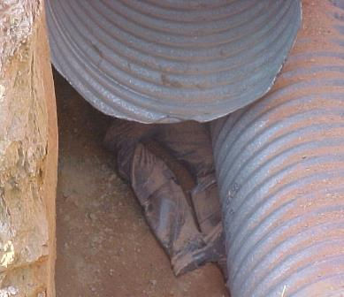
GeneralRequirement
Exposure to vehicle traffic
Employees exposed to public vehicle traffic shall be provided with and wear warning vests or other suitable garments
Marked or made with reflectorized or highly visible material
Requiring a designated, trained flag person along with signs, signals, and barricades when necessary
Exposure to falling loads
No employee shall be permitted underneath loads handled by digging or lifting equipment
Stand away from vehicle being loaded or unloaded to avoid being struck
Notes:
Victim was working underneath load being moved

Slide 13
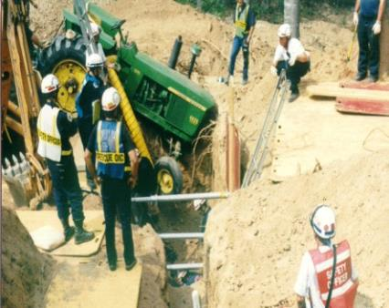
General Requirements.
Warning systems for mobile equipment
When operator does not have clear view of edge of excavation
Warning system shall be utilized
Barricades
Hand or mechanical signals
Stop logs
Notes:
Victim was ejected from tractor into the trench (lower center )
How much vibration does a concrete truck put on the side of a trench when mixing his load. Enough to cause collapse?

Slide 14
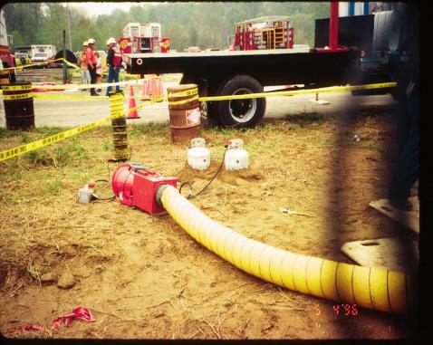
General Requirements..
Hazardous Atmospheres
Testing and controls
To prevent harmful levels of atmospheric contaminants
Less than 19.5% or more than 23.5% oxygen
Atmosphere tested before entry
Adequate precautions shall be taken
Ventilation
Proper respiratory protection
Testing done often as necessary
Notes:
TEST IN MULTIPLE LEVELS – TOP/MIDDLE/BOTTOM ( SAME AS CONFINED SPACE)
Monitoring for hazardous atmospheres
Ventilation Blowers-Propane system for heated ventilation

Slide 15
Emergency Rescue Equipment
Rescue equipment
Breathing equipment
Safety harness and line or basket stretcher
Must be readily available
Must be attended
Bell-bottom pier holes, deep and confined footing excavation shall wear a harness with a lifeline securely attached to it

Slide 16
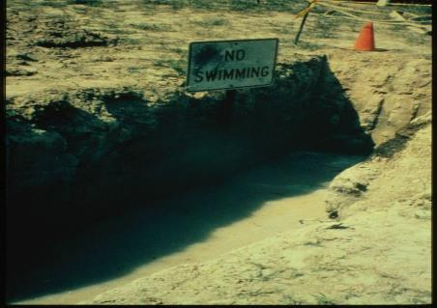
General Requirements…
Water Accumulation
Employees shall not work in excavations where there is accumulated water, or where water is accumulating, unless adequate precautions have been taken, to protect employees.
Notes:
Well point system to lower ground water, pipes placed in ground to pump out water
How much water is too much?

Slide 17
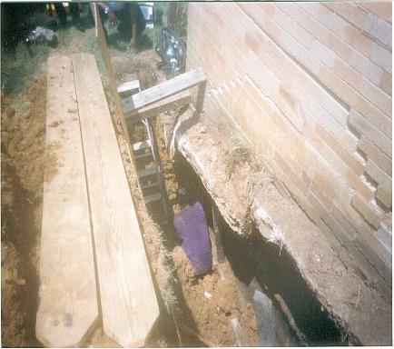
General Requirements….
Stability of adjacent structures
Where stability is endangered by excavation operations
Support systems such as shoring, bracing or underpinning shall be provided
Sidewalks, pavement and appurtenant structures shall not be undermined unless support systems are used to protect employees
Notes:
Worker buried up to his waist, beneath concrete and brick veneer collapsing

Slide 18
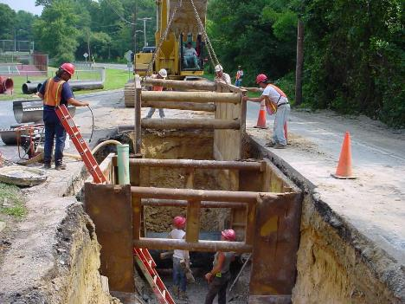
General Requirements…..
Protection from loose rock and soil
Hazard from falling or rolling from excavation face
Scaling to remove loose materials
Installation of protective barricades
Other means (retaining devices)
2 feet from edge of excavation
Notes:
Good – protective system in place, ladder, water removal, no one under moving load.

Slide 19
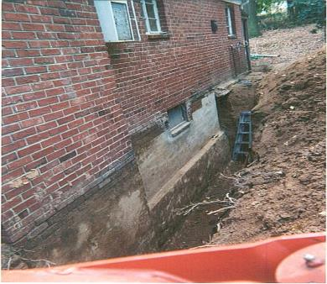
General Requirements….
Inspections
Daily and before start of work
As needed throughout the shift
After snowstorms, windstorms,thaw, earthquake
Employees shall be removed until precautions have been taken
When fissures, tension cracks, sloughing undercutting, water seepage, bulging at the bottom
Change in size, location or placement of the spoil pile
Indication of movement in adjacent structures
Notes:
Who inspected this trench? Ladder to short, no protective system, soil pile to close

Slide 20
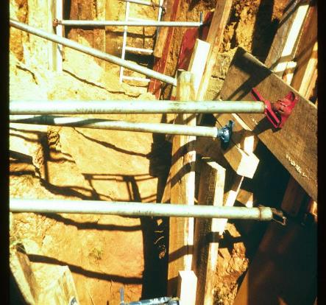
General Requirements
Fall protection
If walkway provided
Where employees permitted to cross, guard rails provided where 6 feet or more above lower levels
Fall protection standard
Requirements of Protective Systems
Employees shall be protected from cave-in by an adequate protective system except;
Entirely in stable rock
Less than 5 feet in depth with no indication of cave-in
Notes:
How many laws are broken here? Screw Jack used for cross member must be in trench to install

Slide 21
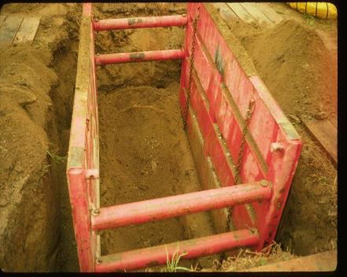
Protective System Designs using Manufacturers Data
Deviation will only be allowed after manufacturer issues specific written approval
Written form at the job site during construction
Trench Boxes: Make sure all cross members and safety pins are used when necessary
Notes:
Trench Boxes: Make sure all cross members and safety pins are used when necessary

Slide 22
Installation & Removal
Excavate to no greater than 2 feet below – only if system is rated at full depth and there are no indications of a loss of soil from behind or below the support system
Employees are not permitted to work below other employees unless adequately protected from falling, rolling, sliding material
Employees are not allowed in shields when installed, removed or moved vertically

Slide 23
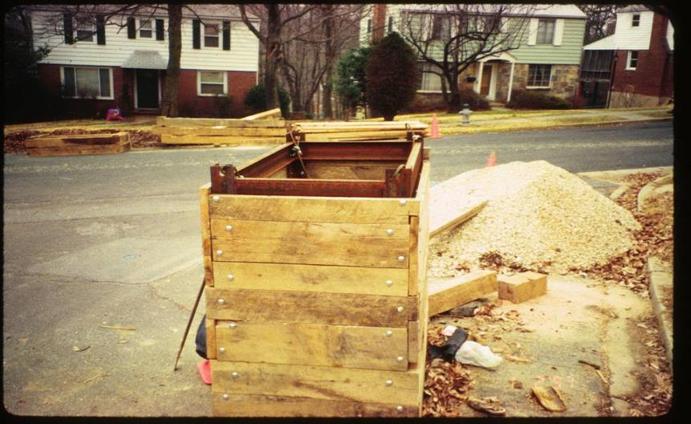
Not a certified trench box. Made by laborers on site

Slide 24
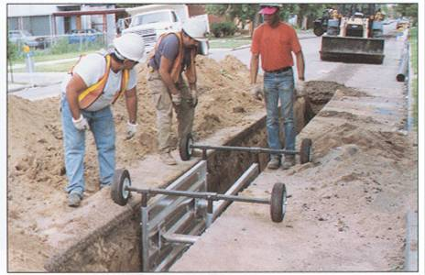
Good – easy system to use, a lot of work done quickly. Bad – not tall enough, no ladder

Slide 25
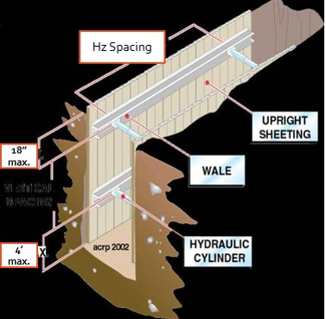
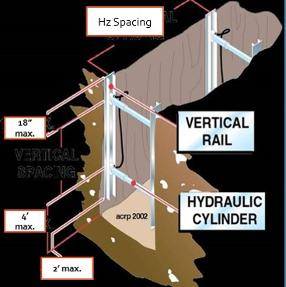
Horizontal and Vertical Shoring Dimensions
Hz. Shoring Dimensions
Vt. Shoring Dimensions

Slide 26
SHIELD USAGE AND SAFETY Shields are used to protect workers from cave-ins, not to provide support for the trench.
Manufacturer’s Data must be present at work site.
Top of the shield must extend to the top of the trench.
If used with sloping, top of shield must extend 18 inches above vertical trench walls.
Shields may be stacked, provided the bottom one is rated for the total depth of the trench.
The trench may be dug 2 feet lower than the shield bottom, but the shield must be rated for that depth.
Backfill around the box to prevent lateral movement.
Notes:
Trench boxes must be designed to be stacked.You can put any box on top of another

Slide 27
Soil Classifications
Stable rock
Natural solid mineral material that can be excavated with vertical sides and remain intact while exposed. Examples are granite and sandstone.
Type A
cohesive soils with an unconfined compressive strength of 1.5 tons per square foot [tsf]
Clay, silty clay, sandy clay
No soil is type A if;
Fissured
Subject to vibration
Previously disturbed
Seeping water
Part of a sloped or layered system of four horizontal to one vertical
Notes:
NO SOIL IS A, IF FISSURED, SUBJECT TO VIBRATION,
PREVIOUSED DISTURBED,SEEPING WATER
SOIL TEST VISUAL-
SIDES OF TRENCH FOR LAYERING
EVIDENCE OF WATER
PREVIOUSLY DIETURBED SOIL
TENSION CRACKS, SPALLING, BOILING
MANUAL TEST
PLASTICITY
DRY SRRENGTH
THUMB PRENETRATION

Slide 28
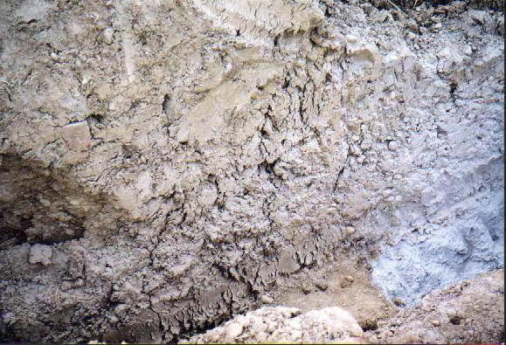
Soil Fissuring
Notes:
How soon will it fail?

Slide 29
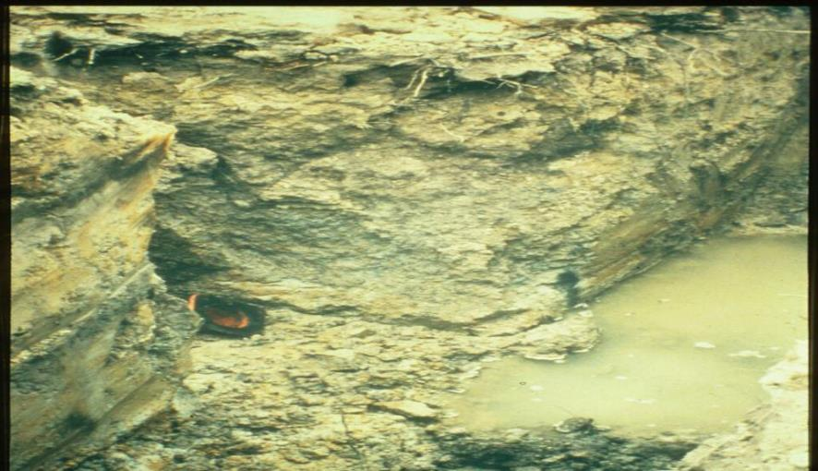
To Much Water?
Notes:
What do you have to do to make this trench safe?

Slide 30
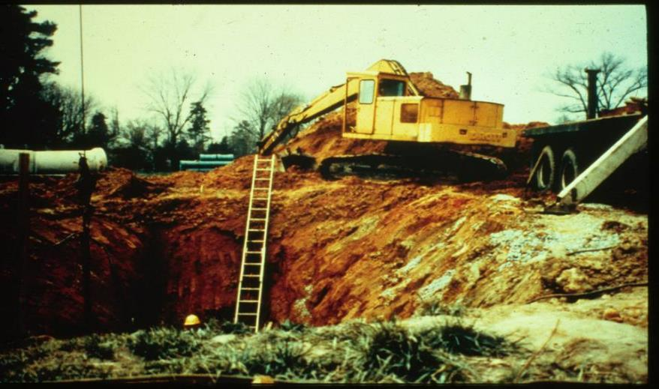
Weight and Vibration
Notes:
How much pressure does it take from an outrigger to make this trench fail

Slide 31
Soil Classification
Type B
cohesive soils with an unconfined compressive strength greater than 0.5 tsf but less than 1.5 tsf
Silt, silt loam, angular gravel
soils that are fissured, or subject to vibration
Type - C
cohesive soils with a unconfined compressive strength of 0.5 tsf or less
gravel, sand, loamy sand, submerged soil, soil from which water is freely seeping
Notes:
PREVIOUSLY DISTURBED UNLESS CLASSIFIED AS C. Define Silt and Loam type soils

Slide 32
Basis of classification
The classification of deposits shall be made based on the results of at least one visual and one manual analysis conducted by a competent person

Slide 33
Acceptable visual test
Determine qualitative information on site in general
Soil adjacent to excavation
Soil forming the sides of the open excavation
Soil taken as samples from excavated material
Estimate range of particle sizes
Observe evidence of surface water
Water seeping from the sides
Location of the level of the water table
Sources of vibration that may affect stability
Evidence of previously disturbed soil

Slide 34
Acceptable manual test
Plasticity
Ribbon and thread test
Dry strength test
Thumb penetration test
Other strength test
Pocket penetrometer
Hand-operated shearvane

Slide 35
Field Sedimentation Test
Determines sand content
Used only on sandy soils
Flat bottom container - at least 7 inches high (old olive jar)
1 1/2 to 2 inches of soil
Place soil in the glass jar
5 inches of water on top of soil

Slide 36
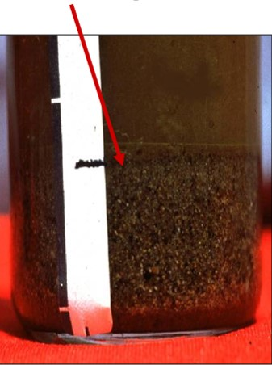
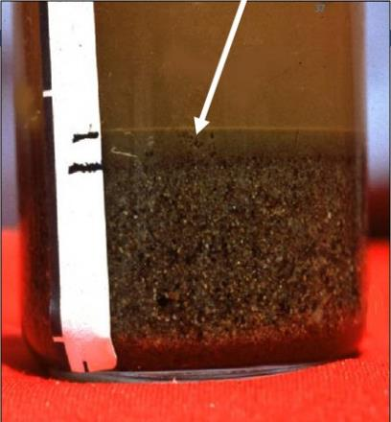
Example
After 30 seconds granular sand type material settles at the bottom
After 3 minutes silt type material settles on top of the sand

Slide 37
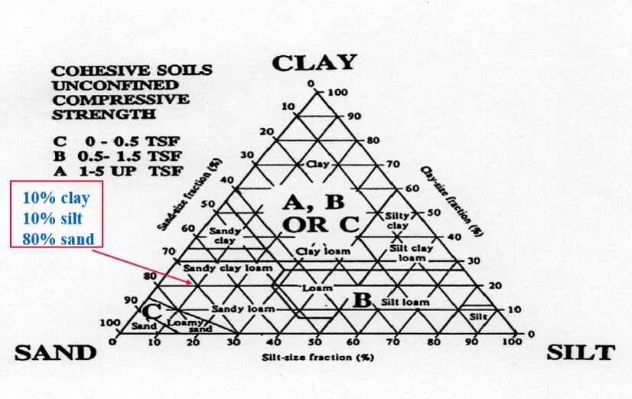
Compressive strength

Slide 38
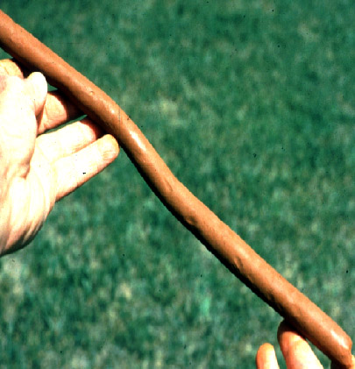
The Ribbon Test
Run only on that part of the soil which passes # 40 sieve
Mix soil + water to make into plastic mass
Roll mass into cylindrical shape 1/2 to 3/4 inch diameter
Lay across palm of hand
Press between thumb and second joint of index finger

Slide 39
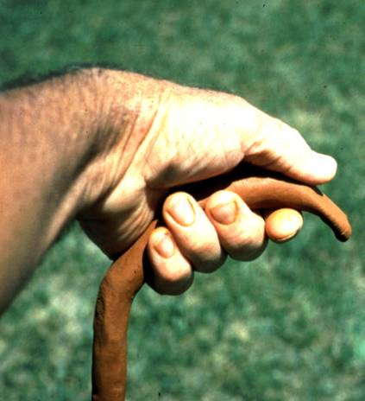
The Ribbon Test (continued)
Pass through thumb
Squeeze until it takes the shape of a 1/8 to 1/4 inch thick strip
Allow to hang freely from hand

Slide 40
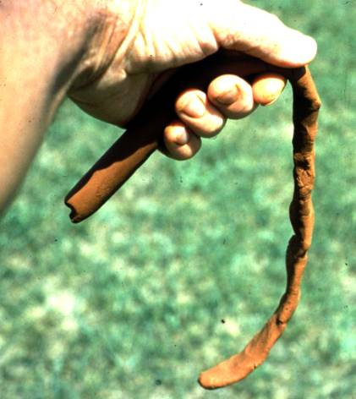
The Ribbon Test
Clay loam will barely ribbon and break easily
Clay = relatively long ribbon 6 to 8 inches or more
More clay = longer and stronger ribbon
Silt has tendency to produce short ribbon with broken appearance

Slide 41
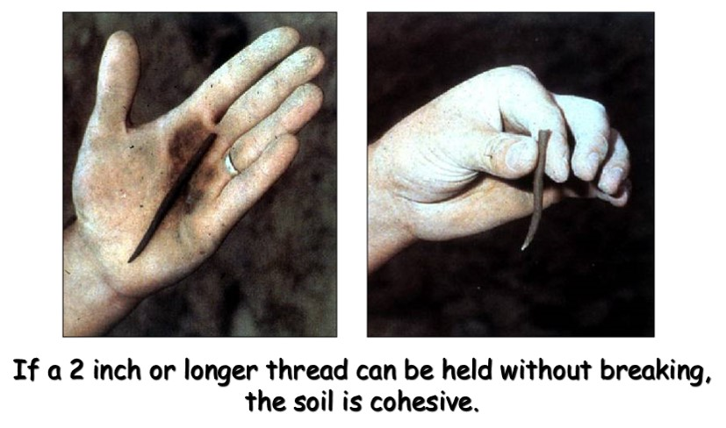
Penciling

Slide 42
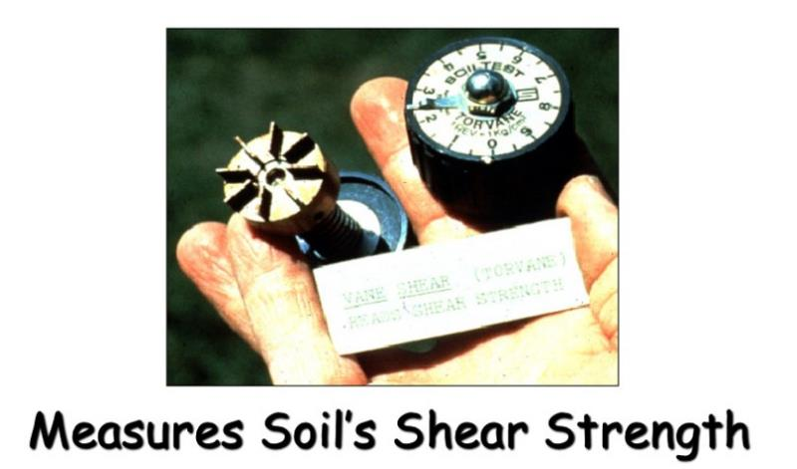
Shearvane/Torvane

Slide 43
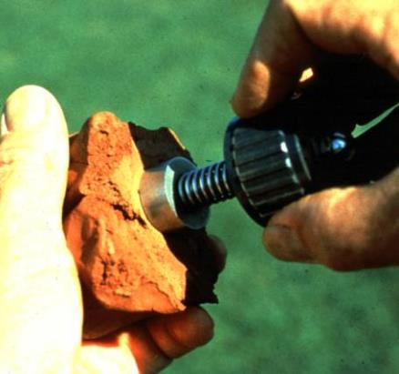
Shearvane/Torvane
Select fresh clod or block of undisturbed soil from spoil pile
Cut a smooth surface on the clod
Insert vanes of device into the soil
Retract vanes to show foot imprint
Set indicator at zero
Hold device firmly against soil and twist in clockwise manner until soil fails in shear

Slide 44
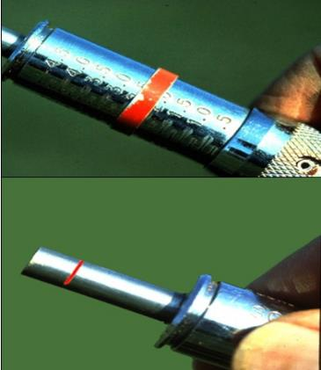
Pocket Penetrometer Test
Device is designed to work on saturated clay soil
Measures unconfined compressive strength of soil
Twice the value of shear strength of same soil
Note machine ring

Slide 45
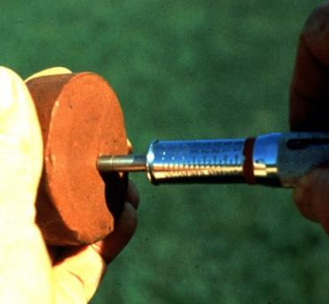
Pocket Penetrometer Test
To begin test, remove red protective cap, push ring against body so that low side reads “O”
Slowly insert piston until engraved mark is level with soil

Slide 46
Pocket Penetrometer
Read strength in tons/sq ft using low side of ring (side closest to the piston end). Record reading and repeat step #1.
For weak soils, use 1” adaptor foot, multiply by .0625

Slide 47

Thumb Penetration Test
If the thumb makes an indentation in the soil only with great difficulty, the soil is probably Type A.
If the thumb penetrates no further then the length of the thumb nail, it is probably Type B soil.
If the thumb penetrates the full length of the thumb it is Type C soil.
The thumb test is subjective and is therefore the least accurate of the tests.
Notes:
OSHA TECHNICAL MANUAL – SECTIONV: CHAPTER2

Slide 48
Soil Strength is Dependent Upon:
Type of Soil.
Amount of Moisture in the Soil.
Whether the Soil Has Been Previously Disturbed.

Slide 49
If Water is Added
It Brings Additional Weight
Hydrostatic Pressure
It Erodes the Trench Wall
Water movement typically moves soil
It Can Freeze and Thaw
Resulting in cracks & false cohesion
REMOVAL OF GROUND WATER IS CRITICAL

Slide 50
SOIL COMPONENTS
Clay:
Composed of mineral particles less than 0.002 mm in diameter
Silt:
Individual mineral fragments that range from 0.002 to 0.05 mm in diameter.
Sand:
Individual rock or mineral fragments that range in diameter from 0.05 to 2.0 mm in diameter.
Gravel:
Can be either angular or rounded.

Slide 51
COHESIVE SOIL
Soil with a high clay content which has cohesive strength.
It does not crumble.
It can be excavated with vertical side slopes.
It is hard to break up when dry.
It can be molded.
It exhibits significant cohesion even when submerged.

Slide 52
GRANULAR SOIL
Soils that include gravel, sand, silt.
Very low clay content.
It has no cohesive strength.
Some moist granular soils exhibit apparent cohesion.
It cannot be molded when moist and crumbles easily when dry.

Slide 53
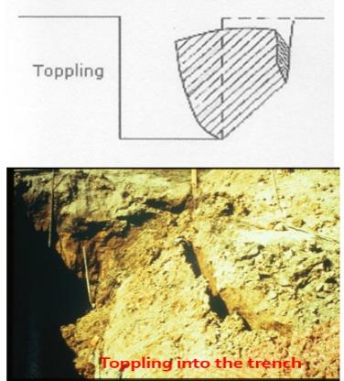
Soil Mechanics
Toppling occurs when the trench’s vertical face shears along the tension crack line and topples into the excavation
Notes:
Toppling into the trench

Slide 54
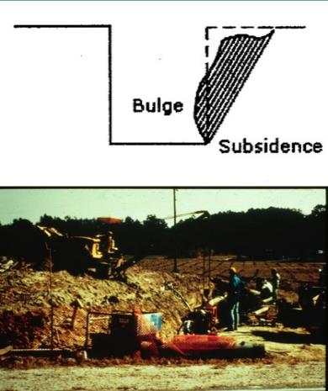
Soil Mechanics…..
Subsidence and bulging occurs when an unsupported excavation can create an unbalanced stress in the soil which causes subsidence at the surface and bulging of the vertical face Can the weight of this crane cause bulge or failure?
Notes:
Can the weight of this crane cause bulge or failure

Slide 55
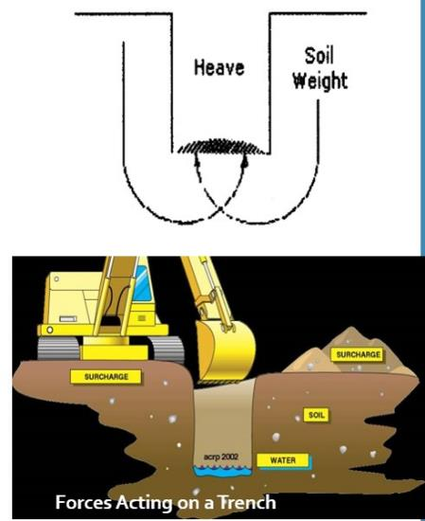
Soil Mechanics.
Heaving or squeezing is caused by the downward pressure created by the weight of adjoining soil or equipment
Can occur even when shoring or shielding has been properly installed

Slide 56
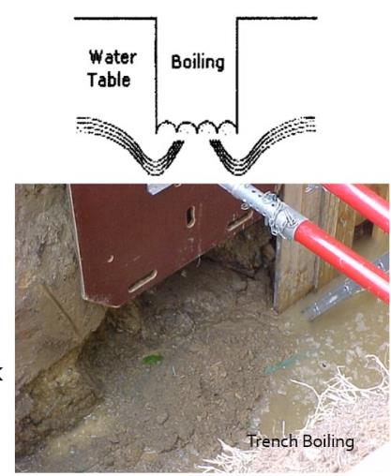
Soil Mechanics..
Boiling is evidenced by an upward water flow into the bottom of the cut
High water table is one cause
Boiling produces a quick condition even when trench boxes are used
Notes:
Boiling and toe failure

Slide 57
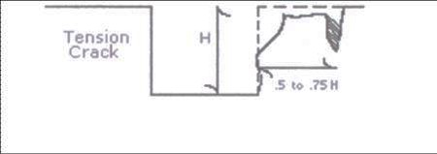
Soil Mechanics…
Tension cracks usually form at a horizontal distance of 0.5 to .75 times the depth of the trench

Slide 58
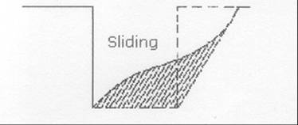
Soil Mechanics….
Sliding or sloughing may occur as a result of tension cracks

Slide 59
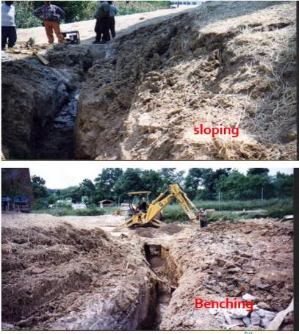
Design of Sloping and Benching
Allowable configurations and slopes
Not steeper than 1 1/2 horizontal to 1 vertical
Designs using other tabulated data
Shall be in written form
Must identify limits of use of the data
Identify the registered professional engineer who approved

Slide 60
Allowable Slopes
Soil type Height/depth Slope angle
Stable rock Vertical 90 deg
Type A ¾ to 1 53 deg
Type B 1 to 1 45 deg
Type C 11/2 to 1 34 deg
Type A
short term ½ to 1 63 deg
max excavation depth 12 ft

Slide 61
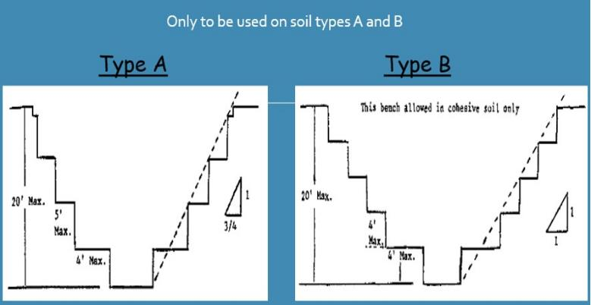
BENCHING

Slide 62
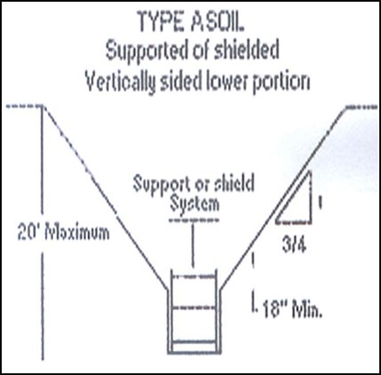
Allowable Slopes.
Type A soil
Supported of shielded vertically sided lower portion
¾ to 1
20 feet max depth
Shield 18 inches above to prevent rollover

Slide 63
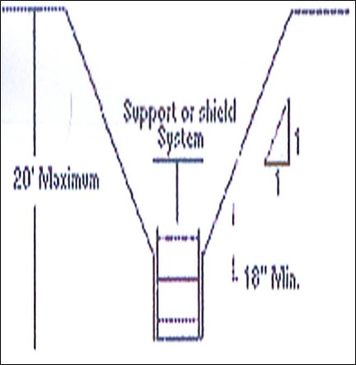
Allowable Slopes..
Type B soil
Supported of shielded vertically sided lower portion
1 to 1 sloped
18 inches minimum at top of shield to prevent rollover

Slide 64
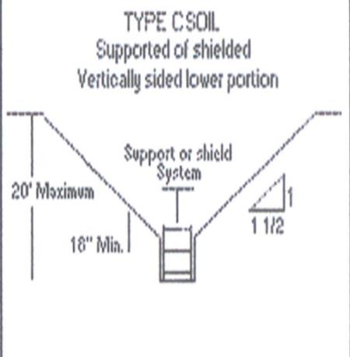
Allowable Slopes
Type C soil supported of shielded vertically sided lower portion
1 ½ to 1
20 feet max depth
18 inches above to prevent rollover

Slide 65
Other Factors Influencing Cave-Ins
Intersecting Trenches
Previously Disturbed
Vibration
Surcharged Load
Inclined Layers
Drying / Saturation
Free standing time

Slide 66
Fallacies And Misconceptions
Most incidents occur in bad weather
False
Good weather - crews are more careful in bad weather
At what depth/width do most incidents occur
Between 6-8 ft. deep and less than 6 ft. wide
Most utilities found in this area

Slide 67
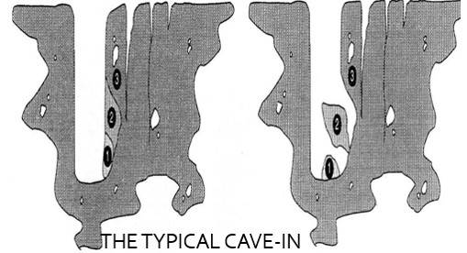
Fallacies And Misconceptions
Clay is the least dangerous soil type
False
Clay looks strong but it is very deceptive - most fatal trench accidents occur in clay soil

Slide 68
Competent Person
Has specific training in and be knowledgeable about soil analysis, use of protective systems and the requirements of the standard

Slide 69
COMPETENT PERSON MUST BE AWARE OF:
Falling loads or equipment
Hazardous atmospheres
Weather conditions and forecast
Stability of adjacent structures.
Surface and overhead encumbrances
Underground utilities
Access and egress
Vehicular traffic
Continuation of trade activity

Slide 70

KEEP THE JOB SAFE

