Slide 1

Chemical Hazard Communication
Susan Harwood Training Grant

Slide 2
Disclaimer
This material was produced under grant SH-16625-2007 from the Occupational Safety and Health Administration, U.S. Department of Labor. It does not necessarily reflect the views or policies of the U.S. Department of Labor, nor does mention of trade names, commercial products, or organizations imply endorsement by the U.S. Government.
Revisions were made to this material under grant number SH-31240-SH7 from the Occupational Safety and Health Administration, U.S. Department of Labor.

Slide 3
What is OSHA?
OSH Act is the federal law that established the Occupational Safety and Health Administration (OSHA)
OSHA sets and enforces workplace safety and health standards

Slide 4

Your Rights As A Whistleblower
Whistleblower: One who informs on a person or organization engaged in illegal activity.
Your Rights: You are protected from retaliation. Employees are entitled to a workplace free from known health and safety hazards. An employer cannot retaliate by taking adverse action for reporting safety concerns.
File a Complaint: (800) 321-OSHA (6742)

Slide 5

Employer Responsibilities
Employers must provide safe workplaces environment
Comply with OSHA standards, rules, and regulations
Provide training to workers in a language and vocabulary they can understand

Slide 6
Employer Responsibility
Hazard Communication Program
  Keep and maintain a chemical inventory/list
  Have written hazcom program
  Label all chemicals being used
  Keep, maintain, and make available to employees current Safety Data Sheets (SDSs)
  Train employees on chemicals used

Slide 7

Employee Responsibilities
Read and follow safety posters and signs
Comply with OSHA rules and regulations
Use your personal protective equipment (PPE) when required
Report hazardous conditions and job related injuries ASAP

Slide 8

Statistics
In 2016, 5190 people died from fatal workplace injuries

Slide 9

Lesson Objectives
Hazard Communication Standard
7 major elements of the Globally Harmonized System

Slide 10

Quiz Time!

Slide 11

Information Nation!
Hazard Communication Standard or HCS
    Requires chemical manufacturers, importers, and distributors to properly label chemicals and maintain accurate SDSs
    The standard that gives workers the right to know, and the right to understand.
Globally Harmonized System or GHS
System for making chemical hazard classification and communication more consistent.

Slide 12
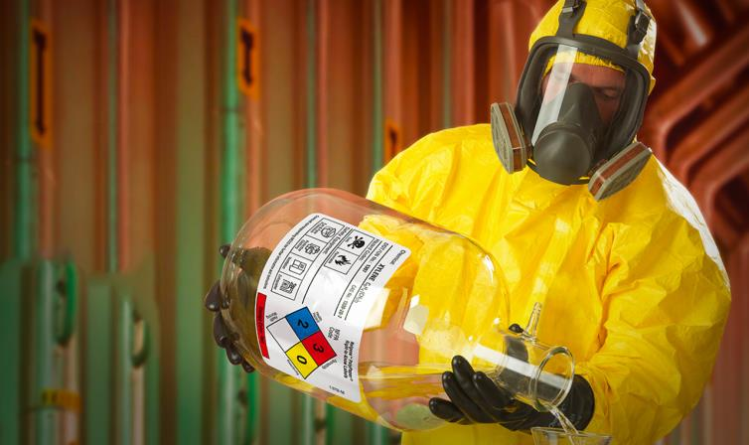
Potentially Exposed Employees
Notes:
About 32 million workers work with and are potentially exposed to one or more chemical hazards. There are an estimated 650,000 existing chemical products, and hundreds of new ones being introduced annually. This poses a serious problem for exposed workers and their employers.

Slide 13
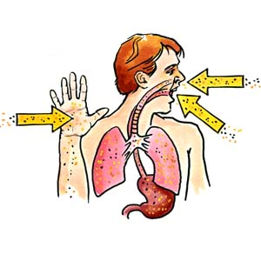
Health Effects
Notes:
Chemical exposure may cause or contribute to many serious health effects such as heart ailments, central nervous system, kidney and lung damage, sterility, cancer, burns, and rashes. Some chemicals may also be safety hazards and have the potential to cause fires and explosions and other serious accidents.

Slide 14

Safety Goals
Notes:
Because of the seriousness of these safety and health problems, and because many employers and employees know little or nothing about them, the Occupational Safety and Health Administration (OSHA) issued the Hazard Communication Standard. The basic goal of the standard is to be sure employers and employees know about work hazards and how to protect themselves; this should help to reduce the incidence of chemical source illness and injuries.

Slide 15

Globally Harmonized System
Known as GHS
Provides common approach to classifying chemicals and communicating hazard information on labels and SDSs

Slide 16
What is GHS?
https://youtu.be/PGS0-hWmu0I
Notes:
Slide: 16 –What is GHS?
Video: https://youtu.be/PGS0-hWmu0I
GSH, or the Globally Harmonized System, is a set of standards created by the U.N and adopted by a number of countries around the world. They provide guidelines on how chemicals are to be safely classified and labeled. GHS provides a standardized system to inform workers about hazardous chemicals. This will improve the worker’s understanding of present hazards and lead to safer handling and use of chemicals. That means fewer workplace injuries and an increased environmental awareness. GHS helps to simplify and increase international trade by improving communication between countries through a globally recognized system. It reduces worker confusion caused by different standards and provides a framework for countries without chemical safety systems. GHS also reduces the cost associated with government enforcement and company compliance of having to meet the standards of multiple countries. Created by the United Nations GHS is a system that can be adopted by any country wishing to participate in the international commerce or trade of hazardous materials. If a country decides to adopt GHS; that country is responsible for the enforcement of the GHS standards they wish to adopt. A growing number of countries all over the world use GHS: China, Japan, Greece, Iceland, The UK, Brazil, South Africa and over fifty more. In the US, OSHA implemented the HazCom 2012 standards which incorporate components of GHS. Over 5 million workplaces in the U.S. have environments where employees could be exposed to hazardous chemicals and OSHA predicts the implementation of GHS in the US will result in a reduction in accidents, fatalities, injuries and illnesses from exposure to hazardous chemicals. To find out more about GHS, how it’s being incorporated into OSHA’s HazCom 2012 standards or to ensure compliant labeling at your facility- visit graphic products.com, follow the link, fill out the form and receive your free copy of our GHS Best Practice Guide.

Slide 17
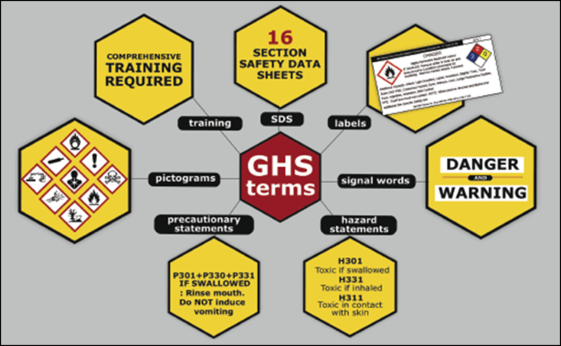
Introduction
Seven major elements in the GHS-aligned Hazard Communication Standard
Source: OSHA
Notes:
Seven Major Elements to Hazard Communication/GHS include:
SDS
Labels
Signal words
Hazard statements
Precautionary statements
Pictograms
Training

Slide 18


Signal Words
Word used to indicate the relative level of severity of hazard.
Only two words used:
  Danger: most severe
  Warning: less severe

Slide 19
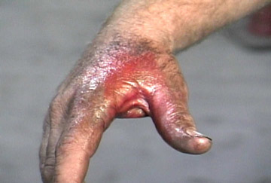
Hazard Statements
Classification of Health Hazard:
  Acute Toxicity
  Skin Corrosion
  Serious Eye Damage
Classification of Physical Hazards:
  Explosives
  Flammable Gases
  Flammable Liquids
Hazard Statement:
  Causes severe burns and eye damage

Slide 20

Precautionary Statements
Prevention:
  “Wash face, hands and any exposed skin thoroughly after handling.”
  “Wear eye/face protection”
Response:
  “If skin irritation occurs: get medical advice/attention.”
Storage
  “Store in a dry place.”
Disposal
  “Dispose of contents to…”

Slide 21
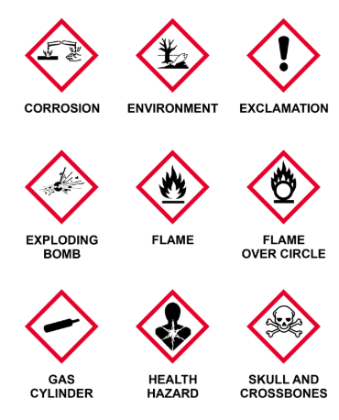
Hazard Communication Pictograms

Slide 22

Health Hazard Pictogram
Distinct Hazard
Carcinogen
Mutagens
Reproductive Hazards
Respiratory Sensitizer
Target Organ Toxicity
Aspiration Toxicity
Health Hazard
Source: OSHA
Notes:
Source: Source: Hazard Communication Standard Pictogram (2012), OSHA QuickCard 3491-02, https://www.osha.gov/Publications/HazComm_QuickCard_Pictogram.html

Slide 23

Flame Pictogram
Distinct Hazard
Flammables
Self-Reactives
Pyrophorics
Self-Heating
Emits Flammable Gas
Organic Peroxides
Flame
Source: OSHA
Notes:
Source: Source: Hazard Communication Standard Pictogram (2012), OSHA QuickCard 3491-02, https://www.osha.gov/Publications/HazComm_QuickCard_Pictogram.html

Slide 24

Exclamation Mark Pictogram
Distinct Hazard
Irritant (skin and eye)
Skin Sensitizer
Acute Toxicity (harmful)
Narcotic Effects
Respiratory Tract Irritant
Hazardous to Ozone Layer (Non-Mandatory)
Exclamation Mark
Source: OSHA
Notes:
Source: Source: Hazard Communication Standard Pictogram (2012), OSHA QuickCard 3491-02, https://www.osha.gov/Publications/HazComm_QuickCard_Pictogram.html

Slide 25

Gas Cylinder Pictogram
Distinct Hazard
Gases under pressure
Gas Cylinder
Source: OSHA
Notes:
Source: Source: Hazard Communication Standard Pictogram (2012), OSHA QuickCard 3491-02, https://www.osha.gov/Publications/HazComm_QuickCard_Pictogram.html

Slide 26

Corrosion Pictogram
Distinct Hazard
Skin Corrosion/Burns
Eye Damage
Corrosive to Metals
Corrosion
Source: OSHA
Notes:
Source: Source: Hazard Communication Standard Pictogram (2012), OSHA QuickCard 3491-02, https://www.osha.gov/Publications/HazComm_QuickCard_Pictogram.html

Slide 27

Exploding Bomb Pictogram
Distinct Hazard
Explosives
Self-Reactives
Organic Peroxides
Exploding Bomb
Source: OSHA
Notes:
Source: Source: Hazard Communication Standard Pictogram (2012), OSHA QuickCard 3491-02, https://www.osha.gov/Publications/HazComm_QuickCard_Pictogram.html

Slide 28

Flame Over Circle Pictogram
Distinct Hazard
Oxidizers
Flame Over Circle
Source: OSHA
Notes:
Source: Source: Hazard Communication Standard Pictogram (2012), OSHA QuickCard 3491-02, https://www.osha.gov/Publications/HazComm_QuickCard_Pictogram.html

Slide 29

Skull and Crossbones Pictogram
Distinct Hazard
Acute Toxicity (fatal or toxic)
Skull and Crossbones
Source: OSHA
Notes:
Source: Source: Hazard Communication Standard Pictogram (2012), OSHA QuickCard 3491-02, https://www.osha.gov/Publications/HazComm_QuickCard_Pictogram.html

Slide 30

Environment Pictogram
Distinct Hazard
Non-Mandatory
Aquatic Toxicity
Environment
Source: OSHA
Notes:
Source: Source: Hazard Communication Standard Pictogram (2012), OSHA QuickCard 3491-02, https://www.osha.gov/Publications/HazComm_QuickCard_Pictogram.html

Slide 31

Hope you were paying attention!
PICTOGRAM
MATCH
GAME

Slide 32
SAFETY DATA SHEETS (SDS)

Slide 33
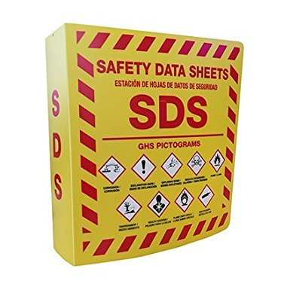
Safety Data Sheets
Available and accessible to workers
Required for all hazardous chemicals used
Do not use hazardous chemicals if there is no SDS available
Has a 16-section format
Source: OSHA
Notes:
Source: Hazard Communication Standard: Safety Data Sheets (2012), OSHA Brief DSG BR-3514, https://www.osha.gov/Publications/OSHA3514.html

Slide 34

SDS: Section 1
Identification
Product identifier
Other means of identification
Recommended use
Supplier of SDS details
Source: OSHA
Notes:
Section 1: Identification - If you want to know the name of the product or its common chemical name, this is the section where you will look. It also identifies the manufacturer, their address and emergency contact information, and recommendations or restrictions for the product’s use.

Slide 35

SDS: Section 2
Hazards Identification
Classification
Signal Words
Hazard Statements
Appearance
Precautionary Statements
Other Information
Source: OSHA
Notes:
Section 2: Hazard(s) identification – This section lists the hazard classifications, signal word, hazard statements, precautionary statements, and pictograms that appear will also appear on the container label. Basically, it includes all hazards regarding the chemical, and the required label elements

Slide 36

SDS: Section 3
Composition/
Ingredients
Synonyms
Chemical Name
Source: OSHA
Notes:
Section 3: Composition/Ingredients – Here you’ll find information on the chemical ingredients, including the name of each hazardous chemical present in the product (including percentages for each chemical if the product is a mixture). You will also find the identity of any impurities and stabilizing additives which are hazardous and contribute to the classification of the chemical, along with any unique identifiers such as the Chemical Abstracts Service (CAS) number. You can also find trade secret claims in this section.

Slide 37

SDS: Section 4
First Aid Measures
General Advice
Most important symptoms and effects
Indication of medical attention
Notes to Physician
Source: OSHA
Notes:
Section 4: First-aid measures – Here is where you will find a description of the initial care that should be given to an individual who has been exposed to a chemical. It includes important information regarding symptom effects whether acute or delayed; as well as required medical treatment. This care can be provided by an untrained individual. This section includes necessary first-aid instructions by routes of exposure. For example, inhalation, skin and eye contact, and ingestion.

Slide 38
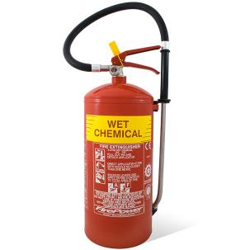
SDS: Section 5
Fire Fighting Measures
Suitable Extinguishing Media
Unsuitable Extinguishing Media
Specific Hazards Arising From the Chemical
Explosion Data
Protective Equipment and Precautions For Firefighters
Source: OSHA
Notes:
Section 5: Fire-fighting measures – In Section 5 you will find recommendations of suitable equipment for extinguishing a fire involving the chemical, as well as information about extinguishing equipment that is not appropriate. There are also warnings about any hazardous by-products created when the chemical burns.

Slide 39
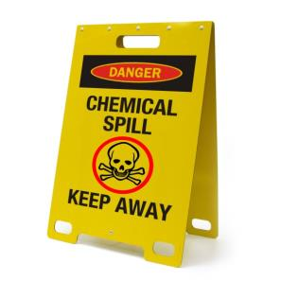
SDS: Section 6
Accidental Release Measures
Personal Precautions
Environmental Precautions
Source: OSHA
Notes:
Section 6: Accidental release measures – This section lists emergency procedures and protective equipment to be utilized during clean up. It will also provide recommendations on appropriate response to spills, leaks, or accidental releases of the chemical, including containment and cleanup practices to prevent or minimize exposure to employees and the general environment.

Slide 40

SDS: Section 7
Handling and Storage
Precautions for Safe Handling
Conditions for Safe Storage
Source: OSHA
Notes:
Section 7: Handling and storage – Section 7 provides guidance on the safe handling practices and conditions necessary for the safe storage of the chemical. This includes precautions for safe handling, including recommendations for handling incompatible chemicals, minimizing the release of the chemical into the environment, and recommended general hygiene practices. This could mean eating, drinking, and smoking in work area.

Slide 41
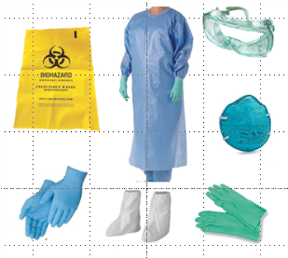
SDS: Section 8
Exposure Controls/Personal Protection
Control Parameters
Engineering Controls
Personal Protective Equipment
Source: OSHA
Notes:
Section 8: Exposure controls/personal protection – This section provides the OSHA permissible exposure limits for the chemical(s), threshold limit values, suitable engineering controls (such as ventilation systems), and recommended personal protective equipment (PPE) for workers to help prevent exposure

Slide 42

SDS: Section 9
Physical and Chemical Properties
Physical State, Appearance, Color, and Odor
Properties
Other Information
Source: OSHA
Notes:
Section 9: Physical and chemical properties – This section lists the chemical’s characteristics. It has technical information about the product, such as its flash point (temperature it gives off enough vapors to ignite and burn), vapor density (tells if vapors are lighter or heavier than air), and a whole lot more is provided in this section. It describes the physical state of appearance of the chemical, including the color and odor.

Slide 43

SDS: Section 10
Stability and Reactivity
Reactivity
Chemical Stability
Possibility of Hazardous Reactions
Conditions to Avoid
Incompatible Materials
Hazardous Decomposition Products
Source: OSHA
Notes:
Section 10: Stability and reactivity – This section discusses whether the chemical is stable or unstable under normal ambient temperature and conditions, either while in storage, or while being handled. It also contains information about possible hazardous reactions, conditions to be avoided, and incompatible products and agents.

Slide 44

SDS: Section 11
Toxicological Information
Likely Routes of Exposure
Toxicological Effects
Delayed and Immediate Effects
Numerical Measures of Toxicity
Source: OSHA
Notes:
Section 11: Toxicological information – Here you can see the toxicological and health effects of over-exposure to the chemical. It also provides information about known or likely routes of exposure such as inhalation, ingestion, or skin and eye contact. In addition, it offers a description of overexposure symptoms, the acute and chronic effects; and numerical measures of toxicity.

Slide 45
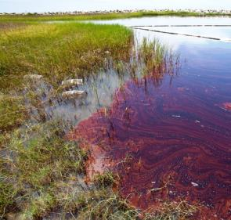
SDS: Section 12
Ecological Information
Ecotoxicity
Persistence and Degradability
Bioaccumulation
Source: OSHA

Slide 46
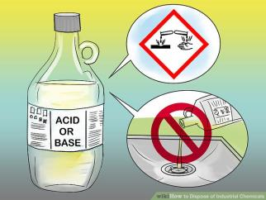
SDS: Section 13
Disposal Considerations
Waste Treatment Methods
Source: OSHA

Slide 47

SDS: Section 14
Transport Information
DOT-Department of Transportation
TDG-Transportation of Dangerous Goods
ICAO-International Civil Aviation Organization
IATA-International Air Transport Association
IMDG-International Maritime Dangerous Goods
Source: OSHA
Notes:
Section 14: Transport information- Section 14 of your GHS compliant SDS covers all relevant transportation information regarding classification information for hazardous substances and mixtures by road, rail, sea, or air. Note that not all substances and mixtures will have transportation information, and thus, information must be specifically stated as not available if it is not provided.

Slide 48

SDS: Section 15
Regulatory Information
International Inventories
US Federal Regulations
US State Regulations
Other Information
Source: OSHA

Slide 49

SDS: Section 16
Other Information
Revision Info
Disclaimer
Other
Source: OSHA

Slide 50
LABELS

Slide 51

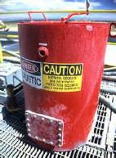


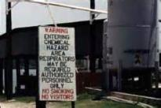
Hazard Communication Labels
Types of labels:
HCS shipping labels
HCS workplace labels
NFPA 704 labels
HMIS labels
DOT shipping labels, placarding, and markings
Source of graphics: OSHA
Notes:
There are several types of labels that might be found on hazardous chemicals in a workplace, including:
Hazard Communication Standard (HCS) shipping labels
Hazard Communication Standard (HCS) workplace labels
National Fire Protection Association 704 labels
Hazardous Materials Information Systems
Department of Transportation shipping labels, placarding, and marking

Slide 52
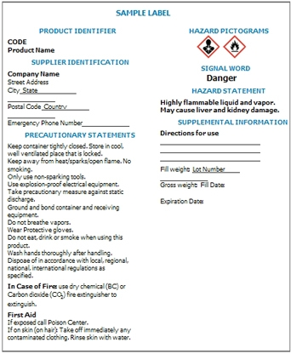
HCS Shipping Labels
Required elements for HCS shipping labels:
Product identifier
Signal word
Hazard statement(s)
Precautionary statement(s)
Pictogram
Name, address, telephone number
Source: OSHA
Notes:
Source: Hazard Communication: Small Entity Compliance Guide for Employers That Use Hazardous Chemicals (2014), OSHA #3695-03, https://www.osha.gov/Publications/OSHA3695.pdf
According to the HCS, the term, label, is defined as “an appropriate group of written, printed or graphic information elements concerning a hazardous chemical that is affixed to, printed on, or attached to the immediate container of a hazardous chemical, or to the outside packaging” (pg. 2).
“To increase uniformity of labels, the HCS requires “the following information, located together (other information may also appear on the label):
Product identifier
Signal word
Hazard statement(s)
Precautionary statement(s)
Pictogram
Name, address, telephone number of the responsible party [manufacturer, importer, or distributor]”
(pg. 14)

Slide 53
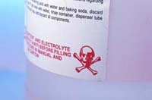
HCS Workplace Labels
Requirements for workplace labels:
Employers can create own labeling system that works for their workplace/employees
Can choose same label required for shipped containers or alternative labels as long as they provide general information about hazards
Train employees to understand
Source: OSHA
Notes:
Employers may choose to label workplace containers either with the same label required for shipped containers of the chemical, or may instead use alternative labels, as long as those labels provide employees with general information about the hazards of the chemical, and the employer provides training so that employees exposed to the chemical understand the specific hazards it presents.

Slide 54
National Fire Protection Association Labels
  NFPA 704 – hazards and severity ratings
White = Other Special Hazards
W= reactivity to water
OX = oxidizer
SA = simple asphyxiant
Flammability Hazard
Blue = Health Hazards
0= normal material that
poses no health
1 = slight hazard
2 = moderate hazard
3 = extreme hazard
4 = deadly hazard
Yellow = Instability Hazards
0= normally stable
1 = slight hazard
2 = moderate hazard
3 = extreme hazard
4 = deadly hazard
Red = Flammability Hazards
0= will not burn
1 = flashpoint above 200°F
2 = flashpoint between
100 – 200°F
3 = flashpoint below 100°F
4 = flashpoint less than 73°F
Health Hazard
Instability Hazard
Other Special Hazard
Source: OTIEC
Notes:
Source: Comparison of NFPA 704 and HazCom 2012 Labels (2013), OSHA QuickCard 3678-08, https://www.osha.gov/Publications/OSHA3678.pdf

Slide 55
NFPA 704 Label Example
Source: OSHA
Notes:
Example:
2 = Moderate health hazard
4 = Highly flammable, flashpoint less than 73°F
0 = Normally stable
W = reactive to water; do not use water

Slide 56
Hazardous Materials Identification System
HMIS label
  Intended for “In-plant” (workplace) labeling compliance
  Color-coded bars
  Numerical scale, 0-4,
  with 0 as lowest
  hazard and 4 as
  highest hazard
    0 = minimal hazard
    1 = slight hazard
    2 = moderate hazard
    3 = serious hazard
    4 = severe hazard
(Product identifier)
HEALTH
FLAMMABILITY
PHYSICAL HAZARD
PERSONAL PROTECTION
Source: OTIEC
Notes:
Source: HMIS or HMIG (Hazardous Materials Identification System), n.d., https://www.uwosh.edu/ehs/campus-health-and-safety/lab-shop-and-studio-safety/chemical-safety/hazard-communication-1/022bHazardComLabelingHMIS1.pdf
The Hazardous Materials Information System was developed by the American Coatings Association to support “In-Plant Labeling” compliance with the Hazardous Communication Standard.
The top space is used to identify the produce and the four color-coded bars indicate different hazards. A rating scale of 0 to 4 indicates the severity of the hazards, with 0 being a minimal hazard and 4 being a severe hazard. Letter codes or icons indicate what personal protective equipment should be used.

Slide 57
HMIS Indicators
HMIS hazard indicators
PPE Index:
A = safety glasses
B = safety glasses + gloves
C = safety glasses + gloves + apron
D = face shield + gloves + apron
E = safety glasses + gloves + dust
respirator
F = safety glasses + gloves + apron
+ dust respirator
G = safety glasses + gloves + vapor
respirator
H = splash goggles + gloves + apron
+ vapor respirator
I = safety glasses + gloves + dust
and vapor respirator
J = splash goggles + gloves + apron
+ dust and vapor respirator
K = air-line hood or mask + gloves +
full suit + boots
X = ask supervisor or safety specialist
Flammability ratings:
0 = will not burn
1 = flashpoint >200°F
2 = flashpoint ≥100°F,
but <200°F
3 = flashpoint <73°F and
boiling point >100°F,
or flashpoint between
73°F and 100°F
4 = flashpoint <73°F and
boiling point <100°F
(Product identifier)
Health ratings:
The second space signifies chronic health hazard with an asterisk (*)
Health ratings:
0 = no significant risk
1 = irritation/minor injury
2 = temporary/minor injury
3 = major injury
4 = life-threatening
HEALTH
Physical Hazard ratings:
0 = normally stable
1 = normally stable, but
can become unstable
2 = unstable
3 = explosive
4 = readily explosive
FLAMMABILITY
PHYSICAL HAZARD
PERSONAL PROTECTION
Source: OTIEC
Notes:
Source: HMIS or HMIG (Hazardous Materials Identification System), n.d., https://www.uwosh.edu/ehs/campus-health-and-safety/lab-shop-and-studio-safety/chemical-safety/hazard-communication-1/022bHazardComLabelingHMIS1.pdf
Blue bar indicates health hazards
0 = no significant risk
1 = possible irritation or minor injury (reversible condition)
2 = temporary or minor injury may occur
3 = major injury likely without prompt action/medical treatment
4 = life-threatening, major, or permanent damage may result due to single exposure or repeated exposures
Note: there are two spaces in the health bar; the second space is used to signify chronic health hazards, which is indicated by the presence of an asterisk (*), and warns of health problems due to long-term exposure.
Red indicates flammability hazards
0 = will not burn
1 = liquids, solids, and semi-solids that can ignite if preheated: flashpoint above 200°F
2 = ignition can occur if material is moderately heated or exposed to high ambient temperatures: flashpoint at or above 100°F but below 200°F
3 = ignition can occur under most normal temperatures: flammable liquids with flashpoint below 73°F and boiling points above 100°F, and liquids with
flashpoints between 73°F and 100°F
4 = ignition can spontaneously occur with air: flammable gases or very volatile flammable liquids with flashpoints below 73°F and boiling points below
100°F
Orange indicates physical hazards (hazard classes include Water Reactive, Organic Peroxides, Explosives, Compressed gases, Pyrophoric material, Oxidizers, and Unstable Reactive)
0 = non-explosive; normally stable (even under fire); will not react with water, polymerize, decompose, condense, or self-react
1 = normally stable, but can become unstable with high temperatures and pressures; may react non-violently with water; hazardous polymerization may
occur in the absence of inhibitors
2 = unstable materials; under normal temperatures and pressures, violent chemical changes may occur and there is a low risk for explosion; violent
reactions may occur with water; peroxides may form when exposed to air
3 = explosive mixtures may form with water that can detonate or have explosive reaction with strong initiating source; under normal temperatures and
pressures, polymerization, decomposition, self-reaction, or other chemical changes may occur with a moderate risk of explosion
4 = at normal temperature and pressure can have readily explosive water reaction, detonation or explosive decomposition, polymerization, or self-
reaction
White indicates personal protective equipment requirements for safe handling – letter codes and icons correspond to required PPE
A = safety glasses
B = safety glasses and gloves
C = safety glasses, gloves, and apron
D = face shield, gloves, and apron
E = safety glasses, gloves, and dust respirator
F = safety glasses, gloves, apron, and dust respirator
G = safety glasses, gloves, and vapor respirator
H = splash goggles, gloves, apron, and vapor respirator
I = safety glasses, gloves, dust and vapor respirator
J = splash goggles, gloves, apron, dust and vapor respirator
K = air-line hood or mask, gloves, full suit, and boots
X = ask supervisor or safety specialist about special handling requirements

Slide 58
HMIS Label Example
Ammonium Hydroxide
HEALTH
*
2
FLAMMABILITY
0
PHYSICAL HAZARD
0
PERSONAL PROTECTION
J
Source: OTIEC
Notes:
Example:
Product is “ammonium hydroxide”
Health hazard
* = chronic hazard
2 = moderate hazard that may cause temporary or minor injury
Flammability – minimal hazard; material will not burn
Physical Hazard – minimal hazard; normally stable material
Personal Protection – PPE needed includes splash goggles, gloves, apron, and dust/vapor respirator

Slide 59

Department of Transportation Labels
DOT Shipping Containers
  Uses graphic elements on placards or labels to identify hazardous shipments
  Where shipping container is also container used in workplace, workers must be made aware of DOT pictograms
  DOT Classification groups hazardous materials based on dangers posed in transportation
    9 classes total
Notes:
Source: Hazard Communication: Small Entity Compliance Guide for Employers That Use Hazardous Chemicals (2014), OSHA #3695-03, https://www.osha.gov/Publications/OSHA3695.pdf
“One of the systems that has long used pictograms is the international transport system. This system has been adopted by the U.S. Department of Transportation (DOT), and is familiar to those who handle shipping containers in the United States. The symbols have been harmonized as much as possible for the hazards covered both in transport and in the workplace. While both pictograms are diamond-shaped, the transport system’s pictograms have backgrounds of various colors. Where the shipping container is also the container used in the workplace, workers must be made aware of the DOT pictograms¹, as they may appear on the label in addition to, or instead of, the HazCom 2012 pictograms used to represent the same hazard.” (pg. 15)
Source: https://www.fmcsa.dot.gov/regulations/hazardous-materials/how-comply-federal-hazardous-materials-regulations
Class 1 Explosives
Class 2 Gases
Class 3 Flammable Liquid
Class 4 Flammable Solid
Class 5 Oxidizing Substance; Organic Peroxides
Class 6 Poisonous (Toxic) and Infectious Substances
Class 7 Radioactive Material
Class 8 Corrosives
Class 9 Miscellaneous Dangerous Goods (includes Environmentally Hazardous Substances, Elevated Temperature Material, Hazardous Wastes, and Marine Pollutants)

Slide 60
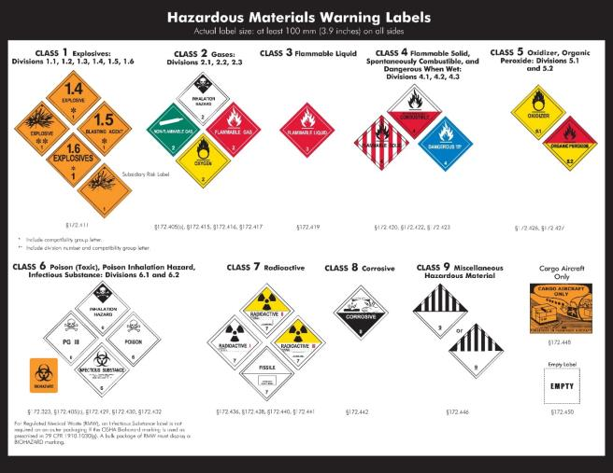
DOT Warning Labels
Source: DOT - PHMSA
Notes:
Source: DOT Chart 15, Hazardous Materials Markings, Labeling and Placarding Guide (n.d.), U.S. Department of Transportation, Pipeline and Hazardous Materials Safety Administration, PHH50-0138-0413, https://www.fmcsa.dot.gov/sites/fmcsa.dot.gov/files/docs/Hazardous_Materials_Markings_Labeling_and_Placarding_Guide_508CLN.pdf
49 CFR 172 Subpart E
§172.400 General labeling requirements.
Source: How to Comply with Federal Hazardous Materials Regulations (n.d., Federal Motor Carrier Safety Administration. https://www.fmcsa.dot.gov/regulations/hazardous-materials/how-comply-federal-hazardous-materials-regulations
“General labeling requirements are contained in 49 CFR subpart E Part 172. Each person who offers for transportation or transports a hazardous material shall ensure the package is properly labeled. There are a number of exceptions to the labeling requirements contained in 172.400a. Prohibited labeling is contained in 172.401.”

Slide 61
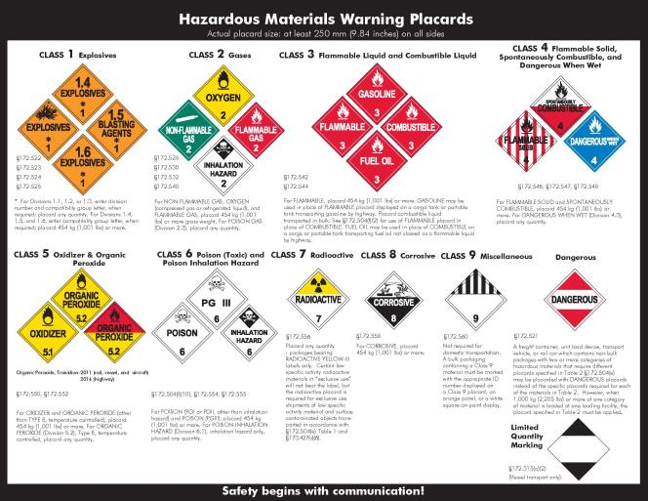
DOT Warning Placards
Source: DOT - PHMSA
Notes:
Source: DOT Chart 15, Hazardous Materials Markings, Labeling and Placarding Guide (n.d.), U.S. Department of Transportation, Pipeline and Hazardous Materials Safety Administration, PHH50-0138-0413, https://www.fmcsa.dot.gov/sites/fmcsa.dot.gov/files/docs/Hazardous_Materials_Markings_Labeling_and_Placarding_Guide_508CLN.pdf
49 CFR 172 Subpart F
§172.500 Applicability of placarding requirements.
(a) Each person who offers for transportation or transports any hazardous material subject to this subchapter shall comply with the applicable placarding requirements of this subpart.
Source: How to Comply with Federal Hazardous Materials Regulations (n.d., Federal Motor Carrier Safety Administration. https://www.fmcsa.dot.gov/regulations/hazardous-materials/how-comply-federal-hazardous-materials-regulations
“General placarding requirements are contained in 172.504. Each bulk packaging, freight container, unit load device, transport vehicle, or rail car containing any quantity of hazardous materials must be placarded on each side and each end with the placards specified in Tables 1 and 2.”

Slide 62
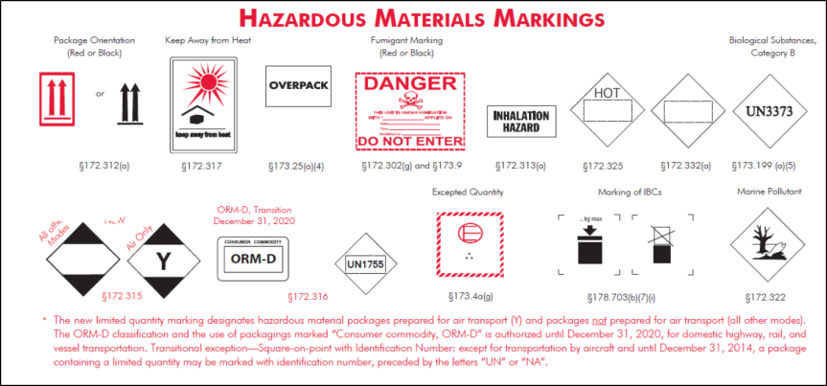
DOT Markings
Source: DOT - PHMSA
Notes:
Source: DOT Chart 15, Hazardous Materials Markings, Labeling and Placarding Guide (n.d.), U.S. Department of Transportation, Pipeline and Hazardous Materials Safety Administration, PHH50-0138-0413, https://www.fmcsa.dot.gov/sites/fmcsa.dot.gov/files/docs/Hazardous_Materials_Markings_Labeling_and_Placarding_Guide_508CLN.pdf
49 CFR 172 Subpart D
“§172.300 Applicability.
(a) Each person who offers a hazardous material for transportation shall mark each package, freight container, and transport vehicle containing the hazardous material in the manner required by this subpart.”
Source: How to Comply with Federal Hazardous Materials Regulations (n.d., Federal Motor Carrier Safety Administration. https://www.fmcsa.dot.gov/regulations/hazardous-materials/how-comply-federal-hazardous-materials-regulations
“The requirements for marking of packages are contained in 49 CFR, Subpart D, Part 172. The basic marking requirement consists of the proper shipping name and identification number of the hazardous materials contained in the package. Markings should be durable, in English, and not obscured by other markings or labels. Depending on the material there may be additional marking requirements.”

Slide 63

Training Requirements
Training requirements:
Train employees on
hazardous chemicals
in their work area
  Before initial assignment
  When new hazards are introduced
  Nonroutine tasks
Include in training
  Methods/observations to determine presence/release of chemical in work area
  Hazards of chemicals
  Appropriate protective measures
  Where and how to obtain additional information
Source: OSHA
Notes:
Source: Hazard Communication: Small Entity Compliance Guide for Employers That Use Hazardous Chemicals (2014), OSHA #3695-03, https://www.osha.gov/Publications/OSHA3695.pdf
“For information and training to be effective, the workers in the training must comprehend the hazards in the workplace and ways to protect themselves. OSHA does not expect that workers will be able to recall and recite all data provided about each hazardous chemical in the workplace. What is most important is that workers understand that they are exposed to hazardous chemicals, know how to read labels and SDSs, and have a general understanding of what information is provided in these documents, and how to access these tools. Workers must also be aware of the protective measures available in their workplace, how to use or implement these measures, and who they should contact if an issue arises.” (pg. 25)
Training… must address the following:
Methods and observations used to determine presence or release of chemical in work area, such as:
1. Monitoring – conducted by employer; continuous monitoring devices
2. Visual appearance or odor of hazardous chemical when being released
Hazards of chemicals in the work area, including:
1. Physical hazards
2. Health hazards
3. Simple asphyxiation
4. Combustible dust
5. Pyrophoric gas
6. Other hazards not otherwise classified
Measures employees can take to protect themselves from hazards, including
1. Specific procedures employer has implemented to protect employees from exposure to hazardous chemicals
2. Examples – Appropriate work practices, emergency procedures, PPE to be used
Details of hazard communication program developed by employer
1. Explanation of labels received on shipped containers and the workplace labeling system used by the employer
2. SDS, including format (where each type of information is located)
3. How employees can obtain and use the appropriate hazard information
(pg. 25-26)

Slide 64
Review
Employers are required to have a written hazard communication program which includes five elements:
  Keep and maintain a chemical inventory/list
  Have written hazcom program
  Label all chemicals being used
  Keep and maintain current Safety Data Sheets (SDSs)
  Train employees on chemicals used
Hazard Communication Standard is the standard that classifies hazardous chemicals and gives employees the right to know

Slide 65
Review Continued
Globally Harmonized System is the system for making chemical hazard classification more consistent internationally
Seven major elements in the GHS system are:
  Signal Words
  Hazard Statements
  Precautionary Statements
  Pictograms
  Safety Data Sheets
  Labels
  Training

Slide 66

Skills Review!

