Slide 1
Fall Protection

Slide 2
OSHA Susan Harwood Grant
This material was produced under Grant Program # SH-31246-SH7 from OSHA, U.S. Department of Labor. It Does not necessarily reflect the views or policies of the U.S. Department of Labor, nor does mentioning of trade names, commercial products, or organizations imply endorsement by the U.S. Government. Revisions were made to this material under grant number SH-22317-11 from the Occupational Safety and Health Administration, U.S. Department of Labor.

Slide 3
Training Audience
Water Utility Operators
Heavy equipment operators
Electricians
Plumbers
Mechanics
Welders
Carpenters
General laborers
Trades people

Slide 4

Training Objectives
Occupational Safety and Health Act of 1970 and your rights as a whistleblower.
Introduction into the OSHA construction standards and fall protection requirements.
Case studies and exercises.
How to use safe work practices to prevent fall hazards.

Slide 5
OSH Act of 1970-SEC.5.Duties
(a) Each employer shall:
(1) Furnish to each of his employees employment and a place of employment which are free from recognized hazards that are causing or are likely to cause death or serious physical harm to his employees;
(2) Comply with occupational safety and health standards promulgated under this Act.
(b) Have each employee comply with occupational safety and health standards and all rules, regulations, and orders issued pursuant to this Act which are applicable to his own actions and conduct.

Slide 6
Your Rights as a Whistleblower
You may file a complaint with OSHA if your employer retaliates against you by taking unfavorable personnel action because you engaged in protected activity relating to ‘workplace safety or health’, asbestos in schools, cargo containers, airline, commercial motor carrier, consumer product, environmental, financial reform, food safety, health insurance reform, motor vehicle safety, nuclear, pipeline, public transportation agency, railroad, maritime, motor vehicle safety, and securities laws.

Slide 7
Unfavorable Personnel Actions
Applying or issuing a policy which provides for an unfavorable personnel action due to activity protected by a whistleblower law enforced by OSHA:
Blacklisting
Demoting
Denying overtime or promotion
Disciplining
Denying benefits
Failing to hire or rehire
Firing or laying off
Intimidation
Making threats
Reassignment to a less desirable position, including one adversely affecting prospects for promotion
Reducing pay or hours
Suspension

Slide 8
When Filing a Complaint-Legal Time Limits
Occupational Safety and Health Act -30 days to file
Solid Waste Disposal Act-30 days
Toxic Substance Control Act-180 days
Federal Water Pollution Act-30 days
Compensation and Liability Act-30 days
Clean Air Act-30 days
Safe Drinking Water Act-30 days

Slide 9
Filing Complaint
Visit or calling the local OSHA office
Mailing a written complaint to the regional or area office
Written complaints can be sent by facsimile, electronic communication, hand delivery during business hours
https://www.whistleblowers.gov/

Slide 10

Construction’s Fatal Four Occupational Hazards
Falls — 384 out of 991 total deaths in construction in 2016 (40%)
Struck by Object - 93 (10%)
Electrocutions - 82 (8%)
Caught-in/between - 72 (7%)
Notes:
As you can see by this data falls rank at the top of the list when it comes to fatal occupational hazards.

Slide 11
Top 10 most frequently cited OSHA standards violated in FY 2017
Fall protection, construction (29 CFR 1926.501)
Hazard communication standard, general industry (29 CFR 1910.1200)
Scaffolding, general requirements, construction (29 CFR 1926.451)
Respiratory protection, general industry (29 CFR 1910.134)
Control of hazardous energy (lockout/tagout), general industry (29 CFR 1910.147)
Ladders, construction (29 CFR 1926.1053)
Powered industrial trucks, general industry (29 CFR 1910.178)
Machinery and Machine Guarding, general requirements (29 CFR 1910.212)
Fall Protection–Training Requirements (29 CFR 1926.503)
Electrical, wiring methods, components and equipment, general industry(29 CFR 1910.305)
Notes:
As you can see by the most frequently cited top ten OSHA standards fall protection-construction, scaffold-general and construction, ladders-construction followed by fall protection training make the top ten.

Slide 12

Define Fall Protection
A series of reasonable steps taken to prevent falls while working at heights.

Slide 13
How Can We Plan for Fall Hazards?
Prevention through design practices recommend that fall protection becomes a key part of the project planning process, from constructability, to systems installation, to use and maintenance
A project cannot be truly safe unless fall protection is added into every phase of the construction process-even the smallest projects
Best if fall protection is planned and designed prior to construction-keeps cost down
Regular safety briefs will keep workers safe and minimize liability for all parties involved

Slide 14
How Can We Control Fall Hazards?
Select the proper fall protection systems for each situation.
Use proper construction and installation of safety systems
Effectively supervise employees
Ensure supervisors are responsible and accountable for fall protection at workplaces
Use safe work procedures
Train Workers in the proper selection, use, and maintenance of fall protection systems
Evaluate the effectiveness of all steps

Slide 15
Introduction to Fall Hazards
Fall Hazards
Accident Prevention
Building Structures
Exterior Construction Areas
Scaffolds
Stairs
Ladders
Heavy Equipment
Water storage tanks
Deep excavation
Guard Rail Systems
Warning Lines
Personal Fall Arrest Systems
Floor Covers
3 Point of contact

Slide 16
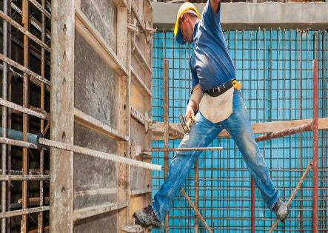

Working Above Dangerous Equipment and Objects
Falls from a short distance can result in serious injury
All workers must be protected from falling onto sharp objects and equipment
Notes:
Class Participation: Can you identify any hazards in this photograph? Answers should include ‘Yes’. There are struck against and impalement hazards. Safety tip: When working above any height workers need to be protected from sharp objects and other equipment without the use of a fall protection system.

Slide 17
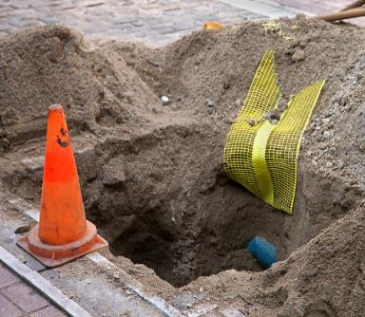
Open Excavation
Excavation and Trenching Fall Hazards
All open excavation areas and holes in the earth or manholes must be guarded or protected
Adequate signage to WARN people of the open fall hazards
Notes:
Class Participation: What hazards can you identify in this photograph? Answers should include slip trips and falls. Are cones sufficient hazard warning to prevent us from falling or tripping in that hole? The answer is no. Safety Tip: Cones do not communicate the hazards. Rather what should be done is placing a barrier around open excavations and signs to warn people of the fall hazards.

Slide 18
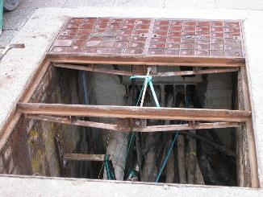
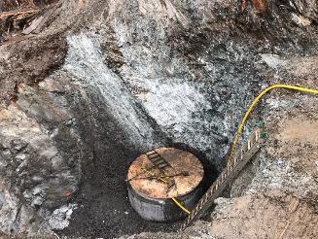
Holes in Floors, Roofs or Walking Surfaces
Open areas require guarding
Proper signage required to WARN people of the fall hazards
Lift stations or vaults
Notes:
Class Participation: Can you identify hazards in this photographs? The answer is ‘Yes’ The top photo shows that no guarding or signage is in place to prevent and warn people of the fall hazards. The bottom photo shows a deep excavation with a ladder that is not properly placed at a 4 to 1 ratio. Additionally, the ladder is not fully extended at least 3 feet above the edge of the excavation. Safety Tip: As part of the preplanning phase of any work the fall hazards should be properly identified and selected controls to prevent fall hazards such as barriers and signage.

Slide 19
Introduction to Fall Protection Requirements
Working 6 feet or more above the lower level requires the use of fall protection
Unprotected sides and edges
Leading Edges
Excavations
Walking/working surfaces
Regardless of the height, fall protection must be used when working above:
Dangerous equipment
Sharp objects
Piercing objects

Slide 20
Introduction to Fall Protection Systems
When working at the height of 6’ above a lower level you must use fall protection that include one at least of the following:
Guardrail system
Personal fall arrest system
Warning line system

Slide 21
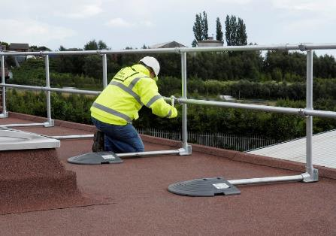

Guardrail Systems
Guardrail system structure must be properly installed and maintained in order to provide any worker protection when working above 6 feet.
Guardrail systems are also added to protect workers from dangerous equipment and sharp objects

Slide 22

Wood Guardrail Systems
Top Rail 42”
  Adequate strength 200lbs outward or downward direction
Mid-rails- In between the top and walking surface
  Adequate strength 150lbs outward or downward direction
Toe-board
  Adequate strength 50lbs outward or downward direction

Slide 23
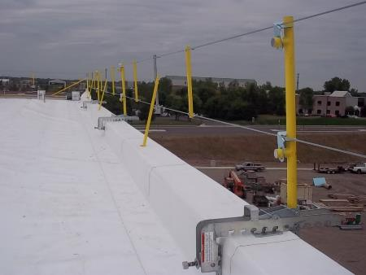
Cable Guardrail System
Top rail 42”
  Can not deflect below 39”
Marked every 6’
  High visibility material
Termination and attachments must meet standards (per Appendix B Subpart M)
Wire rope
  1/4” nominal diameter

Slide 24
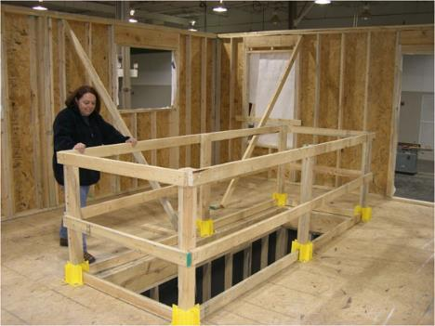
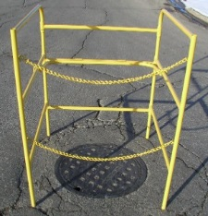

Guardrail Systems to Cover Openings
Guardrail over open construction
Guardrail over manhole cover
Notes:
As you can see from these two photos, barriers can be constructed to prevent falls. Safety Tip: Don’t forget to place signage on these structures to communicate the reason why you put them there.

Slide 25
Damaged Guardrail Systems
Damaged or missing guardrails must be fixed immediately
Toe boards, screens and or netting must be installed and maintained to prevent materials from falling onto workers

Slide 26
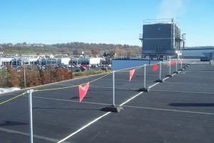
Warning Lines
Warning lines are only used to keep workers away from unsafe edge
Must be located at least 6 feet from the edge
Must withstand 16 lbs. of tipping pressure
Must be at least 34 inches from the ground
Must be maintained

Slide 27
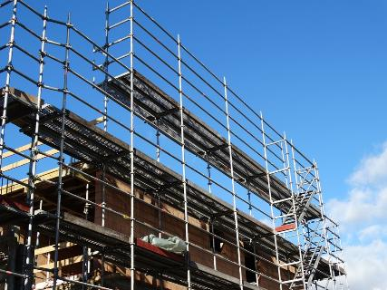
Introduction to Temporary Work Platforms
The role of the competent person during construction of scaffolds
Supported scaffold
Access ladders
Power lift platforms

Slide 28
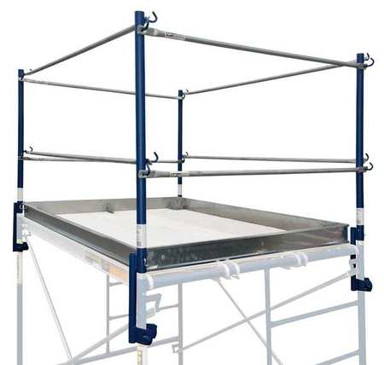

Scaffolds
Guardrails must be in place when working 10 feet above the lower level
Guardrail system must be installed on all open sides to include top and mid rails
Must include a toe board on all sides
Scaffold must not more than 9.5 inches from structure

Slide 29
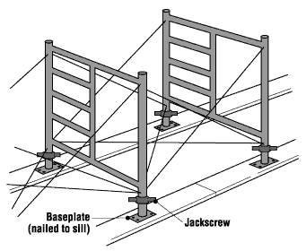
Platform Construction
Scaffold base must rest on base plate and a mud sill
Base plate is designed to support and level the scaffolding
Requires a competent person to design and install

Slide 30
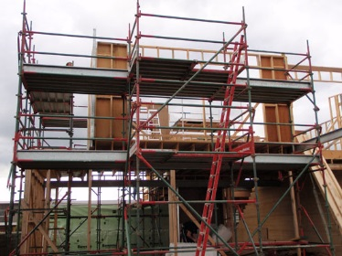

Access Ladders on Scaffolding
The ladder must be firmly secured to the scaffolding
When using hook on ladders, it must be positioned to prevent de-stabilizing the scaffolding
In addition, the spacing of the ladder rungs must be 16 ¾ inches or less and have a minimum length of 11 ½ inches.
Scaffolds must be fully planked –no gaps greater than 1 inch

Slide 31
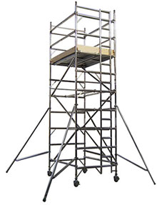
Mobile Scaffold
Mobile scaffolds are a type of supported scaffold set on wheels or casters.
They are designed to be easily moved and are commonly used for painting and plastering, where workers must frequently change position

Slide 32
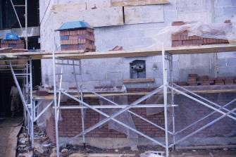
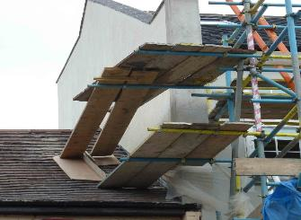
Avoiding Hazards
Only work from scaffolds that are properly constructed and supported
Never use scaffolds that do not have proper guardrails system installed
Never use blocks, brick, walk boards, and other unsafe methods to access a scaffold
Electrical hazards
Platform slip hazards
Wind hazards

Slide 33
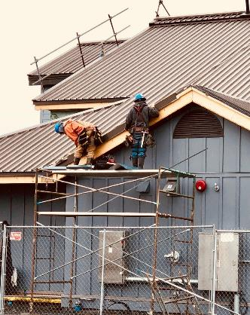
Unsafe Work Practices on Mobile Scaffold
Notes:
Class Participation: Can you identify the hazards in this photograph? The answer is ‘Yes’. Two workers are working above 10 feet above a lower level without fall protection. Why? The scaffold is missing an upper rail, mid rail and toe board. In addition, the top level is missing two planks and the ladder does not extend to the top level. Safety Tip: Ensure scaffolds are properly constructed and maintained and meets the requirements of a top, mid rail and toe board.

Slide 34
Competent Person Duties
Design and preplanning of the scaffold including weight limitations, scaffold type, fall protection, tie-offs, supports, etc.
Overseeing the erection of the scaffold
Final inspection of the scaffold prior to initial occupation for use.
At a minimum, daily inspection and documentation of the condition of the scaffold and its ability to be occupied safely.
Inspections of scaffolds after changes / alterations have been made.
Oversight and inspections of mobile scaffolds.
Training of other competent persons, scaffold erectors, and users.

Slide 35
Introduction to Powered Lift Platforms
Only use equipment that is designed for lifting personnel and suitable for the assigned task
Ensure equipment is functioning properly
Never use a powered platform that requires maintenance or is unsafe to operate
Fall protection is required for most power lift platforms
Direct supervision and use of a spotter are good safe work practices

Slide 36
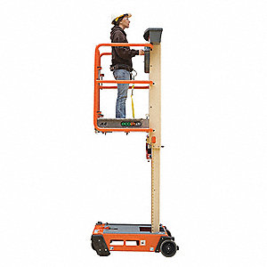
Personal Lift System
Battery powered systems
Eliminate the risk of using a ladder at heights
Must be rated for the scope and application in your work environment
Weight and height limitations
Use for indoors
Use on flat even surfaces

Slide 37
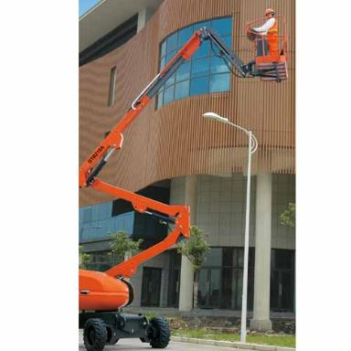
Articulating Power Lift Systems
Battery and propane powered systems
Use indoors
Gas and diesel powered systems
Use outdoors only
Requires personal fall arrest system to be used while inside the bucket
Use of a spotter to avoid struck against injuries

Slide 38
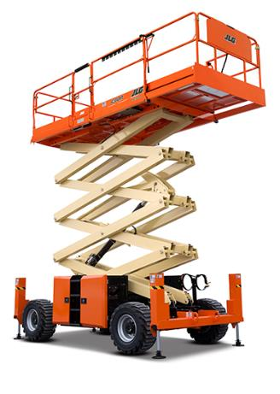
Scissor Lift Systems
Battery and propane powered
Use indoors
Use on a flat even surface
Gas and diesel powered
Use outdoors on flat even surfaces
Personal fall arrest system MAY not be required if:
Guardrail system meets ANSI standards for fall protection

Slide 39
The Hazards of Mobile Lift Platforms
Equipment malfunction
Lack of situational awareness
Struck against injuries
Contact with electrical power lines (electric Shock)
Uneven surfaces
Slip, trips and falls
Ejection
Exhaust

Slide 40
Ejection Hazard
Show an ejection hazard video

Slide 41
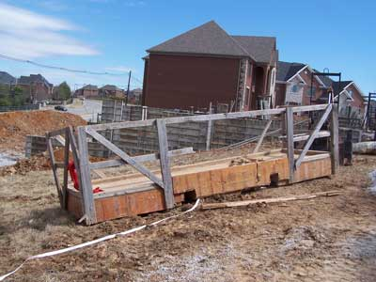
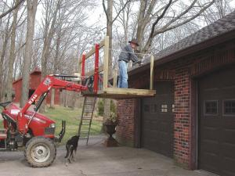

Makeshift Work Platform-Safe or Unsafe?
Notes:
As you can see from these two photographs. Modifying a system as a platform for you to stand in can actually create more hazards. First, equipment may not be rated for any modifications when it comes to construction and anchoring the make shift platform. Second, it may add more weight causing the equipment to tip over. Safety Tip: Never modify any piece of equipment as a make shift platform. Instead refer to the manufactures instructions. Use equipment only for what its intended purpose.

Slide 42
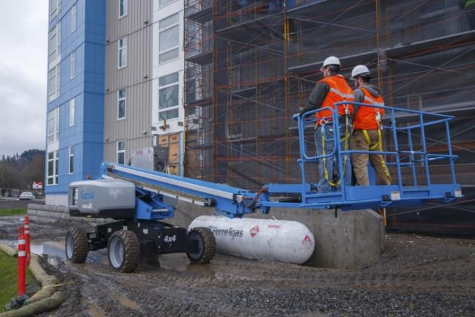

Power Lift Platforms-Safe or Unsafe?
Notes:
Ensure the equipment is fully retracted and that you are traveling on flat even ground.

Slide 43
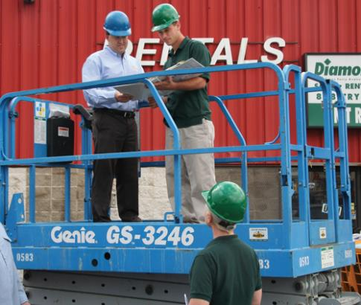
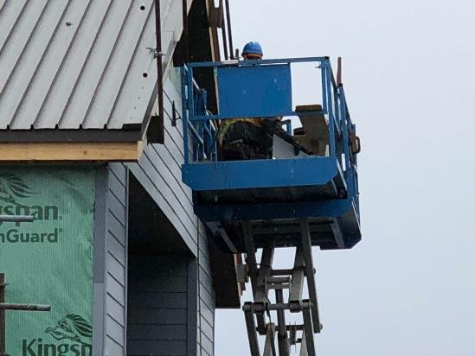
Power Lift Platforms Safe or Unsafe?
Notes:
Class Participation: Is there safety issues with the photograph on the left? The answer is ‘No’. Equipment is retracted with an inspection being done. Is there any safety issues with the photograph on the right? The answer is ‘Yes’. You can barely see that the gate door with the top and mid rail is open to allow for materials that are being cut. This scissor lift equipment has been modified to suit the job task however still poses a fall hazard. Safety Tip: OSHA requires fall protection if you are working 6 feet above a lower level. To eliminated the use of a harness the guard rail systems on a scissor lift needs to be serviceable. Do not modify what intended to protect you from a fall.

Slide 44
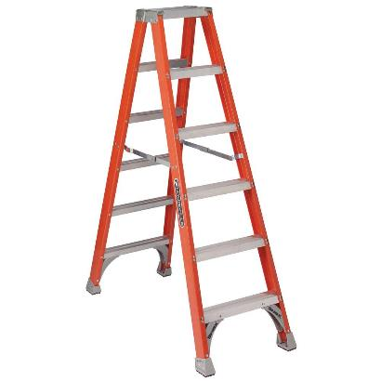
Introduction to Ladders
Ladders are constructed of wood, aluminum and fiberglass
Step ladders
Extension ladders
Platform ladders
Step stools
Telescoping ladders
Folding and articulated ladders

Slide 45
Important Factors for Selecting the Right Ladder
Its type:
Wood, aluminum (light weight) and fiberglass (heavy weight)
It’s length
Strength
Rated for how much weight the ladder is rated for.
Wood and aluminum ladders are subject to damage and corrosion by water and wind
Aluminum and wood ladders are conductors for electricity
Fiberglass ladders are lower conductors for electricity and ideal for most working conditions

Slide 46
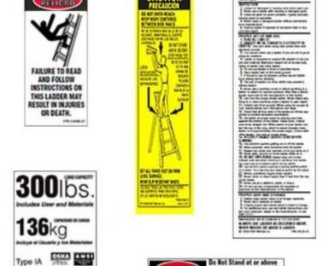
Ladder Safety Tip
Read ladder instructions to ensure proper use
Must be inspected prior to use
Must be kept in a good working condition and at a safe location

Slide 47
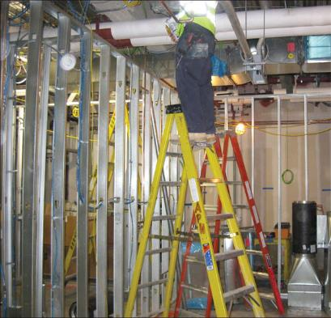
Ladder Safety Tips
Always maintain good footing on a step ladder
Use correct size ladder for the intended work task
Never sit on top of the ladder
Never straddle the ladder
Always use ladders on stable surfaces
Never use the last two rungs

Slide 48
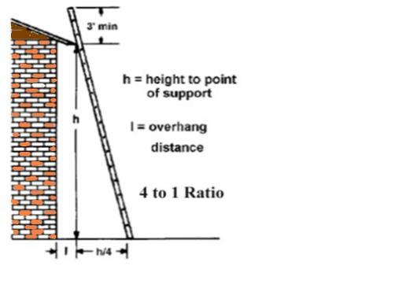
Ladder Safety Tips
Proper position of ladders
Ladders must be positioned at a safe angle to avoid potential fall hazards when climbing
Extension ladders must extend 3 feet over the landing for safe access and egress

Slide 49
Ladder Safety Video
Show a ladder safety video

Slide 50
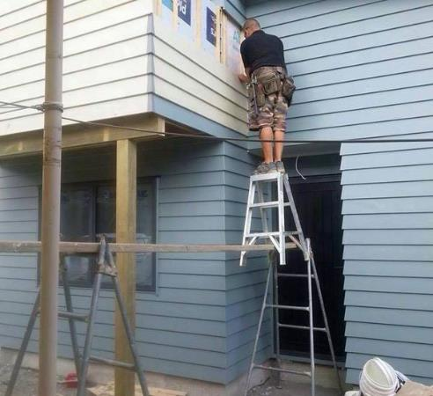
Do Not Stand on Top of the Ladder
Notes:
Safety Tip: Never use what materials you have laying around to complete a task. Take the extra steps to acquire the equipment and materials you need to do the job task safely.

Slide 51
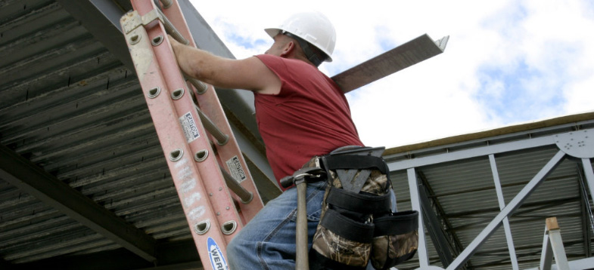
Safety Tip-While Climbing Ladders
Use both hands while climbing-keep a firm grip
Always face the ladder when climbing up or down
Never climb a ladder while carrying materials
Hoist materials or bucket or two person approach

Slide 52
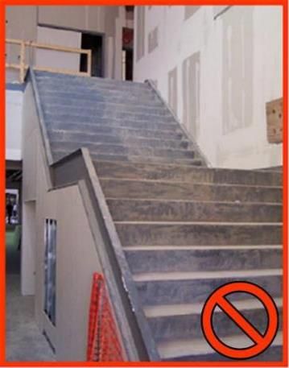
Safety Tips for Stairs
Stairways must have a stair rail along each unprotected side or edge.
Stairs that have walls on both sides must have at least one hand rail on the right-hand side when climbing down
Never use stairs that are not complete are unsafe
Notes:
Even with new construction-if there are delays installing the new permanent rails temporary rails must be constructed to prevent falls.

Slide 53
Introduction to Fall Arrest System
A personal fall arrest system is one option of protection that OSHA requires for workers on construction sites who are exposed to vertical drops of 6 feet or more
Ensure that personal fall arrest systems will, when stopping a fall:
Limit maximum arresting force to 1,800 pounds.
Be rigged such that an employee can neither free fall more than 6 feet nor contact any lower level.
Bring a worker to a complete stop and limit maximum deceleration distance to 3½ feet.
Have sufficient strength to withstand twice the potential impact energy of a worker free falling a distance of 6 feet, or the free fall distance permitted by the system, whichever is less

Slide 54
Fall Arrest System Considerations
Inspect systems before each use for wear, damage, and other deterioration, and remove defective components from service.
Do not attach fall arrest systems to guardrail systems or hoists.
Rig fall arrest systems to allow movement of the worker only as far as the edge of the walking/working surface, when used at hoist areas.
Evaluate swing fall hazard to avoid striking objects
Remove systems and components from service immediately if they have been subjected to fall impact.

Slide 55
Swing Fall Avoidance
Show a swing fall avoidance video

Slide 56
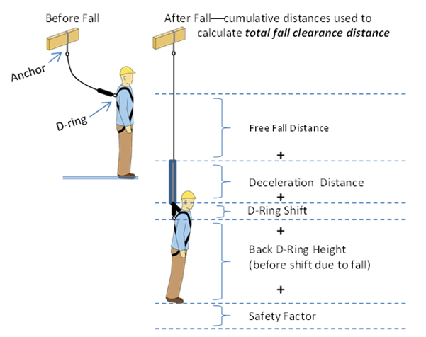
Fall Distance Calculation
  D-ring ABOVE Anchor-Free fall distance =Lanyard Length + vertical distance from D ring to Anchor
  D-ring BELOW anchor-Free fall vertical distance = Lanyard Length -Distance from D-ring to anchor
  D-ring LEVEL with anchor-Free fall distance = Lanyard length

Slide 57
Calculating Your Fall Clearance Distance
Demonstrate calculating fall clearance distance

Slide 58
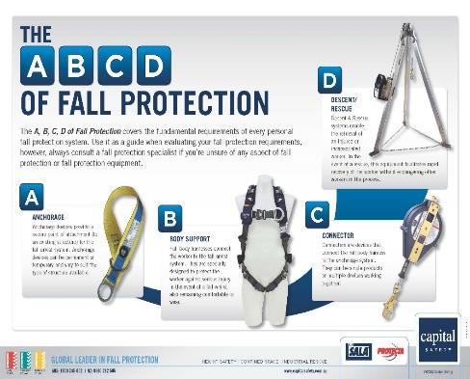
The A, B, C, add D of Fall Protection
A = Anchor
Anchorages used for attachment of personal fall arrest equipment must be independent of any anchorage being used to support or suspend platforms, and capable of supporting at least 5,000 pounds per employee attached, or must be designed and used as follows:
As part of a complete personal fall arrest system which maintains a safety factor of at least two
Under the supervision of a qualified person

Slide 59
Improper Anchor Points
Standard Guardrails
Standard Railings
Ladder/Rungs
Scaffolding
Light fixtures
Conduit or Plumbing
Ductwork or Pipe Vents
Pipe Hangers
C-Clamps
Cable Trays
Another lanyard
Roof stacks, vents
Joists, girders (unless qualified person allows same)

Slide 60
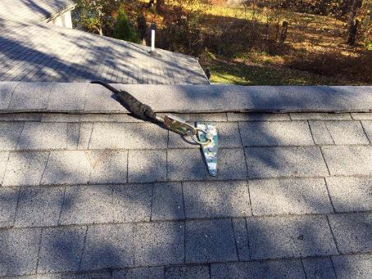
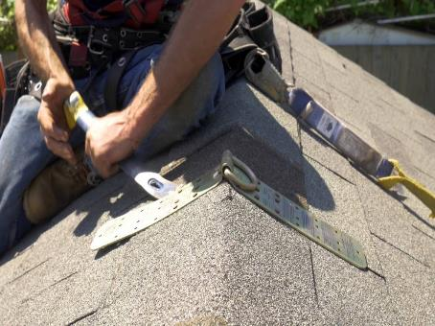

Common Roof Top Anchor Points

Slide 61
Can you Install an Anchor Point without Fall Protection?
OSHA 1926 Subpart M, (1926.500(a))1)) states “The provisions of this subpart do not apply when employees are making an inspection, investigation, or assessment of workplace conditions prior to the actual start of construction work or after all construction work has been completed.”

Slide 62
Initial Installation of an Anchor Point
The key to this industry standard states that prior to the actual start of construction work the competent person will focus on identifying fall protection needs.
Survey the roof to determine if there are pre-installed anchorages available that can be used. If not, then plan immediately to identify those systems needed to protect workers from falls and have them in place before the workers report to the job.
The first person on the roof conducting the inspection will be the one to install anchor point without initial fall protection in place. However once the anchor point is installed he or she will need to connect in right of way before any construction work can begin.

Slide 63
Introduction to Fall Protection Harness Inspection
Add a video to show fall protection harness inspection

Slide 64
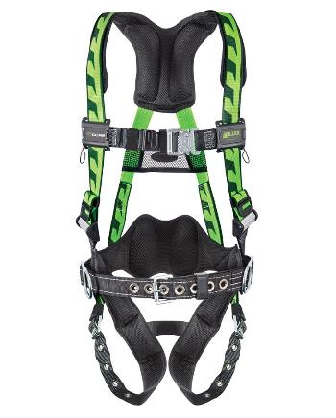
B = The Body Harness
Requires daily inspection before use
Recommend monthly by Competent Person
Should never be modified unless approved by the manufacturer
Should be taken out of service immediately if defective or exposed to an impact

Slide 65
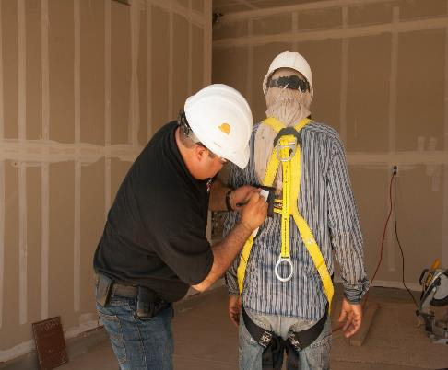
Proper Adjustment
Be able to reach your D-Ring with your thumb
Maximum four (flat) fingers of slack at the legs, straps as high as comfortably possible
Ensure chest strap is across the chest/breastbone
Have a buddy double check for twist..etc......

Slide 66
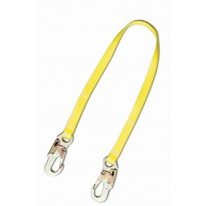
C = Connector
Connectors are devices that connect to the full body harness system
Connectors such as shock absorbing lanyards or self retracting lifelines connect a worker's harness to the anchorage
They can be single products or multiple products working together
Connectors, including D-rings and snap-hooks, must be made from drop-forged, pressed or formed steel, or equivalent materials. They must have a corrosion-resistant finish, with smooth surfaces and edges to prevent damage to connecting parts of the system

Slide 67
Snap Hook Type
Must have a minimum tensile strength of 5000 pounds, and be proof tested to a minimum tensile load of 3,600 pounds without cracking, breaking, or becoming permanently deformed
Must be double locking and designed to prevent the disengagement of the snap hook by the contact of the snap-hook keeper with the connected member

Slide 68
Snap Hook Type Continued
Must have a minimum tensile strength of 5000 pounds, and be proof tested to a minimum tensile load of 3,600 pounds without cracking, breaking, or becoming permanently deformed
Must be double locking and designed to prevent the disengagement of the snap hook by the contact of the snap-hook keeper with the connected member

Slide 69
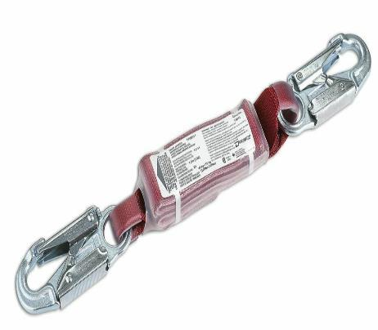
Snap Hooks Must Not Be Engaged To:
Directly to webbing, rope or wire
To each other
To a D-ring to which another snap-hook or other connector is attached
To a horizontal life line
To any object which is incompatibility shaped in relation to the snap-hook such that the connected object could depress the snap-hook keeper and release itself

Slide 70
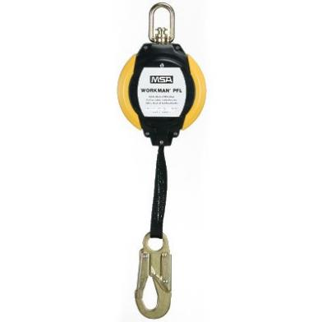
Retractable Life Lines
Very effective for vertical applications
Will normally lock up in 1 to 2 feet, minimizing total fall distance and impact forces on the employee’s body

Slide 71
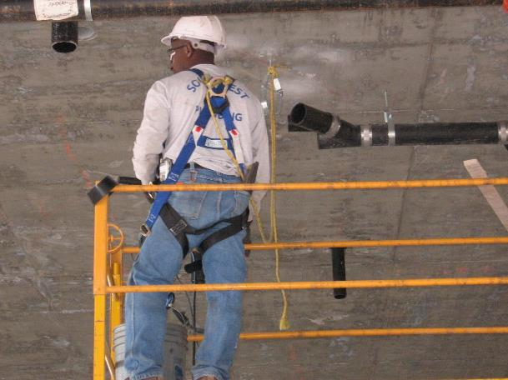

Fall Protection-Safe or Unsafe?
Notes:
Class Participation: Can you identify the hazards in this photograph? The answer is ‘Yes’. As you can see from this photo the worker is using a poly rope tied to a concrete I-bolt that used to hold pipe in place. Secondly, the other end of the rope is tied to the D-ring. Safety Tip: Only use proper equipment and anchor points to reduce the risk of fall.

Slide 72
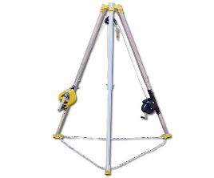
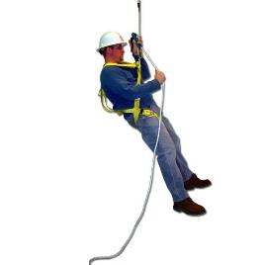
D = Descent and Rescue Systems
Enable the retrieval of and injured or incapacitated worker
Equipment facilitates rapid recovery of the worker without endangering other workers in the process

Slide 73
Rescue Plan
Under 29 CFR 1926.502 (d)(20) requires employers to provide prompt rescue of fall employees, IF the employee can not rescue themselves
Notify community health aid or 911 system of injuries
Provide immediate first aid
Execute a written rescue plan of action
Ensure employees are trained and qualified to rescue injured workers
Evaluate all your options in a worst case scenario to ensure the safety of everyone during a rescue operation

Slide 74

Competent Person
Means one who is capable of identifying existing and predictable hazards in and surrounding, or working conditions which are unsanitary, hazardous, or dangerous to employees, and how has the authorization to take prompt corrective measures to eliminate them

Slide 75

How Can a Competent Person Become Qualified
By possessing a recognized degree, certificate, or professional standing, or by extensive knowledge, training and experience, has successfully demonstrate their ability to solve or resolve problems related to the subject matter

Slide 76

This Concludes our Training

