Slide 1
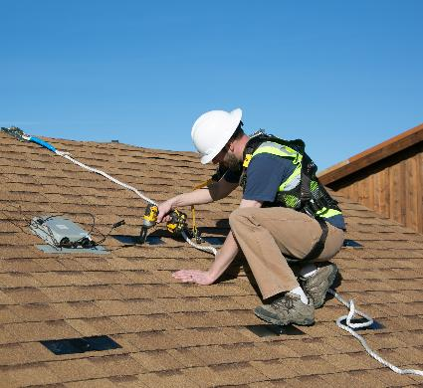
Fall Protection
Disclaimer: This material was produced under grant number SH-31237- SH7 from the Occupational Safety and Health Administration, U.S. Department of Labor. It does not necessarily reflect the views or policies of the U.S. Department of Labor, nor does mention of trade names, commercial products, or organizations imply endorsement by the U.S. Government.
Notes:
Welcome to SEI’s presentation on OSHA fall protection for the solar industry.
Already reviewed the Intro lesson and lesson 1: ladders & lift safety

Slide 2
Learning Objectives
Become familiar with fall protection requirements
List equipment options
Choose fall protection for PV installation
Describe inspection of common equipment
Notes:
Upon completion of this course, students will be able to:
Identify fall protection requirements
List equipment options
Choose fall protection for PV installation
Describe inspection of common equipment

Slide 3
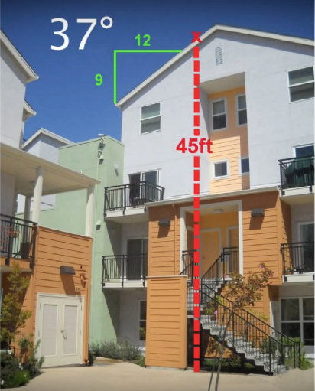
Solar Installation Fatality
A solar installer fell 34 feet to his death during racking installation
Roof edge where the victim fell off
Concrete sidewalk where the victim landed
Source: cdc.gov/niosh
Notes:
Accidents really can and do happen!
In 2010 in CA, a 30 yr old installer was working at this 3-story apartment complex.. He only needed to use a short extension ladder to access the roof but there was a 45 foot drop off at the side roof edge. He was checking the alignment of the racking and presumably walked backwards off the edge, falling to his death on the concrete below.
Note that this was a 37 degree roof and the installer was not wearing fall protection
https://www.cdc.gov/niosh/face/stateface/ca/10ca003.html

Slide 4
Why is Fall Protection Important?
Falls are leading cause of death in construction fatalities
In 2016 38.7% of construction related deaths were from falls
Typically most common OSHA citation
*Source: www.osha.gov
Notes:
Review OSHA fall injury/fatality statistics as introduction to the topic: falls are the leading cause of death in construction fatalities: http://www.ecmweb.com/safety/osha-s-top-10-violations-2017/gallery?slide=1
Workers in the solar industry are often exposed to fall hazards. Hundreds of thousands of PV systems are on pitched roof tops with no parapet or walls. Know the federal and state laws regulating how workers must be protected when at risk of falling. Whether on the roof of single family home or on some sort of personnel-lift, personal fall protection must be provided AND worn.
http://www.ecmweb.com/safety/osha-s-top-10-violations-2017/gallery?slide=1

Slide 5
Employer Responsibility - Fall Protection OSHA 29 CFR 1926.501 & 1926.503
Must provide necessary equipment to do job safely
Shall provide training program for each employee using fall protection
Training led by competent person
Recognition of fall hazards
Procedures to minimize hazards
Erecting, maintaining, disassembling, & inspecting fall protection systems
Role of employees in fall protection plans
Written certification record
Source: OSHA
Notes:
It is the employer’s responsibility to provide a training program and the necessary equipment!
Training must be led by a competent person- A competent person means one who is capable of identifying existing and predictable hazards in the surroundings or working conditions which are unsanitary, hazardous, or dangerous to employees, and who has authorization to take prompt corrective measures to eliminate them.
OSHA requires a written record
https://www.osha.gov/stopfalls/index.html
http://blog.osha4you.com/tips/fall-protection-in-three-steps-plan-provide-train/
OSHA 1926.501, which sets forth requirements for employers to provide fall protection systems for its employees. This violation category is new to the top 10 list this year. Section 1926.503 focuses on Fall Protection – Training Requirements. The employer shall provide a training program for each employee who might be exposed to fall hazards. The program shall enable each employee to recognize the hazards of falling and shall train each employee in the procedures to be followed in order to minimize these hazards. There were a total of 1,523 violations issued in this category.

Slide 6
When is Fall Protection Required? OSHA 29 CFR 1926 subpart M 500 – 503
Employee exposed to fall hazard of 6 feet (1.8 m) or more
Rooftops
Carports
Protect employee from falling by
Guardrail system
Safety net system
Personal fall arrest system
Installed before employee begins work that necessitates fall protection
>6’
Notes:
Review when fall protection is required
Anyone working over 6’
What situations would this apply to
Roofs
Carports
What type of fall protection techniques can be used to meet the OSHA requirements
Guardrails
Safety nets
PFAS
When does fall protection need to be installed
Before work starts
Low-slope roof OSHA 1926.501(b)(10)
Steep-slope roof OSHA 1926.501(b)(11)

Slide 7
When Might Fall Protection Not Be Required?
During inspection, investigation, or assessment of workplace conditions
Sales visit or site survey
Post-installation inspection
Immediately prior to or after construction
First Man Up (FMU) / Last Man Down (LMD)
Based on exposure time and necessity to go near the danger zone
Just because it may not be required, doesn’t mean it isn’t a good idea!
Notes:
OSHA 1926 Subpart M, (1926.500(a)(1)) tells us that, “The provisions of this subpart do not apply when employees are making an inspection, investigation, or assessment of workplace conditions prior to the actual start of construction work or after all construction work has been completed.”
When might this standard apply on a solar installation?
During inspection, investigation, or assessment of workplace conditions
Initial sales visit (typically weeks if not months prior to installation)
Site survey (days/weeks before installation)
Post-installation inspections (days/weeks after installation)
Immediately prior to or after construction
Installing anchor not considered construction, even though it typically happens right before construction work begins
So remember, if you are not using fall protection based on the exception in the above standard, it MUST be prior to the actual start of construction work or after all construction work has been completed. Otherwise you MUST use fall protection when there is a fall hazard.
The ‘First Man Up’ (FMU) is the employer’s designated, trained, and suitably-equipped qualified person (QP) assigned to access an elevated workplace (more than 6 feet above a lower level) for the sole purpose of installing a personal fall arrest system to protect those workers that follow.
The ‘Last Man Down’ (LMD) is the employer’s designated person assigned to removing temporary devices or securing permanent fall protection anchors before descending to a lower level.
Based on exposure time and necessity to go near the danger zone
Just because OSHA may not require fall protection in a particular pre- or post-construction scenario, the fall hazard still exists and it’s better to be safe than sorry!
Archived Notes
https://www.osha.gov/pls/oshaweb/owadisp.show_document?p_table=INTERPRETATIONS&p_id=27314
This subpart sets forth requirements and criteria for fall protection in construction workplaces covered under 29 CFR Part 1926. Exception: The provisions of this subpart do not apply when employees are making an inspection, investigation, or assessment of workplace conditionsprior to the actual start of construction work or after all construction work has been completed. (Emphasis added).
OSHA has set this exception because employees engaged in inspecting, investigating and assessing workplace conditions before the actual work begins or after work has been completed are exposed to fall hazards for very short durations, if at all, since they most likely would be able to accomplish their work without going near the danger zone....[R]equiring the installation of fall protection systems under such circumstances would expose the employee who installs those systems to falling hazards for a longer time than the person performing an inspection or similar work. (Emphasis added).

Slide 8
Fall Protection System Options
Guardrail systems 1926.502(b)
Safety net systems 1926.502(c)
Personal Fall arrest systems 1926.502(d)
Positioning device systems 1926.502(e)
Warning line system 1926.502(f)
Controlled Access Zone 1926.502(g)
Safety monitoring systems 1926.502(h)
Covers 1926.502(i)
Protection from falling object 1926.502(j)
Fall protection plan 1926.502(k)
Notes:
Identify what options are available to meet OSHA fall protection requirements and where to find the requirements for those options
For residential solar installation PFAS and positioning systems are most common
Should also mention guardrails for flat roofs
Mention the other systems are available but are uncommon on residential PV installations
This is just an overview slide- to let people know there are more options out there, and where to get the requirements for them

Slide 9
Choosing Fall Protection
Guardrails
Best way to prevent a fall is to remove a hazard
Put a barrier between worker and fall hazard
Fall restraint mechanisms
Second way to prevent a fall is to restrain worker from reaching the fall hazard
Fall arrest equipment
Least preferred form of fall protection is equipment that stops a fall after it happens
Notes:
Reviewed levels of control in intro lesson, start by removing the hazard if possible, then use engineering to eliminate the hazard, and finally use PPE like fall protection.
Review when the different options that make the most sense for time required to install a fall protection system vs ease of doing the PV install work for example on a large flat roof that is going to take a while to install a guardrail system might be the best choice but it takes a while to install and can be expensive to buy or rent.
For smaller jobs fall restraint or fall arrest may be quicker to install although they may slow down the PV installation process a bit
https://simplifiedsafety.com/fall-protection/difference/

Slide 10
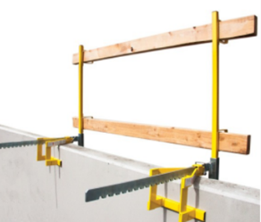
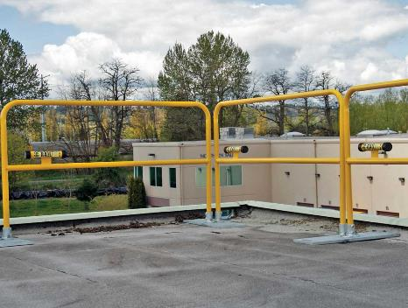
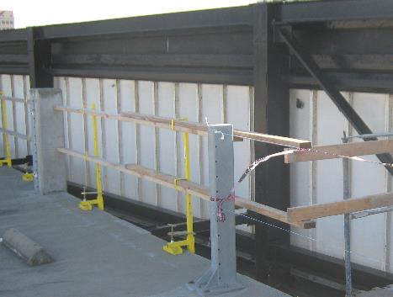
Guardrails OSHA 29 CFR 1926.502(b)
Common on low slope or ‘flat’ roofs
Perimeter of roof plane
Height of top rail 42 inches +/- 3inches
Skylights and wells
Uncommon in residential PV construction
Free-standing
Parapet extensions
Source: SolarPro
Source: Sun Light & Power
Notes:
Give a general description of what a guardrail system is and that they’re most commonly used on commercial systems
Cover specific requirements for guardrail systems
Rail size requirements
Height and spacing requirements
Notes: Top rails and midrails of guardrail systems must be at least ¼ of an inch nominal diameter or thickness to prevent cuts and lacerations. If wire rope is used for top rails, it must be flagged at not more than 6-foot intervals with high-visibility material. Steel and plastic banding cannot be used as top rails or midrails. Manila, plastic or synthetic rope used for toprails or midrails must be inspected as frequently as necessary to ensure strength and stability. The top edge height of top rails or (equivalent) guardrails must be 42 inches plus or minus 3 inches (39- 45 inches) above the walking or working level. When workers are using stilts, the top edge height of the top rail or equivalent member must be increased an amount equal to the height of the stilts.

Slide 11
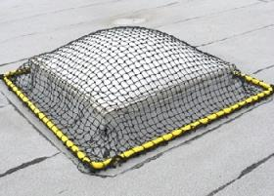
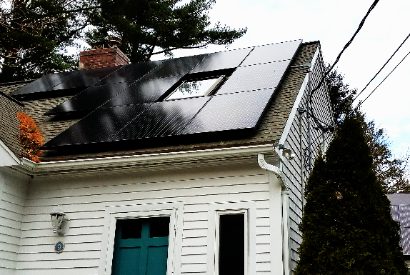
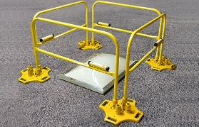
Skylights OSHA 29 CFR 1926.501(b)(4)
Employees shall be protected from falling through skylights
Guardrails – prevent access
Nets or covers – must be rated appropriately
Personal fall arrest system (PFAS)
Notes:
Review why it’s important to protect skylights
Cover OSHA requirements
Discuss options for meeting skylight protection requirements
Nets
Rails
Covers
Tell story about skylight deaths in the solar industry
https://www.cdph.ca.gov/Programs/CCDPHP/DEODC/OHB/FACE/CDPH%20Document%20Library/SolarFatality.pdf
Mention that commercial skylights are typically plastic and pretty fragile
Notes: Each employee shall be protected from falling through holes (including skylights) more than 6 feet (1.8 m) above lower levels, by personal fall arrest systems, covers, or guardrail systems erected around such holes.

Slide 12
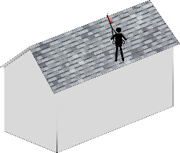
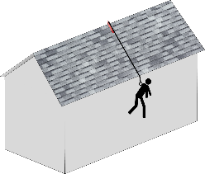
Fall Arrest, Positioning, Fall Restraint Additional training required
Fall restraint system
Lanyard length prevents user from getting to a position where they can fall
Fixed length lanyard
Adjustable lanyard
Less common in residential PV
Positioning system
Body harness system supports user on an elevated vertical surface
User can work with hands free, leaning backward
Common on very steep sloped roofs
Fall arrest system
Protects users in case they fall
Does not limit movement of user
Used on jobs close to roof edge
Most common in residential PV
Notes:
Briefly review the requirements for each topic (we’ll go into more detail in the following slides)
Be sure to cover maximum fall distance for each topic
Fall arrest = 6’
Positioning systems = 2’
Fall restraint = 0’
Discuss when each option would be used
Notes https://www.osha.gov/dts/osta/otm/otm_v/otm_v_4.html#fall
OSHA has no specific standards for restraint systems, however, at a minimum, fall restraint systems should have the capacity to withstand at least 3,000 pounds of force or twice the maximum expected force that is needed to restrain the worker from exposure to the fall hazard.
Positioning Device Systems—1926.502(e) Positioning device systems using body belts or harnesses are to be set up so a worker can free-fall no more than 2 feet while supported on an elevated or vertical surface. They must be secured to an anchorage capable of supporting at least twice the potential impact load of an employee’s fall or 3,000 pounds, whichever is greater. Requirements for snap hooks, D-rings and other connectors used with positioning device systems must meet the same criteria as those for PFA systems.

Slide 13
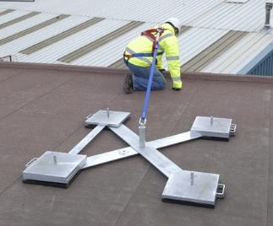
Fall Restraint Systems
No specific OSHA standard
Must prevent user from falling any distance
No potential to fall
Must withstand 3,000 pounds of force or twice the expected load
Most common on flat roofs
Can be used on sloped roofs
Source: simplifiedsafety.com
Notes:
Review the basics of what fall restraint is
Uses same gear as fall arrest or positioning
Prevents employee from any fall
There’s no specific OSHA standard for fall restraint
Must be able to withstand 3,000 pounds of force or twice the expected load incase of a fall
Commonly used on flat roofs but can be used on any roof type

Slide 14
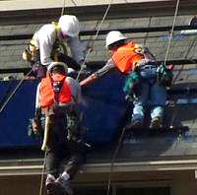
Positioning Device Systems OSHA 29 CFR 1926.502(e) & 1926.500(b)
Used to allow installer positioning on very steep roofs
Shall be rigged such that employee cannot free fall more than 2 feet (0.6 m)
Shall be secured to anchorage capable of supporting
At least twice the potential impact load of an employee's fall
Or
3,000 pounds, whichever is greater
Source: Quick Mount PV
Notes:
Cover OSHA requirements in more detail than previous slide
Describe practical application especially on steep roofs when installing solar
Review different attachment points vs PFAS
Side dee-rings vs back dee-rings
Note that the anchor load requirement is lower (3,000 vs 5,000) for positioning because the allowable fall distance is shorter
Call out lower installer in photo, notice he doesn’t have an attachment on the dee-ring on his back but he clearly is attached to a rope, this is positioning
Notes: Positioning Device Systems – 29 CFR 1926.502(e) OSHA defines a positioning device system as a body belt or body harness system rigged to allow a worker to be supported on an elevated vertical surface, such as a wall, and work with both hands free while leaning. ■ Body belt or body harness systems are to be set up so that a worker can free fall no farther than 2 feet. 29 CFR 1926.502(e)(1). ■ Body belts or harnesses must be secured to an anchorage capable of supporting at least twice the potential impact load of a worker’s fall or 3,000 pounds, whichever is greater. 29 CFR 1926.502(e)(2).

Slide 15
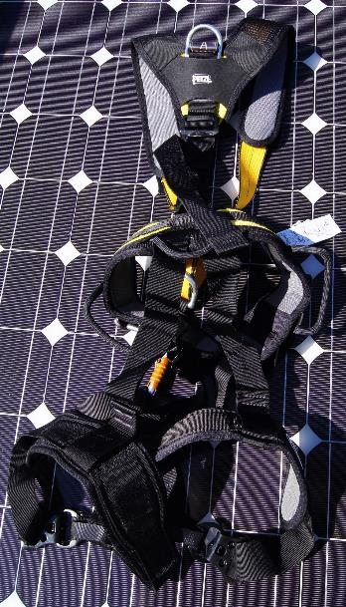
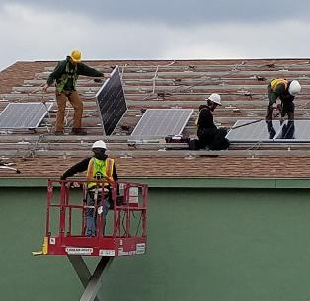
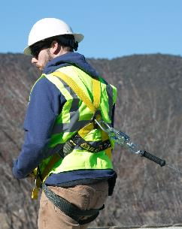
Personal Fall Arrest System OSHA 29 CFR 1926.502(d)
Effectiveness relies on component compatibility
Often, components are supplied as a set
Using non-compatible fittings can lead to damage & failure
Source: SameSun of Vermont
Notes:
Make sure all components are compatible
If they don’t work together they might fail during a fall
Archived Notes
Personal fall protection system effectiveness relies on component compatibility. Often, components are supplied together as a set. Using non-compatible fittings can lead to damage and system failure (see 29 CFR 1926.502(d)(5)).
OSHA says that if an employee can fall six feet or more onto a lower level, fall protection must be provided.
What type of fall protection will I need?
In most cases, a guardrail system, a safety net system, or a personal fall arrest system must be used. In some cases fences, barricades, covers, equipment guards or a controlled access zone may be used. For many pitched roofs the best, or only, option will be a Personal Fall Arrest System (PFAS) including anchorage points, lifelines, and body harnesses. Use of any PFAS requires training and following the manufacturer’s instructions.
Employees must be protected not just from falling off a surface, but from falling through holes and from having objects fall on them from above. Working in the solar industry often exposes the worker to fall hazards (hundreds of thousands of PV systems are on roof tops with no parapet or walls). Know the Federal and state laws and how workers must be protected while at risk of falling. Whether on a single family homes’ roof or some sort of man-lift, personal fall protection must be provided AND worn. When a worker is getting on a roof to make measurements and conduct a shade analysis, some form of fall protection is required. For instance, on a residential home with asphalt composition shingles, the worker could use a Personal Fall Arrest System (PFAS), consisting of at least four items:
An anchor – many products are available specifically for fall protection systems, for all types of roofs, equipment and structures. Some anchors have more than one D-ring, or point of attachments for more than one person. Never should two people attach to one D-ring! Each anchor must be rated for 5,000 pounds of force per worker and must be installed per the manufactures instructions.
The lifeline – there are ropes and cables available to attach workers to the anchor in a safe manner, while still allowing the worker to move freely and work efficiently. The lifeline attaches from the anchor to the body harness.
Body harness – each worker should be issued their own personal body harness, sized properly for their body.
Proper training – all workers using a PFAS must be trained in how to use AND inspect each piece of equipment. Ropes, cables and harnesses should be checked before each use and treated with care so as to avoid damage and compromise the equipment.
There are numerous organizations/companies that provide fall-protection training - go get certified!

Slide 16
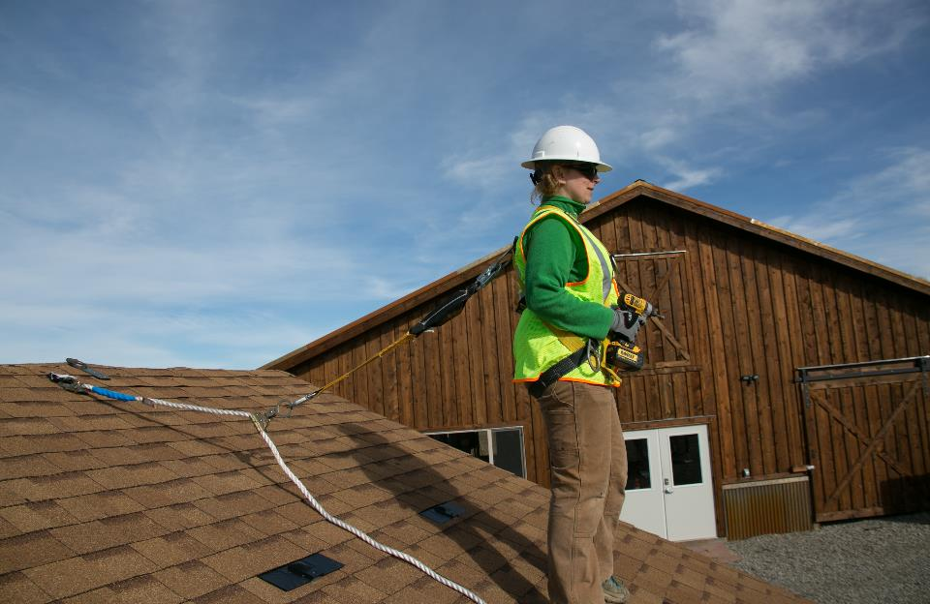
Personal Fall Arrest System Components OSHA 29 CFR 1926.500(b)
4. Shock Absorbing Lanyard
3. Deceleration device
(Rope Grab)
1. Anchor
6. Full-body Harness
5. Snap Hook
2. Life Line
Notes:
Briefly review the components of a PFAS. We’ll go into details in the following slides
Anchor
Lifeline
Lanyard
Rope grab
Harness
(review in the same order as they’re presented in the following slides)
Archived Notes
OSHA says that if an employee can fall six feet or more onto a lower level, fall protection must be provided.
What type of fall protection will I need?
In most cases, a guardrail system, a safety net system, or a personal fall arrest system must be used. In some cases fences, barricades, covers, equipment guards or a controlled access zone may be used. For many pitched roofs the best, or only, option will be a Personal Fall Arrest System (PFAS) including anchorage points, lifelines, and body harnesses. Use of any PFAS requires training and following the manufacturer’s instructions.
Employees must be protected not just from falling off a surface, but from falling through holes and from having objects fall on them from above. Working in the solar industry often exposes the worker to fall hazards (hundreds of thousands of PV systems are on roof tops with no parapet or walls). Know the Federal and state laws and how workers must be protected while at risk of falling. Whether on a single family homes’ roof or some sort of man-lift, personal fall protection must be provided AND worn. When a worker is getting on a roof to make measurements and conduct a shade analysis, some form of fall protection is required. For instance, on a residential home with asphalt composition shingles, the worker could use a Personal Fall Arrest System (PFAS), consisting of at least four items:
An anchor – many products are available specifically for fall protection systems, for all types of roofs, equipment and structures. Some anchors have more than one D-ring, or point of attachments for more than one person. Never should two people attach to one D-ring! Each anchor must be rated for 5,000 pounds of force per worker and must be installed per the manufactures instructions.
The lifeline – there are ropes and cables available to attach workers to the anchor in a safe manner, while still allowing the worker to move freely and work efficiently. The lifeline attaches from the anchor to the body harness.
Body harness – each worker should be issued their own personal body harness, sized properly for their body.
Proper training – all workers using a PFAS must be trained in how to use AND inspect each piece of equipment. Ropes, cables and harnesses should be checked before each use and treated with care so as to avoid damage and compromise the equipment.
There are numerous organizations/companies that provide fall-protection training - go get certified!

Slide 17
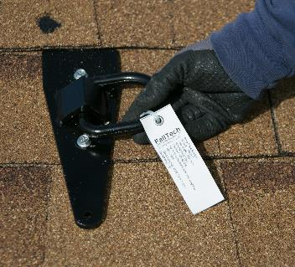
Anchor Requirements OSHA 29 CFR 1926.502(d)(15) & 1926.1423(g)
Shall be capable of supporting at least 5,000 pounds per employee attached
OR
Shall be designed, installed, and used
As part of complete personal fall arrest system
With safety factor of at least two
Under the supervision of a qualified person
Anchors not effective if attached to weak materials
Follow anchor manufacturer instructions for proper installation
Notes:
Describe what an anchor is and what it’s used for
Review specific OSHA anchor requirements
Talk generally about how anchors should be installed
Must go into structural member
Be sure to talk about reading manufactures instructions because installation requirements will vary
Archived Notes
Certain structural members may not be strong enough to hold the sudden weight imposed by a falling worker. The anchorage manufacturer should provide instructions on anchor installation (see 29 CFR 1926.502(d)(15); 29 CFR 1926.1423(g)).
Anchors are fixed to a strong structural member. Anchors are not effective if they are attached to weak materials. Certain structural members may not be strong enough to hold the sudden weight imposed by a falling worker. The anchorage manufacturer should provide instructions on anchor installation (see 29 CFR 1926.502(d)(15); 29 CFR 1926.1423(g)).

Slide 18
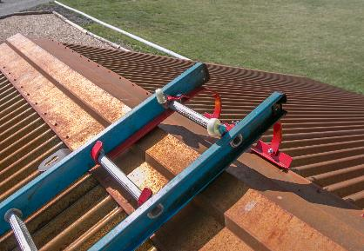
Fall Protection Anchor Installation
First person up installs anchors
Best practice – not OSHA
Must be qualified / trained
At least one anchor per person
Install fall protection first by using ladder with ridge hook
Limit number of people on each anchor
Typically one person per anchor
Unless rated for more than one by manufacturer
Notes:
Review how to safely install a roof anchor
Install anchor first thing when you get to the job
Who should install the roof anchor
Competent person – refer to OSHA definition
Best practice on how to install the anchor
Use a chicken ladder
Cover roof anchor limitations
One person per anchor
Archived Notes
https://simplifiedsafety.com/blog/selecting-the-right-anchor-point/
Shy of a good ol’ structural I-Beam, it’s going to be hard to make a case for making a field decision to use any other structural member as an anchor point. In order for something to qualify, it must be able to withstand 5000 lbs. of force per person attached or a safety factor of 2 (meaning 2x the forces that would be applied to it in a fall). Now, here’s a little test. Grab any person in the field and ask them what the criteria for an anchor point is. Those who don’t know can’t possibly make a decision on which part of the structure to choose. Still, if you have anybody remaining that did know the criteria, ask which parts of the structure meet these criteria. Many are going to say “I don’t know.” Eliminate them as well, because they can’t select an anchor point by their own admission. If somebody gives you an answer other than “I don’t know,” ask them how they know what they selected meets the criteria. If they can’t explain, then they can’t select an anchor point either. If they can (or attempt to), ask them if they’d be willing to sign a piece of paper stating that the anchor point is sufficient or provide data that supports their selection.
The point I’m trying to make is that, other than an engineer who has stopped to review some specs and perform some calculations, most people aren’t going to know what can or can’t meet the requirements of an anchor point and, even if they could, they’re not going to be able to provide the proof you need to make the anchor point a valid option. I-Beams are pretty much your only randomly selected option. Like all other options, the connection still needs to be approved by an engineer and you’re going to need to make sure you have the proper equipment with which your workers will connect. Whether a beam clamp, a beam wrap, or some other designed system, every last piece needs to be in place. It only takes the failure of one component for the whole system to fail
https://www.osha.gov/dte/grant_materials/fy12/sh-23536-12/StudentReferenceMaterials.pdf
From https://www.roofingcontractor.com/articles/91575-first-man-up-last-man-down – “The ‘First Man Up’ (FMU) is the employer’s designated, trained, and suitably-equipped qualified person (QP) assigned to access an elevated workplace (more than 6 feet above a lower level) for the sole purpose of installing a personal fall arrest system to protect those workers that follow.”

Slide 19
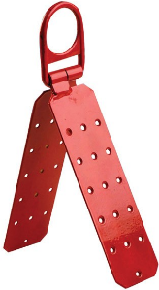
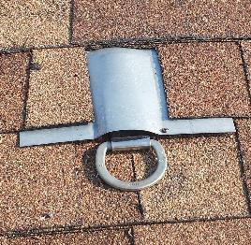
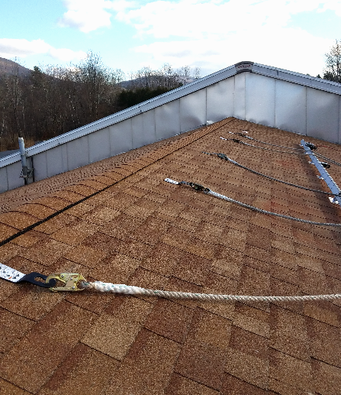
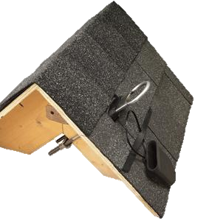
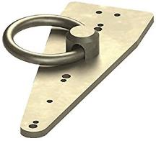
Composition Shingle Anchors
Source: SameSun of Vermont
Notes:
Review anchors that can be used on a comp shingle roof
The bull ring anchor in the top center is one of the best options
Requires fewer roof penetrations
Easy/fast to install
Easier to repair roof
Doesn’t have to be at ridge
The hinged anchor takes longer to install and requires significantly more roof penetrations plus it’s harder to repair the roof after it’s removed
Talk about permanent anchors which can be a good option especially if there’s regular O&M required

Slide 20
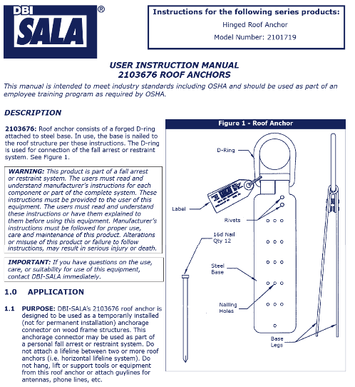
Read Manufacture’s Instructions!
Anchor attachment must follow manufacturers instructions
including specifications of fastener
In example, hardware must be twelve 16d nails
Notes:
How the roof anchor is attached must following manufactures instructions including the swpecifications of the screws.
In the specific example, the attachment must be 2” x #10 Wood Screws.

Slide 21
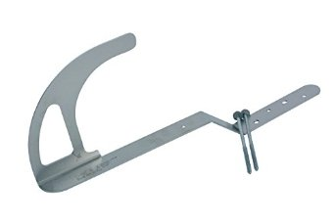
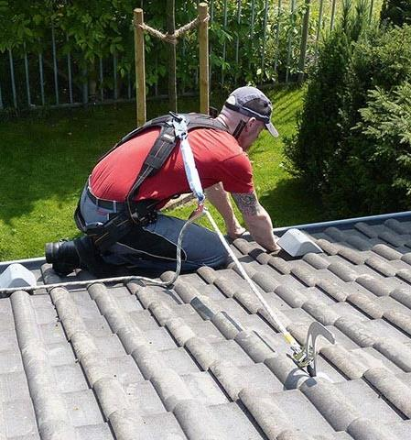
Tile Roof Anchors
Notes:
Discuss anchor options for tile roofs
Review best practice on how to install and remove tile roof anchors

Slide 22
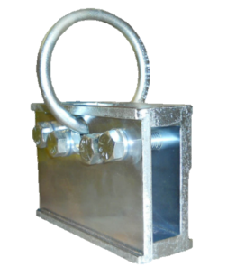
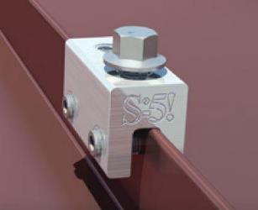
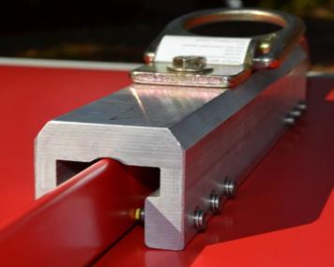
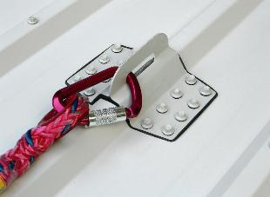
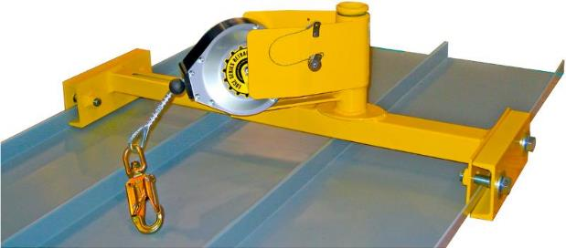
Metal Roof Anchors
Notes:
Review metal roof anchors
Discuss standing seam anchors
Make sure to talk about how the load capacity of the anchor depends significantly on how the metal roof is attached to the building since the anchor attaches directly to the roofing
Note that there are no penetrations in the roof
Discuss screw down metal roof anchors
Must be attached to structural member below the roof
Next to impossible to repair roof if the anchor is removed
Consider permanent anchors or anchoring to something off the roof
Review how any clamp not designed to be used for fall protection, like the S-5 clamp, can’t be used as an anchor even though some roof anchor systems may use that type of clamp
from http://www.criticaltool.com/safewaze-extreme-fs-ex311-single-standing-seam-roof-bracket?gdffi=1966c90999b544b7b4dee8376ab0fa30&gdfms=BCCF162879F64E42919CC8F19F242E1B&gclid=EAIaIQobChMIhdGW45-X2AIVCG1-Ch3IQARGEAQYAyABEgLlafD_BwE

Slide 23
Anchor Placement Example
Typ 8’
Typ 8’
Typ 8’
Min 6’
Min 6’
Anchors at roof ridge – prevents striking a lower level during a fall
30º
30º
Safe working range to reduce swing fall hazards
* Always follow manufacturers instructions!
Notes:
Review the best practices of how to work with a roof anchor
Anchor spacing (follow manufacturers instructions)
How to reduce swing hazard
Best places to locate a roof anchor
Top of roof near ridge above where array will be located
Archived Notes
Minimize swing falls:
Work directly below the anchor.
Do not extend your work zone more than 30º from the anchor.
Manage the slack in the rope.
It is widely recommended that swing fall hazards be prevented by not working greater than 30 degrees from the anchor point. This data comes directly from roof anchor manufacturers and is even recognized by CAL/OSHA.
DBI-SALA (leading manufacturer) http://www.fallprotectionusa.com/DBI/Anchors/Instructions/2103670.pdf
Discuss that workers should not work beyond 30 degrees of the anchor point in order to reduce swing fall hazards.
It is widely recommended that swing fall hazards be prevented by not working greater than 30 degrees from the anchor point. This data comes directly from roof anchor manufacturers and is even recognized by CAL/OSHA.
DBI-SALA (leading manufacturer) http://www.fallprotectionusa.com/DBI/Anchors/Instructions/2103670.pdf

Slide 24
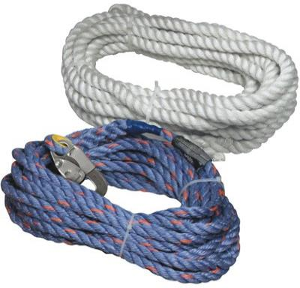
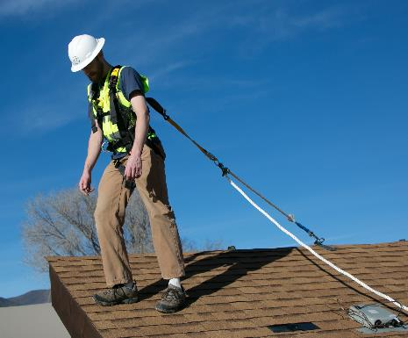
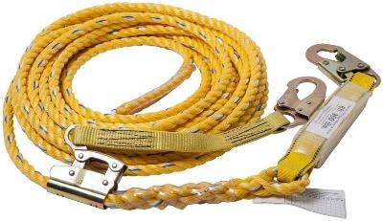
Vertical Lifeline Requirements OSHA 29 CFR 1926.502(d)
Shall have minimum breaking strength of 5,000 pounds
Each employee shall be attached to separate lifeline
Notes:
Describe what a lifeline is and the different types that are available
What’s the best length to use 25’ vs 50’
Mention they tend to be a trip hazard on low slope roofs
Talk about how they aren’t designed to be wrapped around things like chimneys, trees, or structural members and attached back to themselves (snaphook can’t be attached back to the lifeline)
Have to be kept slack out of lifeline to prevent falls of more than 6’
Review OSHA lifeline requirements
Each employee has their own
Min breaking strength of 5,000 #
Min 5/8”
Must be made of synthetic fibers
Archived Notes
Vertical lifelines and lanyards must have a minimum breaking strength of 5,000 pounds. 29 CFR 1926.502(d)(9). ■ Lifelines must be protected against being cut or abraded. 29 CFR 1926.502(d)(11).
Vertical lifelines are usually made of synthetic rope that is 16-mm (5/8-in) in diameter or larger. The photo in the center shows a three-strand twisted rope made from a polypropylene/polyethylene blend. The different-coloured strands indicate that this rope is approved as a lifeline
Ropes and straps (webbing) used in lanyards, lifelines, and strength components of body belts and body harnesses must be made of synthetic fibers. 29 CFR 1926.502(d)(14).

Slide 25
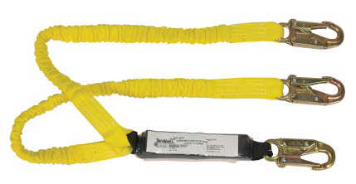
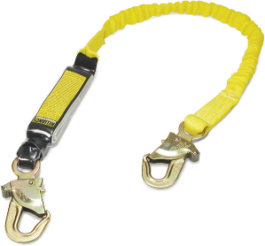
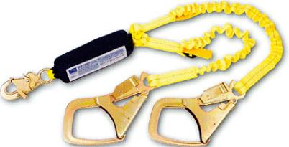
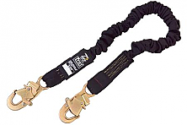
Lanyards OSHA 29 CFR 1926.502(d)(9)
Minimum breaking strength of 5,000 pounds
Shall be made from synthetic fibers
Do NOT use fall protection lanyards to hoist materials
Notes:
Review what a lanyard is and when it’s used
Mention that 3’ lanyards are significantly easier to use on a pitched roof vs a 6’ lanyard because they get the rope grab closer to the worker which allows them to keep the slack out of the lifeline easier
Talk about integrated deceleration devices (rip webbing or expanding webbing, etc)
Talk about Y lanyards
Review OSHA lanyard requirements
Min breaking strength of 5,000 #
Made of synthetic materials
Can’t be used to hoist materials
Archived Notes
Energy absorber When you are using fall arrest equipment, use a lanyard with an energy absorber (commonly called a shock absorber). It will absorb some of the energy exerted on your body while your fall is being stopped. This could save your life.
Vertical lifelines and lanyards must have a minimum breaking strength of 5,000 pounds. 29 CFR 1926.502(d)(9).
Lifelines must be protected against being cut or abraded. 29 CFR 1926.502(d)(11).
* Lanyards used for personal fall protection are not to be used for hoisting materials. (OSHA29 CFR 1926.502(d)(18)).

Slide 26
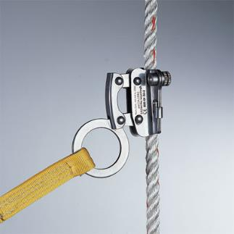
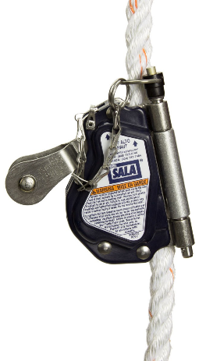
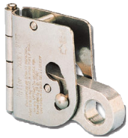
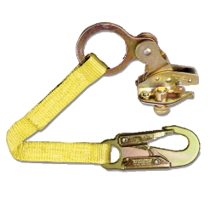
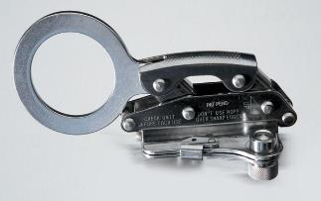
Rope Grabs OSHA 29 CFR 1926.500(b)
Will lock with sharp tug or pull
Notes:
Describe what a rope grab is and how they’re used
Must be kept tight to limit fall distance to 6’ or less (limit slack on lifeline)
Can be removable from lifeline
Some are permanently attached to lifeline (less expensive)
Some have lanyard permanently attached
Separate components allow easy replacement if one part is damaged, if they’re integrated (rope grab to lifeline and/or lanyard to rope grab) the whole unit will need to be replaced if damaged
Many different styles, some are easier to work with than others, try a couple out and find one you like
Archived Notes
Rope grab – a deceleration device which travels on a lifeline and automatically, by friction, engages the lifeline and locks so as to arrest the fall of a worker. A rope grab usually employs the principles of inertial locking, cam/level locking, or both.
Deceleration device – any mechanism (such as a rope grab, rip-stitch lanyard, specially-woven lanyard, tearing or deforming lanyards, automatic self-retracting lifelines/ lanyards, etc.) which serves to dissipate a substantial amount of energy during a fall arrest, or otherwise limit the energy imposed on a worker during fall arrest.

Slide 27
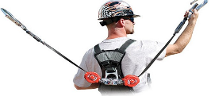
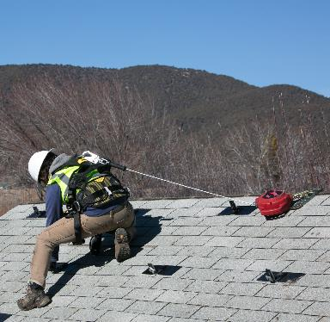
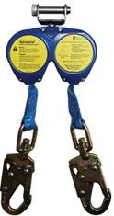
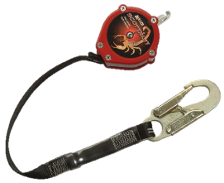
Self-retracting Lanyards OSHA 29 CFR 1926.502(d)(12) & (13)
Free fall limits
≤ 2’ fall distance = minimum load 3,000 lbs
≥ 2’ fall distance = minimum load 5,000 lbs
May have deceleration device to dissipate energy during a fall
Tearing and deforming lanyards
Rip-stitch lanyards
Notes:
Describe what a self-retracting lanyard is
Has a cam like a seat belt in a car that locks when force is applied to the lanyard but can move free when no force is applied
Mention that they’re really useful on low pitch roofs because they tend not to get tangled in rails and they reduce the trip hazard when compared to a rope lifeline
Review the OSHA requirements for self-retracting lifelines
Max 2’ free fall distance
Min load of 3,000 #
More than 2’ freefall (but less than 6’)
Min load of 5,000 # (Same as regular lanyard)
Archived Notes
Self-retracting lifelines and lanyards that automatically limit free fall distance to 2 feet or less must be capable of sustaining a minimum tensile load of 3,000 pounds applied to the device with the lifeline or lanyard in the fully extended position. 29 CFR 1926.502(d)(12).
Self-retracting lifelines and lanyards which do not limit free fall distance to 2 feet or less, ripstitch lanyards, and tearing and deforming lanyards must be capable of sustaining a minimum tensile load of 5,000 pounds applied to the device with the lifeline or lanyard in the fully extended position. 29 CFR 1926.502(d)(13).

Slide 28
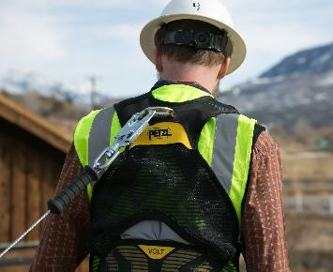
Dee rings and Snaphooks OSHA 29 CFR 1926.502(e)(6) & (7)
Minimum tensile strength of 5,000 pounds
Proof-tested to minimum tensile load of 3,600 pounds
Without cracking, breaking, or taking permanent deformation
Sized to be compatible with member to which they are connected
Prevents unintentional disengagement of the snaphook
Snap hook
Dee ring
Notes:
Review what a snaphook is and how it’s used
Be sure to talk about different types
Rebar hooks
Standard ones
Etc.
Review OSHA snaphook requirements
Must be locking
Load tested to 3,600#
Sized properly for what they’re connected to
Archived Notes
Snaphooks must be the locking type and designed and used to prevent disengagement from any component part of the personal fall arrest system. 29 CFR 1926.502(d)(5).
Locking type snaphooks may also be used when designed for the following connections:
directly to webbing, rope, or wire rope;
to each other;
to a Dee-ring to which another snaphook or other connector is attached;
to a horizontal lifeline; or
to any object which is incompatibly shaped or dimensioned in relation to the snaphook, such that unintentional disengagement could occur by the connected object being able to depress the snaphook keeper and release itself. 29 CFR 1926.502(d)(6).

Slide 29
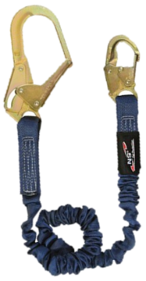
Snaphooks OSHA 29 CFR 1926.502(e)
Only locking type snaphooks shall be used
Will prevent ‘twist out’
Unless designed for, snaphooks shall not be engaged
Directly to webbing, rope, or wire rope
To each other
To a dee-ring that already has another snaphook or connector attached
To a horizontal lifeline
Notes:
Identify how snaphooks can’t be used
Connected directly to a rope
Connected to each other
Connected to a dee-ring or anchor that already has another snaphook connected to it
Connected to a horizontal lifeline
Archived Notes
(1926.502(e)(3)Connectors shall be drop forged, pressed or formed steel, or made of equivalent materials.1926.502(e4)Connectors shall have a corrosion-resistant finish, and all surfaces and edges shall be smooth to prevent damage to interfacing parts of this system.1926.502(e)(5)Connecting assemblies shall have a minimum tensile strength of 5,000 pounds (22.2 kN)

Slide 30
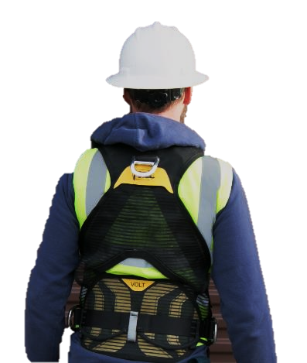
Body Harnesses OSHA 29 CFR 1926.502(d)(17)
PFAS uses dee-ring between shoulder blades to attach lifeline
Never use harness to hoist tools or equipment
Notes:
Review what a body harness is and how it’s used
Specifically point out that to meet PFAS requirements the lanyard has to be attached to the back dee-ring
Side dee-rings are for fall hazard lanyards attached to equipment like a drill or for positioning not fall arrest
Discuss OSHA harness requirements
Limit max force on the worker to 1,800#
Be rigged so the worker can’t freefall more than 6’ or hit a lower level
Max deceleration distance of 3.5”
Sufficient strength to withstand twice the potential impact energy of a worker free falling 6’
Be inspected prior to each use
Removed from service if it’s defective
Archived Notes
Limit the maximum arresting force on a worker to 1,800 pounds when used with a body harness. 29 CFR 1926.502(d)(16)(ii). ■ Be rigged so that a worker can neither free fall more than 6 feet nor contact any lower level. 29 CFR 926.502(d)(16)(iii). ■ Bring a worker to a complete stop and limit the maximum deceleration distance a worker travels to 3.5 feet. 29 CFR 1926.502(d)(16)(iv). ■ Have sufficient strength to withstand twice the potential impact energy of a worker free falling a distance of 6 feet or the free fall distance permitted by the system, whichever is less. 29 CFR 1926.502(d)(16)(v). ■ Be inspected prior to each use for wear, damage, and other deterioration. Defective components must be removed from service. 29 CFR 1926.502(d)(21).

Slide 31
Body Harnesses OSHA 29 CFR 1926.502(d)(16)
Each worker should be issued their own personal body harness, sized for their body
Notes:
Use this slide to compare different harness types
Harness on the left is a cheap uncomfortable harness that usually comes in a “safety in a bucket” package
Middle harness is a pretty standard harness that’s reasonably comfortable and relatively affordable
Harness on the right is a high end harness that is very comfortable (for a harness) but it’s expensive

Slide 32
Suspension Trauma Straps
Used while hanging after a fall
Relieves pressure on legs
Allows blood flow to legs
Reduces risk of blood clots / stroke
Notes:
Photo Source: http://www.safetydirect.ca/0303AccStraps.htm

Slide 33
PFAS Total Fall Distance
Must stop before hitting lower level!
OSHA required maximum distances
Freefall = 6’
Deceleration = 3.5’
Lifeline elongation = 2’
Total max fall before stopping = 11.5’
Notes:
Review maximum allowable fall distances
Freefall = 6’
Deceleration = 3.5’
Lifeline elongation = 2’
Total distance = 11.5’
Talk about how it is important to minimize slack in rope to keep freefall below 6’
Discuss how all these maximum distances add up so fall distance may be long but PFAS must still prevent employee from hitting the lower level. May be challenging on a roof that’s only 10’ high.

Slide 34
Equipment Inspection OSHA 29 CFR 1926.502(d)(21)
Personal fall arrest systems shall be inspected prior to each use
Notes:
Briefly talk about inspecting equipment, we’ll go into more detail on the next slide
PFAS’s must – “Be inspected prior to each use for wear, damage, and other deterioration. Defective components must be removed from service. 29 CFR 1926.502(d)(21)”

Slide 35
Equipment Inspection OSHA 29 CFR 1926.502(d)(21)
Webbing / ropes
Cuts, frays, holes, deterioration
Dee-rings / snaphooks
Missing parts, deformation, cracks, rust / corrosion
Harness
Cuts, frays, holes, damaged buckles
Anchors
Rust / corrosion, deformation, damage
Notes:
Discuss why it’s important to inspect your equipment before the start of each day.
Review what to look for when inspecting the system
Talk through each of the bullet points
Review OSHA requirement for equipment inspection

Slide 36
Pre-Installation Site Visit: Identify Hazards
Roof vents can be a trip hazard
Skylights
Roof leading edge
Possible falling objects during installation
Notes:
This slide will review how to identify different roof hazards
Overhead power lines
Falling objects
Skylights
Roof vents/trip hazards
Leading edge/fall hazards

Slide 37
Pre-Installation Site Visit: Determine Equipment
Personal Fall Arrest System (PFAS) needed for heights over 6’
PFAS will also protect from hitting lower level if employee falls through a skylight
Back door will need to be blocked to reduce falling objects hazard
Notes:
Use this slide with the same picture as the last to show safety equipment in use to protect from hazards that were identified in last slide
Archived Notes
Step ladder for attic could be either fiberglass or aluminum

Slide 38
JHA
Kayla
1/1/2018
30 Jones Rd.
Montpelier, VT
Ctrl VT Med Center
130 Fisher rd, Berlin, VT
Single story building with skylights
Installing racking
Installing modules
☑
Use Personal Fall Arrest System
☑
Fall protection required
☑
Mark fall hazard area with caution tape and block front door from inside with traffic cones
Body harnesses, anchors, rope, lanyards, rope grabs, traffic cones
Notes:
Describe a job hazard analysis form
Review topics that would be addressed on the form specific to fall protection
Be sure to talk about the OSHA requirements for documentation

Slide 39
Considerations when Choosing Fall Protection System
Where is the array located?
Pitch of roof
Multiple array locations
Different work zones
Proximity of work to roof edge
How many people working on roof?
How big of a system is being installed?
What jobs will be performed?
How long will they take?
How frequently do they occur?
Freedom of movement required
Notes:
Review how the site affects fall protection equipment choices
Discuss some of the solar specific best practices when using a PFPS
Steep roof – may make sense to put in toe boards and use a rope for positioning
Low slow roofs – retractable lanyards are easier as they don’t lay on the roof which reduces trip hazards
Might be worth installing permanent anchors for jobs that will require O&M
Larger jobs with flat roofs may be worth using a guard rail system small jobs might be easier to use PFPS

Slide 40
Getting off the Roof
All work is complete
Happens at every site
Need to disconnect from anchor
Have plan / procedure to protect workers
Ensure good footing when stepping onto ladder / lift
Roof surface clear of debris
Notes:
Review best practices for transitioning on and off of the roof
Connect fall protection before getting off ladder onto the roof
Get onto the ladder first before disconnecting fall protection when leaving the roof
Review how to remove the fall protection system safely
Opposite of how to install it
Competent person on a ladder with a peak hook
Archived Notes
The ‘Last Man Down’ (LMD) is the employer’s designated person assigned to removing temporary devices or securing permanent fall protection anchors before descending to a lower level.
From https://www.roofingcontractor.com/articles/91575-first-man-up-last-man-down

Slide 41
After a Fall OSHA 29 CFR 1926.502(d)(19) & (20)
Follow company’s rescue plan
Addresses procedures, equipment, and personnel needed
Aided rescue - employer provides for prompt rescue of employees
Self-rescue - employer insures employees are able to rescue themselves
Immediately remove equipment from service
Not used again until inspected by competent person
Notes:
Review what to do if someone falls off a roof
Have a specific rescue plan
Have equipment and plan read for aided rescue
Have the ability for the worker to self-rescue
In most cases on a residential roof other employees will be able to put up a ladder to rescue the fallen employee
Remove equipment from service until its been inspected by competent person
Best practice is to destroy equipment that’s subject to a fall, better safe than sorry
Per Ryans comment - https://www.osha.gov/pls/oshaweb/owadisp.show_document?p_table=INTERPRETATIONS&p_id=24871
Question #1: What is the maximum allowable time for an employee to remain suspended from a harness and lanyard after falling or being ejected from a vehicle-mounted elevating and rotating work platform? Answer: OSHA standards do not provide specifically for a maximum allowable time to remain suspended in a harness following a fall event. There are, however, circumstances that, when taken in consideration with other OSHA requirements, could result in a maximum allowable suspension time. An example of this is 1910.269(b)(1)(ii), where the standard requires that employees exposed to electric shock at fixed work locations must be able to be reached by trained persons within four (4) minutes. ¹ Therefore, if a fall event occurred at a fixed location following an electric shock, then the employee could be suspended no longer than four (4) minutes after being discovered, as a result of the requirements of 1910.269(b)(1)(ii).
'you cannot leave a worker hanging in a harness for more than 5-10 minutes. Need to have a plan to lower them to ground ASAP. Once on the ground, have them sit down with their legs out in front to stop possible clots going to brain or heart.

Slide 42
Additional Resources
SolarPro issue 5.2
Fall Protection Systems
Fall Protection Equipment Inspection and Maintenance
Guardian Fall Protection
Inspection Forms
ProfessionalRoofing.net
Solar Safety
Preventing Falls in the Solar Industry video
https://www.youtube.com/watch?v=imiFPy2DZkM&feature=youtu.be
Notes:
Review some other resources for more information on fall protection
Guiardian forms were complied by me into one pdf and prof roofing article was found here http://docserver.nrca.net/technical/9954.pdf

