Slide 1
Why Focus on Falls?
Nearly 40% of all fatal accidents on constructions sites are fall events
Almost all fatal falls could have been prevented if conventional fall protection had been used
DISCLAIMER: This material was produced under grant number SH-31204-SH7 from the Occupational Safety and Health Administration, U.S. Department of Labor. It does not necessarily reflect the views or policies of the U.S. Department of Labor, nor does mention of trade names, commercial products, or organizations imply endorsement by the U.S. Government.
Notes:
Read out loud the slide’s first point.
In CIRPC’s annual report “fall from roofs” has been the top event cause since the report started in 1991.
Read out loud the slide’s second point.
In all cases (except for a minor few) conventional fall protection, used correctly, would have prevented the fatality.
DISCLAIMER: This material was produced under grant number SH-31204-SH7 from the Occupational Safety and Health Administration, U.S. Department of Labor. It does not necessarily reflect the views or policies of the U.S. Department of Labor, nor does mention of trade names, commercial products, or organizations imply endorsement by the U.S. Government.

Slide 2
What is Conventional Fall Protection?
Guardrail systems
Safety net systems
Personal fall arrest systems (PFAS)
Notes:
The three points in the slide are the three main types of conventional fall protection.
Guard rails can be seen in many flat roof construction projects (or leading edges) like roofing.
Nets are normally seen in conjunction with other protection, or in cases where PFAS is more difficult to use. They can also be used to protect pedestrians from falling debris.
PFAS is the most commonly used. It is comprised of an anchor point with a lanyard and harness.

Slide 3
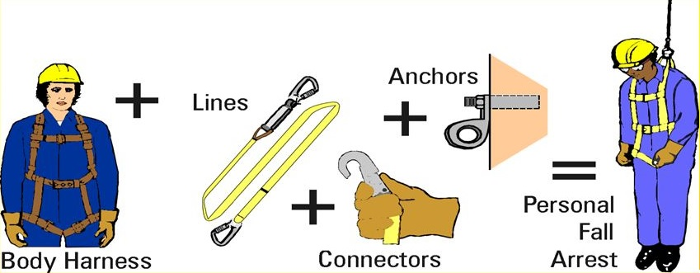
The Components of a Personal Fall Arrest System
Notes:
Explain what the PFAS components are (from the picture).
Anchors and connectors have to hold at least 5,000 pounds per employee attached.
Lines should have a maximum of 6 feet free fall distance (or less depending on the type of lines).
Harness should have an connection point on the back of the employee close to shoulder height.

Slide 4
When to Use Conventional Fall Protection
The 6 Foot Rule…
  Any location when a 6 foot fall could occur → Use Fall Protection
  Roofs
  Structures
  Towers
  Power Poles
  Any leading edge, walking, or working surface of a 6 foot height
  Exceptions:
  Scaffolding (10 feet)
  Steel Work (15 feet)
  When the employer can demonstrate that it is infeasible or creates a greater hazard to use these systems, THEN the employer must develop and implement a fall protection plan which meets the requirements of 29 CFR 1926.502(k).
Notes:
Here are locations where fall protection should be used. Basically any location/leading edge 6 feet above a lower level.
Exceptions are scaffolding and steel work. CAL-OSHA has a 15 foot rule for trusses, beams, and purlins and it does not have to classify as steel work to meet this. Wooden trusses come under the 15 foot rule exception.
Alternative fall protection plan must to be approved by OSHA area office before use.

Slide 5
Competent vs. Qualified Person
29 CFR 1926.32(f) states: "Competent person" means one who is capable of identifying existing and predictable hazards in the surroundings or working conditions, which are unsanitary, hazardous, or dangerous to employees, and who has authorization to take prompt corrective measures to eliminate them.
29 CFR 1926.32(l) states: "Qualified" means one who, by possession of a recognized degree, certificate, or professional standing, or who by extensive knowledge, training and experience, has successfully demonstrated his ability to solve or resolve problems relating to the subject matter, the work, or the project.
Notes:
Here is a question that is always asked… So what’s the difference? Competent person could be the foreman with 25 years experience that understands the process and safety involved with it. A qualified person could be the college degreed person in a matching area.
An example would the setting up of a scaffold. The competent person could set it up, but the qualified person is needed to design it.

Slide 6
Categories of Falls
Roofing/Structure Falls
Ladder Falls
Scaffolds/Platform Falls
Bucket/Aerial Lift Falls
Fall though Opening
Notes:
Read the slide out loud to the class.
These are the categories of falls the training class will cover.

Slide 7
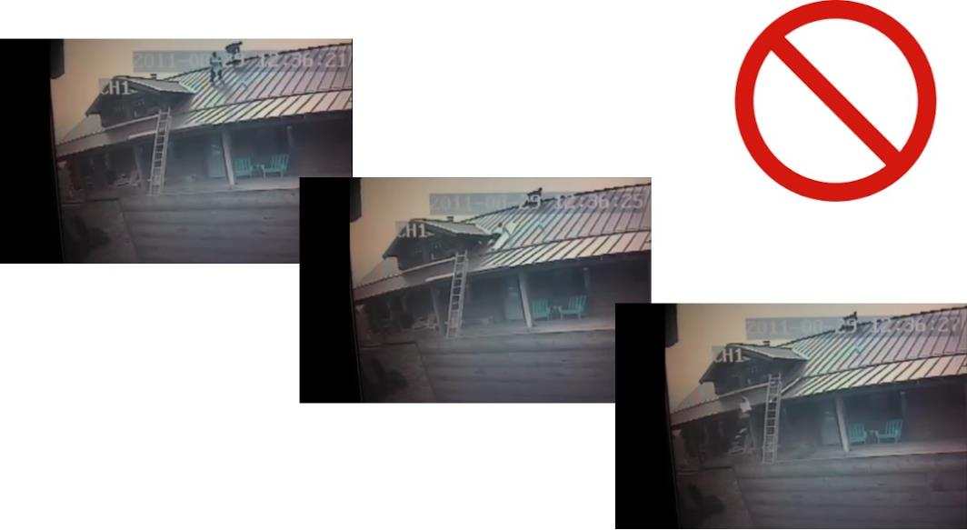
I. Roofing/Structures
Photos of slipping and sliding off a roof without fall protection
Notes:
In the first picture, it shows a roofer on the roof working.
The 2nd picture shows him slipping and starting to slide off the roof.
In the last picture, it shows him sliding off the roof and heading towards the ground.

Slide 8
I. Roofing/Structures
Low Sloped Roof
Low Sloped Roof (Not greater than 4 in 12)
Guardrail system
Safety net system
Personal fall arrest system
A combination of conventional fall protection systems and warning line systems, or
A warning line system and a safety monitoring system.
Notes:
Safety devices that can be used in low sloped roof situations.
Read out loud the different devices.
A warning line system is a rope with flags hanging off it. They are set back a number of feet from the edge to alert workers of the hazard.
A safety monitor is a person actively watching the workers and alerting them if they get to close to the edge.

Slide 9
I. Roofing/Structures
High Sloped Roofs
High Sloped Roofs (Greater than 4 in 12)
Guardrail systems with toe boards,
Safety net systems, or
Personal fall arrest systems.
Notes:
For roofs with a slope greater than 4/12, these three safety devices can be used.
Toe boards help prevent sliding and guard rails stop a falling/sliding person from falling off the roof.
Personal fall arrest systems (PFAS) can be used effectively to keep workers safe on both low and high slope roofs.

Slide 10
I. Roofing/Structures
Walking and Working Surfaces
Guard all hazards – any potential places for a fall – holes, edges, trips.
Area should be clean and dry.
Inspect the area regularly.
Use the appropriate fall protection.
Train and re-train as needed.
Notes:
Go over each of the points in the slide.
Guard any potential fall hazard if they can’t be removed. Keep the area clean and free from any trip hazards.
Inspect the area regularly for any potential hazards that may arise during construction.
Use the appropriate fall protection as needed. Meet the requirements for scaffold fall protection and leading edges (6 feet).
Train all new employees and re-train as needed.

Slide 11
I. Roofing/Structure
Case Study Background
Roofing/Structure Fall Case Study
Jones Roofing
Company is in South
27 years in the roofing business
4 Employees and Owner/Supervisor
Specializing in Roof Replacements (Commercial or Residential)
Note: All names (employee and company) have been changed
Notes:
Case study of a fall from roof fatality.
Read the slide’s information out loud.

Slide 12
I. Roofing/Structure
Narrative
Roofing/Structure Fall Case Study
Narrative of the event:
On a Friday morning (10:30 am) in the month of October three employees were working on a 4:12 re-roofing operation of a two-story apartment building. The three employees (Johnny, Tommy, and Billy) were on the roof putting down chalk lines as guides prior to installing shingles. They had already marked the spacing and had “popped” the initial chalk lines at 11 inches from the bottom edge and then another 20 inches up from there. Johnny and Tommy were at each end of the chalk line and Billy was in the middle to “pop” the line on the tar paper covered roof.
Before marking the third line the chalk line needed to be re-chalked. The line was reeled back and chalked. Then Tommy held the chalk box and Johnny walked backwards with the line in his hand. Tommy and Billy watched Johnny walk backwards towards the edge and then, while still backwards, walk off the roof and fall 19 feet to the ground below.
Johnny passed away in the ambulance ride to the hospital.
Notes:
Read the narrative of the event out loud to the class.
Ask if there are any questions and make sure everyone understands what happened.

Slide 13
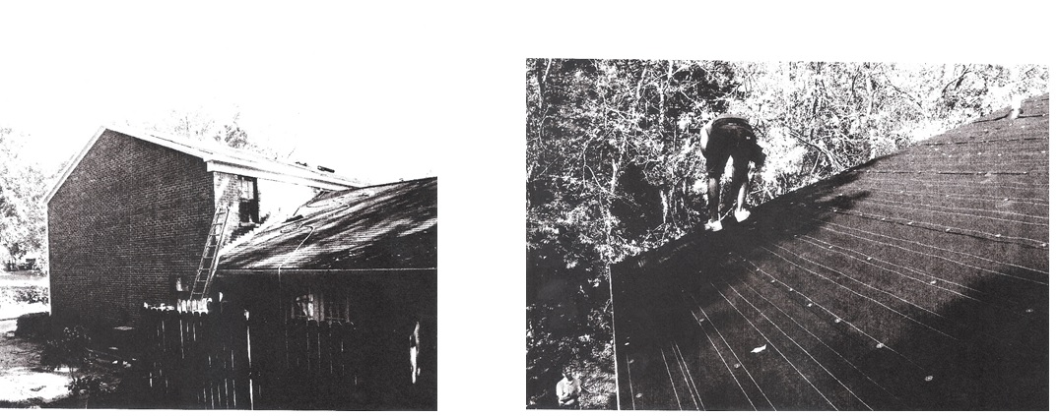
I. Roofing/Structure
Site Pictures
Roofing/Structure Fall Case Study
Notes:
Here are two pictures of the location of the event.
The first picture is of the roof and apartment building.
The second picture is the approximate area where the victim stepped off the roof.

Slide 14
I. Roofing/Structure
What contributed to the event?
Roofing/Structure Fall Case Study
Contributing Factors…
Notes:
Question the class to identify potential contributing factors that may have resulted in the event occurring.
If the class is slow to answer, offer up 1 or 2 answers to see if it will spur conversation.

Slide 15
I. Roofing/Structure
Contributing Factors
Roofing/Structure Fall Case Study
Contributing Factors
No fall protection used
No written safety and health plan (only verbal)
Lack of attention to surroundings
Lack of hazard training (no records)
Notes:
Here are the contributing factors the OSHA inspector discovered as he did the investigation.
At the end of reading the factors, ask the class “what was one thing that could have prevented the event from occurring?”
3. Answer - If fall protection (PFAS, safety nets, etc.) had been used the fatal event would have not occurred.

Slide 16
I. Roofing/Structure
Citations
Roofing/Structure Fall Case Study Penalties
OSHA Violations
No Safety and Health Program - 1926.20(b)(1) $225
No Fall Protection – 1926.501(b)(11) $5,600
Ladder not secured – 1926.1053(b)(8) $375
No First-Aid/CPR Responder – 1926.50(c) $0
Total $6,200
2018 Total (Inflation Adjusted) $11,456
Notes:
The slide shows the OSHA inspector’s citations that were issued to the employer.
Ask the class if they agree with violations.
Ask the class if they would add any additional ones.
Question the class why the one fine is greater than the others. Answer – most serious/life threatening.

Slide 17

I. Roofing/Structure
Quick Review
What is wrong with this picture?
Notes:
Do a verbal test with the class. Do they see the hazards in the picture? What do the workers need to be doing to be safe?
Answer – It appears that no fall protection was used.

Slide 18
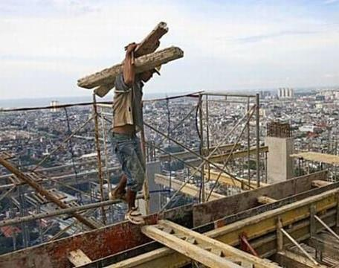
I. Roofing/Structure
Quick Review (Continued)
What is wrong with this picture?
Notes:
Do a verbal test with the class. Do they see the hazards in the picture? What do the workers need to be doing to be safe?
Answer – No fall protection was used.

Slide 19
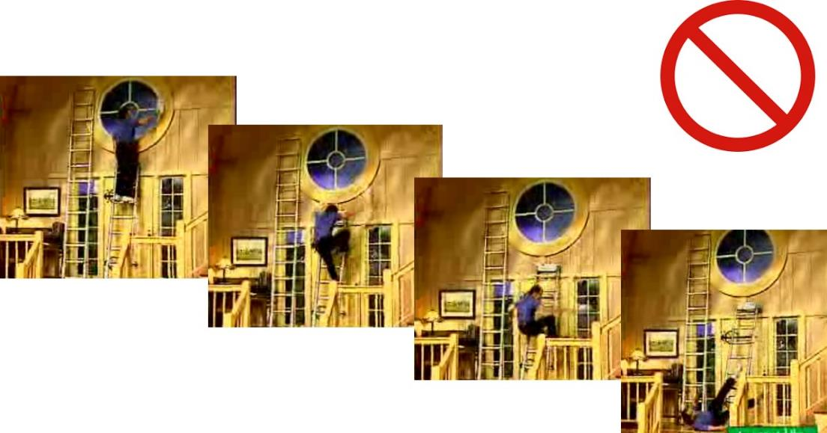
II. Ladders
Photos of a fall from a misstep on a ladder
Notes:
This section will look at the basics of ladder safety requirements.
The first photo is a person cleaning a window from a ladder.
The next two photos show the person miss-stepping as he was descending the ladder. He loses his balance and is starting to fall.
The last picture shows him striking the ground.

Slide 20
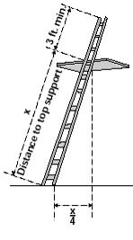
II. Ladders
Requirements:
When using ladders…
Always have three points of contact when on ladder
Extend 3 feet above landing
Free from damage, wear, bending, etc.
Watch for energy sources (power lines)
Maintain the correct angle
Use per the manufacturer requirements (No user modifications)
Complete ladder training
Notes:
The basics of ladder safety requirements.
Always have three points of contact. Use a lift/hoist for tools/equipment to maintain three points when climbing.
Always have the ladder extend at least 3 feet above the landing. This allows it to be much easier exit when ascending and descending.
Inspect the ladder prior to use for damage or wear that could affect its use.
Watch for power lines. When moving the ladder be aware of winds that can disrupt balance and fall into power lines.
Use the correct angle. The picture in the slide shows the proper angle. If height is 12 feet, the ladder needs to be 3 feet from the base of the wall.
Train new employees and retrain current employees as needed to keep rules fresh in their minds.

Slide 21
II. Ladders
Case Study Background
Ladder Fall Case Study
USA Construction Company, Inc.
Company is in South
20 years in the construction business
1000 Employees
General Contractor – Commercial work
Note: All names (employee and company) have been changed
Notes:
Fall from ladder case study – Read the slide out loud to the class.

Slide 22
II. Ladders
Narrative
Ladder Case Study
Narrative of the event:
A USA Construction crew had been caulking and painting at an existing apartment complex. Charlie, a temporary labor service worker, had been assigned to paint guard rails located on the second level breezeway. Charlie had painted the inside section of the guard rail on the second level, but could not reach over the rail and paint the outside section. Charlie decided to use a ladder. He set it up in the breezeway ground floor landing area, which was about 10 feet below the guard rails. He climbed up the ladder and started painting the outside section. As Charlie was painting, the ladder feet slipped on the ground surface causing Charlie and the ladder to fall 10 feet. Charlie received several lacerations to his extremities and chest as well as multiple blunt force trauma. After a week in the hospital, Charlie passed away from complications caused by the trauma.
The ladder Charlie had chosen was the top half of a 24 foot extension ladder. The bottom half was missing. The section he used did not have slip resistant feet on it.
Notes:
Read the narrative of the event out loud to the students.
Ask if there are any questions and make sure everyone understands what happened.
The employee was too short to reach over the guard rails and paint them.
The employee was told a ladder would not be needed and not to use one.

Slide 23
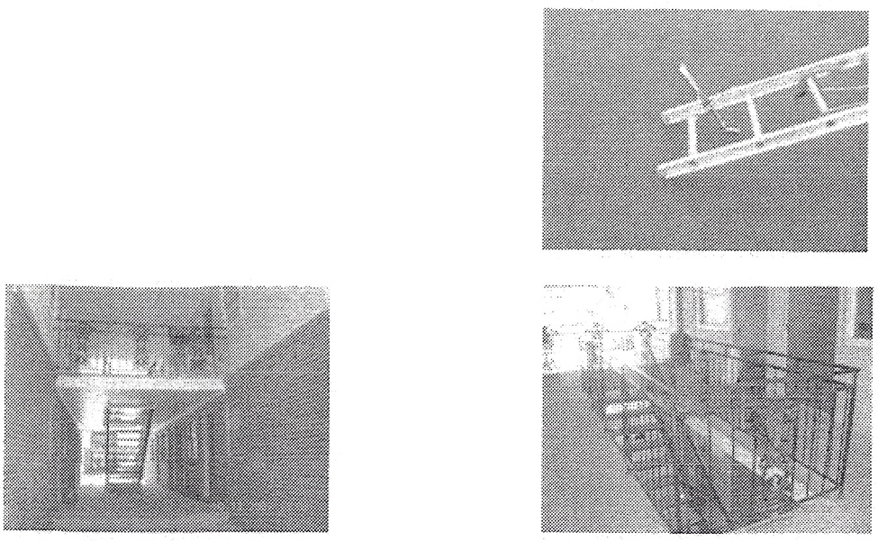
II. Ladders
Site Pictures:
Ladder Fall Case Study
Notes:
The first picture is of the base of the ladder that was used. Note the missing ladder feet.
The second and third pictures are of the guard rail the victim was painting.

Slide 24
II. Ladders
What contributed to the event?
Ladder Case Study
Contributing Factors…
Notes:
Question the class to identify potential contributing factors that may have resulted in the event occurring.
If the class is slow to answer, ask the following questions to see if it will spur conversation: Did the employee follow instructions not to use a ladder? Should the employer have taken the faulty ladder out of service to ensure it not be used?
Talking Point from the case file: Who trains temporary employees from a staffing company?

Slide 25
II. Ladders
Contributing Factors
Ladder Case Study
Contributing Factors:
Ladder did not have slip resistant feet
Ladder not used per manufacturer’s design (separate parts)
Victim was from a temporary labor service and had not been trained in hazard recognition.
No ladder training
Notes:
Here are the contributing factors the OSHA inspector discovered as he did the investigation.
At the end of reading the factors, ask the class “what was one thing that could have prevented the event from occurring?”
Answer - Following direction/procedure or using proper equipment (undamaged) could have prevented the event from occurring.
Could this have been employee misconduct? Probably not, because the untrained employee did realize the potential hazards.

Slide 26
II. Ladders
Citations
Ladder Case Study Penalties
OSHA Violations
Ladders were used for purposes other than designed for – 1926.1053(b)(4) $6,300
OSHA 300 Log/301 Logs (Not recording Injury) – 1904.29(b)(3) $900
Report death of employee within 8 hours – 1904.39(a) $4,500
Total $11,700
2018 Total (Inflation Adjusted) $21,618
Notes:
The slide shows the OSHA inspector’s citations that were issued to the employer.
Ask the class if they agree with violations.
Ask the class if they would add any additional ones.
Discussion question: Why is timely reporting of an employee death so important?

Slide 27
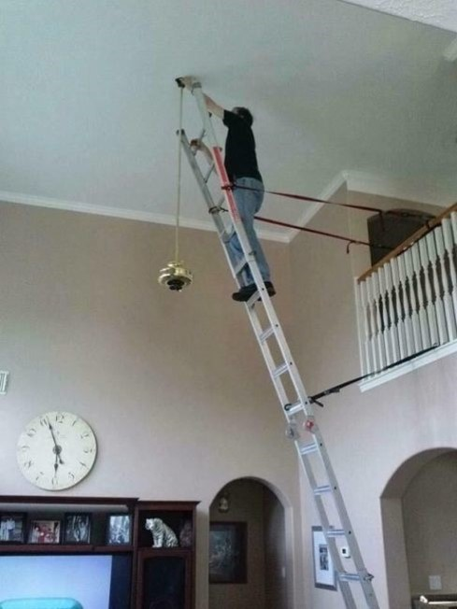
II. Ladders
Quick Review
What is wrong with this picture?
Notes:
Do a verbal test with the class. Do they see the hazards in the picture? What does the worker need to be doing to be safe?
Answer – Improper use of ladder; not using to manufacturers’ requirements(or directions); lack of three points of contact.
Other potential answers – No one holding the ladder or improper ladder angle.
What else could go wrong with this set up? Answers: The strap could break, strap connection to the ladder/railing could fail, and railing post could break.

Slide 28
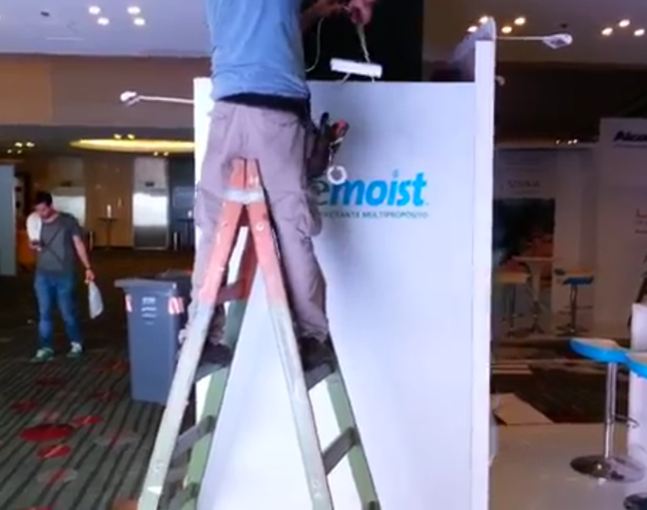
II. Ladders
Quick Review (Continued)
What is wrong with this picture?
Notes:
Do a verbal test with the class. Do they see the hazards in the picture? What does the worker need to be doing to be safe?
Answer – Improper use of ladder; not using to manufacturers’ requirements (or directions); modified/damaged the ladder.

Slide 29
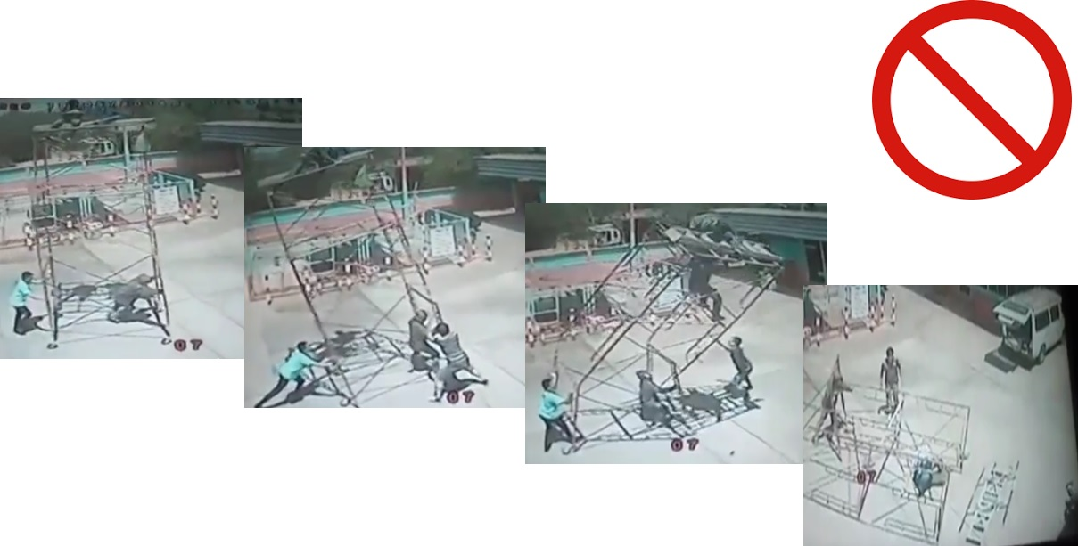
III. Scaffolds/Platforms
Photos of a collapsing mobile scaffold with two workers on top.
Notes:
This section will look at the basics of scaffold safety requirements.
The first picture shows three people moving a mobile scaffold with two people on top.
In the second picture, the scaffold starts to rock back and forth.
Control is lost and the scaffold starts to tip in the third picture.
Lastly the scaffold tips over and the two workers on top of it fall off.

Slide 30
III. Scaffolds/Platforms
Requirements:
Supported & Suspended Scaffolds:
Use scaffolds according to the manufacturer’s instructions.
Never overload a scaffold beyond its maximum rated capacity.
Do not use makeshift methods to increase the working height of the scaffold platform (ladders, buckets or blocks).
Employees must not work on platforms covered with snow, ice, or other slippery material.
The employer must provide suitable access to and between scaffolds.
Notes:
Read out loud the points in the slide.
Always use the scaffold per the manufacturer requirements. No modifications without an engineer or manufacturer approval.
Always make sure the scaffold is fulling planked!
Never use a scaffold if it is covered in snow or ice.
Use a ladder system to access the scaffold, not the cross braces.

Slide 31
III. Scaffolds/Platforms
Requirements (Continued):
Fall protection arrest system required (at 10 feet)
Guardrail system is required
Competent person for daily inspections
Train, train, train!!
Notes:
Fall protection is needed when the scaffold is 10 feet or over.
Guard rails are needed on the scaffold if 10 feet and over (really best at all heights). The top rail needs to be between 38 and 45 inches high and the mid rail at 20 to 30 inches high.
Daily inspections are required by a competent person. Competent or qualified person needs to set up and disassemble the scaffold.
All workers using scaffold are required to have training..

Slide 32
III. Scaffolds/Platforms
Case Study Background
Scaffold/Platform Case Study
Patch You Up Drywall
Company is in Mid-West
10 years in the construction business
3 Employees
Sub Contractor – Drywall residential work
Note: All names (employee and company) have been changed
Notes:
Fall from ladder case study – Read the slide out loud to the class.

Slide 33
III. Scaffolds/Platforms
Narrative
Scaffold/Platform Case Study
Narrative of the event:
Luke was taping drywall for a new large residential house. Luke could not reach the next section, so he used an extension ladder that he had placed on a 12 foot high scaffold. The scaffold was planked with one 19 inch metal sheet. Luke climbed approximately 4 feet up on the ladder, when the metal sheet slipped. This caused the ladder and scaffold to overturn. Luke fell from the ladder-scaffold combination and struck his head against several objects, as he fell to the concrete floor below. Luke was rushed to the nearest hospital, where he later died from severe head injuries.
Notes:
Read the narrative of the event out loud to the students.
Ask if there are any questions and make sure everyone understands what happened.
The scaffold was not fully planked and it did not have guard rails.

Slide 34
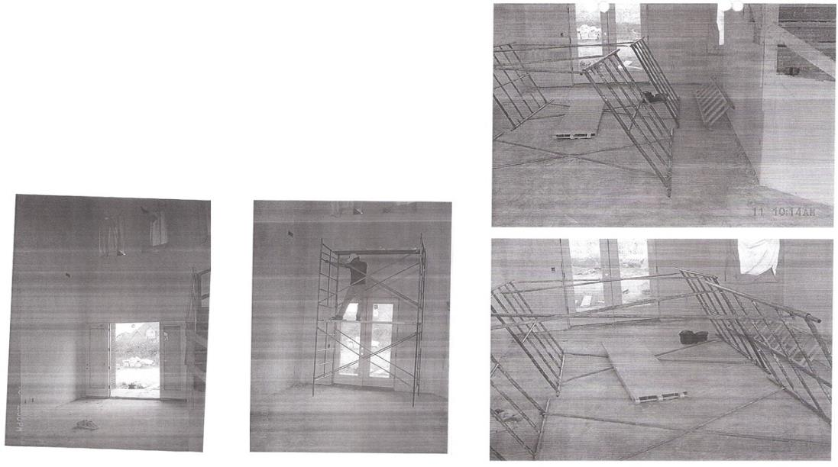
III. Scaffolds/Platforms
Site Pictures
Scaffold/Platform Case Study
Notes:
Pictures of the site with scaffold collapsed and reassembled in the original location. Note: the scaffold was 12 feet high.
Pictures 1 and 4 show the scaffold after it collapsed.
Pictures 2 and 3 show the scaffold in it’s working location.

Slide 35
III. Scaffolds/Platforms
What contributed to the event?
Scaffold/Platform Study
Contributing Factors…
Notes:
Question the class to identify potential contributing factors that may have resulted in the event occurring.
If the class is slow to answer, offer up 1 or 2 answers to see if it will spur conversation.

Slide 36
III. Scaffolds/Platforms
Contributing Factors
Scaffold/Platform Study
Contributing Factors
Use of a ladder on a scaffold
Improperly planked scaffold
Lack of guardrails on scaffold
Lack of fall protection on scaffold (10 feet)
Lack of training – Scaffold/Fall Protection/Ladder
Communication Issue? (Luke was Hispanic)
Notes:
Here are the contributing factors the OSHA inspector discovered as he did the investigation.
At the end of reading the factors, ask the class “what was one thing that could have prevented the event from occurring?”
Answer - Following direction/procedure of not using a ladder on a scaffold.

Slide 37
III. Scaffolds/Platforms
Citations
Scaffold/Platform Case Study Penalties
OSHA Violations
Violations were not issued – Company is out of business
Could have been cited for
Improper use of scaffold
Not properly planked
No guard rails
No fall protection
No scaffold/ladder/fall protection training
Notes:
The company closed their business after the event. OSHA will not issue citations when this happens.
If OSHA did issue citations what would they have been?
Potential citations are listed… can the class think of others?

Slide 38
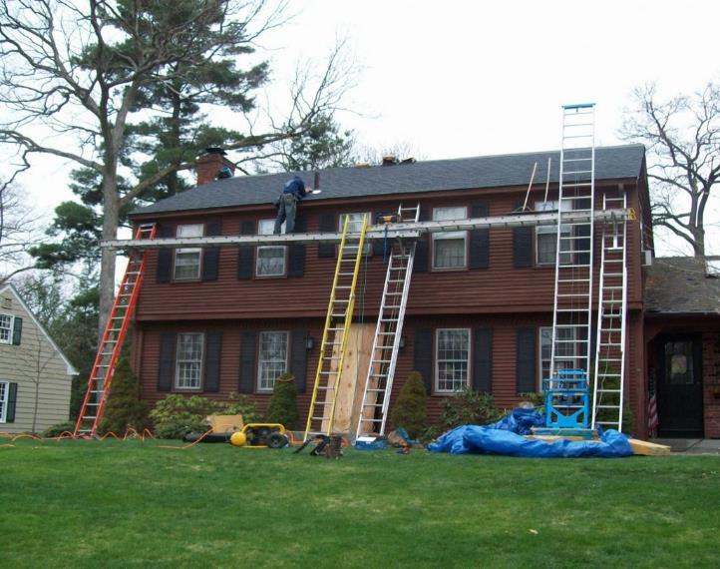
III. Scaffolds/Platforms
Quick Review
What is wrong with this picture?
Notes:
Do a verbal test with the class. Do they see the hazards in the picture? What do the workers need to be doing to be safe?
Answer – Improper use of ladder (as a walking surface; scaffold/platform), No guard rails, no competent person on site, and no fall protection.

Slide 39
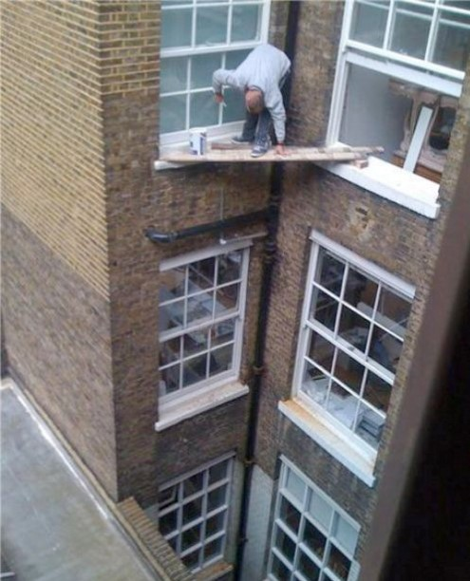
III. Scaffolds/Platforms
Quick Review (Continued)
What is wrong with this picture?
Notes:
Do a verbal test with the class. Do they see the hazards in the picture? What does the worker need to be doing to be safe?
Answer – No fall protection, no guard rails, planks not secured, and not fully planked.

Slide 40
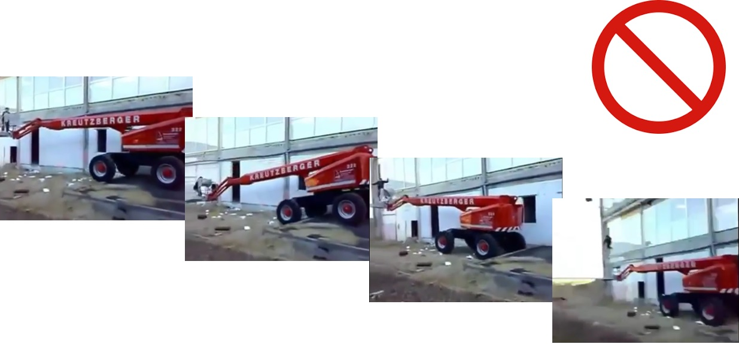
IV. Buckets/Aerial Lifts
Photos of an aerial lift “catapulting” a worker without fall protection
Notes:
his section will look at the basics of buckets/aerial lift safety and requirements.
The four pictures are of a worker moving an aerial lift down a ramp while in the basket.
The uneven ground caused the lift to dip and then bounce upward catapulting the workers from the basket of the lift (pictures 3 and 4).

Slide 41
IV. Buckets/Aerial Lifts
Examples
• Extendable boom platforms,
• Aerial ladders,
• Articulating (jointed) boom platforms,
• Vertical towers, and
• Any combination of the above.
Notes:
The examples of the types of buckets and aerial lifts.
Definition is any mechanical device that can lift a worker to a worksite that contains a basket like platform.

Slide 42
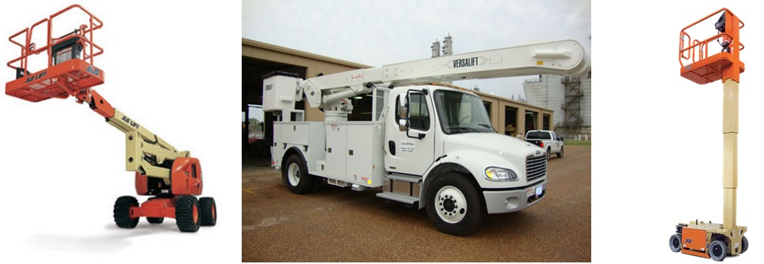
IV. Bucket/Aerial Lifts
Examples of different lifts:
Notes:
The first picture is an aerial lift (articulating).
The second is or a boom lift or cherry picker.
The last is a vertical lift.

Slide 43
IV. Bucket/Aerial Lifts
Requirements
Essential Precautions:
Training
Pre-job inspection of equipment
Use outriggers!
Use fall protection (PFAS)
Work zone inspection (electrical lines, ground stability, weather, etc.)
Notes:
Read out loud the points in the slide.
Training in the hazards associated with the lift, as well as fall and hazard awareness (like power lines).
Use outriggers anytime the lift rises into the air. They can prevent tip overs.
Use fall protection – it’s very easy to be catapulted from the basket (as seen in the pictures).
Inspect the work zone prior to using the lift. Check for electrical lines and soft/uneven ground. Inspect the lift and its equipment for their condition.

Slide 44
IV. Bucket/Aerial Lifts
Case Study Background
Bucket/Aerial Lift Case Study
Speedy Construction Inc.
Company is in West
5 years in the construction business
3 Employees
Sub-Contractor - Laborers
Note: All names (employee and company) have been changed
Notes:
Fall from bucket/aerial lift case study – Read the slide out loud to the class.

Slide 45
IV. Bucket/Aerial Lifts
Narrative
Bucket/Aerial Lift Case Study
Narrative of the event:
Speedy Construction had been tasked with site clean up of a new multi-family dwelling being built. Jake and two co-workers were asked to remove a number of icicles from the inside corner of the building at the roof level. Jake and his co-workers decided to use the all terrain forklift and a job-made plywood box to lift him up to the roof level and use a hammer to knock the icicles off the edge.
Jake was lifted to the roof level and walked out to the right edge of the box. This caused the box to become unstable and tipped off the forklift. Jake and the box fell 50 feet the surface below.
Jake suffered severe head trauma and multiple internal injuries and passed away before medical personnel arrived.
Notes:
Read the narrative of the event out loud to the students.
Ask if there are any questions and make sure everyone understands what happened.
The basket of the lift was job-made.

Slide 46
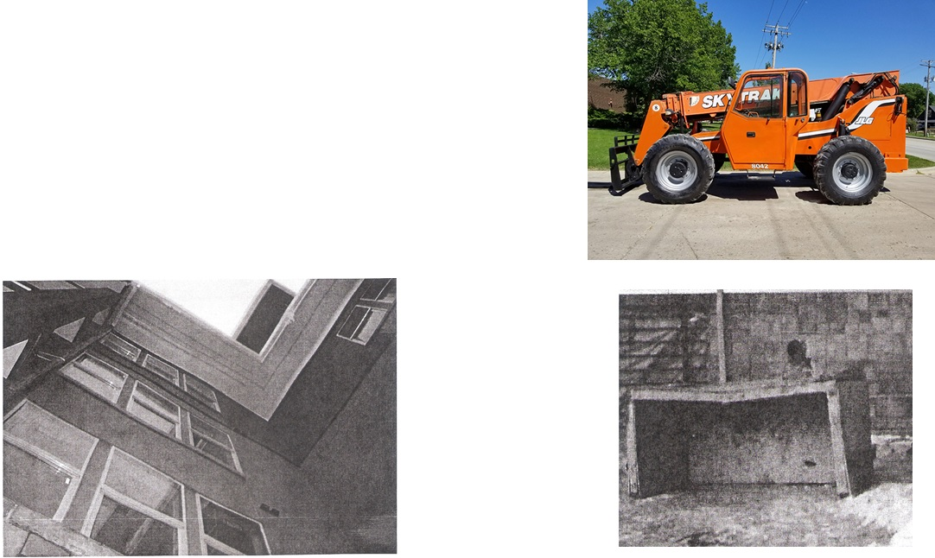
IV. Bucket/Aerial Lifts
Site Pictures
Bucket/Aerial Lifts Case Study
Notes:
The first picture is of the lift used in the event.
The second picture is of the location of the icicles on the building.
The last picture is of the job-made basket used in the event.

Slide 47
IV. Bucket/Aerial Lifts
What contributed to the event?
Bucket/Aerial Lift Study
Contributing Factors…
Notes:
Question the class to identify potential contributing factors that may have resulted in the event occurring.
If the class is slow to answer, offer up 1 or 2 answers to see if it will spur conversation.

Slide 48
IV. Bucket/Aerial Lifts
Contributing Factors
Bucket/Aerial Lift Study
Contributing Factors
No Fall Protection
Improperly designed “bucket”
Lack of training (hazard recognition, fall, and forklift)
Notes:
Here are the contributing factors the OSHA inspector discovered as he did the investigation.
At the end of reading the factors, ask the class “what was one thing that could have prevented the event from occurring?”
Answer – A manufacturer approved “basket” for the lift.

Slide 49
IV. Bucket/Aerial Lifts
Citations
Bucket/Aerial Lift Study Penalties
OSHA Violations
No safety program (no training, inspections, etc.) – 1926.20(b)(2) $1,050
Total $1,050
2018 Total (Inflation Adjusted) $1,940
Notes:
The slide shows the OSHA inspector’s citation that was issued to the employer.
Ask the class if they agree with violations.
Ask the class if they would add any additional ones.
Question the class if they think the total penalty is fair for a case where a life was lost?
Should there be a penalty? What is the purpose served by a penalty?

Slide 50
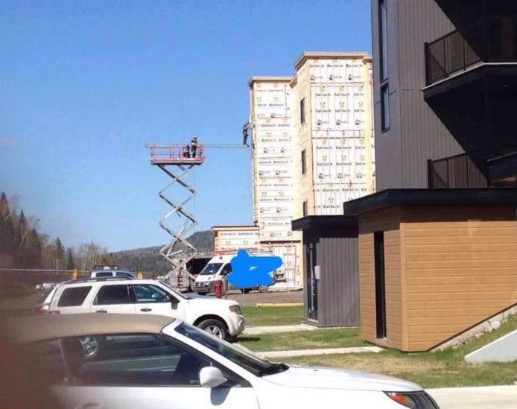
IV. Bucket/Aerial Lifts
Quick Review
What is wrong with this picture?
Notes:
Do a verbal test with the class. Do they see the hazards in the picture? What do the workers need to be doing to be safe?
Answers – No fall protection used, improper scaffolding (guard rails, design/support, planking), and potential tip over (weight off balance).

Slide 51
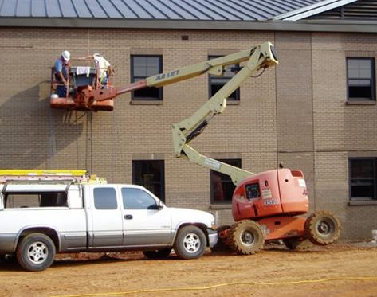
IV. Bucket/Aerial Lifts
Quick Review (Continued)
What is wrong with this picture?
Notes:
Do a verbal test with the class. Do they see the hazards in the picture? What do the workers need to be doing to be safe?
Answers –No job site inspection (level/soft ground) and potential tip over (weight off balance/no outrigging).

Slide 52
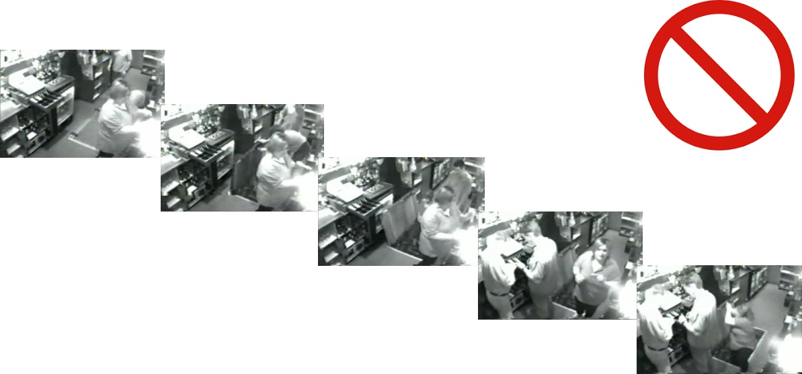
V. Fall Through Opening
Photos of employee falling in a floor hole
Notes:
This section will look at the basics of (fall through) openings safety requirements.
Pictures 1 through 5 show a person opening a basement floor door and walking down it (leaving the door open). Another employee steps back and into the hole falling to the basement floor.

Slide 53
V. Fall Through Opening
Requirements
Cover or guard floor holes as soon as they are created.
Mark cover with “Hole.”
Construct all floor hole covers so they will effectively support two times the weight of employees, equipment, and materials that may be imposed on the cover at any one time.
Notes:
Read out loud the points in the slide.
The idea is to cover/guard a hole immediately after creating it.
Covers must hold 2 times the weight placed on them. This would include equipment, materials, and people weight.

Slide 54
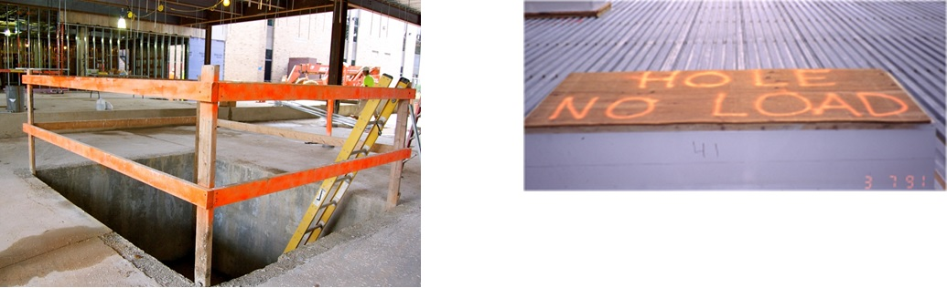
V. Fall Through Opening
Examples of guards and covers
Notes:
Examples of covers and guarding.
The first picture is an example of a guarded hole using guard rails.
The second picture is a marked floor hole cover.

Slide 55
V. Fall Through Opening
Case Study Background
Fall Through Opening Case Study
HazMat Clean Up Inc.
Company is in Mid-West
21 years in the construction business
5 Employees
Hazardous Material Clean up - Asbestos
Note: All names (employee and company) have been changed
Notes:
Fall through opening case study – Read the slide out loud to the class.

Slide 56
V. Fall Through Opening
Narrative
Fall Through Opening Case Study
Narrative of the event:
Three employees of HazMat were to perform asbestos testing at an existing industrial plant. The employees took a 30 minute contractor safety program from the plant before they were allowed into the facility.
The employees were taking samples at the 4th floor of a boiler room where a small section of the roof had collapsed inward and debris was on the floor. The room had a 3 ½ foot yellow barricade splitting the room in half. One of the employees, Larry, offered to get a sample on the other side of the barricade. He jumped over the barricade and stepped on a sheet of Styrofoam that covered an equipment hole. The Styrofoam had dust and debris on it and looked identical to the surrounding floor. The Styrofoam broke and Larry fell 32 feet to the surface below.
Larry passed away from complications of the injuries from the fall.
Notes:
Read the narrative of the event out loud to the students.
Ask if there are any questions and make sure everyone understands what happened.
The yellow barricade was a permanently installed metal guard railing.

Slide 57
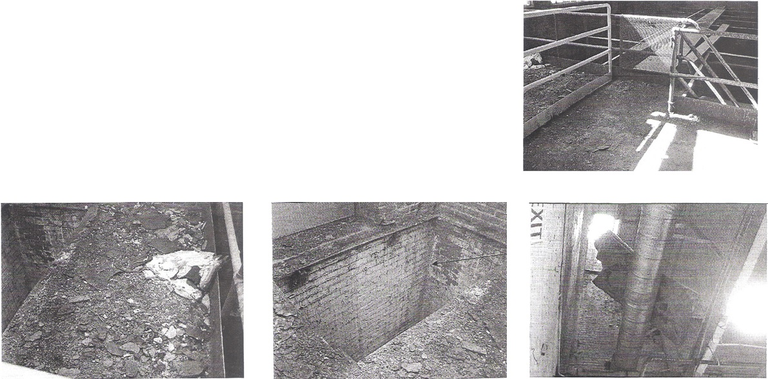
V. Fall Through Opening
Site Pictures
Fall Through Opening Case Study
Notes:
The first picture is of the yellow metal barricade.
The second is the area of where the roof collapsed inward and the debris on the ground.
The third is the hole the victim fell through.
The last is a picture looking upwards through the hole with the broken hole cover caught on over head pipes.

Slide 58
V. Fall Through Opening
What contributed to the event?
Fall Through Opening Study
Contributing Factors…
Notes:
Question the class to identify potential contributing factors that may have resulted in the event occurring.
If the class is slow to answer, offer up 1 or 2 answers to see if it will spur conversation.

Slide 59
V. Fall Through Opening
Contributing Factors
Fall Through Opening Study
Contributing Factors
No signage of fall hazard/hole
Improper hole cover
No fall protection
Hazard recognition training
LACK OF COMMUNICATION!
Notes:
Here are the contributing factors the OSHA inspector discovered as he did the investigation.
At the end of reading the factors, ask the class “what was one thing that could have prevented the event from occurring?”
Answer – Better communications or a stronger hole cover.

Slide 60
V. Fall Through Opening
Citations
Fall Through Opening Case Study Penalties
OSHA Violations
Hazard Recognition Training – 1926.21(b)(2) $1,500
Fall Protection Training – 1926.503(a)(1) $0
No Fall Protection Used – 1904.501(b)(4)(i) $1,500
Protection from Falling Objects – 1926.501(c)(3) $750
No Exposure Assessment – 1926.1101(f)(2)(iii)(B) $750
No EPA Required Training – 1926.1101(k)(9)(v) $750
Total $5,250
2018 Total (Inflation Adjusted) $9,702
Notes:
The slide shows the OSHA inspector’s citations that were issued to the employer.
Ask the class if they agree with violations.
Ask the class if they would add any additional ones.
There are three training violations. What is the employer’s obligation to train questions? Answer: For all hazards/equipment they might reasonably encounter.
When is an employee fully trained so that no more training is required? Answer: Never… All employees need training on new methods and equipment as well as periodic refresher training.

Slide 61
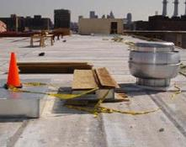
V. Fall Through Opening
Quick Review
What is wrong with this picture?
Notes:
Do a verbal test with the class. Do they see the hazards in the picture? What do the workers need to be doing to be safe?
Answers – No cover or guarding

Slide 62
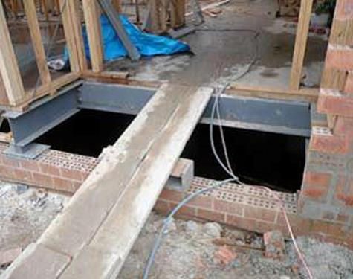
V. Fall Through Opening
Quick Review (Continued)
What is wrong with this picture?
Notes:
Do a verbal test with the class. Do they see the hazards in the picture? What do the workers need to be doing to be safe?
Answers – No cover, no guarding, no guard rails, or secured platform/walkway.

Slide 63
General Note:
In addition to the penalties OSHA issues for a fatal event, a company could face…
Productivity loss/costs
Insurance costs
Criminal/Civil lawsuits
Adverse Public Opinion
Notes:
The cost of losing a worker and work stoppage.
Increases in the workmens’ compensation and insurance premiums.
Possible criminal and civil lawsuits. OSHA can and occasional has brought criminal charges against an employer/foreman. Civil lawsuits from families, site owners, or co-workers are all possible.
The public opinion – media coverage and social media influence could quickly impact all future business for the company.

