Slide 1
Regulation Updates in OSHA
What has changed that could affect me?
DISCLAIMER: This material was produced under grant number SH-31204-SH7 from the Occupational Safety and Health Administration, U.S. Department of Labor. It does not necessarily reflect the views or policies of the U.S. Department of Labor, nor does mention of trade names, commercial products, or organizations imply endorsement by the U.S. Government.
Notes:
This section will discuss the most recent regulation changes.
It will explain what changed and how to meet the requirements of the new regulations.

Slide 2
Regulation Updates in OSHA
Date of Changes
11/2017 – Crane Certification Rule Change – Extended to 11/10/18
7/2017 – Monorail Hoists
7/2017 – Injury and Illness Data Collection
6/2017 – Beryllium
11/2016 – Walking and Working Surfaces
3/2016 – Eye & Face Protection
5/2015 – Confined Space
6/2011 – Residential Roofing Update
Notes:
Read each update out loud.
Each of these are the most recent changes.
Even though it’s not “recent”, included is the residential roofing update, because of the importance it has on the construction/roofing industry’s fall hazards.

Slide 3
Regulation Updates in OSHA
Walking and Working Surface Update – General Industry (1910)
    Can choose protection that will be most effective in the particular workplace operation or situation.
    Anchorage points and rope descent changes
    Fixed ladder updates
    Unprotected edges
    Training
Notes:
Employer can choose a non-conventional fall protection, if it’s temporary work and the fall hazards are very limited.
Anchorage points have to be tested for 5,000 pounds and inspected every 10 years. Additional, rope descents can not be over 300 feet.
Fixed ladder will be required to have cages and fall protection (in the future).
Unprotected edges need either guardrail system, safety nets, PFAS, positioning device, or travel restraint system.
Updated training requirements – must be trained in how to use fall protection (hook up, anchor, tie off techniques), install and disassemble fall protection systems, and be able to inspect and maintain fall protection systems.

Slide 4
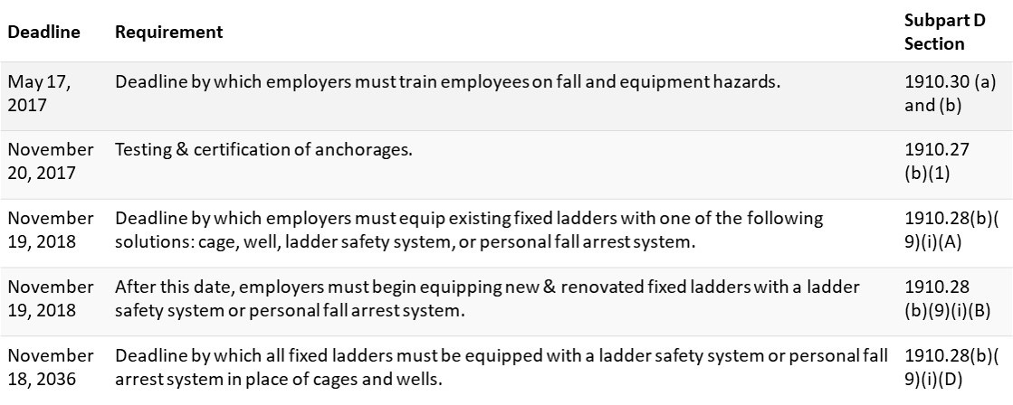
Regulation Updates in OSHA
Walking and Working Surface Deadlines
Notes:
Deadline dates on the needed changes for the walking and working surface changes.
OSHA tried to allow for the required time and costs to make the changes.

Slide 5
Regulation Updates in OSHA
Residential Roofing Update – Construction Industry [1926.501(b)(13)]
    Cancels OSHA Directive STD 03-11-001
    Old Directive allowed slide guards and safety monitors as only protection needed
    6 foot and above use guardrails, safety nets, and/or PFAS (depending on roof slope)
    Allows alternative fall protection IF conventional fall protection is deemed a danger to use
Notes:
This cancels the previously issued STD 3-11-001.
The old directive allowed certain activities (roofing being one of them) to only need slide guards and safety monitors as the only fall protection needed.
New directive requires a fall protection system at heights above 6 feet.
The alternative fall protection plan is very unlikely to be approved by an OSHA area office without overwhelming proof that a conventional fall protection method creates a greater hazard.

Slide 6
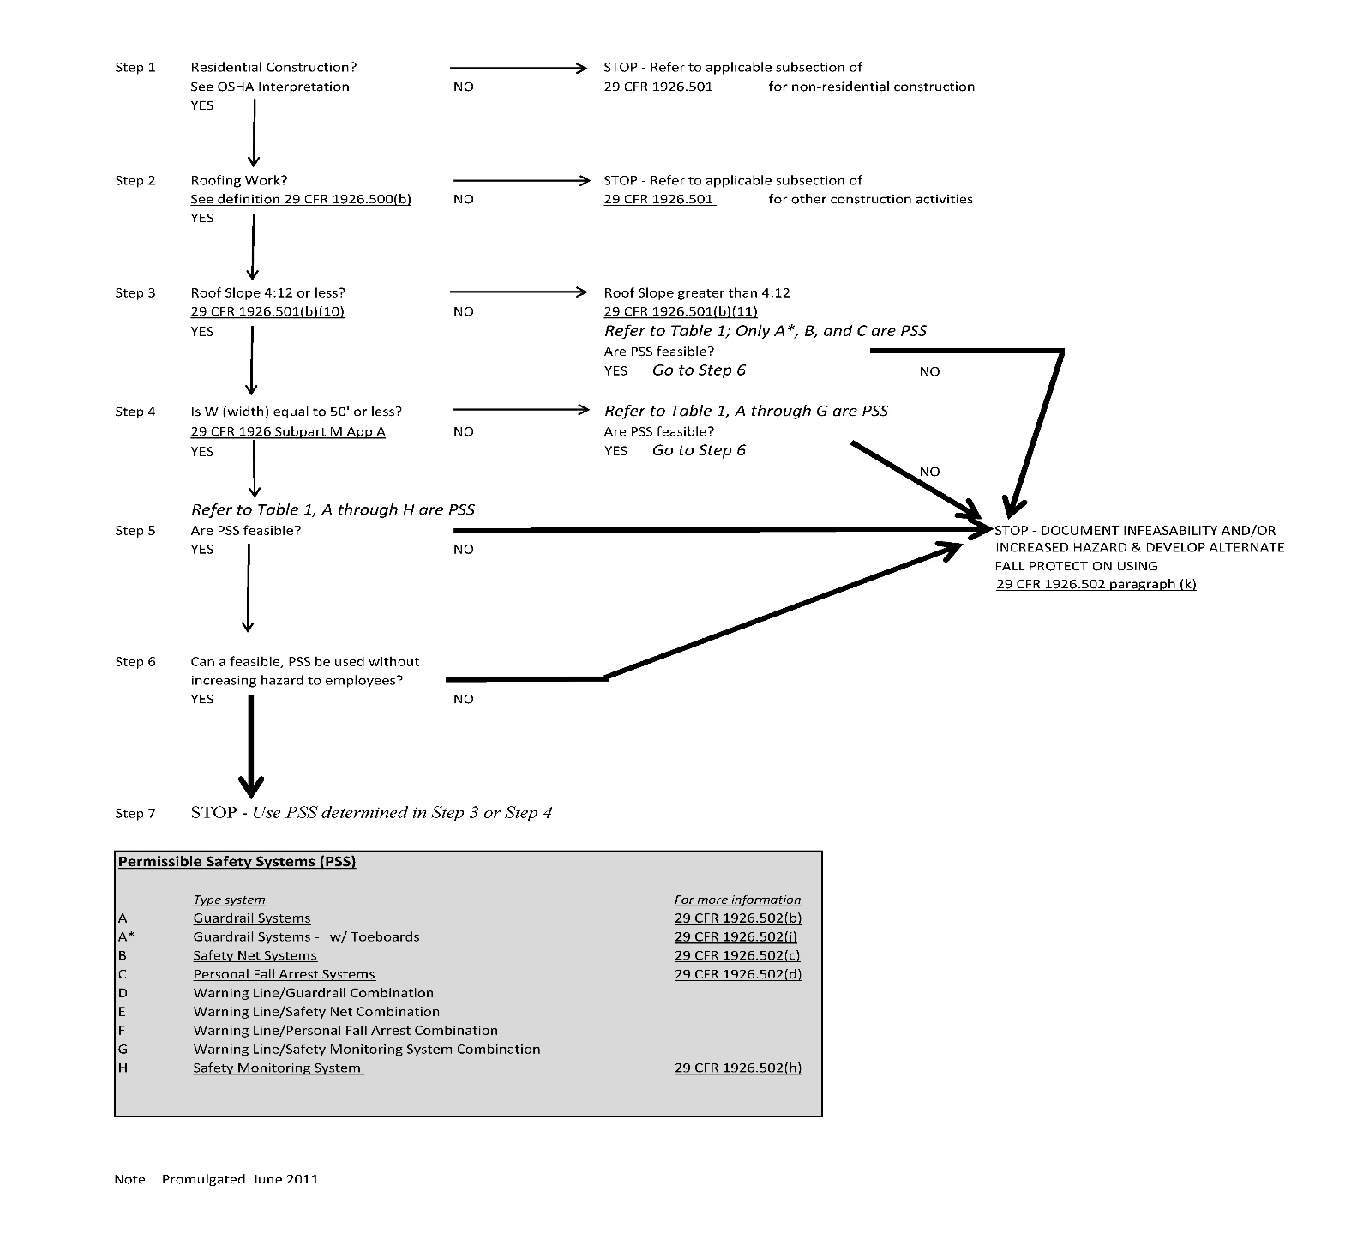
Regulation Updates in OSHA
Residential Roofing Update
Flowchart
Notes:
1. Residential roofing flow chart to choose the correct fall protection for a given situation.

Slide 7
Regulation Updates in OSHA
Crane Certification Rule Change – Construction Industry (1926.1427)
      Extended to 11/10/18
      Multiple extensions
      Certified by type and capacity?
      Certified deems operator qualified?
Monorail Hoists Change – Construction Industry Subpart CC (1926)
      Excluded from the Crane and Derrick section
Notes:
Crane Certification has been extended again (to November 10th, 2018). There have been multiple questions of the regulation’s interpretation. For example, does it mean operator certification is required only for a type of crane or operator certification is required for both type of crane and capacity. If it’s the second, an operator would need to be tested on each type of crane and for each level of capacity.
Monorail hoist was removed from the crane and derrick section of the regulations because of many of the requirements were unrealistic with a monorail hoist that is mounted in a fixed location.

Slide 8
Regulation Updates in OSHA
Injury and Illness Data Collection – All Industries (1904)
      Electronically submitted
      All employers with 250 employees
      High Risk industries with 20 employees
Beryllium Exposure Update – General, Const., Longshore (1910, 1915, 1926)
      Exposure 1949 – 2.0 micrograms, 1975 – 1.0 micrograms, 2017 – 0.2 micrograms
Notes:
Injury and Illness data collection update change was only on the submitting of the data. Now it can be electronically submitted. Previous changes to the Injury and Illness made it required to report if you have over 250 employees (prior to this is was not required to send it to OSHA). Also included were required reporting of certain high risk industries (construction being one of them) of employment of 20 or greater.
Beryllium exposure rate was decreased from 1.0 micrograms to 0.2 micrograms.

Slide 9
Regulation Updates in OSHA
Eye & Face Protection – General Industry Subpart D & I (1910)
      Updates references of ANSI Standards
      Includes advancements of eye and face PPE
Confined Space – Construction (1926.1200)
      Mirrors 1993 General Industry Standard
      Requires initial jobsite inspection, continuous monitoring, data sharing, and prior rescue team contact
Notes:
Eye and Face protection updated the references of the older ANSI Standards (1968) to more modern ANSI Standards (2010). Part of the change was needed to meet the technological advancements of eye and face protection.
The construction regulation now mirrors the general industry regulation. Included in the changes are continuous monitoring of the confined space (you can not just test once at the beginning of the operation). If the worksite has multiple contractors going in and out of the confined space, then they are required to share the data (monitoring, activities, etc.) of the space. Also required is an initial jobsite inspection and prior notification of local rescue personnel of the confined space operation.

