Slide 1
Introduction to OSHA
DISCLAIMER: This material was produced under grant number SH-31204-SH7 from the Occupational Safety and Health Administration, U.S. Department of Labor. It does not necessarily reflect the views or policies of the U.S. Department of Labor, nor does mention of trade names, commercial products, or organizations imply endorsement by the U.S. Government.
Training materials developed with grant funds will be posted at:
http://www.osha.gov/dte/library
Notes:
1. Read the Harwood Grant disclaimer.

Slide 2
Introduction to OSHA
History
Employer Responsibilities
Worker Rights
Notes:
Introductions of the students and instructor.
Who you/we are (the instructor), your organization?
Why are we here?
Explain the class sections, length, and breaks.

Slide 3
Introduction to OSHA
Purpose:
  To provide introductory knowledge of OSHA
        OSHA’s History
        What are your worker rights?
        What are the employer responsibilities?
        OSHA Standards and Violations
        Where to go for help
Notes:
Read out loud the five topics from the slide.
Introduction to OSHA is required of all OSHA training.

Slide 4
Introduction to OSHA
History
OSHA stands for the Occupational Safety and Health Administration, a Federal agency of the U.S. Department of Labor
OSHA’s responsibility is to improve worker safety and health protection
On December 29, 1970, President Nixon signed the OSH Act
This Act created OSHA, the agency, which formally came into being on April 28, 1971
Notes:
Explain the history of OSHA.
Why OSHA was created.
How and who enacted it.

Slide 5
Introduction to OSHA
Mission Statement
The mission of OSHA is to assure safe and healthful working conditions for working men and women by setting and enforcing standards and by providing training, outreach, education and assistance.
  Developing job safety and health standards and enforcing them through worksite inspections
  Providing training programs to increase knowledge about occupational safety and health
Notes:
Read the mission statement out loud.
Explain the basics of safety and health standards and inspections.
Explain the training aids OSHA has available on their website. (They can be found at http://www.osha.gov/dte/library. The website has multiple training PowerPoints, posters, information on a wide Varity of topics)
QUESTION - Who is not covered by OSHA? Farming, self employed, other government agencies (Mines, Department of Energy, Coast Guard)

Slide 6
Introduction to OSHA
Statistics
Are we safer with OSHA?
Worker deaths in America are down–on average, from about 38 worker deaths a day in 1970 to 14 a day in 2016.
Worker injuries and illnesses are down–from 10.9 incidents per 100 workers in 1972 to 3.6 per 100 in 2016.
Per OSHA & Bureau of Labor Statistics (BLS)
Notes:
The statistical background on why OSHA was needed.
Stress the point of 38 workers death to 14 (65% decrease).
Injuries decreased by 7.3 per 100 from 1972 to 2016 (67% decrease).
History of Federal Safety Statutes: 1893 Safety Appliance Act, Required safety equipment (PPE) but only covered railroad. In 1910, a mine safety act was introduced for miners. Before OSHA, construction safety was handled internally for each company. Some protected, some did not.
Joseph Strauss and the Golden Gate Bridge… 1 fatality per 1 million dollars of a project. He decided to use all safety techniques currently available.

Slide 7
Introduction to OSHA
The Situation Today…
5,190 Occupational Fatalities in 2016!
or 14.2 fatalities per day
991 Construction Fatalities!
or 2.7 construction fatalities per day
Notes:
Read the statistics out loud to the class.
Explain the second number is the construction industry only.
Statistics are from Bureau of Labor Statistics and may include cases not in OSHA jurisdiction.

Slide 8
Introduction to OSHA
Worker Rights:
Under OSHA Each Worker has the Right to…
  A safe and healthful workplace
  Know about hazardous chemicals
  Report injury to employer
  Complain of potential hazard
  Request hazard correction from employer
  Receive training by the employer
  Notification of hazard exposure and access to your medical records
  File a complaint with OSHA
  Participate in an OSHA inspection
  Be free from retaliation for exercising safety and health rights
Notes:
Under the OSH Act workers are granted certain worker rights for a safe workplace and receive training needed to do their job.
Go over each point/topic; explain if needed (further explanation is included in the next slides)

Slide 9

Introduction to OSHA
Worker Rights:
OSHA Posters
Notes:
This a picture of the Worker Rights Poster (If you have one, pass it around the classroom).
All employers are required to post it in the workplace.

Slide 10
Introduction to OSHA
It is your right to…
Be provided a workplace free from serious recognized hazards and which complies with standards, rules and regulations issued under the OSH Act.
Workplace conditions which conform to applicable OSHA Standards.
Have and use safe and properly maintained tools and equipment.
Notes:
Employers are required to provide safe and hazard-free work places.
If not they can be cited and fined for violating OSHA standards.

Slide 11
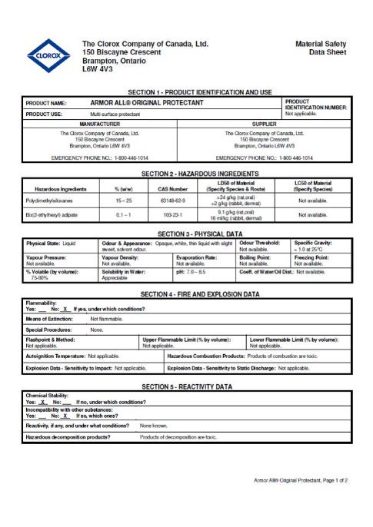
Introduction to OSHA
Materials Safety Data Sheet
As an example of your rights…
Employers with hazardous chemicals in the workplace must develop and implement a written hazard communication program.
Training of employees on the hazards they are potentially exposed to and the taking of proper precautions (and a copy of safety data sheets must be readily available).
Notes:
If you have hazardous chemicals you must have a written Hazard Communications Program.
Here is an example of a MSDS – they are currently being phased out and replaced with SDS.
SDS are made up of 16 sections (more than MSDS had) and are stricter in their formatting.

Slide 12

Introduction to OSHA
OSHA 300 Logs
It is your right to…
Workers have the right to report an injury and to review current logs
Workers also have the right to view the annually posted summary of the injuries and illnesses (OSHA 300A)
Notes:
You are protected from employer retaliation if you report an injury.
OSHA 300 logs are records of all work caused injury and illness events. OSHA 300 logs have to posted at the worksite/company trailer/etc. from February to April each year.

Slide 13
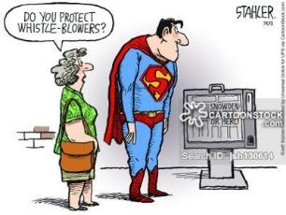
Introduction to OSHA
Whistle-Blowers
It is your right to…
Complain and Request Safety Changes
Workers may bring up safety and health concerns in the workplace to their employers without fear of discharge or discrimination
OSHA rules protect workers who raise concerns to their employer or OSHA about unsafe or unhealthful conditions in the workplace
Notes:
Read the points out loud.
OSHA has strict whistleblower rules, which have recently been rewritten and reinforced.

Slide 14
Introduction to OSHA
Training
It is your right to…
Get training from employers on a variety of health and safety hazards and the standards that employers must follow.
Be trained in a language and vocabulary you can understand
Notes:
QUESTION – Once you’ve been trained, you never have to be trained again… right? Wrong?
Your employer is required to train (and re-train) in safety, hazard recognition, and equipment usage.
The training has to be provided in a language and level you can understand.

Slide 15
Introduction to OSHA
Medical Records
It is your right to…
Examine your exposure and medical records
from the employer
Possible exposures include:
Dusts and Metals
Biological
Physical Stresses
Notes:
1. The medical records your employer keeps on you (hearing tests for example) can be viewed at anytime.

Slide 16
Introduction to OSHA
Complaints
It is your right to…
File a Complaint with OSHA
Workers may file a confidential complaint with OSHA if they believe a violation of a safety or health standard, or an imminent danger situation, exists in the workplace
If a worker files a complaint, they have the right to find out OSHA’s action on the complaint and request a review if an inspection is not made
Notes:
You can file an anonymous complaint with OSHA at anytime (phone call or on their website). You can typically get updates on the status of the complaint/investigation and OSHA will issue a findings letter sent to you after the investigation has been completed.
Limited data updates and information can be found on osha.gov. Any violations discovered can be found on the website.

Slide 17
Introduction to OSHA
Inspection
It is your right to…
To be involved in an OSHA Inspection
Workers can attend the OSHA walk-through
Meet privately with the inspector
Notify the inspector of hazards, injuries, near misses, or any other potential health/injury concerns
Be informed of the inspection and (if needed) the abatement requirements
Notes:
QUESTION – Has anyone been through an investigation?
Read the points out loud.
You are welcome to attend the investigation walk through and meet with the inspector privately to notify of any hazards you might be aware of.

Slide 18
Introduction to OSHA
Retaliation
It is your right to…
To be free from retaliation
Workers have a right to seek safety and health on the job without fear of punishment
This right is spelled out in Section 11(c) of the OSH Act
Workers have 30 days to contact OSHA if they feel they have been punished for exercising their safety and health rights
Notes:
Read the points out loud.
Talking point – Recently a former Norfolk Southern employee was awarded back pay, benefits, and returned to his job over a whistleblower firing. He had been let go because of alerting management over potential on the job hazards. (Source OSHA Quicknotes)

Slide 19
Introduction to OSHA
Responsibilities
Employer Responsibilities
Provide a workplace free from recognized hazards and to comply with OSHA standards
Provide training required to meet OSHA standards
Keep records of injuries and illnesses
Provide medical exams when required by OSHA standards and provide workers access to their exposure and medical records
Not discriminate against workers who exercise their rights under the Act (Section 11(c))
Post OSHA citations and hazard correction notices
Provide and pay for most personal protection equipment (PPE)
Notes:
Read each out loud.
Examples of medical exams would be hearing tests.
If violations are found in an inspection – The violations and corrective actions need to be posted and available to all at worksite.
Almost all (rarely it’s not) PPE will be provided to the worker by the employer.

Slide 20
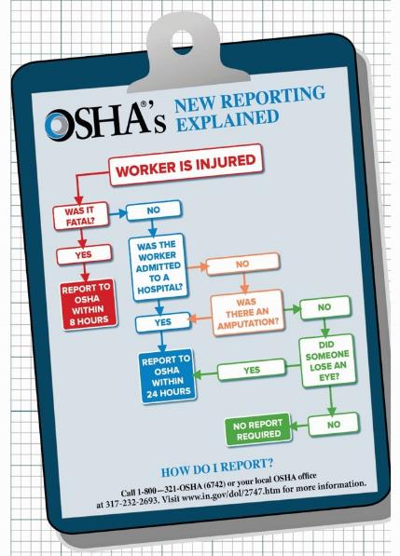
Introduction to OSHA
Injuries and Illnesses
Employers are required to…
Report fatalities to OSHA within 8 hours of the event
Report all hospitalization, amputations, and eye-loss events to OSHA
Maintain injury and Illness records
Inform workers how to report an injury or illness to the employer
Make records available to workers
Allow OSHA access to records
Post annual summary of injuries and illnesses (Feb to April)
Notes:
Employer is required to inform OSHA of a fatal event within 8 hours.
Employer is required to inform OSHA of a hospitalization, amputation, and/or eye loss within 24 hours.
A citation can be issued if it’s not reported in time.

Slide 21
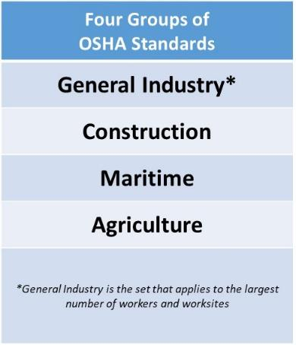
Introduction to OSHA
Regulations
OSHA Standards
Rules that describe the methods employers must use to protect employees from hazards
Designed to protect workers from a wide range of hazards
Notes:
The OSHA standards are broken up into four parts. One for each of the industry sectors that OSHA covers.
General Industry is the largest coverage which can include restaurants, office workers, hair salon workers, and universities.
The standards can cross industries. A construction site can be issued General Industry standard citations if there was a violation of a standard. This is typically seen in electrical standards.

Slide 22
Introduction to OSHA
Permissible Exposure Limits
OSHA Standards
Limit the amount of hazardous chemicals, substances, or noise to which workers can be exposed
Require the use of certain safe work practices and equipment
Require employers to monitor certain hazards and keep records of workplace injuries and illnesses
Notes:
Two current hot topic hazardous chemicals are silica and beryllium. Both have new standards for exposure.
QUESTION… Anybody see the video from DOL on Bill Ellis (from TN)… on developing silicosis and how the lungs slowly decreased breathing.
“Popcorn Lung” can be caused by silica. Fine particles of silica are breathed into the lungs, where they stay and cause scarring.

Slide 23
Introduction to OSHA
OSHA Inspections
The OSH Act authorizes OSHA Compliance Safety and Health Officers (CSHOs) to conduct workplace inspections at reasonable times
OSHA conducts inspections without advance notice
In fact, anyone who tells an employer about an OSHA inspection in advance can receive large fines and jail time
Notes:
Emphasize the point of no advanced warning of an inspection.
QUESTION… What happens if you prevent an inspector from coming on to your site?
Inspectors can also get a judge-signed warrant to get access of a worksite if it is blocked by an employer.

Slide 24
Introduction to OSHA
Fatal or Serious Injury Inspection Steps
Steps of an OSHA Inspection
The event
Notify OSHA (8 hours/24 hours)
Opening conference with inspector
Walk around (inspection)
Closing conference
Informal settlement
Formal settlement
Abatement
Notes:
Opening conference is a sit-down with the inspector to talk about the event, the companies 300 log history, safety plans, training, and the affected employees/victims.
Closing conference is another sit-down where potential citations are discussed, possible corrective actions, abatement procedure, and settlement options.
Informal settlement conference is a chance to present evidence of corrective action, negotiate the citations, and possibly receive a discount or removal of penalties and/or citations.
Formal settlement conference takes place in front of a judge who makes the decisions of violations and penalty amounts.

Slide 25
Introduction to OSHA
Violations
OSHA Penalty Breakdown
Notes:
Examples of OSHA penalty per type of violations.
For years penalties did not increase, now they will increase as inflation does. New rates will be issued each year.

Slide 26
Introduction to OSHA
Review
What are some of your OSHA given employee rights?
What happens to you if you are a whistleblower?
How long does an employer have to report a fatality and a hospitalization to OSHA?
Does my employer have to train me?
Notes:
Verbally test the students with review questions.
Answers:
A Safe and healthy workplace, knowledge of hazardous chemicals, report injuries, complain of hazards, request hazard correction, training, hazard exposure, your medical records, file a complaint with OSHA, participate in an OSHA inspection, and free from retaliation.
You are protected by section 11c from any employer retaliation.
Fatality -8 hours, hospitalization – 24 hours
Yes… employers are required by OSHA to provide training.

Slide 27
Introduction to OSHA
Where to go for additional information…
OSHA website (www.osha.gov)
National Institute for Occupational Safety and Health (NIOSH) – OSHA’s sister agency (www.cdc.gov/niosh)
OSHA Training Institute Education Centers
Compliance Assistance Specialists in the area offices (addresses and phone numbers can be found on OSHA’s website)
Public libraries
Notes:
Sources of additional information.
Another useful source is the “Quick Notes” from OSHA. It’s a bi-weekly email with updates on regulations, notable inspections, news, and other happenings in the world of safety and OSHA. Sign up is on the OSHA website.
On-site Consultation Program offers free confidential safety and health services to small and medium sized businesses. They will do a free inspection that does not result in violations or penalties.

