Slide 1
Healthy Nail Salons: Protecting the Safety and Health of Workers, Employers, and their Clients

Slide 2
Acknowledgements
This material was produced under a grant from the Occupational Safety and Health Administration (#SH29648SH6), U.S. Department of Labor. It does not necessarily reflect the views or the policies of the U.S. Department of Labor, nor does the mention of trade names, commercial products, or organization imply endorsement by the US government.

Slide 3
Training Objectives:
Identify hazards that exist in nail salons, and how those hazards affect the safety and health of workers;
Learn how chemicals can enter the body and cause harm;
Understand the principles of occupational safety and health and hazard prevention and control, and learn how these principles apply to nail salons;
Review health and safety laws that apply to nail salons

Slide 4
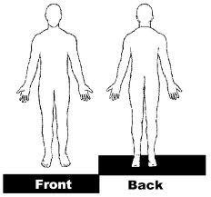
Identifying Hazards in your Nail Salon
EXERCISE 1:
Use the “body map” to show “where it hurts: or “where you feel sick” as a result of your work.
OR
Exercise 2: Large group discussion:
What are the hazards that exist in nail salons?
Hazard: a chance of being injured or harmed; a danger in the workplace

Slide 5
Nail Salon Hazards can be:
Chemical (acetone, nail polish, removers)
Biological (fungi, hepatitis B and C)
Ergonomic (muscle and joint aches and pains)
Others: poor indoor air quality, electrical hazards, workplace violence, etc.

Slide 6
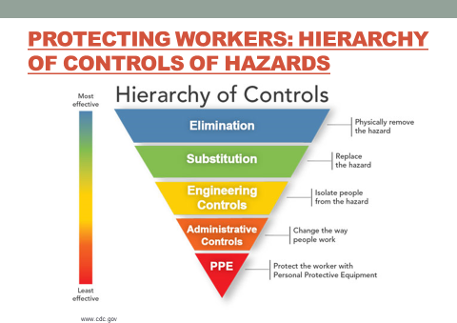
Protecting Workers: Hierarchy of controls of hazards

Slide 7
How Chemicals Can Harm You
Toxicity (how harmful a substance is), depends on:
Physical form of the substance (is it a solid, liquid, gas, vapor, mist, fume, dust?)
Route of entry (how does the chemical get into my body?)
Dose response (how much am I exposed to, and for how long? The longer the the exposure, the greater the risk)
Synergy (the interaction of multiple substances can produce an effect different from or greater than the sum of their individual effects, i.e. ammonia and bleach)
Sensitivity (how strong will an individual’s reaction be when exposed to a hazardous substance?)

Slide 8

Routes of entry: how chemicals get into your body
Inhalation
Ingestion
Direct contact
Absorption
Based on the hazards identified in your nail salon, which are the most common routes of entry?

Slide 9
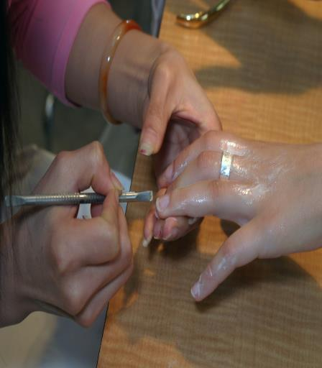
Chemicals in Nail Salons
Acetone (nail polish remover): can cause headaches, dizziness, and eye, skin and throat irritation
Acetonitrile (finger glue remover: can irritate nose /throat, cause breathing problems, nausea, vomiting

Slide 10

More chemicals
Butyl acetate (nail polish remover): headaches, irritated eyes, nose skin, mouth and throat
Dibutyl phthalates (nail polish): nausea and irritated eyes, skin, mouth, throat; long-term exposure can lead to serious effects.

Slide 11
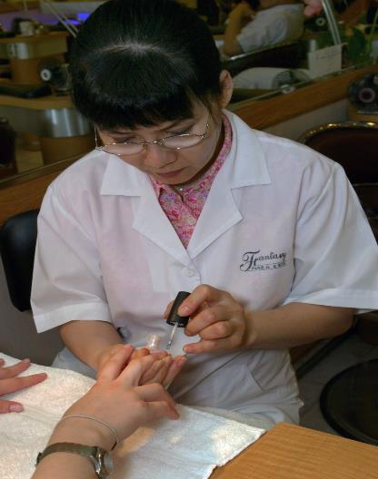
Nail salon chemicals…
Methyl methacrylate(MMA): in artificial nail products; Can cause asthma, irritation, difficulty concentrating
Formaldehyde (nail polish and hardeners): difficulty breathing, allergic reactions, irritation

Slide 12

More chemicals….
Disinfectants: irritation, may cause asthma
Toluene (polish, fingernail glue): dry skin, headaches, irritation, can cause damage to liver and kidneys, and harm to unborn children during pregnancy

Slide 13
You have a right to know…
Occupational Safety and Health Administration (OSHA)/US DOL – federal agency that oversees worker safety and health
  Under OSHA’s Right-to-Know Standard, employers must provide training so employees understand the hazards when working with these chemicals, and how you can use the products more safely.

Slide 14
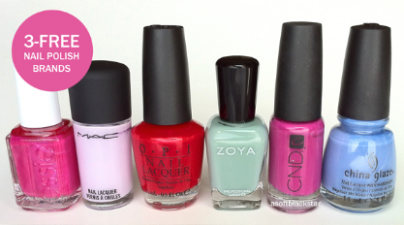
Elimination and Substitution: Use Safer Products
Use “3-free” products – don’t contain toluene, formaldehyde or dibutyl phthalates (“toxic trio”)
Use “acid-free” products e.g. primers without methacrylic acid
Check the SDS for product information

Slide 15


Engineering Controls:
Mechanical Ventilation
Provides adequate fresh air, regulates temperature/humidity, removes contaminants
Always keep system on; keep HVAC system on during work hours
Have system cleaned and filters replaced regularly

Slide 16
Engineering Controls – Source Capture/Local Exhaust Ventilation (LEV)
System should:
Be close to client’s hand
Draw vapors away from you, not blow vapors towards you
Vent directly to the outside
http://www.lhwmp.org/home/health/nail-salons.aspx

Slide 17
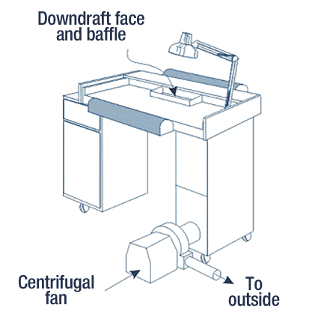
Engineering Controls: Ventilation table one type of local exhaust ventilation

Slide 18
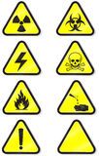

Administrative Controls: Getting information on chemicals
Read the product labels
Safety Data Sheets (SDSs) – OSHA requires that employers must make these available to the employees

Slide 19
Safety Data Sheets (SDS)
Product manufacturers must provide SDSs to the salon owner.
SDSs contain information on:
  Ingredients
  how you can be exposed
  health and safety risks when using the product
  steps for safely using and storing the product
  what to do in an emergency

Slide 20


More Administrative Controls: Safe Work Practices
All chemicals should be kept in small bottles and labeled; close tightly when not in use
Use metal trashcans with tight lids; put cotton balls in immediately after use, and empty can often
Safely dispose chemicals; do not pour in sink or toilet.
Go out to get fresh air on your break
Keep food and drinks covered at all times; do not eat in work areas.

Slide 21
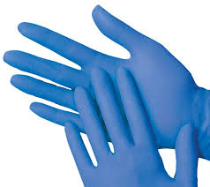
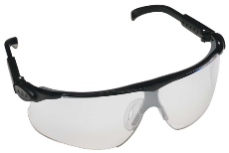
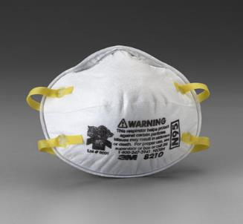
Personal Protective Equipment for Nail Salon Employees
Employers must provide at each workstation:
N-95 or N-100 respirator to reduce dust inhalation when buffing/filing nails or using acrylic powder;
Nitrile gloves (or something similar if employee is allergic) in sufficient quantity, when handling chemicals or waste, during cleanup, and when performing any service that could break a customer’s skin;
Eye protection when preparing, transferring, or pouring chemicals

Slide 22
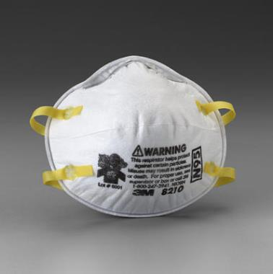
Respiratory Protection
Paper or cloth medical masks do not offer any protection from gases, vapors or dust
You should make available NIOSH-approved filtering facepiece respirators (N-95s are one type) to protect from dust, viruses and germs
Use when buffing or filing nails, or using acrylic powders

Slide 23
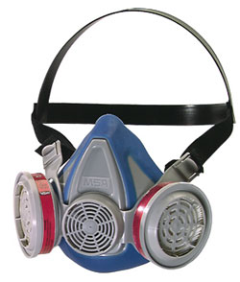
Respirators to protect against exposure to vapors
Half-face respirators with chemical cartridges help from breathing in vapors (like formaldehyde)
Use this when transferring chemicals from larger to smaller bottles, or cleaning up large spills
If using a respirator, you must be trained and fit-tested, cartridges need to be changed regularly

Slide 24
Preventing exposure to biological Hazards (fungi, bacteria and viruses - hepatitis B/C, HIV)
OSHA Bloodborne Pathogen covers nail salon workers:
Avoid touching blood or bodily fluids
Wear gloves, throw away after using them
Wash hands with soap and water
Cover open cuts or broken skin to prevent contact; do not touch blood
Consider getting the hepatitis B immunization
Clean and disinfect tools, foot basins and spas after each client; follow state policy
Store all disinfected tools in clean and covered area

Slide 25
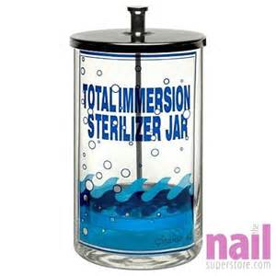
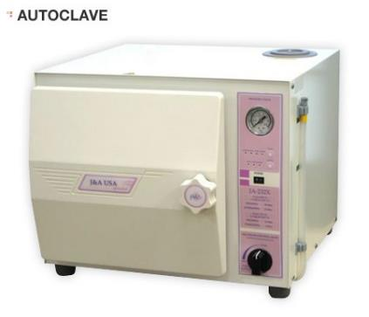
Cleaning, disinfection or sterilization of implements
Cuticle scissors and other implements that clip superficial layers of skill should be cleaned with warm water, dried, and immersed in EPA-approved hospital-grade disinfectant for no less than 10 minutes.
Implements that penetrate the skin or enter pores should be single-use disposable or sterilized (use an autoclave, packaged before sterilization)
Transport clean and dirty implements in covered containers.

Slide 26
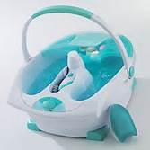
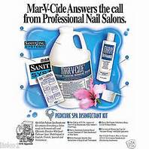
Disinfect footbaths, bowls
Bowls/footbaths cleaned, rinsed, and disinfected after each use

Slide 27
Ergonomic Hazards
Nail salon workers can get aches and pains from leaning over a worktable for a long time.
Repetitive movements like filing and buffing nails; and resting hands, wrists, and forearms and/or elbows against hard surfaces or sharp edges of worktables are ergonomic (musculoskeletal) hazards because they affect muscles and bones.
Ergonomics is the science of “fitting the task to the worker” so that you are more comfortable and efficient when doing your job.
Good ergonomic practices will reduce stress to your body and help to avoid aches and pains.

Slide 28
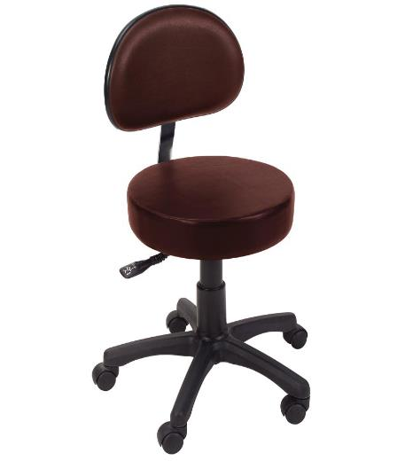
Reducing Ergonomics Hazards
Use adjustable chair
Adjust the lighting
Raise clients’ hand/foot to reduce bending
Take frequent breaks
Use towel or foam pad to soften table edge
Do gentle stretching exercises

Slide 29
Workers can file an OSHA complaint
Workers can file a complaint by calling 1-800-321-OSHA (6742) or filing online at www.osha.gov
An OSHA complaint and an investigation of the workplace can result in penalties against the employer if there are violations
It is illegal for an employer to retaliate against a worker for filing a complaint with OSHA by firing, demoting, or otherwise taking discriminatory action against the worker
Get informed: employers can access OSHA’s free consultation program

Slide 30

Questions?
Any questions, comments on any topic we discussed?

