Slide 1
Work Zone Employee Safety
Internal Traffic Control Plans
This material was produced under grant number SH-31248-SH7 from the Occupational Safety and Health Administration, U.S. Department of Labor. It does not necessarily reflect the views or policies of the U.S. Department of Labor, nor does mention of trade names, commercial products, or organizations imply endorsement by the U.S. Government.
Notes:
Welcome the class and let them know the following.
Emergency exits and actions
Location of rest rooms
Breaks
Cell phone usage
Any other housekeeping issue
Have student introduce themselves.

Slide 2
What is an INTERNAL Traffic Control Plan (ITCP)?
Plan for coordinating the flow of construction vehicles, equipment, and workers operating within the work space
  For improved safety within the work zone
A typical ITCP addresses
  Parking issues within the work space
  Safe entry and exit of heavy equipment, trucks and workers to and from the work space
  Interactions of heavy equipment, trucks, and on-foot workers
Notes:
Definition: An internal traffic control plan (ITCP) is a plan that is used to coordinate the flow of construction vehicles, equipment, and workers working in close proximity within the activity area, so that the safety of the workers and operators is ensured.
An ITCP addresses the interaction of heavy equipment, trucks, and on-foot workers commonly experience within the work space associated with work zones.
ITCP also addresses the safe entry and exit of construction equipment and trucks to and from the work area in the work zone.
ITCP can additionally address the parking issues within the work space for workers; public road crossings for worker access on the site, and safe operations on the haul roads.

Slide 3
ANSI A10.47 – 2015 on ITCP
Employers shall develop traffic control plans for inside their work zones
This plan shall be communicated to all employees
The onsite supervisor/safety person shall modify the plan
The ITCP should include the following elements:
  A diagram showing travel routes for construction equipment and employees
  A plan for communicating changes in the ITCP
Notes:
Discuss the fact there is an ANSI (American National Standards Institute) standard dealing with traffic control and in that ANSI standard is a section on Internal Traffic Control Plans (ITCP)
Employers shall develop traffic control plans for inside their work zones to minimize backing and other conflicts between employees and work vehicles/equipment and to maximize the separation of vehicles and pedestrians.
This plan shall be communicated to all employees on the site and all vehicle operators entering the site.
The onsite supervisor/safety person shall modify the plan should work progression alter the plan due to site operations or environment dictate. All employees and drivers shall be notified of changes to the plan as they are implemented.
The ITCP should include the following elements:
1. A diagram showing travel routes for construction equipment and employees within the activity space, access and egress points and the location of equipment and materials storage and staging areas.
2. A plan for communicating changes in the ITCP to employees, equipment operators and truck drivers.

Slide 4
Developing an ITCP
Development and implementation of an ITCP should be required for most jobs
Must accommodate changing requirements in various stages of construction
Should incorporate all relevant input/feedback from employees
Must be developed in coordination with the overall traffic control plan
Notes:
A traffic control officer/traffic control plan specialist/site safety officer should initiate and coordinate the development and implementation of an ITCP for all job sites.
Each stage of the construction project may affect the design of the ITCP; consequently, the plan must be developed to accommodate changing requirements.
The traffic control plan specialist (or designated person) must be flexible in approach and seek input from workers, on-site representatives, construction managers, and other reliable sources in order to gain a grasp of the schedule and be able to adjust the plan at appropriate times during the project.
An ITCP is usually developed once the work zone temporary traffic control plan has been established.
Once the ITCP has been developed, it should ensure that the ITCP is coordinated with the overall work zone temporary traffic control plan.

Slide 5
Principles of an ITCP
Basic principles of ITCP for conflicting movements
  Separation by space
  Separation by time
  Controls
Schematic diagrams needed for movement of construction workers, vehicles and equipment in the work space
Notes:
ITCPs should be developed for all medium, large, and multi-contractor jobs. For small recurrent operations such as filling potholes, routine maintenance, and mowing, a checklist could be used in place of a complete ITCP.
Schematic diagrams should be developed depicting the movement of construction workers, vehicles and equipment's within the workspace.
The basic guiding principles of internal traffic control is separation of conflicting movements of vehicles, workers and equipment. This can be accomplished by:
Separation by space
Separation by time
Controls

Slide 6
Steps in developing an ITCP
Identify project and scope
Determine the construction sequence during the project (should be reviewed daily and updated)
Determine locations of safe movements
Determine vehicle and equipment movement
Determine safe movement for workers
Assess potential internal traffic conflicts
Id individuals who need to understand the ITCP
Develop the plan
Communicate responsibilities
Notes:
Review these steps of ITCP development with the class. Have them discuss the points especially dealing with equipment/vehicle movement.

Slide 7
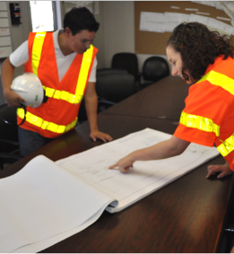
Responsibilities of Superintendent/Project Manager
PRIMARY ROLE: OVERSIGHT
  Oversee ITCP Implementation
  Ensure Subcontractor Coordination and “Buy-in”
  Assign personnel to carry out the plan
Notes:
The project superintendent and/or project manager is a key person in ensuring an ITCP is implemented properly on the site. While the superintendent/manager may assign one or more foremen to directly implement the plan, he/she controls the various factors that must be coordinated to ensure cooperation in ITCP implementation.
To properly implement the plan, workers, operators, dump truck drivers, inspectors – virtually all site visitors must be apprised of the plan and made aware of its basic operation. Such coordination and implementation is greatly facilitated with support of the person in charge of site operations and the project schedule.

Slide 8
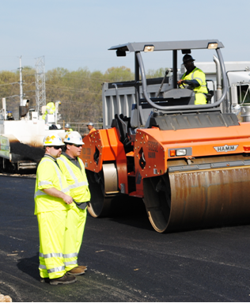
Responsibilities of Supervisor and Lead Person
PRIMARY ROLE: IMPLEMENTATION
  Plan and implement the ITCP site
  Responsible for coordination among personnel and subcontractors at the construction site
  Ensure changes are made to ITCP as site conditions change
Notes:
With direct responsibility for on-site operations, compliance with the project schedule and coordinating personnel, the supervisor or lead person will play the most important role in developing and executing the ITCP. He/she should be involved in initial planning activities.
The supervisor/lead person will implement the plan by directing onsite operations and ensuring workers on foot, operators, dump truck drivers and other onsite workers are apprised of the ITCP and know where and how they should carry out their duties in compliance with the plan. The lead person/foreman will be responsible to ensure the plan is updated as work progress and site conditions change. He/she is also responsible for general work place safety.

Slide 9
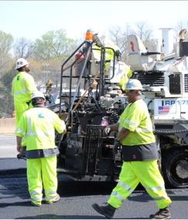
Responsibilities of Workers on Foot
PRIMARY ROLE: UNDERSTAND, COMPLY and CORRECT DEFICIENCIES
  Learn the elements of ITCPs and how to comply
  Understand the hazards of working around equipment
  Take responsibility for personal safety; apply safety training lessons
Notes:
The ITCP concept was conceived and designed to protect workers on foot from being struck by dump trucks and other construction equipment while working. These workers must be trained and disciplined to understand the basic elements of an ITCP – both in terms of how it protects them and the specifics of what has been planned for the site where they are assigned to work.
For workers on foot to be able to comply with ITCP protections, they must
understand the plan;
be supported in their efforts to comply;
be provided with site conditions that allow for their protection (including access to restrooms, coolers, parking, etc.). In other words, workers on foot need to understand the hazards of working around equipment including blind areas, stopping speeds, and communications with operators.

Slide 10
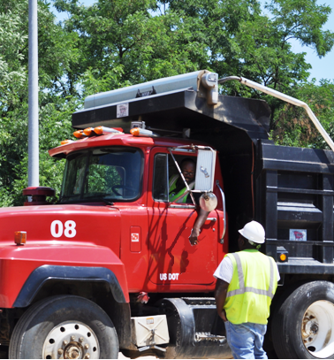
Responsibilities of Truck Boss
PRIMARY ROLE: COMMUNICATE WITH OTHER DRIVERS
  Share ITCP instruction on where drivers should operate
  Assist in communicating safe site procedures with all truck drivers
Notes:
The truck boss needs to be informed about the daily plan as well as the initial planning of the site. He will provide vital information affecting operation safety that should be considered in the planning process. In the training process those involved need to recognize the primary purpose of the truck drivers; to deliver material. They want to do this as efficiently as possible so they can return with another load. Their focus is aligned with the ticket taker on site, and the dump man once the truck is in the queue.

Slide 11
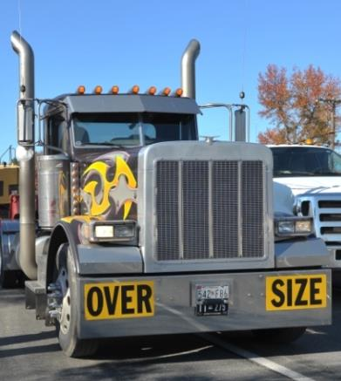
Responsibilities of Truck Drivers
PRIMARY ROLE: KEEP A SAFE DISTANCE FROM WORKERS ON FOOT
  Receive ITCP instruction on where they should operate
  Receive navigation assistance (spotters) when appropriate
  Never operate into a blind area without checking for pedestrians
Notes:
Dump truck drivers present the greatest risk to workers on foot.
According to data from the Bureau of Labor Statistics, dump trucks are responsible for over ¼ of all runover or backover deaths in this industry. This is primarily because dump trucks have large blind areas into which the driver cannot see; they are “visitors” to the site (bringing asphalt, aggregate and other materials) and may not be aware of current site conditions and operations, and they are in constant movement on the site as they enter, back-up, empty materials, and then exit the work area.
With regard to ITCPs, it is critical that drivers be informed of the plan and know where they should and should not go. Drivers should be provided with ITCP instructions and receive navigation assistance (spotters) when driving in the work space when appropriate. Simply, truck drivers on site need to understand the ITCP and operate under the guidelines of the ITCP. This means it needs to be reasonable, understandable, and communicated.

Slide 12
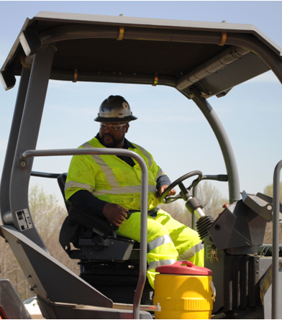
Responsibilities of Equipment Operators
PRIMARY ROLE: KNOW THE LOCATION OF WORKERS ON FOOT
  Do not move until the blind area is checked or a spotter is designated
  Know blind area for equipment you are operating
  Stay out of areas designated for workers on foot
  Do a 360° “walk-around” before moving equipment
Notes:
Like dump truck drivers, equipment operators can easily strike workers on foot because he/she is unaware they are laboring near the equipment. Construction equipment also has blind areas where the operator cannot see workers or objects. While operators may be more familiar with site conditions than truck delivery drivers, they must also understand ITCP procedures to ensure safe operations. These include using spotters or performing a visual check when entering blind areas; not allowing workers to approach them without a clear signal to do so, and staying outside of areas designated for workers on foot.
Remember, operators are paying close attention to their task. When the operator is focused on the task at hand, he or she may not see you even in plain sight.

Slide 13
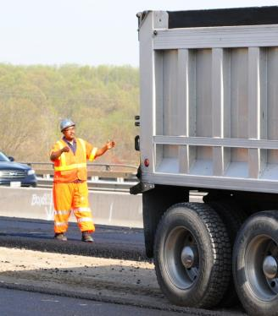
Responsibilities of Spotters
PRIMARY ROLE: SAFE BACKING
  Ensure operator knows where you are and will be located; make eye contact
  Ensure workers know your responsibilities and wait for permission to enter area
  Receive training in safe spotting procedures and know the signals
  Stay in continuous communication with operator and remain visible at all times
Notes:
Spotters are recommended by ANSI and other organizations for backing operations, particularly those with large blind areas. They should be trained in standard signaling procedures. Some states (Virginia and Washington) require a spotter when camera/radar systems are not used. Remember, spotters can also be in danger from vehicles – who is spotting the spotter? Spotters can help when you must work with your back to equipment or traffic. If a driver/operator looses visual contact with the spotter, he/she must stop immediately until the spotter is located.

Slide 14
Elements of an ITCP
Typically, an ITCP should cover
  Roles and responsibilities of parties
  Site specific information
  Communication plan
  Schematic diagrams
  Hazard assessments
  Training of site personnel on ITCP
  Effectiveness evaluation
Notes:
This slide presents an overview of the elements of an ITCP should cover.
Let the class know that the ITCP includes written procedures in addition to diagrams.

Slide 15
Elements of an ITCP – Project Specific Information
Contact information (company personnel, emergency services, etc.)
Location, time table, and scope of project
On-site equipment and personnel
Interface between internal and external traffic control plans
Notes:
An ITCP should include information specific to a particular project and site. This covers contact information of company personnel, other on-site contractors, the contracting agency, and emergency response services, which should be posted on site.
The ITCP should also include the location, time table, and scope of the project, along with all the on-site equipment and personnel. The interface between internal and external traffic control plans is an essential part of the internal traffic control plan, and must be clearly delineated.
REMIND THE STUDENTS THAT THIS INFORMATION NEEDS TO BE KEPT UPDATED

Slide 16
Elements of an ITCP – Hazard Assessment and Control
Checklist of site specific hazards and mitigation methods
Reporting system for incidents and near misses
Safe procedures for traffic control in work space
Anticipated traffic volumes, speeds, and speed limits
Specifications for lighting
Safe speed limits, clearances from high voltage power lines, blind corners , warnings of drop-off hazards, etc.
Notes:
An ITCP should include the checklist of site-specific hazards with descriptions of how these hazards will be minimized: through safe operating procedures, safety equipment, and control strategies.
An ITCP should have reporting requirements for all incidents including near misses. It should incorporate a plan for safely handling intermittent traffic stoppages. It also needs procedures of handling traffic emergencies.
It should also include the anticipated traffic volume, speed and the speed limits for the operation within the work space. Safe speed limits shall be posted and enforced in all areas within the work zone. Examples of other signs are clearances below high voltage lines, blind corners, and warnings for drop-off hazards for machine operators.
In addition, an ITCP should include specifications for lighting in the work space as required for night time work activities.

Slide 17
Elements of an ITCP – Communication Plan
  Designated channels for communication
  Communications between workers on foot and in vehicles
  Designation of personnel to monitor communications between vehicle and equipment operators
Notes:
Effective communication is very important in the work space. An ITCP should include a communication plan that contains the following:
Designated channels of communication regarding changes in the ITCP
A means for on-foot workers to communicate with equipment operators, truck drivers, and other personnel in charge of controlling or coordinating the flow of traffic and equipment entering and leaving the work space and the movement of heavy equipment within work space
A means for personnel like grader operators, dozer operators, scraper operators, and truck drivers to communicate with each other and with the general contractor and subcontractor personnel
Designated personnel responsible for monitoring on-site communications between vehicle equipment and equipment operators

Slide 18
Elements of an ITCP – ITCP Diagrams
Typically include
  Standard symbols
  A layout of the work space
  Locations of proximate traffic control devices (e.g. drums, cones, etc.)
  Areas around equipment and operations prohibited to on-foot workers
Notes:
Typically ITCP will include
Standard symbols for pieces of equipment, traffic control and project personnel on site
A layout of the work space positioned in the overall work zone
Locations of proximate traffic control devices (e.g. drums, cones, etc.)
Areas around equipment and operations prohibited to on-foot workers

Slide 19
Elements of an ITCP – Diagrams
Also, diagrams showing
  Locations for staging, storing and servicing materials and equipment
  Locations of visitor and worker parking areas
  Dimensions and locations of lateral buffer zones
  Description of internal signage and all internal traffic control devices
Notes:
A typical internal traffic control plan includes a diagram showing the various activity areas within the work space. The diagrams include:
Standard symbols for pieces of equipment and project personnel that will be on site
Overview of how the activity area fits within the temporary traffic control plan
Locations of proximate traffic control devices
Delineated areas around specific pieces of equipment and operations where on-foot workers are prohibited (e.g., swing radius of an excavator, blind areas of a dump truck, etc.)
The ITCP diagrams also include:
Locations for storing and servicing materials and equipment
Location of parking for visitors and workers
Size and location of lateral buffer zones within the work space
Description of internal signage and all internal traffic control devices

Slide 20
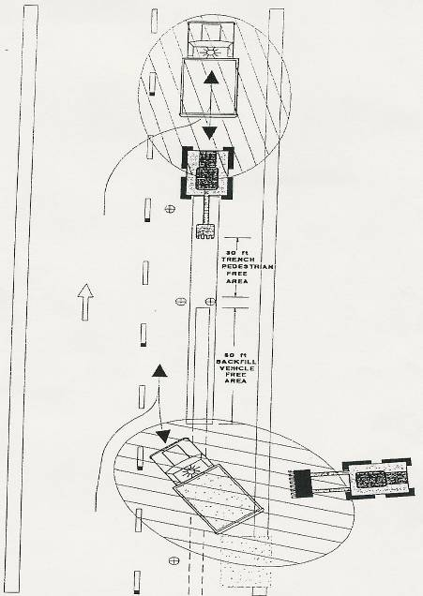
Ingress/Egress
30 ft trench
Pedestrian free area
Sample Internal Traffic Control Plan for
Trenching Work in a Highway Work Zone
60 ft backfill
Vehicle free area
Notes:
This slide shows a simple internal traffic control plan for a work zone that includes trenching activities. This diagram shows the points of ingress and egress for trucks, location of equipment, as well as areas that should be avoided by pedestrians/workers and/or other areas, due to the hazards they may be exposed to.

Slide 21
Elements of an ITCP - Training
Training is essential for all personnel
Orientation of truck drivers to work space activities and ITCP
Training delivered through
  General’s safety meeting
  Tool box safety meetings
  Distribution of site-specific safety materials (e.g. a copy of ITCP, safety guidelines)
  Self-paced e-training (not recommended)
Notes:
Training is essential for all personnel for the implementation of the ITCP for each project.
The training component of ITCP includes the training materials and procedures for effectively implementing the internal traffic control plan. The training part of the ITCP include the following:
A procedure for orienting independent truck drivers to the work space and the ITCP (e.g., staging area locations)
Distributing the site specific safety materials, including a copy of the ITCP and safety guidelines for on-foot workers, to all drivers and visitors coming in to the work space (usually at the entrances). Other means of communicating this information include the tool box safety meetings, faxing the ITCP to other employers who will be on site, and distributing the ITCP to truck drivers at the loading facility
Provision to ensure that contracting agency staff understand the ITCP for each project so that they can comply with the ITCP when they travel to a work site during inspections

Slide 22
Elements of an ITCP – Effectiveness Evaluation
Comprehensive approach
  Review of ITCP during normal work zone inspections
  Review and analyze incidents, near misses, and potential hazards
  Retain schematic drawings and other documents for future use
Notes:
An ITCP should include an approach for evaluation of effectiveness of implemented ITCP. This includes:
Evaluation of the effectiveness of the ITCP throughout the project, noting the changes required as the project evolves
Inspection of the ITCP during the normal work zone inspections
A continuous process for reviewing incidents, close calls, and potential hazards involving workers and equipment within the work space and for elimination of reported hazards
Documenting and retaining the schematic drawings and other documents for use in developing the future ITCPs

Slide 23
Steps in developing
Identify project and scope
Determine the construction sequence during the project
Determine locations of safe movements
Determine vehicle and equipment movement to and from each operation
Determine safe movement for workers
Assess potential internal traffic conflicts
Id individuals who need to understand the ITCP
REMEMBER – as the job progress these will have to be updated
Notes:
Review the steps in developing an ITCP.

Slide 24
Conflicting Movements of Trucks, Equipment and Workers
Conflicts create potential for accidents
Conflicts between
  Trucks and trucks
  Trucks and equipment
  Trucks and on-foot workers
  Equipment and on-foot workers
  Equipment and equipment
  Overhead hazards
Notes:
The basic cause of a conflict is that two or more objects attempt to occupy the same space at the same time. In the work space, when there is a conflict, there is a chance of an accident.
The major conflicts in work zone can be between:
Trucks and trucks
Trucks and equipment
Trucks and workers on foot
Equipment and workers on foot
Equipment and equipment
The severity of potential accidents varies depending upon the speed and size of the trucks or equipment. However, most of the time, the accidents involving truck(s) or equipment and worker(s) on foot produce severe injuries or fatalities.

Slide 25
Conflicting Movements of Trucks and Equipment
Minimize conflicting interactions as much as possible
  Separation by space
  Separation by time
Determine the locations of and design various internal movements
  Entry and exit locations for trucks and equipment
  Truck and equipment routes within work space
  Other activity locations and pedestrian paths (e.g., rest room locations, site office, etc.)
Notes:
Since conflicts between trucks, equipment and workers can cause accidents and resulting injuries, the best way to avoid the potential injuries is to avoid conflicts among them as much as possible.
The interactions among the equipment, trucks and workers are minimized by separations. These can be:
Separation by space which is also called physical separation
Separation by time, mainly by scheduling
Another way of minimizing the conflicts within the work spaces is to determine the locations of various internal movements by designing
Entry and exit locations for trucks and equipment
Equipment paths within work space
Truck paths within work space
Other activity locations (e.g., rest rooms, site office, and pedestrian paths in the work space)

Slide 26
Conflicting Movements of Trucks
Separation by space
  Use channelizing devices, such as barriers
  Separate activities (e.g., excavating, grading, staging, etc.)
Separation by time
  Schedule work with safety in mind
    Arrival and departure of trucks
    Loading and unloading
Combination of both approaches
Notes:
Control of Interactions Between Trucks, Equipment and Workers:
Physical separations between movements of trucks, equipment and workers is a way of eliminating the conflicts. Wherever possible, endeavors shall be made to control the interactions by separation.
One of the ways to control the interactions is separating them by space (physical separations). This includes:
Separation using channelizing devices
Separating work spaces for each activity
Locating equipment/truck paths away from on-foot workers
The other way of separating the interactions is separating them by time. This can be done by:
Work scheduling
Arrival and departure scheduling of trucks
Scheduling of loading and unloading equipment
Combination of both approaches, that is separation by both space and time, should be considered whenever possible.

Slide 27
Conflicting Movements of Trucks and Workers
Properly design the elements of internal traffic control that cause conflicts
  Safe entry and exit points
  Speed change lanes
    Deceleration lane
    Acceleration lane
  Turning radius
  Traffic control devices
Notes:
Design the locations of Various Internal Movements:
To reduce the conflicting movements, all the locations of internal traffic movements shall be designed properly. Among such locations, entry and exit points of the work space within the work zone, acceleration and deceleration lanes and internal movement paths are important. While designing such locations, turning radii and traffic control devices shall be duly considered for effective functioning.
The locations of entry and exit points of the work space within the work zone requires keen attention. The design of acceleration and deceleration lanes are required to minimize the conflict due to speed differential between the moving traffic and merging or diverging trucks from the through traffic. Turning radius and geometry vary for different truck sizes. Appropriate traffic control devices at the entry and exit points minimizes the risk of accidents at the interfaces of internal and external traffic zones.
The details of the designs are explained in the following slides.

Slide 28
Conflicting Movements of Trucks
Design of entry and exit points
  Consideration of roadway size and type
  Locations of existing driveways
  Access design and management
Notes:
Entry and Exit Points:
The design of entry and exit points for construction trucks and equipment to and from the roadway within the work zone is extremely important to minimize the conflicts between the moving traffic and equipment.
Wherever possible, the entry and exit points shall not be located where:
The geometry of the roadway is irregular
There are other driveways or entry and exit points very close to the proposed entry and exit point
The sight distance is insufficient for the moving traffic for the designated work zone speed
The location is such that deceleration and acceleration lanes can not be provided
The points are to be selected by a competent traffic control and operation specialist. The access management guidelines and principles can be useful for providing safe and efficient entry and exit points in the work zone.
The exit and entry points shall be physically separated from the through lanes. Separate points for exit and entry cause minimum conflicts.

Slide 29
Conflicting Movements
Design of deceleration and acceleration lanes
  Length of speed change lanes
  Speed of trucks
    Terminal speed at entry/exit point
    Cruise/operating speed (speed of roadway traffic)
    Separate entry and exit points to reduce conflicts
Notes:
The drivers of trucks entering a highway/street from an exit point in the work zone accelerate until attaining the desired through traffic speed. Because the change in speed is usually substantial, provisions should be made for acceleration. The same applies for the trucks decelerating to take the exit to enter into the work space. A safe acceleration and deceleration is accomplished only if auxiliary lanes are provided to minimize interference with through traffic which will reduce crash potential.
A speed change lane should have sufficient length to enable the driver to make the appropriate change in speed between the highway and work zone entry/exit point. Moreover, in the case of acceleration lane, there should be additional length to permit adjustment of speed for through vehicles and trucks so that the truck driver can position himself entering into the gap in the through-traffic stream and maneuver into it before reaching the end of the acceleration lane.
The speed change lanes can be of two types:
Taper type
Parallel type
The taper type speed change lane provides direct entry or exit at a flat angle, where as the parallel type speed change lane has an added lane for changing speed. Although, both types function satisfactorily when properly designed, the parallel type is more preferred.
“A policy on Geometric Design of Highways and Streets”, version 2001, published by American Association of State Highway Officials (AASHTO) provides tables for the length of acceleration and deceleration lanes. Although the design lengths provided in this document can not be directly applied to the work zone acceleration and deceleration lane, they can provide some intuition to the designer for the length of the speed change lanes.

Slide 30
Acceleration Lanes
Rigid Barriers
Taper Length
Work Space
A Typical Diagram Showing an Acceleration Lane
Notes:
Discuss the importance and danger of work zone accelerations lanes.
Vehicles need enough room to get up to speed. So think about the vehicle’s acceleration rate.

Slide 31
Turning Radius and Geometry
Turning radius at entry and exit points
  Varies with the type of vehicles
  Off tracking
    Larger vehicles - larger off tracking
    Off tracking can cause injuries/fatalities
Turning radii must be designed by a qualified person
  Geometric design specialist
Perform trial runs
Notes:
The turning radius, also called ‘turning curb radius’ of a vehicle is the circular arc formed by the turning path radius of the front outside tire of the vehicle.
Trucks and heavy equipment negotiating a curve require a sufficiently large turning radius. Since construction traffic is composed of mostly trucks and heavy equipment, the turning radius at the entry and exit points to or from the work space must be designed accordingly.
Off tracking, which is more frequently observed in larger vehicles, is the difference in the paths of the front and rear wheels of a tractor/semitrailer as it negotiates a turn. This is because the path of the rear tires of a turning truck does not coincide with that of the front tires.
If the turning radius is insufficient, off tracking will cause to encroachment into the extra space of the roadway, not allocated during design, thus causing hazards at that area.
Note that injuries resulting from the off tracking of trucks to workers and others due to insufficient turning radius may be quite serious.

Slide 32
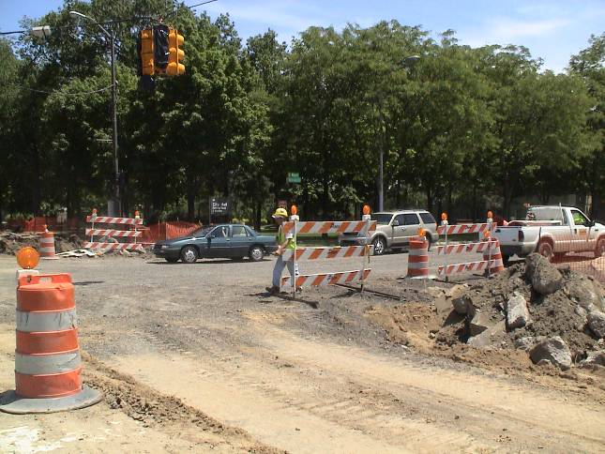
Turning Radius
Turning radius for trucks should be designed properly
Notes:
Emphasize the importance in understanding the turning radius of the vehicles that are going to be operating on the site.

Slide 33
Conducting a Trial Run for ITCP
Company Foreman and Safety Reps meet
Job Hazard Analysis for jobs to be done, next day or future
Walk thru areas that need ITCP
Use equipment that will be in the area to test traffic pattern
Draft and agree on plan
Educate all workers on plan
Set up control area
Notes:
Cover points with class

Slide 34
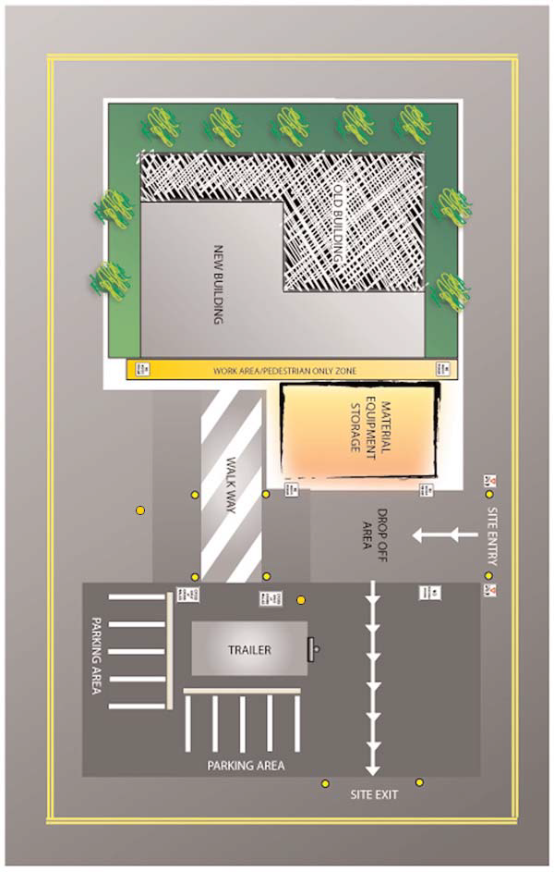
Traffic Flow
Safety Points
Vehicle traffic flow is separated from pedestrian traffic
Pedestrian worker free areas have been designated
Storage locations for material and equipment are designates
Worker and visitor parking areas are designated away from vehicular traffic
Notes:
Safety Points
Vehicle traffic flow is separated from pedestrian traffic. Vehicles are prohibited in areas where pedestrian workers are working.
Pedestrian worker free areas have been designated around specific pieces of equipment and operations.
Vehicle backing has been eliminated or severely restricted.
Storage locations for material and equipment are designated away from pedestrian worker flows.
Worker and visitor parking areas are designated away from vehicular traffic.

Slide 35
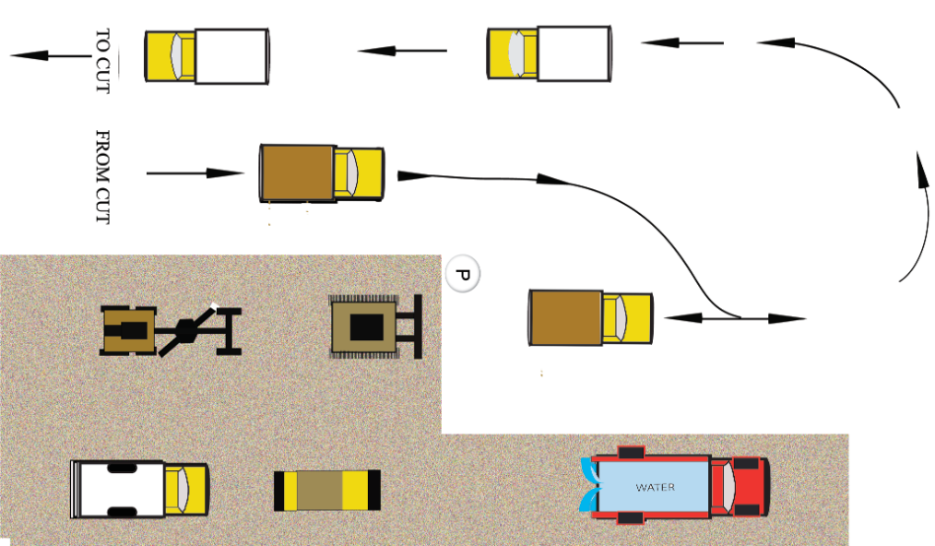
Vehicle Movement
Notes:
Another example of vehicle movement on a site.
Remind students that vehicle movements change on a regular basis and they need to be kept updated.

Slide 36
Summary
Injury potential is extremely high in highway and street construction work zones
Half of highway and street construction workers are killed by construction trucks and equipment
Development of Internal Traffic Control Plans is essential for safe operations inside the work space
It is imperative to eliminate conflicting movements of trucks, equipment and workers
Most of the construction site hazards also exist inside the work space
Notes:
Review the summary points on the importance of an ITCP

Slide 37
Why Internal
Traffic Control?
Notes:
Section slide to introduce next section on why an ITCP

Slide 38
ITCPs Protect Workers on Foot
Workers on foot are those employees who perform most of their duties outside vehicles and equipment. They are particularly vulnerable to being struck by equipment. Every person on the site has the responsibility to be vigilant and work safely
Require all workers to wear Hi-viz apparel
Notes:
Workers on foot – or pedestrian workers - ground workers – are those employees who perform their tasks outside construction equipment and other vehicles. They are exposed to the hazards of being struck by motorists and construction vehicles.

Slide 39

Two “Struck-By” Hazards
Workers Killed by Motorists
Workers Killed by Construction Trucks and Equipment
MORE WORKERS ARE KILLED BY CONSTRUCTION
VEHICLES THAN BY MOTORISTS
Notes:
Struck by is one of OSHA’s focus four and is a big hazard in a traffic control zone. Struck by both the motor public and construction equipment.
The leading cause of highway construction worker injuries and fatalities is contact with construction vehicles, objects, and equipment. These injuries and deaths are preventable through a number of good practices – Federal Highway Administration.

Slide 40
Work Zone Crashes
Work Zone Crash Frequency
On average, in 2015:
  A work zone crash occurred once every 5.4 minutes
  Every day, 70 work zone crashes occurred that resulted in at least one injury
  Every week, 12 work zone crashes occurred that resulted in at least one fatality
Crash Severity
In 2015 the distribution of work zone crashes by severity included:
  73.0% (70,499) of work zone crashes were Property Damage Only (PDO)
  26.4% (25,485) of work zone crashes involved at least one injured party
  0.7% (642) of work zone crashes involved at least one fatality
  This distribution is very similar to non-work zone crashes.
Notes:
Information taken from the Federal Highway Administration.

Slide 41
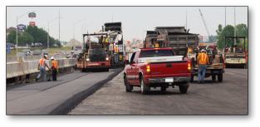
Construction Vehicles are the Greatest Hazard
Compliance with the MUTCD and OSHA regulation is a necessary
The interaction between workers on foot and construction trucks and equipment is the single biggest hazard
There are several hazards workers should be aware of to enable them to protect themselves against work zone hazards
Notes:
Compliance with the MUTCD and OSHA regulations is a necessary first step in providing a safe work environment. However, these sources, taken together, do not provide comprehensive guidance to ensure worker safety in roadway work zones. The interaction between workers on foot and construction trucks and equipment is the single biggest hazard in the heavy and highway industry. There are several hazards workers should be aware of to enable them to protect themselves against work zone hazards.

Slide 42
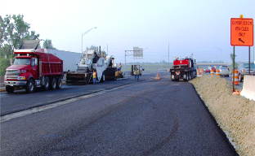
Vehicles Frequently Enter and Exit
The constant movement of vehicles can create hazards
ITCPs can communicate the need to keep entry and exit points free
Start each day with a risk assessment discussion with workers and subcontractors (including employees)
Notes:
The constant movement of vehicles in and out of the work area can create hazards if the travel paths are not set and coordinated. ITCPs can also be used to communicate the need to keep entry and exit points free of parked vehicles and equipment. Note the tire marks on the pavement indicating vehicles are turning around in the work area. Ideally, ITCPs minimize backing and turning. Start each day with a risk assessment discussion with workers and subcontractors (including employees).

Slide 43
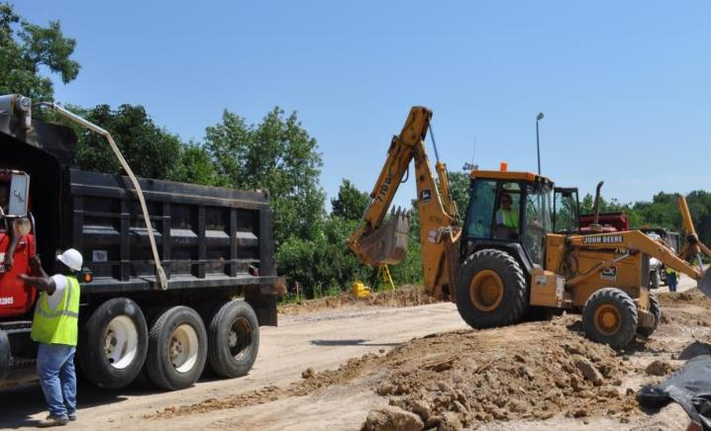
Workers on Foot Labor in Close Proximity to Large Vehicles
Note the size of workers on foot in relation to the size of the construction equipment and vehicles.
Notes:
Note the size of workers on foot in relation to the size of the construction equipment and vehicles. Because workers are relatively short compared to construction vehicles, it can be difficult or impossible to see them, especially in areas known as “blind spots.”

Slide 44
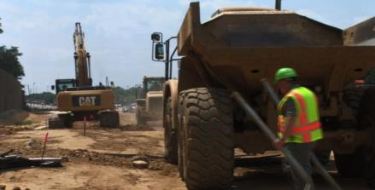
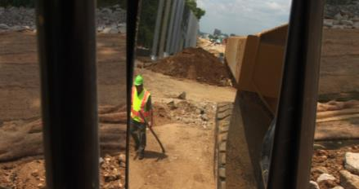
Blind Spots
Blind Spots are the locations around equipment
Behind the Vehicle
Outside Mirror Range
Notes:
A blind spot (or blind area) is the area around a vehicle or piece of construction equipment that is not visible to the operator, either by direct line-of-sight or indirectly by use of internal and external mirrors. Blind areas can be reduced by properly setting mirrors on equipment in a “mirror check station.”

Slide 45
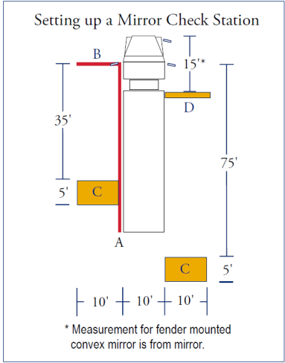
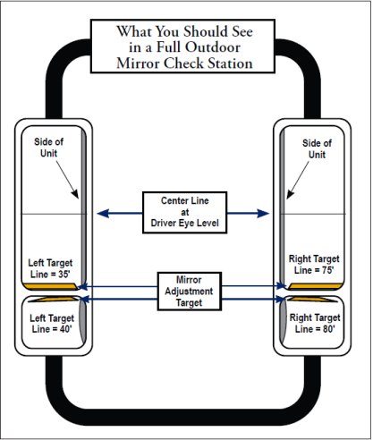
Mirror Check Station
Notes:
Images provided by, and used with permission of Liberty Mutual Insurance.

Slide 46
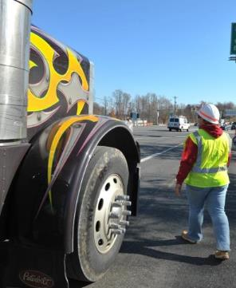
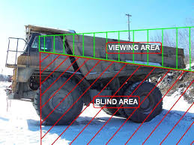
Workers Are Vulnerable in Blind Spots
Notes:
As a worker on foot, if you can’t see the driver and the driver can’t see you, you’re in a dangerous situation. Companies and projects should identify a specific side of the vehicle where a worker should walk for each operation. Consistency is important for safety.

Slide 47
SITUATIONAL AWARENESS – INCIDENT PREVENTION
Stay focused
  Mind on Task
Keep your eyes and ears open
  Eyes on Task, Line of Fire, Balance/Traction/Grip
Identify & assess new hazards as you see them
Be aware of change and stop to re-assess
  THINK BIG PICTURE
Communicate with the team and others
If in doubt stop the job and re-assess
Notes:
Explain to the class that being aware of their surroundings is situational awareness and that this does help in the prevention of incidents.

Slide 48
Key Elements
Perception
  Gathering or collecting information
Comprehension
  Interpreting information
Projection
  Anticipating future status
Notes:
Discuss the key elements with the class.

Slide 49
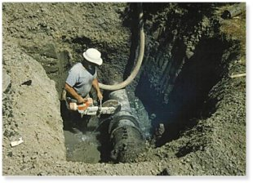
What is a “hazard”?
condition
practice
An unsafe _________________ or _________________ that could cause an ___________ or _______________ to an employee.
injury
illness
How can a person be a walking hazardous condition?
Notes:
Define what a hazard is based on this slide

Slide 50
Mistakes / Errors
When employees make mistakes increasing the risk of injury it is usually because they were either rushing, frustrated, fatigued or complacent.
Notes:
Review the error states and conditions statement with the class.

Slide 51
CONDITIONS
Mind Sets
Mistakes
Increased
Risk
of Injury*
Hurried
Angry
Tired
Complacency
Eyes not on task
Mind not on task
Line-of-fire
Balance, traction, grip
* Over 90% of all injuries at home, at work or on the road are caused by these error patterns.
Notes:
Discuss that the mind sets we are in (what we are feeling) affects our ability to work safely and can lead to mistakes which will eventually lead to injury.
The next slides will go into more detail regarding mind sets.

Slide 52
States of Mind
Hurried - When you exceed the pace at which you normally perform the task
Angry - Caused by relationships inside and outside of the workplace
Tired - Too tired to do the job safely
Complacency - Familiar enough with the hazards to become considerably less concerned over time
Notes:
Hurried - When you exceed the pace at which you normally perform the task, whether it is working, driving, walking or running, lifting or moving.
Angry - Caused by relationships inside and outside of the workplace, malfunctioning equipment, inadequate tools, conflicting objectives and pressures, etc.
Tired - Too tired to do the job safely, either physically or mentally. Includes being too tired to react quickly, prolonged concentration is difficult.
Complacency - Familiar enough with the hazards to become considerably less concerned over time. Contributes significantly to not watching or thinking about what you are doing.

Slide 53
Critical Mistakes
Anyone can get hurt if they are not looking at what they are doing/paying attention
While this may appear to sound like “common sense”, unfortunately common sense is not always common practice
Notes:
Discuss with class

Slide 54
Eyes not looking at what you’re doing
Not looking where you are going or what is coming your way. Includes not moving your eyes before moving your body or not being able to see where you are stepping, where your hands are reaching into, etc.
Notes:
Discuss with class

Slide 55
Not thinking of the job
Not concentrating on the job. Being unaware of dangers. Forgetting things, making more errors than usual, going on “auto-pilot”, “drifting away”.
  What time do I get the kids?
  Why can’t I break 100 for 18 holes?
Notes:
Discuss with class

Slide 56
Standing in the Line-of-Fire
Being conscious of where you are or where you are going in relation to the direction of the hazard.
  If the driver doesn’t see me, where does the vehicle go?
  Which way will the drunk drive?
Notes:
Discuss with class

Slide 57
Balance/Traction/Grip
Doing something that could cause you to lose your balance, traction, or grip. This can include not wearing good footwear/gloves, not having a good grip in the first place, or not seeing or thinking about the hazard.
Notes:
Discuss with class

Slide 58
Workers Killed by Motorists
As noted previously, the primary cause of worker deaths in roadway construction is caused by workers being struck by construction vehicles and equipment.
The second highest cause is workers being struck by motorists or when a vehicle crashes.
Notes:
While much of this training focuses on keeping workers safe from construction vehicles and equipment, ITCP planning will also consider hazards posed by motorists driving next to the work space.
Review with the class the importance of being aware of your surroundings.

Slide 59

Two Ways Workers Are Killed by Motorist
Workers Enter the Traffic Space
Motorists Enter the Work Space
Notes:
Review the two ways workers are killed by the motorist.
Either the vehicle enters the workspace and hits the worker or the worker enters the traffic space and gets hit. Discuss why this could happen.

Slide 60
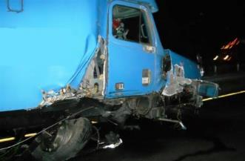
Workers Killed
Motorists are likely to enter the work space when:
  Workers are not visible to motorists
  Motorists are surprised by the work zone and Temporary Traffic Control set up
  Motorists ignore warnings
  TTCDs are confusing/not compliant
Notes:
In situations where motorists strike workers, those in the construction industry often assume the fault is with the driver. We must be careful in both the design and execution of the TTCP and ITCP that our work is not a contributing factor. Improper TTC design and workers straying into the traffic space are often cited as a cause of worker fatalities.

Slide 61
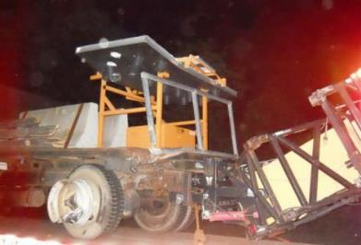
Killed by Motorists
Motorists are likely to enter the work space when:
  Drivers are distracted or impaired (phones, food, drugs, alcohol, drowsy, etc.)
  Traffic is traveling at high speed through the work zone
  Equipment / work zone lighting
Notes:
One of the most common reasons drivers stray into the work space is because they are impaired, distracted or speeding.

Slide 62
Risky Worker Behavior
Workers stray into traffic space
  Preoccupied by work
  Become “comfortable” in dangerous environment
  No convenient access to and from work space
    rest rooms
    food and water
    shade/breaks
    other local work areas
    staging of company and personal vehicles
  Workers cross traffic lanes (especially in high-speed locations)
Notes:
The organization of the work space can and does impact worker behavior. Workers are more likely to take risks such as entering the traffic space if circumstances entice or compel them to do so. When creating your safety/ITCP plan, consider the location of rest areas, water stations, parking, etc. To the extent feasible, these should be located to minimize workers crossing traffic or construction vehicle pathways.

Slide 63
How Can We Prevent Deaths
Caused by Motorists?
Temporary Traffic Control Devices Must be Set Up Properly
  Comply with MUTCD or corresponding state document
  Inspect and maintain TTCDs
  Ensure only a qualified person makes necessary modifications
Create Safe Procedures for Deployment and Retrieval of TTCDs
Ensure sufficient TTCDs for all parts of the project (ramp geometry, exits, closures, etc.)
Notes:
Depending upon the nature of the work being done, TTCDs may be set-up by the site workers, or on more complex or large jobs, this will be accomplished by a specialized contractor or crew. In any situation, the devices should be set-up in compliance with the MUTCD or comparable document. TTCDs not only provide guidance for traffic, but are part of the worker safety strategy.

Slide 64
How Can We Prevent Deaths?
Workers Should Be Aware of TTCDs in their work location.
Workers should be trained to notify supervisor immediately if devices are:
  Not in proper position
  Damaged or dirty
  Not being observed or recognized by motorists
Workers may correct misaligned devices if it is safe for them to do so and they understand where the device is supposed to be situated.
Notes:
Workers should be able to recognize if TTCDs are out of place. They should be informed if they have the authority to re-set misaligned devices or the process for notifying their supervisor when they see a problem. In all situations, misaligned, missing or non-performing devices should be corrected immediately.

Slide 65
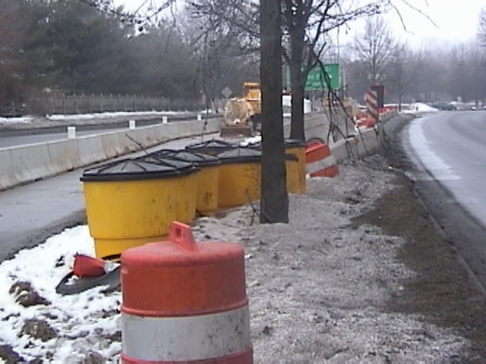
Workers Should be Aware of
Basic TTC Rules
Notes:
Most workers will not be trained to set up and maintain temporary traffic control. Nevertheless, they should understand the purpose of a temporary traffic control plan and function of temporary traffic control devices so they can recognize when they are not functioning correctly.

Slide 66
ITCP Research Recommendations
Ensure that there is a detailed safety plan
Daily safety meetings should be conducted
Spotters should have direct communication
A crew member should be designated to communicate with the rest of the crew when the paving machine is backing up.
A crew member should be designated to communicate with the rest of the crew
Truck drivers need instructions on how to enter and exit the work zone
All others on site should also be made familiar with the ITCP
For night work, light standards need to be placed
Notes:
1. Ensure that there is a detailed safety plan that meets 29 CFR requirements with specific documented training for all employees. Require a competent person who meets 29 CFR standards to be on site during the work.
2. Daily safety meetings should be conducted with all personnel, including truck drivers, inspectors, etc. The ITCP should be discussed, along with updates in operations.
3. Spotters should have direct communication with the material truck drivers through the use of radios or other communication devices.
4. A crew member, most logically the screed operator, should be designated to communicate with the rest of the crew when the paving machine is backing up.
5. A crew member should be designated to communicate with the rest of the crew when other equipment is operating in the work area.
6. Truck drivers need instructions on how to enter and exit the work zone and how to maneuver within the work zone. This could be accomplished by the designated safety officer going over the ITCP with them prior to the work commencing.
7. All other equipment operators or passenger truck drivers on site should also be made familiar with the ITCP so that they can more safely and efficiently operate within the work area.
8. For night work, light standards need to be placed so that lighting is consistent along the work site.

Slide 67
ITCP Research Recommendations (cont’d)
All safety vests should be checked for reflectivity for night operations
Establish desirable operating speeds
Seat belts should be required for all vehicles
Establish a specific lock-out, tag-out program for use when servicing the machinery
Notes:
9. All safety vests should be checked for reflectivity for night operations.
10. Establish desirable operating speeds for vehicles on public roads and in the work space.
11. Seat belts should be required for all vehicles and a seat belt or harness should be required for the rebar setter on PCC paving machines.
12. Establish a specific lock-out, tag-out program for use when servicing the machinery.

Slide 68
Thank You
Questions????
68
Notes:
End of the class and ask if there are any questions.
Thank the class for their participation dismiss them.

